Slide 1
HERD HUMANITIES PROGRAM
Introductory Luncheon for University Advisors
Thursday, September 28, 2023

Slide 2
Timeline of the Herd Humanities Program
Fall 2017: The Cornerstone Program starts at Purdue University (2 courses, 100 students)
June 2021 – November 2022: Marshall University committee (1 rep from each COLA department) begins researching and grant writing for Cornerstone: Learning for Living grant program (NEH/Teagle).
May 2023: Marshall is awarded a Cornerstone planning grant for our Herd Humanities Program.
Spring 2024: Marshall will offer our first sections of Herd Humanities courses.

Slide 3
2021-2023 Herd Humanities Committee
Dr. Melissa S. Atkins – Associate Professor and Undergraduate Coordinator, Psychology Department
Dr. Allison E. Carey – Professor and Department Chair, English Department; Chair of Council of Department Chairs
Dr. Del Chrol — Professor and Department Chair, Humanities Department
Dr. Hilton A. Córdoba – Assistant Professor, Geography Department
Dr. Boniface Noyongoyo – Assistant Professor, Department of Sociology and Anthropology
Prof. Daniel J. O’Malley – Associate Professor and Coordinator of Undergraduate Programs, English Department (committee chair)
Dr. Greta Rensenbrink – Professor and Department Chair, History Department
Dr. Zelideth María Rivas – Professor of Japanese, Department of Modern Languages; Assistant Provost for Global Education; Hedrick Teaching Fellow, 2022-2023
Dr. Julie Snyder-Yuly – Assistant Professor, Department of Communication Studies

Slide 4
Interviews with Marshall stakeholders: Associate Deans, advisors, administrators, students
Dr. Nancy Lankton and Lacie Bittinger, LCOB
Dr. Greg Michaelson, CECS
Dr. Gary McIlvain, COHP
Dr. Brian Antonsen, COS
Dr. Brian Hoey, Honors College
Dr. Montserrat Miller, Drinko Academy
Honors students (from STEM fields)

Slide 5
Spring 2024 Herd Humanities Courses
CMM 280 (SCLA 101)
ENG 280 (SCLA 102)
2 sections
Transformative Texts CMM: Identity & Community
Counts towards the following requirements:
  Core II Communications
  Critical Thinking (CT)
  Multicultural (MC)
2 sections
Transformative Texts ENG: Reality & Perception
Counts towards the following requirements:
  Core II Composition
  Core II HUM
  Writing Intensive (WI)

Slide 6
Next step? Creation of a Herd Humanities Certificate Program
5 themed tracks
  Science & Technology
  Environment & Sustainability
  Healthcare & Medicine
  Management & Organization
  Conflict Resolution & Justice

Slide 7
What ARE
“Transformative Texts”?

Slide 8
The origins and impact of the Cornerstone Program at Purdue …

Slide 9
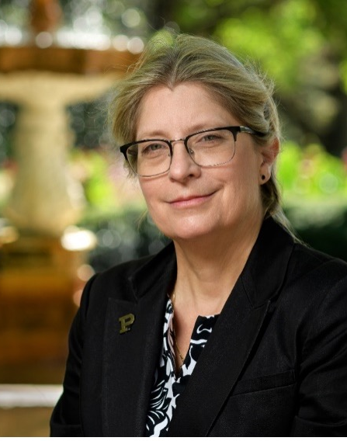
Dr. Melinda S. Zook, Purdue University
Germain Seelye Oesterle Professor of History
Director of Cornerstone: Integrated Liberal Arts for the College of Liberal Arts, Purdue University
Award-winning teacher
Accomplished scholar
Innovative educator

