Slide 1
​ ​ WVPBIS Virtual Academy​ Part 2: Day 1​ Feedback and Acknowledgement​ TFI 1.9

Slide 3
Feedback and Acknowledgement
1.9 Feedback and Acknowledgment

Slide 4
Today’s Objectives
TFI 1.9 Feedback and Acknowledgment
A formal system (i.e., written set of procedures for specific behavior feedback that is [a] linked to school-wide expectations and [b] used across settings and withing classrooms) is in place and used by at least 90% of a sample of staff and received by at least 50% of a sample of students.

Slide 5
Today’s Objectives
Acknowledging Appropriate Behavior
a
Using Acknowledgements
a
Rewards & Incentives
a
Using Rewards & Incentives

Slide 6
Acknowledging Appropriate Behavior

Slide 7
Manipulation? The Big Bang Theory Video

Slide 8
Acknowledge Appropriate Behavior
Teaches students what is expected of them
Provides feedback on how well they’re doing this
a
Makes appropriate behavior more likely to occur
Catches students ‘being good’ and creates momentum
a
Builds positive student/teacher relationships
School climate and culture
a
Counteracts negative peer influences
a
Increases internal motivation in un-motivated students

Slide 9
Acknowledge Appropriate Behavior
If you want something you must teach it…and then you must acknowledge it.

Slide 10
Acknowledge Appropriate Behavior
Identify what you want to grow (school wide expectations, certain behaviors, etc)
a
Provide specific positive feedback for it
a
Watch it grow
A
Example: When you compliment a kid and suddenly all 20 kids want you to see them doing it.
What you feed, grows!

Slide 11
Acknowledge Appropriate Behavior
The National Center on PBIS shares the
“Key Practices” for implementing Tier 1.
a
Continuum of Procedures for Encouraging Expected Behavior
A schools Tier 1 team determines how to acknowledge students positively for exhibiting appropriate behaviors. Schools adopt a system for providing acknowledgements in addition to offering specific praise when students do what’s expected. This system should be:
Linked to school-wide expectations
Used across and within classrooms
Used by 90% or more of all school personnel
Available to all students within the school
https://www.pbis.org/pbis/tier-1

Slide 12
Acknowledge Appropriate Behavior: How to Acknowledge
Name the behavior the student demonstrated
Name the expectation the behavior matched
Provide positive acknowledgement (Verbal, Tangible, etc.)
Example:“ David when you helped Susan with her tray you were being respectful and responsible. You earned a Wild Cat dollar for being such a great helper.”
Refrain from taking or threatening to take away a reward once it has been earned!

Slide 13
Acknowledge Appropriate Behavior: How to Acknowledge
Teacher Greetings
Behavior Specific Praise
Verbal
Greet students by name and made a positive comment. Ex: “Hi Megan, it’s good to see you.”
Nonverbal
Handshake, fist bump, smile
Why?
Low cost, high yield
High rate of response opportunity
Helps build positive relationships
Identify student by name
Jake…
Acknowledge their effort by reinforcing a specific behavior
Jake, you did a great job packing up…
Identify the outcome
Jake, you did a great job packing up. I can tell you’re making sure you have everything you need to take home with you and that shows me you’re responsible.

Slide 14
Acknowledge Appropriate Behavior: How to Acknowledge
Teacher Greetings
Behavior Specific Praise

Slide 15
Acknowledge Appropriate Behavior
Research indicates that you can improve behavior by 80% just by pointing out what someone is doing correctly.
- Laura Riffle

Slide 16
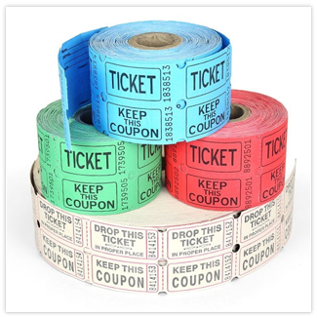
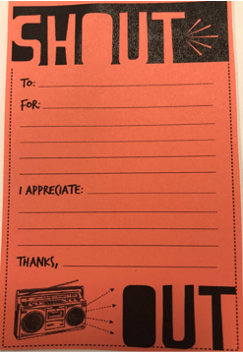
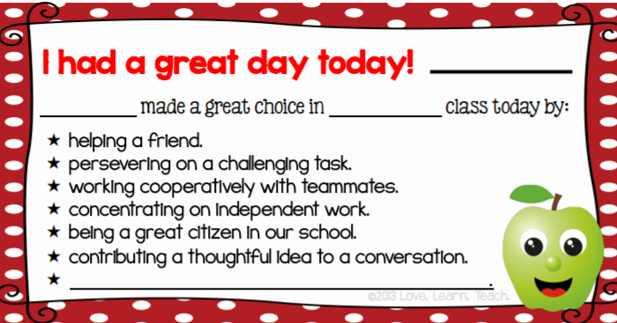
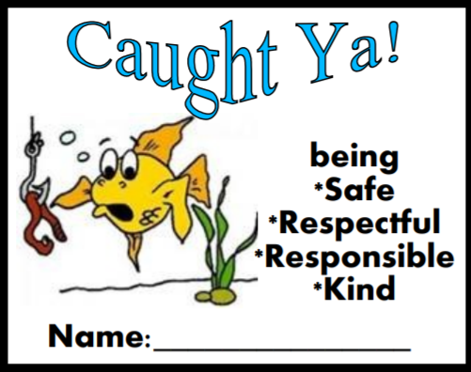
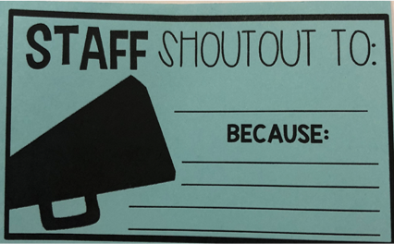
Using Acknowledgements: Real School Examples

Slide 17
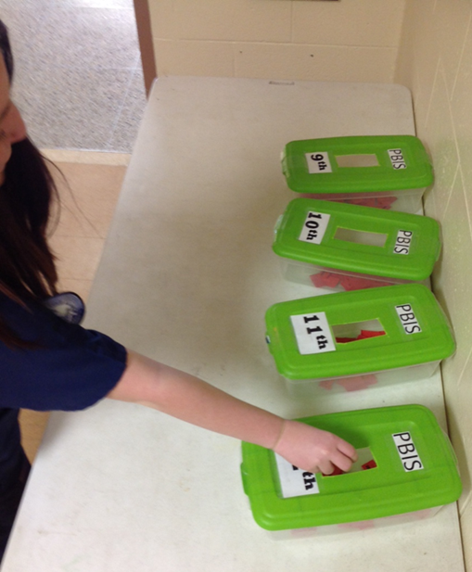
Using Acknowledgements: Real School Examples

Slide 18
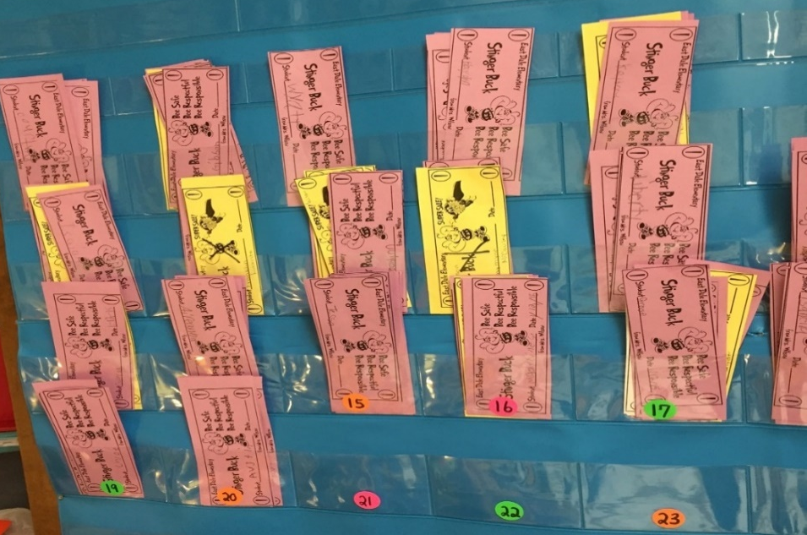
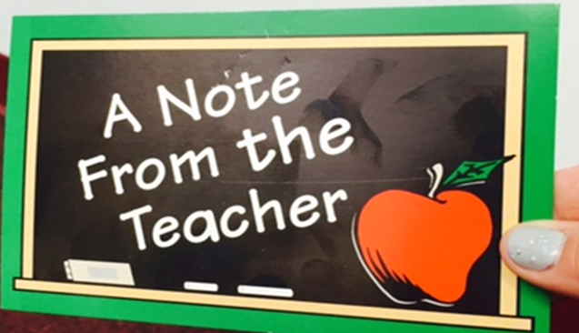
Using Acknowledgements: Real School Examples

Slide 19
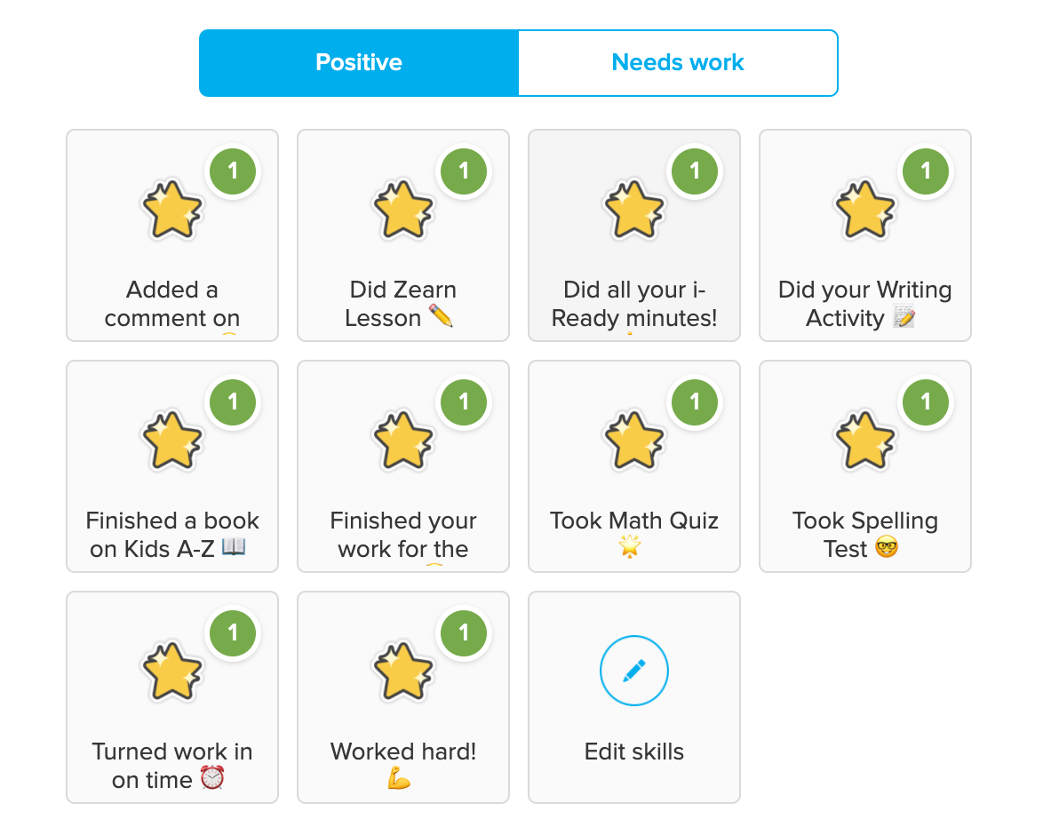
Using Acknowledgements: But We’re Virtual Now!
Thanks for logging in on time and participating during our class lesson. Great work today!

Slide 20
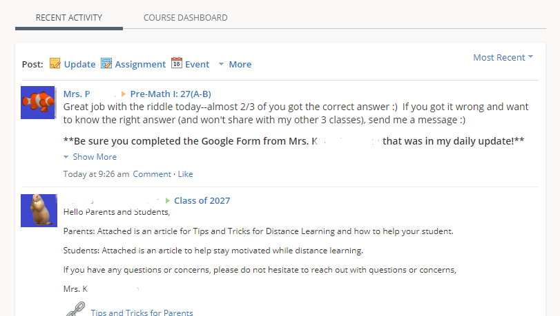
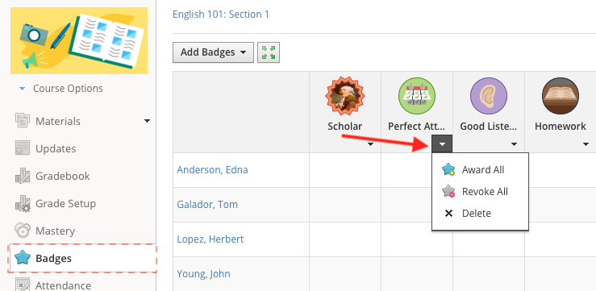
Using Acknowledgements: But We’re Virtual Now!

Slide 21
ACTIVITY: Let’s Share!
**Poll Everywhere – Bulletin Board**

Slide 22
Effects of “Teacher Greetings”
Targeted middle school students with problem behaviors
Teachers greeted each student by name and made a positive statement (e.g., “Good to see you”).
27% increase in:
Actively listening to teacher’s instructions (listening & responding)
Following teacher’s instructions
Seeking help in the proper manner

Slide 23
High Impact Classroom Interventions
Personal Greetings (low-cost, high yield proactive classroom management strategy)
High Rates of Opportunities to Respond
Peer to Peer Coaching/Performance Feedback
Continuum of Consequences for Minor Infractions

Slide 24
Positive Greetings at The Door
Targeted 203 middle school students
10 teachers
PGD (Positive Greetings at the Door)
Greeting using student’s name
Nonverbal (handshake, fist bump, pat on shoulder, smile)
Include some individual and group pre-corrections
Results
Average increase in Academically Engaged Time (AET) 20.95%
Significant decrease in disruptive behavior

Slide 25
Rewards/Acknowledgements
Social
Time with friends
Verbal praise
Activity
Teacher assistant
Art project
School dance
Staff/student games
Sensory
Lights
Temperature
Music
Seating
Escape
“1-Minute Ticket”
Homework pass
Library pass
Tangible
Edibles
Materials
Praise notes
Pencils, notebooks
Stickers
Photos
T-Shirt
Tokens

Slide 26
Using Acknowledgements

Slide 27
Using Acknowledgements: What does the TFI say?
Are they linked to your school-wide expectations?
a
Are they used across settings?
Common areas/school-wide
Classrooms
Grade-level clusters
Individual students
a
Is the system in place with fidelity?
Are staff members giving them?
Are students receiving them?

Slide 28
Using Acknowledgements: Guidelines for Providing Acknowledgement
A Layered Approach
How Often?
Immediate
High Frequency
Predictable
Intermittent
Unexpected
Long Term

Slide 29
Using Acknowledgements: What does the TFI say?
Is there a written set of procedures for specific behavior feedback?

Slide 30
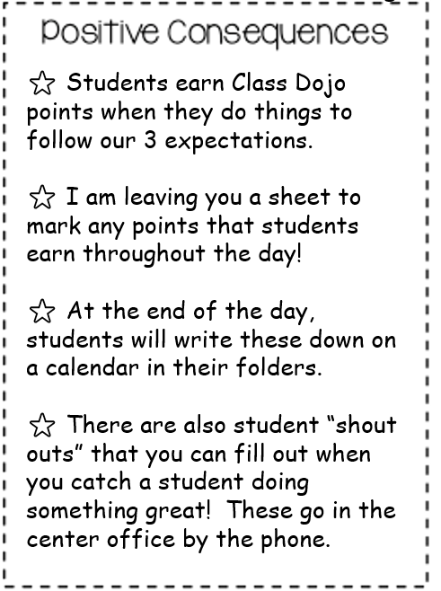
Using Acknowledgements: What does the TFI say?
Is there a written set of procedures for specific behavior feedback?

Slide 31
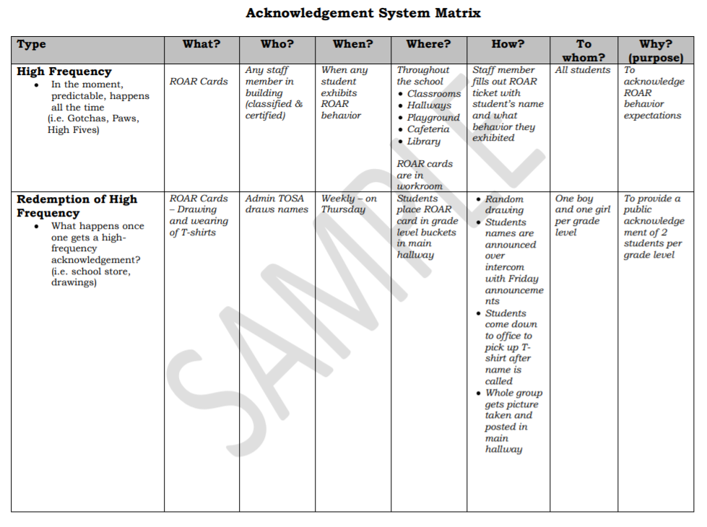
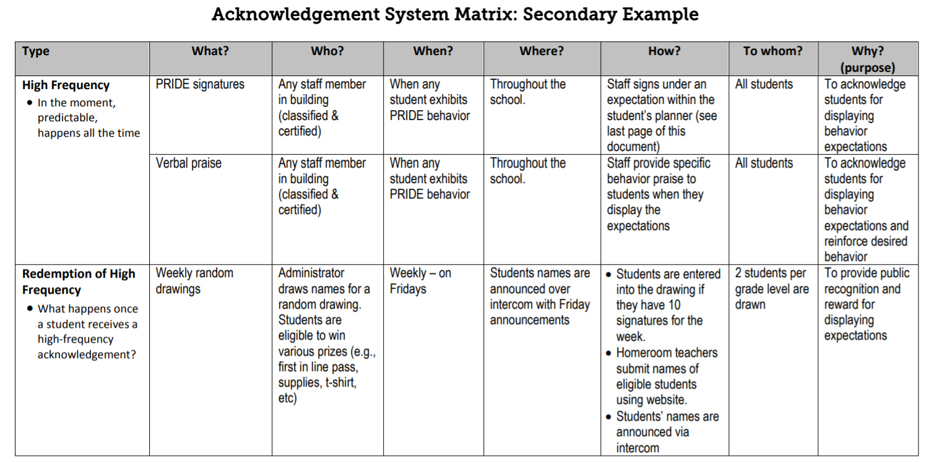
Using Acknowledgements: What does the TFI say?
Is there a written set of procedures for specific behavior feedback?
https://www.cde.state.co.us/pbis/acknowledgementsystemsecondaryschoolexample
https://www.pbisapps.org/community/Documents/5%20Acknowledgement%20System%20Matrix%20example.pdf

Slide 32
Using Acknowledgments: Guidelines for Providing Acknowledgment
When
Immediately after the target behavior occurs (expectation)
Frequently after teaching an expectation
In problem locations or situations
Avoid
Long delays between the display of positive behavior and acknowledgement
Only quarterly or semester events
General
Students should always be eligible to earn acknowledgements

Slide 33
Using Acknowledgements: Acknowledgment Recipients
Students
Teach how acknowledgements will be earned
Every appropriate behavior will not be acknowledged
Solicitations will not result in an acknowledgement
Staff
Acknowledge for using the system
Monitor fidelity of system use
Solicit ongoing feedback
Families
Acknowledge for attending parent/teacher conferences
Student attendance, on-time to school, dress code, homework completed
Solicit ongoing feedback

Slide 34
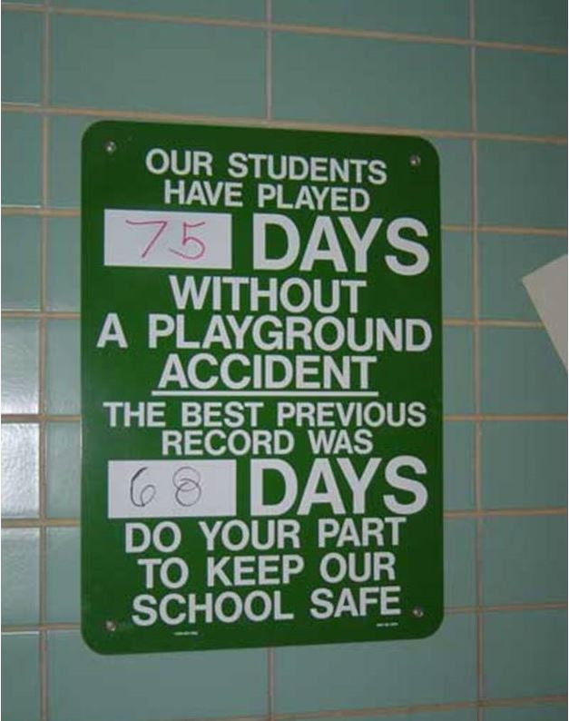

Slide 36
Rewards & Incentives

Slide 37
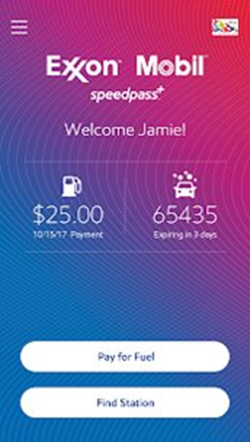
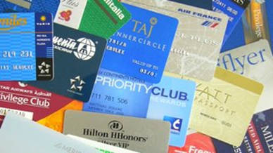
Rewards & Incentives: Just for Kids?
Think about ways you're provided incentives and rewarded as an adult.

Slide 38
Rewards & Incentives : Elementary School Incentives
Lunch with the teacher
Special helper
Recognize during announcements
Small tangibles like stickers
Treasure box

Slide 39
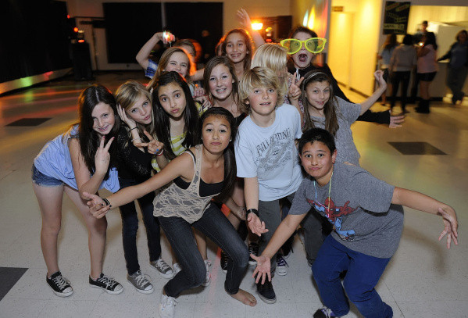
Rewards & Incentives : Middle School Incentives
2nd Chance (redo assignment)
Homework pass
Admission to dance
Admission to school event
Volunteer for field day or field trip
Be a mentor or messenger
Class DJ
Erase a tardy

Slide 40
Rewards & Incentives: ALC Incentives
Earn extra credit
Read/class outdoors
No homework pass
Phone Zone
Free school supplies

Slide 41
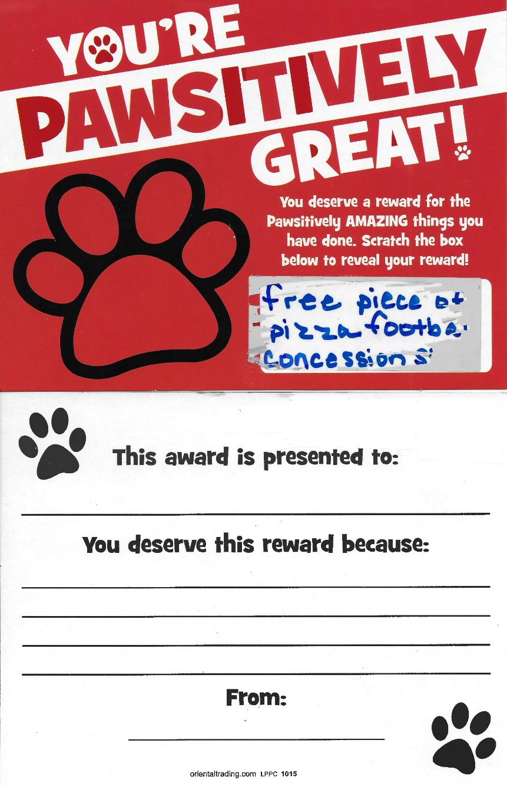
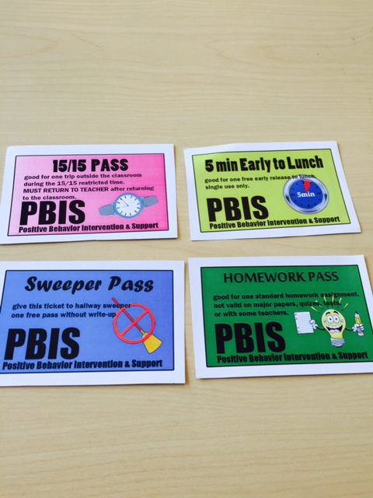
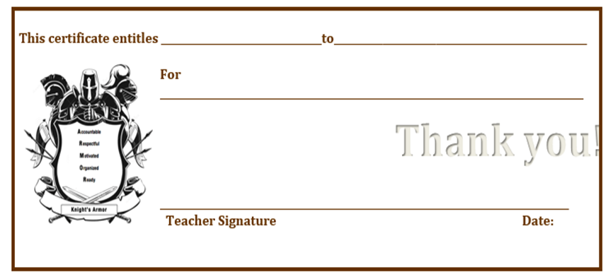
Rewards & Incentives: Real School Examples

Slide 42
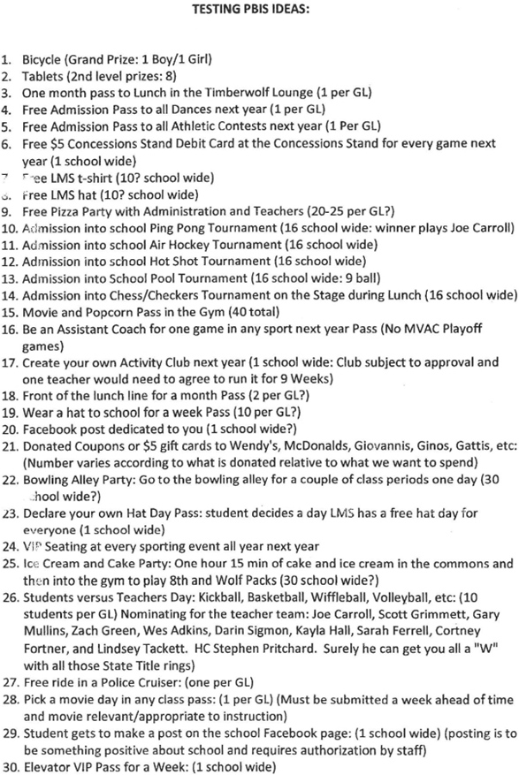
Rewards & Incentives: Real School Examples

Slide 43
Rewards & Incentives: But We’re Virtual Now!

Slide 44
ACTIVITY: Let’s Brainstorm!
**Poll Everywhere – Brainstorm**

Slide 45
Using Rewards & Incentives

Slide 46
Using Rewards & Incentives: Reward System Guidelines
Teach
What behaviors will earn rewards (tie to expectations/acknowledgements)
How and when to reward (i.e., priority locations)
Offer a variety of rewards
Feedback continuum
Survey students and families for ideas
Make it as easy as possible
Use and share data
Decrease in problem behaviors
Increased participation in reward events

Slide 47
Using Rewards & Incentives : Funding Rewards and Ideas
School Improvement funds (SIP)
PTO, Community donations and/or partnerships
Fundraisers
School night at local restaurant
School Yard Sale
Grants
Educational websites
Learning Earnings (http://www.learningearnings.com)
Low cost/No cost
Social activities
School events
Parking pass
First-in-line

Slide 48
Using Rewards & Incentives: Guidelines for Providing These
When
Think about “layers”
What is manageable?
What is the most effective?
Avoid
Long delays between the display of positive behavior and reward
Only quarterly or semester events
General
Some students may need shorter time intervals between rewards
Balance of tangible and privileges
Students should always be eligible to earn rewards
‘No’ parties should not be used in isolation
tardies, referrals, dress code violations, etc.

Slide 49
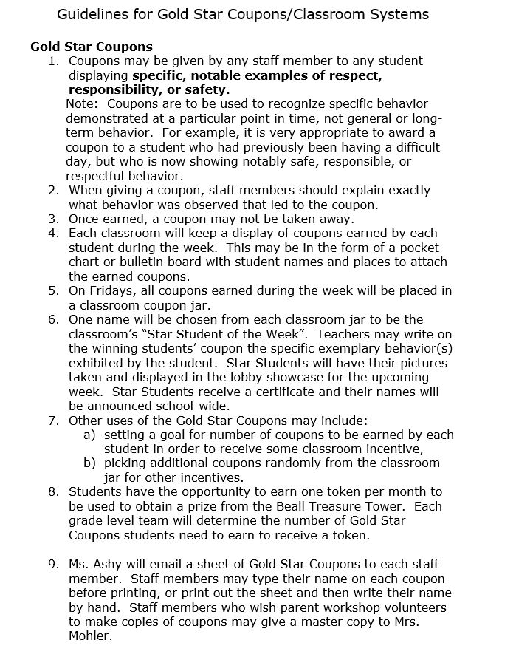
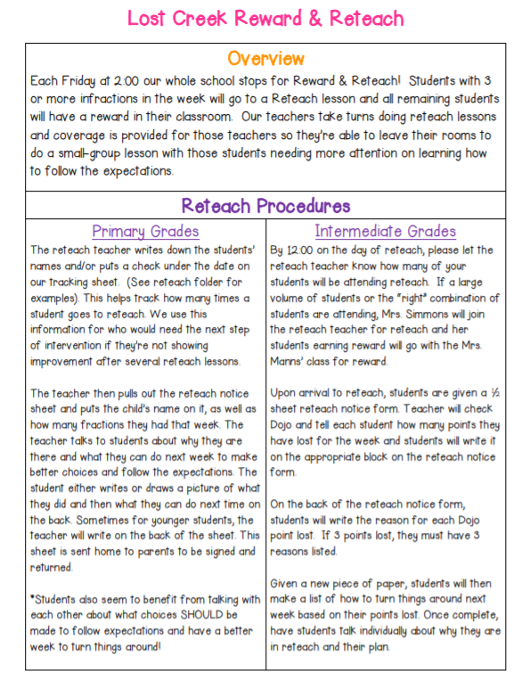
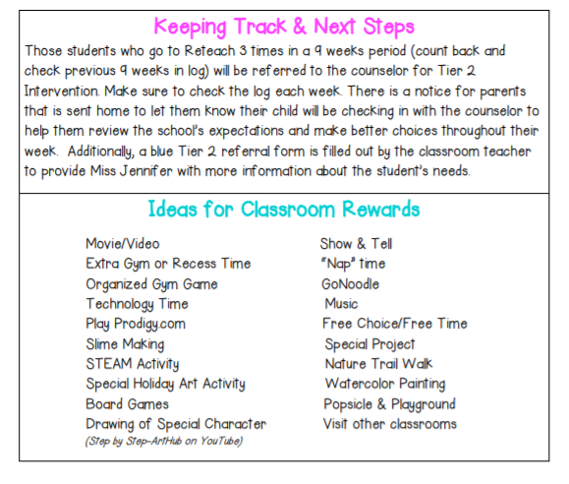
Using Rewards & Incentives: Guidelines for Providing Acknowledgements & Rewards

Slide 50
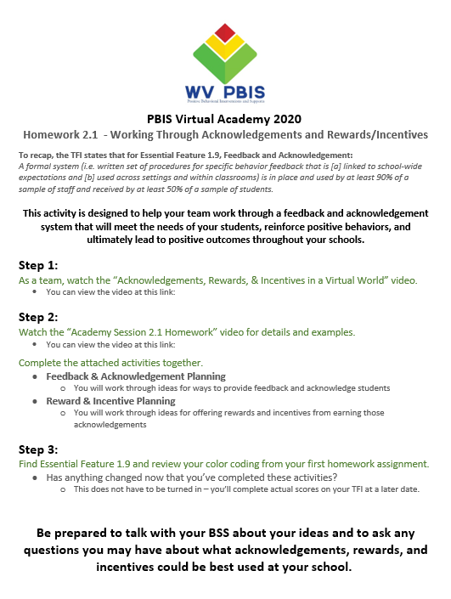
Session 2.1 Homework
Watch Video
Acknowledgements, Rewards, & Incentives in a Virtual World
Team Brainstorming
Complete Homework Pages
Review your TFI
Look at Essential Feature 1.9

Slide 51
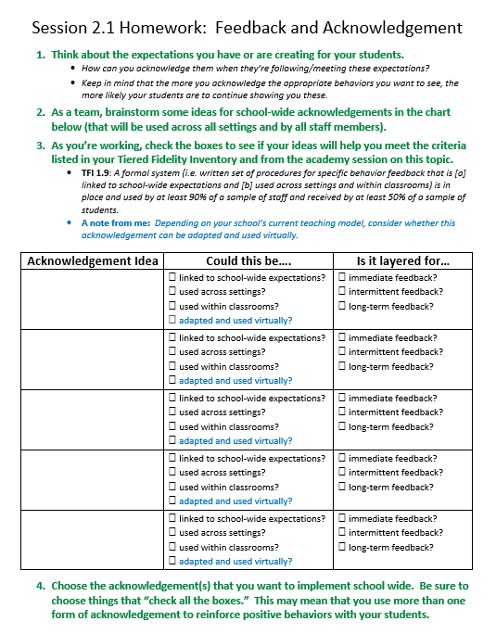
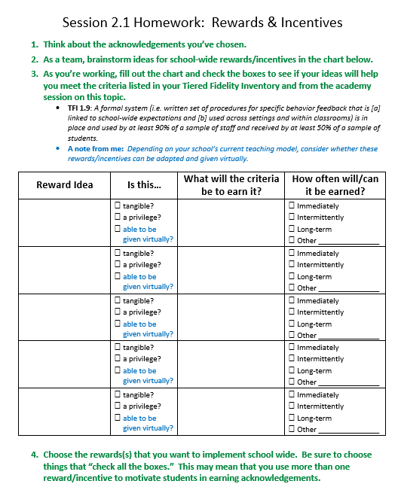
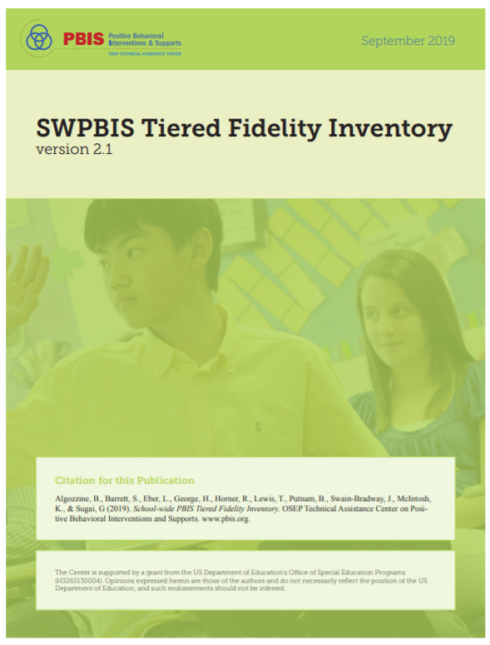
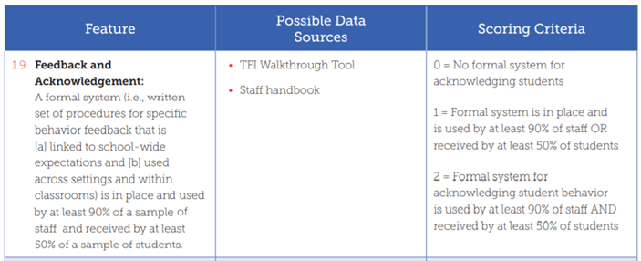
Session 2.1 Homework

Slide 52
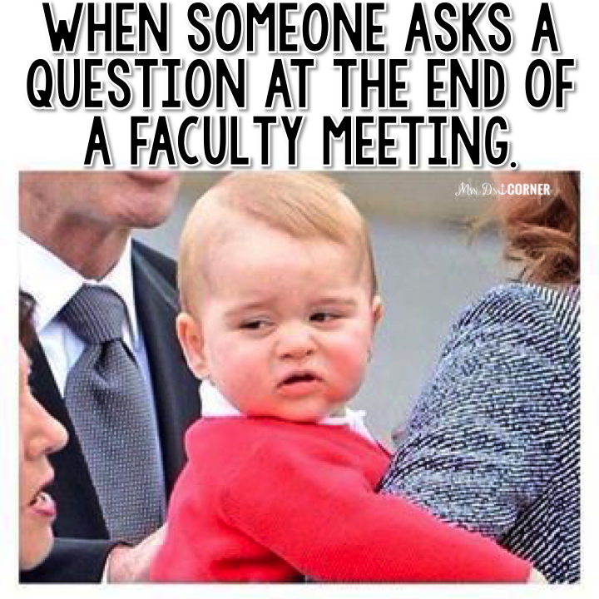
Questions??
Erin Day
Behavior Support Specialist – North
day137@marshall.edu
Next time…..
Problem Behavior Definitions
Discipline Policies

