Slide 1
Office of the Bursar
Orientation 2015
Best. Decision. Ever.

Slide 2
What is a Bursar?
bur-sar [bur-sahr]
Derived from “bursa”, Latin for purse, bursar literally means “keeper of the purse.”

Slide 3
The Billing Process
Tuition is assessed when a student registers for classes
Except for the Fall semester, students can view tuition charges online immediately after registration
Additional time may be required for financial aid figures to be updated (Financial aid processing time varies from student to student)
Students will receive notification via their Marshall email account when new billing activity occurs
Best. Decision. Ever.

Slide 4
Due Dates
A tuition due date is assigned during the billing process
Students may have varying due dates
Factors affecting due dates
Date of registration
Student’s last name
Students paying after the due date, but by the cancellation date will be assessed a $25 late payment fee

Slide 5
Cancellation Dates
Cancellation date is last date a payment may be made before courses are cancelled for non-payment of tuition/fees
Students not paying by the cancellation date will be subject to withdrawal of courses
Failure to receive a billing statement will not be accepted as a reason for missing the payment deadline
Best. Decision. Ever.

Slide 6
Tuition Schedule
For planning purposes, anticipate that tuition payments will be due:
FALL 2nd week of August
SPRING 2nd week of December
SUMMER Throughout May

Slide 7
Tuition & Fees (per semester)
Full-time On-Campus Base Tuition
WV Resident* $3,407
Metro* $5,979
Non-Resident* $7,801
Freshman Residence Hall $3,042
Board/Meal Plan* $1,874
*Base tuition does not include college and program fees
*Electronic courses have an addition $40 per credit hour delivery fee
*Board/Meal Plans may vary
Best. Decision. Ever.

Slide 8
Payment Options
Online (easiest, most convenient)
-American Express, Discover, MasterCard, VISA*
-Electronic Check
Phone
-American Express, Discover, MasterCard, VISA*
-Electronic Check
Mail
-Check or Money Order only
In Person
-Cash
-Check or Money Order
-American Express, Discover, MasterCard, VISA*
*2.25% processing fee will be incurred for each credit/debit card payment

Slide 9
Paying Online
View current/outstanding balances
Send messages directly to Bursar’s Office
View account history by term
E-billing
View payment history
Pay deposits
Pay for parking permits & citations
View financial holds
Parent/Guardian authorization for account access
View/print official receipts
View/print 1098-T tax forms
Apply for room/board
Best. Decision. Ever.

Slide 10
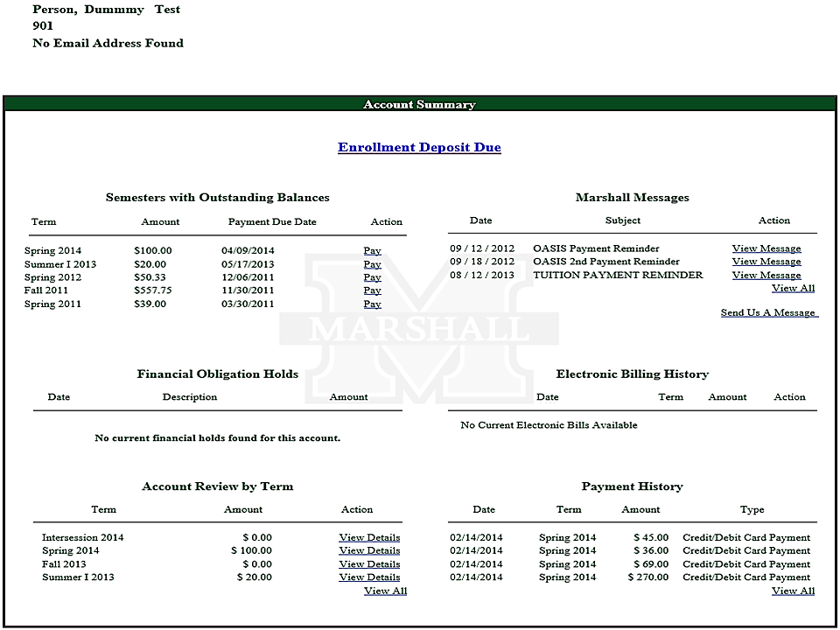

Slide 11
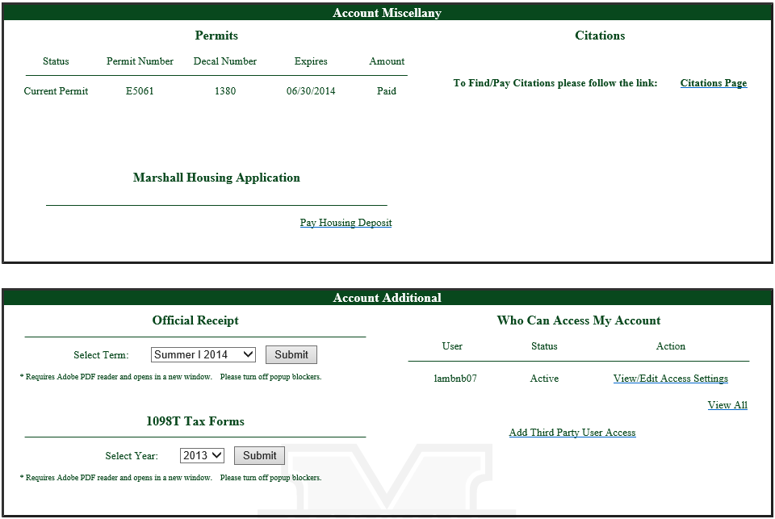

Slide 12
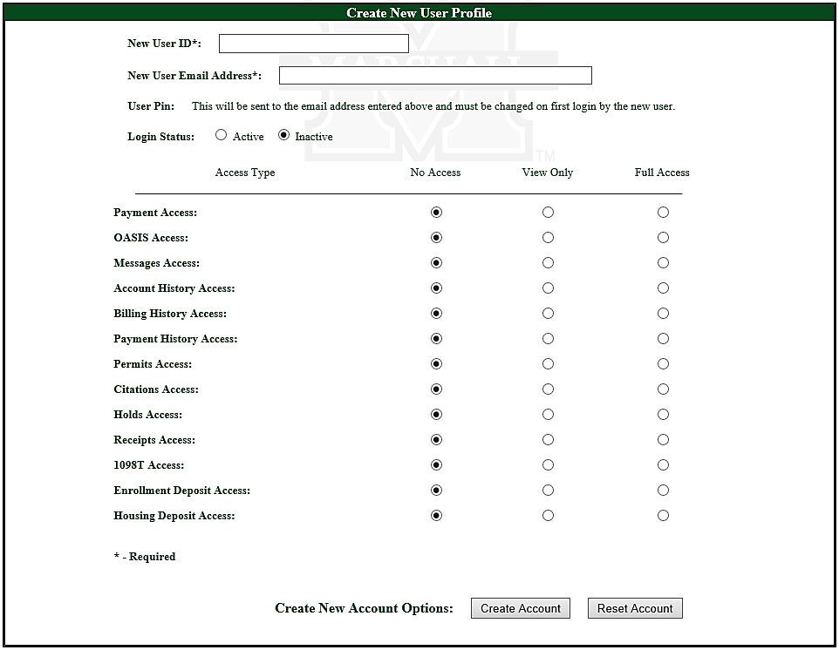

Slide 13
Payment Plan
Exclusive payment plan for tuition and housing costs (Fall and Spring only)
Provides three equal payments for outstanding tuition and/or housing charges after any applicable financial aid has been applied
First payment is due in accordance with due date on paper/electronic billing statement and/or at time of enrollment
A 1% enrollment fee will be charged to your final two payments
For Fall 2015, the 2nd payment is due by September 14th and the 3rd is due by October 14th
A 2.25% processing fee will be applicable on each payment if made by credit/debit card
Enroll online or in person

Slide 14
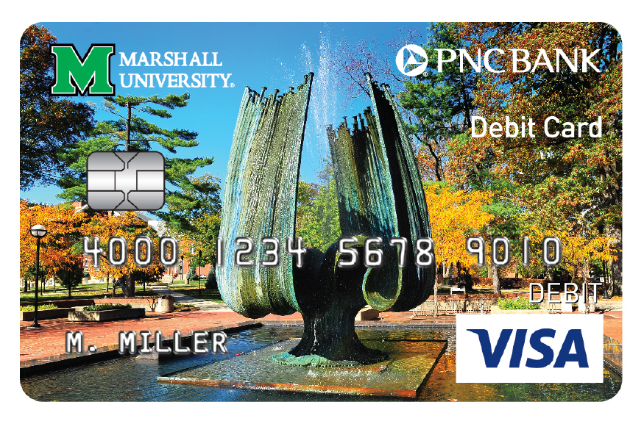
Refunds
All student refunds are issued by Marshall through
Students will select a refund preference logging into utilizing the quick launch button
Open an account through PNC Bank
-Refunds within 1-2 business days
Electronic transfer to an outside bank account
-Refunds within 2-3 business days
Receive a paper check
-Refunds within 7-10 business days
Best. Decision. Ever.

Slide 15
Refunds
Excess Financial Aid
Disbursed 5-7 business days after released to student’s account by the Office of Student Financial Assistance
Earliest disbursement is the first day of classes

Slide 16
Refunds
Tuition and Fees
All other credits to the account that are not caused by Financial Aid
“Regular” refunds take approximately 3 weeks from the date of the transaction causing the credit
Payments made by credit/debit cards are refunded back to that card
All other payments are refunded through PNC Bank via the method previously selected
Financial aid recipient accounts must be reviewed by the Office of Student Financial Assistance before a student fee refund can be issued
Monies may have to be returned to funding source
Best. Decision. Ever.

Slide 17
1098-T Form
Provided to assist families in claiming the American Opportunity & Lifetime Learning tax credits
Mailed to student’s permanent address by January 31st each year
Also available online at www.marshall.edu/bursar
Issued to all students whose tuition and eligible expense charges exceed the amount of scholarships, grants and waivers received during the tax (calendar) year
Please contact your tax consultant to determine if you are eligible to claim the credit(s)

Slide 18
Correspondence
Students should check Marshall email accounts regularly
Electronic communications include:
Billing Activity
Due Dates
Payment Reminders
Cancellation Notices
Best. Decision. Ever.

Slide 19
Questions?
Information Pamphlet provided in Orientation packets about CA$Htrack and Bursar’s Office
101 Old Main, Huntington, WV 25755
(304) 696-6620 or (800) 438-5389
Office Hours: Monday - Friday
8:00AM - 5:00PM
www.marshall.edu/bursar

