Slide 1
Disparities of West Virginian African Americans & COVID-19
Dr. Benjamin I. Wainblat, M.D.
Paul Ambrose Healthcare Policy & Advocacy Fellow
PGY I, Marshall University Family Medicine

Slide 2
A Refugee’s Story

Slide 3
Tuskegee Experiments
Nearly 400 African American Men went untreated for decades with syphilis
  All in the name of science: to see what happens in the later stages of syphilis
  Non-treatment continued despite known treatment development

Slide 4
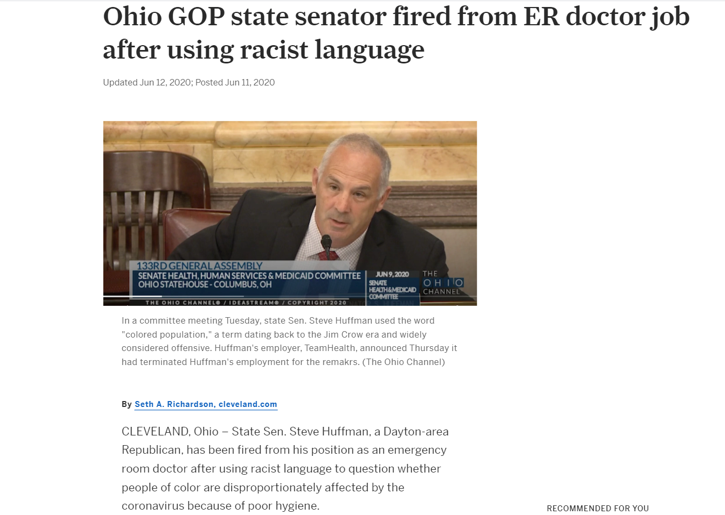
In the News:

Slide 5
Outbreak
3/15/2020: Fairmont, WV, Friendship Baptist Church:
  Multi-church celebration of pastor’s anniversary
  90-120 people in attendance
  Viola York Horton, 88 yo F, performed choir music at this celebration
3/15/2020: later that day, CDC rec’s against gatherings >50 ppl
3/16/2020: Gov Justice Declares State of Emergency for WV
3/29/2020: Viola York Horton is WV’s 1st COVID-19 death
9 days later: 5 attendees hospitalized

Slide 6
Tackling Community Outbreak
Church Community spreads the word on FB that attendees were falling ill
Church Community Member reaches out to regional public health department (Marion County Health Department)
  Devise plan to reach out to attendees
  Health Dept states that if attendees don’t return phone calls, no one can be helped
  Church Community feels frustrated with lack of gov’t direction

Slide 7
Community Outbreak Barriers to Care
Laverna Horton, 85 yo F, Sister-in-Law to Viola Horton (COVID-19 WV death #1), fell ill, was hospitalized, notified physician that other attendees were getting ill, but only had a temp of 96.7 .
  Never allowed to get testing
  Experienced anorexia, loss of taste, and weight loss
  Recovered; still never tested
Marion County Residents directed to neighboring Harrison/Monongalia for testing
  This was due to loss of Fairmont Regional Medical Center in late 3/2020
Marion County (+) COVID-19 Cases >50% AA in a county of 3% AA
Testing Help/State Resources went to Eastern Panhandle instead when a cluster of cases appeared

Slide 8
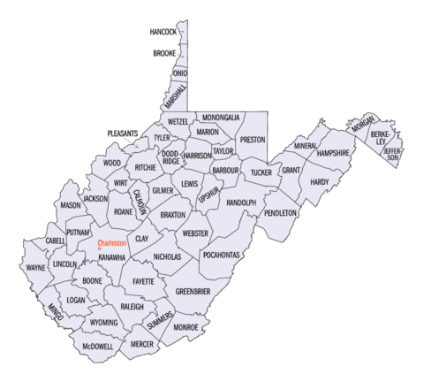

Slide 9
Creation of a task Force
Multiple NAACP chapters in WV & words from US Senator Manchin created the COVID-19 Advisory Commission on African American Disparities
  First meeting = 5/11/2020
  Composed of Director of Herbert Henderson Office of Minority Affairs, Religious Leaders, State Legislators, and NGO Leaders including NAACP
Creation partially spurred by 2/11/2020 CDC Report:
  33% hospitalized COVID pts = black vs 18% community members = black
  Underlying Conditions:
    Living Conditions
    Work Circumstances
    Underlying Health Conditions & Lower Access to Care

Slide 10
Initial Task Force Goals:
Increase Testing availability including w/o a doctor’s order
Reach out to the African American community experiencing higher rates of infection/hospitalization
Setting forth guidelines to address the larger racial disparities and developing partnerships for the future
Evaluation of statistical disparities:
  ~29% AA COVID (+) pop ends up hospitalized vs 14.6% of White pop
  78% of AA COVID (+) pop have sxs vs 68% White pop
Connecting COVID (+) pts to PCPs

Slide 11
Targeted Free Testing begins
Facilitated by the WV State National Guard on 5/22-5/23
  Occurred in several counties including Marion county
  299 tested; 70% were AA
Rolled out in less than 1 wk
Demonstrated strong collaboration btwn gov’t & NGOs

Slide 12
Post-testing task force analysis
Focused on providing more community awareness of testing events & need to be tested
Also focused facilitating testing f/u including filling out paperwork & difficulty in reaching some (+) pts
Noted the general prevalence of distrust by the minority community
  Emphasized importance of transparency

Slide 13
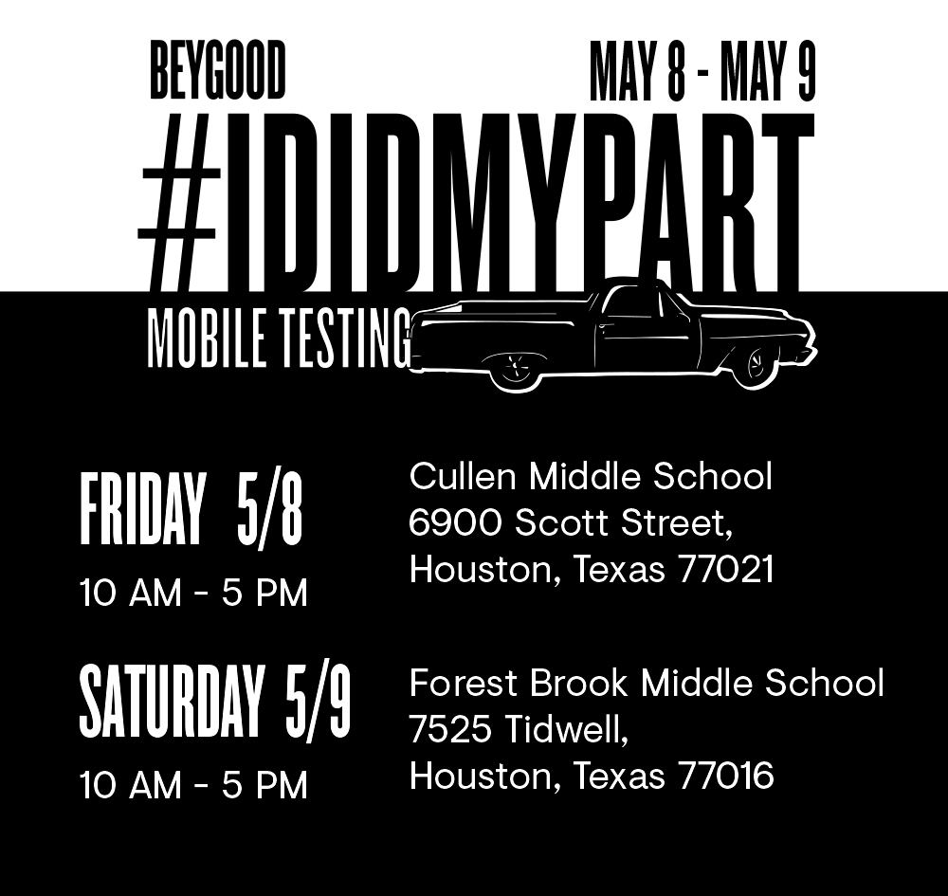
Attempts to reach out
Task Force was advised minority community may come out to a livelier event
  eg: Texas testing event w/Beyonce drew a 5 mile traffic line
  Understood difficulty of fun environment vs social distancing
Attempted to focus on public housing dvpts & those w/o transportation access
Addressed fears of losing job over (+) test w/need to quarantine
  Fear of COVID being a hoax and (+) test results used to oust workers from jobs
  Jobs protected by the ADA

Slide 14
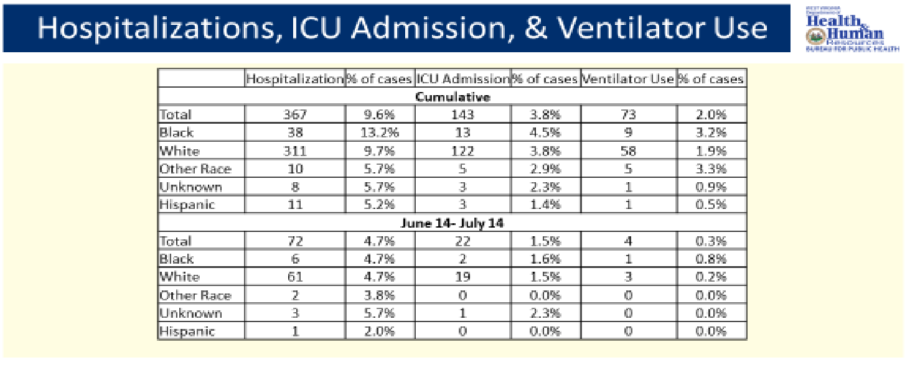
COVID rates, as of 7/16 task force meeting:

Slide 15
What Can/Should be done?

Slide 16


Further Reading Recs:

Slide 17
Works Cited
Adams, Steven. “West Virginia’s Black Community Faces Greater Challenges Due to Coronavirus.” Weirtondailytimes.Com, The Weirton Daily Times, 9 May 2020, www.weirtondailytimes.com/news/local-news/2020/05/west-virginias-black-community-faces-greater-challenges-due-to-coronavirus/. Accessed 13 June 2020.
Allen, Emily. “New W.Va. Group Explores How COVID-19 Disproportionately Impacts African American Communities.” Www.Wvpublic.Org, West Virginia Public Broadcasting, 11 May 2020, www.wvpublic.org/post/new-wva-group-explores-how-covid-19-disproportionately-impacts-african-american-communities#stream/0. Accessed 13 June 2020.
Associated Press. “How COVID-19 Tore Through a Black Church Community in WV.” US News & World Report, U.S. News & World Report, 10 May 2020, www.usnews.com/news/best-states/west-virginia/articles/2020-05-10/how-covid-19-tore-through-a-black-church-community-in-wv. Accessed 13 June 2020.
CDC. Coronavirus Disease 2019 (COVID-19). Centers for Disease Control and Prevention, 11 Feb. 2020, www.cdc.gov/coronavirus/2019-ncov/need-extra-precautions/racial-ethnic-minorities.html. Accessed 15 June 2020.
Griffin, Justin. State’s Outreach Efforts Begin for Minority Groups. Spirit of Jefferson, 13 May 2020, www.spiritofjefferson.com/news/article_8d67c218-9522-11ea-8555-7b7abdb30736.html. Accessed 15 June 2020.
jvincent@herald-mail.com, Jenni Vincent. “State Plans African American COVID-19 Testing in Berkeley, Jefferson Counties.” Herald-Mail Media, 10 May 2020, www.heraldmailmedia.com/news/special/coronavirus/state-plans-african-american-covid-19-testing-in-berkeley-jefferson-counties/article_0f5e5331-b1d2-5e7e-8aef-36ea43383800.html. Accessed 13 June 2020.
Richardson, Seth A. Ohio GOP State Senator Fired from ER Doctor Job after Using Racist Language. Cleveland.com, 11 June 2020, www.cleveland.com/open/2020/06/ohio-gop-state-senator-fired-from-er-doctor-job-after-using-racist-language.html. Accessed 14 June 2020.
“WV Herbert Henderson Office of Minority Affairs.” Wv.Gov, 2020, minorityaffairs.wv.gov/COVID-19/Pages/default.aspx. Accessed 13 June 2020 and 15 November 2020.

