Slide 1


Grant Budgeting Basics

Slide 2
Correct Budgeting is Important
The proposal budget can be one of the most important criteria used in evaluating your proposal
A poorly planned budget can:
  Result in a project not being funded
  Seriously delay award setup
  Lead to unreimbursed costs

Slide 3
Basic Budget Terminology
Budget Detail:
This is the financial plan for your project. This shows the budget using numbers. MURC pre-award provides specially designed spreadsheets for this purpose that can be found here.
Budget Narrative/Justification:
This is the narrative explanation of the budget detail which shows the budget using words. You should write this after you complete your spreadsheet.
If it is not in your project, do not list it in your budget. If it is in your project, be sure and list it in your budget.
The budget spreadsheet and budget narrative should tell the same story as the proposal.

Slide 4
Budgeting Plan
  Know your project: You should have a general idea of what your project entails
  Make a list: List anything that needs financial support
  Read the solicitation: Know the allowable amount, exclusions and requirements
  Contact your MURC Pre-Award Grants Officer as soon as you think you might apply
  The budget should be considered as the proposal narrative is written
  Must be logical and reasonable
  Must conform to funding agency and Institutional rules (this is when your MURC Pre-Award Grants Officer comes in handy)
It is much easier to fix a budget before the proposal has been submitted than after the project has been awarded grant funds.
Your MURC Pre-Award Grants Officer is available to work with you to ensure that your budget is drafted correctly.

Slide 5
Costs must be
Reasonable: Does it contribute to the project?
Purchasing a small boat for a project which entails collecting water samples would be a reasonable expense, as long as it is allowed by the funding agency. Purchasing a small boat for a project studying String Theory would not be considered reasonable.
Allowable: Is it allowed by the agency, institution or federal government?
Read the solicitation. Read the solicitation. Read the solicitation. Most solicitations list unallowable costs or budget line items that are restricted. The US government also has a comprehensive list of allowable/unallowable costs here. Your pre-award officer can help you navigate this if needed.
Allocable: Can the cost be directly attributed to the project?
Items that cannot be directly attributed are usually covered by the institutional indirect costs

Slide 6

Typical Budget Categories
  Personnel/Salaries
  Fringe Benefits
  Supplies (items that are individually less than $5k, laptops, etc.)
  Travel
  Equipment (single item over $5k that is used multiple times)
  Contractual
  Construction
  Other
  Indirect (Facilities and Administrative) Costs

Slide 7
Personnel/Salaries
Anyone being paid from an externally sponsored project will have measurable effort (percent of effort).
  Calculated from the base salary
  Your best estimate of how much time will be spent on the project
  Effort is a commitment whether the grant pays for it or not
  No one can have more than 100% effort

Slide 8
Personnel (salaries)
Marshall Employee: Already employed by Marshall and on Marshall payroll
MURC Employee: Paid from externally funded projects (on MURC payroll)
Most new hires for grant activity will be MURC
Students: GAs are MU employees- GAs must have Graduate College Dean hiring approval before can be budgeted in a proposal application. Student employees can be undergrad or grad, and MURC or MU payroll
Administrative staff: Typically this is unallowable unless specifically stated in the RFA.
Cost-of-Living increase: May or may not be included in a multi-year budget and follows Marshall HR policies. **the NIH and other federal agencies have been discouraging COL increases**
IMPORTANT: MURC follows MU’s policies for COL increases. If MU does not allow for a COL increase in a given year, MURC cannot give a COL raise—even if it has been written into the budget.

Slide 9
Personnel/Salaries: Students
STUDENTS
When will they be working?
Hourly restrictions: During classes students are only able to work 20 hours/week for grad students and 10 hours/week for undergrad students. During summer, or breaks between semesters and holidays, students are allowed to work 37.5 hours
May pay hourly or per semester (check with your college for current rates)
Tuition waivers: Graduate tuition waivers for proposed graduate student positions must be included in the application*
Not included in the annual 3% cost-of-living increase: This is because students are often not the same employees year to year
*New GA positions must be approved by your college, Academic Affairs and the Grad School office BEFORE including in your proposal and submitted to the agency.

Slide 10
Fringe
Fringe costs are real costs to the employer that are above and beyond salary. Marshall University uses a federally negotiated fixed fringe rate*.
  Employer’s portion of health insurance premium
    Medicare, Medicaid, and Social Security withholding
    Unemployment and Workers’ Comp
    Annual Leave/sick leave
Employer’s portion of retirement (both MU and MURC match employee contribution up to 6%)
*Negotiated fringe rates change yearly around July 1. The current rates can be found on the Institutional Data Sheet found here.

Slide 11
Travel
Must be relevant to the grant, allowable, and included in the proposal
Must follow the MURC travel policy:
https://www.marshall.edu/murc/files/Travel-Policy-and-Procedure-Manual.pdf
Must follow the General Services Administration Rates (www.gsa.gov )
Include miscellaneous expenses and registration fees

Slide 12
Supplies
Allocability: must be directly allocable to the project (pipettes, beakers, etc.)
Have a cost of less than $5,000 per unit.
General-purpose office supplies, such as toner cartridges, paper, and writing utensils are typically not allowed.
Computers: Most of the time these are considered supplies

Slide 13
Equipment
Have a cost of more than $5,000 per item
  Unless stated in the RFP, equipment quotes are not needed during the proposal stage
  Must follow MU purchasing guidelines post-award
Examples include:
  Freezers
  Imaging equipment
Note: Most funding agencies maintain an interest in equipment purchased with grant funds.
It will be considered a capital item and a report of its location and use may be required after the project.
MURC and the PI have an obligation to inventory the item and keep it in good working order.

Slide 14
Contractual
Third parties working on grant activities.
Two broad categories:
Subaward/Subcontract
  Work performed that is critical to the project
  Third-party is providing specialized work
  Provisions of the main award are passed to the sub
Service Agreements/Consulting Agreements
  Work is incidental to the project
  Similar services are routinely provided by the vendor to other organizations
MU/MURC employees cannot be paid via a contractual agreement.
All pay must go through the appropriate payroll office and include fringe benefits.

Slide 15
Other Costs
Costs that are not easily classified under the other cost categories.
Examples:
  Postage and freight
  Publication costs
  Long Distance Telephone Charges
  Tuition: tuition must be included in the budget when a new GA position is written into a grant. Tuition must be allowable by the sponsor
  Maintenance

Slide 16
Indirect Costs
Indirect Costs are:
  Also referred to as Facilities and Administrative Costs (F &A) or Overhead
  Real costs that are incurred by a grantee for common or joint objectives and cannot be identified specifically with a particular project or program such as: utilities, building maintenance, and administrative support (computing services, payroll, accounting, etc.).
Example: Electricity is used throughout a university building, but when the electric bill arrives it has the composite charge for the entire building rather break down individual
usage per room or faculty member—that would be rather implausible; however, electricity is a REAL cost (because typically researchers rely on it to power their labs and
classrooms)
  Not a TAX, FEE, or a “MURC cut”

Slide 17
Indirect Costs Continued
Current Rates:
On-campus research 48.00%
Off-campus research 26.00%
On-campus other sponsored activities 30.00%
Off-campus other sponsored activities 22.90%
Where do the Indirect Cost rates go?
A percentage of the indirect cost rate goes to predetermined allocations as determined by university policy, such as the library. From the remainder, indirects are usually distributed as follows:
University President’s Office 25%
MURC 25%
College/Center/Institute 50%*
*allocations to individual departments are determined by each college/center/institute. Check with your dean or director.

Slide 18
Indirect Costs Continued
Marshall University’s Indirect Cost Rate (ICR) is determined by negotiations with the federal government. The ICR is the per dollar amount that the feds have determined that it costs Marshall University to conduct research.
Marshall’s current rate for on-campus research project is 48%. This means that for each dollar spent on research, it cost the university $0.48.
There are specific criteria needed to determine which rate will be applied to your project
MURC will make the final determination of the appropriate rate.

Slide 19
Indirect Costs Continued
Unless specifically listed in the agency guidelines, Marshall’s full appropriate rate will be applied.
Example # 1: Dr. Car D. Atch is applying for a grant from the American Heart Association. The AHA specifically restricts indirect costs to
10%. This is the rate that must be used.
Example #2: Dr. I. M. Karful is applying for a HRSA training grant. HRSA training grants specifically state in the RFA that training grants
are restricted to 8% indirects. This is the rate that must be used.
Under no circumstances should a PI ever negotiate the indirect rate with an agency. Such negotiations should be considered null and void because the PI is not legally authorized to negotiate on behalf of the university.
Example: Dr. Rulzop Shunal is working on a budget for a contract with Homeland Security that has a budget cap of $500,000 (direct and
indirect). In order to have more money for his project, Dr. S decides to use a 10% indirect rate. What is wrong with this?

Slide 20
Cost Share/Matching
Cost Share is the portion of the project or program costs not borne by the funding agency. Types of cost share include:
  Mandatory: required by the sponsor. Example: NASA Graduate Fellowships require a 1:1 Match
  Committed: not required by the sponsor, but reflected in the budget.
  Voluntary: not required by the sponsor, but provided by the research—and reported via the University’s effort reporting system. Voluntary cost share is strongly discouraged unless implied by the agency.
  In-Kind: the value of non-cash contributions provided by the University (equipment use, effort, etc.)

Slide 21
Cost Share/Matching Continued
Cost-share commitments should only be made when the program requires it. This will be stated in the RFA.
Most federal agencies do not recommend or require voluntary cost share. This is sometimes different with foundations. Thus, reading the directions is important.
Federal funds cannot be used as a match for any other federal grant proposal.
Matching that has been written into a proposal must be fully documented, approved, and tracked post-award, even if it was not required by the agency.
Once it has been written in and approved, it has been committed; therefore, you must follow through.

Slide 22

MURC is moving to Cayuse
Cayuse is a sponsored project lifecycle management system from proposal creation to project closeout.
Cayuse Sponsored Projects 4.0:
It will help eliminate administrative burdens by allowing PIs to quickly and accurately prepare a proposal for internal routing and review. This module will replace the current ATS form routing process.
Cayuse Proposals S2S (system to system):
This module is a fast, easy-to-use Web application created specifically to simplify the creation, review, approval, and electronic submission of Grants.gov proposal applications. Anything that can be submitted via Grants.gov will be using Proposals S2S
Watch for further press releases and user training videos/guides coming soon.

Slide 23
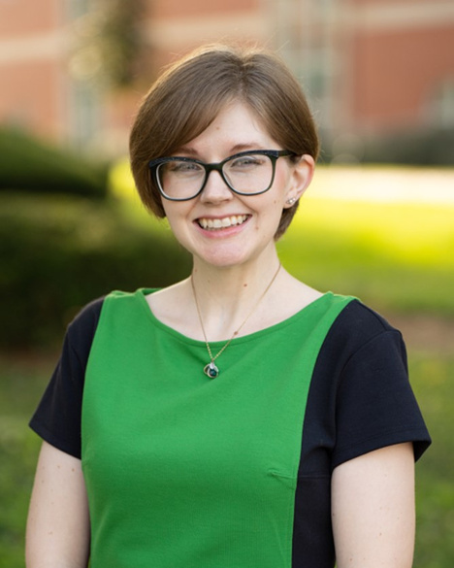
Grants Development Office
Mission:
To grow Marshall University faculty and staff grant participation and research dollars through the pursuit of multi-million dollar multi-disciplinary and multi-institutional grants.
Services we provide:
  Partner with faculty & and staff to develop project ideas.
  Locate grants to support projects.
  Conduct outreach and relationship-building with funders.
  Develop internal and external project partnerships.
  Conduct grantsmanship training.
  Provide Project management for grant applications and projects.
  Review grant applications.
  Write and submit grants.
Niki Rowe-Fortner,
Director of Grants Development
Email: rowe39@marshall.edu
Phone: 304.696.2965
For more information visit: https://www.marshall.edu/murc/grants-development-office/

Slide 24
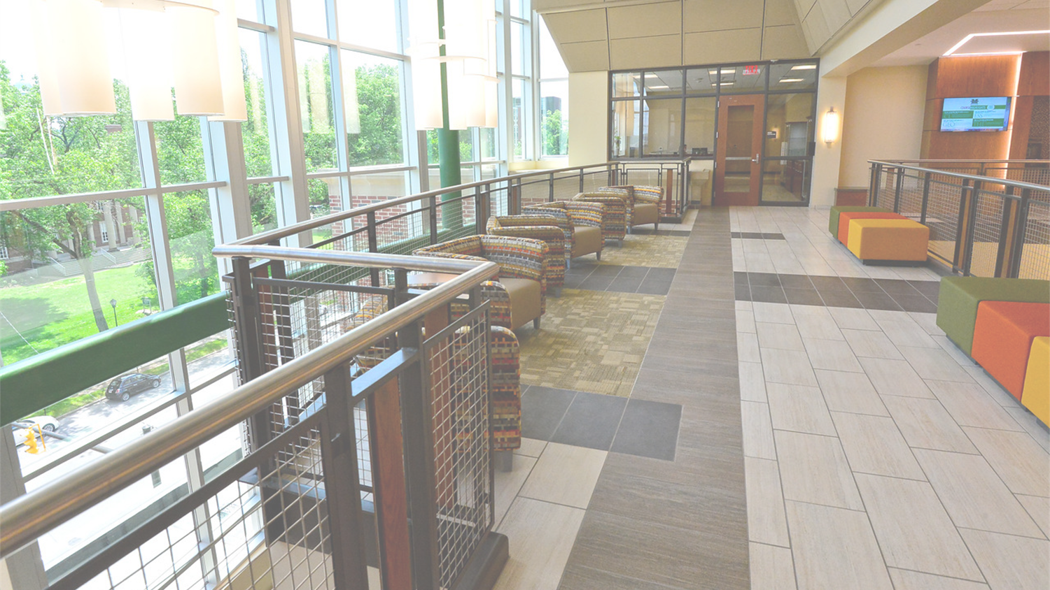
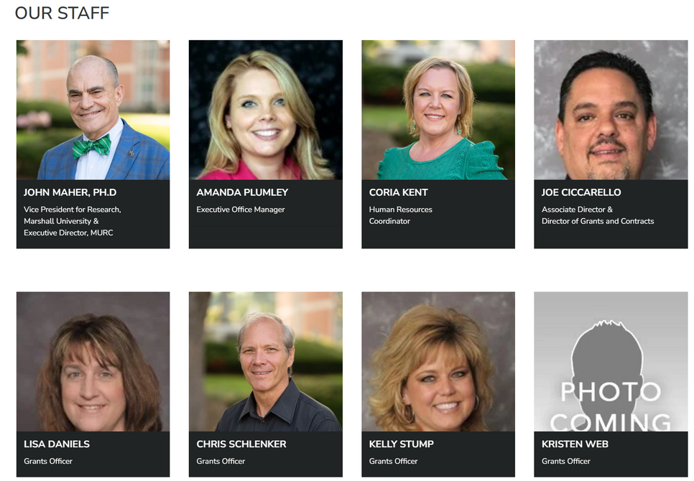
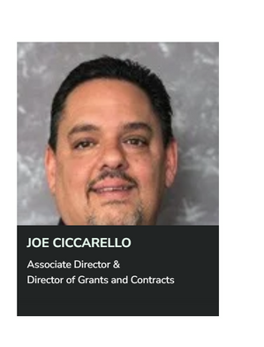



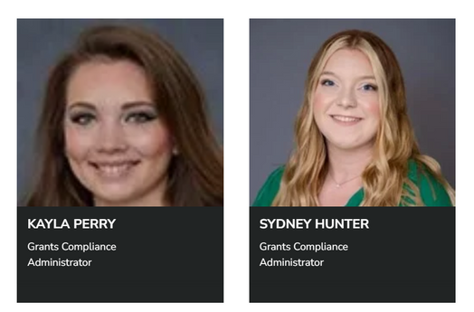
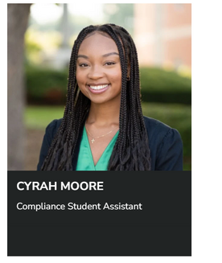
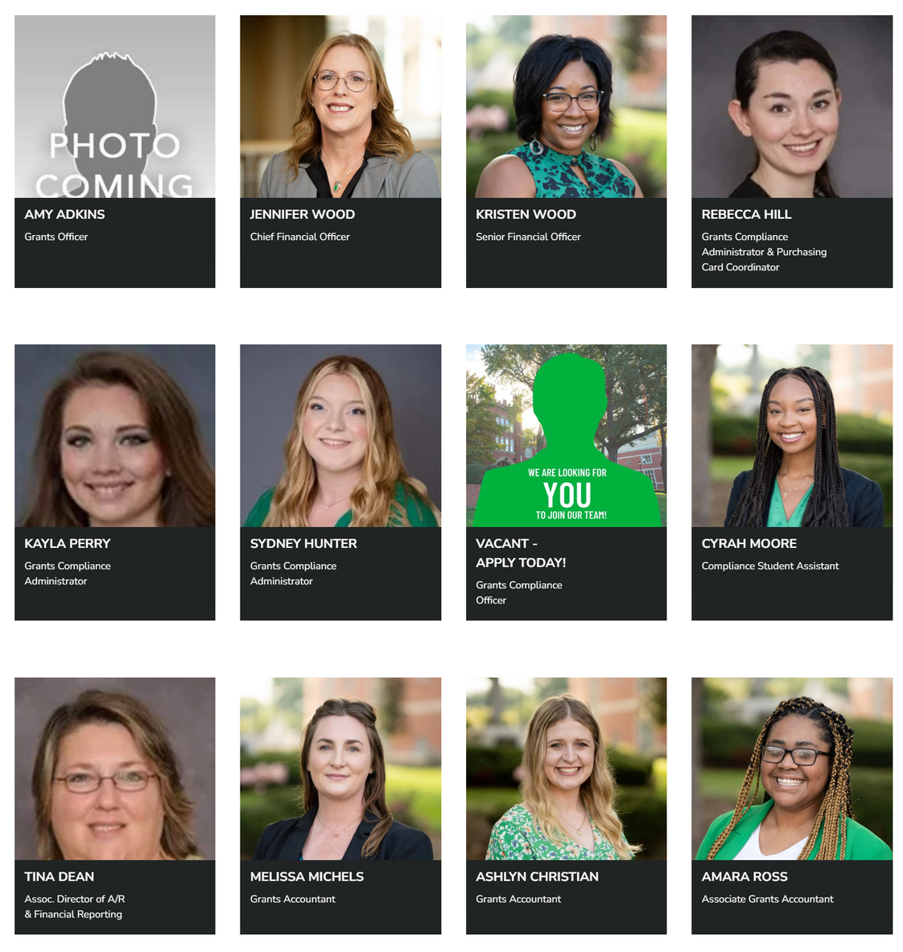

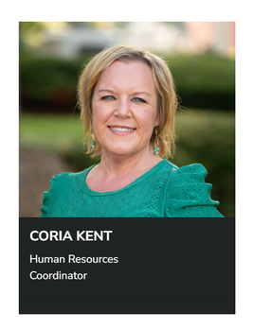


MURC Staff

Slide 25
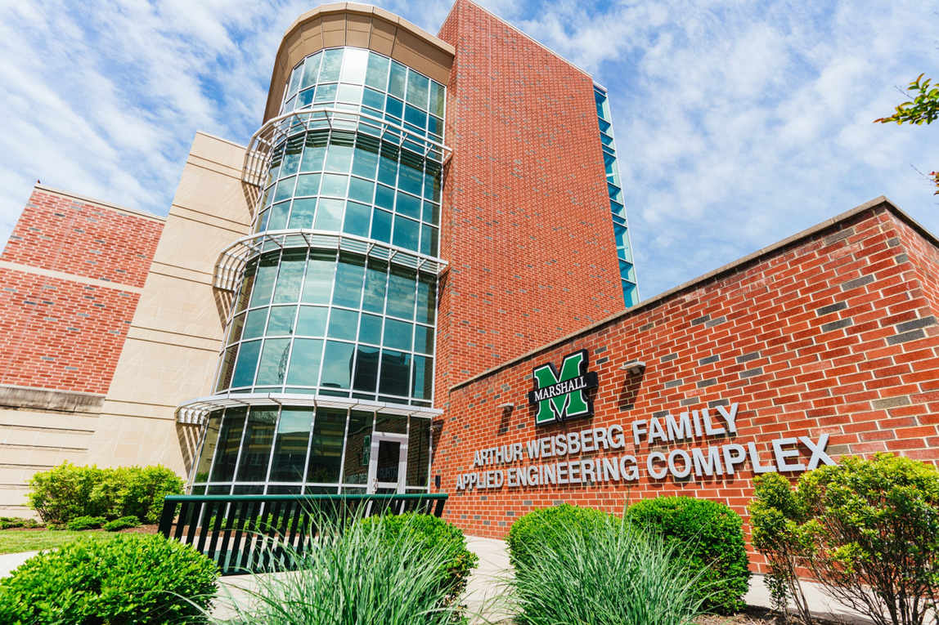
Where to find us on campus.
Recruit more doctors.
Our first key focus.
Physical Address:
Fourth Floor, Arthur Weisberg Family Applied Engineering Complex
1676 Third Ave., Huntington, WV 25703
Mailing Address:
One John Marshall Dr.
Huntington, WV 25755-8100
Phone: 304-696-6271
Fax: 304-696-6300
Email: murcpreaward@marshall.edu
Staff Directory: https://www.marshall.edu/murc/our-staff-new/
We look forward to working with you!

