Slide 1
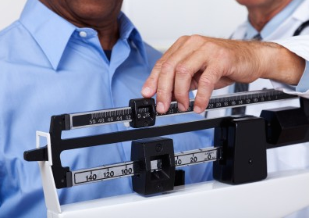
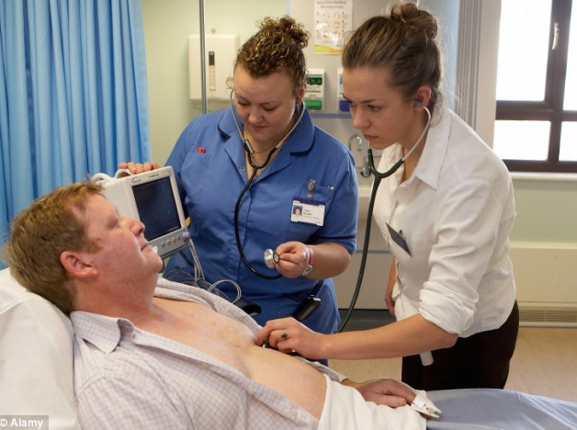
Weight-Related Bias in Medical Students Within an Appalachian University Population: A Proposed Study
Britni Ross, M.A., Penny Koontz, Psy.D., Thomas Holland
Literature Review
Hypotheses
Proposed Methods
Implications
West Virginia leads the nation in obesity rates, at 35.1% (Levi, Segal, Laurent, & Rayburn, 2014)
Research on obesity demonstrates there is a pervasive, culturally accepted negative stereotype of obese people and health care providers are not immune to anti-obesity attitudes and stigma (Sabin, Maddalena, & Nosek, 2012)
Third year internal medicine residents reported feeling incompetent to treat obesity, negative feelings with regards to the physical appearance of obese patients, and that most obese patients would not be able to lose a significant amount of weight (Davis, Shishodia, Taqui, Dumfeh, & Wylie-Rosett, 2007)
Post-graduate students enrolled in health discipline programs (physician’s assistant, clinical psychology, and psychiatric residency) view their patients as lacking motivation, difficult to treat, and non-compliant with any medical treatment, not just those related to weight. Students with higher weight bias also tend to attribute more behavioral causes to obesity (Puhl, Luedicke, & Grilo, 2013)
Health care professionals specializing in treating eating disorders also report negative attitudes toward obese patients, a lack of confidence in obese patients’ ability to achieve and sustain weight loss, and feeling uncomfortable caring for obese patients (Puhl, Latner, King, & Luedicke, 2013)
Nurses generally feel unequipped to address obesity with their patients. They also tend to overemphasize the importance of obesity in all health problems with obese patients and attribute obesity causes to patients’ lifestyle and personal choices, although nurses are more likely to also consider genetic contributions (Brown, Stride, Psarou, Brewins, & Thompson, 2007)
Dietetics and medical students reported a decrease in negative attitudes toward obese patients and an increase in awareness of genetic and environmental influences after watching anti-stigma films (Poustchi, Saks, Piasecki, Hahn, & Ferrante, 2013 and Swift, Tischler, Markham, Gunning, Glazebrook, Beer, & Puhl, 2013)
Hypothesis 1: There will be a significant difference in explicit attitudes toward obese patients between the pre-treatment and post-treatment measures.
Hypothesis 2: There will not be a significant difference in explicit attitudes toward obese patients between the post-test and follow-up measures.
Hypothesis 3: Participant BMI will predict attitudes toward obese patients.
Hypothesis 4: Metro versus non-metro resident status will predict a difference in explicit attitudes toward obese patients.
Participants:
Second and Third-Year Medical students from the Joan C. Edwards School of Medicine in Huntington, W.V.
Measures:
The proposed study will use an adapted version of the Foster et al. (2003) original survey, Primary Care Physicians’ Attitudes about Obesity and Its Treatment. The study will examine two domains related to medical students’ attitudes about obesity: causes of obesity and attitudes towards obesity treatment. Participants will rate their beliefs of perceived causes of obesity on a continuum from not at all important to very important and their beliefs about the efficacy of obesity treatment on a continuum from strongly disagree to strongly agree.
Demographic information obtained will include: age, gender, racial/ethnic group, BMI, and participant resident status based on the Beale 2013 rural/urban continuum codes
Procedures:
Research design will follow a repeated measures model.
Medical students will be assessed on their explicit anti-obesity attitudes using the adapted Foster et al. survey, watch a video presentation on weight bias in health care, and retake the attitude measure. The video presentation will specifically target reducing weight-related bias and stigma in health care settings.
Students will be asked to participate in a follow-up assessment two weeks after the initial intervention.
The results from the pre and post measures and the follow-up will be analyzed to determine whether the targeted intervention was effective in decreasing medical students’ negative attitudes towards obese patients.
Current research on weight stigma does not include participants from specifically rural areas, such as West Virginia
Does residing in a rural area or participant BMI serve as a protective factor against negative obesity attitudes?
As obesity is prevalent in rural areas, does the mere exposure effect serve to soften participant attitudes toward obese patients?
Stigma, bias, and internal attributions related to weight may deter patients from seeking medical care and increase the long-term cost of health care with these patients
Providing brief training and interventions to medical students will serve to increase participants’ awareness of obesity stigma and may encourage increased sensitivity when treating obese patients
References
Reference list provided upon request.
For a list of references or to contact the authors, please email:
Britni Ross
Marshall University Psychology Dept.
One John Marshall Drive
Huntington, WV 25755
Email: graley16@marshall.edu

