Slide 1
Services Portfolio Review
Council of Chairs
December 4, 2014

Slide 2
Background and Project Goals
Service portfolio review emerged from the October 2013 campus leadership retreat. One of eight initiatives.
Goals
Provide a broad review of services, reflecting a university- wide approach.
Focus on services that will support increased net revenue.
Capture cost savings for the university.
Enhance the level of services at the university/address “pain points”.
Project Target – $7-10 million in net revenue for FY16
Justification: $5.8 million of “one-time” items used to balance 2015 budget and one year of faculty and staff raises

Slide 3
Steering Committee Members
John Maher – Co-Chair
Mary Ellen Heuton – Co-Chair
Layton Cottrill
Jan Fox
Buffy Hammers
Brandi Jacob-Jones
Gayle Ormiston
Virginia Painter
Matt Turner

Slide 4
Rapid Response Teams
Duplication of Effort -Denise Hogsett
Leveraging Technology -Brian Morgan
Facilities- Joyce Hannah
Auxiliaries- Karla Murphy
Vendors/Contracts -Allen Taylor
P-Card/Travel -Cammy Holley
Drawn from a broad cross-section of University stakeholders:
Faculty
Classified and non-classified staff
Administration

Slide 5
Rapid Response Team Approach
Identify Opportunities
Conduct Due Diligence
Review Findings
Develop Action Plan
Prioritize Opportunities
5-Step Process
Each subgroup given a charge and potential areas to review
Opportunities developed and researched
Prioritized recommendations by magnitude of cost savings, ease of implementation, speed of implementation and impact on service delivery

Slide 6
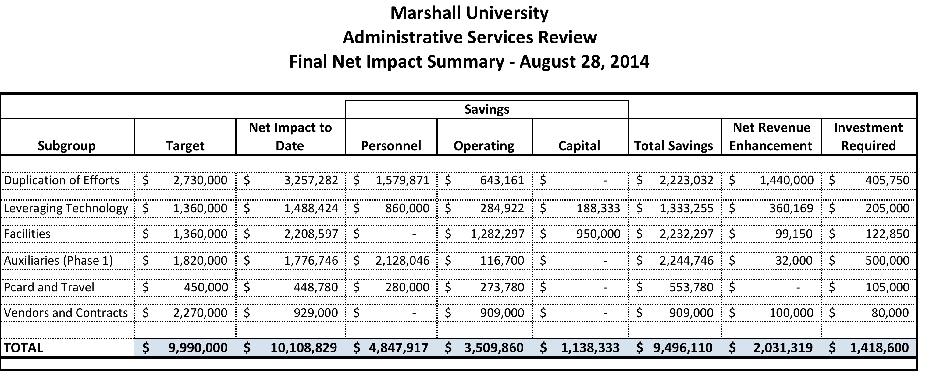
Success! –Target of $10 Million Exceeded

Slide 7
Recommendations – Key Focus Areas
Implement shared services models throughout the University to reduce cost and enhance services.
Consolidate operations where duplication of effort does not yield cost effective, additional service levels
Explore outsourcing of services where appropriate
Invest to drive more energy savings
Sell unused/under used physical assets

Slide 8
Recommendations – Key Focus Areas (cont’d)
Consolidate building utilization during evening and summer hours
Leverage power of networked IT services – e.g. printing
Address pain points in service delivery – e.g. travel and procurement card
Consolidate leased spaces back to University owned property

Slide 9
Quadrant Analysis

Slide 10
Implementation of Recommendations
Prioritize efforts on the top left and top right decision quadrant (i.e. those initiatives with the greatest savings/net revenue opportunity)
Rapid response team approach
Categorize opportunities into “buckets” to optimize implementation

Slide 11
Buckets for Implementation
Printing, faxing and IT related services
Auxiliaries, Facilities and leases
Pcard, Procurement and Travel
Marketing, Public Relations and Website
Libraries
Academic - includes continuing education, distance learning courses
Administrative and Finance – includes business center, expense reductions, temporary services/pool, student insurance

Slide 12
Next Steps
Determine implementation oversight structure-done
Identify Rapid Response Team leads and members-done
Develop process and timeframe for implementation with rpkGroup-mid-December
Kickoff- January

