Slide 1
Charting a Sustainable Future: Marshall University Vision 20/20
Campus Conversation
October 6, 2014 Service Portfolio Review

Slide 2
Vision 20/20: Strategic Planning to Sustain Marshall’s Future
How will the University define and sustain its future?
State and Federal Funding challenges
Declining enrollment
Inability to compensate through tuition increases
Marshall’s strategic planning process will help us determine how we can thrive in a dramatically changing public funding environment.
Challenge: Improve Net Revenue (Revenue-Cost) so we can invest in people, programs and facilities.
Retreat #1 October 11, 2013
Retreat #2 March 25, 2014

Slide 3
October 2013 Retreat
Understand the current external environment for higher education nationally and in West Virginia;
Achieve greater clarity for the stakeholder groups regarding the current and future sustainability of the institution’s business model;
Consider appropriate changes to be explored in the institutional business model to allow for:
Affordable tuition without sacrificing educational quality or the financial health of the University;
Management of financial risk; and
Strategic realignment of the institution’s mission/vision within a more variable resource environment;
Assess resource allocation decision-making at the institution in terms of its transparency and effectiveness in supporting strategic programs and services that provide a mission/market/margin framework;
Create an action plan; and
Identify appropriate information and a communication strategy to support the proposed November Board of Governors’ Budget/Finance Planning Summit.
In addition to these six goals, University leadership created a long term goal for the retreat participants to consider, specifically
how the University might engage in financial re-engineering and sustainability planning in anticipation of a markedly lower public funding environment, potentially approaching 90% less state funding ($50 million reduction in State Support) by Fiscal Year 2024.

Slide 4
Action Plans to Achieve Goal
Communication Plan
Shared Future Vision/Roles and Responsibilities
Academic Portfolio Review
Services Portfolio Review
Budget Process
Pro Forma Model
Key Performance Indicators

Slide 5
Service Portfolio Review Project
Provide a broad and balanced review of services, reflecting a university wide approach.
Configure Rapid Response Teams chosen from a broad cross-section of University stakeholders:
Faculty
Classified staff
Non-classified staff
Administration
Project Target – Identify $7-10 million in net revenue enhancement for FY 2016
Justification: 5.8 million of “one-time” items used to balance 2015 budget and one year of faculty and staff raises
Capture cost savings for the university.
Focus on services that will support increased net revenue.
Enhance the level of services at the university/address “pain points”.

Slide 6
Rapid Response Teams
Assisted by the rpkGroup
Based on their input, configure teams around “opportunity themes”
For the first phase of this effort:
Six themes, teams
5/16/14 kick-off, 9/1 draft report date
July 24 mid-point

Slide 7
Rapid Response Teams
Duplication of Effort
Leveraging Technology
Facilities
Auxiliaries
Vendors and Contracts
P-Card and Travel

Slide 8
Team Targets
Team | Target ($MM)
Facilities | 1.36
Vendors/Contracts | 2.27
Auxiliaries | 1.82
Leveraging Technology | 1.36
Duplication of Effort | 2.73
P-Card | 0.45
Total | 10.00

Slide 9
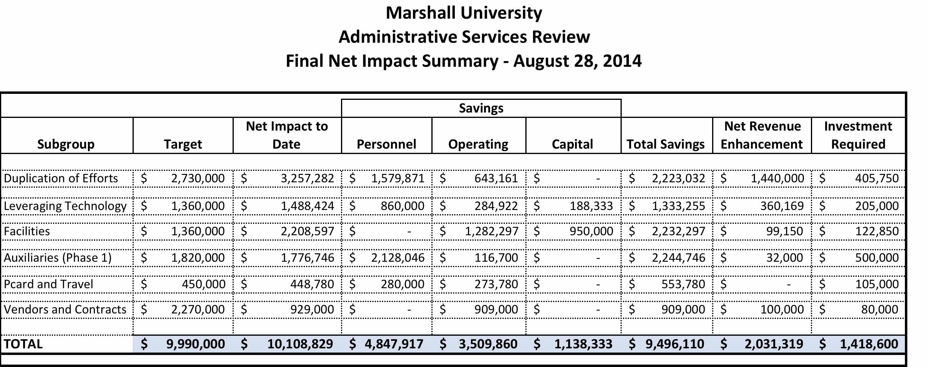
Results

Slide 10
Classification of Recommendations

Slide 11
Next Steps
Working with the recommendations to develop a holistic plan for implementation, beginning with items that can be implemented in the short-term
October 17 Retreat will convene a broad cross-section of the University to kick-off that phase
Questions?

Slide 13
RRT Team Goals

