Slide 1
POWER of Performance 2021 Honorees

Slide 2
Putting People to Work

Slide 3
CONGRATULATIONS
Dan Conant Solar Holler Cabell County
on being selected as this year’s
POWER of Performance 2021 Honoree

Slide 4
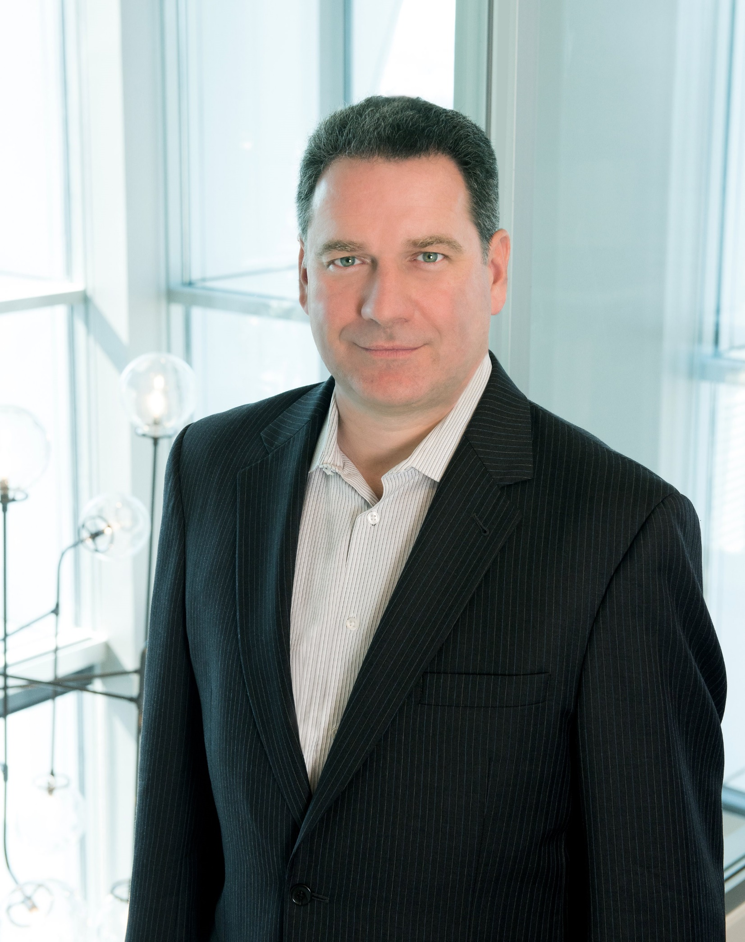
CONGRATULATIONS
Todd Cope CentralApp Putnam County
on being selected as this year’s
POWER of Performance 2021 Honoree

Slide 5
Revitalizing Communities

Slide 6
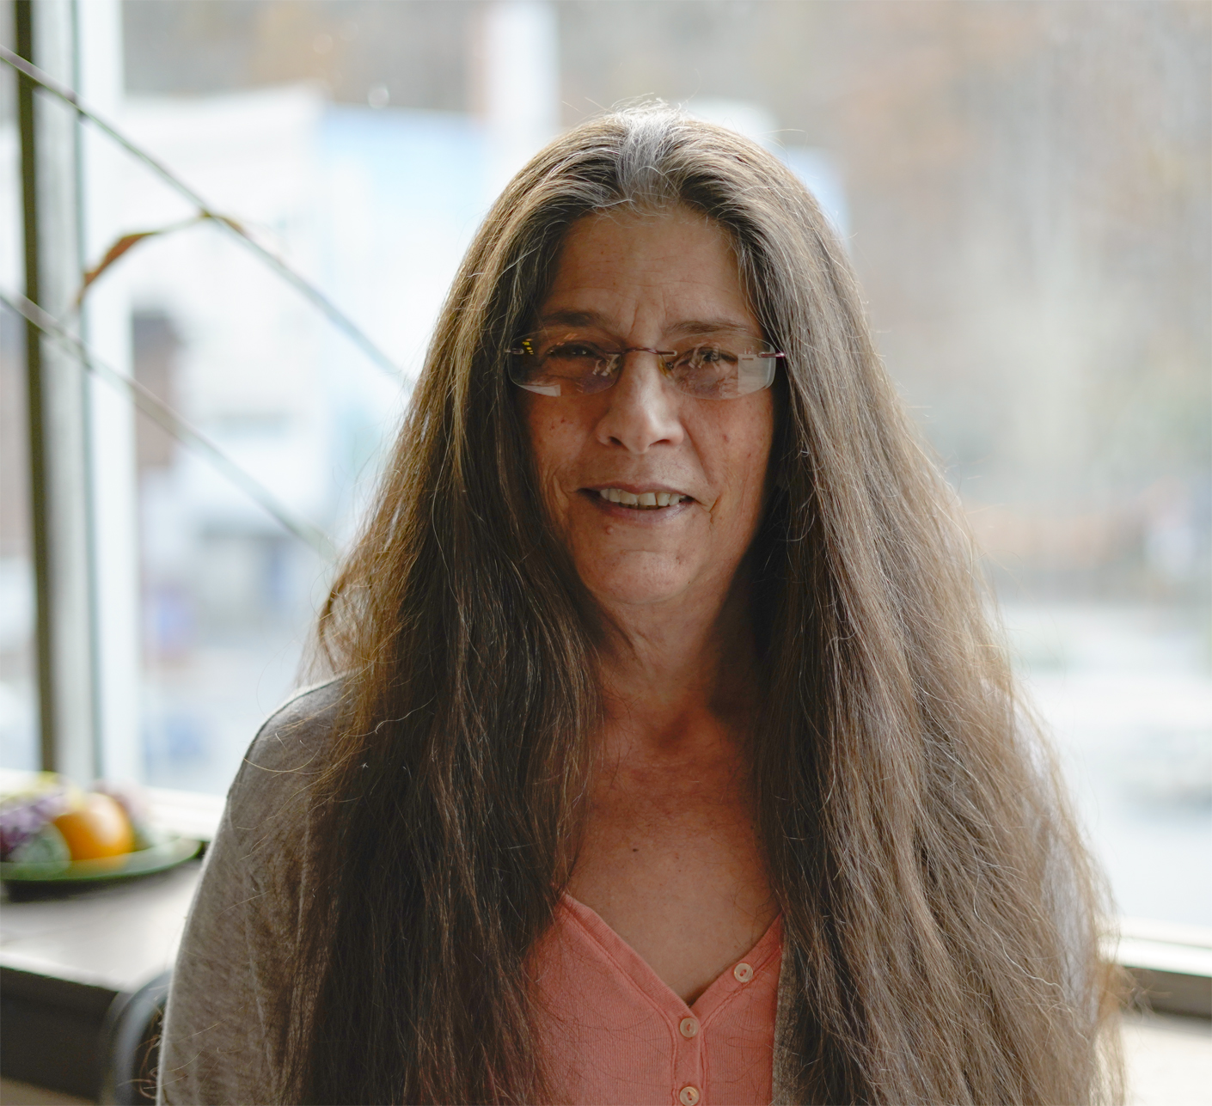
CONGRATULATIONS
Missy Nester Welch Daily New McDowell County
on being selected as this year’s
POWER of Performance 2021 Honoree

Slide 7
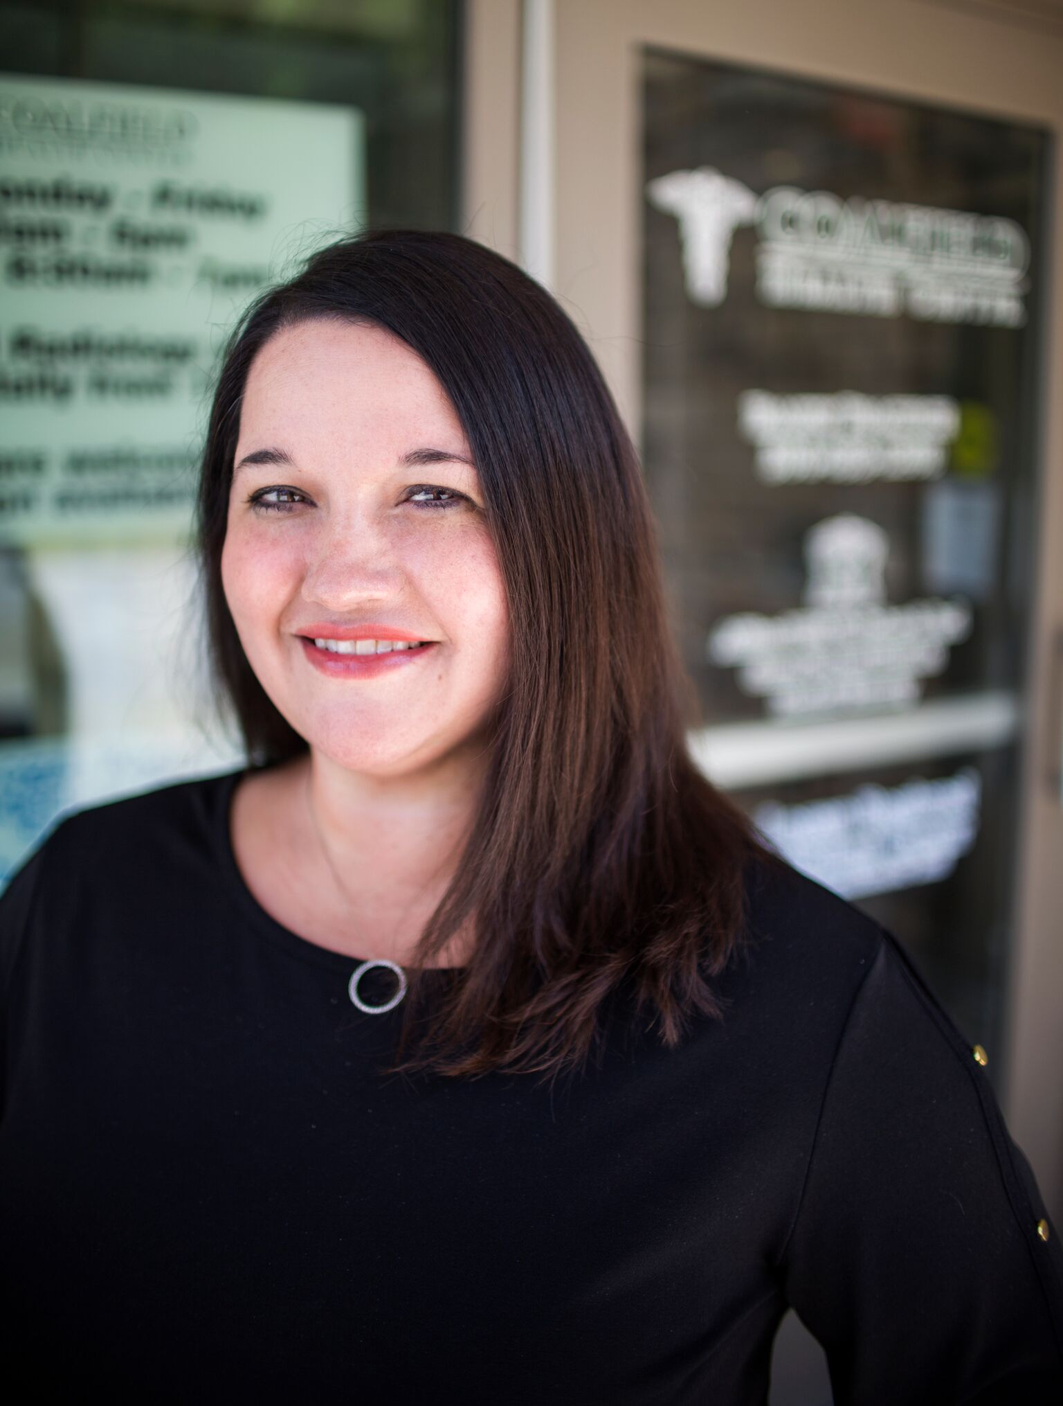
CONGRATULATIONS
Kristin Dial Coalfield Health Center Logan County
on being selected as this year’s
POWER of Performance 2021 Honoree

Slide 8
Changing Lives

Slide 9
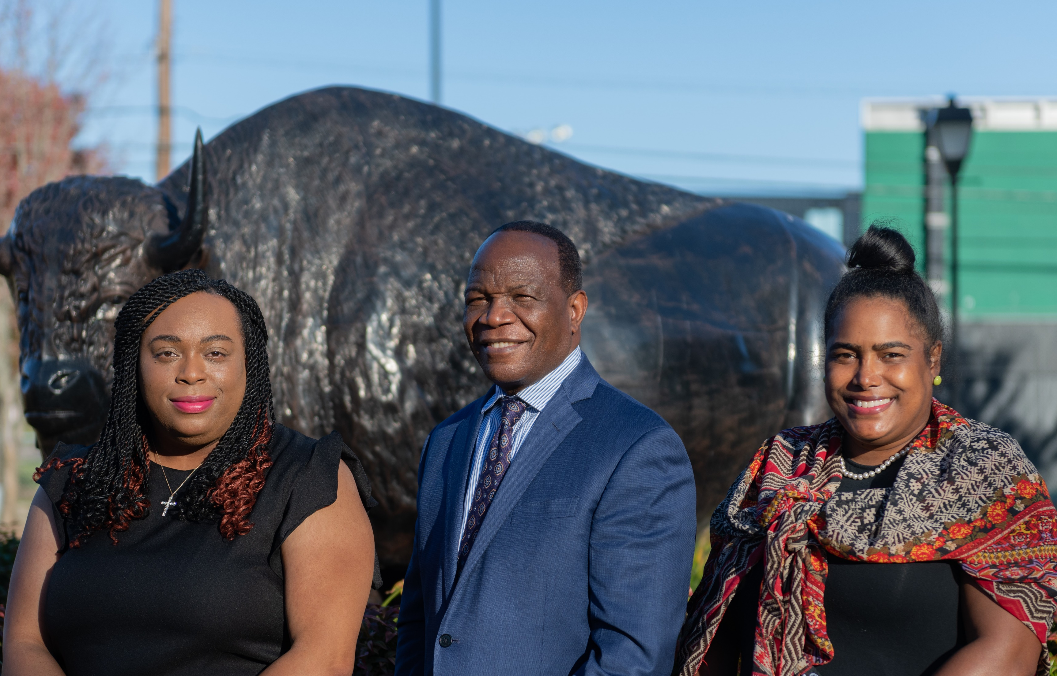
CONGRATULATIONS
Minority Health Institute
on being selected as this year’s
POWER of Performance 2021 Honoree
Dr. Georgiana Logan, Research Associate
Dr. Anthony T. Woart, Founder/Director
LaDawna Walker, WV Minority Health Coordinator

Slide 10
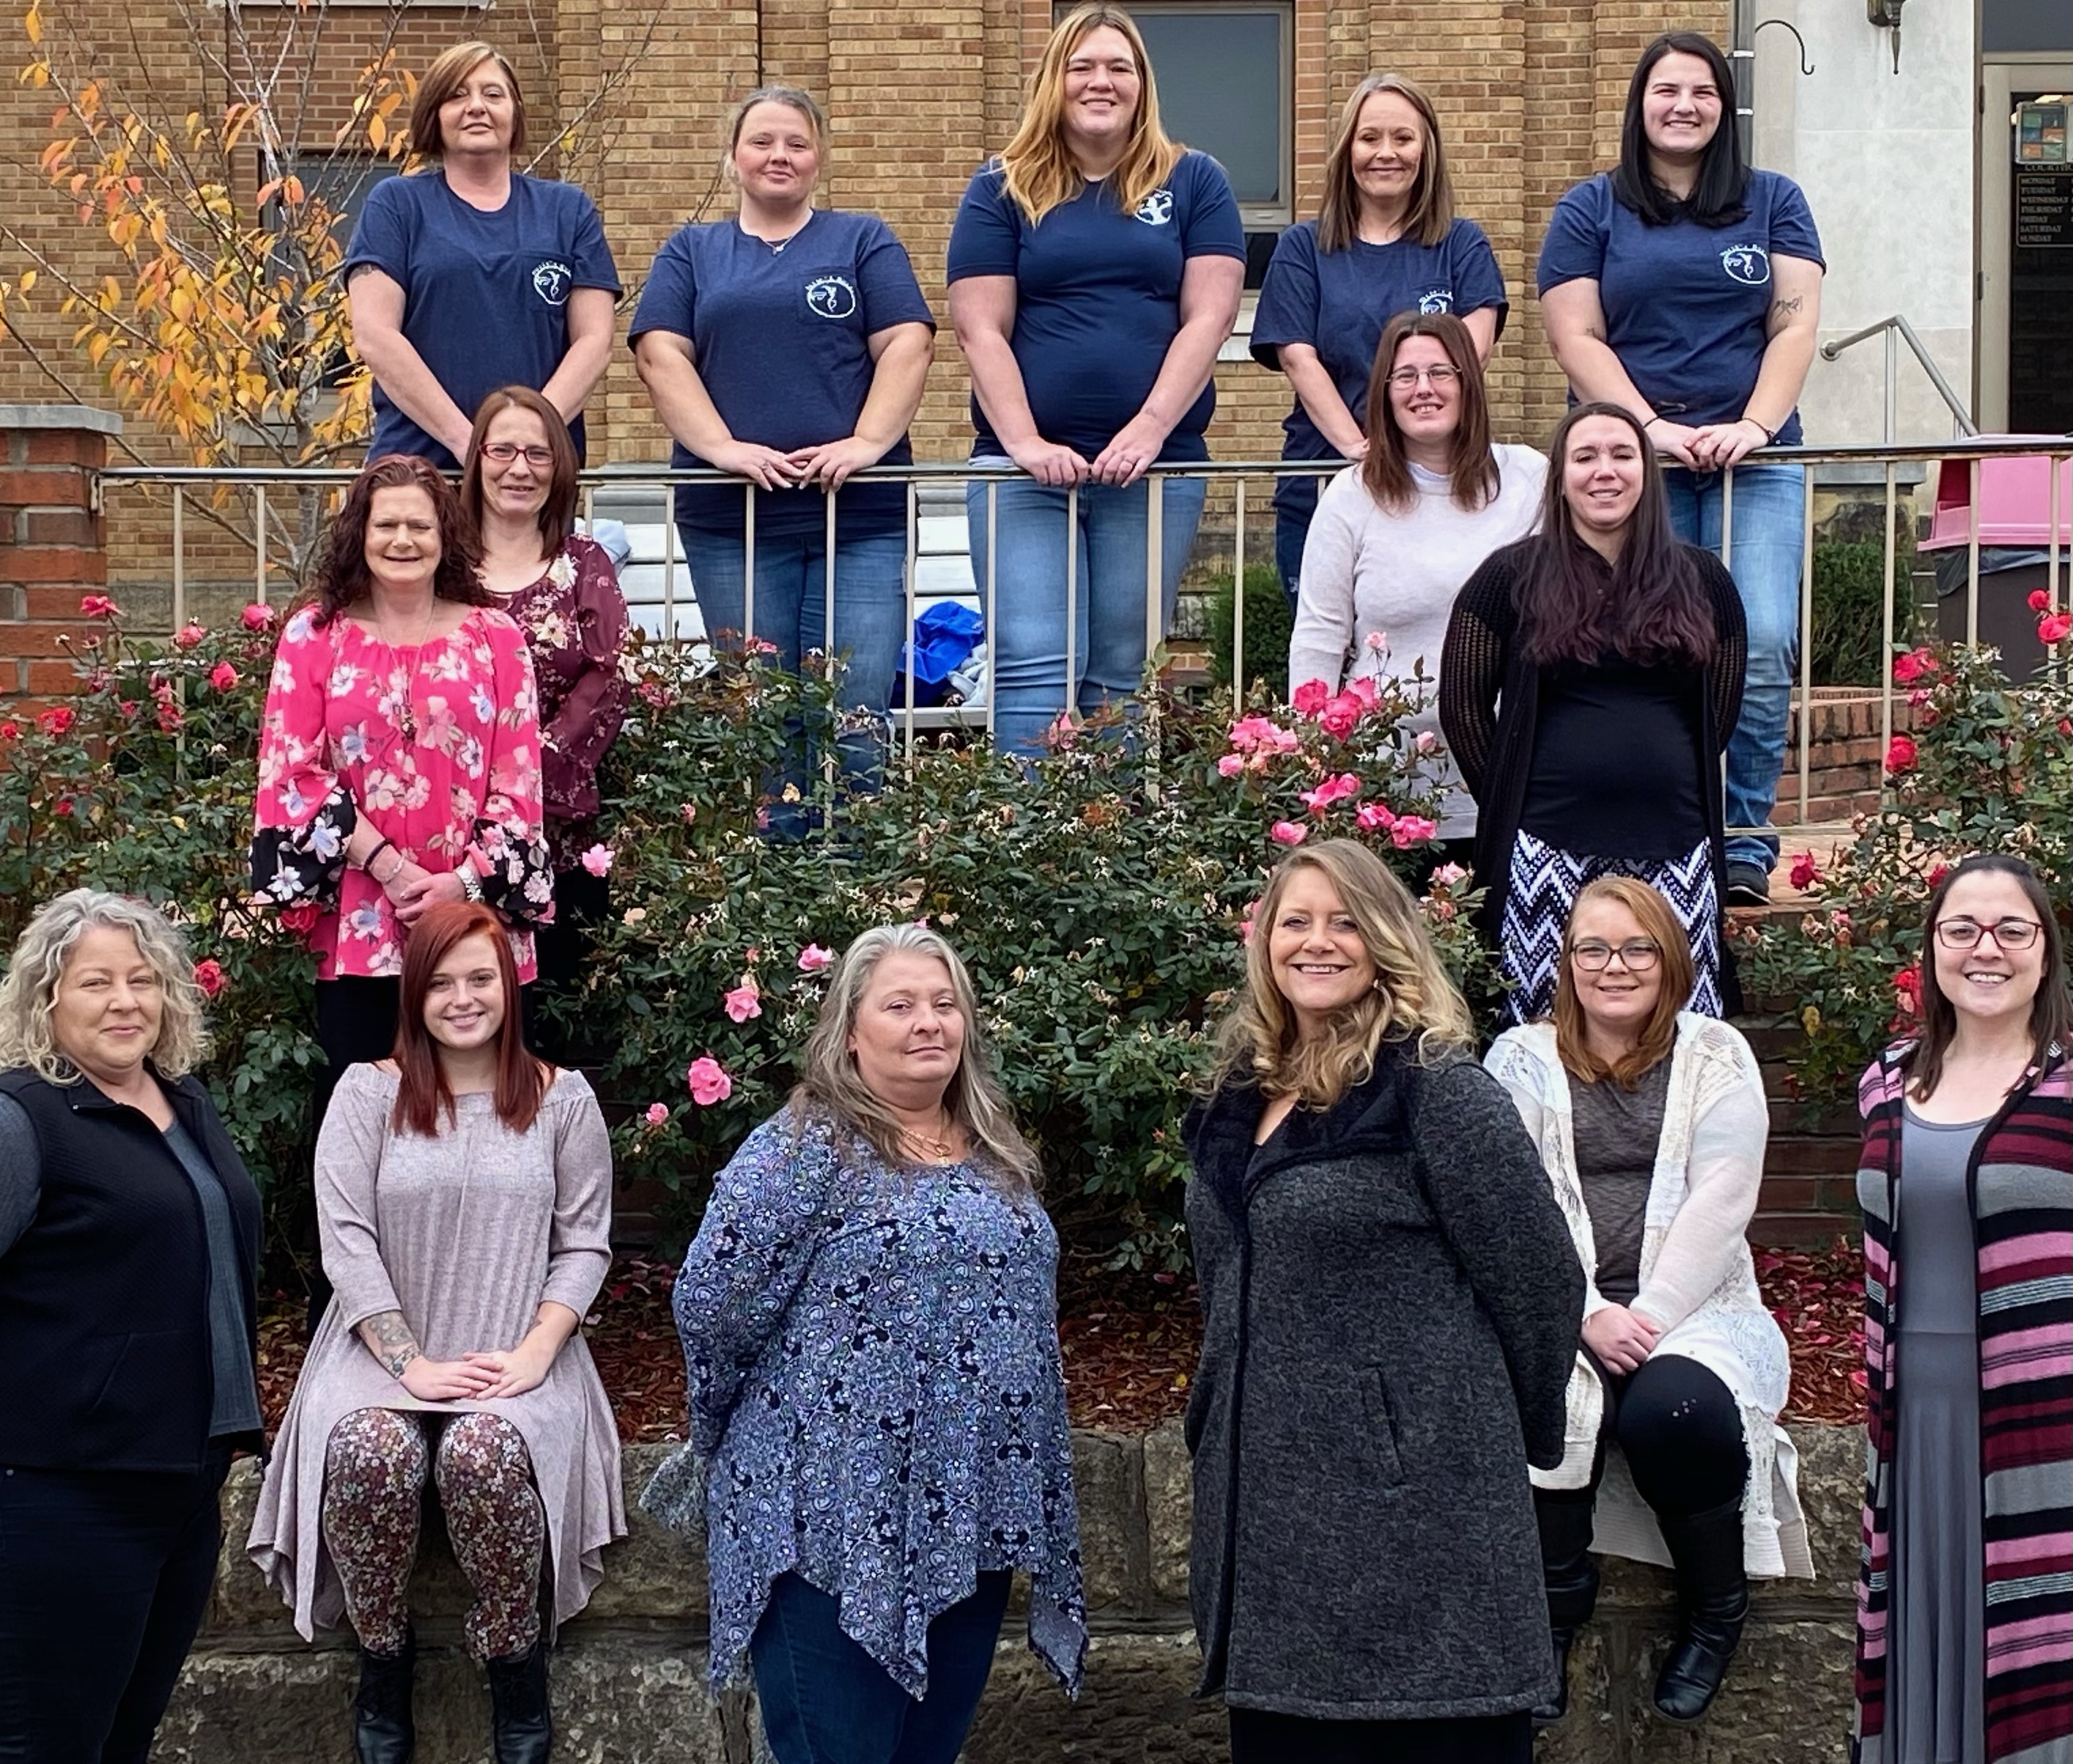
CONGRATULATIONS
Misty Martin, Marie’s Recovery House, Wayne County
on being selected as this year’s
POWER of Performance 2021 Honoree

Slide 11
Small Communities, BIG Solutions 2021 Advocate

Slide 12
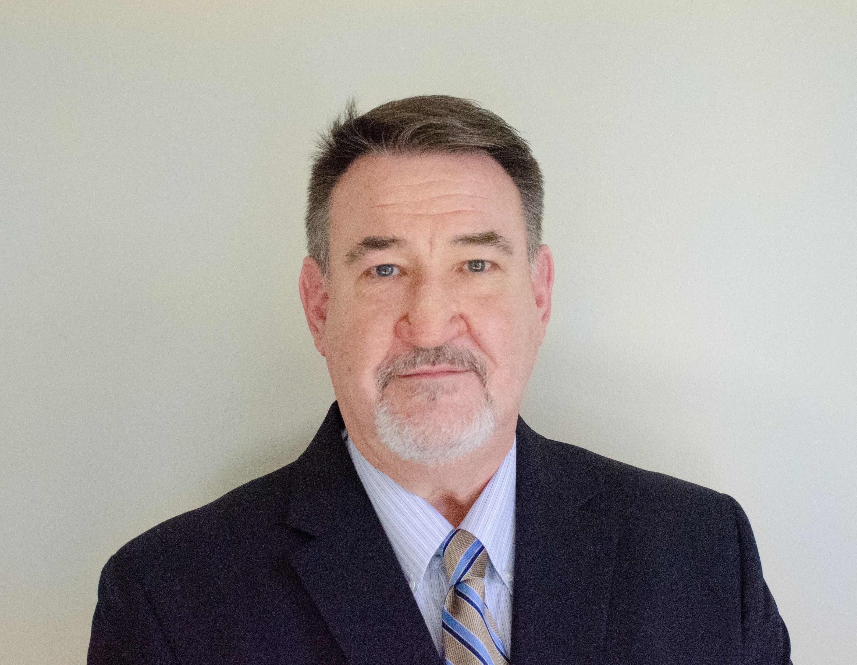
CONGRATULATIONS
Jim Spencer City of Bluefield Mercer County
on being selected as this year’s
Small Communities, BIG Solutions 2021 Advocate

