Slide 1
#WVSolutions Seekers Rising Leaders in WV 2021 Honorees
Sponsored By:

Slide 2
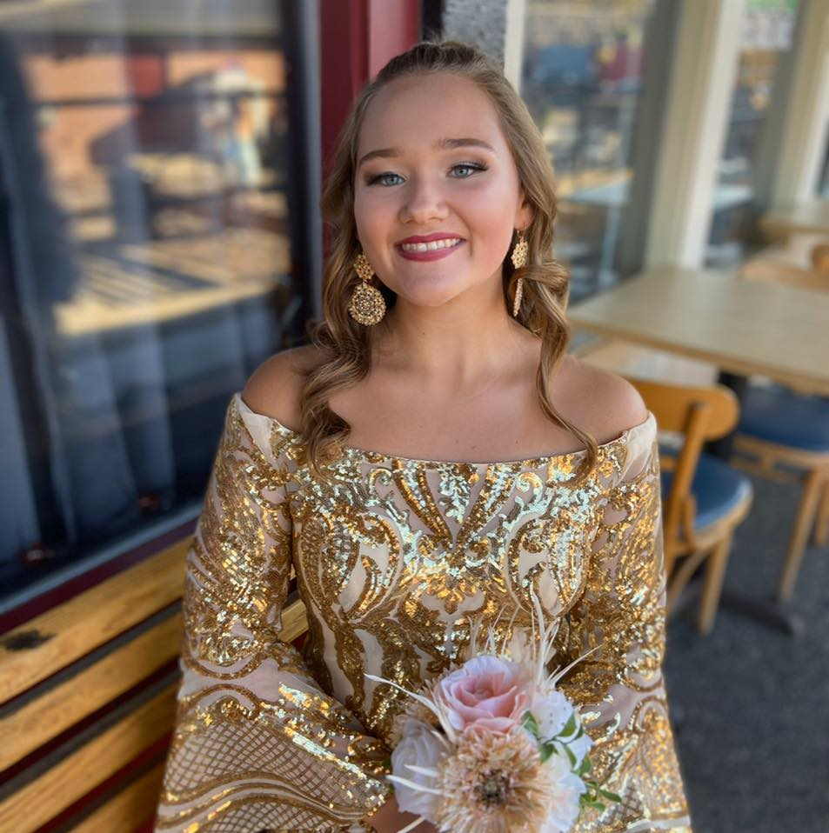
#WVSolutions Seekers
Rising Leader in WV Award
2021 Honoree
Brooklyn Johnson
Junior
Cabell Midland High School
Cabell County
“Everyone is a genius. But if you judge a fish by its ability to climb a tree, it will live its whole life believing that it is stupid.” -Albert Einstein

Slide 3
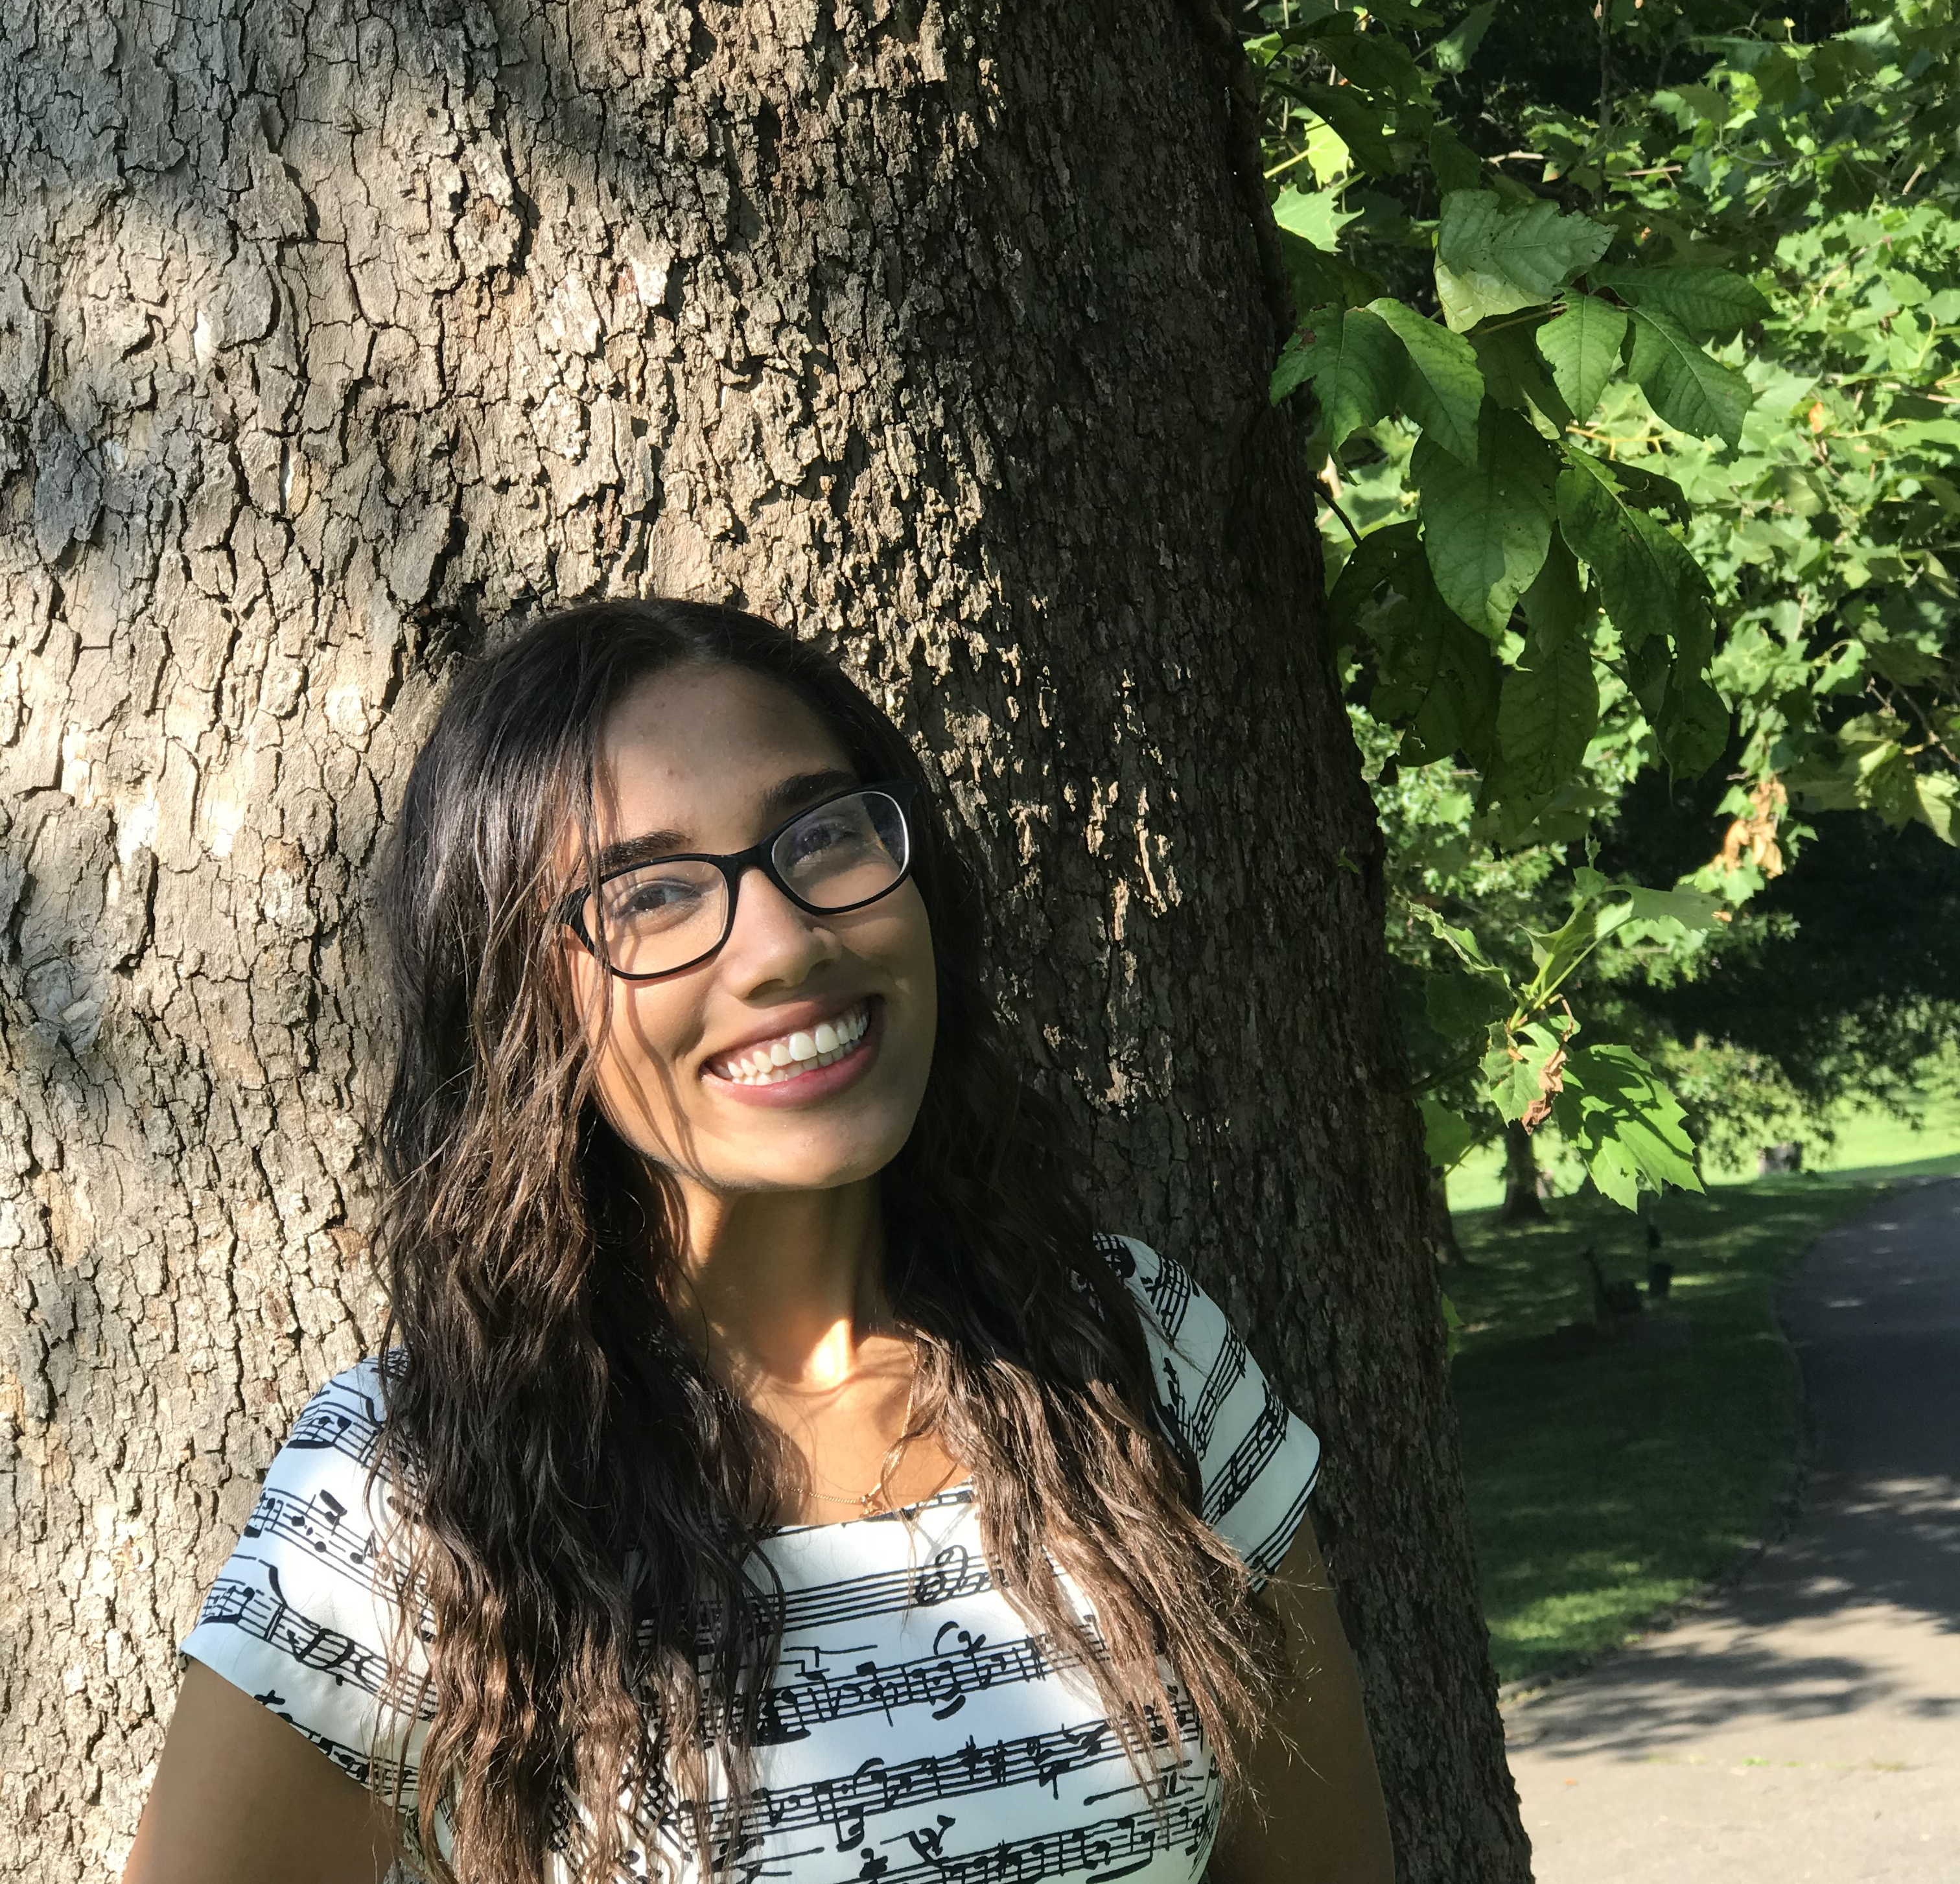
#WVSolutions Seekers
Rising Leader in WV Award
2021 Honoree
Brooklynne Hanshaw
Junior
Huntington High School Cabell County
“I'm sick & tired of life with no desire. I don't want a flame; I want a fire. I want to be the one who stands up and says, “I'm gonna do something”. - Brooklynne Hanshaw

Slide 4
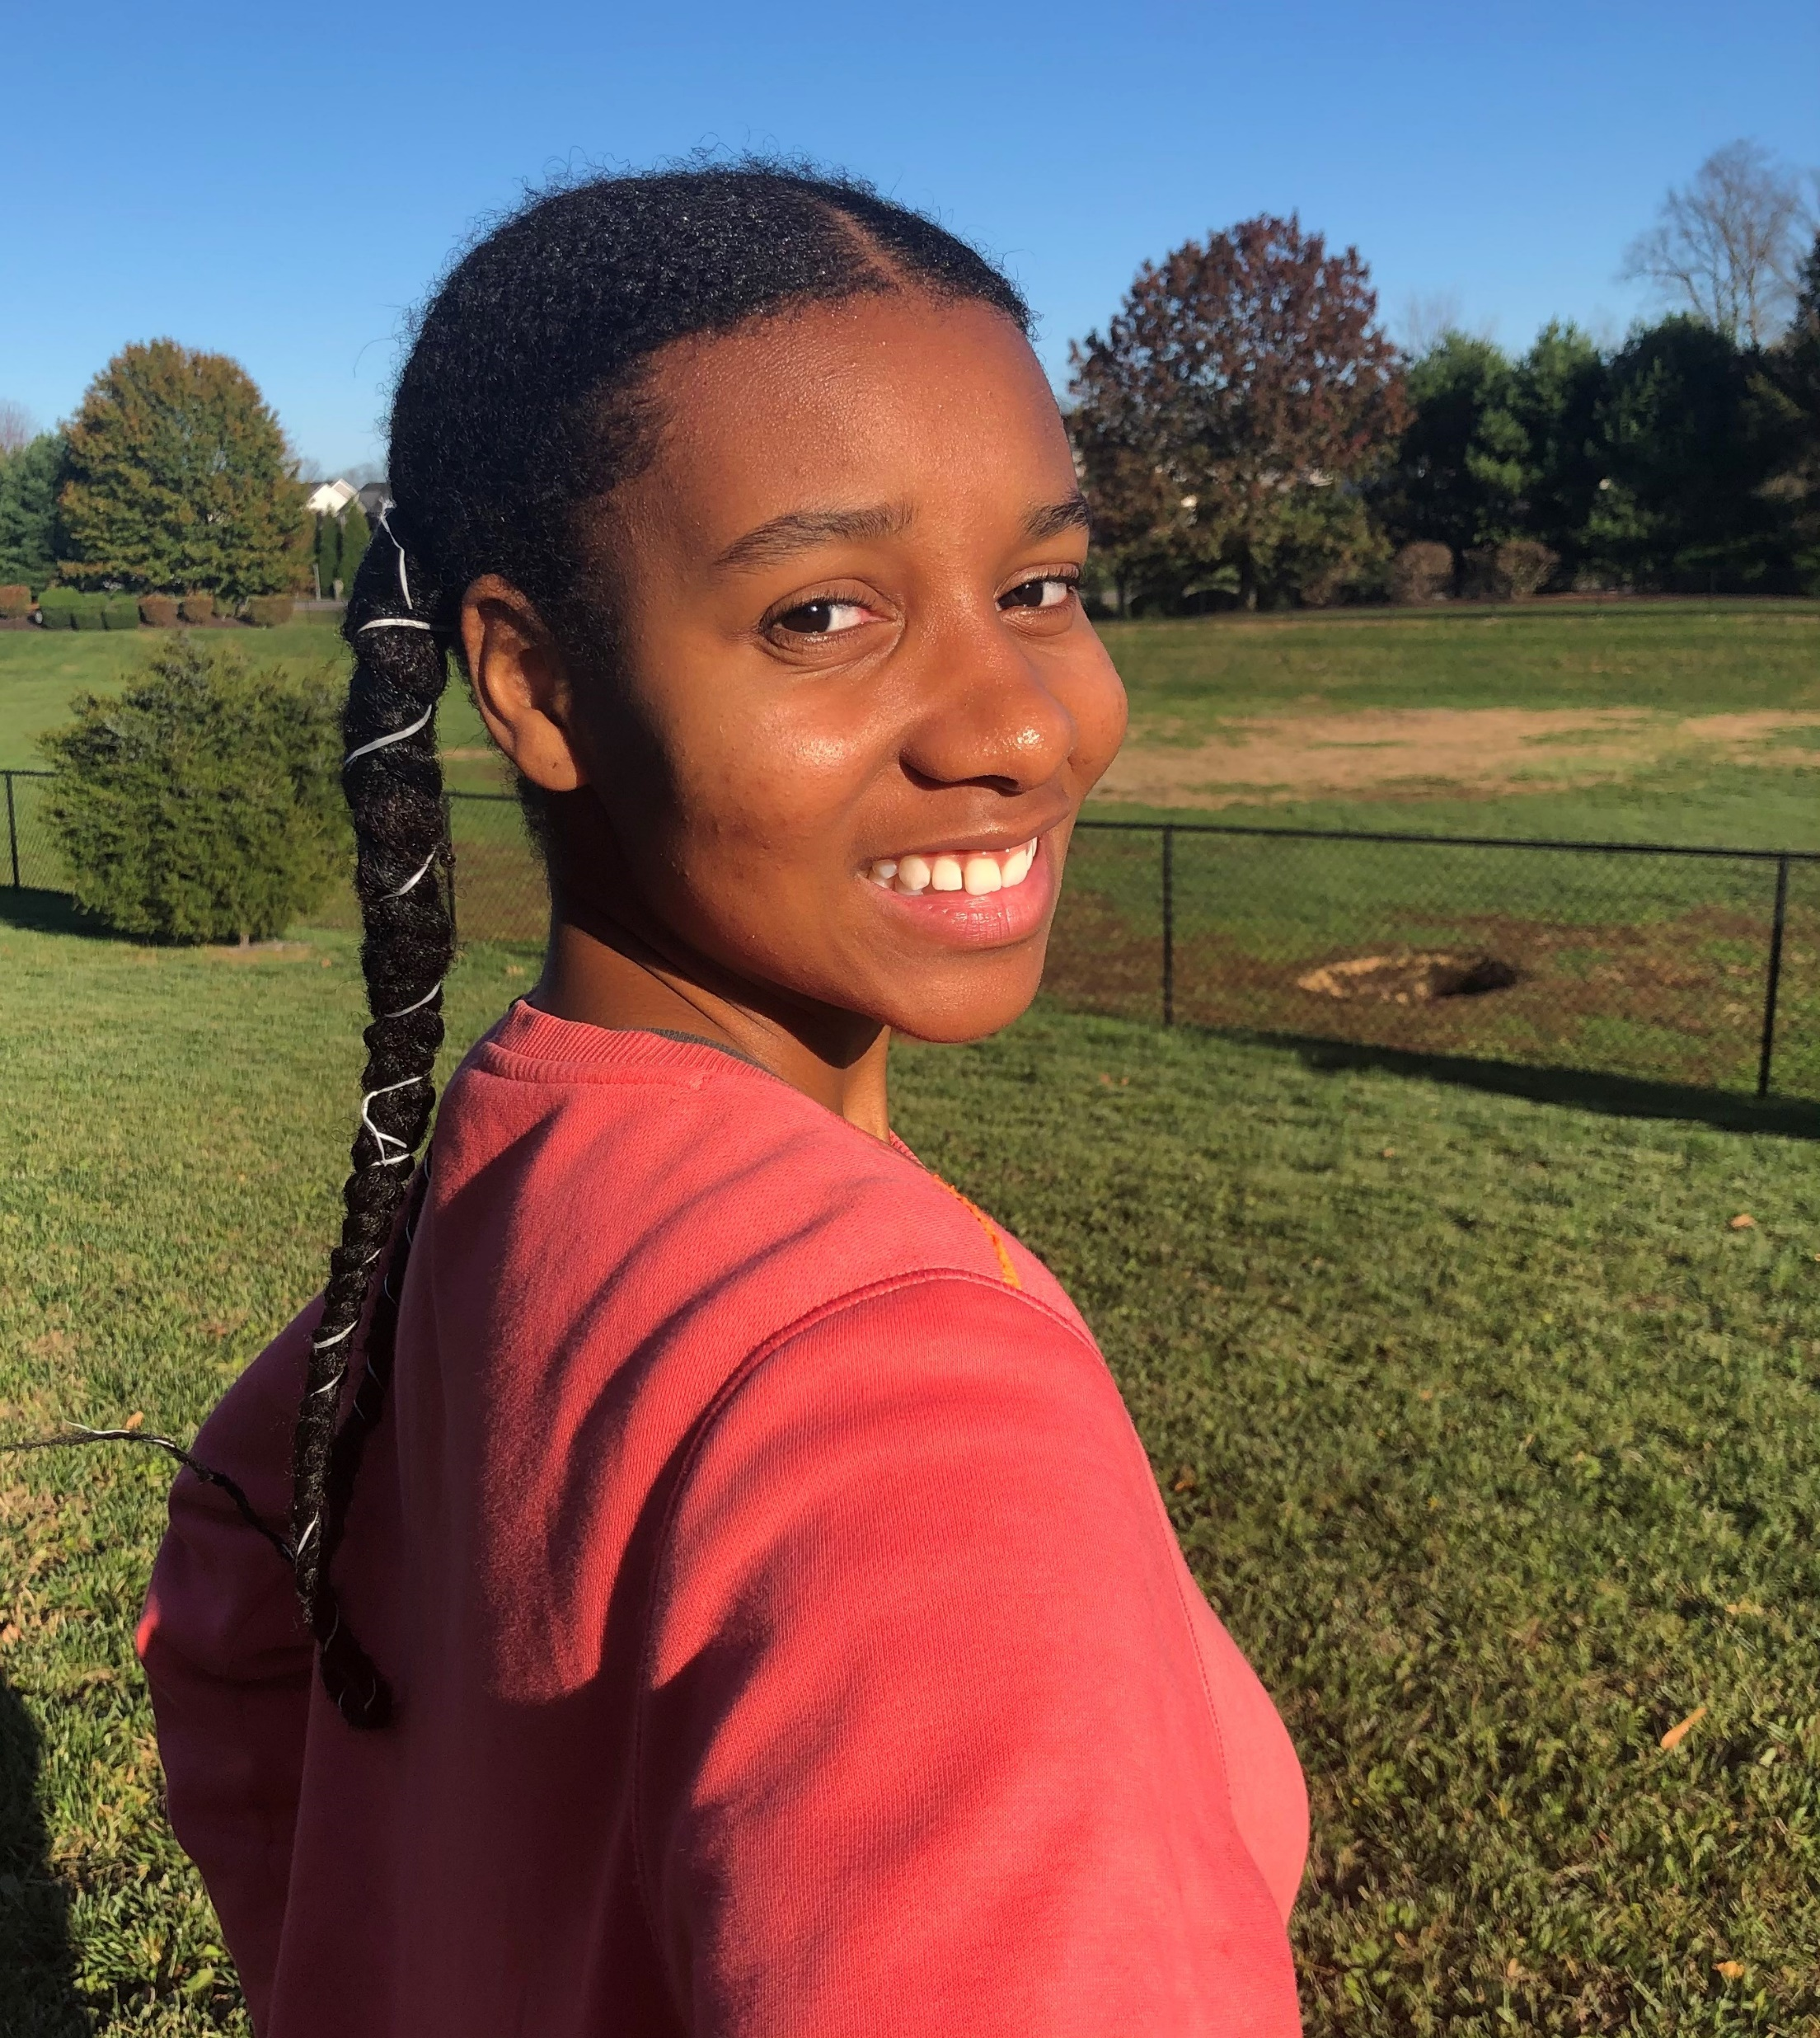
#WVSolutions Seekers
Rising Leader in WV Award
2021 Honoree
Melanie Jimmerson
Senior
Martinsburg High School Berkeley County
“Never let a problem stop you from the possibilities.” - Mom

Slide 5
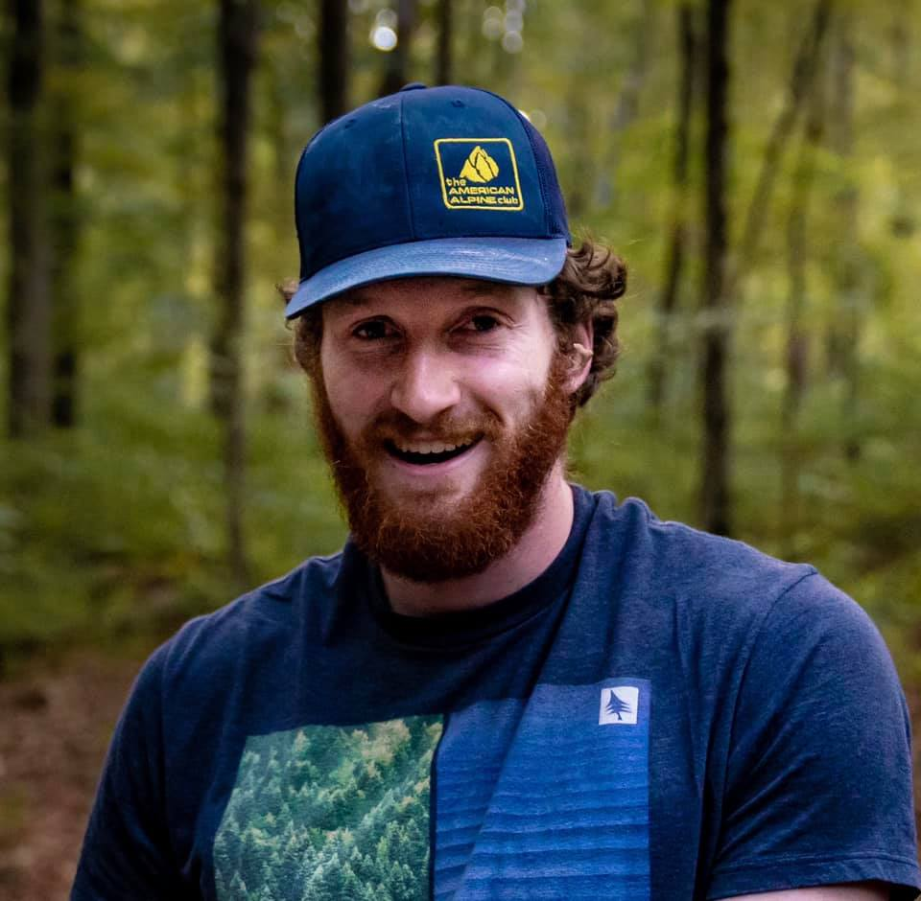
#WVSolutions Seekers
Rising Leader in WV Award
2021 Honoree
Mitch Lehman
Student
West Virginia University Institute of Technology
Fayette County

Slide 6
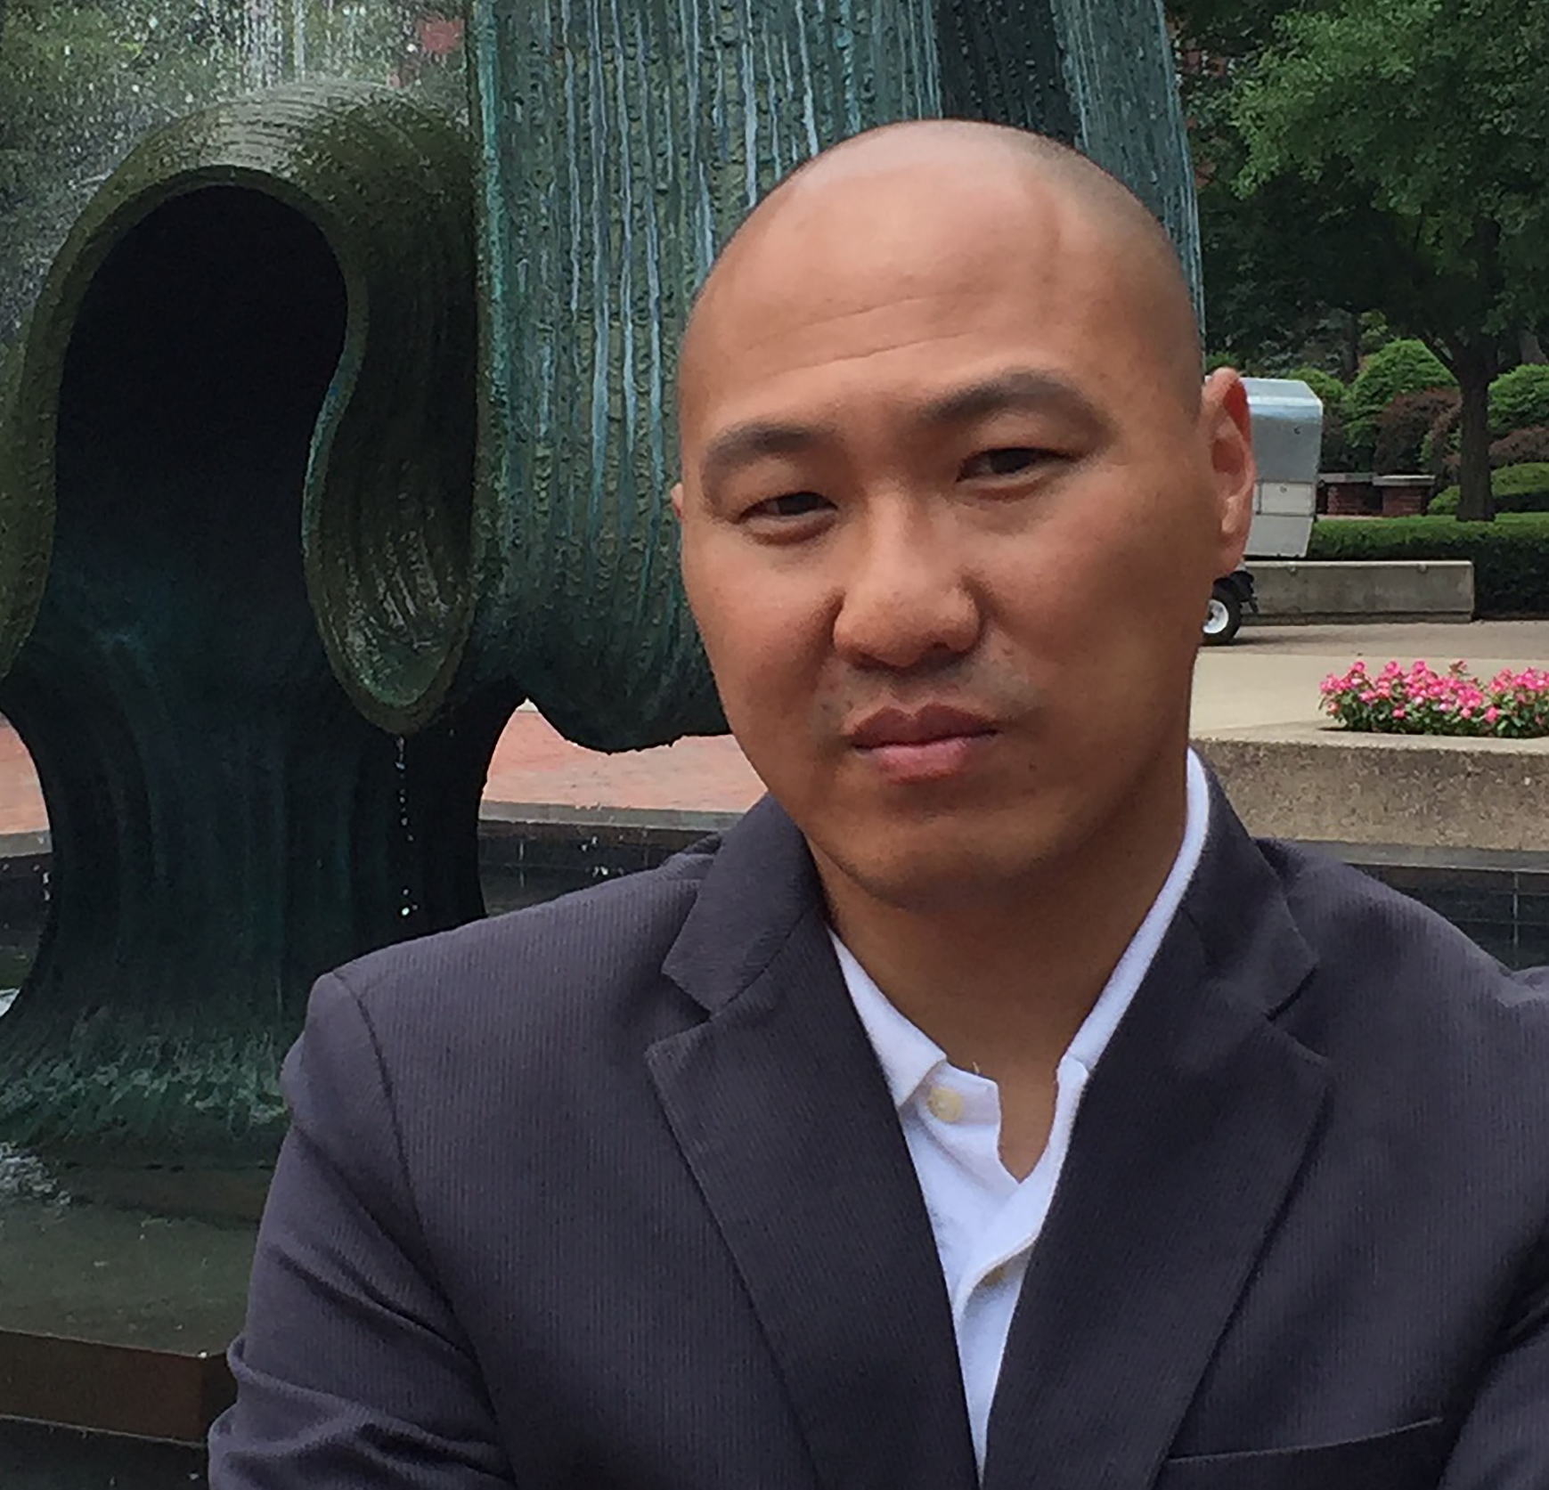
Ben Eng
Assistant Professor of Marketing and Entrepreneurship Lewis College of Business Marshall University

