Slide 2
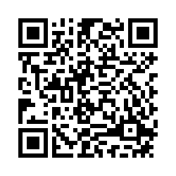

Slide 3
Grad Credits Available!
Information
REGISTER HERE:
Marshall University
220.00
Syllabus on Registration Site
Register by: November 1, 2021
Assignments due: December 3, 2021

Slide 4
Our Guidebook
Tier 1 has 15 essential features.
Self – assessment for your team.
Score yourself 0, 1, 2
Guides your Action Plan
Action Plan – Living, Guiding Document for your team.
We need your data! We will request it in April of each year.

Slide 5
Activity for TFI 1.1
Step 1:
Gather your materials:
3 different colored post-its/post-it flags OR 3 different colored highlighters
Tiered Fidelity Inventory – Book version or printed from here – https://www.pbis.org/resource/tfi
Step 2:
Find the Universal – Tier 1 Section. On the downloadable document this starts on page 6.
With your team, read and review each of the essential features of Tier 1.
Choose a post-it/highlighter colors that will represents strengths, weaknesses, and inconsistencies.
Review the essential features again. Mark each essential feature for how your team views your initial standing in regard to what you already have in place at school. Mark each section as either:
Strength – You already have this in place at your school and it works!
Weakness – This doesn’t exist in your school…yet.
Inconsistencies – Your team can identify that this exists in your school, but it needs work.
This will help you begin to identify “wins” that you already have at a school and where your team might need to concentrate during our time together.
Be prepared to talk with your BSS about what you identified as strengths, weaknesses, and inconsistencies.

Slide 6
WVPBIS Virtual Academy Day 1:Session 2 Teaming TFI 1.1 and 1.2

Slide 8
Today’s Objectives
TFI 1.1 Team Composition
Tier 1 team includes a Tier 1 systems coordinator, a school administrator, a family member, and individuals able to provide (a) applied behavioral expertise, (b) coaching expertise, (c) knowledge of student academic and behavior patterns, (d) knowledge about the operations of the school across grade levels and programs, and for high schools, (e) student representation.
TFI 1.2 Team Operating Procedures
Tier 1 team meets at least monthly and has (a) regular meeting format/agenda, (b) minutes, (c) defined meeting roles, and (d) a current action plan.

Slide 9
Teaming

Slide 10
PBIS Team Members
PBIS Coaching Facilitator
Team Leader
Administrator
Behavior ‘Expert’
Data Specialist
Recorder
Timekeeper
Classroom Teacher Liaison
Family Liaison
Student Liaison
Snack Master
Each role/responsibility should be covered, but there is flexibility in assignments
TFI 1.1 Team Composition

Slide 11
Team Membership
Examine individual skills, strengths, and preferences prior to finalizing team membership and roles:
What skills do I bring to the team?
What skills will each member bring to the team (beyond grade level or subject representation)?
Are the appropriate people on the team?
TFI 1.1 Team Composition
Notes:
Discuss the stages of change/buy in from Dr. Jim Harris.
Think of stages of change and assess where your staff members are…. TEAMING: do you have the right people on your team to help make changes in school? Assess this with readiness

Slide 12
Guidelines for Effective Teaming
Shared goals & responsibilities
Transparency in actions
Trust between team members
Quality communication
Balance task & process
Rule by consensus
Observe dynamics & resolve conflict constructively
Administrative support for time & resources
TFI 1.1 Team Composition

Slide 13
Team Vision
Vision
Does your school have a vision that compels new ways of thinking and acting?
All team members need to have the same vision (!)
If you could create the school of your dreams, what would it look like and sound like with a positive, proactive, and instructional approach to discipline?
Align your Vision
How will/does this vision of your school align with your School Improvement Plan, your Mission Statements, your school policies?
TFI 1.1 Team Composition
Notes:
Assessing your culture and readiness around beliefs

Slide 14
Team Vision
Action Plan for your Vision
What desired outcomes will you create to align to your vision?
How will you monitor the effectiveness of your vision?
TFI 1.1 Team Composition

Slide 15
Vision Activity
Create your Vision
Activity – Think, Pair, Share
Think: Using post-its & on your own – write descriptors of what you would see, hear, and achieve in the school of your dreams. It is recommended to include your whole staff.
Pair: Get into groups to share your vision statements, creating a team poster through words and/or pictures representing what it will look and sound like.
Share: Hang your poster on the wall and share out with the other groups.
Create: As a staff, create your schools PBIS Vision Statement.
In the school of our dreams, it will…
Looks like… What will we see? | Sounds like… What will we hear? | Achieve these outcomes…
TFI 1.1 Team Composition
Notes:
*Add word cloud for the T-chart (poll everywhere)* 5-8 mins

Slide 16
Team Operating Procedures (Responsibilities)
Meets monthly with an agenda and keeps minutes
Defines team member roles (see new chart)
Collects data to use to make decisions
Oversees Tier 1 interventions
Trains school staff
Evaluates fidelity of implementation using the TFI
Edits action plan as needed
TFI 1.2 Team Operating Procedures

Slide 17
Team Leadership, Roles, and Groups
All teams should consider having groups or individuals that are responsible for:
Roles | Responsibilities
Communication | Facilitates communication between staff, students, parents, and stakeholders.
Teaching | Responsible for creating, distributing, and scheduling behavioral lesson plans.
Data | Regularly aggregates and shares data with the school, families, communities, etc.
Acknowledgements | Creates, teaches, schedules and focuses on acknowledgements for students and staff.
Professional Development | Develops professional development for staff to scaffold their learning about PBIS. This responsibility may fall on the whole team or a group but it should be made a priority to build your staff’s understanding, language, and buy-in.
Notes:
Think of it as committees within your team- give them a chance to stop and talk about they could break up these roles within their team
*Maybe you don’t need all of these or one person could take 2
All apart of acknowledgements
Does your team have a plan to make sure all of this info is being put out to the rest of the school….
Think of how you can dispurse this info uptop to the staff meeting
Activity: Pretend your going into a staff meeting- would would be in charge

Slide 18
Running Effective Meetings (Setting Ground Rules)
Data & agenda distributed in advance
Time limits on each agenda item
Meeting starts and ends on time – no exceptions
Team leader moves team through agenda
Minutes are recorded
Stay on-topic
Every member participates
Every member volunteers for action plan items
New Action Plan items added
Update Action Plan
TFI 1.2 Team Operating Procedures

Slide 19
What teams/initiatives can you combine?
Notes:
This can be a BRIEF large-group discussion, if circumstances allow for it. The purpose here is to make sure all PBIS core team members are clear about what their SBLT does, and how their Tier 1 PBIS Core team is different (if it is different).

Slide 20
Administrator Responsibilities
The single most important perceived factor in sustainability is school administrator support.
(McIntosh and Nese 2014)
TFI 1.2 Team Operating Procedures
Notes:
Leaders: What’s best for kids rather than what’s best for adults

Slide 21
Administrator Responsibilities
Active participant on the PBIS Team
Attends all meetings
Actively communicates commitment to PBIS
Knows school’s current data and reporting system *
Ensures behavior is written into the School Strategic Plan
Allocates staff time for PBIS activities *
Ensures PBIS meeting dates/times are posted on master schedule
*If the Principal is not committed to the change process, it is unwise to move forward with PBIS implementation*
TFI 1.2 Team Operating Procedures
Notes:
The administrator’s role is another one we want everyone to understand; the administrator has a huge impact on successful implementation. Active communication means more than just lip service; this is even more important at the secondary level. If administration is not on board, it’s unwise to try to move forward.
Coaches may want to encourage all administrators to participate on the school-based PBS Team or may determine that one administrator is adequate.
If only one administrator is actively participating, it is essential that the Coach meet with the administration between meetings to guide communication and follow-through of action plans.
In addition, the sole administrator should be one who intercepts many of the school’s discipline referrals (i.e., has experience with the school’s current system of discipline operations).
If this administrator is not involved with the team or committed to the change process, it is unwise to attempt to go further with developing the PBS school-wide plan.
The involved administrators should also have a long-term commitment to the change process and to the school.
Constantly changing administrative support will negatively impact the implementation of a school-wide positive behavior support plan.

Slide 22
Team Leader Responsibilities
Creates meeting agenda
Submits end of the year data
Keeps the team on track/vision/goals
Helps lead the training of faculty
Lead contact for your regions Behavior Support Specialist
TFI 1.2 Team Operating Procedures

Slide 23
If You Have a Coach
Attend all team meetings
Supports teams as the are implementing all PBIS features with fidelity
Help team analyze discipline data
Support teams in addressing challenges and/or barriers to the process
Support teams to stay on track and remain positive
Support staff in sharing responsibilities for teaching, acknowledging, and promoting PBIS efforts
Complete Baseline and End-of-Year Evaluations

Slide 24
Invite faculty to PBIS meetings
Tap into faculty and family talents
Art Teacher
Music Teacher
Computer/Technology Teacher
Remain focused on the skills the individual brings to the table. Caution: If teams get too big they can become ineffective
Consider student voice
Family & community participation

Slide 25
Let’s Talk About Your BSS
Occasionally attend team meetings
Offer support through roadblocks
Provide resources
Be the external voice
Answer questions about implementation
Provide overviews for staff or take part in staff development trainings
Cannot be your coach

Slide 26
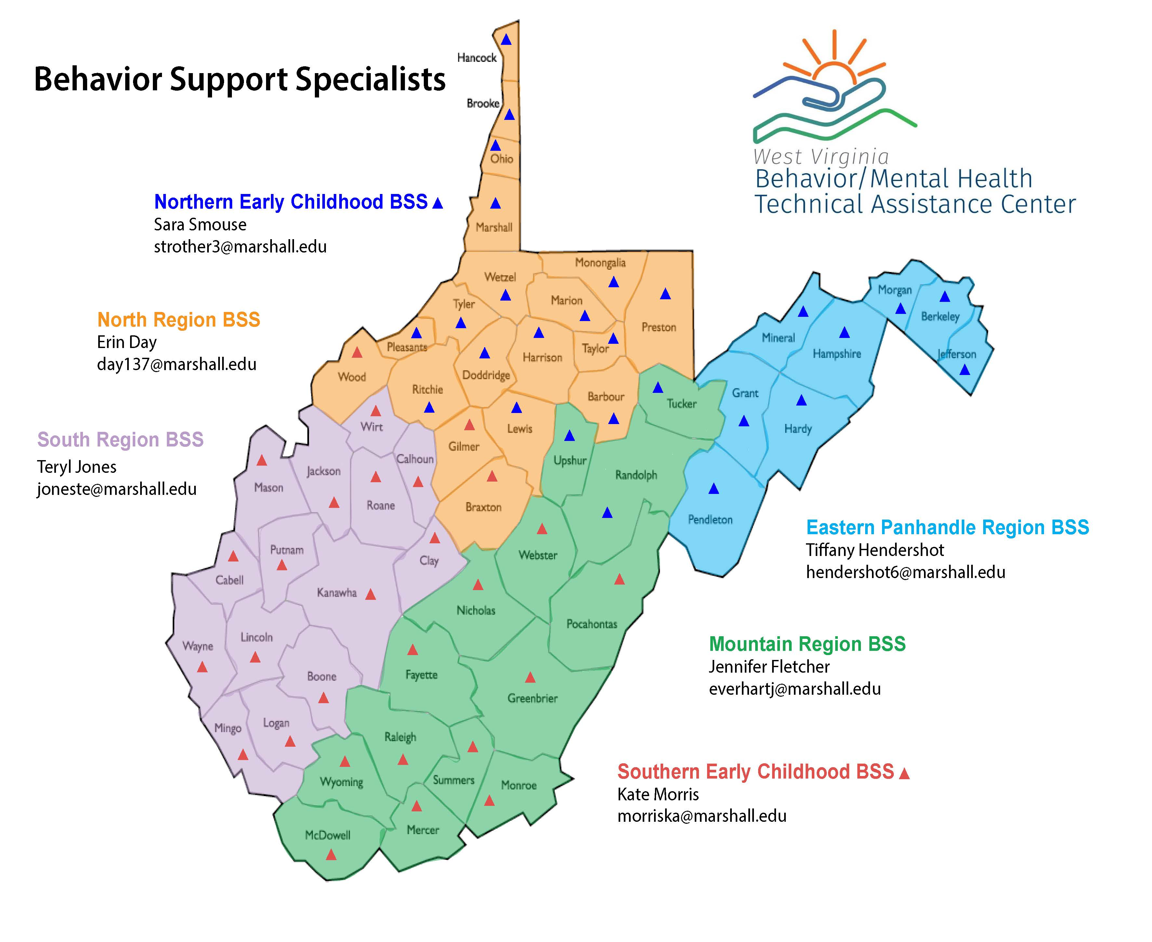
AWARE BSS
Christy Fubio
kroll3@marshall.edu

Slide 27
To Be Completed ☺
Complete PBIS Team Roster
Discuss current team members and potential members
Team Member Contact Information
Try out different roles during training
Finalize roles by the end of the academy
Team Meetings
Establish meeting dates and time
Consider availability of team members
Family/community representation
School psychologist, behavior specialist
Discuss possible ground rules
Create/finalize your team vision with your school staff
Now that you know look back at your scores for:
1.1-Team Composition
1.2-Team Operating Procedures

Slide 28
Find the TFI online!
Visit www.wvpbis.org
Click on “Evaluation/Data”
Click “TFI Tool V2.1”

Slide 29
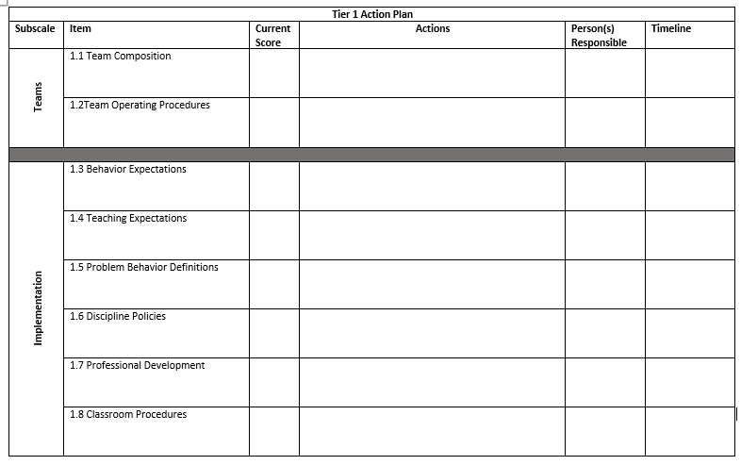
Item​ | Current​ TFI Score ​ | Actions​ | Person (s) Responsible​ | Timeline​
1.1 Team Composition 1.2 Team Operating Procedures | Where are you now on the TFI? ​ | What areas of focus do we have for these features? | Who should do it? ​ | When do you want it done by? ​
Find the TFI online!
Visit www.wvpbis.org
Click on “Evaluation/Data”
Click “TFI Tool V2.1”

Slide 31
Expectations
Thursday
3:30 – 5:00
Teryl Jones

