Slide 1
WVPBIS Virtual Academy Part 3: Day 1 TFI 1.3 and 1.4

Slide 2
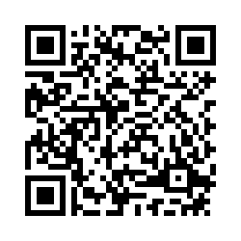
Attendance
Check the Chat Box for a Link

Slide 4
Today’s Objectives
TFI 1.3 Behavioral Expectations
School has five or fewer positively stated behavioral expectations and examples by setting/location for students and staff behaviors (ie., school teaching matrix) defined and in place.
TFI 1.4 Teaching Expectations
Expected academic an d social behaviors are taught directly to all students in classrooms and across other campus settings/locations.

Slide 5
Behavioral Expectations
1.3 Behavioral Expectations

Slide 6
The Ideal Student
What does an Ideal Student look like in your school?
Examples: A Student
Who comes to class prepared
Who does not run in the hallway

Slide 7
“Why Should We” Establish School-wide Behavioral Expectations?

Slide 8
Why School-wide Expectations are Important
They create environments that promote
Student Success
HOW
Students know what is expected of them
Feel more confident, engaged and connected to the school community
They create environments that are consistent and predictable
What is Anxiety =
When you have a Anxious Student =
Give a Kid a “chance” to feel Successful
What am I supposed
to do?
Fear of the Unknown
Dysregulated Student

Slide 9
Tier 1 Expectations Should Be
Broad and Positively stated behaviors that are easy to remember (select 3-5)
Be Safe
Be Respectful
Be Responsible
Demonstrated by all staff, students, and family in all settings
Cafeteria
Hallway
Bathroom
Office etc.
Posted throughout campus (parking lot)
Consistent with school’s mission statement (you may need to change your mission statement)

Slide 10
What’s Wrong With Ms. Mutner’s Expectations?
T H E DO NOTs
(A Non-Example)
She’s not telling her students what she’s looking for…

Slide 11
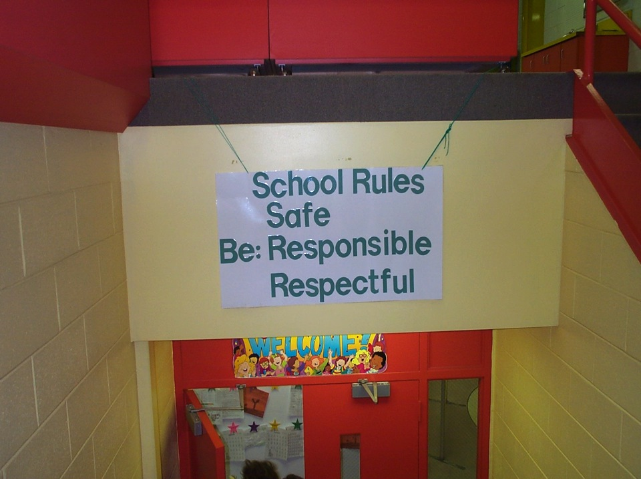
What Type Of “School Climate” Are These Expectations Creating?
School Rules
NO Food
NO Weapons
NO Backpacks
NO Drugs/Smoking
NO Bullying
School Expectations
Notes:
11

Slide 12
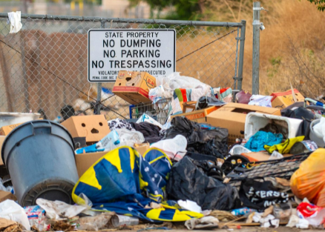
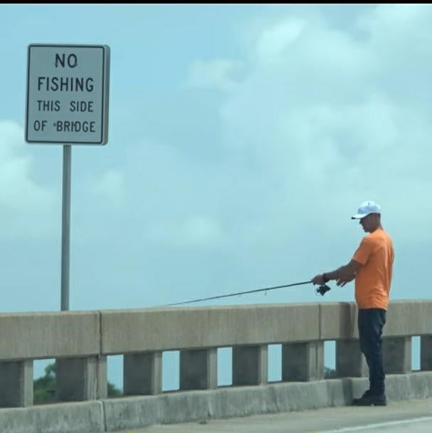
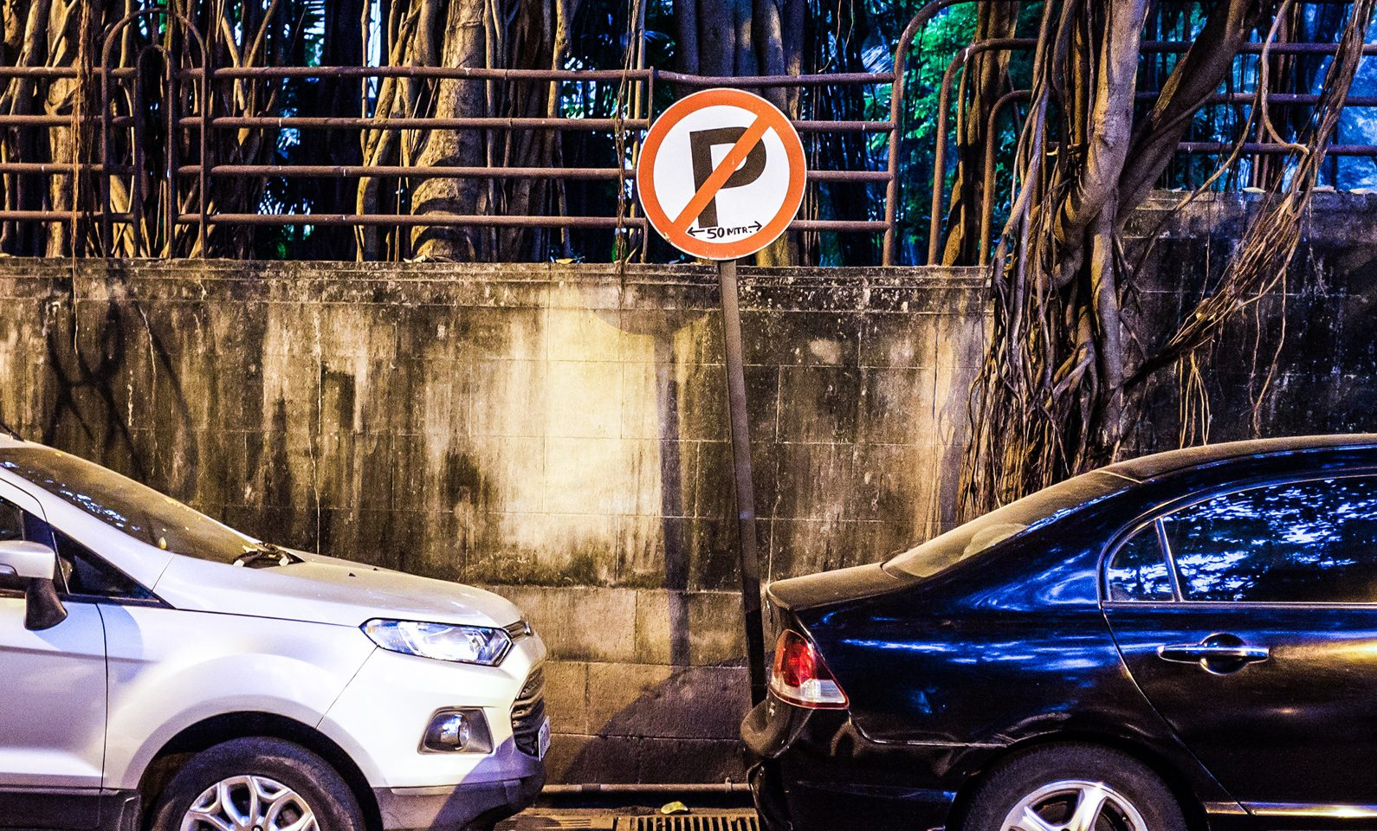

Slide 13
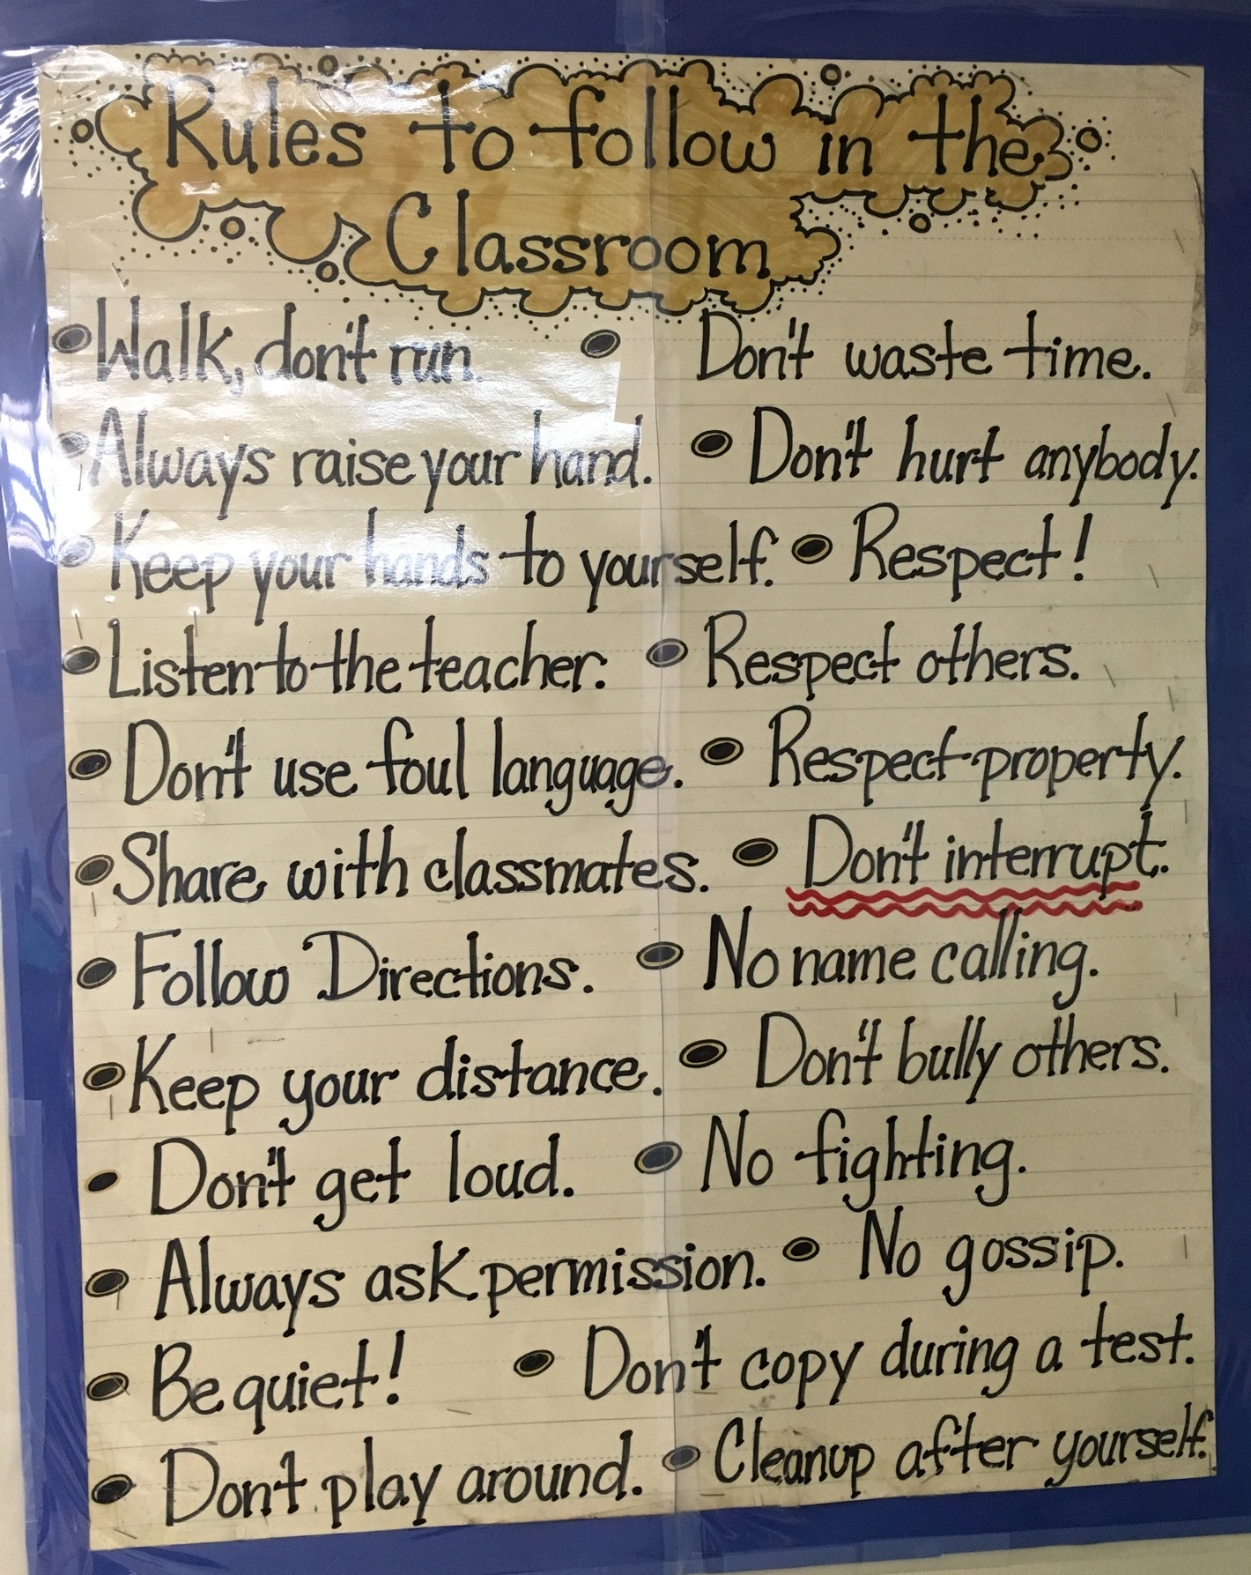
Expectations vs Rules
“Rules” are simply a list of things that we should not do.
“Expectations” communicate the desired behavior, teaches a skill and sets the tone for the environment.

Slide 14
Behavioral Expectation Examples
Be Respectful
Be Responsible
Be Safe
Be Ready to Learn
Be Kind
Be Organized
Be On Time
Accountability
• Dedication
• Honesty
• Optimism
• Determination
• Excellence
High Expectations

Slide 15
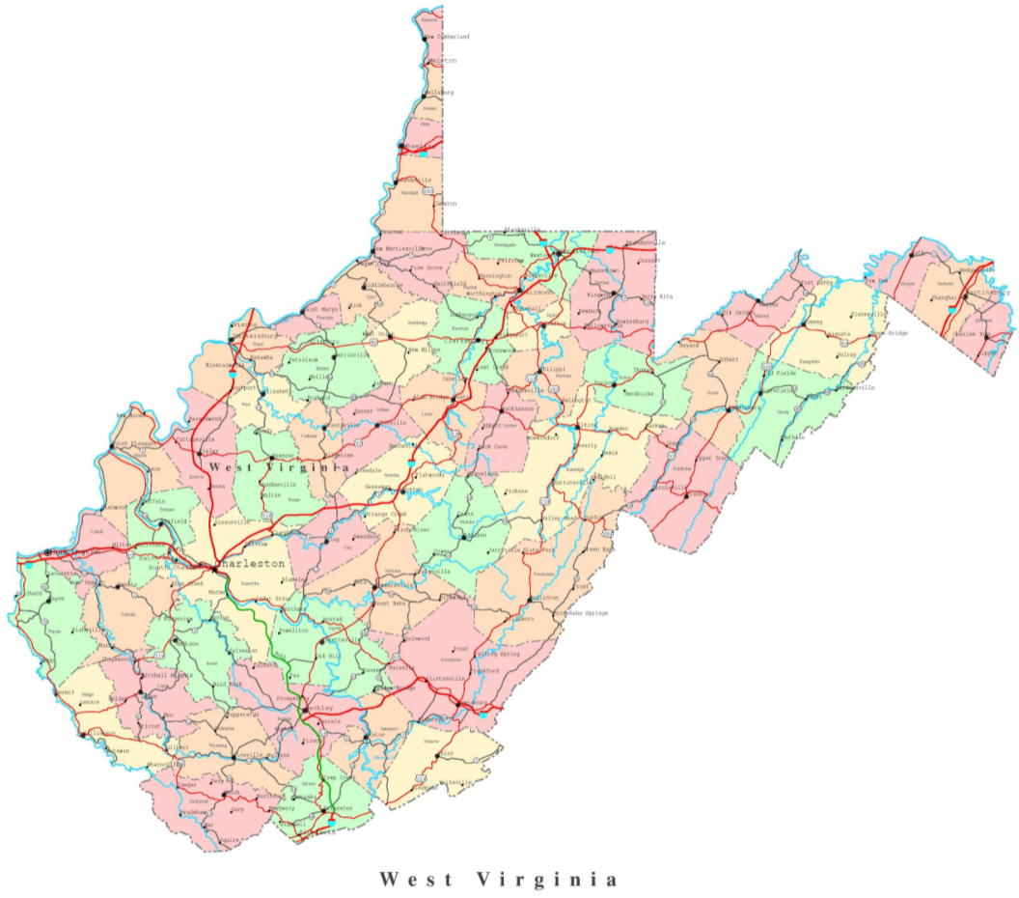
PBIS West Virginia Schools

Slide 16
PBIS Tier 1 Spotlight School
Matewan PK-8 Elementary
Mingo County

Slide 17
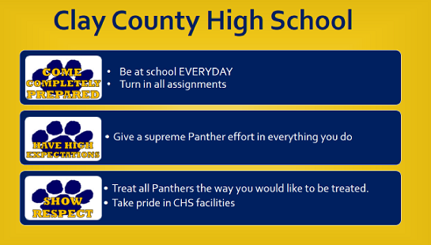
PBIS Tier 1
Model School

Slide 18
PBIS Spotlight School Kanawha County
Notes:
Other Schools might Connect
Their Expectations with their Mascot
Such as THE BULLDOGS at Glad Elementary
Because it “Ties-In”
Such as BARK ….Read Slide
This Makes it Easier for
Staff and Students to Remember.
Note: It “fits-in” with the Mascot
They did not Have to Force it to Fit

Slide 19
Wheeling Park High School Ohio County
PBIS Spotlight School

Slide 20
Triadelphia Middle School Ohio County

Slide 21
Mount View High School 6-12
McDowell County

Slide 22
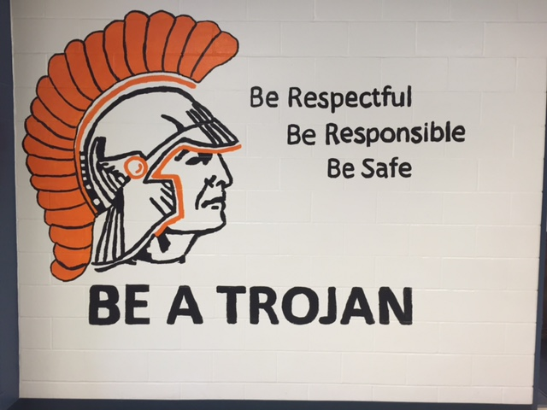
Moundsville Middle School Marshall County

Slide 23
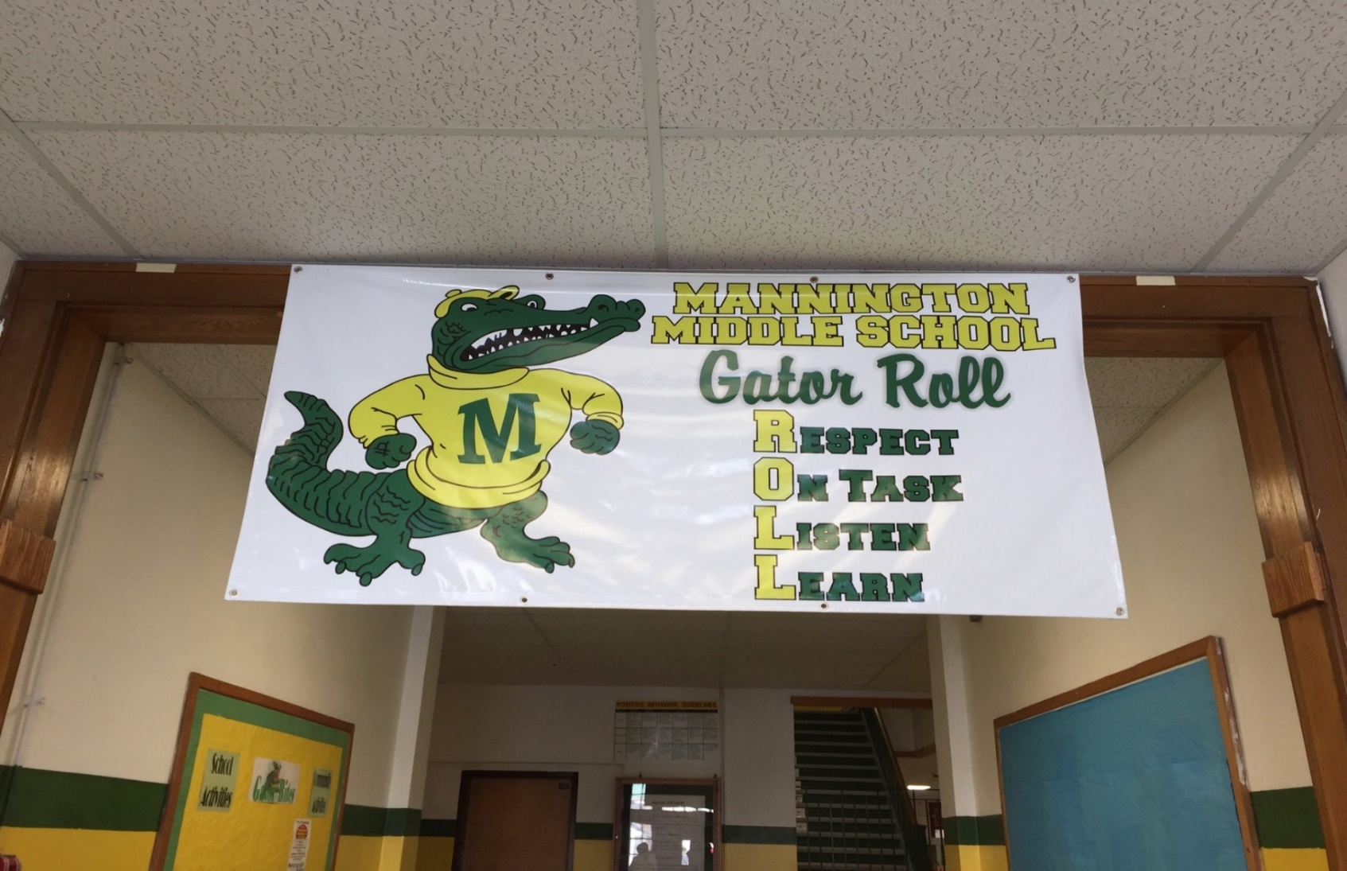
Mannington
Middle School
Marion County

Slide 24
Common Mistakes
Making it cute
Negatively stated…..☹
Connecting with school mascot if it doesn’t connect
Making it too difficult
Combining with other initiatives
Not able to compromise or come to a consensus (too many cooks in the kitchen)
Not looking at your data
Not getting staff and student input

Slide 25
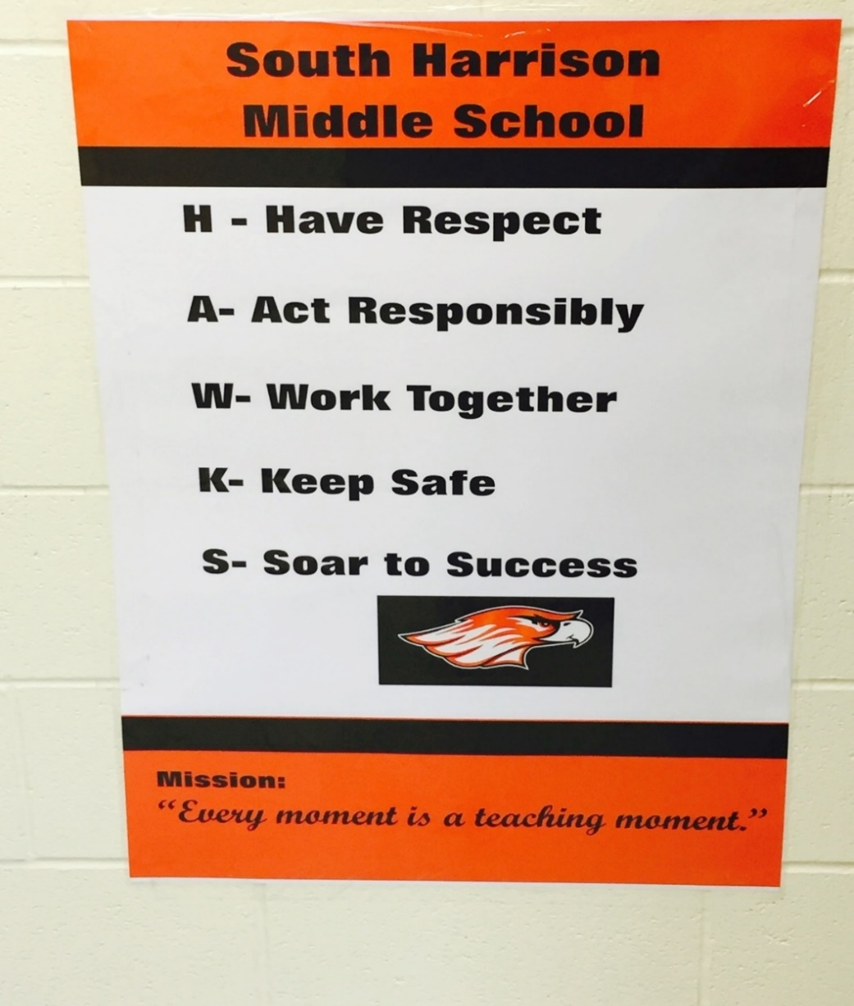
Where Are You At Establishing Your School-wide Expectations
Has your school established
SW behavioral expectations?
DON’T BE SHY! Please Share in the Chat Box… ☺ ☺
Will your expectations pass the fidelity test?
Are they positively states and easy to remember?
Do they align with what your data suggests?
Did you get faculty, student and family input?
For best practices, lets review the
Ideal Student Activity

Slide 26
The Ideal Student Activity Building Core Values and Expectations
Helps build consensus among staff, students and families
Shared vision
Shared Language
Shared Expectations
Organization
“People are happier, more cooperative and productive, and more likely to make positive changes in behavior when those in authority do things with them, rather than to them or for them."
Buy-In

Slide 27
Four Steps in Creating Effective School-wide Expectations
Quick Overview
Step 1: Identify Important
Behaviors and Themes
Step 2: Check Your Data
Step 3: Check Guidelines
Step 4: Collaborate to
Finalize Expectations

Slide 31
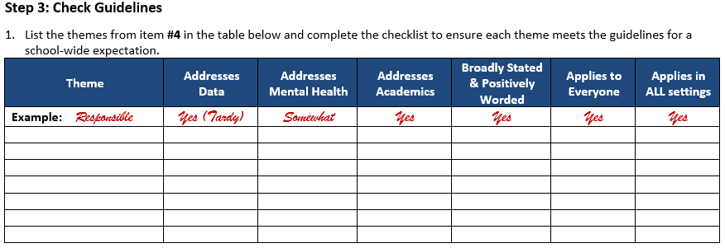

Slide 33
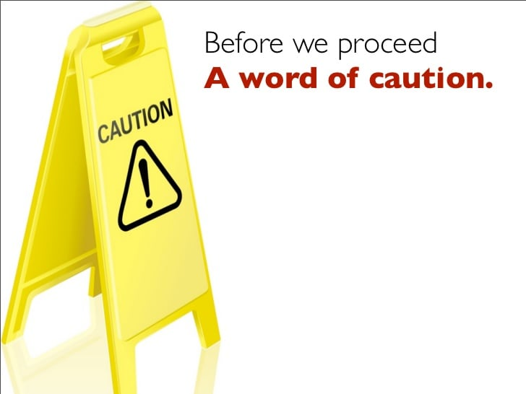
Your School-wide Expectations should not be final unless you:
Used Your Data
Collected Input From Your Stakeholders

Slide 34
Teaching Expectations
1.4 Teaching Expectations

Slide 35
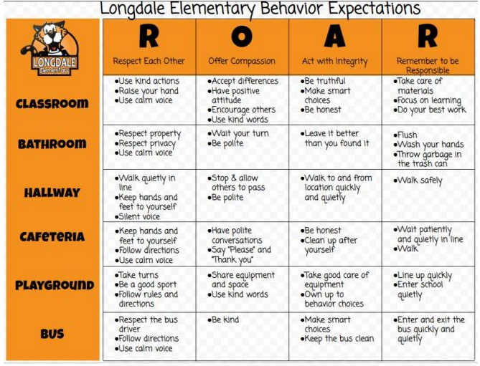
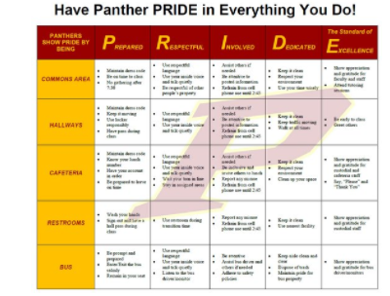
“Why” Create a School-wide Behavioral Expectation Matrix

Slide 36
Answer: A School-wide Expectation Matrix
Creates Environments that are Supportive
When students are taught the “how to”, they are provided with skills on how to be successful.
Provides the conditions and state for learning…
Common Mistake: Students “should” know how to behave…

Slide 37
What do you want from me?
A Dysregulated Student
A Dysregulated Adult
Not that He “Won’t” but “Can’t”
Build Skills Before You Push Motivation

Slide 38
Modeling and Teaching the “How To” Prevents Dysregulation

Slide 39
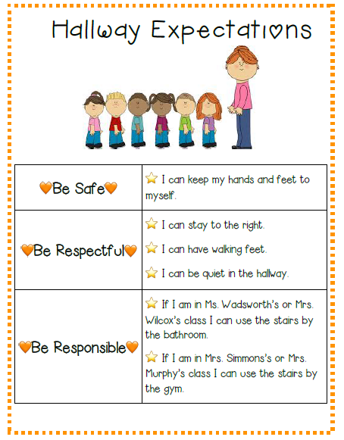
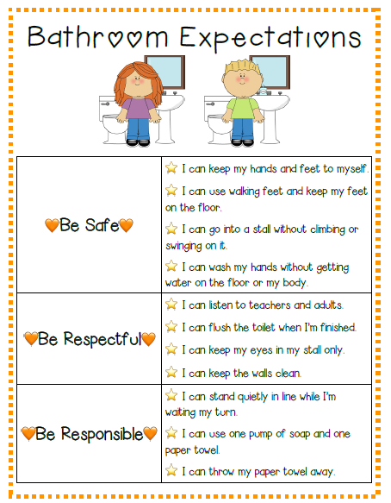
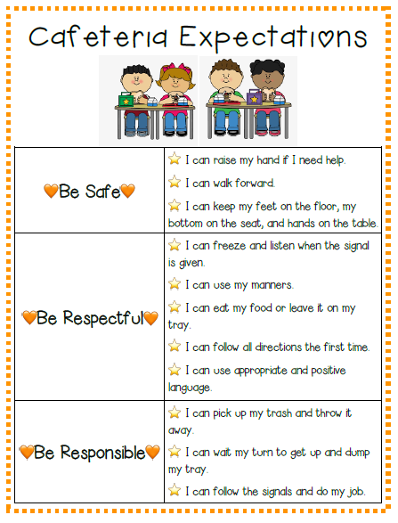
PBIS Model School, Lost Creek Elementary
The “HOW To” Be Successful

Slide 40
Weimer Elementary, Kanawha County

Slide 41
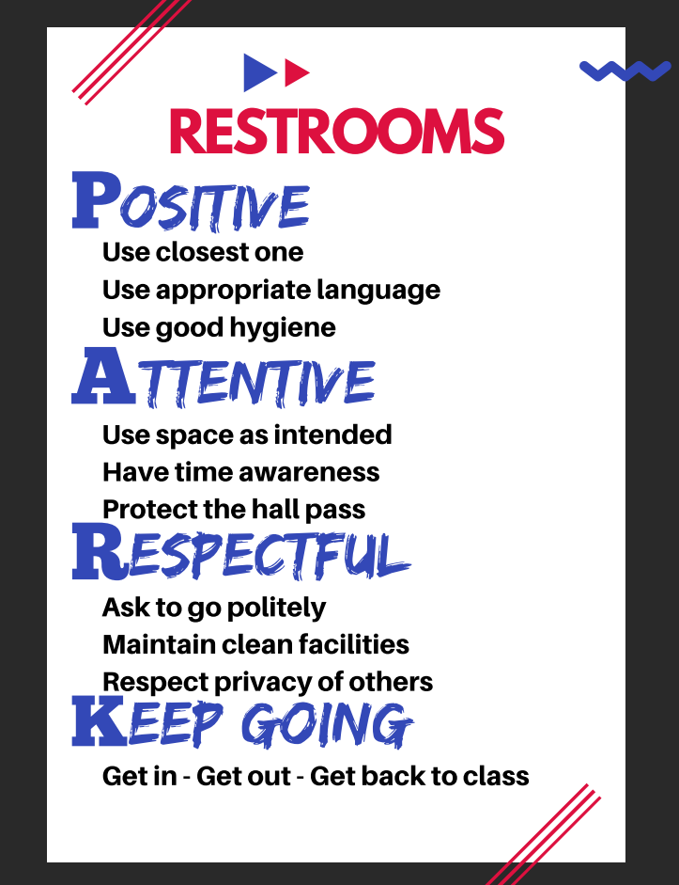
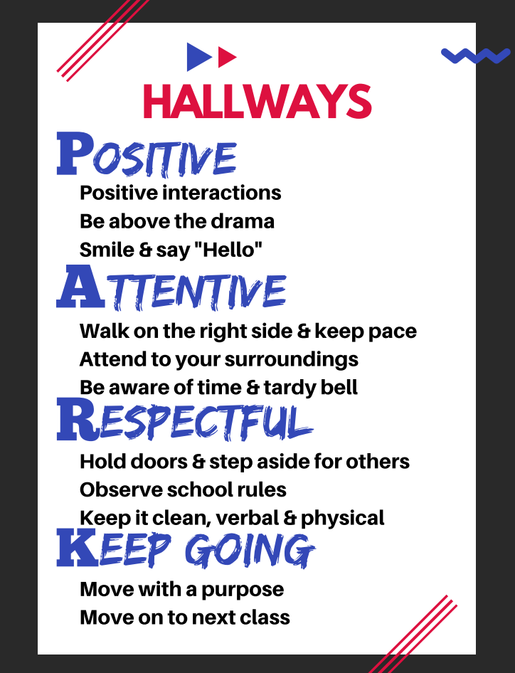
Wheeling Park High School

Slide 42
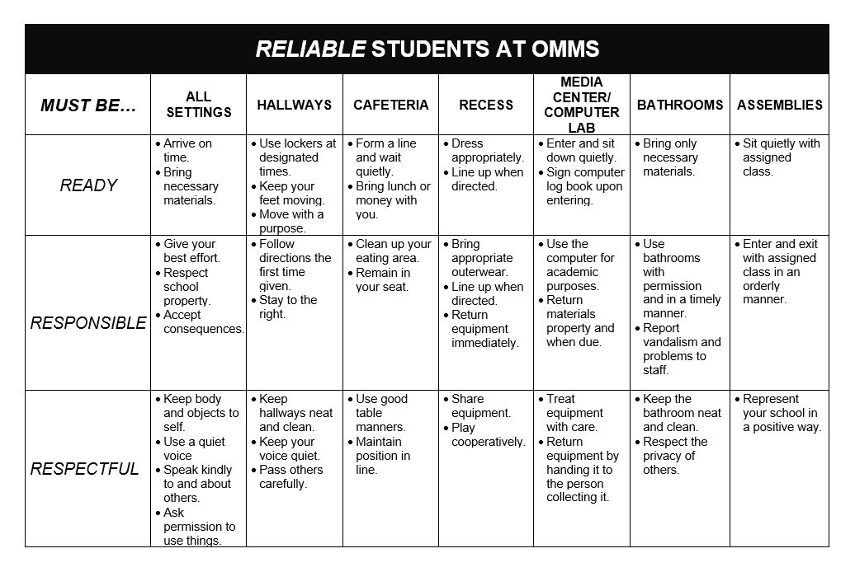

Slide 43
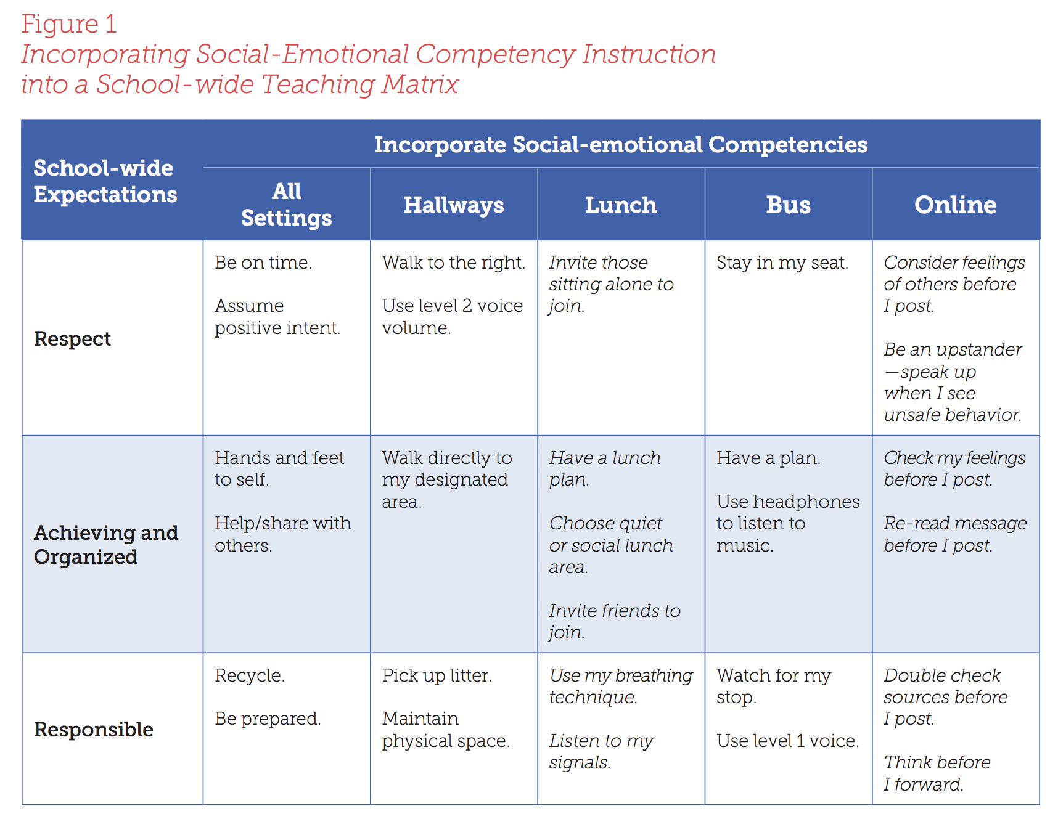
Integrating Social-Emotional Competencies in your Teaching Matrix
https://www.pbis.org/Common/Cms/files/pbisresources/TeachingSocialEmotionalCompetenciesWithinAPBISFramework.pdf

Slide 44
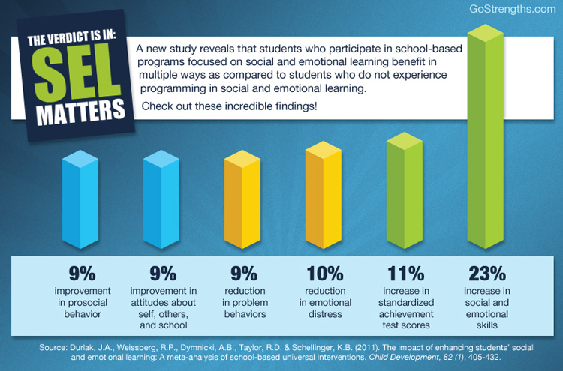
The Why
WV Standards for Student Success
WV Policy 2520.19

Slide 45
“Why” Develop a System for Teaching Social Emotional and Behavioral Skills….
Behaviors are prerequisites for academics.
Procedures and routines create structure.
Repetition is key to learning new skills.
For a child to learn something new, it needs to be repeated on average ? times (Joyce and Showers, 2006)
Adults average ? (Joyce and Showers, 2006)
For a child to unlearn an old behavior and replace with a new behavior, the new behavior must be repeated on average
? times (Harry Wong)
8
25
28
What About A Child Who Is Dysregulated???

Slide 46
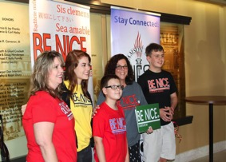
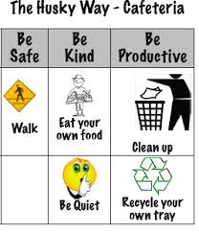
When and How to Teach Behavioral Expectations?
Kick-off Events
Beginning, mid-year and after holiday breaks
On-going Direct Instruction
Classroom Lesson Plans
Pre-correction or Re-teaching “immediately” after behavioral errors
Videos
Making sure they are data driven
Students should demonstrate the positive examples only
Ensure students involved are representative of your student body
Booster Trainings
Scheduled and data-driven
Continued Visibility
Visual Displays – posters, agenda covers, t-shirts
Daily announcements
Newsletters

Slide 47
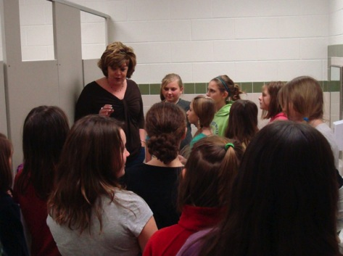
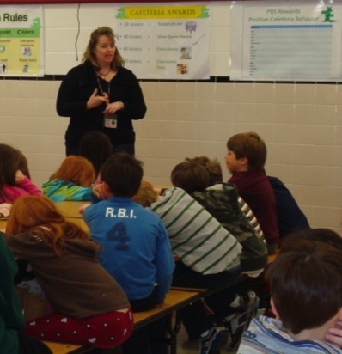
Teach in Context
…in the cafeteria
…in the restrooms

Slide 48
Resource Manual PBIS.org

Slide 49
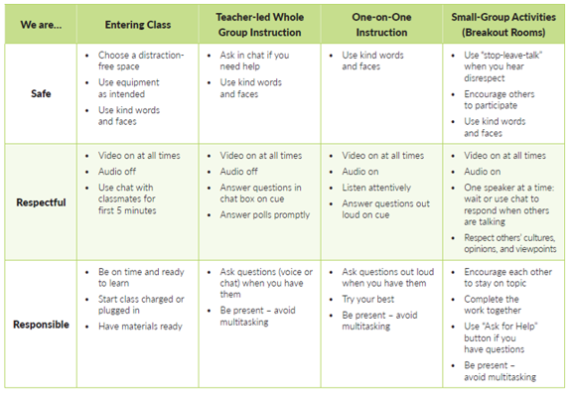
Remote Learning Matrix Example

Slide 50
Hybrid Learning Behavioral Matrix

Slide 51
Teaching Matrix |  | SETTING
 |  | Hallways | Cafeteria | Library/ Computer Lab | Bus | Classroom
 | Be Respectful | Keep hands feet and other objects to self | Eat only your food | Study, read, compute | Watch for your stop
 | Be Responsible | Use quiet voice | Replace trays & utensils | Push in chairs. Treat books carefully. | Wipe your feet Sit appropriately
 | Be Safe | Maintain your own physical space Stay to the right | Clean up your eating area | Whisper. Return books | Use a quiet voice Stay in your seat
 | Conditions for Learning | Stand in hall during passing periods | Supervise students until all enter cafeteria | Instruct from back to keep eyes on all screens | Ensure students enter bus calmly
What about the classroom?
Expectations

Slide 52
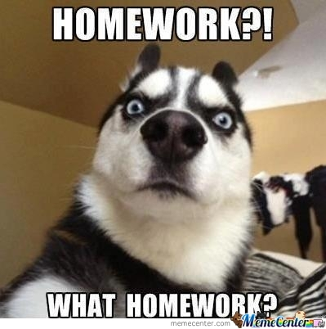
Homework Assignment
Features 1.3 and 1.4
Ideal Student Activity: Develop or Enhance SW Expectations
Develop SW Behavioral Expectation Matrix
Watch Video: How to Develop your SW Expectation Matrix
Review PowerPoint Slides
Get Feedback from Stakeholders
Teach SW Expectations and Matrix to Faculty, Students & Families
Be Sure to Update Your TFI and Action Plan for Features 1.3 & 1.4. (Behavior Support Specialists Will Be Following-Up With PBIS Teams)

Slide 53
Find the TFI online!
Visit www.wvpbis.org
Click on “Evaluation/Data”
Click “TFI Tool V2.1”

Slide 54
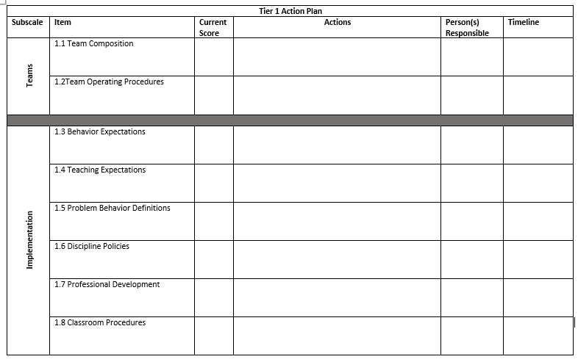
Item​ | Current​ TFI Score ​ | Actions​ | Person (s) Responsible​ | Timeline​
1.3 Behavior Expectations 1.4 Teaching Expectations | Where are you now on the TFI? ​ | What areas of focus do we have for these features? | Who should do it? ​ | When do you want it done by? ​
Find the TFI online!
Visit www.wvpbis.org
Click on “Evaluation/Data”
Click “TFI Tool V2.1”

Slide 56
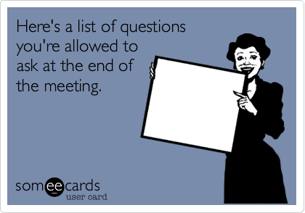
Questions??
Next time…..
Feedback/Acknowledgement (1.9)
Discipline Systems (1.5 and 1.6)
Data (1.12 and 1.13)
Day 2 – October 5th , 6th and 7th

Slide 57
Notes:
School-wide PBIS Resources
Website
Facebook
Online TFI
Implementation Stories

Slide 58
Notes:
School-wide PBIS Resources
Behavior Support Specialists
EC Behavior Support Specialists
Request for Assistance – QR Code
Coordinator Contact Info

