Slide 2
Your Hosts for Today:
Notes:
Introduce the TA Center & collaboration with ATC and WVDE
Why we were created

Slide 3
TA Center Projects
Notes:
Intro of the projects we house and who coordinates them

Slide 4
The mission of the WV BMHTAC is to assist teachers, students, families and communities that are faced with challenging behaviors and mental health issues through training, resources, and promotion of evidence-based strategies and interventions.
Childhood Trauma and Trauma Informed Classrooms
Challenging Behaviors and Classroom Procedures
Functions of Behavior and Data Analysis
Family Engagement
Self-Care for Educators
We can Develop a Training to Fit your Needs
4
Notes:
Review types of trainings/PD we offer

Slide 5
This Week’s Objectives
Attendance, Meet the Team, Housekeeping, and Expectations
2. Stages of Change – Dr. Jim Harris
Understanding Why You Are Here and
Overview
Tiered Fidelity Inventory (Fidelity Tool)
Teaming
Expectations

Slide 6
Content
Activity
Homework
Behavior Support Specialist Contact

Slide 7
Sessions
Date | Time | Content
September 14, 2021 | 3:30 to 5:00 | Introduction to PBIS
September 15, 2021 | 3:30 to 5:00 | Teaming
September 16, 2021 | 3:30 to 5:00 | Expectations
October 5, 2021 | 3:30 to 5:00 | Feedback/Acknowledgement
October 6, 2021 | 3:30 to 5:00 | Discipline Systems
October 7, 2021 | 3:30 to 5:00 | Data
November 16, 2021 | 3:30 to 5:00 | Classroom Practices
November 17, 2021 | 3:30 to 5:00 | Buy-In and Professional Development
November 18, 2021 | 3:30 to 5:00 | Family, Fidelity, and Figuring It Out

Slide 8
Homework
Three homework activities in between sessions.
The homework is created to fill in our content but also to help you build your framework.
Your Behavior Support Specialist will support you with this work.
Homework is due the Friday before the next session to your BSS.

Slide 9
Behavior Support Specialist Check-In
We will be checking in with your team every in between sessions.
We will be asking for a team member to be your Point of Contact.
We will be asking for when the best time for you to communicate with you.
We can communicate via email, phone, Zoom, and Teams.

Slide 10
Attendance

Slide 11
Meet the Team

Slide 12
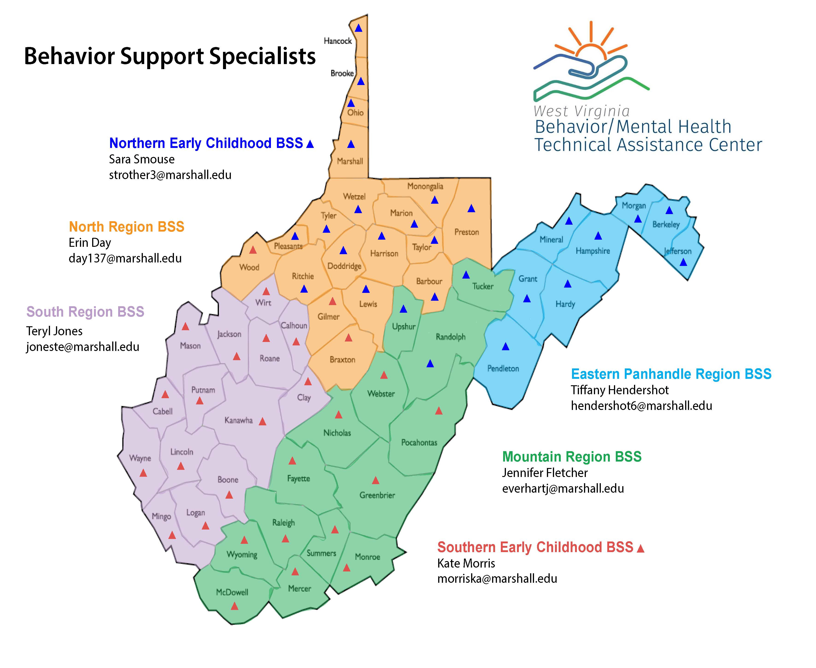
AWARE BSS
Christy Fubio
kroll3@marshall.edu
Program Evaluator
Anna Shreve
Rubenstein@marshall.edu

Slide 13
Our Expectations
Communicate
Be Receptive
Be Respectful
Have Fidelity to the Process

Slide 14
Expectation | Our Partners Will: | We will:
Communicate | Respond to emails/phone calls. tell us what you need. Collaborate. Be engaged. | Respond to emails/phone calls. Meet you where you are at. Share knowledge-based practices. Have courageous conversations.
Be Receptive | Be open to mindset shifts. Be vulnerable. Be honest. | Listen openly. Accept feedback. Be honest and direct.
Be Respectful | Be respectful our each of our time. Be engaged. Be proactive Meet deadlines. Have integrity. | Work from the understanding that “Clear is Kind.” Respect boundaries. Respect your time. Go at your pace.
Have Fidelity to the Process | Be consistent Have accountability to implementation. Provide TFI’s and Data. Be solution focused. Emphasize buy-in. Action Plan. | Hold you accountable. Be consistent and reliable. Follow through. Let the data guide us. Be solution focused.

Slide 15
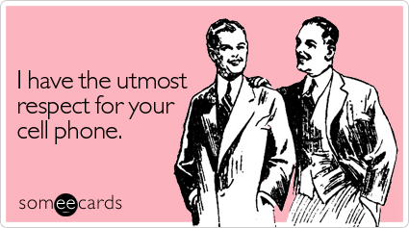

Slide 16
2021 Additional Expectations
Have grace!
Openly communicate!
Take. Big. Breaths!

Slide 17
Let’s Introduce Ourselves
1.) Answer the poll – Are you with your team or are you watching individually?
2.) In the chat -Tell us what school you are and what county you are from.

Slide 19
Why Are You Here? Activity
Discussion on why your school signed up?
What is your goal? Reduce office discipline referrals, increase attendance, decrease suspensions and expulsions?
Were you voluntold to be here?
Please be prepared to share your answers by unmuting or in chat.

Slide 20
Answers we have heard…
Voluntold
Past experience and want it at our school
Behavior is a challenge at our school
County-wide
Increase in trauma, grand families, opioid substance abuse crisis etc.
I have no idea and still don’t know what PBIS really is
Do any of these apply to you?

Slide 21
Let’s Put This In Action

Slide 22
Getting Dressed Activity
Take a post-it note.
Write down the order that you get dressed in.
Be specific. Right leg? Left Leg? Arms first? Head First? All Socks? Then All Shoes?
Remember your audience! Start where you are comfortable!
Share with your team. Do you do it the same? Different?

Slide 23
New “Dressing” Policy
A team (somewhere) has decided that EVERYONE needs to get dressed the same way.
Here’s how it’s required:
Socks first (right then left)
Shirt (head first then arms)
Pants (left then right)
Shoes (tied before you put them on)
HOW’S THAT GOING TO GO?

Slide 24
What Would You Need To Make the Change?
An explanation of why?
Examples?
Solid Expectations?
To be taught?
Visuals?
Encouragement/Acknowledgement?
Grace, Patients, and Reteaching?

Slide 25
You are the Ambassadors
You will leave this training being the ambassadors, experts, school leaders on PBIS.
Your staff needs you to guide them on why changes are necessary and how to do it!
You will need to be able to identify where they are at in their “Stages of Change”.
Meet them where they are at.
Give them what they need.
We CAN help!

Slide 27
PBIS Overview

Slide 28
What is PBIS?
Positive Behavioral Interventions and Supports
Evidence-based 3-tiered framework
Way to support everyone, especially students with disabilities, to create the kinds of schools where all students are successful.
Commitment to addressing student behavior through systems change.

Slide 29
Multi-Tiered System of Support
A Multi-Tiered System of Support (MTSS) is a data-driven, problem-solving framework to improve outcomes for students.
MTSS relies on a continuum of evidence-based practices matched to student needs.
PBIS is an example of an MTSS centered on social behavior.

Slide 30
Alignment of Initiatives Related to PBIS is Guided by the Six MTSS Features
McIntosh, K.& Goodman, S. (2016). Integrated Multi-Tiered Systems of Support: Blending RTI and PBIS. New York: Guilford Press.
Academic RTI
Schoolwide PBIS
Focus on teaming
Scientifically based interventions
Instruction as prevention
Tiered continuum of supports with increasing intensity based on need
Regular screening for early intervention
Use of a problem-solving model and data-based decision rules
Emphasis on improving quality of implementation
Embedded into school improvement plan
Specific social behavior assessments and interventions
Use of free materials that are adapted to fit the school’s context
Use of indirect assessment of behavior
Continuous assessment of social behavior with existing data sources
Focus on schoolwide teaming
Described in IDEA as schoolwide prevention and individual intervention approach
Specific academic assessments and interventions
Use of published curricula selected by school or district
Use of direct assessment of skills
Periodic assessment through benchmarking periods
Focus on grade-level teaming
Described in IDEA as special education eligibility determination approach
Team based leadership and coordination
Evaluation of implementation fidelity
Three-Tiered Continuum of evidence-based practices
Continuous data-based progress monitoring and decision-making
Comprehensive universal screening
On-going professional development including coaching with local content expertise
Core Features of MTSS
Notes:
Slide Starter: “We just want to briefly reference that PBIS itself is an MTSS framework, and includes these 6 core features…

Slide 31
Multi-Tiered System of Support
TIER 3
1-5%
Intensive
TIER 2
10-15%
Targeted
TIER 1
80-90%
Universal

Slide 32
Mindset Shift
Instead of PBIS:
POSITIVE BEHAVIORAL INVTERVENTIONS AND SUPPORTS
(Being stuck on the thought that everything is positive)
Let’s think of it as:
WHAT SYSTEMS AND PRACTICES ARE WE PUTTING IN PLACE TO GET THE POSITIVE BEHAVIOR THAT WE WANT TO SEE?
Shift your mindset to…

Slide 33
PBIS – A Model
Data is how we make our decisions.
Practices are how we support youth.
Systems are how we support grown ups.
PBIS is the foundation of how a problem-solving process.

Slide 34
PBIS is the foundation of your problem-solving process.
What changes do we need to make to the environment?
Behavioral issues ARE Learning issues. What do we need to build so kids can be successful?
Climate and Culture Issues? Let’s build external systems that support everyone.
Trauma and Toxic Stress are prevalent? How do we make our school predictable, consistent, positive, safe, and equitable?
Extra Mental Health Supports? How do we use our data to guide our decisions?

Slide 35
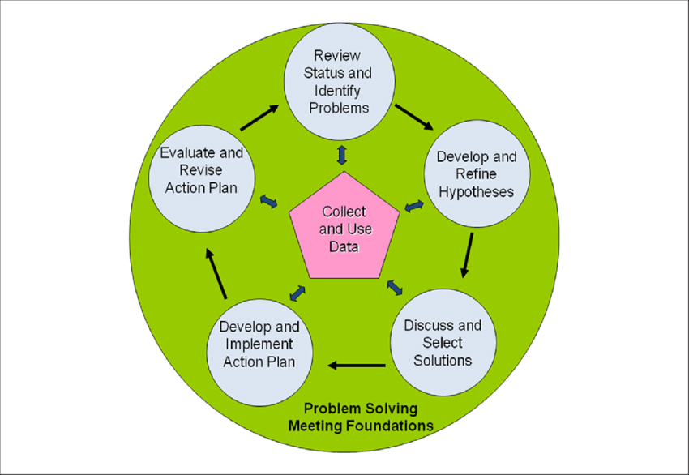
Data and Team Initiated Problem - Solving

Slide 36
At Your School, Would You Want…
Staff that are willing to have mindset shifts?
Adults who are on the same page?
Individuals knowing what to expect if they do something wrong?
Students to know what is expected of them?
Individuals be told what they are doing correctly?
Behaviors to be taught?
Adults to make decisions based on data – not on assumptions?
For adults to model behavior and teach how to respond?
For their families to be engaged in their education?
For schools and educators to do what they say they are doing?

Slide 37
SURPRISE!
Leadership Team
(1.1, 1.2)
Schoolwide Expectations
(1.3, 1.4)
Schoolwide Expectations
(1.3, 14)
System to Acknowledge
(1.9)
Consequences for problems? (1.5, 1.6)
Staff that are willing to have mindset shifts?
Adults who are on the same page?
To know what is expected of them?
To be told what they are doing correctly
To know what to expect if they do something wrong?
Classroom Practices
(1.8)
Data and Decision Systems
(1.7, 1.10, 1.12 -13)
Social Emotional Learning
(1.4)
Family Collaboration
(1.11)
Fidelity
(1.15)
To be taught?
Adults to make decisions based on data – not on assumptions?
For adults to model behavior and teach how to respond?
For their families to be engaged in their education?
For schools and educators to do what they say they are doing?

Slide 38
Leadership Team
(1.1, 1.2)
School Wide Expectations
(1.3, 1.4)
System to Acknowledge
(1.9)
Classroom Practices
(1.8)
Consequence for Problems
(1.5, 1.6)
Data and Decision Systems
(1.7, 1.10, 1.12-15)
Bully Prevention
(Social/Emotional Learning)
(1.4)
Family Collaboration
(1.11)
Tier 1: Core Features

Slide 39
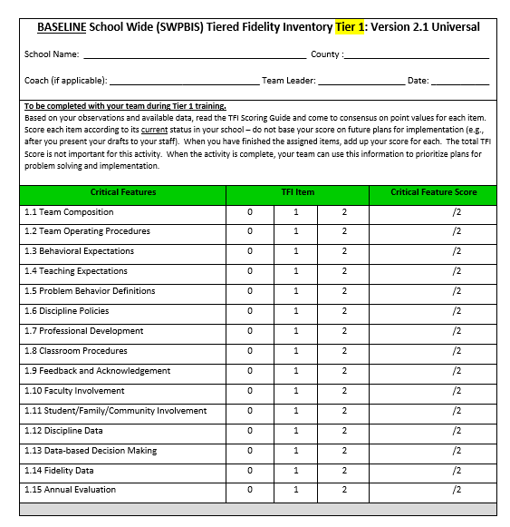
Guiding Document

Slide 40
Misconceptions of this Work (What PBIS is NOT)
Parties, assemblies and ice cream socials
Rewarding youth (for doing things they should already know how to do)
Enabling our youth
People talking in really high voices and “being positive” all the time
Childish
Mascots on steroids
It’s only for “naughty” kids

Slide 41
Positive Behavioral Interventions and Supports

Slide 42
CliffsNotes for PBIS
Framework
Helps organize discipline systems
Evidence-based interventions
School-wide Project
Academic and behavior outcomes for all students
PBIS, School-wide PBIS & PBS

Slide 43
What Are We Getting Into?

Slide 44
WV’s PBIS Project
The mission is to support school teams via training and technical assistance as they take a proactive systems approach to creating and maintaining a safe and positive school.
The goals include:
Increase positive school culture and climates
Decrease Office Discipline Referrals
Increase proactive teaching strategies
What we do:
Provide training
Ongoing technical assistance
Coaching support
Data collection

Slide 45
Six Basic Recommendations for Implementing PBIS
Never stop doing what is already working
Always look for the smallest changes that will produce the largest effect
Avoid defining a large number of goals
Do a small number of things well
Do not add something new without also defining what you will stop doing to make the addition possible
4. Collect and use data for decision-making
5. Adapt any initiative to make it "fit“ your school, community, culture and, context
6. Establish policy clarity before investing in implementation
Sugai

Slide 46
Tier 1
Readiness
Academy
Common Roadblocks
Technical Assistance
Admin not on board
Trying to do too much at one time
Needing more support but not asking for it
Buy-in
Voluntold
Commitment/Sustainability
Funding Misconceptions
Acknowledgements/School stores
Provide Professional Development to the staff
Meet with teams to help overcome hurdles
Example : Weimer Elementary and TCMS
Commitment and Buy-In
Data Analysis
Overviews
Teaming
Current Practices Evaluation
Aligning Initiatives
Staff PD/Feedback
Intro to the TFI
Three Separate Days
Focuses on Teaming, Expectations, Acknowledgements, Responding to Challenging Behavior, Data- Systems, SEL, Families, and Fidelity
Follow-Up in the Spring

Slide 47
But that’s not all…

Slide 48
In chat – What outcomes do you think you might see from implementing PBIS?

Slide 49
Why Implement School-wide PBIS?

Slide 50
Our Goal
Build your framework!
For you to become your school experts!
To build your relationship with your Behavior Support Specialist so we can support you!

Slide 51
Will this work?
Sure it will!
The research says so!
National & State Collaboration
WVEIS Discipline System
WV Schools are very familiar with the multi-tiered intervention model
A solid implementation and evaluation plan

Slide 52
WVPBIS.org Scavenger Hunt

Slide 53
Grad Credits Available!
Information
REGISTER HERE:
Marshall University
220.00
Syllabus on Registration Site
Register by: November 1st
Assignments due: December 3rd

Slide 54
See You Tomorrow!
3:30 – 5:00 tomorrow
Alicia Ziman and Jen Fletcher
TFI, Action Planning, and Teaming

