Slide 1
Office of the Bursar
CA$Htrack

Slide 2
View current/outstanding balances
Send messages directly to Bursar’s Office
View account history by term
E-billing
View payment history
Pay deposits
Pay for parking permits & citations
View financial holds
Parent/Guardian authorization for account access
View/print official receipts
View/print 1098-T tax forms
Apply for room/board

Slide 3
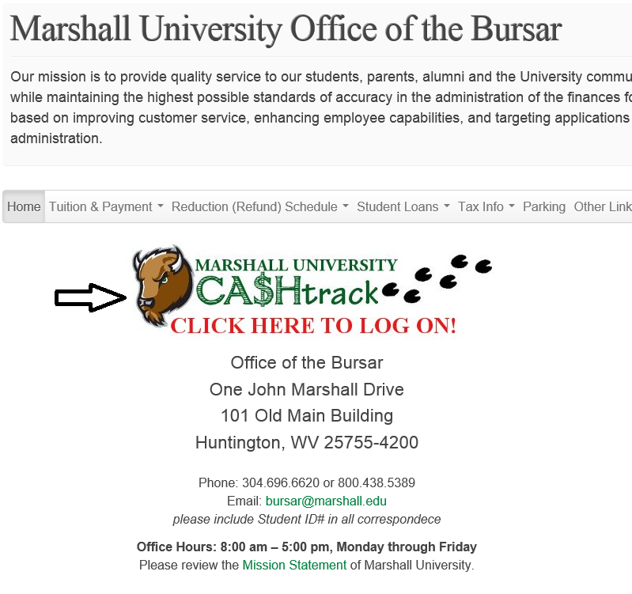

Slide 5
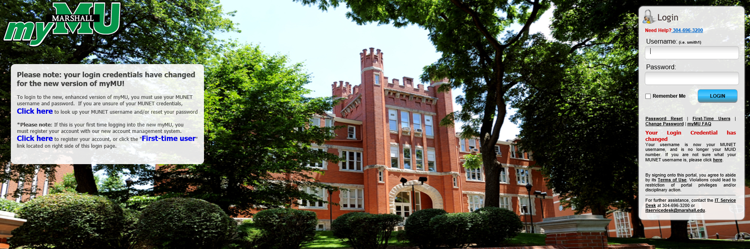

Slide 6
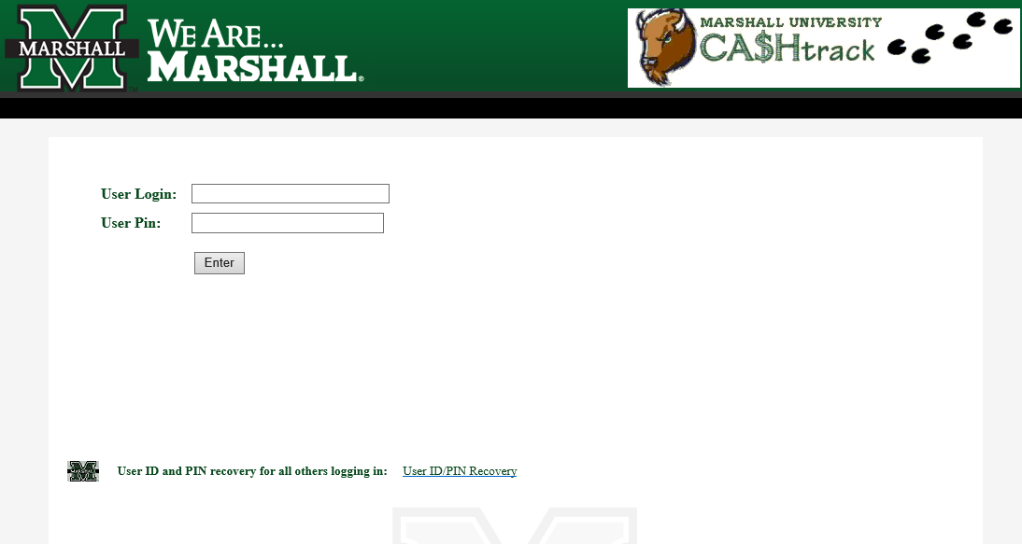

Slide 7
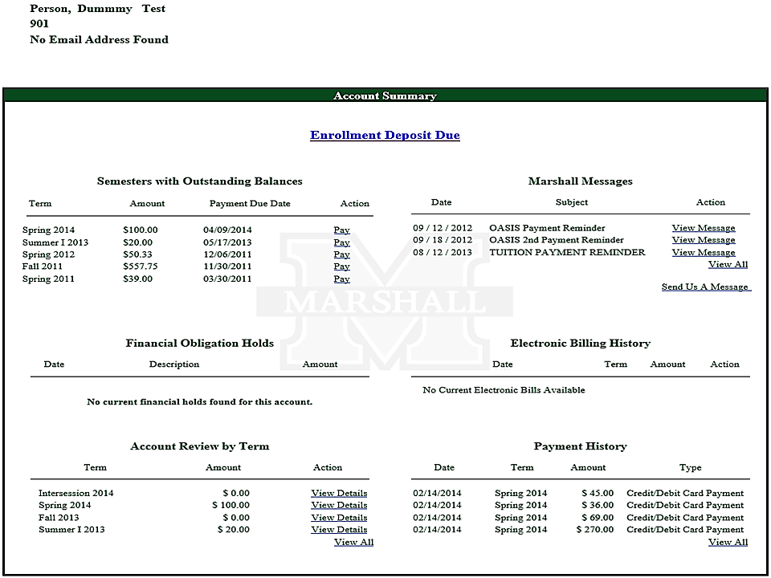

Slide 8
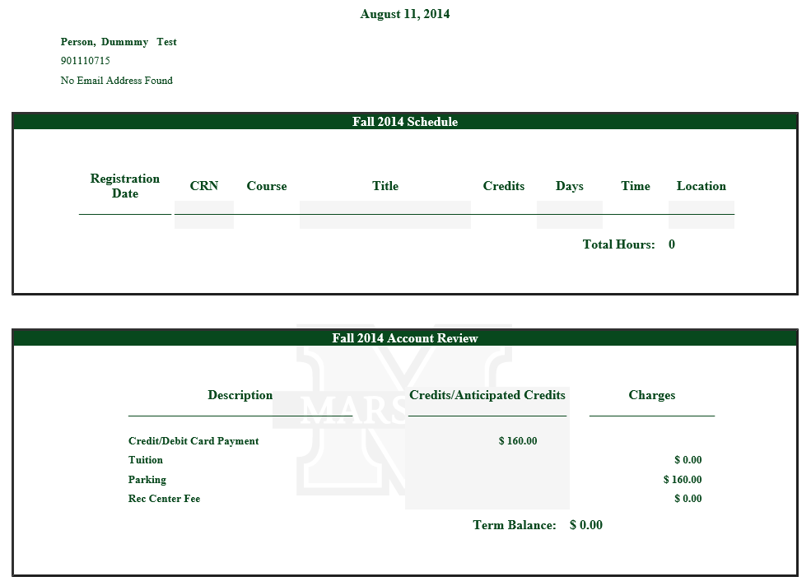

Slide 9
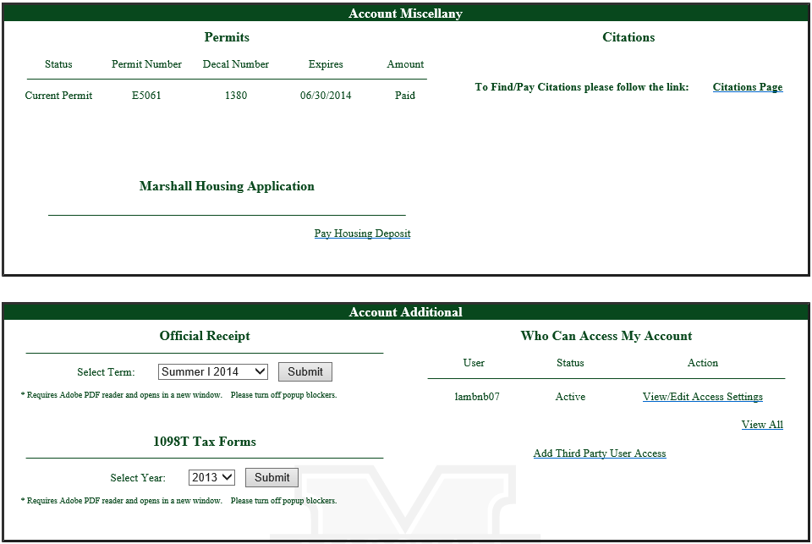

Slide 10
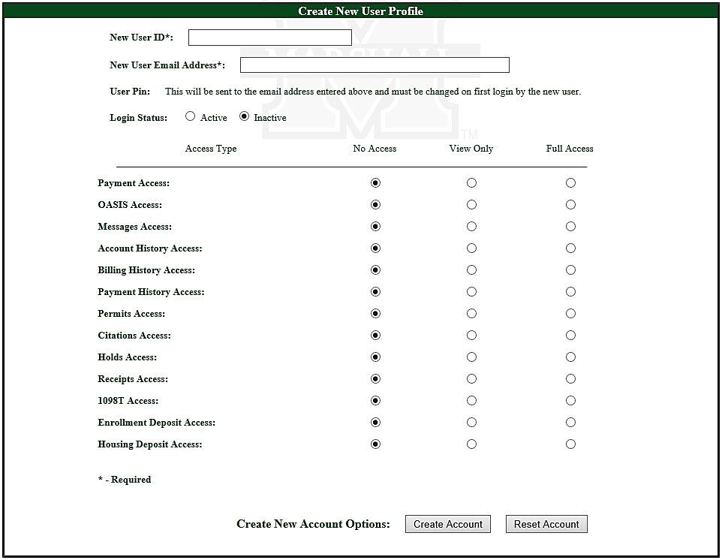

Slide 11
Questions?
If you need additional information concerning CA$Htrack, please contact Marshall University’s Office of the Bursar.
304/696-6620 or 800/438-5389
www.marshall.edu/bursar

