Slide 1
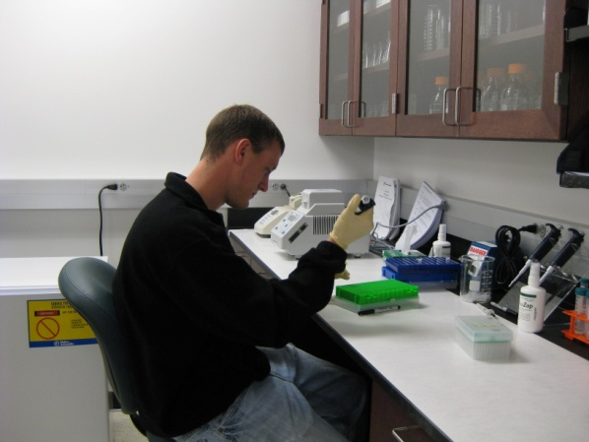
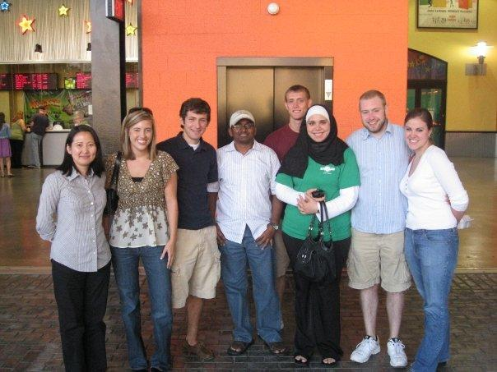
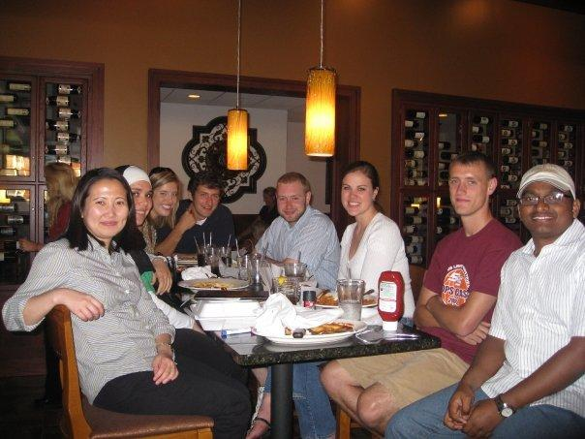
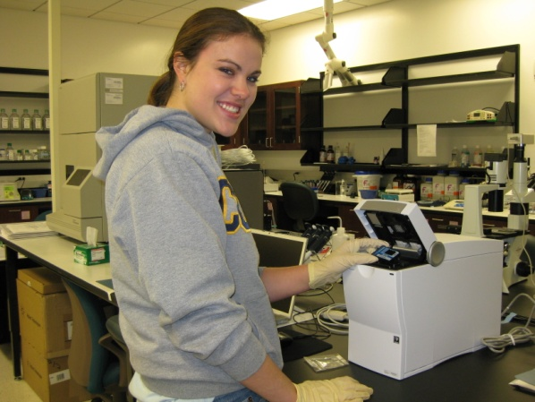
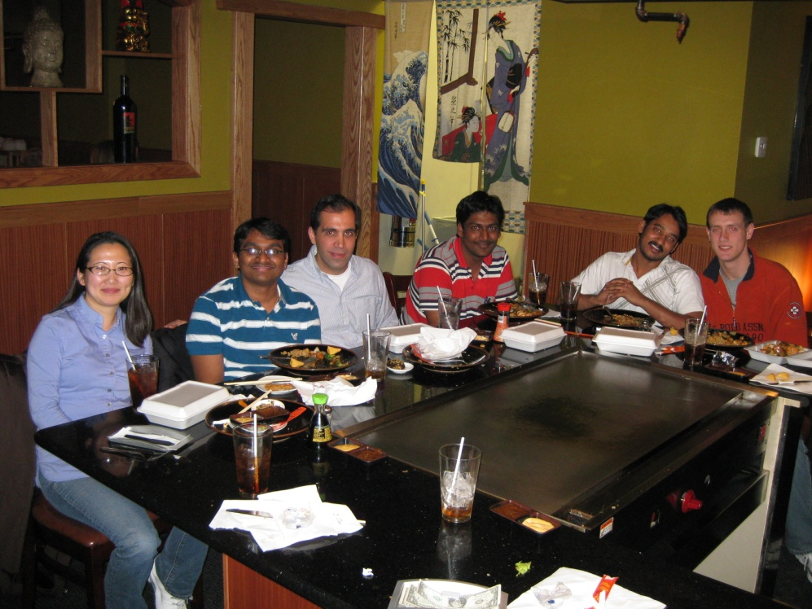
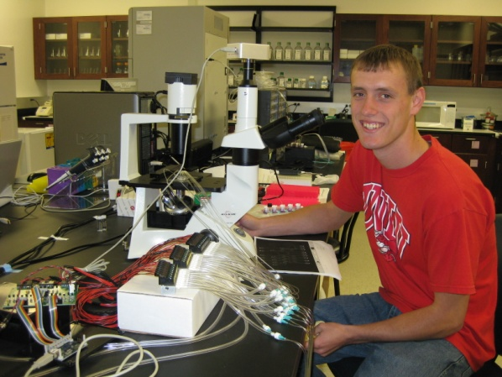
Wang Group

Slide 2
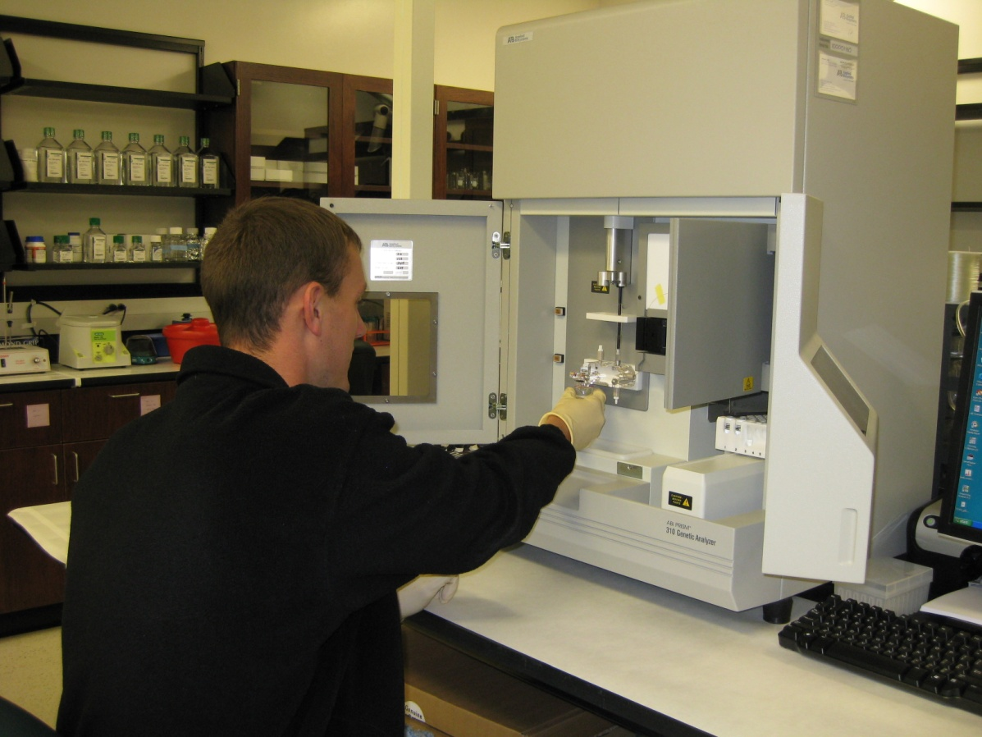
Project 1. RNA Structural Determination
RNA structural analysis at single nucleotide resolution using selective 2’-hydroxyl acylation analyzed by primer extension (SHAPE)

Slide 3
Project 2. Lab-on-a-Chip
Design and develop microfluidic devices for miniaturized and automatic RNA structural analysis, cell culture, and biosensing

Slide 4
Project 3. RNA Nanotechnology
Design and develop static RNA nanoarchitectures and mobile nanomachines for biosensors and related applications

