Slide 1
Making the Invisible Visible:
Reflections of an Artful Scholar and Researcher
Kay Lawson
Portfolio Presentation
October 16, 2013

Slide 2
Collage
Collage – (kə-ˈläzh, kȯ-, kō-), n.1. a: an artistic composition made of various
materials (as paper, cloth, or wood) glued on a surface; b: a creative work that resembles such a composition in incorporating various materials or elements. Syn. - jambalaya, mash-up, montage, olio, pastiche.

Slide 3
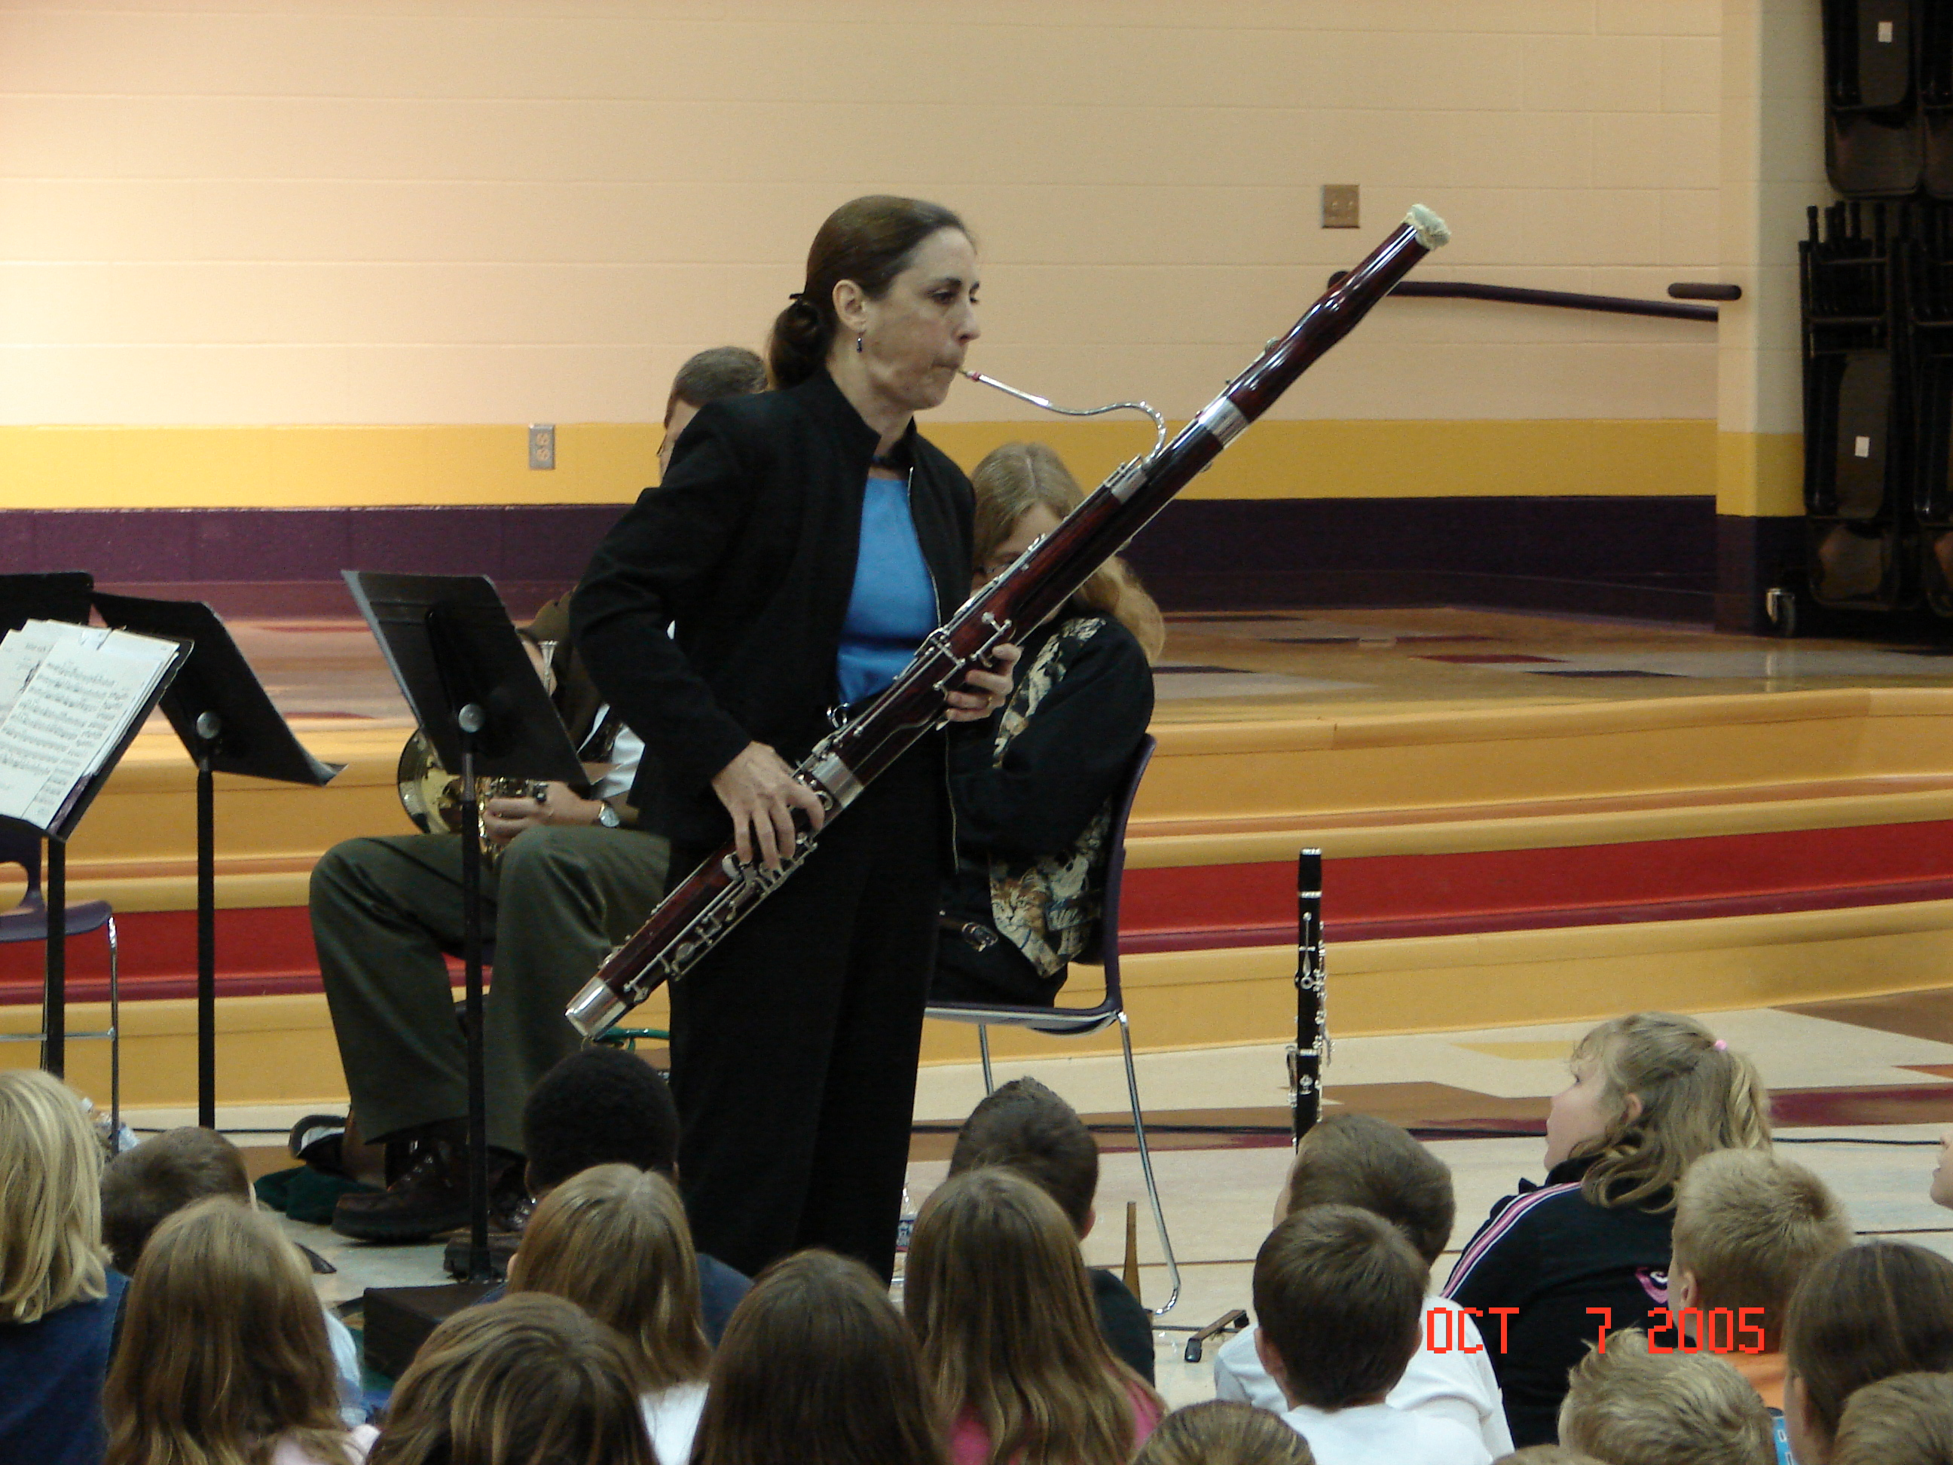
Goals as an Educator
Integrate music education background with
wider perspectives in education
Strengthen knowledge in curriculum
and instruction
Update skills and background
Refresh strategies in teaching
and learning
New and different professional opportunities

Slide 4
Curriculum & Instruction
Pastiche – (\pas-ˈtēsh, päs-\), n., a musical, literary, or artistic composition made up of selections from different works

Slide 5
Theories, Theorists, & Models
Constructivism
Multiple Intelligences
Brain-based Learning
Phenomenology
Postmodernism, Poststructuralism
Inquiry and Inductive Teaching Models

Slide 6
Personal Curriculum Theory: Synthesis of Meanings & Values
A Personal Curriculum Theory: Synthesisof Meanings and Values
Phenonmenology
The lived experience
Truthfulness
Authenticity
Poststructuralist
Openness Diversity
Multiple voices
Aesthetic
Unanticipated ends
The creative
Political and Gendered
Radical
Inclusive

Slide 7
Area of Emphasis
Mash-up – (\ˈmash-ˌəp\), n.,: something created by combining elements from two or more sources: as 1. a: a piece of music created by digitally overlaying an instrumental track with a vocal track from a different recording; b: a movie or video having characters or situations from other sources; c: a Web service or application that integrates data and functionalities from various online sources.

Slide 8
Educational Computing
Relied on self-taught skills and need-to-know learning
Updated background and expanded knowledge
Numerous opportunities with greatest challenges

Slide 9
Collaboration
Olio – (\ˈō-lē-ˌō\), n., 1. a: a miscellaneous mixture; b: a miscellaneous collection (as of literary or musical selections)

Slide 10
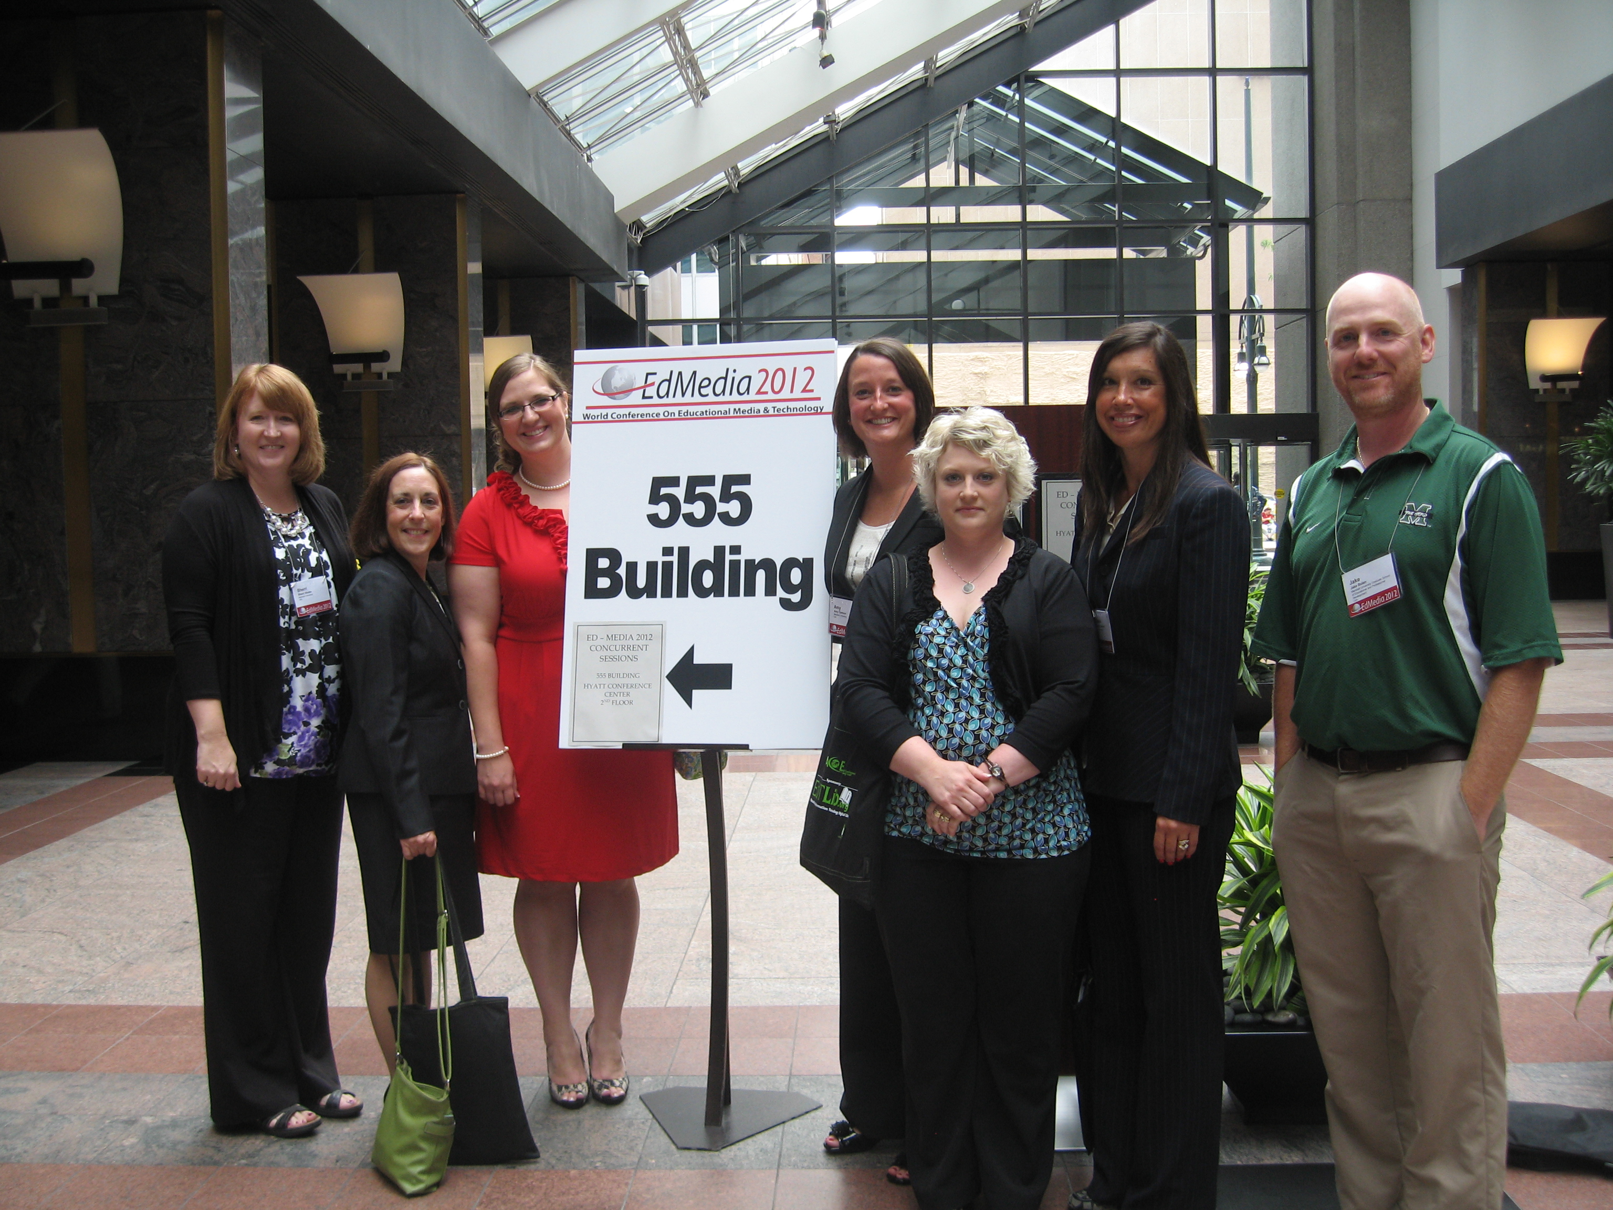
Professional Connections
Value of collaborative learning
Shared efforts in reaching goals
Develop network of colleagues
Collaborations with faculty

Slide 11
Scholarship
Jambalya - ( \ˌjəm-bə-ˈlī-ə), n. 1. a mixture of diverse elements

Slide 12
Artful Scholar
Emphasis on meticulous writing, communication of ideas, thinking in language, writing mechanics
New information and skills in technology, rethink how to teach and what to teach
New learning in curriculum and instruction

Slide 13
Research
Montage – (\män-ˈtäzh, mōⁿ(n)-\), n., 1. a: a literary, musical, or artistic composite of juxtaposed more or less heterogeneous elements; b: a composite picture made by combining several separate pictures; 2. a heterogeneous mixture

Slide 14
Artful Researcher
Practice in asking well-crafted and probing questions
Elements of research design
Greater proficiency in statistical concepts
Strategies for writing literature reviews

Slide 15
Developing Dissertation Proposal
Study of Marshall University’s First Year Seminar
Interdisciplinary studies as innovative undergraduate curriculum change
Faculty involvement in undergraduate curriculum development
Potential for contributing to teaching and learning

Slide 16
The Invisible Made Visible
Extent of integration between music education and curriculum and instruction
Abilities as a scholarly writer
Background of diverse professional experiences
Aptitude for using educational technology
Broad range of interdisciplinary studies experiences
Opportunities in my program of study augmented and brought together connections between arts background and learning in curriculum and instruction
Papers and publications demonstrating clarity of writing style, focus of content, and flow of ideas.
Value of my background and past experiences have become strengths as a scholar and researcher
Technology skills, a variety of projects and applications of new teaching strategies are outcomes of coursework in educational computing
Depth of preparation in research skills and knowledge of the qualitative approach provide the background to move on to the next stage of doctoral studies in conducting interdisciplinary studies research

Slide 17
With appreciation to my committee
Committee Chair, L. Eric Lassiter, Ph.D.
Ronald B. Childress, Ed.D.
Lisa Heaton, Ph.D.
Frances Hensley, Ph.D.

Slide 18
Image Credits
Jitterbug Collage
http://vintageprintable.com/wordpress/vintage-printable-art-and-design-2/art-paintings-miscellaneous/vintage-printable-art-thematic-dada-and-related/art- dadaish-jitterbug-collage-3/
Pastiche – maids and spinners
http://edsoncamposart.files.wordpress.com/2012/03/eves_dream.jpg
Area of Emphasis
http://www.environmentalgraffiti.com/news-wall-and-other-art-old-vinyl-records
Collaboration
http://www.loyola.edu/academic/finearts
Scholarship
http://cavemanstrong.com/wp-content/uploads/2010/08/aug-10-065.jpg

Slide 19
Image Credits
Research
http://collageillustration.wordpress.com/2010/07/29/my-collage-illustrations/
Thank you
http://halfwaybetweenthegutter.wordpress.com/2012/05/18/thank-you/

