Slide 1
Morphing into a
Doctoral Student
Bill Bissett
Doctoral Student
College of Education & Professional Development
Marshall University
November 30, 2011

Slide 2
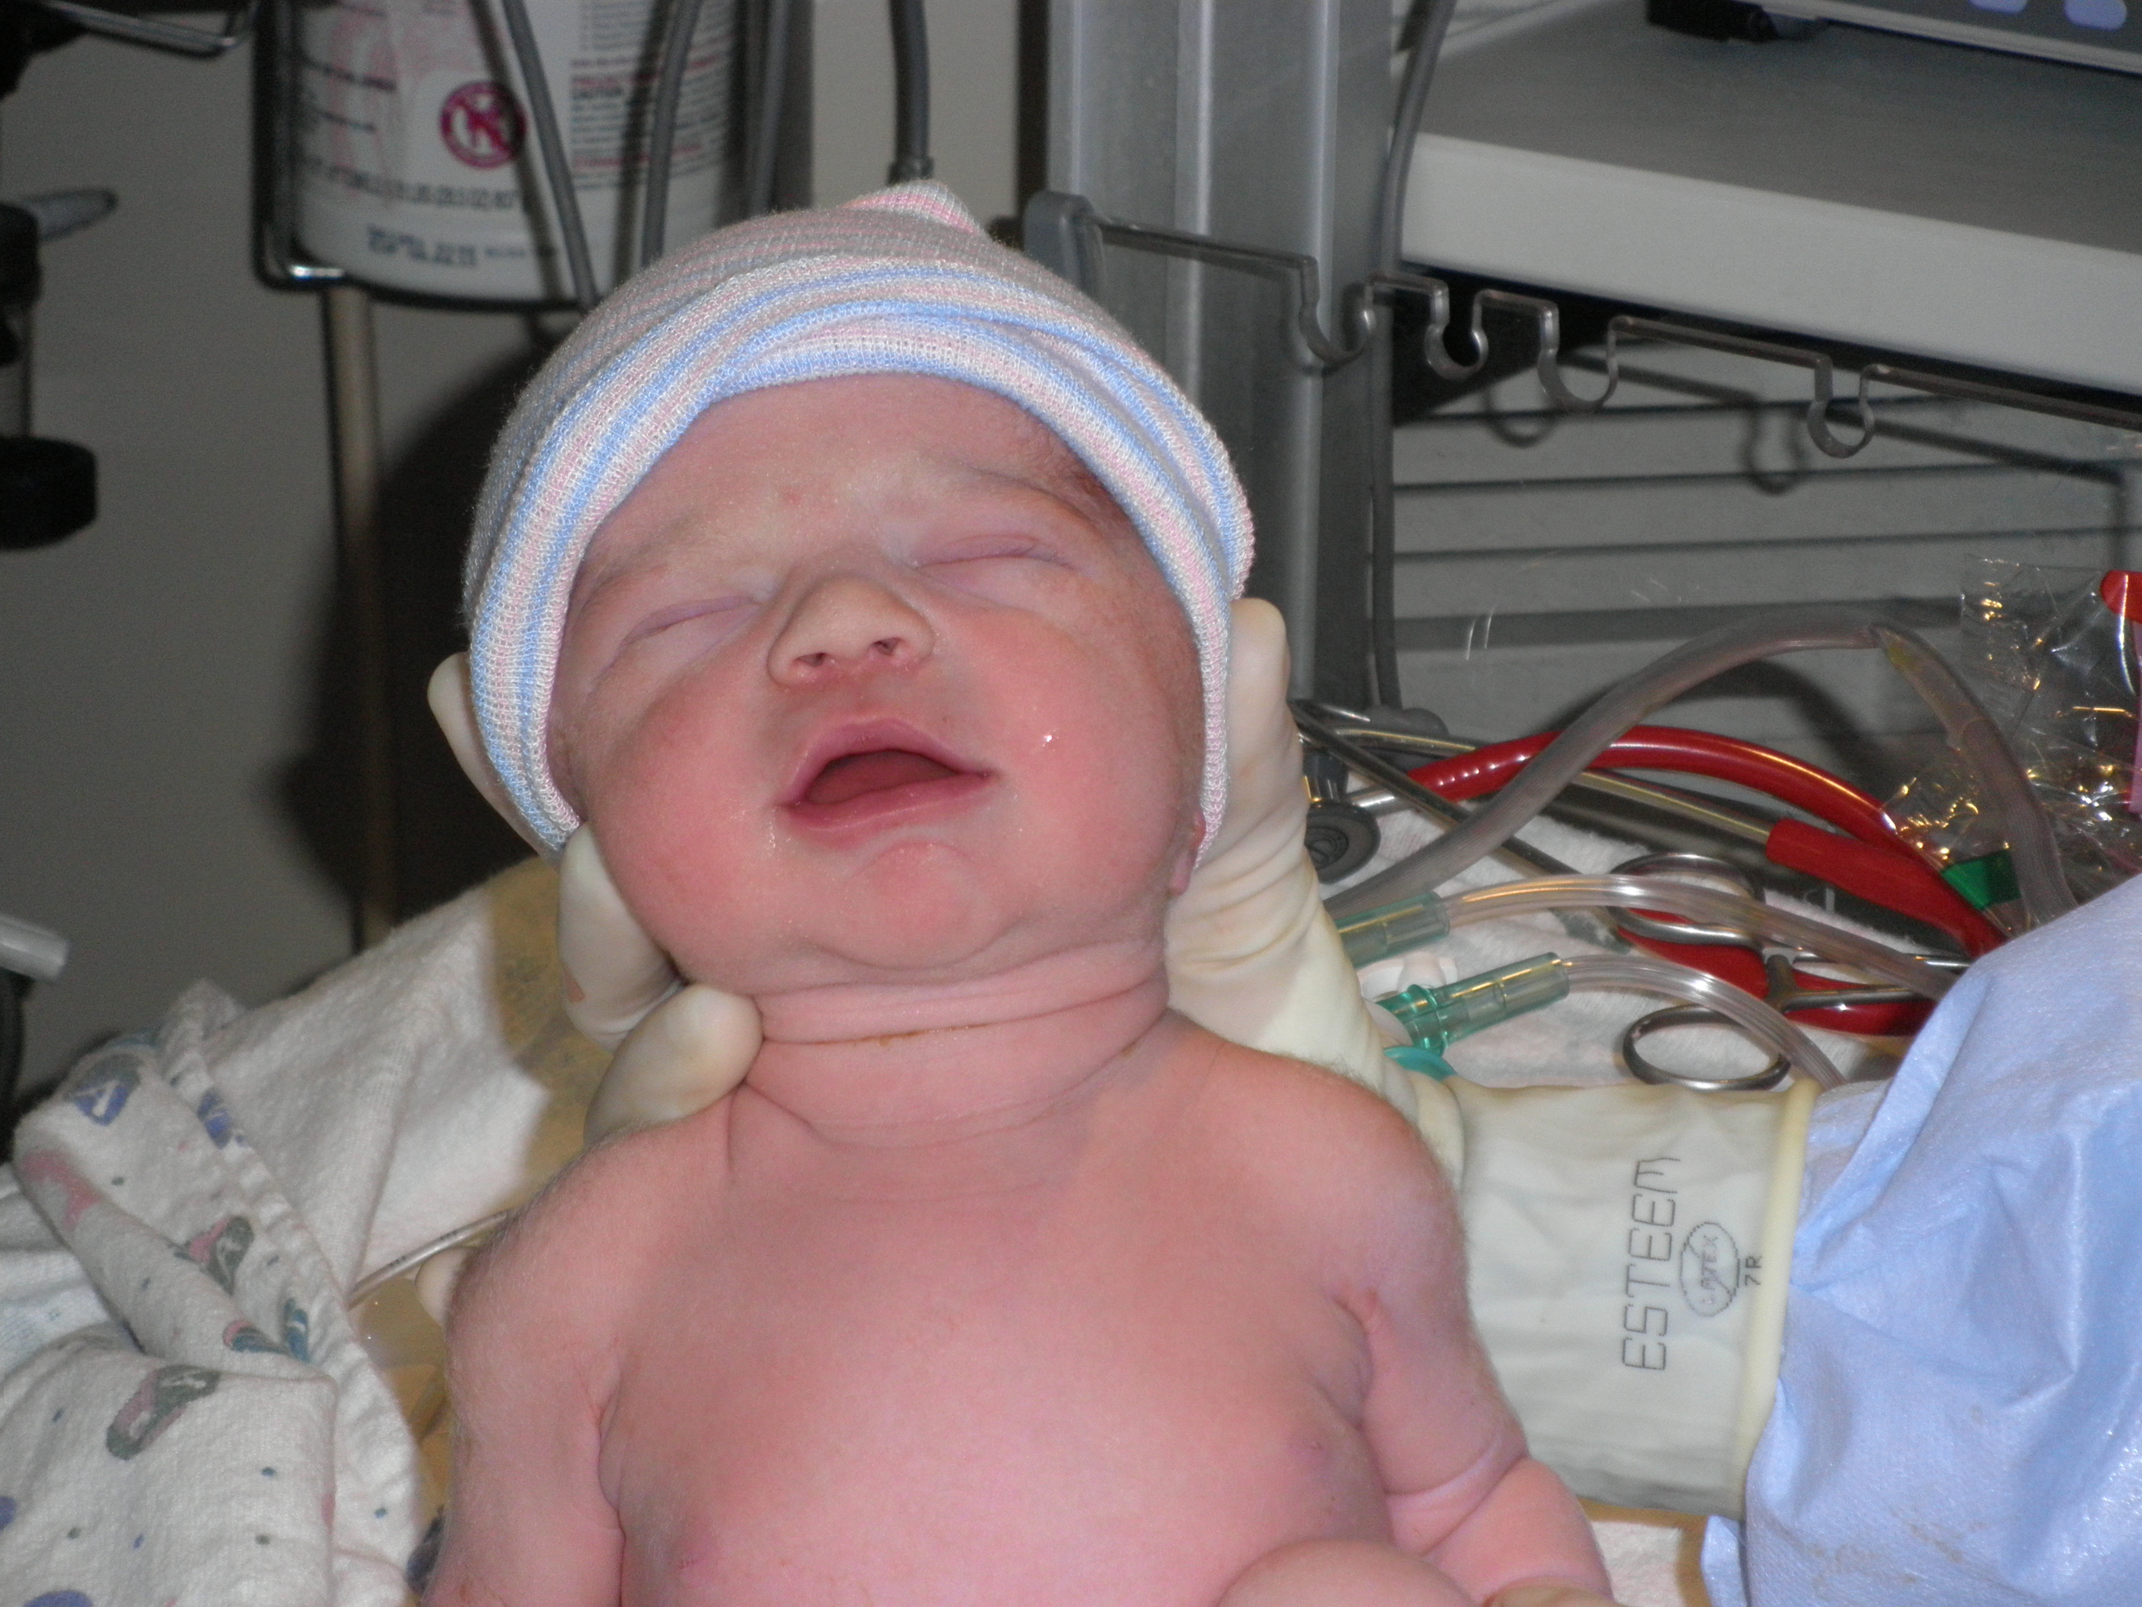
Molly Kathleen Bissett – 11/8/11

Slide 3
Morphing Into A Doctoral Student
“Congratulations – She looks just like you when you were in class.”
Dr. Dennis Anderson

Slide 4
The Portfolio Process

Slide 5
The Portfolio Process
SURPRISE! Not as tortuous as I expected…

Slide 6
The Portfolio Process
SURPRISE! Not as tortuous as I expected…
Kept most of my materials and work product

Slide 7
The Portfolio Process
SURPRISE! Not as tortuous as I expected…
Kept most of my materials and work product
Looking back to 2006, I am now more conversant in Education.

Slide 8
Explaining the Doctoral Program

Slide 9
Explaining the Doctoral Program
LS 719 – Introduction to Doctoral Studies

Slide 10
Explaining the Doctoral Program
LS 719 – Introduction to Doctoral Studies
Process explained

Slide 11
Explaining the Doctoral Program
LS 719 – Introduction to Doctoral Studies
Process explained
Faculty want their students to succeed

Slide 12
Explaining the Doctoral Program
LS 719 – Introduction to Doctoral Studies
Process explained
Faculty want their students to succeed
Clear benchmarks of progress

Slide 13
Explaining the Doctoral Program
LS 719 – Introduction to Doctoral Studies
Process explained
Faculty want their students to succeed
Clear benchmarks of progress
Working with nontraditional students

Slide 14
Explaining the Doctoral Program
LS 719 – Introduction to Doctoral Studies
Process explained
Faculty want their students to succeed
Clear benchmarks of progress
Working with nontraditional students
Remember what is important

Slide 15
Parallel Tracks

Slide 16
Parallel Tracks
2005 - Director of Communications at South Charleston Campus

Slide 17
Parallel Tracks
2005 - Director of Communications at South Charleston Campus
2006 - Admitted to Doctoral Program

Slide 18
Parallel Tracks
2005 - Director of Communications at South Charleston Campus
2006 - Admitted to Doctoral Program
2007 - Named Chief of Staff/Senior Vice President for Communications

Slide 19
Parallel Tracks
2005 - Director of Communications at South Charleston Campus
2006 - Admitted to Doctoral Program
2007 - Named Chief of Staff/Senior Vice President for Communications
Continued Coursework

Slide 20
Parallel Tracks
2005 - Director of Communications at South Charleston Campus
2006 - Admitted to Doctoral Program
2007 - Named Chief of Staff/Senior Vice President for Communications
Continued Coursework
2010 - President of Kentucky Coal Association

Slide 21
Parallel Tracks
2005 - Director of Communications at South Charleston Campus
2006 - Admitted to Doctoral Program
2007 - Named Chief of Staff/Senior Vice President for Communications
Continued Coursework
2010 - President of Kentucky Coal Association
2011 - Finishing Coursework at UK/Marshall U.

Slide 22
Area of Emphasis

Slide 23
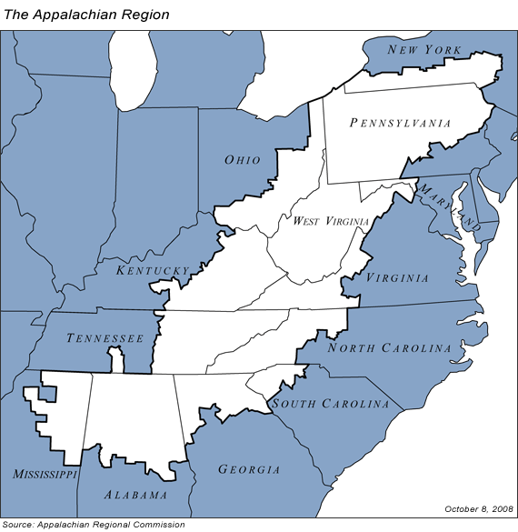
Area of Emphasis

Slide 24
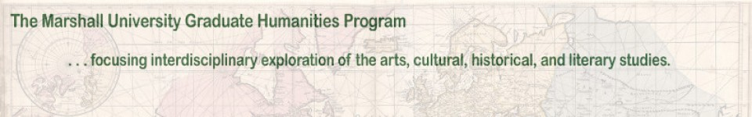
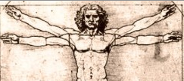
Humanities

Slide 25
Area of Emphasis
HUMN 600 - Introduction to the Humanities

Slide 26
Area of Emphasis
HUMN 600 - Introduction to the Humanities
Independent Study – Dr. Luke Eric Lassiter - Development of an annotated bibliography of Coal in Appalachia

Slide 27




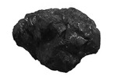



Coal in Appalachia
VERSUS

Slide 28

Coal in Appalachia
VERSUS

Slide 29
Area of Emphasis
HUMN 600 - Introduction to the Humanities
Independent Study – Dr. Luke Eric Lassiter - Development of an annotated bibliography of Coal in Appalachia
Independent Study – Prof. Al Cross, University of Kentucky’s Institute for Rural Journalism
  Presentations to Appalachian Studies Association & National Newspaper Association

Slide 30


Weekly Newspapers in Appalachia

Slide 31
Portfolio Items
SRCEA Paper Presentation
Revision of Organizational Analysis Course
Develop Higher Education Public Relations Course
Communications Plan for Doctoral Program

Slide 32

Southern Regional Council on Educational Administration

Slide 33
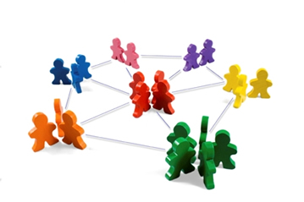
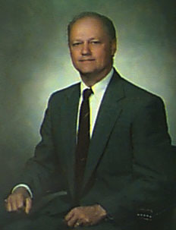
Organizational Analysis Course

Slide 34


Higher Education Public Relations Course - SOJMC

Slide 35
Commo Plan for Ed. D. Program

Slide 36

Commo Plan for Ed. D. Program

Slide 37

Commo Plan for Ed. D. Program

Slide 38
CONCLUSIONS

Slide 39
CONCLUSIONS
I am now well versed in higher education:
  Depth = Levels of culture
  Breadth = Scope of culture

Slide 40
CONCLUSIONS
I am now well versed in higher education:
  Depth = Levels of culture
  Breadth = Scope of culture
My work in Higher Education (and KCA) is improved through involvement in the doctoral program.

Slide 41
CONCLUSIONS
I am now well versed in higher education:
  Depth = Levels of culture
  Breadth = Scope of culture
My work in Higher Education (and KCA) is improved through involvement in the doctoral program.
I will never be fully prepared, but now know how to find the answers.

Slide 42
CONCLUSIONS
I am now well versed in higher education:
  Depth = Levels of culture
  Breadth = Scope of culture
My work in Higher Education (and KCA) is improved through involvement in the doctoral program.
I will never be fully prepared, but now know how to find the answers.
Higher Education is sort of a business.

Slide 43
CONCLUSIONS
I am now well versed in higher education:
  Depth = Levels of culture
  Breadth = Scope of culture
My work in Higher Education (and KCA) is improved through involvement in the doctoral program.
I will never be fully prepared, but now know how to find the answers.
Higher Education is sort of a business.
Education remains a highly political environment.

Slide 44
Horace Mann said…
“Education then, beyond all other devices of human origin, is the great equalizer of the conditions of men, the balance-wheel of the social machinery.“

Slide 45
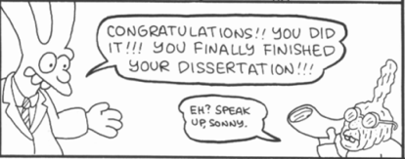
Morphing Into A Doctoral Student
Bill Bissett
Doctoral Student
College of Education & Professional Development
Marshall University
November 30, 2011

Slide 46
Morphing into a
Doctoral Student
Bill Bissett
Doctoral Student
College of Education & Professional Development
Marshall University
November 30, 2011

