Slide 1
Development of a Doctoral Student in Preparation for the Dissertation: A Program Logic Model
Frances Pack
Marshall University
Portfolio Presentation
Qualifying Assessment

Slide 2
“If you don’t know where you are going, how are you gonna’ know when you get there?” Yogi Berra
Request for Proposal
Planned Work
  Preparation for Research
  Public School Administration
  Theory and Leadership
  Area of Emphasis
  Portfolio Activities
Intended Results
  Outputs
  Outcomes
  Impact

Slide 3
Request for Proposal
Desire
Knowledge of personal strengths and challenges
Ignorance

Slide 4
Planned Work
Preparation for Research
  Survey Research in Education LS 711
    Considering for upcoming research
  Qualitative Research EDF 625
    IRB Approval
    Developed connections with foster parents

Slide 5

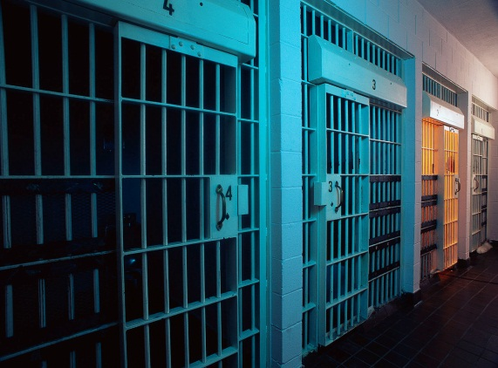
Planned Work
Public School Administration
  School Finance
  Superintendency

Slide 6

Planned Work
Theory and Leadership
  Personal Philosophy
    Ecological System Theory – Urie Bronfenbrenner

Slide 7
Planned Work
Leadership Style
  Servant Leadership – Robert Greenleaf

Slide 8

Planned Work
Area of Emphasis
  Special Education
    Learning from classmates
    Special Education Laws

Slide 9
Planned Work
Portfolio Activities
  Revision of the Attendance and Social Services Certification Program
  Curriculum Analysis Report
  Presentation to the Southern Regional Council on Educational Administration

Slide 10
Attendance and Social Services Certification Program Revision
“To live is to change; to live well is to have changed often”
Cardinal Newman
Reduction of required coursework.
Pre/post assessment
Realignment of coursework to curriculum standards

Slide 11

Curriculum Analysis Report
“I need to see you as soon as you get a chance”
Dr. Sue Hollandsworth
Ignorance
Stress
Improvement in the certification program
Developed a strategy for dealing with life’s uncertainties

Slide 12
Presentation to the Southern Regional Council for Education Administrators
Research on Homeless High School Students
Dissemination of research into a written document
Presentation to an audience of Education Administrators
SRCEA
11/4/11

Slide 13
Intended Results
Outputs
  Gained Knowledge of public school administration
  Identified a personal leadership style
  Developed a desire to work more collaboratively with outside agencies

Slide 14

Intended Results
Outcomes
  Role as an Ambassador

Slide 15
Intended Results
Impact
  “I counsel you then to be aware of your priceless gift of creativity. No matter how small and flickering a light it may seem to be at the time, cultivate it as a pearl beyond price. Whatever your competence in your chosen field turns out to be, and regardless of the size of the opportunities that may come your way in the foreseeable world, your imaginative capacity will measure the productive use of your strengths and opportunities.” (Greenleaf, 1998)

Slide 16
Thank you for helping me make this journey
  Dr. Michael Cunningham
  Committee Chair
  Dr. Teresa Eagle
  Committee Member
  Dr. Rebecca Goodwin
  Committee Member
  Dr. Michael Sullivan
  Committee Member

Slide 17
References
Greenleaf, R. (1998), The Power of Servant
Leadership. San Francisco, CA:
Berrett-Koehler Publishers, Inc.

