Slide 1
Portfolio Presentation Residency Requirements
John F. Yaun
Doctoral Student
College of Education & Professional Development
Marshall University
April 26, 2012

Slide 2
Overview
Welcome
Overview/Goals of Portfolio Plan
Portfolio Activities
Other Professional Development activities
Personal Framework
Wrap Up/Questions

Slide 3
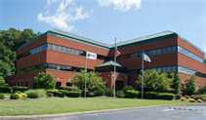
Committee Members –Thank You…
Dr. Mary Harris-John, Chair
Dr. Dennis M. Anderson
Dr. Michael A. Gilbert
Dr. Eric Lassiter

Slide 4
Goals of Portfolio Plan
Centered around several themes:
1. Research
2. Leadership Development
3. Teaching and Pedagogy
4. Curriculum and Course Development

Slide 5
Portfolio Activities
II. Scholarship
Co-authoring a proposal for submission and co-presenting at a national conference in
collaboration with a faculty member.
- Co-authored, co-presented Dr. Teresa Eagle.
- Conference Proposal/Research: What Do Students Do
with an Ed.D. after Graduation: A Case Study at Marshall University.
- SRCEA Conference in Savannah, GA (October, 2010).
- Research tasks: identify survey group; develop questionnaire; gather
and analyze data; create summary of findings; and present
research at conference.

Slide 6
Portfolio Activities (ct’d)
III. Other Professional/Academic Pursuits
A. Co-teaching a Course with a Faculty Member.
- Spring 2011
- Dr. Mary Harris-John
- Co-taught LS 679 - Problem Report
- Tasks: review submissions from course participants and
provide feedback on submitted work via Blackboard;
communicated with Dr. Harris-John on my activities and
contact with students.
LS 697
Problem Report

Slide 7
Portfolio Activities (ct’d)
III. Other Professional/Academic Pursuits
C. Develop a Course in Conjunction with a Faculty Member.
- Spring 2011
- Dr. Dennis M. Anderson
- LS 615: Leadership in the Public Sector
- Tasks included researching articles and textbooks for
materials and readings related to course theme; researching
potential textbooks; creating a syllabus and activities for the
syllabus; reviewing course with Dr. Anderson, etc.
LS 615
Leadership in the Public Sector

Slide 8
Other Professional Development activities from 2009-12
Panel Discussion at Fall 2011 Doctoral Seminar
Taught several courses at Marshall:
- African Political Systems (Spring 2012)
- Comparative Genocide (Spring 2011)
- University 101 (Fall 2011)
- Understanding the Holocaust (Fall 2010)
- Politics of American Government (Spring 2010)
Conferences Attended:
- Living Learning Conference (2009)
- NASPA (2011, 2010, 2012)
- ACUHO-I (2009-2011)
- SRCEA (2010)

Slide 9
Other Professional Development activities from 2009-12
National Organization Committee Invovlement:
- NASPA Program Review Committee, 2010;
- SAPAA Communications Committee, 2010;
- ACUHO-I Planning Committee: Review Coordinator for “Academic
Initiatives & Partnerships” and “Sustainability” committees, 2009-2011
Co-editor, SYNERGY Magazine (NASPA), 2011-12
Articles/Publications
- ‘Career Services: What Housing and Residence Life Programs Can
Do To Support This Goal, 2011 SYNERGY Magazine, Fall 2010
- ‘Social Media in LLCs.’ SYNERGY Magazine, NASPA, February 2011
- ‘Sustainable Living at Marshall University.’ COLLEGE Planning
Magazine, October 2010

Slide 10
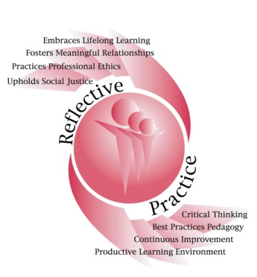
Personal Framework – Reflective…
Embrace Lifelong Learning
Foster Meaningful Relationships
Practice Professional Ethics
Uphold Social Justice
Utilize Best Practices
Continuous Improvement
Productive Learning Environments
Lead a Life of Purpose

Slide 11
Conclusions
What I know now that I didn’t know three years ago:
- Conducting quantitative and qualitative research;
- Developing online courses;
- IRB process;
- Importance of committee’s guidance and support;
- Importance of collaboration with peers and faculty;
- Knowledge of educational theory, higher education law, research methods,
statistical methods; higher education finance;
- Writing, research, and critical thinking skills have all improved through involvement in
the Ed.D. program at Marshall.

Slide 12
Next Steps
Dissertation Proposal;
Potential Dissertation Topic: Student Retention and Community Colleges - the Effects of Living on Campus on Student Retention at Public, Two -Year Community Colleges;
Summer 2012: LS 797 with Dr. Harris-John;
Articles for publication for Fall 2012 through ACUHO-I on 1) best practices in public-private partnerships and 2) university retention practices to peer-reviewed/refereed journal.

Slide 13
References
Residency Requirements. Marshall University
Graduate Catalog. (2009). Retrieved from
http://marshall.edu/catalo/Gradaute/F2009/gr_fa09_
published.pdf

Slide 14
Thank You…
Questions?

