Slide 1
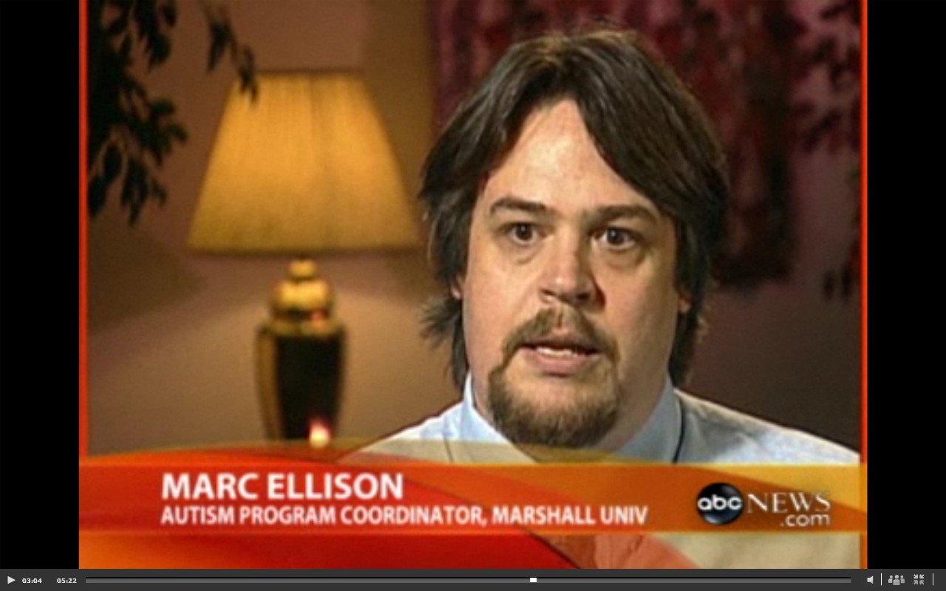
Transformation: My Lifelong Journey Toward Becoming a Leader in Education

Slide 2
The Undergraduate “If isolation tempers the strong, it is the stumbling block of the uncertain” ~ Paul Cezanne
Slightly above-average HS student from rural, central WV
Leadership potential
Largest distance traveled through senior year: Mountaineer’s Boy’s State in Jane Lew, WV
First generation college student, went to college to be with girlfriend
Struggled with coursework. No direction, poorly motivated, no academic or emotional support
Changed undergrad major three times in three years
Attempted 181 credit hours, earned 154, and graduate with a 2.59 GPA

Slide 3
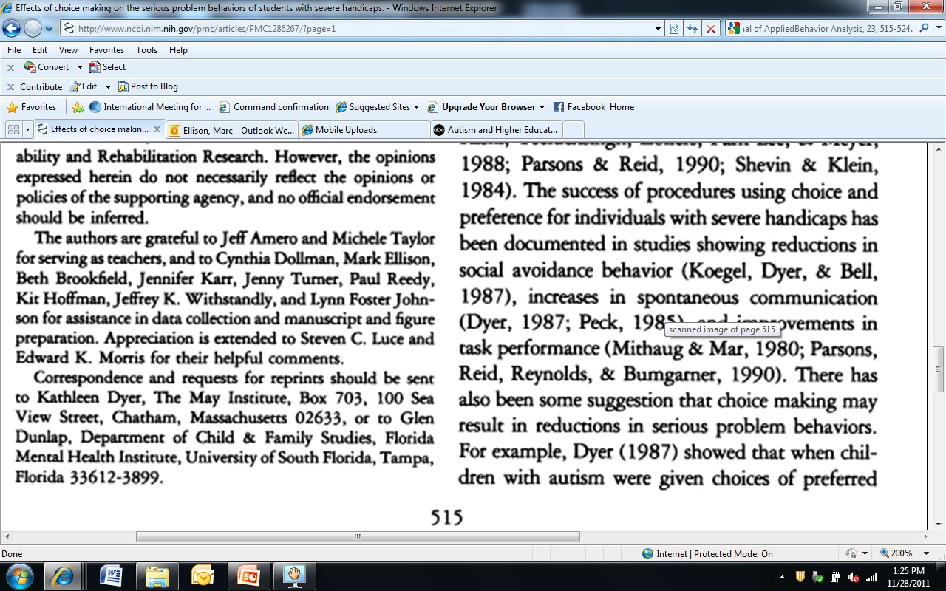
"A mentor is someone who sees more talent and ability within you than you see in yourself, and helps bring it out of you." ~ Bob Proctor
Dyer, K., Dunlap, G., & Winterling, V. (1990). The effects of choice-making on the serious problem behaviors of students with developmental disabilities. Journal of Applied
Behavior Analysis, 23, 515-524.

Slide 4
The Clinician “Suspecting and knowing are not the same” ~ Rick Riordan
Long career in behavioral health, developing and supervising community-based programs for individuals with autism
Completed 48-hour M.A. in Counseling in less than two years, with 3.93 GPA
Created department that delivered more than110,000 direct service hours annually to clients, and helped grow agency to more than 500 clients and 400 employees
Collaborated with WV Autism Training Center on various projects
Held long-term dream of one day becoming an administrator at the WV ATC
Certain my lack of research skills and understanding of university infrastructure would prohibit that dream from being fulfilled

Slide 5
In 2006, hired by WV ATC coordinate the first university-based program in country to provide specialized supports to college students with Asperger’s Disorder
Good fit for my clinical skills, and my personal college experience
Program grew 600% in three years. 95% of students supported graduated or on track to graduate
Began speaking on topic nationally, consulting with institutions like University of Alabama, Virginia Commonwealth, Western Kentucky, Bowling Green, Nova University, Baylor, Cal Poly, several community colleges
Our work noticed by ABC News, USA Today, and several regional media outlets
Regularly asked to contribute research on topic, and write on effective supports. Unsure and insecure about how to do either
Investigated MU’s Educational Leadership program, found an emphasis on research and on college administration, and thought it a good fit for my needs. Applied and accepted in Fall, 2008.

Slide 6
The Educational Leader “It’s what you learn after you know it all that counts.” ~ Harry S. Truman
Encouraging Faculty
Emphases on community

Slide 7
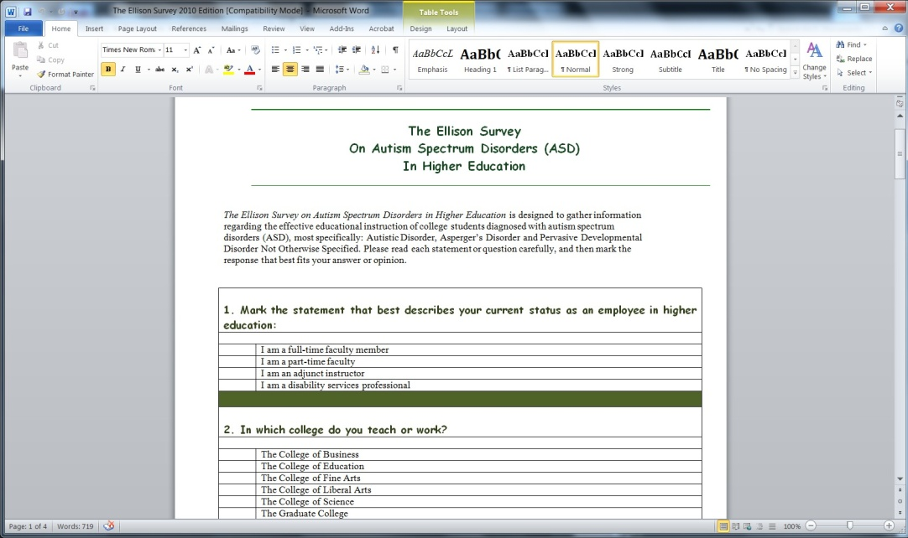
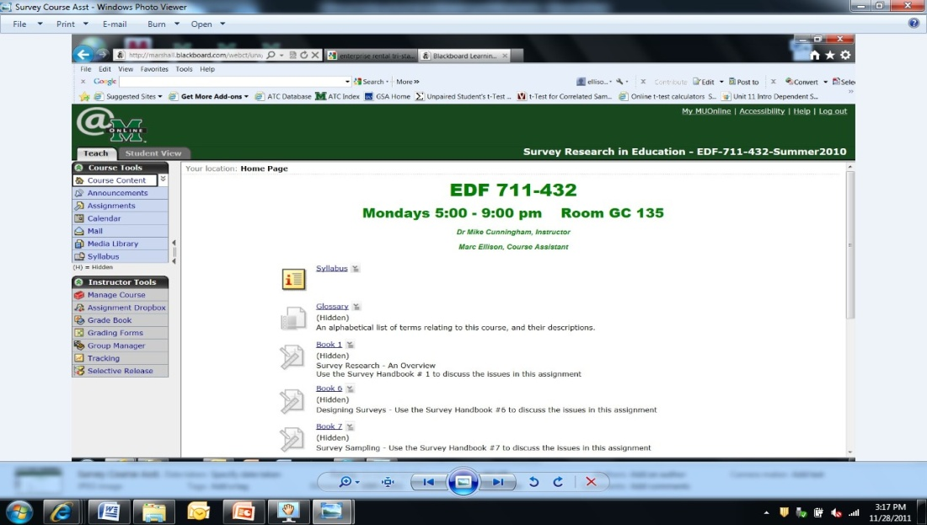
Skill-Building Projects
Scholarly Opportunities

Slide 8
Opportunity to Question and Test Presumptions
From IRB-Approved EDF 627 study:
“Describing how he adjusted his pedagogy to teach the student who, because of his disability, had difficulty understanding abstract concepts, Mr. Alves said:
“There was also another time I couldn’t get him to understand concept of the dynamics of the piece, of increasing and decreasing the volume of what he was playing. It didn’t seem to make sense to him. And I understand that, you guys told me, how difficult sometimes it is for him to do abstractions, but I took a risk and brought him outside the music office. I got some rocks, and I told him “we are just going to throw rocks.” And we threw rocks toward the sky, and as they went down I said “Do you see how that goes up, then down like that?” He answered “yes,” and started to relax. When we went back to the studio I said “You are going to now play this phrase, and I want you to do with the phrase the same thing you did with the rock. Imagine that the last note of the scale is going to be at the top there, and the final note of the scale is going to be on the bottom. And immediately he was able to respond to that information. From that point on he was able to play that piece without a problem.”

Slide 9
The Journey Pays Off (Even while the transformation continues)

Slide 10
Important Lessons From The Journey
“Life-long learner” is a term that should be embraced. It is not a term of dishonor. It suggests I’m continuing to improve and grow, and through that better affect the lives of those I support and help educate
Knowing what questions to ask – and how to ask them – may be more important than knowing the answers
Never, under any circumstances, confuse the definition of “sex” with “gender”
The politics of higher education is brutal, and regularly takes priority over the education of students
From my Learning Journal for LS 707:
“King, Jr. writes of the need to get outside one’s comfort zone in order to connect with others and, hopefully, participate in the creation of change. Change for civil rights, change in human relations, change in intellectual thought—it matters less what type of change one is generating, and more that one is actively participating as an agent of change.
Finding the courage to facilitate change can be difficult, especially [when]action might be costly. Sometimes, however, one must step outside their comfort zone and participate, simply because it’s the right thing to do.”

