Slide 1
Literacy, knowledge, and growth: The recursive nature of writing, learning, and life
Stacey Murrell, M.A., M.A.T
Marshall University
Graduate College
Doctoral Committee Members:
Chair: Dr. William (Fred) Pauley
Dr. Terence Stange
Dr. Lisa Heaton
Dr. Vaughn Rhudy

Slide 2
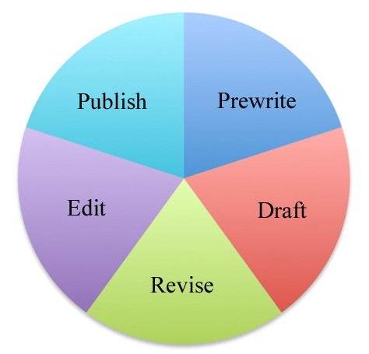
The Process of Writing: The Process of Learning and Life
The key concept in writing is that the process of writing relies on the writer making transitions among the five stages with only the goal of a well-crafted document in mind. (Murrell, 2012, p. 1)

Slide 3
Writing and Revising
“In their thinking and writing, writers ‘go back’ in order to push thought forward.” (McCuen-Metherall and Winkler, 2010, p.26)

Slide 4
Revisions/Reflections
It’s never too late-in fiction or in life- to revise. (Nancy Thayer)
Changes/shifts
Woman to Mother
Teacher to Coordinator
Paper to Technology
Constructivist to Mixture
Curriculum to Assessment
Qualitative to Quantitative
Inside Classroom to State Perspective

Slide 5
Collaboration
Co-teaching CIEC 534 Application Software in the Classroom Curriculum Area
EDF 711 Survey Research in Education. The survey was for RESA VI 2010 Summer Math Professional Development Institute
West Virginia Reading Association Conference November 18-19, 2010 at the Greenbrier Hotel in White Sulphur Springs, WV

Slide 6
Depth of Understanding
CI 677 Writing for Publication
Writing autobiography
CI 702 Curriculum Theories
Autobiographical theory
Postmodern theory
CI 703 Theories, Models and Research of Teaching
Personal theory of learning
CIRG 614 Engaging Intermediate and Middle School Learners with Writing and Reading
Multi-genre research literacy project
Multimodality and Technology
Notes:
Writing autobiography- Unlocking the Secrets of My Diary: The Chronicles of My Writing in the Past, Present, and Future “Whether it is a poem, a story, an autobiographical account, a Feminist research paper, or a scholarly article published in an academic journal, writing will always be the quiet place where I can escape to unlock the secrets I hold.”
Autobiographical theory- The individual is the key element as she explores reality through writing, reflecting, and sharing her autobiographical experiences.
Postmodern theory- According to postmodernism curriculum theory, individuals must learn to navigate and find meaning in an oftentimes meaningless world.
Personal theory of learning- Behaviorism, Humanism, and Constructivism
Behaviorism- B.F. Skinner and behavior modification, negative and positive reinforcement
Humanism- Maslow- goal oriented, hierarchy of needs (physiological, safety, belonging, esteem, and self-actualization)
Constructivism- Vygotsky- social interaction, society shapes individual’s meaning, learning can be strengthened through peer learning experiences
Multi-genre research literacy project- I implemented this learning theory into my classroom as I created a project-based learning experience that students would produce instead of taking a traditional final exam.
Multimodality and Technology- Multimodal literacy is defined as “the meaning-making that occurs at different levels through the reading, viewing, understanding, responding to, producing and interacting with multimodal texts and multimodal communication” (Walsh, 2008 , pg. 106). 12

Slide 7
Scholarship
Impact of web-authoring tools on literacy and learning in the K-8 Classroom- ED-MEDIA June 29, 2010 Conference in Toronto, Canada
Literacy in multimedia environments: Preliminary findings- Society for Information Technology and Teacher Education (SITE) Conference 2011 March 7-11, 2011
Received a SITE outstanding paper award
Adolescent blogging practices and the new literacies which is currently being considered for publication in the Journal of Computer Assisted Learning.

Slide 8
Research
LS 703 Research Design
EDF 711 Survey Research in Education
CIRG 702 Composing using Multimodal Texts
CIEC 700 Technology and Curriculum
Notes:
LS 703 Research Design- African American Appalachian Students and AP Courses
EDF 711 Survey Research in Education- By creating my own individual survey, I was given the opportunity to break down my misconceptions of these instruments.
CIRG 702 Composing using Multimodal Texts- Considering the theories of multimodality and digital literacy, three research questions were formed.
1. What role does customization play in multimedia multimodal composition?
2. What patterns of interaction occur in multimedia multimodal composition?
3. What do students’ perceptions on e-learning indicate about their learning experience relate to multimedia multimodality?
CIEC 700 Technology and Curriculum- Schools need to change their curriculum to stay updated with the new technology, and cell phones are here to stay.

Slide 9
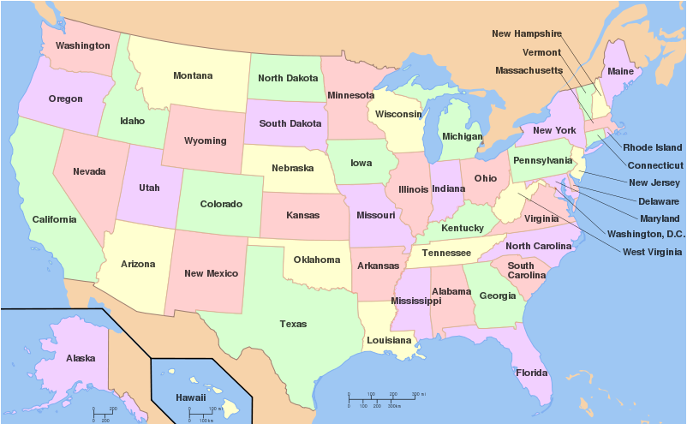
Theory and Life Blur
Notes:
FAST SCASS- Popham and Heritage
WESTEST 2 Planning Meetings
WV Writes Meetings
NAEP National Assessment of Educational Progress

Slide 10
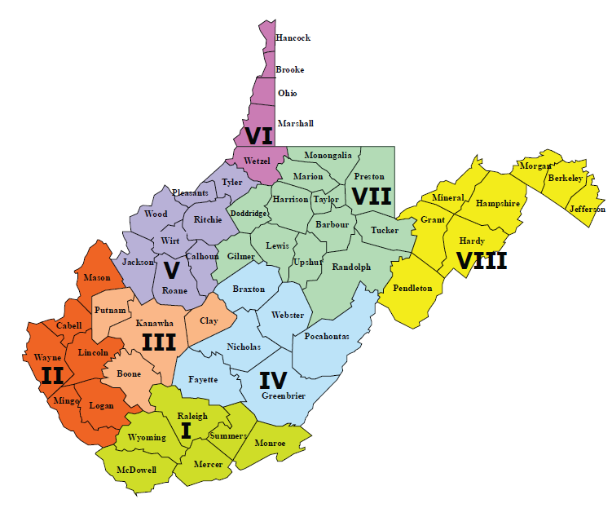
Notes:
WV Writes trainings
ELA NxG and CC alignment to WV extended learning standards
CTE pilot and CTE conferences
WESTEST 2 monitoring
Office of Optional Educational Pathways conference and school trainings
Alignment and formatting of NxG ELA standards
TLI
Textbook alignment
Acuity RLA alignment
WESTEST 2 Online Writing Comparability Study

Slide 11
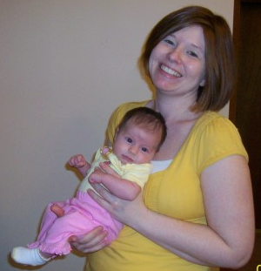
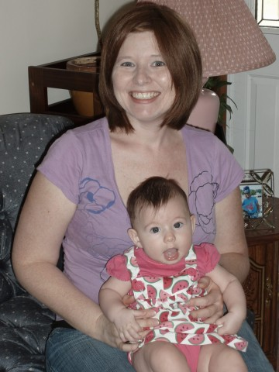
Notes:
In phenomenological theory, the secret place is a special place that individuals retreat to in order to escape the stresses of life or to enjoy a private time of solitude (Murrell, 2012, pg. 18).
Experiencing my new life as a coordinator each day and returning home to share in the joys of watching my daughter grow from an infant to a toddler became my secret place of peace, happiness, and contentment (Murrell, 2012, pg. 18).
Larry’s advice

Slide 12
The Future
Dissertation
Quantitative
Common Core standards
Smarter Balanced Assessment
Technology/Online Assessment
Kindergarten

