Slide 1
Portfolio Presentation by Jake Bolen

Slide 2
Welcome
Dr. Meisel, Committee Chair
Dr. Childress, Committee Member
Dr. Heaton, Committee Member
Dr. Skoretz, Committee Member

Slide 3
Start where you are. Use what you have. Do what you can.
~Arthur Ashe
Notes:
Discuss all three sentences.

Slide 4
Presentation Organization
Academic and Professional Goals
Depth of Knowledge
-- Curriculum & Instruction
-- Technology (Area of Emphasis)
Collaboration
Scholarship
Research
Where from here?
Notes:
Read the slide.

Slide 5
Academic and Professional Goals
Better understanding of curriculum and instruction
Further career
Apply technology to courses
Notes:
Better understanding of C&I will help enhance my current knowledge and apply it to the courses I teach.
Move from adjunct into full-time faculty position. Use research to help make advancements in the field of education.
Move the NRRM program into the present by applying technology to courses. Help students start to use and understand technology and apply it to their own work.

Slide 6
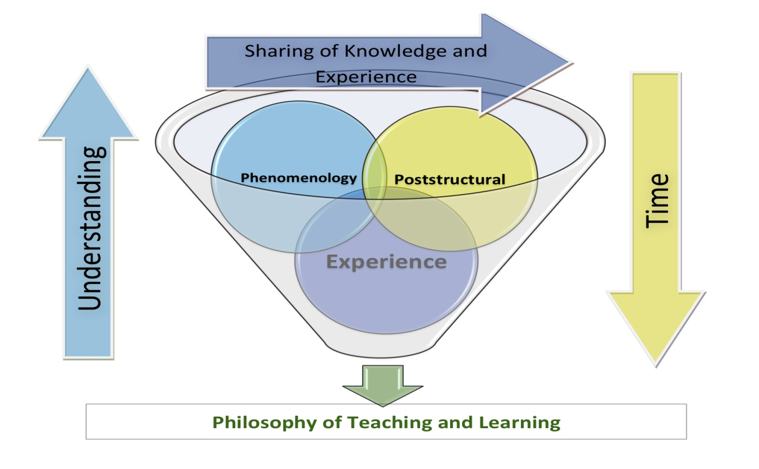
Depth of Knowledge
Curriculum is ever changing
Philosophy of teaching
Notes:
As my understanding of C&I goes up the amount of time I have to share it with others goes down. During that time it is important to apply my understanding of phenomenology, poststructuralism, and personal experience to the classes that I teach and the research that I am involved with.
Peter McLaren
Madeleine Grumet
She approaches education with a strong critical thinking component
Used journaling as a means to teach educators how to better understand their educational roles.
Teachers need to build experiences to help students make connections.
Educators need to collaborate to learn more about the educational system.
Educators need to collaborate liberal arts with the sciences to help students to make connections.
Teachers and students need to build relationships, collaborate, and share ideas.

Slide 7
Collaboration
Community of Practice (Work with others to reach desired goals)
SRCEA (Using a Theory-Based Model for Professional Development: Implementing National Common Core Curriculum)
EdMedia Conference (Exploring the Application of Gaming and Gaming Principles in Education)
NCATE
Notes:
Describe community of practice as - through the process of sharing information and experiences with the group that the members learn from each other, and have an opportunity to develop themselves personally and professionally.
Describe the writing process, the editing process, working with others, and meeting deadlines.
Working with Dr. Heaton and the group to come up with a cohesive presentation from several individual projects.
Working with a group with the specific goal of passing the accreditation process.
Talk about the process of keeping electronic data organized.
Better understanding of APA manual due to NCATE and style guide.
Discuss how I can apply NCATE experience to future work.

Slide 8
Scholarship
Co-teaching an online course (CIEC 534)
Software applications
SRCEA presentation
Quantitative
Qualitative
Notes:
Discuss working with Dr. Heaton to anticipate problems and resolve them in order to enhance learning.
Better understanding of software and the applications (Microsoft programs and Blackboard). To truly understand something one should teach it to others.
Using both the quantitative and qualitative data allowed us to paint a picture of how the training and trainers did presenting the information.

Slide 9
Research
Improving Teacher Quality survey (EDF 711)
Qualitative research opportunities
Interview for multicultural class (CI 706)
Interview to understand freshmen study habits (EDF 625)
Studying how video games enhance the learning process (CIEC 700)
Notes:
Processing the data and building tables that had the pertinent information made me look at what others have done with their own research and use that to report ours.
Interview to better understand the difference of education in cultures
Interviewed four freshmen to try to gain a better understanding of their study habits and history from public education.
Playing an online game to look at online learning communities and how the learning process aligned with James Paul Gee’s Learning Principles.

Slide 10
Survey Research
Designing study skills survey (EDF 711)
Longitudinal study of incoming freshmen (41 quantitative questions)
Comparison of two groups over time
Software analysis
Importance of retention
Presentation of data collected
Notes:
Working with the class and Dr. Childress helped me to understand better how others might view the questions as well as helping to get the most information possible from a two page survey.

Slide 11
Application/Where From Here?
Long-term research
Publication of two papers
Professional report writing
Teaching experiences
Background in research (qualitative & quantitative)
Data analysis
Presentations
~ Start where you are. Use what you have. Do what you can.

Slide 12
Sincere thanks go to:
Dr. Meisel
Dr. Childress
Dr. Heaton
Dr. Skoretz

