Slide 1
Education: Reflections on a Long-term Investment
“An investment in knowledge always pays the best percentage of interest.”
Fred B. Barker
Melissa Rhodes
Portfolio Qualifying Assessment
Marshall University
January 22, 2013
Notes:
Papaw and his words of wisdom – explain encyclopedias, messages,
This was the first message he wrote, how did he know the path I would take?
Learning is a lifelong process

Slide 2
Goals
“Pleasure soon exhausts itself and us also, but endeavor never dies.”
Fred B. Barker
As a teacher educator I will:
Make a difference
Increase understanding
Facilitate positive change
Notes:
Cleo Cherryholmes ( Post-Structuralist Curriculum Theorist) describes the process of curriculum development as naturally full of conflict and unstable. The educational journey that led me to enroll in the doctoral program has also been full of conflict and instability where I continually constructed, deconstructed and reconstructed my own ideas about who I wanted to be and what I wanted to do.
>My band director, Mr. Jarrett made a difference in my life and inspired me.
My main goal is to become a teacher educator in order to inspire others as he inspired me.
I want to offer education and support to teachers, help them understand the types of challenges they will face, understand that they have the power to make a difference in students’ lives, and help them gain education and experience that will help them facilitate positive change.

Slide 3
Collaboration
“Carve your name on hearts, not marble.”
Fred B. Barker
Marshall University Doctoral Student/Faculty Seminar
Committee member
Co-chair
Chairperson
LS 719
Southern Regional Council on Educational Administration (SRCEA) 2011 St. Louis, MO
Collaborated on research, writing, presenting and publishing
Contacted by other presenters regarding our research
Notes:
Collaboration has been one of the most rewarding aspects of the time I have spent in the doctoral program.
Seminar
Role as chairperson gave me the opportunity to put Robert K. Greenleaf's theory of Servant Leadership into practice.
Servant leaders: use position to serve others, make meeting others needs a priority, consistent, don’t’ draw attention to themselves, true to their word, dedicated to the cause, work to build trust and positive relationships, practice accountability.
I try to emulate these qualities when engaged in any collaborative activity.
SRCEA
Collaborated to research, present and write an article for publication.
How I have changed:
Used to dislike collaboration
Now I enjoy it and realize its value.
Multiple people with multiple ideas can combine their efforts to make a greater contribution than one person alone.
I will use what I have learned about collaboration to help me:
Continue to collaborate with faculty and peers
Initiate collaborative experiences with my students and help them learn to work together and learn from and value each others contributions.

Slide 4
Depth of Understanding
“Faith is a vision of the heart. It sees ‘God’ in the dark as in the day.”
Fred B. Barker
Curriculum – what students are taught and not taught, on purpose and on accident and is not limited to academic content. Curriculum and instruction are intertwined and one cannot function without the other.
Notes:
This is my personal definition of curriculum, what the term means to me when I look at it through my own personal lens.
My depth of understanding regarding curriculum and instruction has greatly increased as result of my experiences in the doctoral program.
Each of us view life through different lenses. How we see things depends on many factors, including our education and lived experiences.

Slide 5
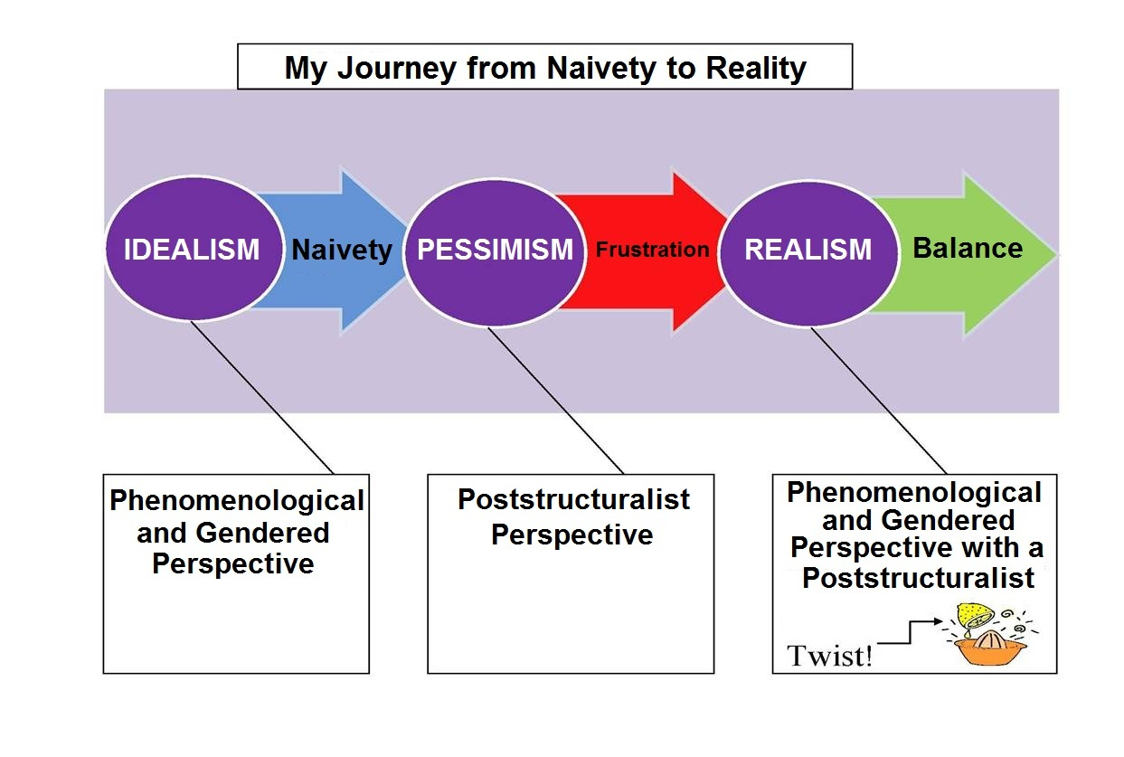
Personal Philosophy of Curriculum
Notes:
Phenomenology – the study of meaning. Aoki states that the rules for understanding meaning are constructed by those who actively dwell within the situation. The individuals lived experiences within a context and the meaning they draw from those experiences.
Teachers need to invest themselves in their students’ lives by learning about their lived experiences he or she can develop an understanding of how those individual experiences affect the manner in which students learn and use them to create meaning an build a bridge between new and prior knowledge.
Van Manen calls for pedagogical thoughtfulness, tact, mindful skills and flexibility. Understand that the lens students see through based on their lived experiences affects their learning!
Gender
Nel Noddings – foster authentic caring relationships with students and teach them social responsibility
Honor all professions and all representations of gender and diversity.
In my classroom hear all voices equally, build a culture of caring and tradition where students can work collaboratively with me and each other in order to reach a point of positive self-expression through the arts.
Poststructuralism
The positive side of poststructuralist tradition is embodied by the work of theorists like Cherryholmes, Lather, Doll and McLaren. Respect for diversity, hearing all voices and empowerment through education and student/student and student/teacher collaboration.
Providing students with an education that combines these factors can help empower students to rise above their circumstances (in our state, the cycle of poverty, etc.)

Slide 6
Area of Emphasis and the Curriculum
Technology and Curriculum
Poverty and the Digital Divide
What Video Games Have to Teach Us About Learning and Literacy
Online Course Development
Create and manage content in online courses
Response Systems for Educators
Final Project in Educational Computing
Portaportal
Notes:
Why I chose my AOE in Educational Computing
I wanted to learn something new! Technology was an area I was very interested in but knew the least about.
Poverty and the Digital divide –
gave me the opportunity to research the literature available on the topic -real eye opener, helped me get a better grasp of why integrating technology into rural WV schools can be so difficult, I was able to relate what I learned to the demographics of the students I had taught, in K-12 as well as GED courses.
We often take access to the internet and technology for granted, when so many of the people around us have limited or no access at all!
Video Games, Learning and Literacy
James Paul Gee’s book, What Video Games Have To Teach Us About Learning and Literacy
Qualitative research opportunity – Explain the project – read, formulated interview questions, conducted interview and then wrote a paper with my findings
changed my point of view about video games and how they can be used to supplement and enhance the educational process.
BIG STEP in my personal development as an educator and how I viewed and used various technologies.
Online course development
Learned how to design courses using Blackboard, I teach 2 online courses and being able to create and manage the content within these courses is important.
This opportunity increased my knowledge of technology, and made me a better designer and teacher in the online format.
Response systems for educators – created in collaboration with Jake Bolen under the direction of Dr. Heaton – helped me come to a better understanding of how response sysemtes can be used to increase student engagement as well as gave me an opportunity to share this information with other educators.
Final Project in Ed. Computing
Explain the project and talk about how I used Portaportal as well as recommended it to other doc students
In closing- I truly feel I am more competent in the area of Technology and Educational computing as a result of my coursework and experiences in the doc program.
Instead of being intimidated by technology as I was when I began, I now find it exciting and embrace the opportunity to learn more about it any time I can.
This is a personal as well as a professional breakthrough!

Slide 7
Scholarship
“Purposes, like eggs, unless they be hatched into action, will run into decay.”
Fred B. Barker
Publications and Presentations
SRCEA
EdMedia International 2012
Co-teaching
CI 560 Family Involvement in Education
CIEC 534 Application Software in the Classroom
Notes:
USE WHAT YOU KNOW!
My time in the doc program has not only allowed me to gain new knowledge but also provided ample opportunities to use and share that knowledge through presentations, written publications, teaching and course development.
SRCEA research paper and presentation in collaboration with Jake and Elbert- my first conference experience
I was able to collaborate with peers, publish a research article and present at a national conference
EdMedia International 2012 in Denver
Explain process to get to conference – how I helped organize what paper was about, etc….
What’s Up With the World of WarCraft – presented our research findings individually as part of a group presentation –session was full, great audience interaction and discussion
First international conference, first time on an airplane, taking public transportation in the city, and first time in a city as large as Denver
The program has given me the opportunities for many FIRSTS
One of my main goals is to teach at the college level
Co-teaching has helped make this goal a reality
Tell what the family involvement course was about
I liked interacting with teachers who were my students, able to relate to them and offer feedback due to my own K-12 experience
CIEC 534 – brush up on technology skills, teach and interact with teachers
Now co-teach a section with Elbert for last 4 semesters
Practicum in Middle Education – explain what I do for this and how much I love doing it!
The co-teaching and independent teaching experiences have prepared me to teach courses that are graduate level, teacher education and online,
I now know this is what I really want to do, I know I can be a successful teacher educator and use the technology available to facilitate learning, relate to my students
The scholarly activities of writing, presenting, teaching and course design have prepared me to complete my dissertation and reach my goal of being a teacher educator.

Slide 8
Research
“Good methodology will teach
you to win time.” Fred B. Barker
Qualitative
Does Age Matter? An investigation of the effects of age related factors on academic performance and successful graduate degree completion.
Growing up Bi-Racial in Rural West Virginia in the 1960’s and 1970’s
IRB Process
Quantitative
Using a Theory-Based Model for Professional Development: Implementing National Common Core Curriculum
Statistical Analysis
Advanced Quantitative Research
Maintain Database of student dispositional data
Notes:
I began with a limited research background.
Program has provided ample opportunities to conduct both qualitative and quantitative research.
Two projects from courses I took with Dr. Debela
Does Age Matter? Provided experience reviewing literature and planted the idea for my dissertation topic.
Growing up Bi-racial – formulated research questions, conducted an interview and find themes in my results,
MOST IMPORTANT – the IRB process Institutional Review Board –
SRCEA paper – design survey, analyze and interpret quantitative data in order to reach a conclusion, share the findings Statistical analysis – understand the basics of statistics learned how to use SPSS in order to analyze the data I collect during my research
Also use SPSS to maintain a database for student dispositional data for Dr. Childress
These research experiences have given me a strong foundation and prepared me for the research portion of the dissertation process!

Slide 9
Concluding Remarks
“Happiness is never perfect until it is shared.”
Fred B. Barker
No matter how far you go, never forget where you came from, someone is where you once were and it is your responsibility to guide them forward as others have guided you.
Notes:
When my papaw said when you change your name, remain the same he was referring to marriage, but I believe it can be looked at from an educational standpoint as well.
Never stop learning and always be willing to share your knowledge and experiences with others and the result will be happiness and fulfillment.
The experiences I have had thus far in the doctoral program have prepared me for the dissertation process
Collaboration
I have learned how to effectively collaborate with faculty and peers
Plan to Initiate collaborative experiences with my students and help them learn to work together and learn from and value each others contributions.
Development of my personal curriculum philosphy and a deeper understanding of curriculum and instruction overall that I can apply to my work and share with my students.
Scholarly activities including teaching, writing , presenting and publishing – prepared me for the defense and composition of the written document
Combination of qualitative and quantitative research experiences, including
Ability to review the literature
Write research questions
Design surveys and interview questions
Analyze and interpret data – prepared me with the skill set I need to complete the research portion of my dissertation
I feel confident in beginning the dissertation process and I am ready and excited to move forward to the next part of my educational journey

Slide 10
A Special Thank You to My Committee
Committee Chair, Lisa A. Heaton Ph.D.
Ronald B. Childress Ed.D.
Edna Meisel Ed.D
Yvonne Skoretz Ed.D

