Slide 1
Finding a New Pattern: My Program Reflection
Georgia N. Thornton
Portfolio Qualifying Assessment
Marshall University
April 17, 2013
Notes:
Discuss the purpose…the quilt analogy
The doctoral process is like making a complicated quilt

Slide 2
The Fabric: Coming to An Understanding
Discovering my learning style
Reflecting on my professional teaching practice
Identifying my personal learning theory
Notes:
Explain “coming to an understanding” dad’s words---not only listen and digest new information, but to use it and change my ways of thinking
Understanding learning theory—self discovery and reflection on my own learning
Realization that I taught the way I was taught—traditional behaviorist —and did not meet my students’ individual learning styles
Conference presentation ATE with two other doc students
I am Humanist and Constructivist--explain

Slide 3
Personal Teaching/Learning Theory
Learning Styles
Needs
Key Skills
Constructive Humanism
Prior Knowledge
Realistic Curriculum
Notes:
Constructive Humanism—Needs (social, emotional, physical, intellectual) much like middle school philosophy
Learning Styles—linguistic, spatial, logical, kinesthetic, musical, natural (Gardner’s Theory of Multiple Intelligences)
Prior Knowledge—activate student learning with something they already can relate to…must know your students well—relationship with students
Realistic curriculum—where will this information fit in their world
Key skills—basic and critical thinking
My theory—teacher is the guide, students use prior knowledge to build connections to new knowledge, engaging cooperative learning experience where problem solving and critical thinking skills combine with basic skills…use of authentic assessment
Background: Maslow (needs of whole child); Gardner (multiple intelligences); Rogers and Maslow (personal, student-centered); Piaget (meaning is created and understood by people on their own); Vygotsky (knowledge is stretched only to an extent that can be handled..not to the point of frustration)

Slide 4
The Fabric: Coming to An Understanding
Collaboration (ATE Orlando, FLA 2011)
  Dividing research, writing, and presenting tasks
  Staying objective
  Using appropriate professional experience during presentations
Communication (New Teacher Survey EDF 711)
  Developing the most appropriate questions for the audience
  Staying objective
  Using professional practice to inform a survey study
Research (EDF 625 and CI 706 Research Projects)
  Listening to the answers of questions to determine next questions
  Using an appropriate note-taking system for qualitative studies
  Communicating as a researcher
Notes:
Deeper understanding of collaboration with peers--conference working with peers on research, writing, and presenting on Humanism (ATE Orlando Florida 2011)
Deeper understanding of communication—working on asking the appropriate questions and keeping the audience in mind; not placing too much subjectivity into my work; use in professional practice to better understand an issue in my school (New Teacher Survey EDF 711)
Deeper understanding about Research—asking the RIGHT questions, IRB challenges, further communication as a researcher in interview process versus survey—talk briefly on both projects (interviewing a family member versus interviewing a stranger)

Slide 5
The Pattern: Reflecting on Purpose
Academic Reflection (Doctoral Class Assignments)
  Strengthened critical thinking skills
  Application of new knowledge
Professional Practice Reflection (Revising a Course Assignment)
  Analyzed a problem and developed a solution through collaboration
  Communicated professional knowledge for specific audience
Reflection During Research Process (ATE 2010, Chicago, IL)
  Deepened my understanding of instruction and education in WV
  Increased confidence in presentation skills
Notes:
Personal reflection was easy; did it as a child
Academic reflection—class assignments reflecting on readings (Dr. Simone’s class—Jalongo); reflecting on peer writings and personal writings after reading about style and technique (Dr. Simone’s CI 677); CIEC 700—personal and professional skills as well as readings
Reflecting on professional practice and academic reading to revise a course assignment with Dr. Meisel CI 623—she wanted to bring it to 21st Century knowledge and asked me to give some ideas on moving writing of objectives to student friendly I Can statements
Reflecting on professional practice and academic reading with Dr. Meyer to present to higher education professors—first time I presented my own ideas about a timely educational issue to an academic audience; opportunity to delve into WV instruction/education

Slide 6
The Sewing: Discovering Real Scholarship
“Scholarship is to be created not by compulsion, but by awakening a pure interest in knowledge” Ralph Waldo Emerson
Scholarship through Collaboration (SRCEA 2011 St. Louis, MO)
  Developed a research process
  Used research to inform professional practice
  Gained new insight and feedback from higher education community
Scholarship Through Writing (CI 677 Article for Publication)
  Gained editing skills
  Reflected critically on writing
  Learned publication process
Notes:
Personal definition: not simply gaining a deeper understanding of a subject, but being able to show that deeper, richer understanding in a way that informs the profession
Conference presentation around Common Core (curriculum focus) and how middle school principals are trained to help implement the curriculum shift; received ideas for possible further research from higher education faculty in attendance—wonderful conversation
Taking a professional experience and writing it for publication—editing skills, critical of own writing, process of publication and writing for a specific audience

Slide 7
The Sewing: Discovering Real Scholarship
Scholarship Through Research (CI 702 Line of Research; Personal Curriculum Theory)
  Persevere through difficult material
  Focus on one question
  Develop personal curriculum theory
Notes:
Scholarship began as a struggle but led to a deeper understanding and reflection on research which resulted in identification of personal curriculum theory
Reading/Struggle of Pinar
Began with the Line of Research—intense study of Patti Lather
A lesson in resiliency

Slide 8
Personal Curriculum Theory
Notes:
ADD MODEL and discuss personal curriculum theory

Slide 9
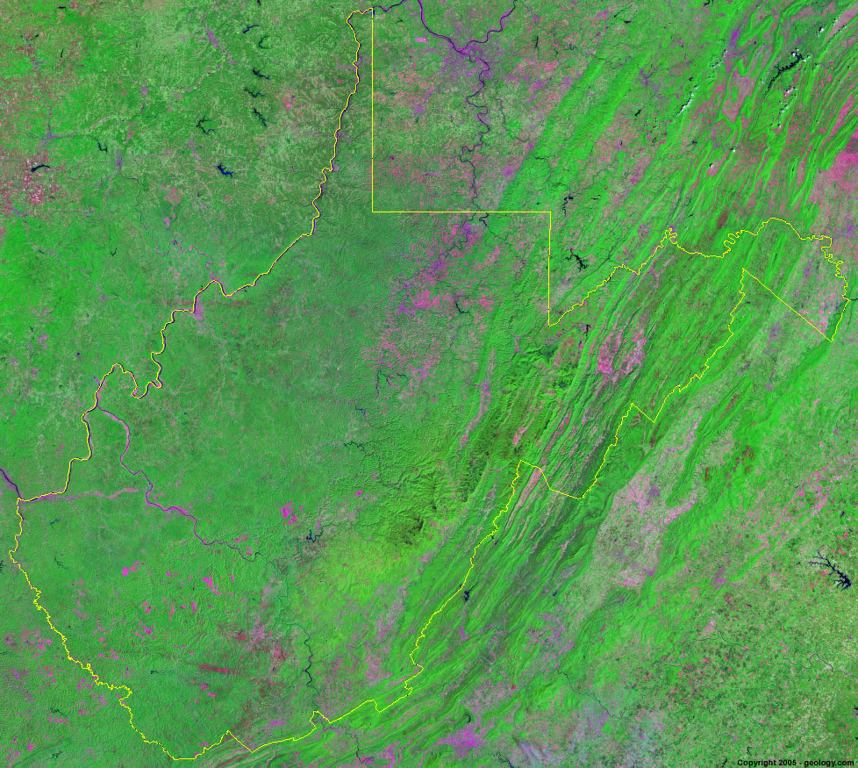
My Lens: Appalachian Woman
Poststructural
Phenomenological
Political
Change
Domination and Power
Multiple Voices
Media
Status Quo
Domination and Power
Hidden Curriculum
Lived Experiences
Safe Spaces
Language
Notes:
Main:Poststructural—element of change that needs to take place and rarely does; white male domination and power oppressing people especially gender, poverty, etc
Multiple voices need to be heard and it isn’t always just empirical data that is useful; media resistance to the images glorifying poverty, homophobia, homelessness, etc.
Secondary: Political—perpetuating status quo in schools (example: math and science get grants; standardized tests; accountability)
Domination and Power of government—NCLB, grant awards to math and science, common core standards—materials made by the people writing the smarter balanced assessment
Power of hidden curriculum and how teachers need to be very aware of this
Phenomenological—lived experiences—the individual experience and the individual voice
Safe spaces—classrooms should not be adult centered, but student centered; ok for students to have their own views and help with their education
Language—powerful in expression of that lived experience; teachers careful of the language with slogans, etc and educational jargon used in classrooms and schools

Slide 10
The Binding: Concluding the Process
Fabric of the Doctoral Program
Rich understanding of curriculum and transferring it to theory and practice
Pattern of the Doctoral Program
Process of reflection uniquely formed from the rich understanding and application
Sewing of the Doctoral Program
Opportunities for scholarship
Binding of the Doctoral Program
Dissertation
Notes:
Still have the frayed edges..will be complete once the dissertation is finished
The experiences I have had thus far in the doctoral program have prepared me for the dissertation process
Recap: foundation of fabric of doctoral program—rich understanding of curriculum and transferring to practice—which have prepared me for the skill set I need to complete the dissertation process
Developing a process for reflection—the pattern of the program uniquely formed from the fabric
Sewing: opportunities for real scholarship
Dissertation completes the process

Slide 11
Next Steps
Continue reading and investigate a possible topic relating to how middle school principals are prepared to implement the Common Core State Standards (CCSS) in their schools
Investigate how WV principals are trained on implementation of the CCSS in WV schools
Consider ideas for recommendations that evolved from SCREA conference presentation
Notes:
Having the experiences of the doctoral program in research, thinking, reflecting, collaborating, creating, and writing, I feel confident that I am ready to begin the dissertation and I am thrilled to begin the process.

Slide 12
A Special Thank You to My Committee
Committee Chair, Ronald B. Childress Ed.D.
Sandra Bailey Ed.D.
Edna Meisel Ed.D
H. Jeffrey Smith Ed.D

