Slide 1
Stephanie A. Clapham
All The World is a Stage:
The Leader as a Director
A Residency Portfolio Reflection
Marshall University Graduate College

Slide 2
Committee Members
Dr. Michael Galbraith, Chair
Dr. Michael Cunningham
Dr. Nega Debela
Dr. Lewis Watts

Slide 3
“”All the world's a stage,
And all the men and women merely players;
They have their exits and their entrances,
And one man in his time plays many parts.”
-William Shakespeare

Slide 4
Overview
₁
Introduction: A leader as a director
₂
Personal & Theoretical Background
₃
Portfolio Process: Scholarship, Professional, Research
₄
Concluding Reflections

Slide 5
Perfecting
the Script
Casting the Actors
A School Leader as a Director
Enter the
Editing Room
Meet the Media & Accepting the Oscar

Slide 6
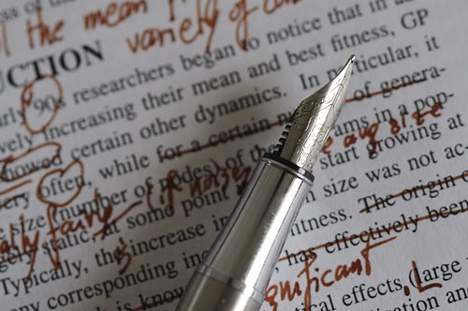
Perfecting the Script
Envisioning a final product
Determining specific goals
Setting a path to meet the goals

Slide 7

Finding the Perfect Cast
Finding the best people for the job
Determining how to build upon their strengths
Serving as motivational force

Slide 8
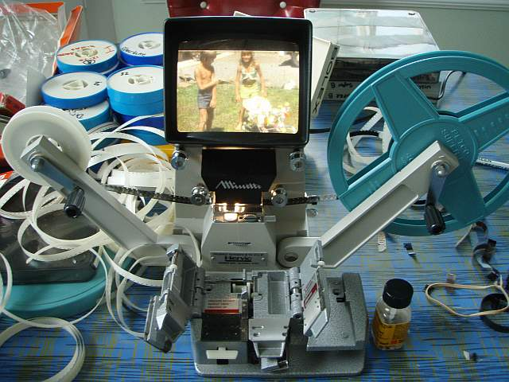
Enter the Editing Room
Meeting with followers to assess progress
Continually revisiting goals and making adjustments to meet the needs of the organization
Reflecting on personal bests and areas in need of attention

Slide 9
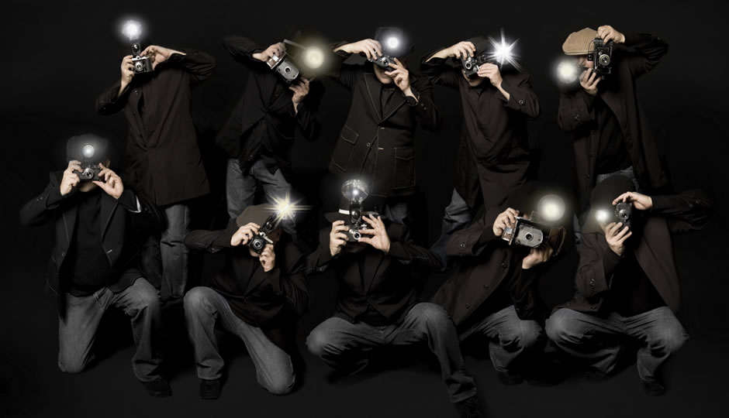
Making the Most of the Media
Use the media to inform others of your goals and initiatives
Draw upon outside sources to enrich the diversity of your organization

Slide 10
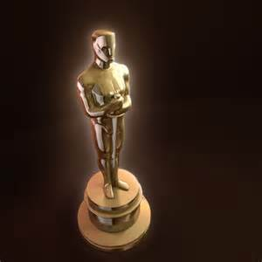
Accepting the “Oscar”
Celebrate success
Recognize individual accomplishments

Slide 11


Educational Background
  Bachelor’s Degree in Elementary Education
    West Virginia State University
  Master’s Degree in Literacy Education
  Marshall University
  Administrative Certification
    Marshall University

Slide 12
Professional Background
Title I Reading Specialist
  Logan County Schools 1994-2009
Adjunct Instructor: Literacy Education
  Marshall University Graduate College
  2008-Present
Assistant Principal
  Chapmanville Middle School 2009-Present

Slide 13
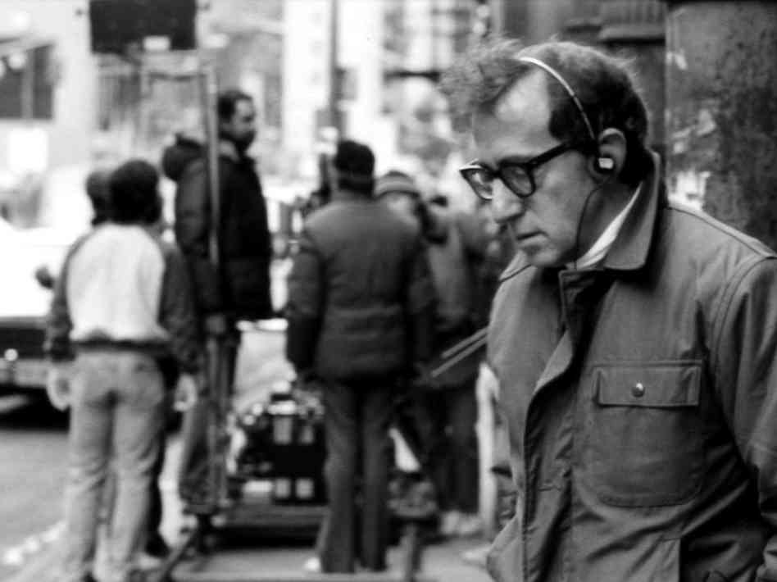
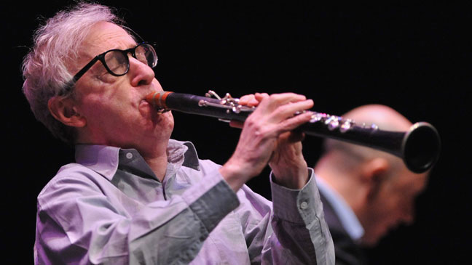
Transformational/Charismatic Leadership
-Bass (1985)
Idealized Influence (II) - the leader serves as an ideal role model for followers; the leader "walks the talk," and is admired for this.

Slide 14
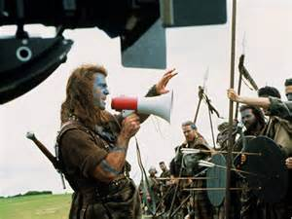
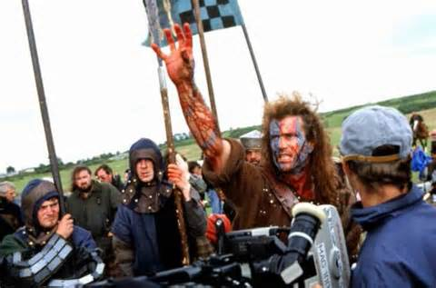
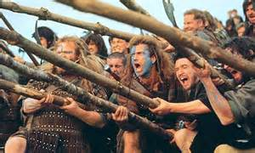
Transformational/Charismatic Leadership
-Bass (1985)
Inspirational Motivation (IM) - Transformational leaders have the ability to inspire and motivate followers.

Slide 15
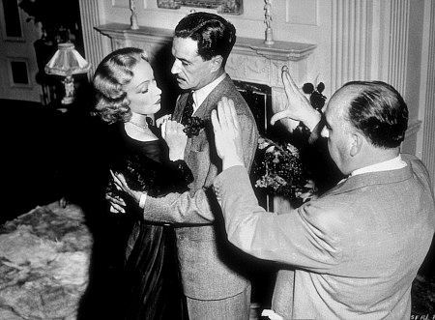
Transformational/Charismatic Leadership
-Bass (1985)
Individualized Consideration (IC) - Transformational leaders demonstrate genuine concern for the needs and feelings of followers. This personal attention to each follower is a key element in bringing out their very best efforts.

Slide 16
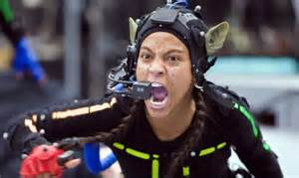

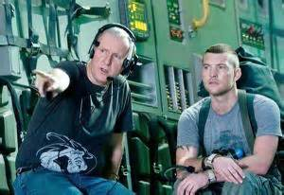
Transformational/Charismatic Leadership
-Bass (1985)
Intellectual Stimulation (IS) - the leader challenges followers to be innovative and creative.

Slide 17
Portfolio Process:
Scholarship
Professional/Academic
Research

Slide 18

Scholarship: Conference Presentations
“Literacy Leaders: A Closer Look at the Challenging Role of Developing Quality Literacy Education Programs”
    Co-Presented with Dr. Barbara O’Byrne at the WV State Reading Conference, White Sulphur Springs, WV, November 17-18, 2011.

Slide 19

Scholarship: Conference Presentations
“Fostering Teacher Leaders: The Role of the Principal in Developing Leadership within a Facility”
  Co-Presented with Dr. Michael Galbraith at the Southern Regional Council on Educational Administration, New Orleans, LA, September 6-9, 2012.

Slide 20
Scholarship: Professional/Academic
Improving Teacher Quality Grant. (Focus on Instructional Practices Related to Literacy Instructional Strategies and Development of Instructional Leadership. Undertaken with Dr. Barbara O’Byrne. Mingo County, WV. March 2010-2011.
Improving Teacher Quality Grant. (Focus on Instructional Practices Related to Comprehension/Vocabulary Instruction and Development of Instructional Leadership. Undertaken with Dr. Barbara O’Byrne. Logan County, WV. March 2012-13.

Slide 21
Scholarship: Professional/Academic
Marshall University Graduate College Doctoral Seminar Planning Committee, March-October 2011.
Seminar Presentation: “Using Social Media and Networking”

Slide 22
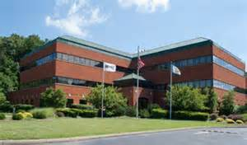
Scholarship: Professional/Academic
Co-Teaching Experiences at MUGC:
  CIRG 623: Literacy Facilitator. Co-taught with Dr. Barbara O’Byrne
  CIRG 580: Vocabulary and Comprehension. Co-Taught with Dr. Barbara O’Byrne

Slide 23
Scholarship: Professional/Academic
Other MUGC Teaching Experiences:
Course | Date
CIRG 637 Literacy Assessment | Fall 2008
CIRG 626 Developmental Reading | Spring 2009 Spring 2010
CIRG 622 Literacy Technology | Summer 2009 Fall 2009
CIRG 613 Children’s Literature | Summer 2012
CIRG 580 Special Topics: Comprehension and Vocabulary | Fall 2012
CIRG 615 Writing in the School Curriculum | Spring 2013
CIRG: CIRG 621 Current Issues and Problems in Reading Education | Summer 2013

Slide 24

Scholarship: Professional/Academic
Recognized by the MU Graduate School of Education and Professional Development for dedication to the field of education and for contributions as a doctoral student (Spring 2012)
Recognized at the Fall 2012 GSEPD Part-Time Faculty Seminar with a Certificate of Appreciation for efforts as a part-time faculty member in the MU Literacy Education Program.

Slide 25


Scholarship: Professional/Academic
Professional Affiliations

Slide 26

Research
Successful completion of EDF 625 Qualitative Research and EDF 626 Advance Qualitative Research
Received IRB approval for proposed research project done under the supervision of Dr. Nega Debela while enrolled in EDF 626
Submission of a finalized project proposal to Dr. Debela for inclusion in a student handbook focusing on qualitative research methods.

Slide 27

Research
Utilization of qualitative and quantitative research methods during the ITQ Grant Proposal Process in both Logan and Mingo Counties.

Slide 28

Final Thoughts
“You simply have to put one foot in front of the other
and keep going. Put blinders on and plow right ahead”
-George Lucas, Director

Slide 29
References
Antonakis, J & Day, D. V.. (2011). The nature of leadership. Sage Publications, Inc.
Bass, B.M. (1985). Leadership and performance beyond expectations. New York: Free Press.

Slide 30
Thank You!

