Slide 1
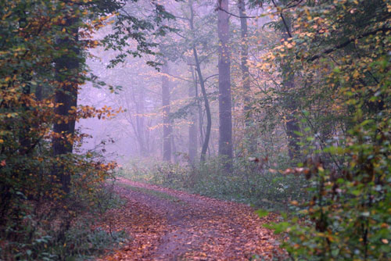
My Timely Journey: A Scholarly Reflection
Deborah Smith M.A.
Marshall University
Graduate College
Doctoral Committee Members:
Chair: Dr. William (Fred)Pauley
Dr. Nega Debela
Dr. Michael Sullivan
Dr. Christine Schimmel

Slide 2
“For everything there is a season, and a time for every purpose under heaven.” Ecclesiastes 3:1
“Life has a way of provoking change” (Smith, 2007, p. 5).
Notes:
I discovered many years ago that finding God’s purpose and timing for my life is imperative to my happiness and well-being. For me, being a life-long learner is essential for personal satisfaction. I was admitted to the Marshall University Graduate College, Curriculum and Instruction program in the Spring of 2006 and was very excited to begin my timely journey into the next phase of my life.
I began my portfolio paper with an excerpt from my first writing class at Marshall. It stated, “Life has a way of provoking change.”

Slide 3
My Timely Journey: A Scholarly Reflection
My goal is not to submit just a personal journal or simply a list of accomplishments, but a scholarly piece that expresses and conveys true evidence of my genuine learning.
Collaboration
Depth of Understanding
Scholarship
Research
Notes:
This presentation will serve as an expression of my growth and development in the discipline. I have truly enjoyed my experience throughout the doctoral program at Marshall University. I feel that I have and will continue to make steady progress on this timely journey. I have divided this presentation into the following four categories:

Slide 4
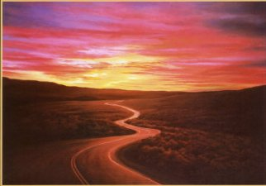
Collaboration
Collaboration occurred through various professional and academic pursuits:
Co-authored proposals and presented at the Professional Development Schools National Conferences in collaboration with Dr. Jane McKee (2006 & 2007) and Dr. Fred Pauley (2008).
Notes:
Webster’s Dictionary defines collaboration as the ability to work jointly with others or together especially in an intellectual endeavor. This definition expresses precisely the relationships that are essential for success in the doctoral program. During the past five years, I had opportunities to collaborate with faculty and staff members at Marshall University, as well as other doctoral students. I co-authored…SLIDE. With each presentation, my breadth of knowledge, understanding, and extent of collaboration increased dramatically

Slide 5
Additional Collaborative Experiences
Co-taught EDF 665 Sociology of American Schools in 2008 with Dr. Fred Pauley
Collaboration was evidenced in the following courses:
Plagiarism Group Research Project EDF 626 with Dr. Debela
Political/Critical Group PowerPoint Presentation CI 702 with Dr. Meyer
Notes:
(SLIDE – I co-taught…)This was wonderful learning experiences; Not only did it increase my collaborative skills, but also improved my technology abilities, because the class was an on-line course.
In Dr. Debela’s Qualitative Research course, we were required to create a collaborative qualitative research study. I found this course very challenging because I feared that my collaborative abilities may be hindered because of my two hour commute to campus. Nevertheless, I was able to be successful in our research on Plagiarism.
In Dr. Meyer’s Curriculum Theory course, we were divided into small collaborative groups and assigned different theories of curriculum. Of which we then collaboratively presented.

Slide 6
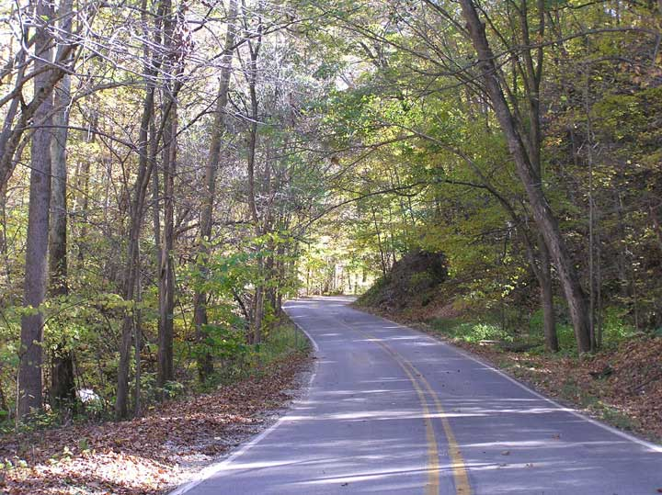
Collaboration Continues
Member of Doctoral Student/ Faculty Seminar
Committee in 2010 and 2011.
“As scholarship itself becomes more complex, collaboration are likely to become more significant” (Neubauer and Brewer, 2004, p. 92).
Notes:
I enjoying demonstrating collaborative skills by serving two consecutive years as a member of the Doctoral Committee for the Marshall University Doctoral Student/Faculty Seminar Fall 2010 and Spring 2011. Through my participation on the committee, I had the opportunity to build many relationships and network. I also facilitated a session in collaboration with Dr. Seymour concerning library skills, as well as greeter.
In a virtual scholarly collaboration case study, Neubauer and Brewer wrote, “As scholarship itself becomes more complex, collaboration are likely to become more significant” (2004, p. 92). I agree with their finding, collaboration is certainly becoming an important necessity.

Slide 7
Depth of Understanding
The following artifacts evidenced increase in my breadth of knowledge and understanding of educational theory:
Personal Goal Statement
Personal Theory of Teaching CI 703 with Dr. Meyer
Report and PowerPoint Presentation CI 707 with Dr. Meyer
Notes:
The next category is Depth of Understanding. A major cornerstone of my internalization and understand of educational theory was constructed by Dr. Calvin Meyer in Curriculum Theories & Models and Theory of Teaching courses. As I struggled through the assigned readings by William Pinar, and muddled through Dr. Myer’s lengthy writings assignment, I slowly realized he was requiring us to become independent thinkers. I began to reexamine, reformulate, and redefine my own personal educational theory of teaching based on scholarly research.

Slide 8
Depth of Understanding
My Personal Theory of Teaching
Just as an artist prepares a canvas for painting, an educator must establish a personal theory of teaching.
Constructivism as my base-color, the primary hue. Behaviorism would be added as the undertone, to create consistency and provide structure.
Notes:
(Slide) Therefore, my theoretical color in learning theory is that of a Constructivist hue with Behavioral undertones. Constructivism is an educational philosophy based upon the belief that knowledge is constructed by the learner, based upon the learner’s prior experiences and personal interpretation. On the other hand, Behaviorism is an educational philosophy based upon the behaviorist learning theory that behaviors are learned as a result of their consequences.

Slide 9
Depth of Understanding
Constructivism + Behaviorism =
Spectrum Constructivist
Notes:
The most profound influence on constructivist learning and teaching was Jean Piaget’s work, which was later extended by von Glasserfield. Brunner increased this theoretical framework that environmental factors and learner’s interpretation of their personal experiences create knowledge to include the social and cultural aspects of learning.
Pavlov, Watson, Thorndike, and Skinner are names closely associated with the behaviorist orientation to learning. Pavlov is best known for his work in classical conditioning, Watson furthered the behaviorist position of stimulus-response associations to include mental terms like desires and goals and B.F. Skinner’s operant conditioning formed the bases for behaviorism. Together these educational philosophies formed an eclectic approach I called “Spectrum Constructivist.”

Slide 10
Scholarship
“To engage authentic student scholarship that begins at the point where the world and students’ lives intersect” (Klausman, 2007, p. 191).
Presented at Professional Development Schools National Conference in collaboration with faculty members as follows:
Notes:
The timing of scholarships opportunities became available at the ideal stage of my career, thereby expanding my knowledge in various capacities. I Co-authored three proposals for submission and presented at the Professional Development Schools (PDS) National Conferences in collaboration with faculty members. I gained not only expertise in my field, but also confidence as a presenter

Slide 11
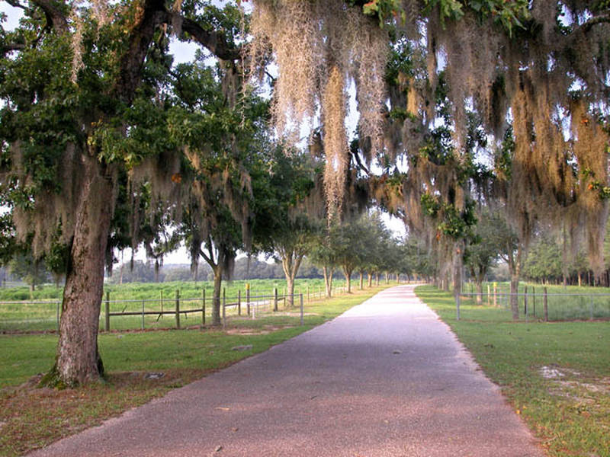
Scholarship
Presented “Hurdles, Roadblocks, and Challenges of Professional Development School Partnerships: Strategies and Structures for Overcoming and Sustaining” with Dr. Jane McKee, at 2006 PDS National Conference in Orlando, Florida
Notes:
As a Professor of Education, Teacher in Residency, I (SLIDE)
The presentation shared creative ways in which the “hurdles/roadblocks” were overcome. Successes of the partnership and methodologies employed for sustainability were also revealed in this presentation.

Slide 12
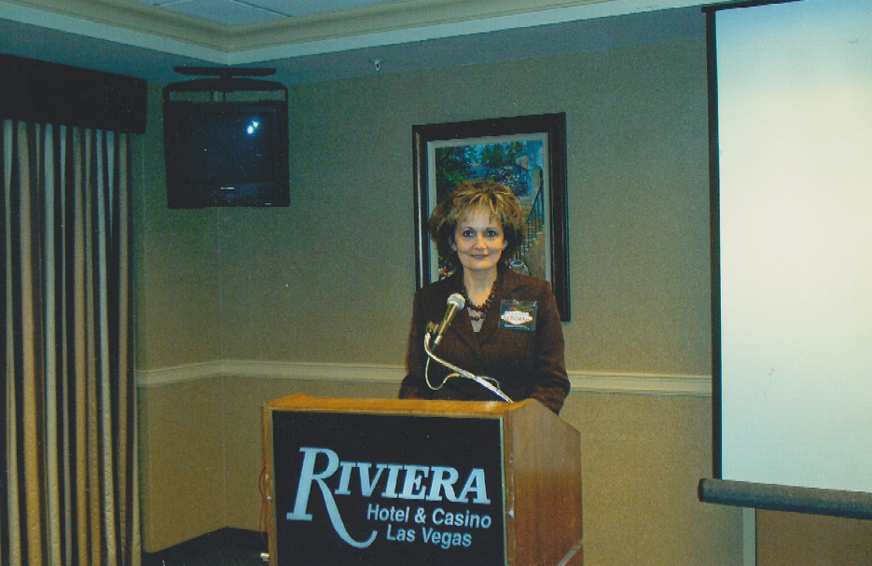
Scholarship Continued
Presented “Students and Teachers Education Positively Under Pressure / STEP-UP” with Dr. Jane McKee, at 2007 PDS National Conference in Las Vegas, Nevada
Presented “The Next STEP-UP (Students and Teachers
Education Positively Under Pressure) The Sago Mine
Disaster: Recovery and Reflection” with Dr. Pauley, at
2008 PDS National Conference in Orlando, Florida.
Notes:
Next, as a high school SPED teacher I….(SLIDE)
Dr. Jane McKee collaboration, input, and suggestions were significant in expanding my own personal professional growth and development. The presentation discussed the strategies utilized during the healing and recovery from the Sago Mine national tragedy. Through the implementation of “STEP-UP”, we were able to assist students with special needs in identifying stressors, recognizing symptoms of distress, and positively responding to healthy outlets for dealing with stress.
Then, Dr. McKee retired and I asked Dr. Fred Pauley to collaborate with me on my proposal. I so much appreciated Dr. Pauley’s willingness and his encouragement and suggestions. Following countless emails and revisions, my proposal was once again accepted for the third consecutive year and I (SLIDE) ) This presentation was a follow-up session in which we shared a variety of classroom practices that we found successful and demonstrated a continuation of the healing process based upon the students’ personal reactions and reflections.

Slide 13
Scholarship
Authored and submitted a manuscript titled “After Sago”
for publication in “The Journal of the National Association
for Professional Development Schools” in collaboration
with Dr. Frances Simone
Notes:
and I also… (SLIDE) Participation in Dr. Simone’s writing for publication course certainly inspired a greater respect and deeper appreciation for scholarly writing. “Trimming the fat” from one’s writing was a completely new concept!

Slide 14
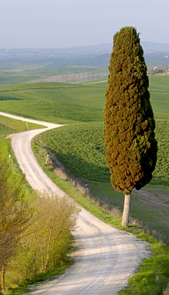
Research
Mission Statement of the Doctoral Program in Education
Personal growth evidenced in the research projects in Dr. Cunningham, Dr. Debela, and Dr. Spatig’s courses as follows:
Notes:
According to the Doctoral Program in Education Student and Faculty Handbook for Marshall University, the mission is to “prepare practitioners to be reflective, ethical educators and researchers who contribute to the field of education.”
When I first read this mission statement, I was dubious as to whether I would ever become a researcher with the ability to make valuable contributions to the educational field. Consequently, it was in this capacity that I feel that I have made the greatest personal strides and academic growth as I progressed through my doctoral program, specifically the research projects in Dr. Cunningham, Dr. Debela, and Dr. Spatig’s courses. My knowledge and proficiency in research methods increased and as I progressed through these courses in the doctoral program.

Slide 15
Research
LS 703 Research and Design with Dr. Cunningham
Collaborative Institutional Training Initiative CITI Human Research Course
“Inclusion of Students with Autism in High School”
Notes:
My induction into scholarly research began in LS 703 Research Design taught by Dr. Cunningham. It was also my introduction to the Collaborative Institutional Training Initiative (CITI). During this course, under Dr. Cunningham’s tutelage, I created a mock dissertation study proposal on a personal topic of interest “Inclusion of Students with Autism in High School”. Dr. Cunningham’s patience and perseverance are worthy of my sincere gratitude, as I revised my research questions several times. The questions focused on the perceptions of high school general education teachers related to the skills and deficits of students with autism.

Slide 16
Research Continued
CI 706 Multicultural and Diversity Issues Qualitative Research with Dr. Debela
Institutional Review Board (IRB) Approval
“Felons Perceptions: Transition from Incarceration to the General Public”
“What you know about your research - reflected in
your interpretations - is intertwined with what you
know about yourself” (Glesne, 2011, p. 242).
Notes:
My next revelation in the field of research came to fruition in Dr. Debela’s Multicultural/Diversity Issues Qualitative Research class. This course provided some of my most practical and valuable scholarship towards becoming an effective qualitative researcher. The course also provided my initiation to the Office of Research Integrity’s Institutional Review Board (IRB) process. The purpose of this qualitative research study was twofold – to gain a better understanding from felons’ perceptions of the transition from incarceration to the general public and to raise public awareness of the process. I recall, that during this class, I discovered my passion for qualitative research. I found that I was able to have a voice and felt connected to the research. For as Glesne wrote…(SLIDE) It was following this course that I asked Dr. Debela to become a member of my doctoral committee.

Slide 17
Research Continued
EDF 626 Advanced Qualitative Research with
Dr. Spatig
Institutional Review Board (IRB) Approval
“High School Students with Autism Speak Out”
“Qualitative research is an ongoing process that involves tacking back and forth between the different components
of the design, assessing the implication of goals, theories, research question, methods and validity threats for one another” (Maxwell, 2005, pg. 85).
Notes:
I would be remiss if I did not express much appreciation to Dr. Spatig for the many valuable learning experiences derived from the Advanced Qualitative Research class. The method in which Dr. Spatig facilitated the course increased my knowledge and proficiency in qualitative methods. I learned of Joseph Maxwell’s Interactive Model of Research design to a qualitative study. According to Maxwell, this interactive design model provides a visual which demonstrates the fact that ….(SLIDE) The explorative qualitative case study examined the experiences and perceptions of high school students with autism.
I believe my qualitative research proposal, “High School Students with Autism Speak Out”, may indeed lend itself to becoming my dissertation topic.

Slide 18
Personal Growth
research
My five precious grandchildren.
Notes:
I have discovered that some of the most fulfilling experiences in life are those that occur when you learn to enjoy the journey, the process, rather than being fixated on the final goal. Progression through my timely journey has provided me with the opportunity to learn and grow in ways that I did not know possible. My experiences in the doctoral program have led to both professional and personal growth. When I began this educational journal, I had two grandchildren; I now have five precious grandchildren.

Slide 19
Professional Growth
Collaboration - realized through collaborative experiences with MU faculty, staff members, and other doctoral students
Depth of Understanding - extended and deepened through the coursework of educational theory at MU and I have redefined my own personal educational theory
Scholarship - gained expertise in my academic field and confidence as a national presenter
Research - increased my knowledge and enhanced skills necessary to become a researcher
Notes:
Through my collaborative efforts with faculty, staff members, and other doctoral students at Marshall University, I now realize the importance of collaboration. Through my coursework at Marshall University, I was able to extend and deepen my breath of understanding of educational theory, as well as redefine my own personal educational theory of teaching based on scholarly research. By participating in various scholarship opportunities, I gained expertise in my academic field and confidence as a national presenter. Finally, I increased my knowledge and enhanced the skills necessary to become a researcher with the ability to make valuable contributions to the educational field.

Slide 20
“ A journey of a thousand miles begins with a single step” (Loa Tzu, ancient Chinese philosopher).
Notes:
So it is with great enthusiasm that I approach the next phase of my timely journey. As the ancient Chinese philosopher wrote, “A journey of a thousand miles begins with a single step.”

Slide 21
REFERENCES
Bruner, J. (1966). Towards a theory of Instruction. Cambridge, MA: Harvard University Press.
Glensne, C. (2011). Becoming qualitative researchers: An introduction (4th ed.). Boston, MA: Allyn and Bacon.
Klausman, J. (2004). Resurrecting the I-search: Engaging students in meaningful scholarship. Teaching English in the Two Year College, 32, 191-196.
Maxwell, J. (2005). Qualitative research design: An interactive approach (2nd ed.). Thousand Oaks, CA: Sage Publications.
Merriam-Webster’s Collegiate Dictionary (10th ed.). (1993). Springfield, MA: Merriam-Webster.

Slide 22
REFERENCES
Neubauer, B., & Brewer, G. (2004). Virtual scholarly collaboration: A case study. Journal of Computing Sciences in Colleges, 19(4), 92-98.
Smith, D. (2007). Education throughout a lifetime. Unpublished manuscript, Marshall University, South Charleston, WV.
Smith, D. (2008). Spectrum constructivist: My personal theory of teaching. Unpublished manuscript, Marshall University, South Charleston, WV.
Tzu, L. (600BC). Think exist. Retrieved April 10, 2011, from
http://thinkexist.com/quotation/14003.html

Slide 23
IMAGE REFERENCES
http://www.pbase.com/10kzoomfz/image/113109273
http://alikat0417.deviantart.com/art/winding-road-2-94173173
http://www.caradvice.com.au/96978/challenging-roads-may-decrease-driver-boredom-study/
http://photo.net/photodb/photo?photo_id=3281251
http://www.se7enty6ix.com/2005/08-05/08-05_windingroad.htm
http://mikedempsey.typepad.com/.a/6a00e5532538c488330105369a5d97970b
http://www.flickriver.com/photos/birdyboo/300945382
http://secretsofviolence.blogspot.com/
http://morethancoping.wordpress.com/2010/04/19/the-long-and-winding-road-truth-vs-feelings/
http://www.forestfoliage.com/2010/08/winding-country-fall-road/
http://www.jmooneyham.com/daytona-2-between-a-ferrari-and-a-hard-place.html
http://www.filmnorthflorida.com/photos/slideshow/96
http://lssacademy.com/
http://www.hicker-stock-photography.com/stockphoto/winding-road-snowcapped-mountain-peaks-kootenay-canada-1856.htm
http://www.berro.com/PhotoAlbum/photos_from_majestic_lebanon.htm

