Slide 1
Portfolio of a Servant Leader: You Can Lean on Me
Tina Lou Edwards
April 6, 2011
By PresenterMedia.com
Notes:
As I prepared to begin my reflection paper and the portfolio assessment presentation, I thought carefully about what to use as my theme. Then all of a sudden it came to me!
I would use one of my favorite songs because the meaning of the song is exactly what has brought me this far.
Lean on Me by Bill Withers is so appropriate for this journey. I have learned to lean upon others, and I hope others have counted on me when they needed support.

Slide 2
Lean on Me
By: Bill Withers
Sometimes in our lives, we all have pain, we all have sorrow. But if we are wise, we know that there's always tomorrow. Lean on me, when you're not strong and I'll be your friend. I'll help you carry on, for it won't be long 'til I'm gonna need somebody to lean on.
Please swallow your pride, if have things you need to borrow. For no one can fill those needs that you won't let show.
You just call on me brother when you need a hand. We all need somebody to lean on. I just might have a problem that you'll understand. We all need somebody to lean on.
Lean on me when you're not strong, and I'll be your friend. I'll help you carry on, for it won't be long 'til I'm gonna' need somebody to lean on.
You just call on me brother if you need a friend. We all need somebody to lean on. I just might have a problem that you'll understand. We all need somebody to lean on.
If there is a load you have to bear that you can't carry. I'm right up the road, I'll share your load if you just call me.
Call me (if you need a friend) Call me (REPEAT AND FADE)
Notes:
In August 2007, I decided to embark upon this journey of a lifetime. I made the choice to enroll in the Educational Leadership doctoral cohort at Marshall University. This had been a dream of mine that I had placed aside while raising my sons. However, now that they were almost grown, I could not pass up this wonderful opportunity.

Slide 3
My Three Sons
JD Duelley, 21
Jeromy Duelley, 27
Jerod Duelley, 23
Notes:
My family is extremely important to me, and I have always tried to be a good role model for my sons. I believe that one of my greatest accomplishments is being a mother.
In LS 710 Principles of Leadership, taught by Dr. Toth, one of our assignments was to complete a questionnaire about what we considered to be our personal best accomplishment as a leader. I chose that of being a mother.
I felt I had to be accepted into the program, and that I must complete this new adventure to show my sons my drive and perseverance.

Slide 4
My Wonderful Husband
John Edwards
Notes:
As part of the admittance process, I was interviewed by Dr. Mike Cunningham and Dr. Lisa Heaton. One question that I remember was whether or not I had support from my family.
I knew, without any doubt, that the answer to this question was,
“YES, I have 100% support from my family.”
I knew that I could call on them for any need that I might have.

Slide 5
Lean on Me
You just call on me brother When you need a hand We all need somebody To lean on I just might have a problem That you'll understand We all need somebody to lean on
Family and Cohort
Notes:
The first class meeting was on August 24th at Braxton County Middle School in Flatwoods, WV. It was a strange feeling to walk into the classroom and meet twenty-one other people with the same dream that I had. It was amazing how quickly we came together as a team.
I believe our cohort is special; we are almost like family.
When looking up the definition of cohort, I found that it is defined as a group of companions and supporters. We are definitely supporters of one another.

Slide 6
Doctoral Committee
For Tina Lou Edwards
Chair
Dr. Mary Harris-John–
Associate Professor
Leadership Studies
Member from Leadership
Dr. Louis Watts –
Assistant Professor
Leadership Studies
Member from Curriculum and Instruction
Dr. Rudy Pauley –
Associate Vice President for Outreach and Continuing Studies
Graduate School of Education and
Professional Development
Member from Outside
Dr. Sara Stankus –
A Professional Colleague Principal of Union Elementary School, Upshur County
Members at Large
Family and Cohort Members –
John Edwards, Jeromy Duelley, Jerod Duelley, JD Duelley, Charles and Katy Stalnaker and
All Members of the Braxton County Cohort
Notes:
After my first two semesters, I felt I was ready to pick my committee. With the opportunity to meet several faculty members either at the seminars or on Saturday visits in Braxton County, I knew that I would like to have Dr. Harris-John as my chair soon after her visit to Flatwoods. The other members fell into place quickly.
I also consider my family and the cohort part of my committee because without them, I may not have made it this far. I truly appreciate the support along the way.

Slide 7
My Framework for this Journey
My Personal Definition of Leadership
LS 710 Principals of Leadership
A work in progress…
Leadership is commitment to your beliefs. It is staying true to your values. Leading requires having confidence in yourself and others. Being a leader means that you allow others to find success. It is making decisions and sticking to them, if they are best for everyone involved. An effective leader has the knack of getting people to work together for the same purpose. Being a leader requires helping others understand why change is needed and then guiding them through the process. Having strong interpersonal skills,
knowing the importance of personal reflection and awareness are also key to being a successful leader.
Notes:
In the course, LS 710 – Principals of Leadership taught by Dr. Toth, we were challenged to examine our leadership style.
All of the reading, research and discussion helped me to develop my own personal definition of leadership:
Leadership is commitment to your beliefs.
It is staying true to your values.
Leading requires having confidence in yourself and others.
Being a leader means that you allow others to find success.

Slide 8
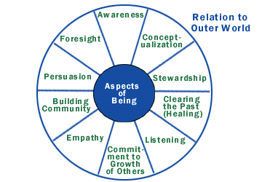
Personal Leadership Style
Servant Leadership
Greenleaf (2003) ten characteristics of servant leadership:
Listening
Empathy
Healing
Awareness
Persuasion
Conceptualization
Foresight
Stewardship
Commitment to the growth of others
Building community
Spears (2004) on servant leadership:
Servant leadership is based upon teamwork and community, one that seeks to involve others in decision making, one strongly based in ethical and caring behavior
Notes:
I believe that my leadership style can be described as a servant leader.
Robert Greenleaf (2003) shares that a servant leader has these ten characteristics: listening, empathy, healing, awareness, persuasion, conceptualization, foresight, stewardship, commitment to the growth of people and building community.
I tend to empower others, and I encourage collaboration and trust in each other. I believe that if, as an organization, we all have the same focus and desire, we can accomplish so much more. It is important to build trust and solid relationships so that, as a team, shared goals can be accomplished.
Larry Spears (2004) states that servant leadership is “based upon teamwork and community, one that seeks to involve others in decision making, one strongly based in ethical and caring behavior.”
Servant leadership follows the pattern of serving others while keeping their integrity and values as a priority.

Slide 9
Portfolio Activities
Portfolio Activity | Date(s) | Performed in Collaboration With | Description of Activity | Sample of Courses Supporting this Activity
Publication | November 2007 | Dr. Fran Simone | National ParentNet Association ParentInvolvementMatters.org Parent Partners: Leading the Way to Success | CI 677 Writing for Publication LS 703 Research Design
Regional Presentation | October 24, 2008 | Dr. Louis Watts, Ms. Peggy Sue Crowe, and Ms. Sarah Lee | Southern Regional Council on Educational Administration, Charleston, WV: Staff and Administrative Views of the Preschool Collaboration Program | LS 710 Principles of Leadership LS 705 Administrative Theory CI 677 Writing for Publication
West Virginia Presentation | November 20, 2008 | Dr. Louis Watts, Ms. Peggy Sue Crowe, and Ms. Sarah Lee | WV Association of Supervision and Curriculum Development, Bridgeport, WV: Collaboration Preschool Program: Perceptions and Suggestions | LS 710 Principles of Leadership LS 705 Administrative Theory CI 701 Curriculum Development
Co-teaching | Summer 2009 (May 26 – Aug 14) | Dr. Mary Harris-John | Co-teaching of LS 610 – Leadership for School Improvement | LS 647 Adult and Continuing Education LS 740 Public School Law CI 702 Theories, Models and Research of Teaching
Developing a course in collaboration with a faculty member | August 2010 | Dr. Mary Harris-John | Co-developed the online course for LS 600 – School Personnel Administration | LS 740 Public School Law LS 707 Ethical Theories CIEC 700 Technology and Curriculum
Marshall University Graduate College requires the doctoral candidate to develop a portfolio of activities and experiences of the doctoral program. This opportunity provides the student with a broader and more fulfilling experience while completing the coursework required. The requirements help to prepare the student for the dissertation stage of the program.
Notes:
As part of the portfolio qualifying assessment certain activities are required. This chart shows my completed activities which will be discussed throughout the rest of this presentation.
These opportunities provide the student with a broader and more fulfilling experience and help to prepare the student for the dissertation stage of the program.

Slide 10
Scholarship
Knowledge resulting from study and research in a particular field
Co-authoring a proposal for submission and co-presenting at a regional or national conference in collaboration with a faculty member. Co-authoring and submitting for publication a manuscript to a peer reviewed/refereed journal, a book, or a book chapter, in collaboration with a faculty member
Notes:
For the Scholarship Section – Knowledge resulting from study and research in a particular field
The requirements of the qualifying portfolio assessment includes:
1. Co-authoring a proposal for submission and co-presenting at a regional or national conference and
2. Co-authoring and submitting for publication a manuscript in collaboration with a faculty member

Slide 11
True Partnerships:
Parent Partners Leading the Way to Success
www.parentinvolvementmatters.org.stories/Ritchie-County.html
Notes:
In CI 677 – Writing for Publication taught by Dr. Fran Simone, I decided to write about a successful accomplishment of my career. I started a program in Ritchie County Schools that gave parent volunteers the opportunity to become leaders. This also supports that my leadership style is that of servant leadership. This program empowers parents and allows them to become leaders in the elementary schools of Ritchie County.
The publication that I wrote describes the program, and it was published on the National ParentNet Association link: ParentInvolvementMatters.org in November of 2007.
Dr. Simone guided our cohort in this process and provided us with many valuable tips on professional writing.

Slide 12
Staff and Administrative Views of the Preschool Collaborative Program
Southern Regional Council on Educational Administration
Charleston, WV: October 24, 2008
Notes:
Next, during the Summer and Fall 2008 Terms, I worked collaboratively with Dr. Louis Watts, Peggy Sue Crowe and Sarah Lee. Ms. Crowe and Ms. Lee are also part of our cohort.
At this time, I was the preschool coordinator of Ritchie County Schools and also the chair of the collaborative preschool committee. I was very interested in the process of collaboratively working with Head Start. Our research project was titled “Staff and Administrative Views of the Preschool Collaborative Between Lincoln County Schools and Southwestern Community Action Head Start” (2008).
Once we began working on the research, we soon decided that we could turn the project into a presentation. We submitted proposals to both the Southern Regional Council on Educational Administration and the West Virginia Association of Supervision and Curriculum Development.

Slide 13
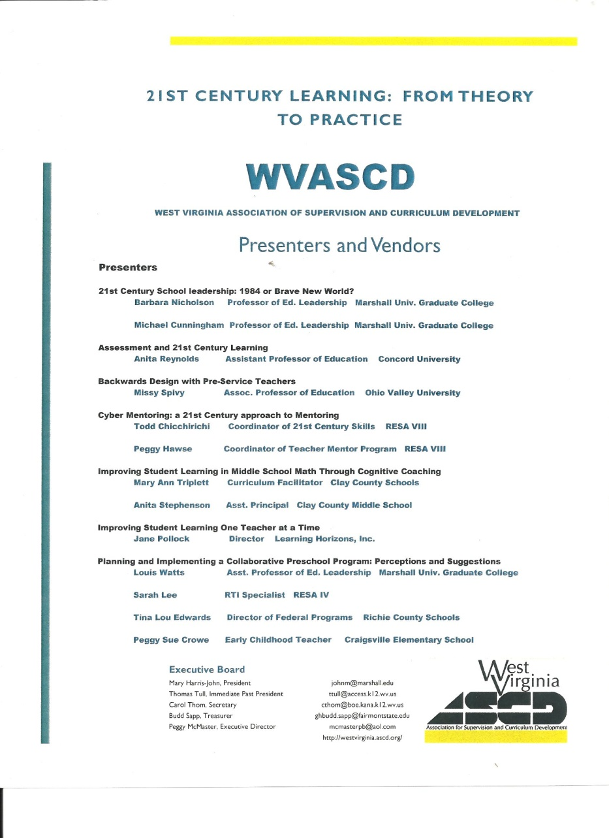
Collaboration Preschool Program:
Perceptions and Suggestions
WV Association of Supervision and Curriculum Development
Bridgeport, WV: November 20, 2008
Notes:
Both organizations accepted our proposals. We were very excited to have this opportunity to complete our research and to share it with other professionals. The goal was to show that the collaboration between public schools and Head Starts could be beneficial to both systems and especially for the preschool students involved. This study helped to guide me in my position as preschool coordinator in Ritchie County.
I know that both Ritchie and Upshur counties have used this study to work towards the universal pre-k collaborative model.
In a study by Barnett and Hustedt (2003), the collaboration between public schools and Head Starts would permit the systems to incorporate Head Start funding, expertise, staff and facilities into universal preK, thereby reducing costs to the public school systems and making maximum use of existing resources.

Slide 14
Professional/Academic Pursuits
The act of striving: the pursuit of higher education
Co-teaching a course with a faculty member
Developing a course in collaboration with a faculty member
Doctoral Seminar participation
Professional growth
Leadership growth
Notes:
Each student must include at least two activities that assist with professional and academic growth.
The combination of the variety of experiences has helped me grow personally and professionally as a leader.

Slide 15
Co-teaching and Co-development of course
A second line of text here
LS 610 – Leadership for School Improvement
West Virginia Five Year Online Strategic Plan
LS 600 – School Personnel Administration
Redesigned for online instruction
Policy input and resources
Notes:
I co-taught LS 610 – Leadership for School Improvement with Dr. Harris-John during the summer of 2009. This was also beneficial to me professionally. At the time, I was just hired as Superintendent for Grant County Schools. Being the superintendent, gave me some insight into school system leadership and school improvement. I had also served as Director of School Improvement for Ritchie County Schools. Dr. Harris-John gave me the opportunity to share with the class the West Virginia Five Year Online Strategic Plan. Sharing the site and how to navigate within the plan, was valuable to me as an administrator. Since then, I have held numerous sessions with administrators and guided them through the process of inputting their school plan.
Finally, in July and August of 2010, I co-developed the online course for LS 600 – School Personnel Administration with Dr. Harris-John. This was another valuable experience. I met with Dr. Harris-John and we discussed a plan for re-designing the traditional course into an online course. My responsibilities included providing policy on West Virginia Employee Code of Conduct, and information on policy 5310, Performance Evaluation of School Personnel and writing a case study on new teacher mentoring. Assisting with this project gave me the chance to learn more about policies and West Virginia Code dealing with school personnel. I am thankful to have had this opportunity and am sure that the knowledge gained from this will enhance my professional career.

Slide 16
Additional Growth Projects
Professional Growth
Leadership Growth
Doctoral Seminar Participation
Notes:
Another example of strong support from Marshall would be the doctoral seminars that are held in the fall and spring. The seminars were well planned and provided us with exceptional and important information that helped us grow and mature as doctoral students. We were given the opportunity to choose topics that were relevant to our place in the journey of the doctoral pursuit. I also helped in the planning and presentation of the seminars.
During the fall 2010 Academic Breakout Sessions, I facilitated the session titled: Role of Higher Education in Professional Teaching Standards lead by Dr. Hollandsworth and Robert Hagerman. I also co-presented the gallery walk session titled: The Portfolio Paper with Mary Ann Triplett. Again, this helped me grow as a leader.
The seminar experiences gave us the chance to meet other doctoral students outside of our cohort and to see them progress and be successful in the endeavor to achieve the prestigious title of Doctorate in Education. I recall feeling like I might never make it to this point early on, but here I am and I know that the encouragement of other students and faculty helped me to make it this far. Seeing others succeed and knowing that they went through some of the same experiences that I had or would experience gave me the strength to carry on with my journey…
The work that I completed throughout the various courses helped me to grow professionally. While I served as superintendent of schools, LS 740, Pubic School Law, gave me many resources that I used in making many of my decisions. The discussions of a variety of court cases and the chance to research several court cases will continue to guide me as a public school administrator. I knew that knowing where to find information would be important to me as a school leader. This course provided us with many resources.
LS 705, Administrative/Leadership Theory also provided many opportunities to grow as a leader. One article that made a strong impression on me was “Getting into the castle of educational leadership” by Ken Kempner (1989). This article described various types of leadership within the administrative world. In the conclusion, it emphasized the importance of “opening the castle door” (p. 121) and the idea of empowering others to serve and to grow as leaders. This idea also subscribes to the servant leadership model.

Slide 17
If we are wise, we know there is tomorrow…
Knowledge gained throughout this journey has prepared me for the future.
Collaboration with Faculty
Cohort
Family
Scholarship
I believe that with all of the experiences I have had to this point I am ready to go on with the next step of this journey. I look forward to researching women in leadership positions and finding out more about the path to superintendency.
Notes:
I believe that with all of the experiences I have had to this point, I am ready to go on with the next step of this journey. I look forward to researching women in leadership positions and finding out more about the path to superintendency. I will share my research proposal Saturday with my classmates in in LS 765 – Advanced Research II.
I look forward to this continued journey and I know that I will succeed.

Slide 18
Lean on Me
You just call on me brother when you need a hand. We all need somebody to lean on. I just might have a problem that you'll understand. We all need somebody to lean on.
Notes:
Any questions?

Slide 19
References
Alexander, K. & Alexander, D. (2009). American Public School Law. Belmont, CA: Wadsworth Cengage Learning.
Barnett, W., Hustedt, J., Friedman, A. Boyd, J., & Ainsworth, P. (2007). The state of preschool 2007: State preschool yearbook. New Brunswick, NJ: National Institute for Early Education Research.
Covey, S. (2003). Principle-centered leadership. New York: First Free Press.
Crowe, P., Edwards, T., Lee, S. & Watts, L. (2008). Staff and administrative views of the preschool collaboration program between Lincoln County Schools and Southwestern Community Action Head Start for the year 2007-2008 . Paper presented at the meeting of the Southern Regional Council of Educational Administration, Charleston, West Virginia.
Edwards, T. (2007). True partnerships: Parent partners leading the way to success. ParentNet. Retrieved from http://www.parentinvolvementmatters.org/stories/Ritchie-County.html
Greenleaf, R. (2003). The Servant Leader: Within a Transformative Path. NJ: Robert K. Greenleaf Center, Inc.
Hass, G. (1977). Curriculum planning: A new approach. Boston, Allyn and Bacon, Inc.
Jalongo, M.R. (2002). Writing for Publication: A Practical Guide for Educators. Norwood, Massachusetts: Christopher-Gordon Publishers, Inc.
Kempner, K. (1989). Getting into the castle of educational administration. Peabody Journal of Education, 66(3), 104-123.
Maxwell, J. (2007). The 21 most powerful minutes in a leader’s day. Nashville, TN: Thomas Nelson, Inc.
Spears, L. (2004). Practicing servant Leadership. Leader to Leader, 7-11. Retrieved from http://www.sullivanadvisorygroup.com/web_sag.html
Notes:
Thank you very much and I look forward to the rest of this journey!

