Slide 2
Knowing You Knowing Me
Anita Stephenson
Portfolio Defense
Notes:
I will give an overview of how this was both a professional and personal learning journey that helped me to know myself better.

Slide 3
McAdam’s Three Levels of Knowing
Encountering Others as Strangers
Discovering Others as Friends
Building Stories and Memories with Friends
Notes:
I’ll just briefly explain the McAdams premise that getting to the point where we build memories and share stories is where we know our role.

Slide 4
Flatwoods Cohort
August 2007 – Present -- Strangers
Course Work -- Friends
Bonding -- Family
Notes:
Here, I will talk about getting to know my classmates and share a few stories. I’ll talk about a presentation where the roof started to leak all over me, but Betsy, Brenda, and I went right on presenting while we found something to catch the water. I’ll also talk about Julius. I also want to talk about attending Randy King’s presentation at the statewide technology conference and meeting his wife. I may share a story about hearing someone talk about Keith, and thinking “that’s my Keith Butcher he’s talking about.” Along the way, he became “mine.”

Slide 5
Scholarly Activities
Notes:
Here, I have a link to the syllabus for the class that Ryan and I cotaught with you, a link to the MUGC Fall Seminar webpage and will also talk about the other panel discussions at seminars, and a link to the article that was published through Principal Magazine.

Slide 6
Portfolio Activity | Date(s) | Performed in Collaboration With | Description of Activity | Courses Supporting this Activity
Presentation and publication | October 2007 | Dr. Teresa Eagle and Mary Ann Triplett, MU Doctoral Student | SRCEA Fall Conference Charleston, WV 21st Century Leadership Skills | LS 710 Principles of Leadership CI 677 Writing for Publication
Round Table Presentation/Discussion | October 2008 | Dr. Mary Harris-John and other MU Doctoral students | Doctoral Seminar, Marshall University Graduate College Conferences, Presentations, and Other Portfolio Opportunities | LS 707 Ethical Theories LS 710 Principles of Leadership CI 677 Writing for Publication
Publication | December 2008 | Dr. Fran Simone and Beth Campbell | Principal Magazine Gaining Ground on AYP | LS 710 Principles of Leadership CI 677 Writing for Publication
Co-teaching with Faculty Member | Spring 2009 | Dr. Mary Harris-John and Ryan Haught, MU Doctoral Student | Co-taught LS 660 Internship School Management II at Clay County Middle School Clay, WV | LS 705 Administrative Theory LS 710 Principles of Leadership LS 740 Public School Law
Research | Summer 2009 | Dr. Eric Lassiter and Beth Campbell | Gathered qualitative data for the Math and Science Partnership Collaboration and Communication Research Project | EDF 625 Qualitative Research CIEC 700 Technology and Curriculum LS 647 Adult and Continuing Education
Round Table Presentation/Discussion | August 2009 | Dr. Calvin Meyer and other MU Doctoral Students | Presentation to New MU Faculty at Orientation Huntington Campus Teaching to a Difficult Text | CI 702 Curriculum Theories CI 703 Theories, Models, and Research of Teaching
Round Table Presentation/Discussion | October 2010 | Dr. Mary Harris-John and other MU Doctoral Students | Doctoral Seminar, Marshall University Graduate College Middle School Task Force | LS 707 Ethical Theories LS 710 Principles of Leadership CIEC 700 Technology and Curriculum CI 706 Multicultural Education

Slide 7
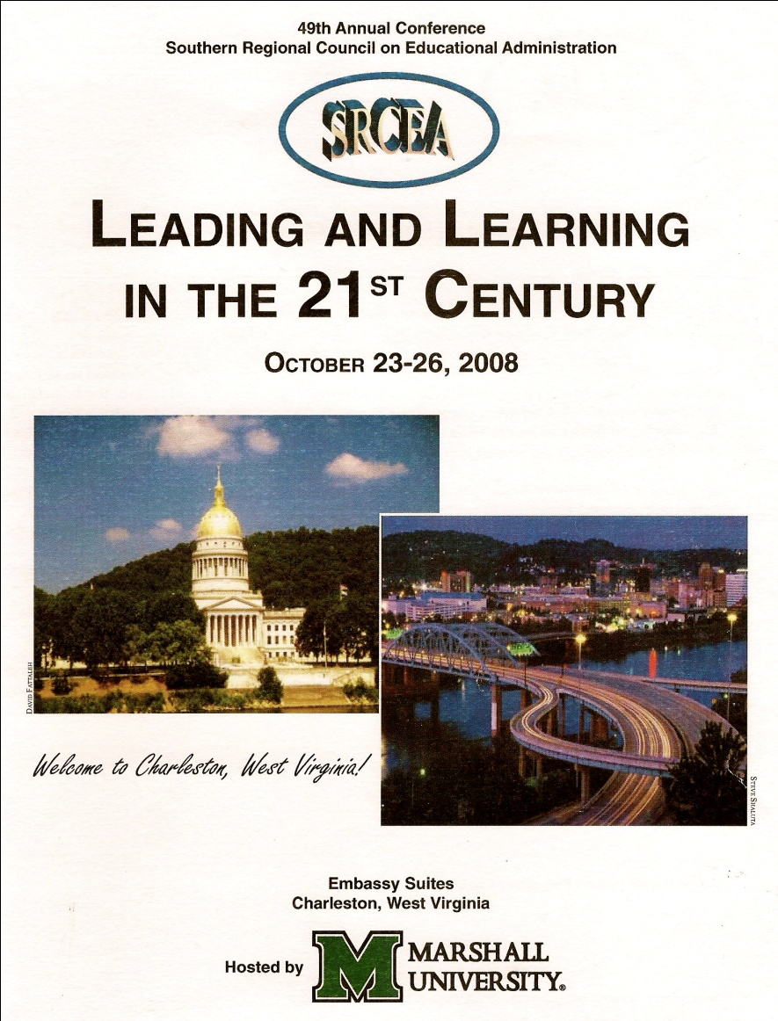
Presentations and Publications

Slide 8
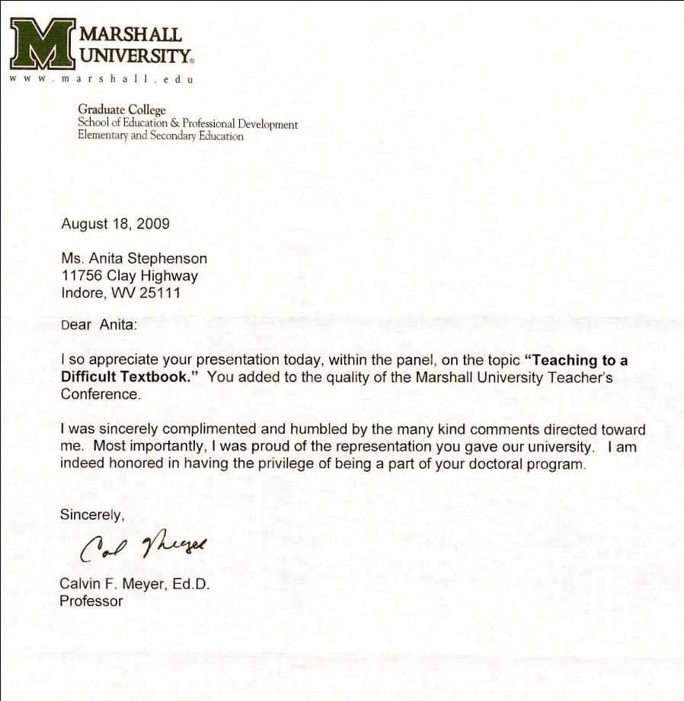
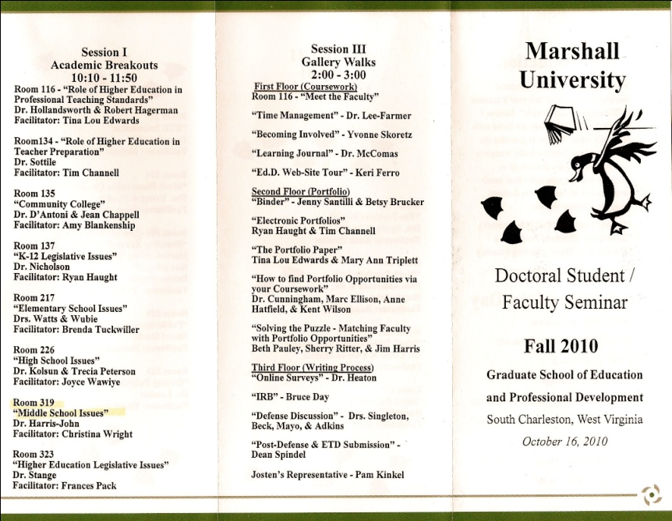
Co-teaching and Round-table Discussions

Slide 9
Notes:
Next, I am going to talk about the collaboration with Dr. Lassiter and Beth Campbell and the work with Dr. Nicholson and Mary Ann Triplett on the Globaloria qualitative research.

Slide 10
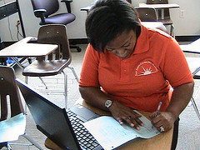
Appalachian Math and Science Partnership-Marshall University and Globaloria
Collaboration in Practice:
A Qualitative Evaluation of the Partnership Enhancement Program (PEP), AMSP-MU
Appalachian Math and Science Partnership-Marshall University
Evaluators: Luke Eric Lassiter, PhD and Elizabeth Campbell, MA

Slide 11
Autobiographical/Biographical Influence of Curriculum
Presenters
Anita Stephenson
Brenda Tuckwiller
Elizabeth Brucker
Notes:
I want to mention that collaboration happened in course also, and this was good for me to work with others rather than doing everything by myself.

Slide 12
Reflection
Professional and Personal Growth
Notes:
Here, I will talk about the scholarly growth and the personal growth that I’ve experienced

Slide 13
I've lived in this place and I know all the faces Each one is different but they're always the same They mean me no harm but it's time that I face it They'll never allow me to change I’m Movin’ On lyrics by Rascal Flatts

Slide 14
Next Steps
Potential Dissertation Topics
Read 180 Program Evaluation
In loco-parentis –
Where does the school’s responsibility begin and end?
Perception of leadership based on leadership style and gender

Slide 15
Crawford, the Royal Raven
Notes:
I will reference the book and talk about how at the beginning I had a lot in common with Crawford and on the next slide I’ll talk about how it’s better to know yourself and find others who are special to let you grow into your specialness.

Slide 17
Credits
McAdams, D. P. (1996). Personality, modernity, and the storied self: A contemporary framework for studying persons. Psychological Inquiry, 7, 295-321.
http://www.childrenslibrary.org/icdl/BookPage?bookid=wilroya_00940006&pnum1=40&twoPage=true&route=text&size=0&fullscreen=false&lang=English&ilang=English
http://www.flickr.com/photos/36351191@N00/sets/72157622783034921/
http://lyricsfly.com/search/view.phd991d1f927&view=442940&hl=&opt=
Presentation Content by Anita Stephenson
Layout and Design by Jesse Stephenson

