Slide 1
The Journey to the “I”: An Autoethnographic Reflection of My Path Through the Doctoral Program
Julie Midkiff, NBCT
Doctoral Student: Curriculum and Instruction
Marshall University
Portfolio Presentation
January 16, 2019

Slide 2
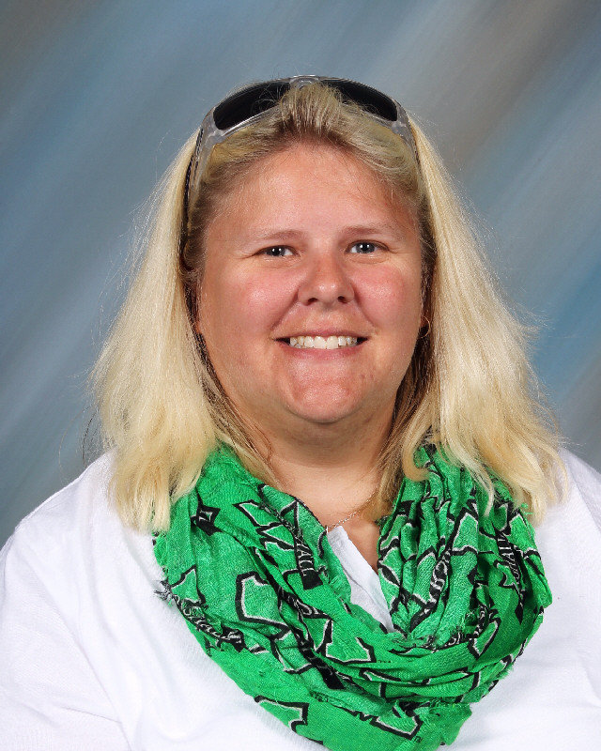
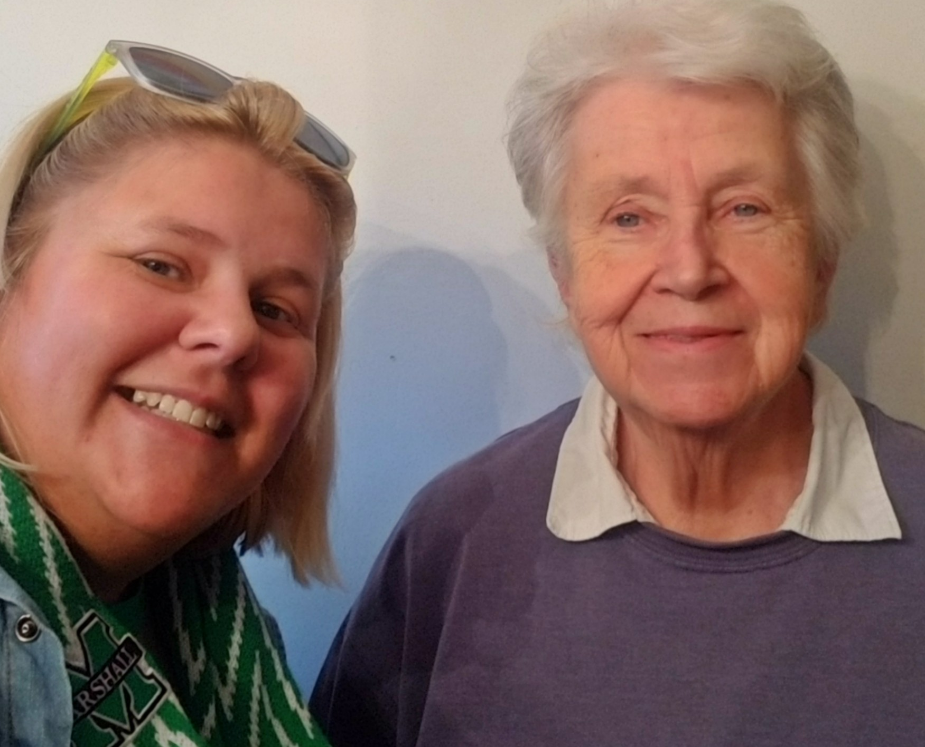
Introduction: How did I get here?
Influential Teachers and Mentors
Undergraduate Degrees: Art Education & Graphic Design/Studio Art: Concord University
1st Teaching Job: Alternative Education Center led to a Masters in Special Education from Marshall University 2006
2nd Job and Current Teaching Career: Art Teacher and Principal’s Designee at Bradley Elementary
National Board Certification in Early/Middle Childhood Art in 2012
Global Rural Trust Fellow: 2013
Certificate in Educational Leadership from Concord University 2015
NEA Foundation Global Fellow: 2018
Doctoral Student: Marshall University

Slide 3
Finding My Footing: Fall Semester 2016
LS 719: Introduction to Doctoral Studies
Outlined the expectations of the Curriculum and Instruction program.
LS 703: Research Design
First became interested in pursuing qualitative research.
CI 701: Curriculum Development
The 6th edition APA manual: First person voice is acceptable in academic writing.
Using “I” shifted my mindset to making me responsible “on paper” for what I was thinking and believing.

Slide 4
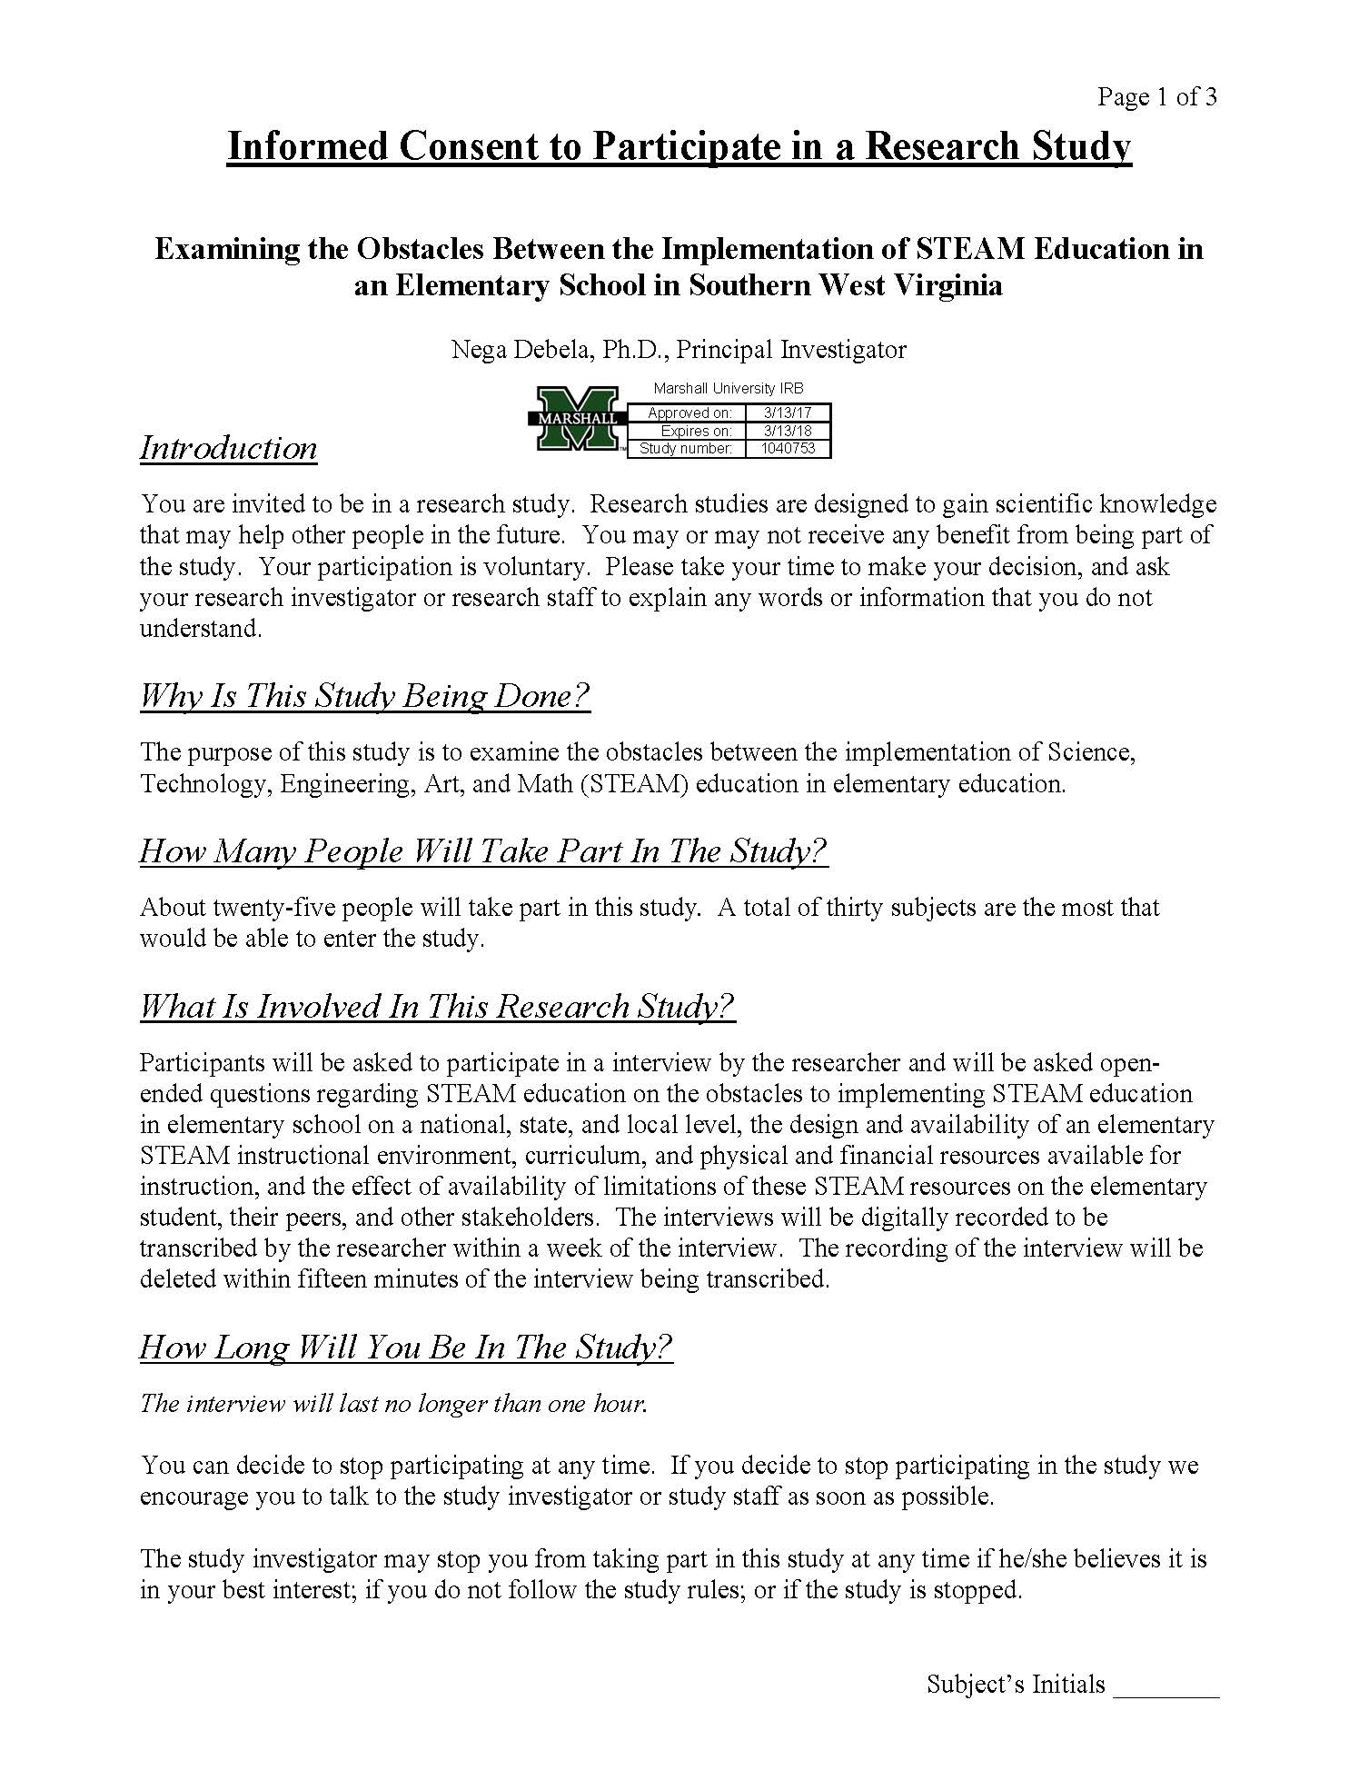
A Foothold Found: Spring 2017
EDF 517: Statistical Methods
Added the statistics component to the groundwork laid into the Research Methods class.
CI 704: Social and Political Determinants
of Curriculum
First engaged in research that was relevant and influential within my school as a mixed methods study examining the obstacles implementing STEAM education.
Went through the process of obtaining IRB approval.

Slide 5
“I” Found My Footing: Summer 2017
HUMN 600: Introduction to Humanities
“being with
Serendipitous Pairing of Classes
Both classes introduced ethnography as “process and product” (Schwandt, 2007, p. 117).
Reconnected with the overall field of the Humanities as a content area.
text”
&
EDF 625: Qualitative Research in Education
Co-taught by Drs. Campbell and Lassiter
First found and researched autoethnography as a form of arts-based method of inquiry.
Significant reading: Carolyn Ellis’s (1997) “Evocative Autoethnography: Writing Emotionally About our Lives.”
“being with
people.”
(Schwandt, 2007, p. 117)

Slide 6
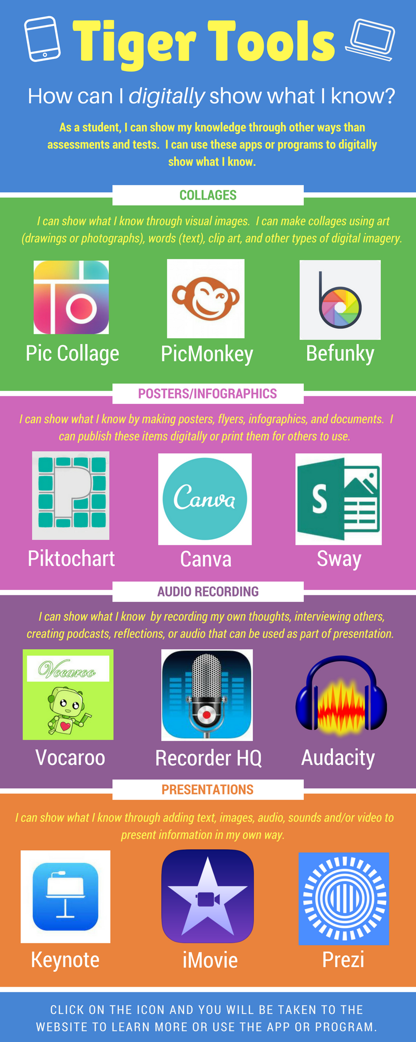
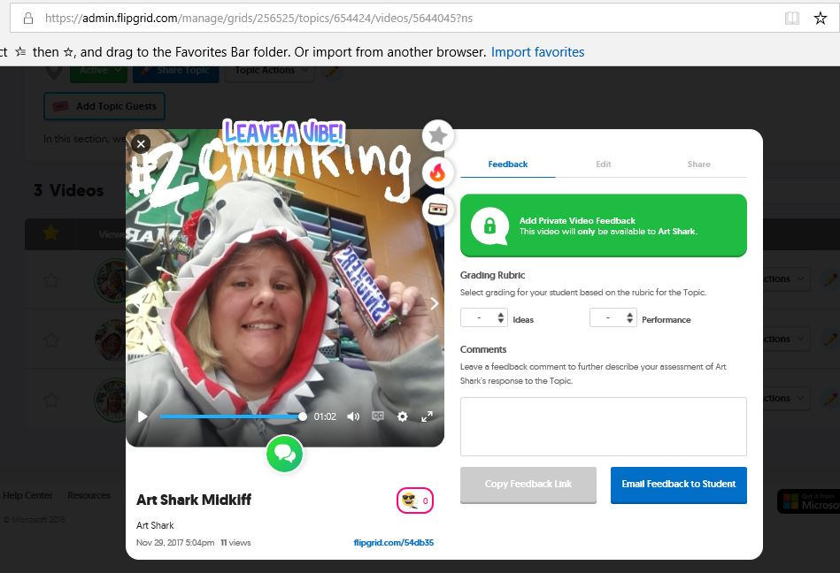
Two Hits and a Miss: Fall 2017
CI 702 Curriculum Theories
“I Am My Experiences: A Personal Theory of Curriculum”
Curricular Theory based upon experiential learning, John Dewey’s theories relating to art, art education and the connection between the arts, social justice, and democracy (Goldblatt, 2006).
CIEC 700: Technology and Curriculum
Gained experience using programs such as word clouds, Flip Grid, infographics, etc. and accessed learning through gamification.
Engaged in school related influential research regarding teachers and students using apps to create digital products.
HUMN 703: Theory of the Arts I consider my first effort into
autoethnography “a miss,” I left the semester determined to find a way to
make this research methodology in the future.
Note: All three of these class lead to accomplishments in later semesters.

Slide 7
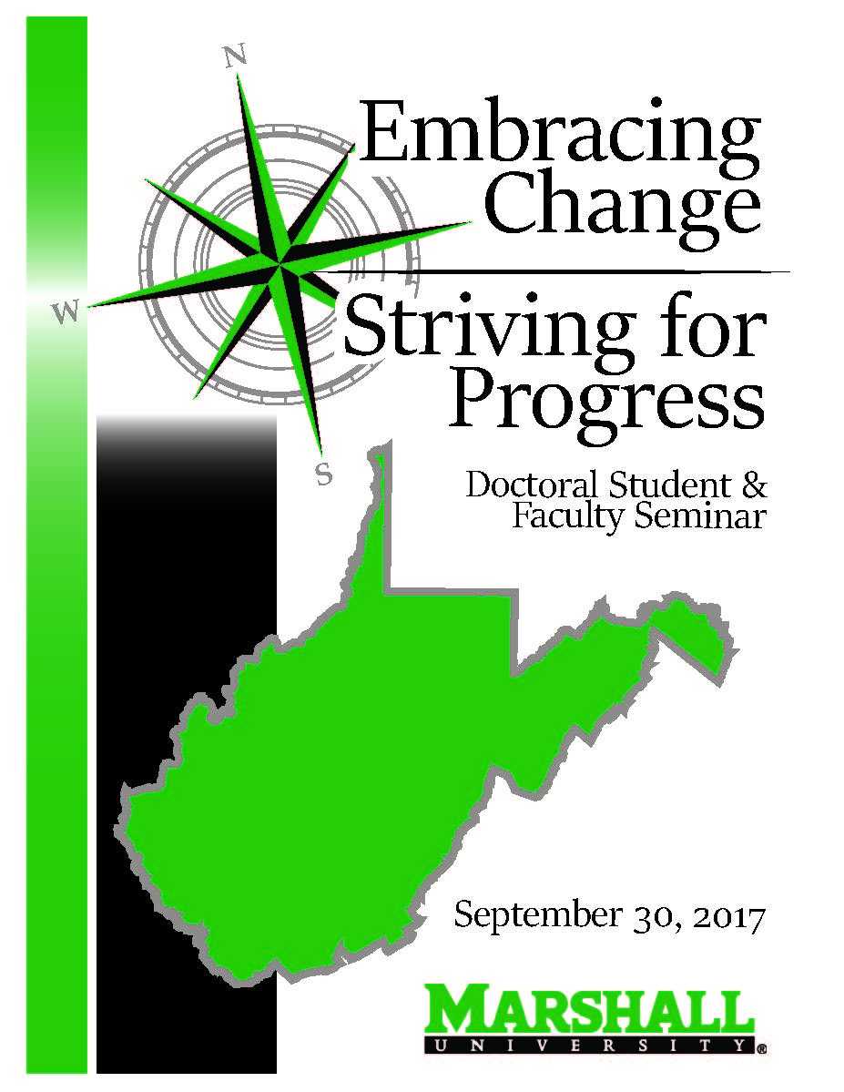
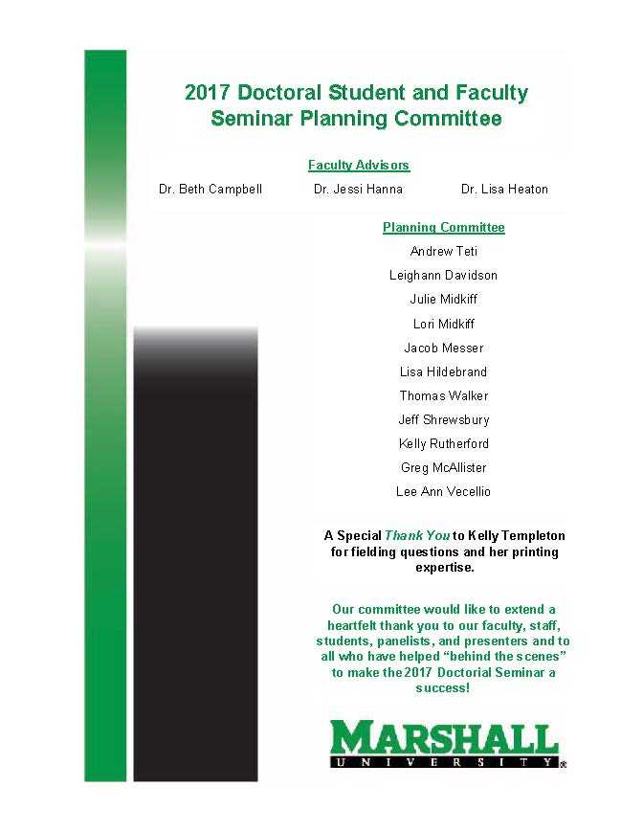
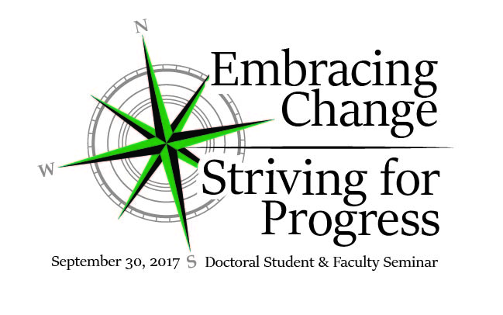
Collaboration: Fall 2017
Worked with Dr. Campbell and the seminar committee to plan and work the Fall 2017 Doctoral Student & Seminar.
Designed the logo, cover, and co-designed the interior pages with Marshall staff members and doctoral students.

Slide 8
Spring 2018: Confidence Regained and the Journey to the “I” Continued
CI 677: Writing for Publication
Another Serendipitous Pairing of Classes
Highly individualized path to reflecting upon the processes and experiences that influenced our writing.
Engaged in writing & submitting a blog entry for potential publication.
Autobiographic and reflective writing assignment titled
“Journey to the I.”
“Oral Histories of the Elk River Chemical Spill: A Practical Retelling of Resilience and the Experiences of Living Through a Water Crisis”
EDF 626 Advanced Qualitative Research
Revisited and dug further into the concepts of Clifford Gertz’s idea of thick description.
Gained experience in finding, selecting, and using a mix of written resources and interviews to write a miniature ethnography based on the 2014 Elk River Chemical Spill.

Slide 9
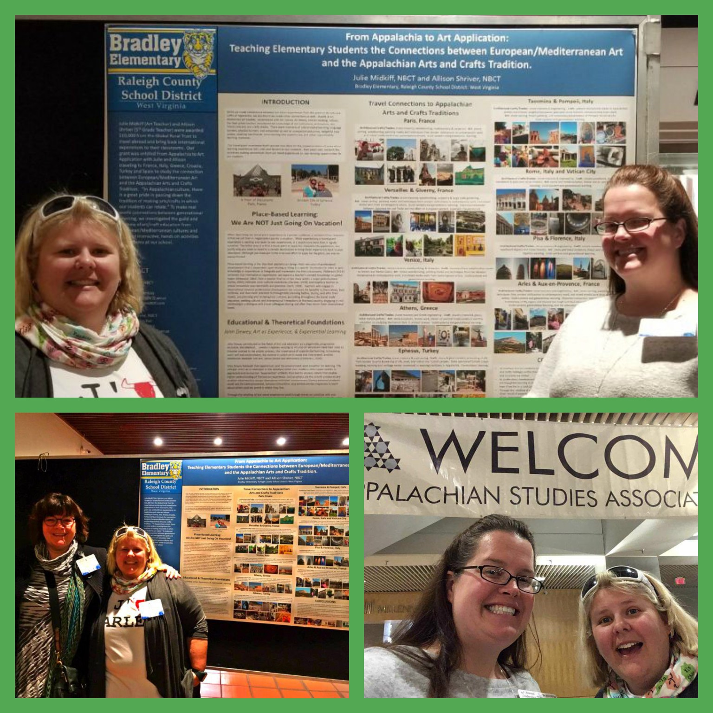
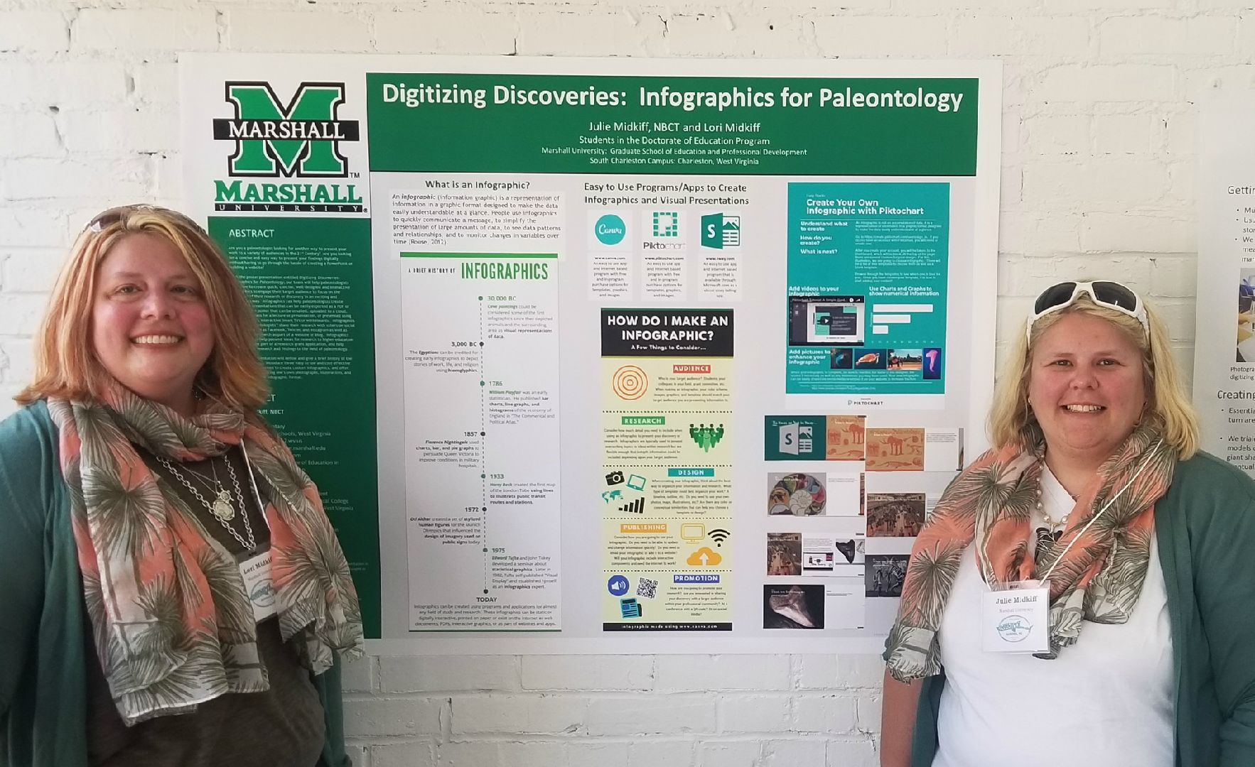
Spring 2018: Confidence Regained and the Journey to the “I” Continued
41​st​ Annual
Appalachian Studies
Association Conference:
April 5-8, 2018 in
Cincinnati, Ohio
Regional Conference Presentations
11th Annual Southeastern Association of Vertebrate Paleontology
May 23-27, 2018 in
Aurora, N.C.
“​From Appalachia to Art Application: A Poster Presentation
in Teaching Elementary Students the Connections between European/
Mediterranean Art and the Appalachian Arts and
Crafts Tradition”
“Digitizing Discoveries: Infographics for Paleontology” by using Canva, Piktochart, and Sway to create concise, well-designed and interactive infographics.
Based upon research from
CI 701 & CI 702
Based upon research from
CIEC 700

Slide 10
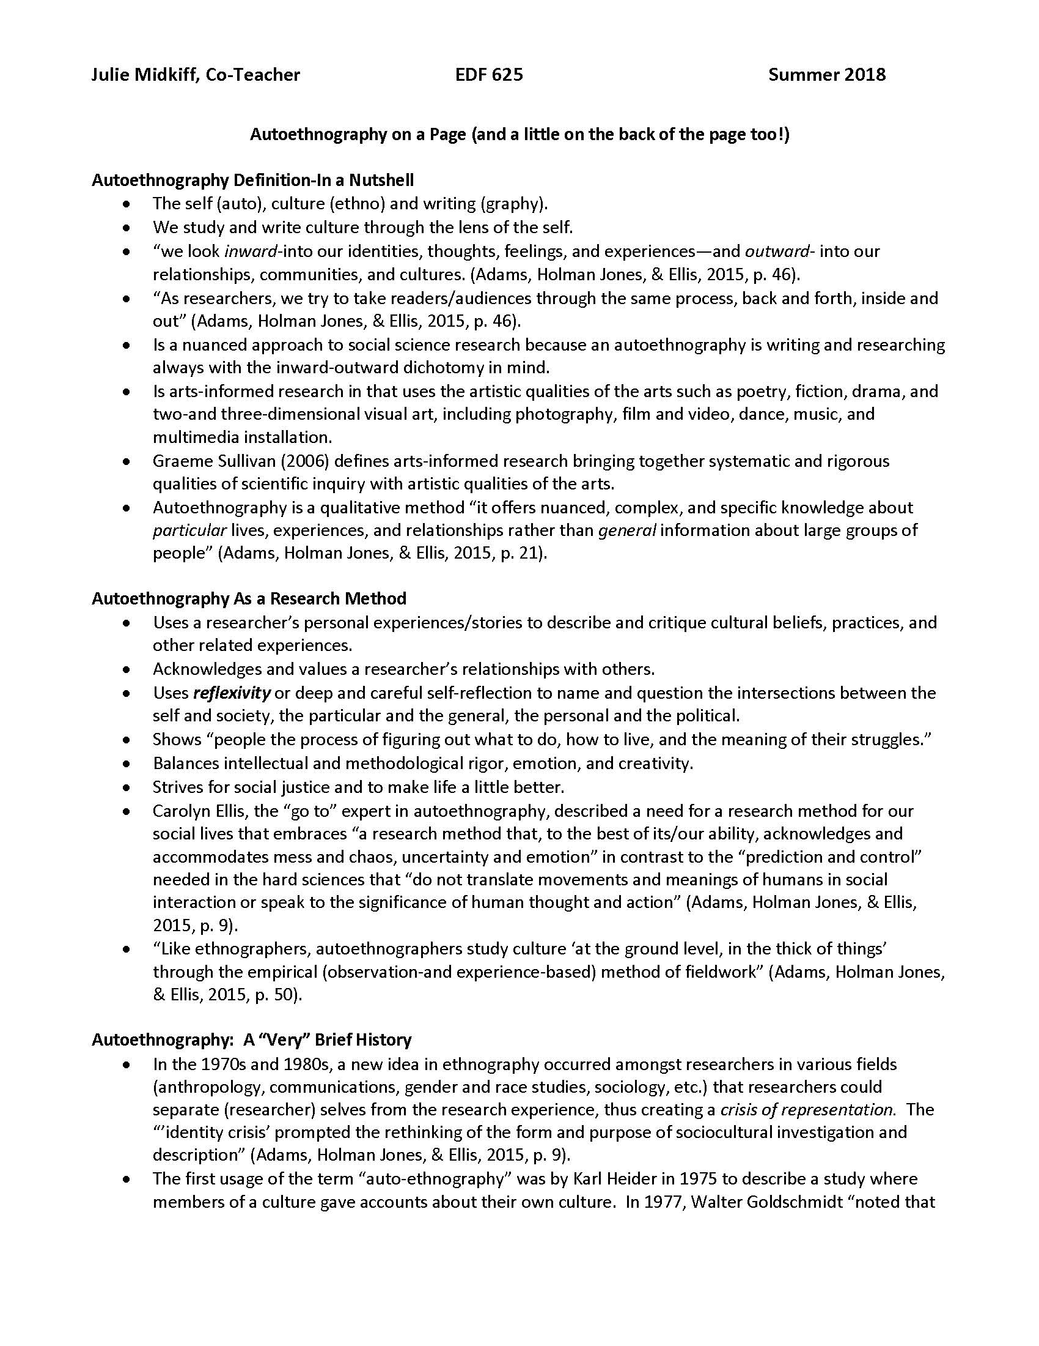
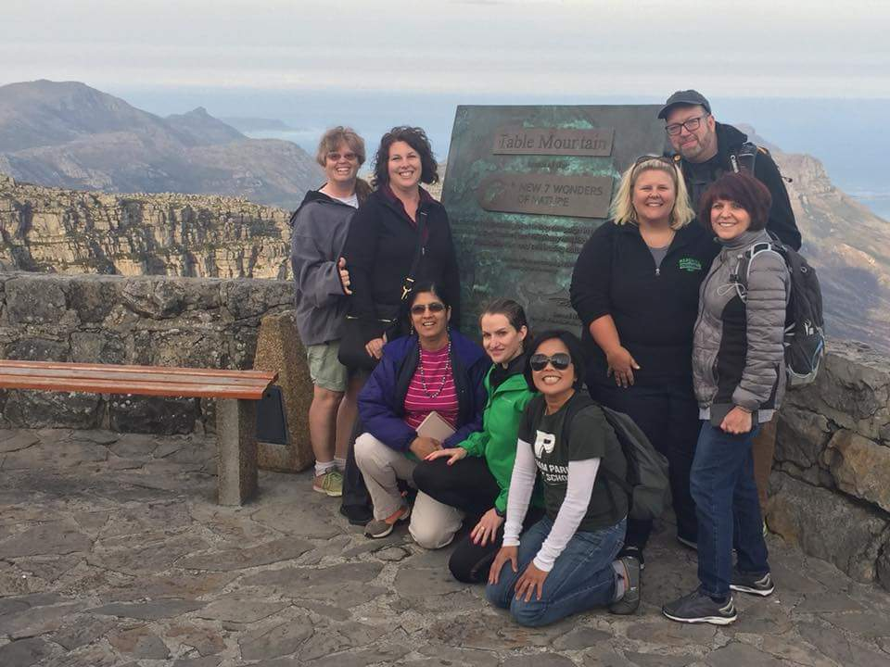
“I” Hit the Ground Running: Summer 2018
Co-Taught EDF 625: Qualitative Research in Education with Dr. Lassiter
Gained insight and experience in co-teaching, grading, and communicating with students in Masters and Doctoral Programs.
Created and presented a resource guide titled “Autoethnography On a Page” a culminating document that was part of my CULS 600 research.
CULS 600: Autoethnography (Independent Study)
I researched and read journal articles and books by experts in the field of autoethnography such as Carolyn Ellis, Art Bochner, Deborah Reed-Danahay, Stacy Holman Jones, and Toney E. Adams.
Created an annotated bibliography of resources that would be used to create the methodology section of my future dissertation.
Completed coursework and participated in 9 day field experience in South Africa
as a 2018 NEA Foundation Global Fellow

Slide 11
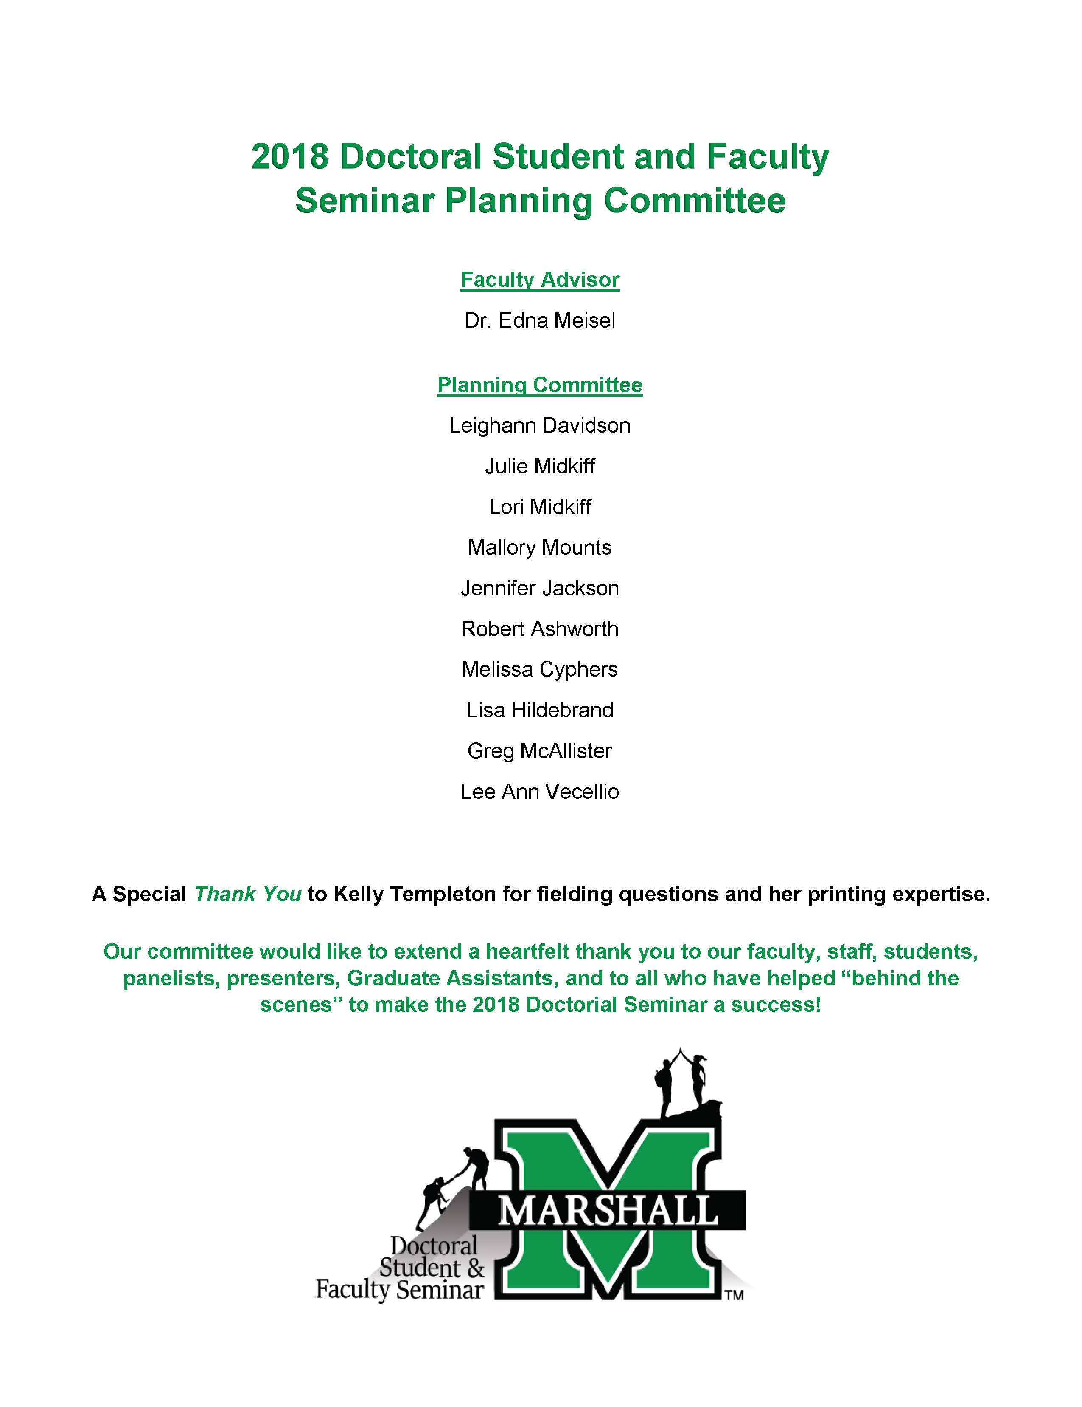
Fall Semester 2018: Along Came a Spider and other Collaborations
The spider bite, infection, and surgery occurred.
The experience quickly reminded me that I am not always in charge, to rely on the help of others, and the importance of working collaboratively with peers in the doctoral program and co-workers at my school.
Worked towards writing and finalizing the portfolio essay and portfolio presentation.
Worked with Dr. Meisel and the seminar committee to plan the Fall 2017 Doctoral Student & Seminar.

Slide 12
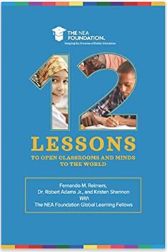
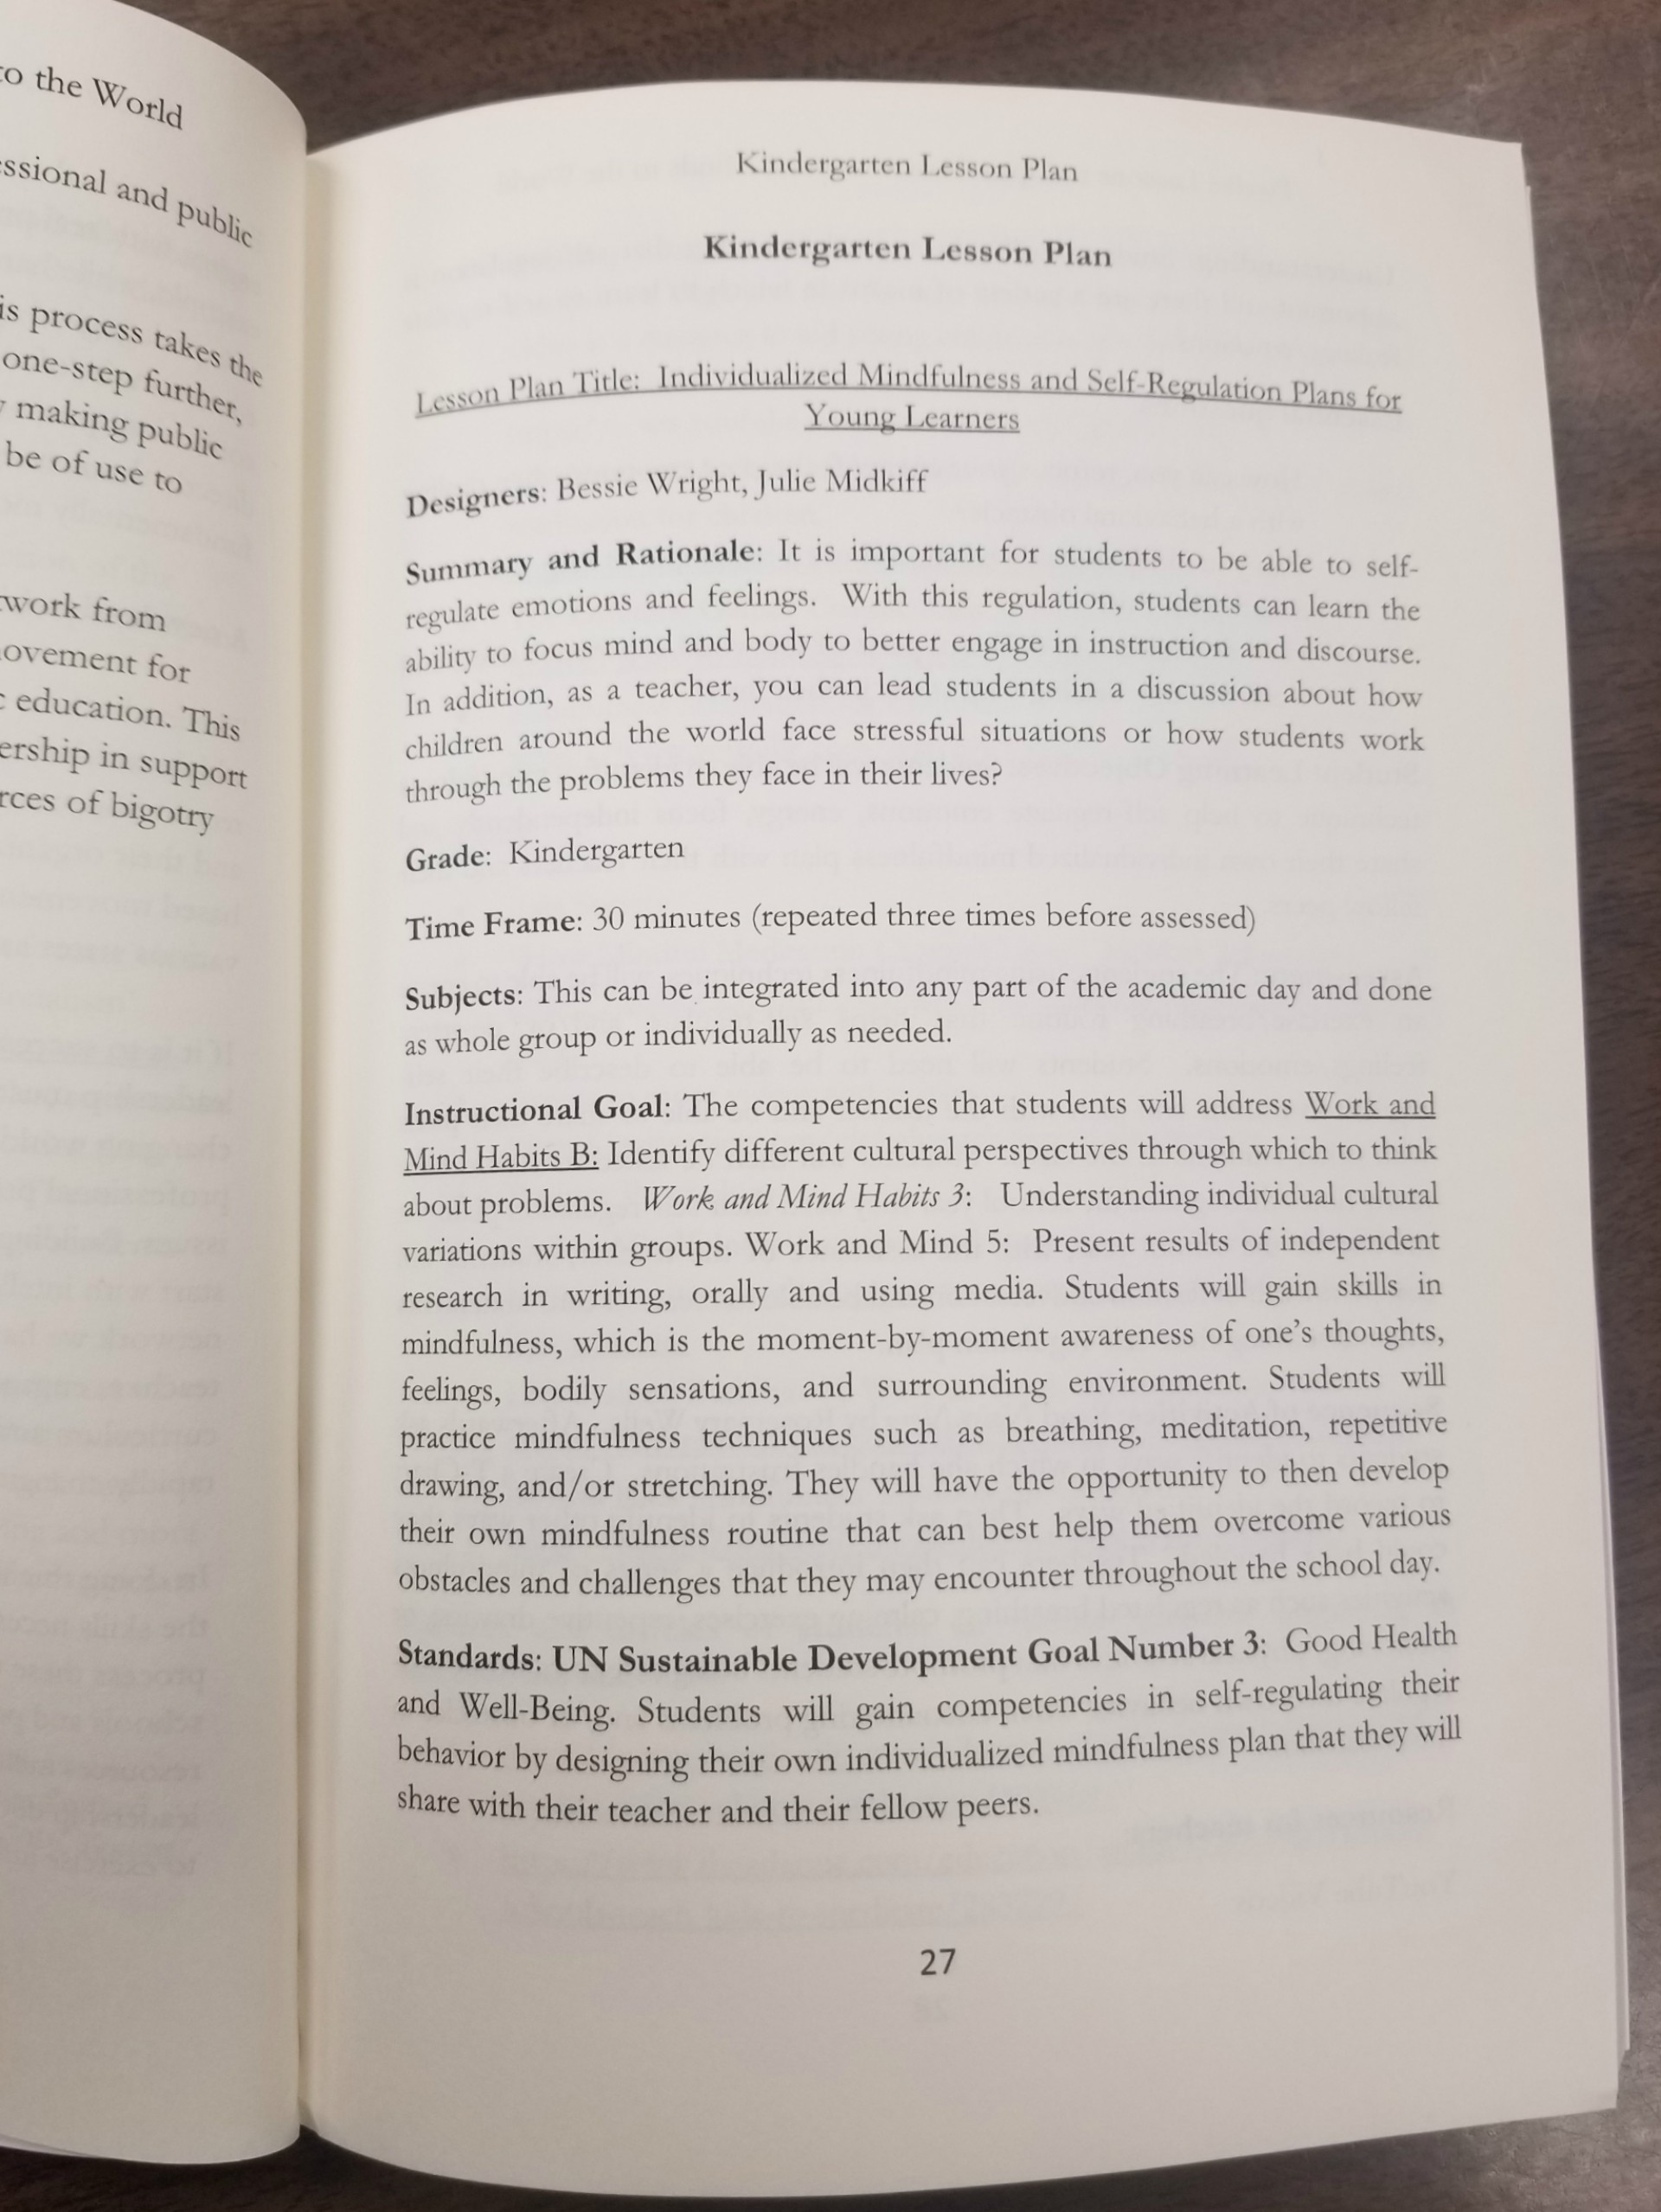
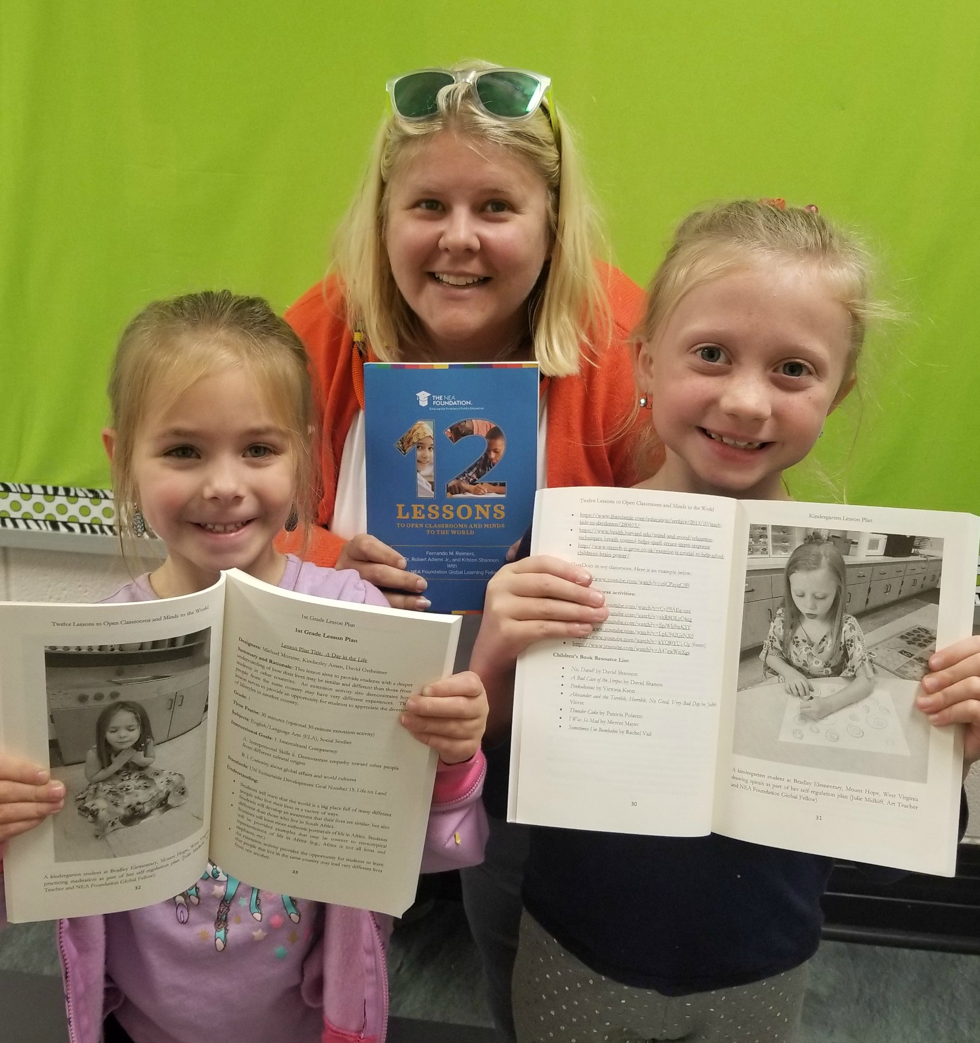
Fall Semester 2018: Collaboration and Publication
“Twelve Lessons to Open Classrooms and Minds to the World” edited by Dr. Fernando Reimers, Dr. Robert Adams, Jr., and Kristen Shannon with contributions from the 2018 NEA Foundation Global Fellows
I helped to cowrite and test a Kindergarten mindfulness lesson plan with resources.
The lesson was peer reviewed by curriculum specialists from Better Lesson, a company whose mission is to provide a simple way for educators to connect and share high-quality lesson plans.

Slide 13
The Journey Continued: Where “I” Will Go from Here…
Onward to working with Dr. Lassiter and my doctoral committee to further refine my research topic of professional development for teachers through travel grant opportunities using the research methodology of autoethnography.
Carolyn Ellis, the “go to” expert in autoethnography, described a need for a research method for our social lives that embraces “a research method that, to the best of its/our ability, acknowledges and accommodates mess and chaos, uncertainty and emotion” in contrast to the “prediction and control” needed in the hard sciences that “do not translate movements and meanings of humans in social interaction or speak to the significance of human thought and action” (Adams, Holman Jones, & Ellis, 2015, p. 9).

Slide 14
Thank you to my committee and Marshall University for supporting my doctoral journey!
Committee Chair: L. Eric Lassiter, Ph.D.
Elizabeth Campbell, Ph.D.
Lisa A. Heaton, Ph.D.
Shelia Chipley, Ed.D

Slide 15
Resources
Adams, T. E., Holman Jones, S., & Ellis, C. (2015). Autoethnography: Understanding Qualitative Research. New York, NY: Oxford University Press.
Ellis, C. (1997). Evocative autoethnography: Writing emotionally about our lives. In W. Tierney & Y. Lincoln (Eds.), Representation and the text: Re-framing the narrative voice (pp. 116-139). Albany: State University of New York.
Goldblatt, P. F. (2006). How John Dewey’s Theories Underpin Art and Art Education. Education and Culture, 22(1), 17-34.
Schwandt, T. A. (2007). The Sage dictionary of qualitative inquiry (Third ed.). Los Angeles: Sage.

