Slide 1
HAVE I REALLY MADE IT TO THIS POINT ALREADY? FITTING IT ALL TOGETHER Doctoral Portfolio Defense Lee Ann Vecellio, MA, EdS June 19, 2018

Slide 2
Why Curriculum & Instruction?
My Background
Why it fits with what I do
I started to see recurring themes as I evaluated more children in the same academic struggles around the same grade levels. I wondered how much of a connection there was between the boxed in curriculum and the students lack of academic success?
Low Achievement scores often can indicate a disconnect with the curriculum and/or instruction in reading and/or math.

Slide 3
Academic Background and Goals
Nationally Certified School Psychologists
Transition to teaching in Special Education at a university
Conduct research related to better address the curriculum needs of Special Education Students
Creating a course for teachers designed to address curriculum and the psychology of instruction

Slide 4
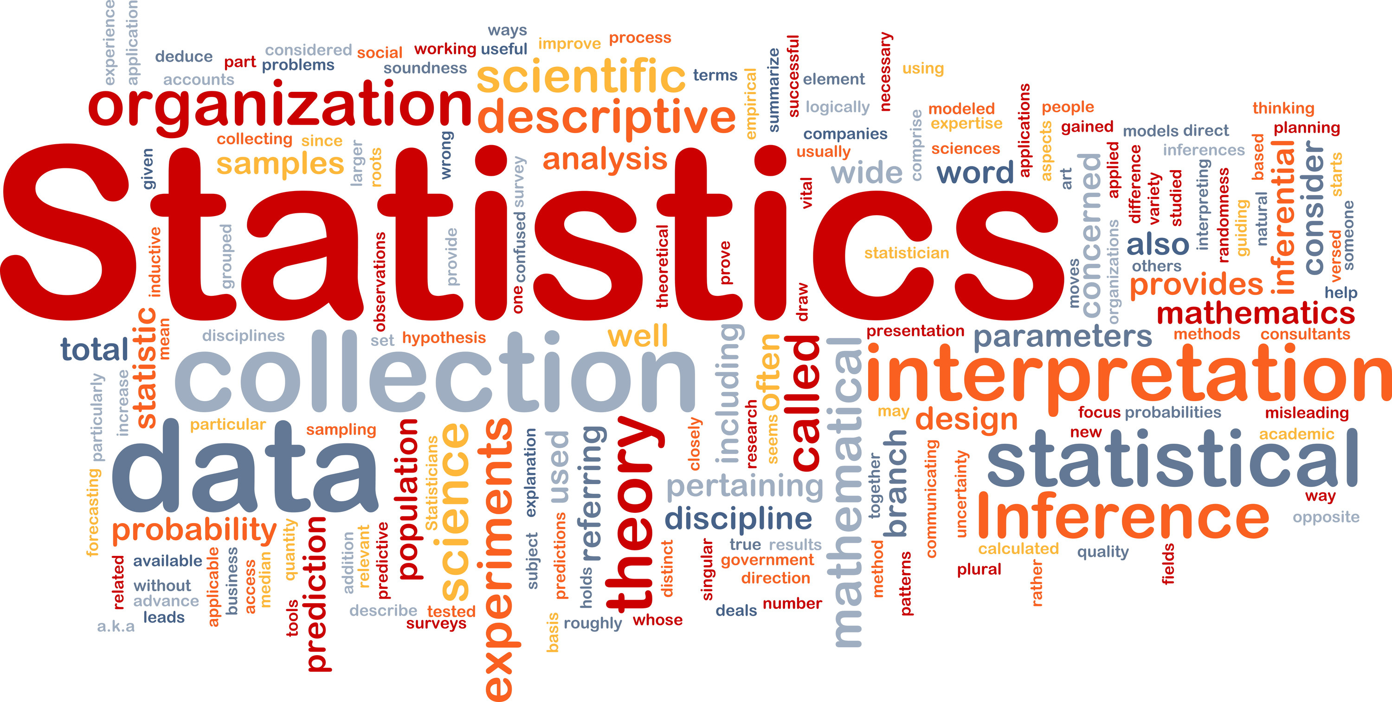
Collaboration
Co-Teaching Statistics 517 (Fall 2016)
with Dr. Meisel
C&I 677 The Secondary Family (Spring 2018)
with Dr. Campbell Final Draft C&I 677 Lee Ann Vecellio.docx
LS 714 Higher Education Administration (Spring 2017) with Dr. Anderson ../../Users/lvecellio/Downloads/LS 714 Presentation.pptx

Slide 5
Research
Retention and Promotion-are these detriments to the student’s goals?
Statistics-why this program was created to help.
Therapeutic writing-is there healing and growth through writing groups?
Publication-learning the process of creating a publishable piece.
Higher Ed Administration-it takes a village to create a final project for Dr. Anderson!

Slide 6
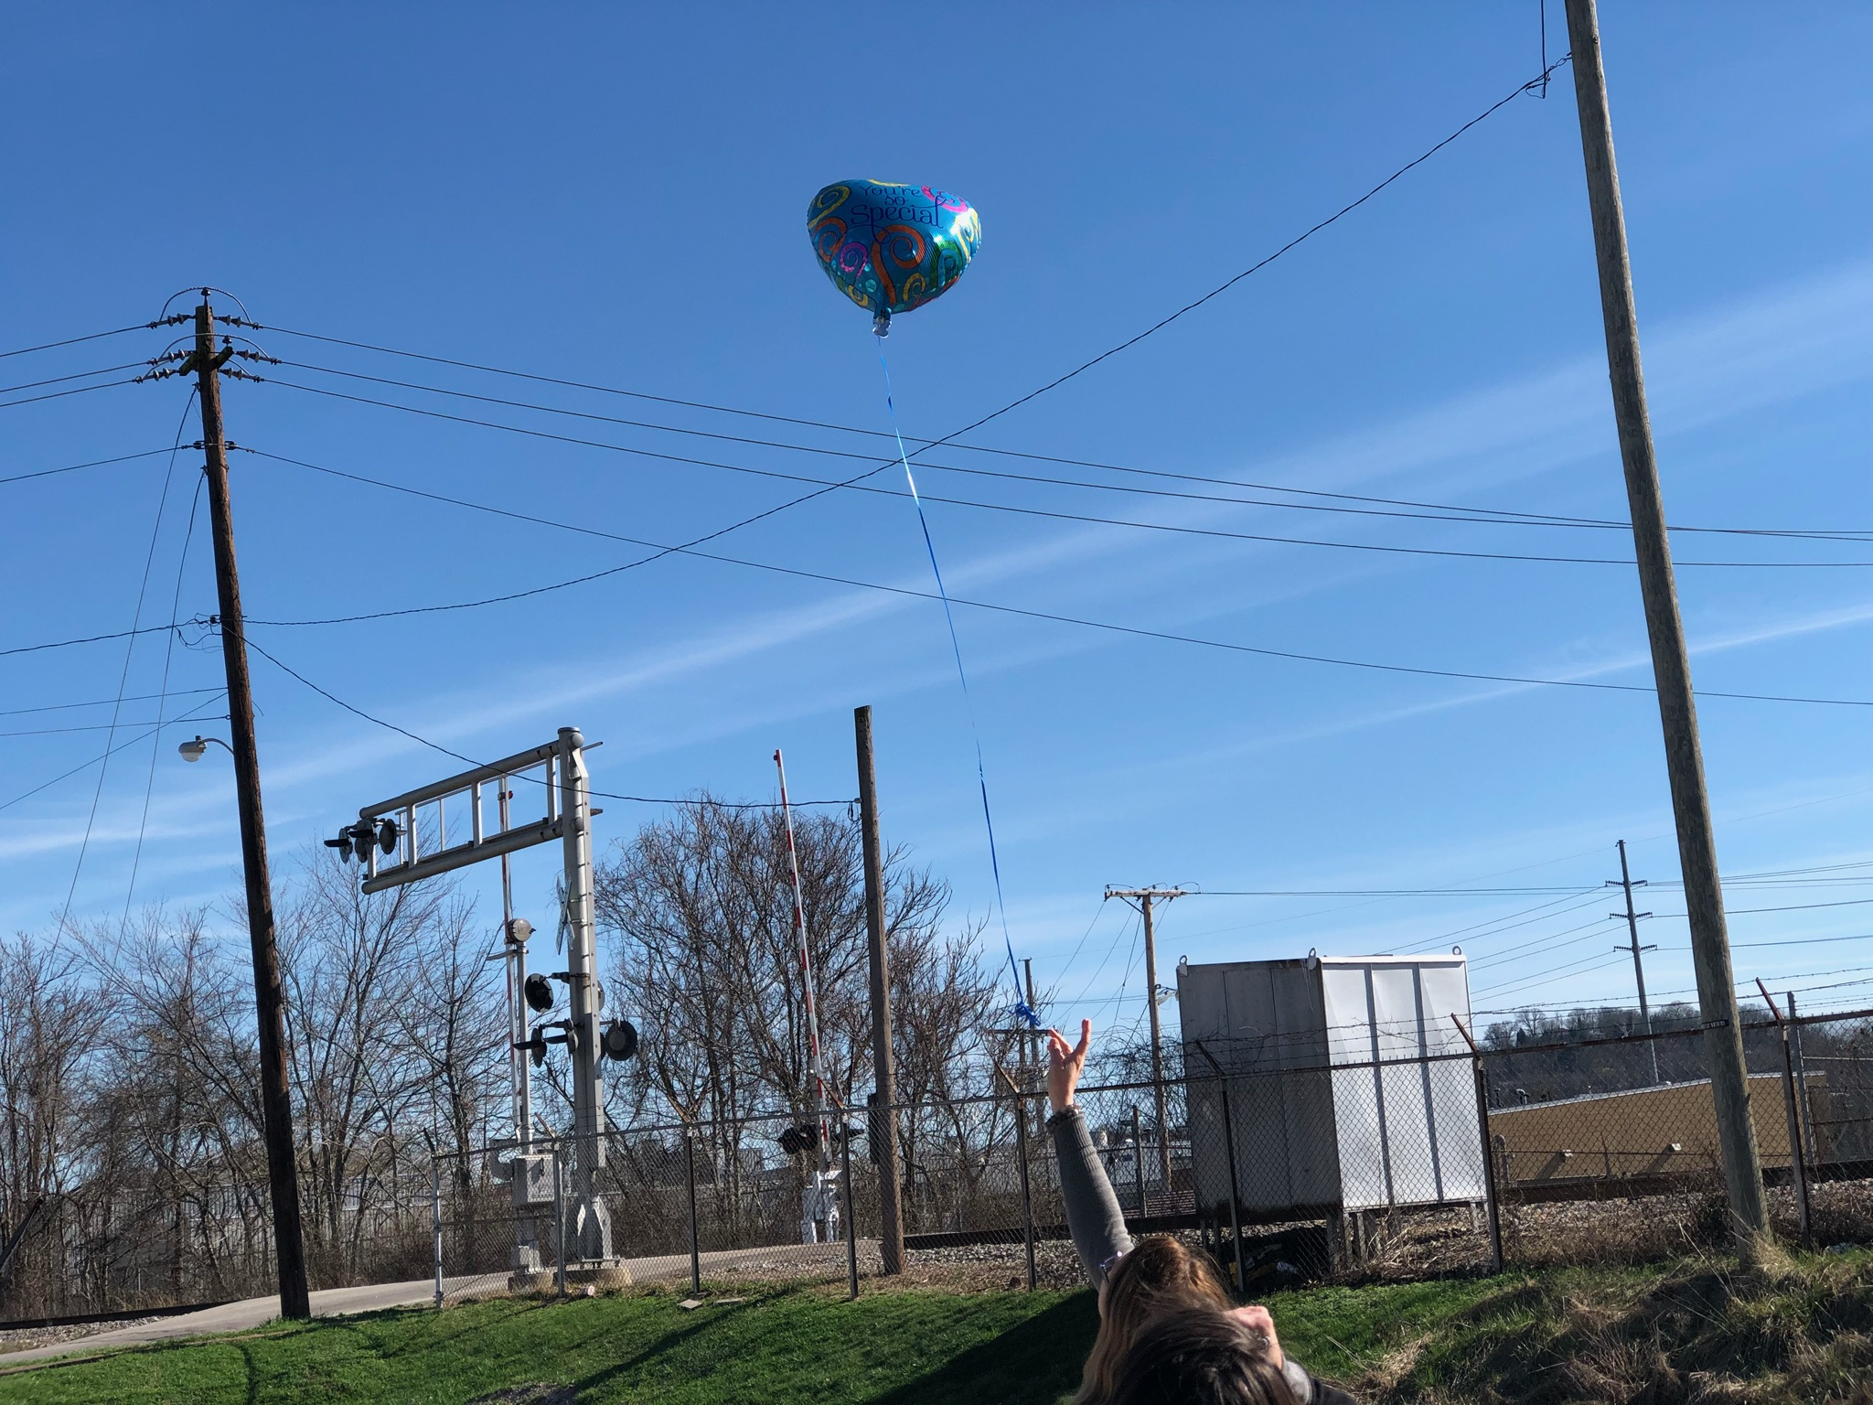
Scholarship
Partnered with Marc Shoemaker to conduct research and present at the SRCEA Conference on Retention and Promotion
promotion and retention (1).docx
Partnered with Leighann Davidson and Dr. Campbell to conduct research for a women’s therapeutic writing group and present at ASA ASA 2018 Powerpoint.pptx
Partnered with Jeff Shrewsbury and Dr. Meisel to conduct a review of the Elementary Math Specialist Certificate program and present information at ATE 2018PresentationEMS (1).pptx

Slide 7
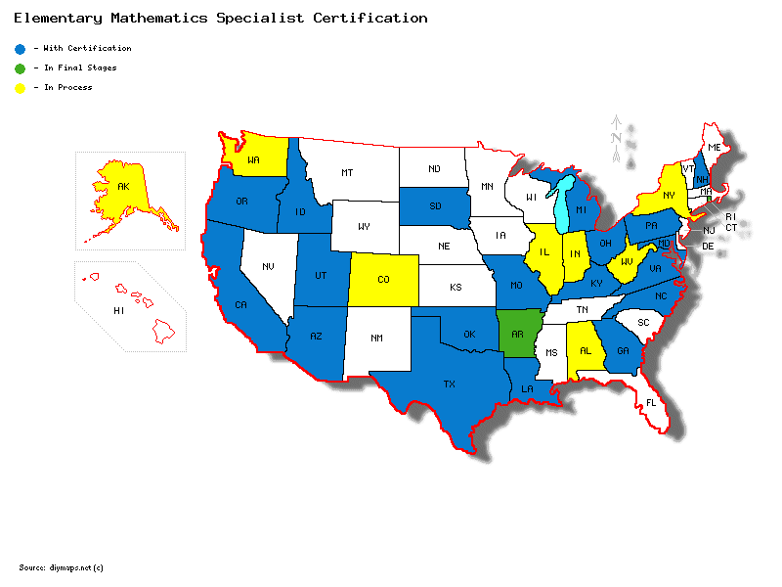
Do not worry about your difficulties in Mathematics. I assure you mine are greater. Albert Einstein
Dissertation Topic
A Review of the Elementary Math Specialist Program at Marshall University.
Marshall University is leading the way to ensure we have strong math teachers in elementary school to solidify those foundational skills.
This study will not just look at the current Elementary Math Specialists, but also how the students are performing comparing yearly summative assessments.

Slide 8
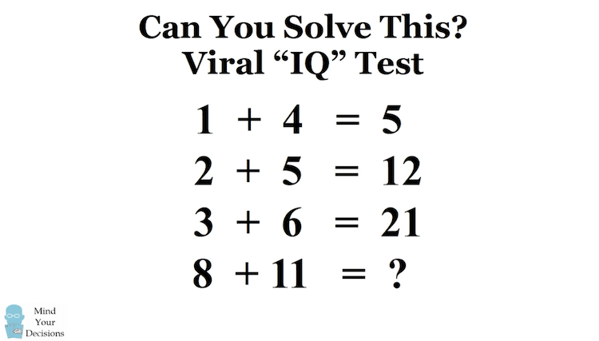
Dissertation Topic Continued
Program Evaluation of the Elementary Mathematics Specialist
Certification Program
Sequential Explanatory
Sample Size: 60 teachers that have graduated from the program
plus existing data at their schools from grades K-6.
Inclusion Criteria for program graduates, not including those
currently taking classes in EMS.
Instrumentation: Using Excel and SPSS for existing quantitative data
and Qualtrics to create a quantitative/qualitative survey with some demographic
information such as: age of the graduate, gender, amount of years in teaching
profession, and size of school district.

Slide 9
How I will Accompish my Dissertation?
Through using theorists who such as Jerome Bruner.
Using outlines and writing techniques from Writing for Publication.
Identifying who technology can play a crucial role in mathematics.
Coordinating a dissertation writing group that meets twice a month.
Collaborating with my committee on what will benefit my research.
Listening and observing when I am conducting qualitative research and research techniques gained from EDF 625 such as naturalistic inquiry and contextualism.
Referencing my Program Evaluation book often!
Utilizing the statistical methods acquired from EDF 517 and LS 776.
Creating a survey through Qualtrics based on the trainings I received through Doc Seminar (Super Saturday!).
Create an Institutional Review Board application (hopefully expedited) using the experience of submitting an application with the Therapeutic Writing Group.

Slide 10
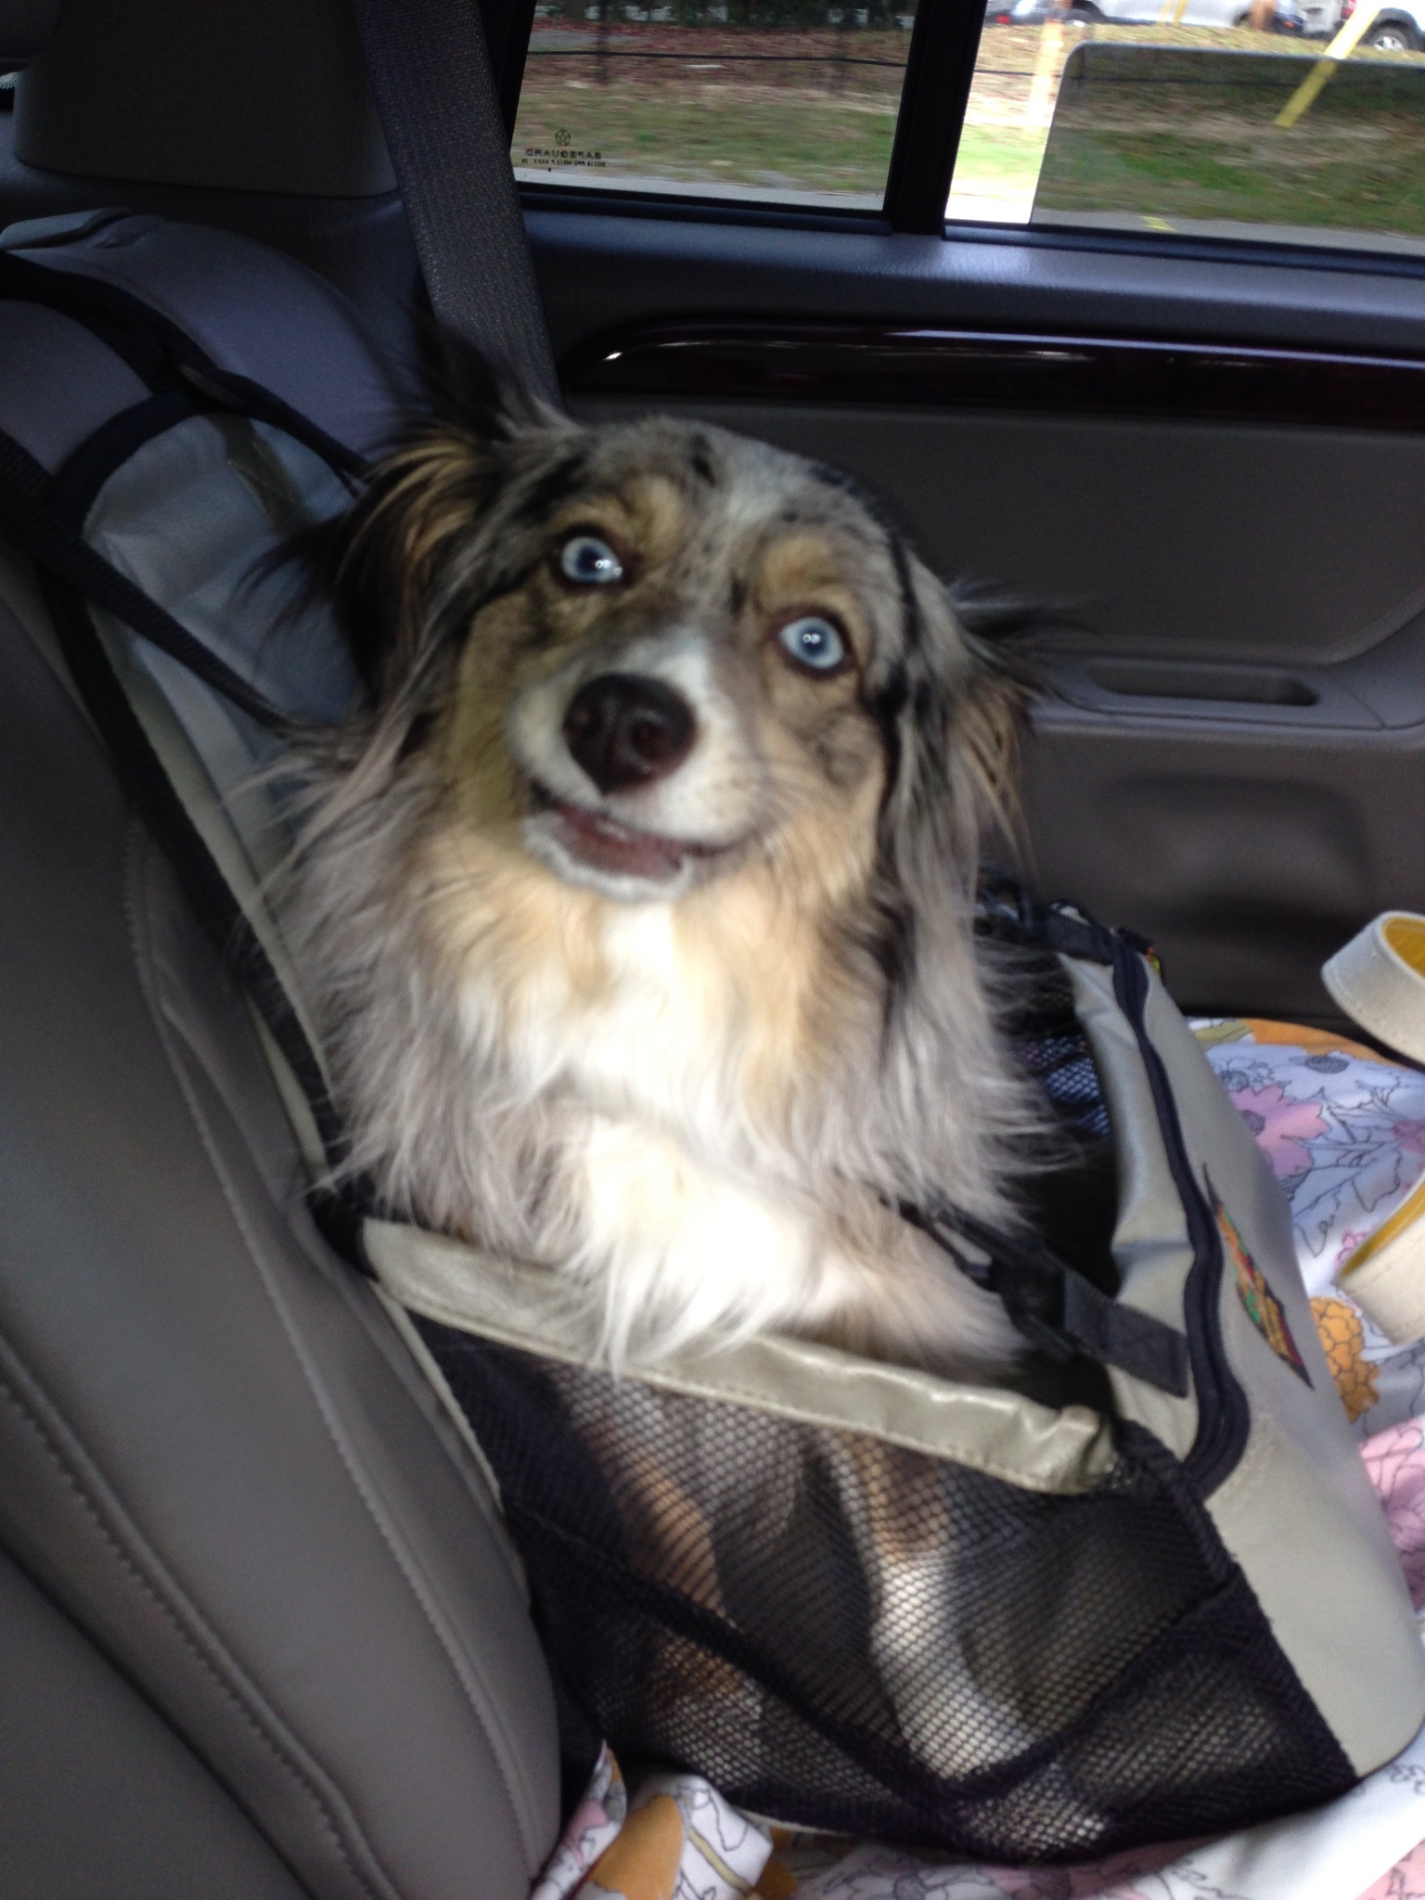
Acknowledgements
Thank you to all of these individuals for their help with getting me to the portfolio and on to dissertation!
Dr. Edna Meisel
Dr. Elizabeth Campbell
Dr. Luke Eric Lassiter
Oscar and Lois Vecellio
*Lucy Vecellio
If you would like to view my electronic portfolio follow the link below.
https://sites.google.com/site/leeannvecellioportfolio/letter

Slide 11
References
Bruner, J. (1960). The Process of Education. Cambrigde, MA: The President and Fellows of Harvard College.
Elementary Mathematics and Teacher Leadership Project (n.d.). Retrieved June 1, 2018, from https://sites.google.com/site/emstlonline/state- certifications
My Modern Met (n.d.). Retrieved June 3, 2018, from https://mymodernmet.com/brain-teaser-math-puzzle/
Qualtrics (n.d.). Retrieved June 10, 2018, from https://www.qualtrics.com/

