Slide 1




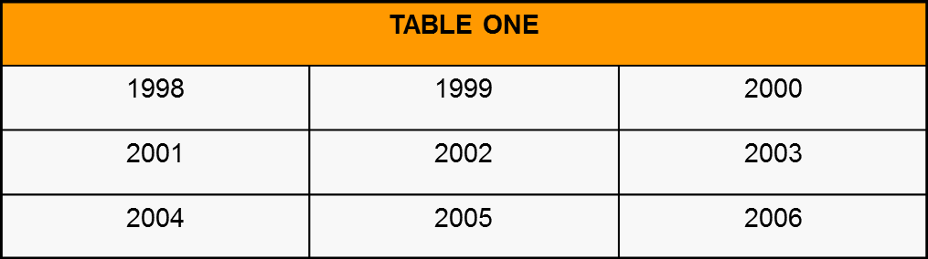
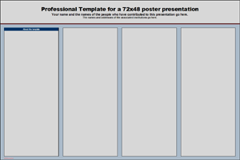
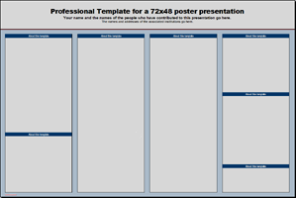



Template for a 48” x 36” Poster Presentation with a 2” Margin
Student’s Name*, B.S.¹; Associate’s Name, M.S.²; MUFSC Advisor’s Name, Ph.D.¹
¹Marshall University Forensic Science Center, 1401 Forensic Science Drive, Huntington, WV 25701
²Associate’s Location and Address
About this Template
Text Sizes
Inserting Photographs
Additional Notes for Posters
This template is designed to produce a 48” x 36” poster. It has a built-in 2” margin to ensure that the poster prints properly. It is completely configurable, and you can modify the text, the headings, and the size of font as needed for your presentation.
By using this template, your poster will look professional, be easy to read, and save you valuable time by pre-configuring the proper placement of titles, subtitles, and text body. Before you start, read all the information in each of the columns! It’s all there to help you make a better poster.
For poster design beginners, there are many helpful tips on the poster template itself. For better understanding of the poster-making process, refer to the online presentations in the student-only section of the web site. This will guide you through the poster design process and answer most of your poster production questions.
For further assistance, contact Ian Levstein at (304) 691-8966.
This template uses Times New Roman font at several recommended (although not absolute) text sizes:
Title – 96
Authors – 54
Location – 40
Column Headers – 40
Text – 32
Figure Text – 20
You can use any typeface and size you want, but you must be consistent. Don’t switch font types – ever! Keep in mind that a serif font (such as TNR) is easier to read on paper, while a sans serif font (such as Arial) is easier to read on a monitor. This poster will, ultimately, be printed, so TNR is more appropriate.
Remember – several small text boxes are easier to work with than a single large text box.
It is highly recommended that you use the largest images to which you have access for your poster. Avoid small images downloaded from the Internet and avoid copying and pasting images instead of using the Insert command. To insert an image, click Insert → Picture.
Note – Copyright law applies to all images and text that exist on the Internet. If you use any picture/graphic or text from a web site, you must acknowledge the source.
First – bullet points. 1) bullet points are talking points, which means they should not be complete sentences! You, personally, fill in the missing information when you talk to someone about your poster; 2) you never put a period (.) at the end of a bullet point; 3) if you have two things to say, either use two separate bullet points, or don’t use a bullet point at all. Don’t put two or more important details into a single bullet point.
Second – keep things short, simple, and to the point. Posters should be self-explanatory – so, remove all non-essential information. The single, most common error is too much text!
Third – I have included a transparent MUFSC logo from the student-only section of the web site. Transparent logos look much better than something with a white or colored background. If you want to create a transparent logo, just ask.
Fourth – for the entire length of this poster, do not put anything between the right edge of this column and the right edge of the poster. Leave that 2” margin alone!
Finally – be consistent. No matter what else you do, you must be consistent throughout.
When the only source of a needed photo or graphic is the Internet, scaling (enlarging) has to be applied with caution. Scaling an image more than three times its original size may introduce pixelation artifacts. Refer to Figure 4 as an example. A simple way to preview the printing quality of an image is to zoom in at 100% or 200%, depending on the final size of the poster. What you see is what will print.
Changing the Poster’s Column Layout
Poster Basics – Poster Layout
Each of the 4 columns in this template is about 29”long by 11” wide. Depending on how you design your poster, you may want to change the column layout configuration. If you do, be certain that all the columns are the same width and length, and that the space between the columns is the same.
Above all else, be consistent.
Figure 4: Original image at 100%, enlarged 200% and 400%.
To start using this template, you may want to delete most of the contents of this page and keep the poster title and one of the blue section headers. If you would prefer to work column by column, that’s okay also.
The cleared template should now look like Figure 1.
After you decide how many sections you need for your poster (Abstract, Methods, Results, References, etc.), use the copy/paste commands to create as many copies of the green section headers as needed.
Move the header copies approximately to where you think they need to be on the poster, so you can get a better sense of the overall poster layout. It will help you organize your content. See Figure 2. You can now start adding your text.
To add text, insert a text box starting from the left edge of a column to the right edge and enter your text. You can also paste the text from another source. See Figure 3. Repeat the process throughout the poster as needed.
Inserting Tables & Graphs
Inserting tables, charts and graphs is easier than inserting photos. To insert a chart/graph from Word, Excel, or other applications, highlight the selection, click CTRL-C to copy and CTRL-V to paste it into PowerPoint. You can scale your charts and tables proportionally by holding down the Shift key and dragging in or out on one of the corners.
References
References should not be numbered unless you refer specifically to the source in the text of your poster. A poster is not a research paper!
References must be alphabetized.
References should use a hanging indent.
It is okay to use a smaller font for your references.
Customizing the Template Color Schemes
For those who wish to further personalize their poster presentation, you can select from any number of alternative color schemes for this poster template.
If you want to change the default design, simply click on the Design tab and select a scheme. If you want to use a different color scheme, click on the Design tab and select the pull-down from the Colors menu. The design pane will open, and you can then select the color scheme of your choice – or even design your own.
Custom Design #10, featured here, gives your poster a Marshall green look and feel, although you can tweak it a bit if you want a more authentic Marshall color scheme.
Labeling your Headers
The green headers are used to identify and separate the main topics of your presentation. The most commonly used headers in poster presentations are:
Acknowledgements
Do not write, “I would like to thank…” or something similar. It will be perceived as an insincere gesture. If you want to thank someone, write simply, “I thank…”!
It is okay to use a smaller font for your acknowledgements.
Abstract, Introduction, or Summary | Conclusions
Materials and Methods | References
Results | Acknowledgements
A
B
C
Figure 1
Figure 2
Figure 3

