Slide 1
“Bath Salts:” Cathinones and Related Toxicology
Lauren Richards-Waugh, Ph.D.
Marshall University
Forensic Science Graduate Program

Slide 2
Outline
Description of the problem
Classification of widely abused synthetic cathinones
Methylone, mephedrone, and 3,4-methylenedioxypyrovalerone (MDPV)
Pharmacology
Case reports
Second generation compounds
Alpha-pyrrolidinopentiophenone (α-PVP)
Pharmacology
Case Reports

Slide 3
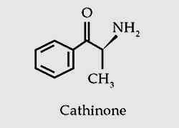
Cathinone
Pharmacologically active, natural component of the khat plant (Catha edulis)
Chewing of the leaves for stimulant properties has a long history
Dried leaves are not as stimulating
Naturally converted to cathine (much less active)
Notes:
Cathinone is contained in the leaves of the Khat plant, which has been grown for use as a stimulant for centuries in the Horn of Africa and the Arabian Peninsula. In those locations, chewing khat predates the use of coffee and is used in a similar social context. The leaves are also brewed for tea
There are more than 40 different compounds within the Khat plant, but the stimulant component has been identified as cathinone
Khat plants are rarely locally grown, so they must be imported by air Here you see khat leaves wrapped in banana leaves to keep them from drying out. As the leaves dry out, the Cathinone (Sch I) rapidly degrades to cathine (Sch IV), usally within 48 hours.

Slide 4
Initial Good Intentions
Methcathinone and mephedrone were first synthesized in the late 1920s
Prescribed as antidepressants
Medical use was not long term
Serious side effects
Had a revival in the mid-2000s
Many more have been synthesized
Notes:
The synthesis of mephedrone was first described in 1929.
Methcathinone was first synthesized in Germany in 1928, and used in the Soviet Union as an antidepressant during the 1930's and 1940's. Abuse of methcathinone, also known as "ephedrone," "Jeff," or "Mulka," has been reported in the Soviet Union since the late 1960's.
In the mid-1950's, American pharmaceutical manufacturer Parke Davis & Company conducted preliminary studies on methcathinone to determine if it had any medicinal potential.
It was tested as both a diet drug and antidepressant, but methcathinone's dangers were thought to outweigh its potential value and it was never distributed commercially in the United States.
Cathinone was unrestricted when it first appeared, but was designated as a Schedule I controlled substance by the Drug Enforcement Administration in 1993.
The first Internet reference to it reportedly occurred in May 2003 .
It was in 2007 that its availability for purchase and its related popularity really took off.

Slide 5
How did we get here?
2004 – move toward combing pharmaceutical literature for novel compounds
Production moves from clandestine labs to international industrial chemical suppliers
Internet marketing and sales
Began with 1-benzylpiperidines (BZP)
Currently, cathinones , cannabinoids, tryptamines, NBOMe compounds
Notes:
In 2004, there was a move toward combing the pharmaceutical literature for novel compounds with production moving from clandestine labs to large industrial chemical suppliers. These compounds are often sold and referred to as “research chemicals”
“Future Synthetic Drugs of Abuse”
Donald A. Cooper, DEA, McLean, Virginia (1988)
• Consumer preferences and law enforcement
activities are the two dominate forces affecting today's illicit drug markets.
• While staying within the confines of consumer demand, the clandestine chemist of the future will synthesize those drugs having the highest possible potency in an effort to limit his exposure to law enforcement activities and to expand his illicit business as well.
It is unclear who has initiated selection of specific substances and what prompts chemical suppliers to include in product lines
— US is experiencing a delayed response relative to European drug markets
The internet provides virtually unlimited access to medical information and a forum for discussion of numerous health-related
topics to over one billion people globally. Unfortunately, it also facilitates the dissemination of potentially hazardous
substances by providing an alternative source of illicit and prescription drugs. Furthermore, not only can drugs
be obtained through the internet, but also instructions, advice, and first-person accounts of drug abuse practices.

Slide 6
Most Commonly Reported Desirable Effects
Increased alertness
Analgesic effects
Increased energy
Stimulation
Increased libido
Euphoria
Empathy
Notes:
Recreational doses enhance mood and increase alertness according to clinical reports
Higher or repeated doses can lead to dangerous cardiovascular and neurological complications
A few interesting quotes from some of these websites can highlight some of these desirable effects.
The big effect of MDPV... Concentration/focus levels go off the scale – I can only concentrate on one thing a time
I believe that MDPV should be considered more of a study aid. So if I've got a pile of emails to write, or a CD collection to re-organize, I might use MDPV.
I have been actively looking for a good legal stimulant drug for a long time because..well..as with many of us approaching middle age in the early 21st century, I hate my job but am stuck in it for the time being. When I hate my job, I have no motivation to do the work. And I have plenty of work to do, all of which I have been having difficultly finding the energy for.
I suffer from mild depression, and when it occurs I find myself becoming emotionless, unstimulated by anything, and I find my attention span shrinking to absolutely nil. I cannot concentrate in this state. I become socially withdrawn without any desire to interact with anyone. My libido vanishes and I have no sexual desire.
For the first time in a long time, I felt motivated and alert. This will be a useful substance for a depressed person who hates anti-depressants. Self-medication is a risky business, but at the end of the day so is Big-pharma.
MDPV experiences are rife with abuse of this drug...feinding, redosing, addiction, and overuse. MDPV should be taken in small doses and NEVER redosed within 24 hours. MDPV, in my opinion, is a 'work' drug like coffee.

Slide 7
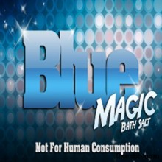
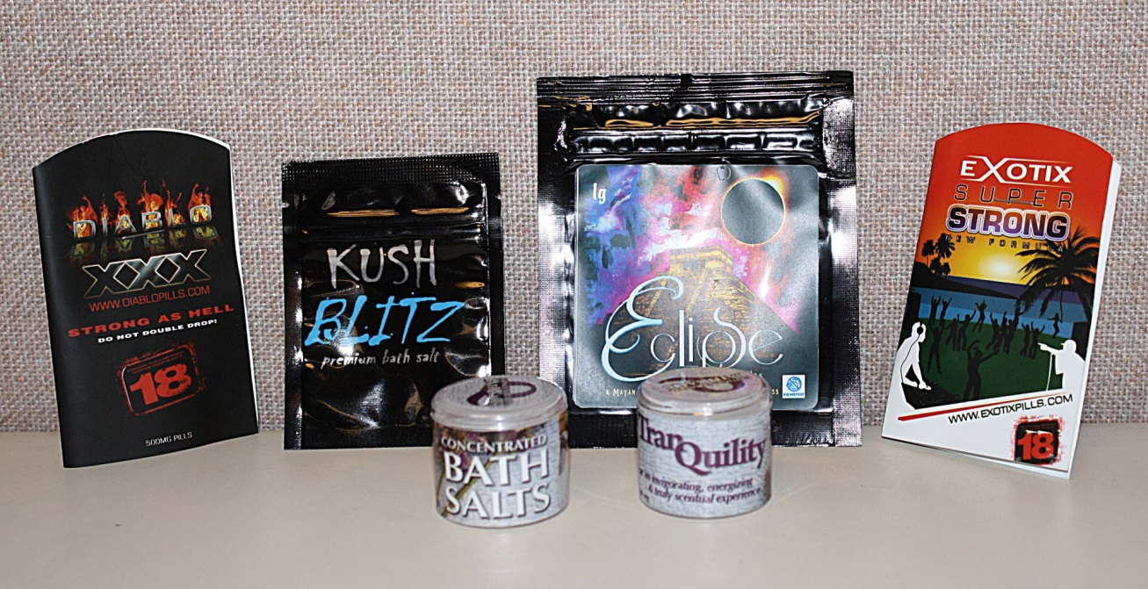
Synthetic Cathinones
Often described as a “legal” alternative to cocaine or amphetamine
“Designer” drugs – structurally similar to existing drugs
Contained within products marketed as bath salts, bonsai food, powder cleaner and many others
Labeled “not for human consumption”
Notes:
Synthetic cathinones are often purchased as “legal highs” that mimic the effects of cocaine, methamphetamine and MDMA, which we will get into a little later why this is not surprising.
They are labeled, “Not for Human Consumption”, this is clearly not the true intention of those selling or purchasing these products.
Existing laws did not restrict these drugs when they first hit the market, however, state legislatures quickly acted to ban their sales.
The active ingredients in the first wave of synthetic cathinones were the stimulants mephedrone, methylone and methylenedioxypyrovalerone (MDPV).
"Bath salts" were found in convenience stores, discount tobacco outlets, gas stations, pawnshops, tattoo parlors, truck stops and other locations.
The danger with most “legal” substances used to get high is that they were developed and tested for some other purpose, and often include warnings about potential dangers or consequences of misusing them. When they are used to get high, the side effects and consequences are essentially unknown. But often those side effects produce serious risks to both physical and mental health. Unfortunately, these only become apparent after the fact, and can lead to permanent impairment or death.

Slide 8
US Poison Control Centers: Calls regarding human Exposures to Bath Salts
https://aapcc.s3.amazonaws.com/files/library/Bath_Salts_Data_for_Website_10.31.2013.pdf
– accessed Nov. 22, 2013
Notes:
There were 304 calls to US Poison Control Centers regarding bath salts in 2010. Then, that number sky-rocketed to 6138 –a 20-fold increase
The number of calls appears to decrease in 2012 – this is likely not because there was a significant decrease in the use/abuse of bath salts but likely that the users became more savvy and physicians became more experienced at treating patients presenting with the symptoms associated with the use of synthetic cathinone compounds
DEA Seizures
2008 – 14 reports in 8 states
2010 – 290 reports in 21 states

Slide 9
MDPV Timeline
Around 2005 – Online discussions of MDPV began
Tracked by The Psychonaut Web Mapping Project
2008 through 2009 – escalating number of user accounts reported online
2010 – first “bath salt” exposure reported to a U.S. Poison Control Center
“Bath salts” cases began to flood the U.S. news media in early 2011
Notes:
MDPV was the synthetic cathinone most frequently detected in products sold in the United States.
Online discussion of MDPV began around 2005 with popularity increasing in late 2008 and escalating through 2009 with the first report of “bath salts” exposures to US Poison control centers in 2010
MDPV is anecdotally reported as a ‘very smooth’ compound with ‘no side effects’ and little come-down effects while other users have reported the exact opposite. The effects are strictly user reported, but appear to be highly dose dependent producing mild CNS stimulation at low doses, but a more potent high (similar to cocaine or methamphetamine) at higher doses.
Syracuse case was "ground zero" for bath salts craze, DEA says
The media was flooded with reports of suicidal, bizarre, and aggressive behavior.
Man Accused In Bath Salts Case Enters Two Guilty Pleas
brandished a deadly weapon and escaped from custody
Man high on bath salts arrested for gun threat
accused of pointing a rifle at family members
Man high on 'bath salts' when he broke into home of deputy
A Nicholas County man told sheriff's deputies he was high on "bath salts" when he allegedly tried to break into the home of a deputy
Teenager 'steals goat and kills it while high on bath salts and dressed in women's underwear'

Slide 10
Classification of Synthetic Cathinones
Phenethylamines
α-methylated
phenethylamines
Methylenedioxy-
phenethylamines
Ring substituted
amphetamines
β-ketonated
amphetamines
Ring substituted
methylenedioxy-
phenethylamines
Substituted
cathinones
Cathinone
β-ketonated
methylenedioxy-
phenethylamines
Pyrrolidine
Derivatives
Notes:
Most newer recreational drugs belong to one of four chemical classes – piperazines, piperidnes, tryrptamines or phenethylamines
The synthetic cathinones fall into the category of phenethylamines (CLICK). I am going to focus most of this presentation on a few of the synthetic cathinones in the interest of time, so I will focus on the classification of those which will be covered.
Phenethylamines can be further classified as alpha-methylated- , methylenedioxy- or ring substituted phenethylamines
The ring substituted cateogory is the classification covering many of the 2C compounds– these will to be covered elsewhere in this workshop
MDPV, MDPPP, ethylone, methylone, butylone have methylenedioxy groups (click), are ring-substituted (CLICK), and contain a beta-ketone (CLICK)
Some of the more classic phenethylamines such as amphetamine and methamphetamine are alpha-methylated phenethylamines (CLICK)
These can be ring substituted or beta-ketonated (CLICK) at this point, please switch the location of the substituted cathionones and beta-ketonated amphetamines in your handouts.
We are going to focus on the beta-ketonated amphetamines, which is where many of the cathinone compounds are categorized (cathinone itself and then the substituted cathinones- CLICK).
Mephedrone, methedrone, flephedrone, methcathinone are all substituted cathinones
There are also pyrrolidine derivatives (CLICK) that include naphyrone, alpha-PPP, naphyrone, MPPP and similar compounds

Slide 11
Most frequently abused synthetic cathinones
United States
3,4-methylenedioxypyrovalerone (MDPV)
Substance most commonly detected in blood and urine in patients hospitalized for bath salts overdose in the US
3,4-methylenendioxymethcathinone (methylone)
Europe
4-methylmethcathinone (mephedrone)
Replacing MDMA in “ecstasy” tablets
Notes:
I will be focusing the majority of this presentation on some of the more widely abused cathiones in the interest of time
In the United States, MDPV was the substance most widely detected in the blood and urine of patients that were hospitalized for bath salts overdose with methylone being second. This was before these compounds were placed into schedule 1 of the controlled substances act in October of 2011.
Mephedrone was the synthetic cathinone of choice in Europe

Slide 12
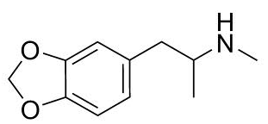
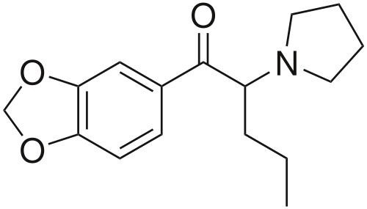
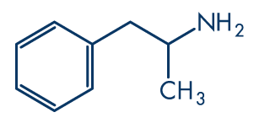
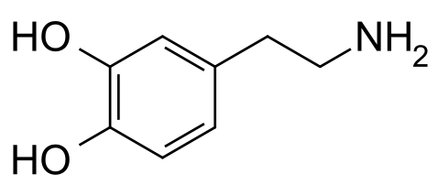
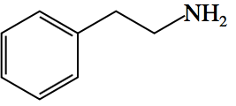
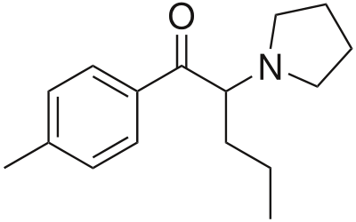
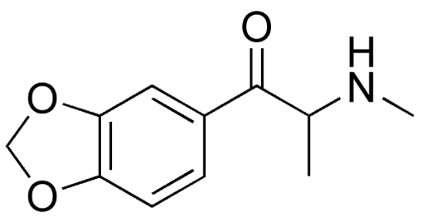
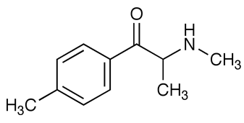
Structural Similarities
Amphetamine
MDMA
MDPV
Dopamine
Phenethylamine
Pyrovalerone
Methylone
Mephedrone
Notes:
When many of the synthetic cathinone compounds were at the peak of their popularity, the pharmacological effects were not well documented. The structural similarities to common neurotransmitters and other, compounds (MDMA, amphetamine, cocaine) gave some clues as to their pharmacological effect.
Some synthetic cathinones have structural similarity to dopamine, methamphetamine, MDMA, and pyrovalerone –
Given their structural similarities and associated behavioral effects, the mechanism of action of MDPV was thought to be comparable to that of amphetamines,
Phenethylamine is the backbone of methylone, mephedrone, and MDPV – add a ketone at the beta carbon (CLICK)
Methylone is methylated on the amine group and alpha carbon, but also has a methylenedioxy group on the aromatic ring (CLICK) as do MDPV and methylone
MDPV and pyrovalerone also have a pyrrolidine group (CLICK) in addition to a propane group on the alpha carbon

Slide 13
Predicted Pharmacology of Synthetic Cathinones
Structural similarities to compounds with known pharmacology
MDMA, amphetamines, dopamine
Increases the amount of extracellular monoamine neurotransmitters
Dopamine (DA), Norepinephrine (NE), Serotonin (5-HT)
Abbreviations for respective transporters = DAT, NET and SERT
Mechanisms leading to increased extracellular neurotransmitters
Stimulate release and Inhibit reuptake
Small number of studies evaluating pharmacology, toxicology, and physiology
Notes:
The reason for pointing out the structural similarities and differences is that before a lot was understood about the pharmacology of these compounds the pharmacology was predicted based on their structural similarities to compounds that were well-studied and the predicted effects of adding certain functional groups such as the beta-ketone, methylenedioxy, and/or pyrrolidine groups.
Amphetamine, Methamphetamine, MDMA are already known to increase extracellular monoamine neurotransporters through dopamine, norepinephrine, and serotonin transporters by either stimulating their release or inhibiting their reuptake
But prior to the past year or two, there were a small number of studies evaluating pharmacology, toxicology, and physiology of many of the synthetic cathinones
However, there are enough differences that they should be considered a unique family of compounds

Slide 14
Mechanism of Action: Mephedrone, Methylone and MDPV
In vitro studies performed using rat brain synaptosomes
IC₅₀ for DAT, NET and SERT uptake measured
Uptake of all three neurotransmitters blocked by methylone and mephedrone
MDPV blocks DAT and NET uptake, but not SERT
EC₅₀ determined for release of DAT, NET and SERT
Mephedrone and methylone stimulate release at all three transporters
MDPV is inactive as a releaser
Notes:
Over the past two to three years, there have been a number of studies published that demonstrate the mechanism of action for these drugs, which is a huge step in providing a better insight into their toxicology.
This publication summarizing the findings of in vitro studies by Baumann et al using rat brain synaptosomes provided a great deal of information about how the three synthetic cathinones (banned in October of 2011) interact with the dopamine, norepinephrine, and serotonin receptors in the brain.
The effectiveness of methylone, mephedrone, MDPV to inhibit the uptake of dopamine, norepinephrine, and serotonin through their respective transporters was measured as well as the old favorites of MDMA, amphetamine, and cocaine. The IC50 or half maximal inhibitory concentration gives an idea of a substances effectiveness to inhibit a biological process. Methylone, mephedrone, and MDPV all effectively inhibited the reuptake of dopamine and norepinephrine. Methylone and mephedrone inhibited the reuptake of serotonin, but MDPV did not.
Further investigation into how these three synthetic cathinones increase the extracellular concentrations of key neurotransmitters was performed. The EC50 or half maximal effective concentration refers to the concentration of a substance that produces a response halfway between the baseline and the maximal response. The EC50s were determined for mephedrone, methylone, MDPV, MDMA, amphetamine and cocaine.
It was determined that mephedrone and methylone stimulate the release of dopamine, norepinephrine, and serotonin similar to amphetamine and MDMA, while MDPV does not stimulate the release of these neurotransmitters – similar to cocaine.

Slide 15
Synthetic Cathinones Administered to Rodents
Lack of scientific literature describing pharmacology and toxicology until very recently
Compounds introduced to market faster than studies can be performed
Several studies performed since 2012
Marusich et al., NeuroToxicology. 2012
Aarde et al., Neuropharmacology. 2013
Baumann et al., Neuropsychopharmacology. 2013
Fentegrossi et al., Neuropharmacology 2013
Cameron et al., Psychopharmacology. 2013
Notes:
The in vitro studies give a great picture of the mechanism of action of these compounds, but in vivo studies were needed as well to further determine the pharmacology of these drugs.
Several in vivo studies using rodents have also been conducted over the past 2 to 3 years to better understand these drugs, but the drugs are coming onto the market faster than scientific studies can be conducted
This findings from a few of these papers will be summarized in the next slide.

Slide 16
Summary of MDPV Effects in Rodents
Self administration
Increased dopamine release
Increased locomotor activity
Time and dose dependent
Tachycardia
Hypertension
Effects and behaviors dependent on temperature
Stereotypy, self injury, hyperthermia
Notes:
The effects observed in rodents under controlled conditions provide a great insight into the behaviors observed in humans.
Rodents were readily trained to self-administer synthetic cathinones. Often, other compounds such as amphetamine or cocaine could be substituted without any significant effects on the self-administration behaviors. There are case and anecdotal reports of individuals repeat dosing.
Increased dopamine release – dopamine plays a major role in reward-motivated behavior, when an individual gets an increase in dopamine when taking a drug, it makes them more likely to want to take the drug again and increases the likelihood of addiction
Increased locomotor activity – many users report hyperactivity and agitation in their online reports on Erowid and other similar sites
Tachycardia and Hypertension are very frequently reported in clinical cases
Of a particularly interesting note were some of the findings in the study by Fantegrossi and others involving mice. MDPV was administered to mice at a cool ambient temperature of 20 and 28 °C and it was found that there were differences in the locomotor effects, self-injurious behaviors (picking and biting), and hyperthermia. These behaviors and effects were either less pronounced or absent in the 20 °C temperature compared to the 28 °C temperature suggesting a greater risk of adverse effects at high ambient temperatures.

Slide 17
Sympathomimetic/Stimulant Toxidrome
Toxidrome = recognizable syndromes related to drug toxicity
Signs and Symptoms
Excessive speech
Excessive motor activity
Tremor
Insomnia
Anorexia
Hyperreflexia
Seizures
Rhabdomyolysis
Causative Agents
Amphetamines
Methamphetamine
Caffeine
Cocaine
Ephedrine
LSD
Methylphenidate
Nicotine
PCP
Salbutamol
Phenylpropanolamine
Tachycardia
Hyperactive bowel sounds
Diaphoresis
Anxiety
Delusions
Mydriasis
Paranoia
Piloerection
Notes:
Many reports from emergency departments documenting their care of patients who have ingested bath salts compounds describe the symptoms as following a typical stimulant toxidrome.
In reading reports, each of the symptoms in the stimulant toxidrome shown here are listed at least once if not multiple times. However, these are not the only symptoms that have been documented in bath salts cases
(NEXT SLIDE)

Slide 18
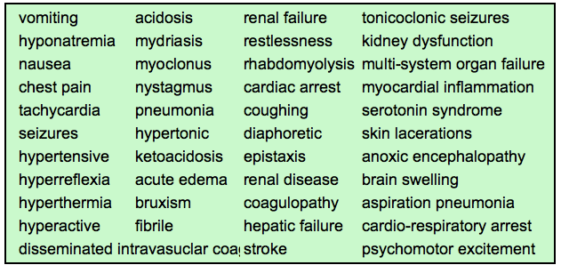
Symptoms Reported in Cases of Synthetic Cathinone Intoxication
Sympathomimetic, cardiovascular, CNS and neuropsychiatric effects
Notes:
Overall, these compounds appear to effect the sympathomimetic, cardiovascular, and central nervous systems as well as producing neuropsychiatric effects
This is not an all-inclusive list, but it does cover a number of cases in which individuals were treated for intoxication with bath salts compounds, which were most likely synthetic cathinones.

Slide 19
Leading Causes of Death in Cases Involving Synthetic Cathinones
1. Acute drug toxicity
Decedent has usually ingested multiple drugs
2. Self harm and at risk behavior
Hanging
Self-inflicted gunshot wounds
Self-mutilation (lacerations)
Jumping from tall structures
Slitting one’s own throat
Notes:
Acute toxicity is the leading cause of death in cases involving synthetic cathinones with self harm and at-risk behavior reported as the second leading cause of death
Abuse of bath salts has been associated with various manifestations involving altered mental status. Aggressive behavior including self-mutilation, suicide, and homicidal gestures may be exhibited by individuals under the influence of bath salts
Some of the reported cases of self harm include hanging, self-inflicted gunshot wounds, self-mutilation or self-lacerations, jumping from tall structures, and there has even been at least one report of an individual slitting his own throat
A study conducted in the United Kingdom and presented at the 2010 Society of Forensic Toxicologists meeting indicated that users of synthetic cathinones, including MDPV, committed suicide by physical means (hangings, gunshot wounds, asphyxiation) more frequently than users of other, non-cathinone drugs
Spiller et al. (2011) reported a case involving MDPV use in which an individual committed suicide by self-inflicted firearm injury (Spiller et al, Clin Tox 2011).
A suicide by hanging was included in the report by Marinetti et al. with MDPV being the only drug detected apart from reported past marijuana use. Deliberate self harm was noted in a patient with local tissue injury due to injection of bath salts in a case series presented by Dorairaj et al (2012). Abrasions and lacerations were documented on postmortem examination of one of the decedents in the present case series. In another decedent, multiple linear scars noted on both wrists appeared to be self-inflicted.

Slide 20
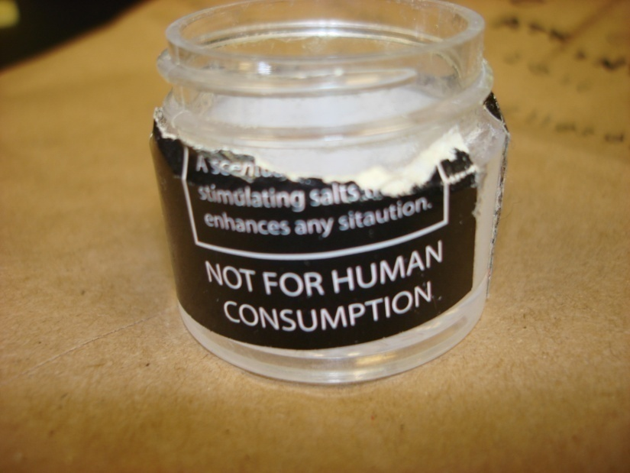
MDPV Case Series Overview
11 Fatalities investigated at the West Virginia Office of the Chief Medical Examiner (WV OCME)
Timeline: March 2011 and November 2011
6 Accidental (Drug Related)
5 were positive for other drugs in addition to MDPV
3 Accidental (Non-drug Related)
1 motor vehicle accident
2 accidental drownings
1 Suicide
Hanging
1 Homicide
Gun shot wound (inflicted by law enforcement)
Notes:
The West Virginia Office of the Chief Medical Examiner investigated 11 fatalities in which MDPV was detected in blood and/or urine of the decedent.
All 11 cases screened negative for amphetamines by immunoassay with a DRI kit from Microgenics.
MDPV was quantitated in six blood specimens with an average concentration of 0.47 mg/L.
The circumstances reported in these fatalities involve instances of driving impairment, suicide, fatal drug toxicity, and domestic conflicts. Everything from extreme violence to individuals being found dead in bed was noted in case histories.
In six cases, illicit drug use, MDPV, or drug-induced delirium was listed as contributory to death with five of the six cases being positive for additional drugs. There is a summary of these cases on the next slide

Slide 21
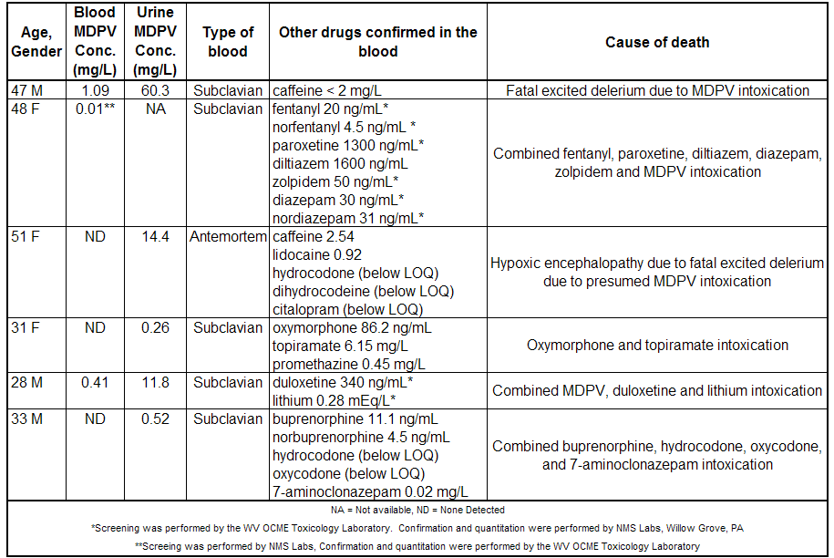
Accidental Drug Overdoses
Notes:
In four of the cases MDPV intoxication was determined to be directly within the primary cause of death taking into consideration the overall death investigation findings. In six cases, illicit drug use, MDPV, or drug-induced delirium was listed as contributory to death with five of the six cases being positive for additional drugs.
Three of the cases in which an accidental drug overdose was listed as the cause of death had a case history in which the individual was found unresponsive and pronounced dead at the scene. One of the three individuals had evidence of self-inflicted lacerations, otherwise, the case narratives were mostly unremarkable – the individual went to bed and was found deceased the next morning.
Three of the cases had narratives that were more indicative of what one might expect to hear with a “bath salts” case. Bizarre and/or aggressive behavior.

Slide 22
Accidental Drug Overdoses
Male, 47 y, COD = Fatal excited delirium due to MDPV intoxication
Female, 51 y, COD = Hypoxic encephalopathy due to fatal excited delirium due to presumed MDPV intoxication
Male, 28, COD = Combined MDPV, duloxetine, and lithium intoxication
Evidence of self mutilation
Previous suicide attempts
Capsules and journal discovered on death scene
Notes:
A search of the literature revealed only one fatality ascribed to isolated MDPV toxicity. Murray et al. (2012) report a fatality in which the decedent exhibited Excited Delirium Syndrome and presented to the emergency room with aggressive, violent, uncontrollable, and delusional, displaying considerable strength and yelling.
I realize the diagnosis of excited delirium has been controversial. There have been theories in which this diagnosis has been questioned as a possible mechanism to excuse law enforcement behavior.
The American College of Emergency Physicians has officially recognized excited delirium as a unique syndrome. However, it has not been recognized as a medical or psychiatric diagnosis according to either the Diagnostic and Statistical Manual of Mental Disorders, 4th Edition, Text Revision (DSM-IV-TR) of the American Psychiatric Association or the International Classification of Diseases of the World Health Organization
The signs and symptoms for excited delirium may include:
Paranoia
Disorientation
Hyper-aggression
Tachycardia
Hallucination
Incoherent speech or shouting
Seemingly superhuman strength or endurance (typically while trying to resist restrain efforts)
Hyperthermia (overheating)/profuse sweating (even in cold weather)
Inappropriately clothed e.g. having removed garments
In two of the cases, a causes of death citing fatal excited delirium were issued. In the first case, MDPV was the only significant finding once the toxicology was completed. There was a very small amount of caffeine, which was present in the product likely consumed.
Case 1: 11-980 - Dr. Mahmoud
A 47-year-old man was reported by family members to have been abusing bath salts for at least two weeks, exhibiting paranoia and insomnia. The decedent caused a disturbance near his home, reportedly running down the street in his boxer shorts and a t-shirt while yelling, kicking over trash cans, and carrying his laptop claiming that someone was trying to take it away from him. He then assaulted an individual before police arrived at the scene. While attempting to restrain the subject, law enforcement noted him to be combative, displaying excessive physical strength before suddenly going limp. Emergency medical services (EMS) found the subject in cardiac arrest and he was later pronounced at a local hospital following unsuccessful attempts at resuscitation.
The decedent’s home and vehicle were searched. An empty plastic container without a lid bearing the designation “White Girl” on a black-colored label was being seized from his vehicle. Investigation of the decedent’s home revealed overturned furniture, significantly damaged walls, and debris strewn about, also as a result of his bizarre behavior. Cause of death was certified as fatal excited delirium due to MDPV intoxication.
Case 3: 11-1277 – Dr. Mahmoud
A 51-year-old woman was noted by her sister to be combative, confused, and flipping over furniture. This behavior lasted more than two hours before the sister called EMS. The subject became combative with EMS personnel upon their arrival and reportedly went into cardiac arrest once she was strapped to the gurney. Following successful resuscitation, she resumed her combative behavior by thrashing around, kicking, and attempting to bite hospital personnel. Her verbal communication was described as incomprehensible. Hospital staff was impeded in their attempts to obtain vital signs given her combativeness. She became cyanotic and went into respiratory arrest upon transfer from the EMS cot and was resuscitated again. Following a third resuscitation attempt, she declined until death, expiring 9.5 hours after hospital admission. Investigation into the circumstances leading to demise revealed a report by the decedent of having snorted Adderal® and awake for approximately two days. Her family also suspected abuse of bath salts. Cause of death was certified as hypoxic encephalopathy due to fatal excited delerium due to presumed MDPV intoxication
The third case in which the overall cause of death was ruled as an accidental cause of death had a few unusual circumstances that are note-worthy
Case 7: 11-2063 – Dr. Schmidt
A 28-year-old man was found deceased in the office of his apartment complex with evidence of overturned chairs, broken glassware, skewed curtains, and blood on a desk that appeared to be from an elbow injury. Numerous small abrasions and lacerations noted on his body were likely self-inflicted. Items found at the scene included white powder residue, instructions for how to prepare medication capsules along with empty capsules, and information about bath salts and drug-related matters. Also recovered was a journal recording his feelings following ingestion of capsules he prepared. Death investigation disclosed two psychiatric hospitalizations for suicidal attempts, most recently three months earlier using drugs. He was reportedly prescribed duloxetine and lithium. Cause of death was certified as combined MDPV, duloxetine and lithium intoxication.
One other case had evidence of self-inflicted injury.
Case 11: 11-3624 Dr. Sabet
A 33-year-old male entered the home of his family one evening and inquired “why am I so messed up?” He then lay down across a mattress and went to sleep. His family checked on him periodically throughout the night and noting him to be snoring loudly until approximately 4 a.m. the next morning. EMS was called several hours later when he was found unresponsive and was pronounced dead at the scene. The decedent’s mother reported a history of drug abuse without knowledge regarding the type of drug(s) involved. No evidence of drugs or paraphernalia were found at the scene. Autopsy findings included multiple, parallel linear scars over the flexor surface of both wrists consistent with self-inflicted injury.

Slide 23
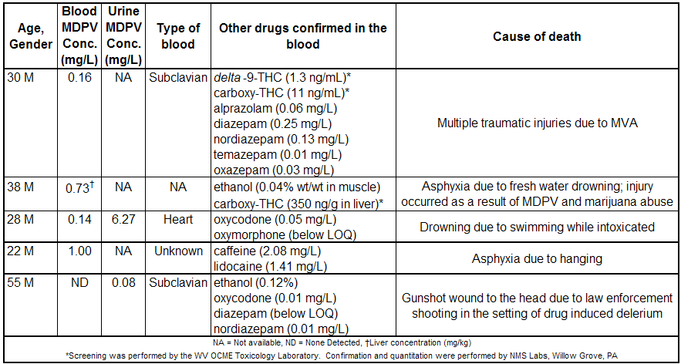
Non-Drug Overdose Cause of Death
Notes:
The summary of the toxicology and cause of death in fatalities in which a drug overdose was not ruled as the cause of death are are summarized
There was a single-vehicle MVA, two drownings, one suicide in which the individual hung himself and a case involving a shooting by law enforcement. In this case, 45-year-old man, was noted by neighbors to be roaming around other people’s property and acting suspicious after they heard a gunshot. Law enforcement was notified and found the decedent sitting on a guardrail holding a bottle of liquor. He was asked to show his hands and instead produced a .45 caliber handgun, aiming the weapon at law enforcement officials. He was shot in the head by law enforcement at close range and was expired at the scene.
FOR REFERENCE ONLY:
Case 6: 11-1902 – Steve/S.E. McIntire
Law enforcement discovered a 30-year-old man in his vehicle which was parked on the side of a roadway with evidence of apparent collision-associated damage with a significant intrusion into the driver’s side of the vehicle. The subject was found pulseless and apenic. Following initial resuscitation, he expired in hospital succumbing to multiple injuries including fractures involving the skull, rib cage, legs, and pelvis. Drug paraphernalia were discovered in decedent’s pockets. No autopsy was performed and cause of death was multiple injuries due to a motor vehicle accident.
Case 8: 11-2203 – Dr. Haikal
The body of a 38-year-old man was found floating face-down in a river with no apparent injuries and no obvious entry point into the river near the location of the remains. Investigation revealed him to be indigent with a significant criminal history including charges for breaking and entering, domestic battery, destruction of property, and assault. He was last known alive two weeks earlier at which time he jumped from a vehicle and ran through the woods in an apparent attempt to evade individuals he believed were following him. Death investigation and autopsy findings were consistent with drowning. Asphyxia due to fresh water drowning was certified as the cause of death.
Case 9: 11-3093 Dr. Arden – water temp was 48 °F
A 28-year-old man had been having marital problems. He was reportedly visiting with a friend at a lake and stated that he needed to be alone. He indicated that he was going to go swimming while waiting for his friend to bring the subject’s wife to him so they could talk. Before leaving, the friend witnessed the decedent getting into the water and starting to swim across the lake. The friend later returned with the decedent’s wife and could not locate him. His body was subsequently retrieved from the lake X hours later. The wife stated to law enforcement that her husband “seemed to be on some type of drug(s) and was very hyper.” The friend reported that the decedent had taken drugs which he believed were bath salts. Drowning was certified as the cause of death with intoxication by methylenedioxypyrovalerone ("Bath Salts") and oxycodone contributing to death.
Case 4: 11-1418 – Regina/Bob Stalnaker
A 22-year-old man was found hanging from a storage building rafter by an electrical cord two hours after verbalizing his suicidal ideations to a friend via telephone. The decedent had reportedly suffered from depression and had indicated to his friend he was despondent over a recent incident in which he had reportedly assaulted his girlfriend, threatening to kill her, and had been arrested for domestic battery. The decedent’s mother stated that he had admitted to using bath salts prior to the incident. No autopsy was performed. Asphyxia due to hanging was the cause of death.

Slide 24
Synthetic Cathinones Banned in the US
October 21, 2011 – mephedrone, methylone, MDPV as well as their salts, isomers, and isomers of salts temporarily placed onto Schedule 1 of the Controlled Substances Act (CSA)
June 2012 – Synthetic Drug Abuse Prevention Act was passed
Mephedrone and MDPV added to Schedule 1 of CSA
October 2012 – Mephedrone scheduling extended until April 20, 2013
Notes:
In June of 2012, the Synthetic Drug Abuse Prevention Act was passed. This act is more known because of the new criteria for scheduling for the synthetic cannabinoids.
There have been emergency schedulings of these drugs and extensions of emergency schedules, but currently MDPV, methylone and mephedrone are all Schedule 1 drugs with more soon to be scheduled. We will get to that in a few slides

Slide 25
New Synthetic Stimulants Reported in Forensic Casework
Marinetti and Antonides, JAT 2013
Most recently –α-pyrrolidonpentiophenone (α-PVP) and Pentylone
Others detected – Methylone, Pyrovalerone and Methedrone
Shanks et al., JAT 2012
Report MPPP, α-PVP and Butylone detected in products analyzed between September 8, 2011 and April 1, 2012 (“Post- federal ban”)
WV OCME
α-PVP detected in several postmortem cases
Pentedrone also detected in one case
Notes:
Soon after the emergency ban that covered MDPV, the compounds detected in forensic case work shifted. This was apparent at the WV OCME and also noted in other laboratories.
The most prevalent synthetic cathionone that was now being detected was Pyrrolidinopentiophenone or alpha-pyrrolidinovalerophenone which will be referred to as α – PVP for the remainder of the presentation.
News reports about a compound known as “gravel” have been reported in the media relatively recently.
“Gravel” contains the research chemical alpha-PVP and sometimes contains klonopin and amphetamine as well.

Slide 26
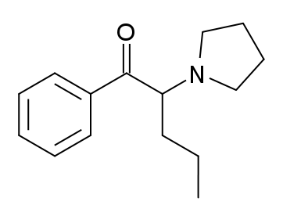
Alpha-PVP –similarities to other well-studied compounds
MDPV and pyrovalerone
Pyrrolidine derivative compounds tend to lack entactogenic effects
Pyrovalerone causes the releases of dopamine and norepinephrine from respective nerve terminals
Structural analogs of pyrovalerone have been shown to inhibit monoamine transporters including dopamine, serotonin and norepinephrine
MDPV
α-PVP
Pyrovalerone
Notes:
Alpha – PVP is structurally similar to MDPV and Pyrovalerone.
It belongs to the phenethylamine family of alkaloid compounds, many of which have stimulant properties, but can have additional psychoactive effects due to “designer” substitutions.
Further classification of α-PVP places it in the pyrrolidinophenone group of the phenethylamines.
Pyrrolidine derivative compounds tend to lack entactogenic effects
– many entactogens tend to have a substituted-amphetamine core and belong to the phenethylamine class of psychoactive drugs, but the pyrrolidine derivatives seem to lack entactogenic effects
The mechanism of action for the similar pyrrolidinophenone compound pyrovalerone is the release of dopamine and norepinephrine from respective nerve terminals. Several structural analogs of pyrovalerone, including alpha-PVP, have been found to inhibit monoamine transporters including dopamine, serotonin and norepinephrine.
Risks to humans ingesting pyrrolidinophenone compounds have been shown to include life-threatening serotonin syndrome, hepatotoxicity, neurotoxicity, psychopathology, and abuse potential

Slide 27
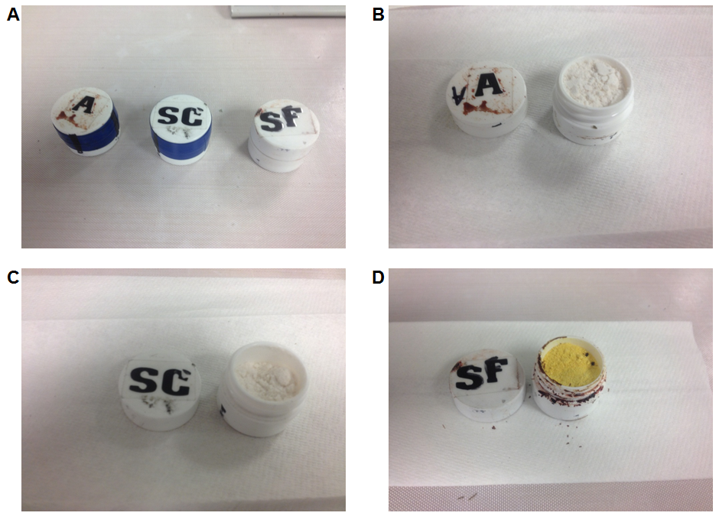
α-PVP Case Series
Six fatalities investigated at the WV OCME between March and December 2012
Many more clues in α-PVP cases than MDPV cases
Evidence submitted in one case
All three vials contained α-PVP and pentedrone
Vial “SF” also contained N-ethylcathinone, 4-methyl-N-ethylcathinone, butylone, and 3',4'-methylenedioxy-α-pyrrolidinobutiophenone (MDPBP)
Notes:
Six fatalities were investigated at the WV OCME between March and December 2012
Often, cases in which the history documents bizarre, aggressive, hallucinogenic, or paranoid behaviors, and/or symptoms consistent with overstimulation of the sympathetic nervous system are positive for compounds such as α-PVP or other cathinone derivatives
The alpha-PVP cases contained many more clues that a designer stimulant may have played a role in the death of the individual
A history of bath salt abuse was noted in the several of the case histories. Evidence was submitted in one case. In this case…
Case 1: Law enforcement responded to a call regarding a 31-year-old man with weapons that had reportedly ingested bath salts. He was reportedly paranoid, armed with multiple guns, holding another individual against her will and threatening suicide. The subject exited the residence with weapons raised at law enforcement, who then fired shots at him. He was pronounced dead on the scene. Several small, white, plastic vials containing powder were discovered in the decedent’s pockets. The photo on the slide shows three of the vials that were found in the decedent’s pocket. What was likely a fourth vial was also discovered, but it was almost completely destroyed as a result of the shots fired by law enforcement

Slide 28
α-PVP Case Series: Toxicology Findings, COD and MOD
Notes:
Case 2: A 51-year-old man was found deceased on the floor of his bathroom at approximately 7 AM. He was last known alive at approximately 1 AM complaining of abdominal pain. Law enforcement discovered empty packages of bath salts in the residence. Yellowish-tan powder was noted in the decedent’s nostrils.
Case 3: A 35-year-old male was found deceased in his wheelchair. He had been wheelchair-dependent for 10 years due to paralysis resulting from injuries sustained in an all-terrain vehicle accident. His significant other reported he died due to a seizure event. The subject had a reported history of bath salt abuse.
Case 4: The body of a 24-year-old female was discovered in the trunk of her car by law enforcement after fleeing from home confinement. She was known to law enforcement due to a reported history of bath salt abuse.
Case 5: A 53-year-old female was last known alive at 4 PM snoring loudly while asleep on her couch. She was found unresponsive the next morning. Medications found in the residence were either not prescribed to her or were significantly off-count. The decedent was noted to have a pronounced nasal plume.
Case 6: A 43-year-old male was found dead as the result of a self-inflicted gunshot wound to the head. The decedent documented his suicide using a webcam on his computer.
Again, the case histories are quite varied ranging from the expected bizarre and violent behavior that has been associated with the abuse of synthetic cathinones to cases in which the individual was found already deceased

Slide 29
January 28, 2014 – DEA Notice of Intent to Schedule
(1) 4-methyl-N-ethylcathinone (4-MEC)
(2) 4-methylalpha-pyrrolidinopropiophenone (4-MePPP)
(3) alphapyrrolidinopentiophenone (α-PVP)
(4) 1-(1,3-benzodioxol-5-yl)-2-(methylamino)butan-1-one (butylone)
(5) 2-(methylamino)-1-phenylpentan-1-one (pentedrone)
(6) 1-(1,3-benzodioxol-5-yl)-2-(methylamino)pentan-1-one (pentylone)
(7) 4-fluoro-Nmethylcathinone (4-FMC)
(8) 3-fluoro-N-methylcathinone (3-FMC)
(9) 1-(naphthalen-2-yl)-2-(pyrrolidin-1-yl)pentan-1-one (naphyrone)
(10) alpha-pyrrolidinobutiophenone (α-PBP)
Notes:
On January 28, 2014, the DEA issued a notice of intent to temproarily schedule 10 more synthetic cathinone compounds into Schedule 1 of the Controlled Substances Act. These will be published in the Federal Register and effective by February 27th.

Slide 30
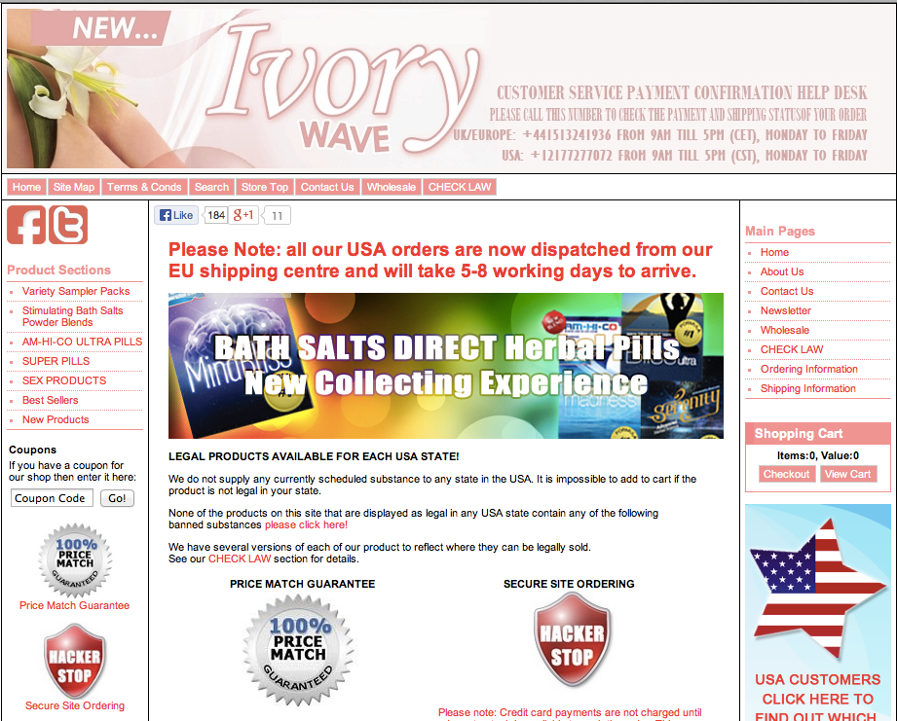
Current Products for Sale
www.bath-salts-direct.com
- Accessed November 19, 2013
Notes:
Controlled substance analogs appear to be a problem that we are going to be dealing with for quite a while. It seems as though each time we get a handle on the latest compounds that are showing up in both clinical and forensic cases a new one pops up to replace it. Each time a series of compounds is banned, new compounds are quickly manufactured to circumvent the new laws.
After MDPV, methylone, and mephedrone were placed into Schedule 1 of the controlled substances act, alpha-PVP emerged as one of the compounds frequently observed in case work. Pentedrone, pentylone, butylone and a few others have been detected as well.
As I was preparing these slides, I had a few of my graduate students surf a few sites that sold “bath salts” to see what is listed as the active ingredient in some of the more recently sold products.
This bath salts direct site was a relatively easy site to navigate
This site claims that if a product is scheduled in your state that you cannot add it to your cart. It also has lists of products that are legal in each state.
When you click on the “Please click here” it lists the compounds that their products do not contain
This list includes mephedrone, MDPV, and Methylone on that list as of February 6th. It will be interesting to see if the list updates on February 27th, which is when the 10 more compounds are supposed to be scheduled according to the notice of intent to schedule

Slide 31
Current Products for Sale
Notes:
If you scroll down the webpage, they offer stimulating bath salts powder blends that are legal based on location (US, Europe, or Worldwide)
You may purchase energizing or euphoric and energizing blends. Just in case you cannot decide which you would like, variety packs are available.
We went through all of the “Legal in the United States” products to determine the research chemical that each was listed to contain and found the following list…
NEXT SLIDE

Slide 32
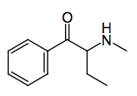
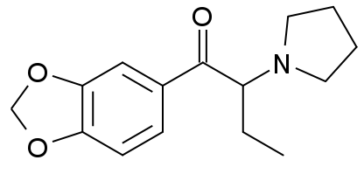
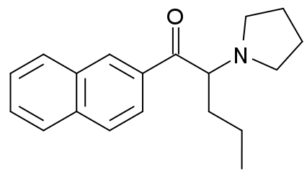
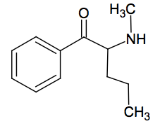
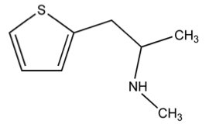
A Few Compounds Advertised in Products Currently for Sale
3',4'-Methylenedioxy-a-pyrrolidinobutyrophenone (MDPBP)
α-pyrrolidinopentiophenone (α-PVP)
MDPBP
α-PVP
Buphedrone
Naphyrone
Methiopropamine
Pentedrone
Notes:
These six research chemicals were contained in the “legal in the United States” products.
Naphyrone, pentedrone, and alpha-PVP are soon to be scheduled, but there are already several compounds that are being sold that are not scheduled or on their way to being scheduled and have been seen in case work. MDPBP was one of the compounds present in evidence submitted to the WV OCME, but it was not detected in any of the biological samples. It and Buphedrone have been around for quite some time based on posts in drug forums such as Erowid, but just did not seem to take off as much as MDPV and others.
Methiopropamine is a structural analog of methamphetamine containing a thiophene ring in place of the benzene ring. Thiophenes are a standard replacement for phenyl in drugs. The longer C-S bond makes it sterically similar to a 6 member ring aromatic. However, chemically, it is not classified as an amphetamine or phenethylamine. According to a 2010 article published in the European Journal of Pharmacology, it is a norepinephrine and dopamine reuptake inhibitor with little activity as a serotonin reuptake inhibitor. Under the analog act, it can be considered as a methamphetamine analog, but it differs more than most compounds successfully argued under the analog act.

Slide 33
Summary and Conclusions
In general, synthetic cathinones cause an increase in the extracellular concentrations of the neurotransmitters DA, NE and/or 5-HT
Symptoms of synthetic cathinone intoxication include sympathomimetic, cardiovascular and CNS overstimulation as well neuropsychiatric effects
Manufacturers of bath salts products quickly adjust to legislation to change the composition of their products
Results in limited knowledge regarding pharmacology and toxicology of newer compounds
Due to structural similarities, many synthetic cathinones (will likely) have similar pharmacology and toxicology
Notes:
In general, synthetic cathinones cause an increase in the extracellular councentrations of the neurotransmitters dopamine, norephinephine and serotonin. Some are selective for while others are nonselective. The increase in extracellular concentrations of neurotransmitters can be due inhibiting their reuptake, increasing their release or both.
The most commonly reported signs and symptoms of synthetic cathinone intoxication are sympathomimetic, cardiovascular, and CNS overstimulation. Neuropsychiatric effects have also been reported in many cases.
Because the manufacturers of bath salts products are not subject to any kind of regulations they can very quickly adjust to changes in the legislation. As indicated in this presentation MDPV, methylone, and mephedrone were already schedule 1 substances by the time many of the in vitro and in vivo pharmacological studies could be properly conducted.
The effects of various substitutions on the phenethylamine core structure have been studied and the effects of various substitutions documented. Many of these compounds are expected to have similar pharmacology associated with increased extracellular concentrations of key neurotransmitters.

Slide 34
Your Brain on Bath Salts
http://www.pbs.org/newshour/multimedia/bath-salts/

Slide 35
Full References for Studies Listed During Presentation
Aarde, S. M., P. K. Huang, K. M. Creehan, T. J. Dickerson and M. A. Taffe (2013). "The novel recreational drug 3,4-methylenedioxypyrovalerone (MDPV) is a potent psychomotor stimulant: self-administration and locomotor activity in rats." Neuropharmacology 71: 130-140.
Baumann, M. H., J. S. Partilla and K. R. Lehner (2013). "Psychoactive "bath salts": not so soothing." Eur J Pharmacol 698(1-3): 1-5.
Baumann, M. H., J. S. Partilla, K. R. Lehner, E. B. Thorndike, A. F. Hoffman, M. Holy, R. B. Rothman, S. R. Goldberg, C. R. Lupica, H. H. Sitte, S. D. Brandt, S. R. Tella, N. V. Cozzi and C. W. Schindler (2013). "Powerful cocaine-like actions of 3,4-methylenedioxypyrovalerone (MDPV), a principal constituent of psychoactive 'bath salts' products." Neuropsychopharmacology 38(4): 552-562.
Cameron, K., R. Kolanos, R. Verkariya, L. De Felice and R. A. Glennon (2013). "Mephedrone and methylenedioxypyrovalerone (MDPV), major constituents of "bath salts," produce opposite effects at the human dopamine transporter." Psychopharmacology (Berl) 227(3): 493-499.
Fantegrossi, W. E., B. M. Gannon, S. M. Zimmerman and K. C. Rice (2013). "In vivo effects of abused 'bath salt' constituent 3,4-methylenedioxypyrovalerone (MDPV) in mice: drug discrimination, thermoregulation, and locomotor activity." Neuropsychopharmacology 38(4): 563-573.
Marinetti, L. J. and H. M. Antonides (2013). "Analysis of synthetic cathinones commonly found in bath salts in human performance and postmortem toxicology: method development, drug distribution and interpretation of results." J Anal Toxicol 37(3): 135-146.
Marusich, J. A., K. R. Grant, B. E. Blough and J. L. Wiley (2012). "Effects of synthetic cathinones contained in "bath salts" on motor behavior and a functional observational battery in mice." Neurotoxicology 33(5): 1305-1313.
Shanks, K. G., T. Dahn, G. Behonick and A. Terrell (2012). "Analysis of first and second generation legal highs for synthetic cannabinoids and synthetic stimulants by ultra-performance liquid chromatography and time of flight mass spectrometry." J Anal Toxicol 36(6): 360-371.

