Slide 1
FYS 100: The Bond
Presented by Dr. Sherry L. Early

Slide 2
A Quote from James Herriot
“If having a soul means being able to feel love and loyalty and gratitude, then animals are better off than a lot of humans.”
~All Creatures Great and Small

Slide 3
In this section of FYS 100, we will…
be able to compare and contrast the pros and cons of the human-animal bond;
summarize aspects related to animal activism;
interpret human and animal rights and laws;
describe an interview conducted with an animal activist leader;
identify how to engage in the Charleston community with animals;
write letters to legislators as animal advocates; and
illustrate your comprehensive learning journey in written and presentation forms.

Slide 4
The Assignment—The Bond
Introduction-Revisit/Interpret Metacognitive Thinking
Body (3-5 paragraphs)-Integrate Assignments, Course Material, & Discussion Forum Contributions Regarding the Human-Animal Bond
Conclusion-Comprehensive Takeaways

Slide 5
Written Assignment Rubric
Final Project Rubric (40 points total)
Component | Exceeds Expectations | Meets Expectations | Below Expectations/Missing
Metacognitive Thinking the Introduction | 3-5 points | 1-2 points | 0 points
Incorporated Discussion Forum | 3-5 points | 1-2 points | 0 points
Incorporated Course Assignments | 8-10 points | 1-7 points | 0 points
Conclusion Paragraph | 3-5 points | 1-2 points | 0 points
Proper Citations in Text | 3-5 points | 1-2 points | 0 points
Grammar and Spelling | 3-5 points | 1-2 points | 0 points
Proper Citations in References | 3-5 points | 1-2 points | 0 points

Slide 6
The Bond Presentation Rubric
Final Project Presentation Rubric (10 points total)
Component | Exceeds Expectations | Meets Expectations | Below Expectations/Missing
Metacognitive Thinking Defined | 2 points | 1 point | 0 points
Provided Examples of Course Assignments Connected to their Learning | 3-5 points | 1-2 points | 0 points
Well Prepared | 3 points | 1-2 points | 0 points

Slide 7
Example Presentation
The Bond through the Eyes of the Flintstones

Slide 8
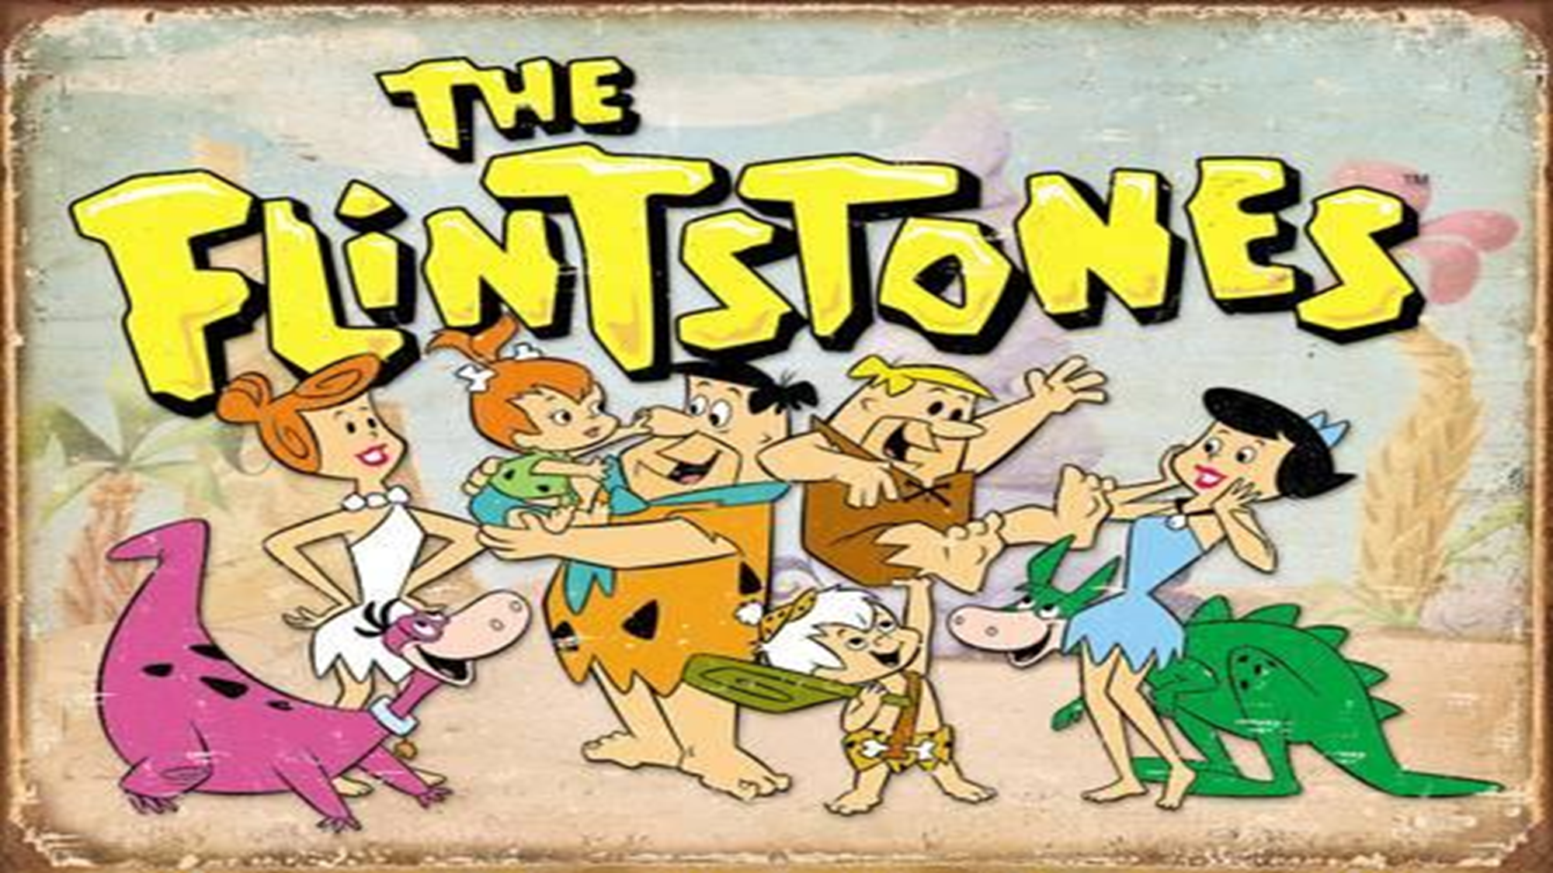

Slide 9
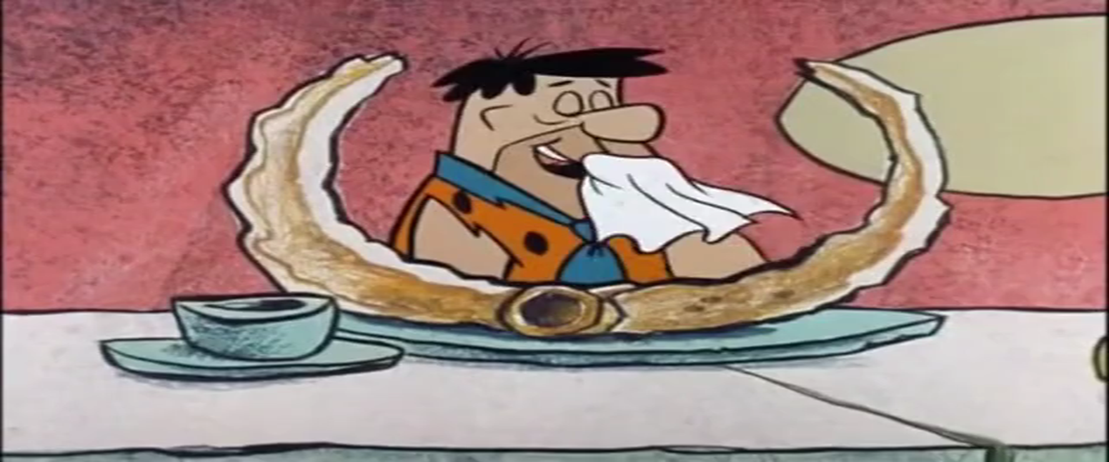
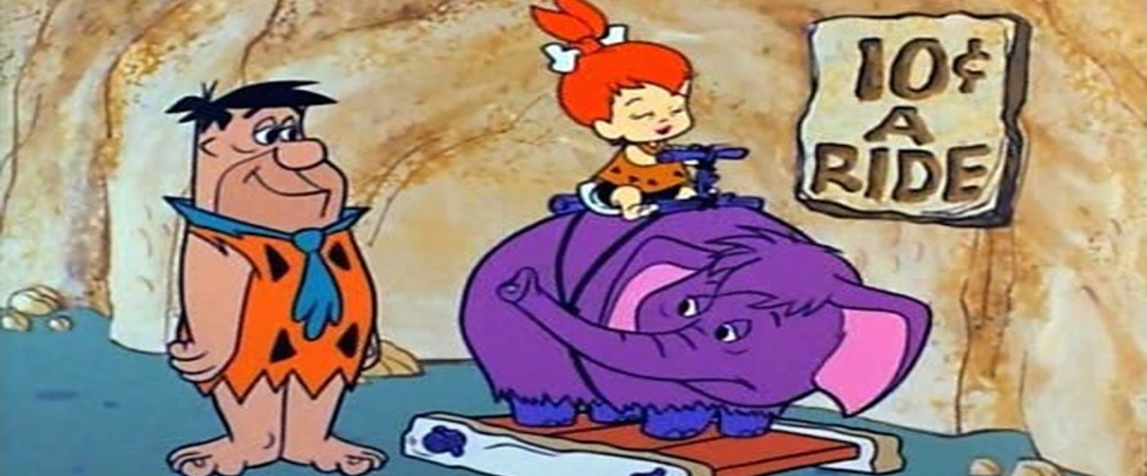
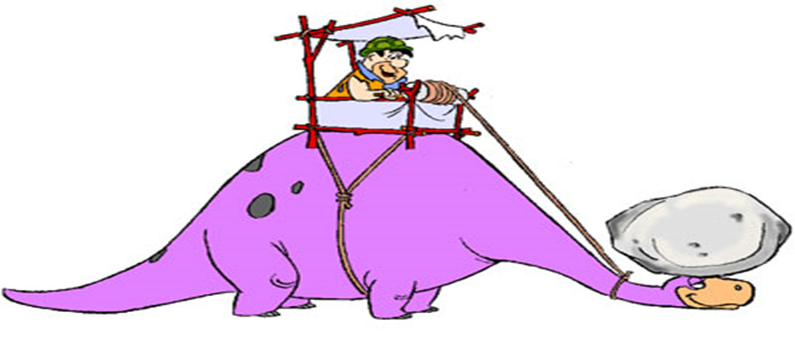
Animals as Resources

Slide 10
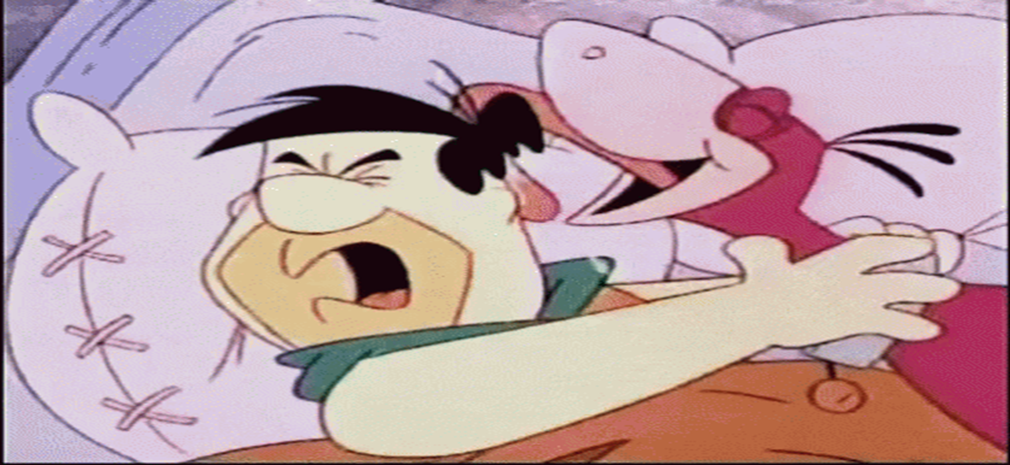
Animals as Pets

Slide 12
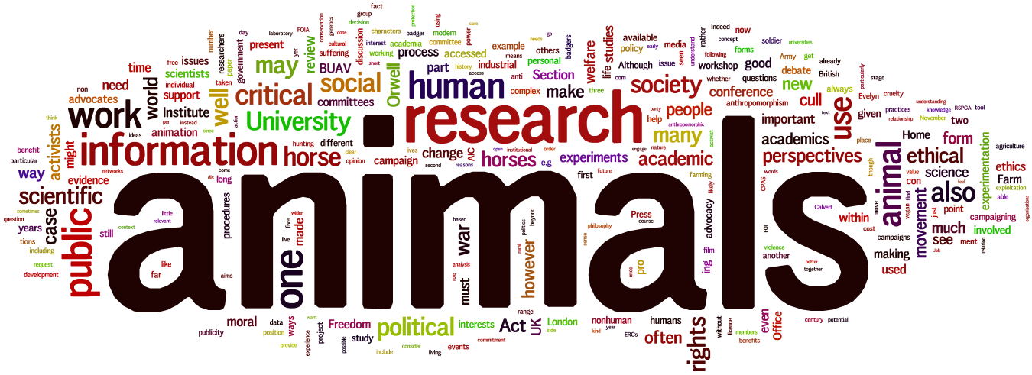

Slide 13
Thank You!
Questions?

