Slide 1
Unified Communication

Slide 2
How to get help?
IT Service Desk
Chat - www.marshall.edu/it
Email - itservicedesk@marshall.edu
Call - (304) 696-3200
Visit - 1st Floor Drinko Library & Info Center

Slide 3
What does Unified Communication Mean?

Slide 4
Notes:
Can mean a lot of things, all brought together. This looks a little daunting.

Slide 5
4 C’s of UC
Communication
Collaboration
Connectivity
Convenience
Notes:
Benefits

Slide 6
Each aspect can be achieved through Unified Communication

Slide 7
Benefits of UC
Improve Efficiency and Productivity
Encourages Mobility and Flexibility – Working Remotely
Reduces Costs
Access on Multiple Devices
Presence features - Availability
Notes:
Benefits

Slide 8
Notes:
What it really provides
We can now attend meetings without walking around campus
if we do walk over to other places on campus, we can still take phone calls/messages just if we are at our desk

Slide 9
BToE
Better Together Over Ethernet
A software application that allows you to control your Polycom Phone via the SFB client
Advantages
Click to answer
Dial from Desktop / Keyboard
Disadvantage – Windows only
Notes:
Benefits

Slide 10
Skype for Business
Notes:
video

Slide 11
Online Resources
www.marshall.edu/sfb
Common Questions Answered
Step by Step
Videos too
Lynda Campus – Lynda.marshall.edu
Skype for Business Essential Training

Slide 12
Changes are Coming…

Slide 13
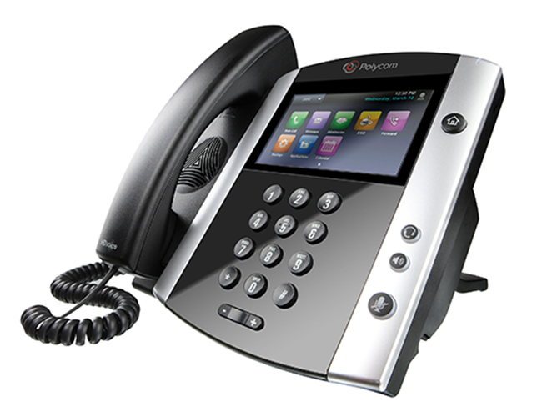
New Phone Interface – October 1st!

Slide 14
Phone Features

Slide 15
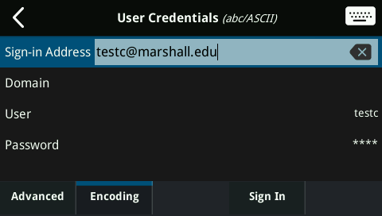
How to Log in
Must use the correct formatting Keyboard function available
You must be signed in for your phone to work. If your name does not appear in the phone line section on the Home view, you are not signed in.
Select “Sign In,” then “User ID.”
Tap “Sign in Address” and enter your full email address (e.g. user1@marshall.edu), click check, leave “Domain” blank, click “User” and enter your full email address again.
Enter your MUNet password just like when you log into your PC. Select the “Sign In” option to complete signing in.

Slide 16
Making a Call
From the Phone
Pick up and dial
Use a favorite button

Slide 17
Making a Call
Using SFB Client
Find Contact – use quick buttons
Add on the fly
Desktop Share
IM
Video Conference

Slide 18
Team Call Group Setting
Forward vs. Transfer
Forwarded calls don’t go to your voicemail
Team Call Group
Set these up yourself (Options in SFB)

Slide 19
Call Forwarding FAQ
You can forward calls to voicemail, a phone number, or a delegate
You can simultaneous ring those options as well
You can choose when to apply these settings
Edit team-call group members and choose to simultaneously ring their phone or after a certain number of seconds instead

Slide 20
Transfer
Blind Transfer
Consultative Transfer

Slide 21
Conference Calls
Adding to Outlook meeting request
How to Create
How to Join
PC vs Mac

Slide 22
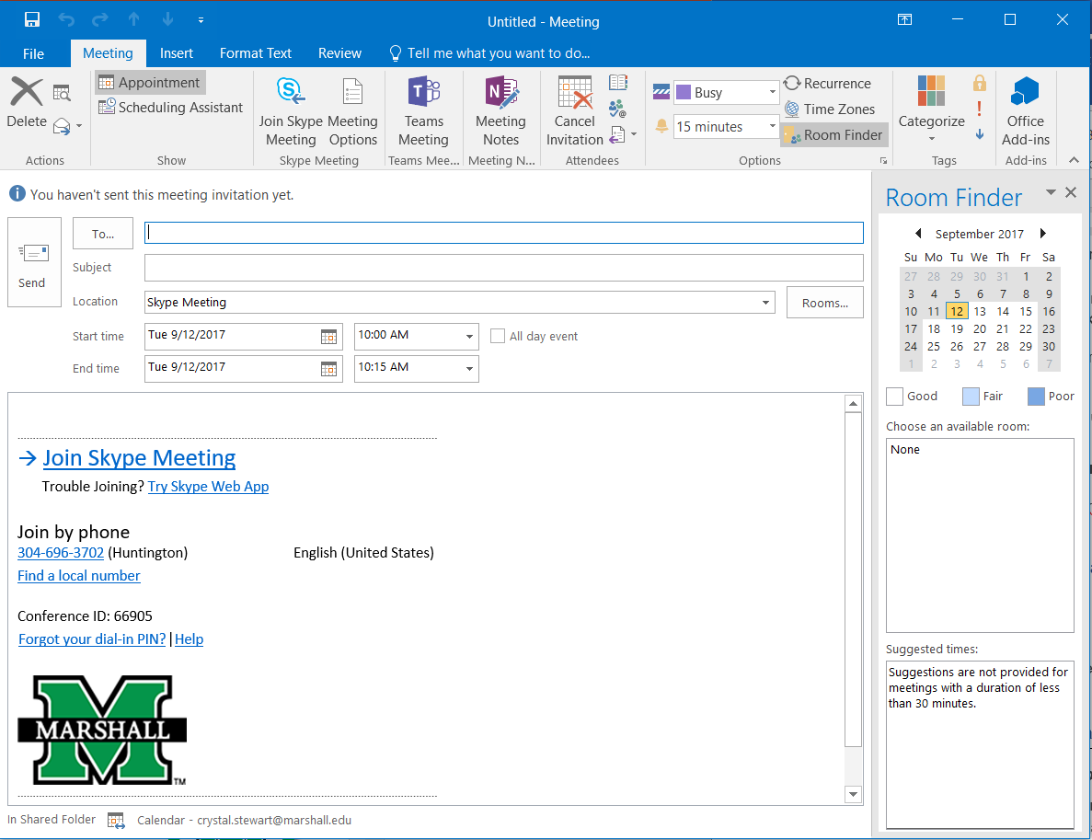
PC vs Mac
Every user gets a personalized link
(like webex or goto meeting)
Expl:
https://meet.marshall.edu/stewar14/ZBJ6C4W9

Slide 23
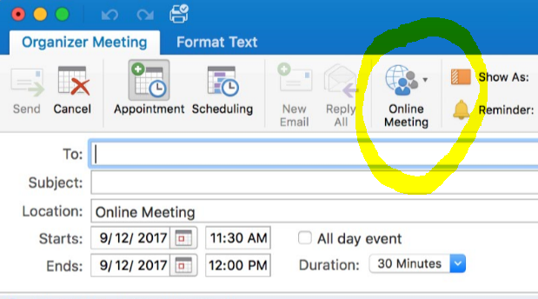

Slide 24
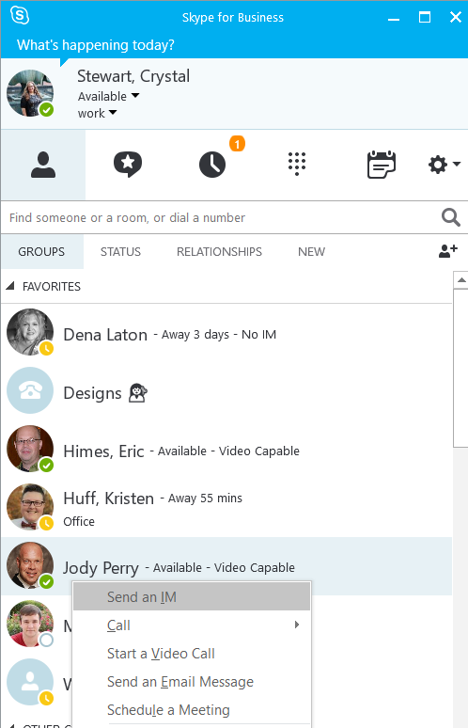
Instant Messaging
Chat with your co-workers one on one or in groups
Right Click for Options

Slide 25
Video Conferencing
As easy as making a phone call
Notes:
Using the SFB client on your desktop you can do video calling

Slide 26
Conference Calls
Adding to Outlook meeting request
How to Create
How to Join
304-696-3702 + Conf ID
PC vs Mac
Using the Phone
Notes:
Anyone can join over a regular phone using 304-696-3702 and the individual conference ID, and emphasize that every user gets a conference ID

Slide 27
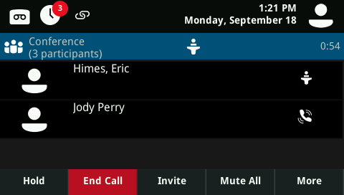
Placing Conference Calls Using the Phone
Call the first party
After the call connects
Select “Confrnc”
Dial and connect with the second party. The call automatically be added to the conference.

Slide 28
Questions?

