Slide 1


Accounts Receivable (A/R) & Grant
Financial Reporting 101 Training
Updated: 7/15/2026

Slide 2







Accounts Receivable & Financial Reporting Department
Jennifer Wood,
CFO & Associate Vice President for Finance and Compliance
Kristen Martin,
Senior Finance Officer
Tina Dean,
Associate Director of A/R & Financial Reporting
Ashlyn Christian,
Senior Grants Accountant
Melissa Hall,
Grants Accountant
Amara Ross,
Grants Accountant
Email: wood@marshall.edu
Phone: 304-696-2829
Email: martinkr@marshall.edu
Phone: 304-696-4665
Email: dean22@marshall.edu
Phone: 304-696-6321
Email: ashlyn.christian@marshall.edu
Phone: 304-696-7320
Email: hall183@marshall.edu
Phone: 304-696-5201
Email: ross358@marshall.edu
Phone: 304-696-2344
Departmental Email: MURC_Grants_Accounting@marshall.edu

Slide 3

Mission of Accounts Receivable
& Financial Reporting Department
Marshall University Research Corporation (MURC) accelerates the success of Marshall University personnel ​engaged in creative and research activities by providing exceptional expertise in grants and contracts ​administration.
We ensure fiscal responsibility and accountability, promote research integrity and compliance, ​minimize administrative barriers, support economic development and community impact, deliver efficient and ​responsive service, and continuously improve our processes and systems, including the comprehensive ​management of grants accounts receivable to optimize funding utilization, transparency, and timely financial ​oversight. ​
The accounts receivable and grant financial reporting department acknowledges MURC’s role in managing ​incoming grant funds, ensuring tracking, collection, and financial accuracy and maintaining continuity from ​grant award through funds management, connecting accounts receivable with administrative support for ​grants and contracts. They will highlight efficiency and adherence to compliance in financial processes ​relevant to accounts receivable and grant financial reporting.

Slide 4
Department Overview
  The grant financial lifecycle
  Where the department fits within MURC
  How the department supports sponsored projects
  Services provided throughout the award
Key Takeaway:
The Grant Invoicing & Receivable Department ensures sponsors are invoiced accurately, funds are received timely, and grant financial reporting requirements of the agency or award are met.

Slide 5
Accounts Receivable & Grant Financial
Reporting Staff
Responsible for:
  Reviewing award agreements for grant invoicing and reporting requirements ​
  Establishing invoice and reporting schedules ​
  Preparing invoices and drawdowns​
  Preparing deposit journal entries for Banner ​
  Prepare Revenue transfers/corrections​
  Completing & submitting periodic and final grant financial reports ​
  Monitoring accounts receivable activity ​
  Tracking payments received ​
  Communicating with agencies, MURC admins, and principal investigators (PIs) ​
  Maintaining documentation in QuickBooks & Cayuse ​
  Outstanding collection efforts

Slide 6
Responsibility by Personnel

Slide 7
CFO & Associate VP for Finance & Compliance
  Manages Accounts Receivable & Grant Financial Reporting Dept.
  Certifies and Approves periodic invoices and grant financial reports
  Signing Authority - manually or electronically
Jennifer Wood,
CFO & Associate Vice President for Finance and Compliance
Email: wood@marshall.edu
Phone: 304-696-2829

Slide 8
Learning Objectives
By the end of this training, participants will be able to:
  Describe the role of the Accounts Receivable/Grant Invoicing Department.​
  Identify key personnel and departmental responsibilities.​
  Explain how sponsors reimburse grant expenditures.​
  Interpret award documents that drive invoicing requirements.​
  Utilize tools and systems to support invoicing and reporting.​
  Recognize differences in grant financial reporting requirements by sponsor type.​
  Understand MURC’s standards for grant invoicing and financial reporting.​
  Identify your role and responsibilities as a PI in assisting the Grant Invoicing & Reporting process.

Slide 9
Senior Finance Officer
  Supervises Accounts Receivable/Grant Financial Reporting
  Oversees processes and functions
  Assists in technical and system support
  Assists in reconciliations, discrepancies, grant closeouts, and other matters as needed.
Kristen Martin,
Senior Finance Officer
Email: martinkr@marshall.edu
Phone: 304-696-4665

Slide 10
Associate Director of A/R & Financial Reporting
Agency Allocations:
  Centers for Disease Control
  Federal Motor Carrier Safety Administration
  Mine Safety and Health Administration
  US Dept of Agriculture
  US Dept of Commerce
  US Dept of Health and Human Services
  US Dept of Interior
  US Dept of Justice
  US Dept of Labor
  US Dept of NASA
  US Environmental Protection Agency
  US National Institute of Health
Tina Dean,
Associate Director of A/R & Financial Reporting
Email: dean22@marshall.edu
Phone: 304-696-6321

Slide 11
Senior Grants Accountant
Agency Allocations:
  Advantage Valley
  Allegany Science and Technology
  Appalachian Regional Commission
  Cabell Huntington Hospital
  Coalfield Development
  Collaborative Inc.
  Duke University
  East Tennessee State University
  East Tennessee Clean Fuels Coalition
  Harvard
  IPS Heart
  Kentucky Transportation
  Mid Atlantic Arts Alliance
  Mississippi State University
  National Science Foundation
  Northeastern University
  Prestera
  Southern Regional Education Board
  STEM FLOC
  The Reach Initiative Inc.
  Thunder Cloud
  University of Missouri
  University of Tennessee
  US Army Corp of Engineers
  US Army of Engineer Research and Development
  US Dept of Education
  US Dept of VA
  WV First Foundation
  WV Dept of Education
  WV Dept of Health & Human Resources
  Yale School of Medicine
  Cicatelli Associates Inc.
Ashlyn Christian,
Senior Grants Accountant
Email: ashlyn.christian@marshall.edu
Phone: 304-696-7320

Slide 12
Grants Accountant
Agency Allocations:
  American Heart Association
  Benedum
  Big Sandy Health Care
  Carequest
  CDC
  CM12
  Community Connections
  Community Sponsorship Hub
  Education Alliance
  Fidelis New Energy
  Hektoen
  High Tech Foundation
  Humanities Council
  Juvenile Justice Delinqiency Prevention
  Kentucky Dataseam Initiative, Inc.
  Lawrence Economic
  Marshall Health
  Maryland Office of Highway Alliance
  Mountain State Educational Services
  Mountwest Community & Tech College
  NASA
  Our Lady Fatima
  South Carolina Motor Vehicles
  Tennessee Dept of Highways
  The Edventure Group
  The Foundation of the Fbricators & MFG Sparkforce
  The Greater Kanawha Valley Foundation
  The WV Dept of Environmental Protection Agency
  US Dept of Justice
  WV Dept of Economic Development
  WV Dept of Highway
  WV High Technology Consortium Foundation
  WV - NASA
Melissa Hall,
Grants Accountant
Email: hall183@marshall.edu
Phone: 304-696-5201

Slide 13
Grants Accountant
Agency Allocations:
  American Friends Service Committee
  American Physiology Society
  Cabell County Board of Education
  City of Huntington
  Dept of Justice
  Ebenezer Medical Outreach
  Fayette County Schools
  Florida International University
  High Rocks Education Corporation
  IGTS
  IPS Heart
  Justice and Community
  Marshall University
  Milan Puskar Foundation
  MU Foundation
  NACDS Foundation
  National Assoc. of Chronic Disease Directors
  National Endowment for the Arts
  South Dakota Dept of Public Safety
  University of Chicago
  University of Illinois
  University of Texas
  University of Utah
  US DOS
  Virginia Commonwealth University
  WV Division of Administration Services
  WV Health Right
  WV Higher Education Policy Commission (HEPC)
  WVU
  WVU Research Corporation
Amara Ross,
Grants Accountant
Email: ross358@marshall.edu
Phone: 304-696-2344

Slide 14
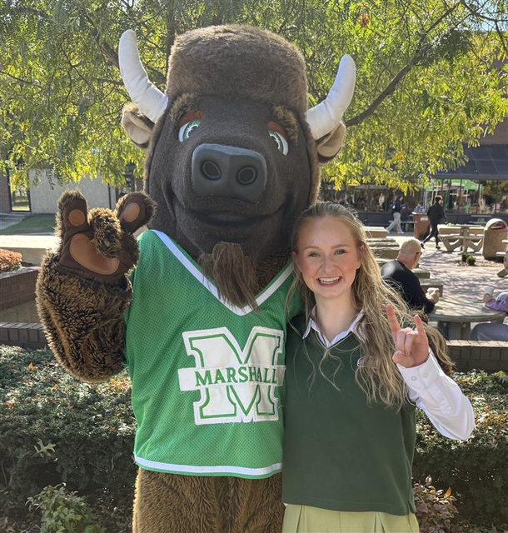
Student Worker
Sierra Bolles,
Student Worker
Email: bolles1@marshall.edu

Slide 15
Understanding Your Award

Slide 16
Principal Investigators (PIs)
Responsible for:
  Reviewing and tracking project expenditures ​
  Providing required cost share documentation ​
  Identifying and submitting final project expenses by the notice due date​
  Responding to requests related to invoicing and reporting ​
  Submitting progress reports directly to the agency, when applicable ​
  Submitting progress reports to A/R contact to be submitted with financials by the requested deadline​
  Informing A/R of transfers, errors or corrections to fund revenue

Slide 17
Compliance Department
Responsible for:
  Award setup in Cayuse Grants System and Banner Financial Management system
  Point of contact for PI for questions pertaining to awarded grant funds
  Review and approve all expense allocations
  Liaison between PI and Funding Agency once award is issued
  Assist with modification of award budget, such as
    Re-budgeting
    Expense transfers

Slide 18
Why Understanding Your Award Matters
Every sponsored award is different. Before the first invoice is submitted or the first expense is charged, the award documents should be reviewed to determine:
  How and when the sponsor pays
  What costs are allowable
  Invoice frequency
  When grant financial reports are due
  Whether cost share is required
  Any restrictions that may impact spending or reimbursement
Key Message: The award document is the roadmap for financial management throughout the life of the project.

Slide 19
Key Documents

Slide 20
Notice of Award (NOA)
Purpose
The official notification that funding has been awarded.
What to Look For
  Award number
  Sponsor name
  Principal Investigator
  Award amount
  Budget period
  Project period
  Start and end dates
  Invoice Frequency
  Grant Financial Reporting schedule
  Payment method
  Sponsor contacts
  Special restrictions

Slide 21
Executed Agreement
Purpose
The legally binding agreement between the sponsor and the institution.
What to Review
  Scope of work
  Payment schedule
  Deliverables
  Invoice instructions
  Financial reporting requirements
  Prior approval requirements
  Closeout requirements
  Billing address
  Required documentation
Why It Matters
Grant invoicing requirements are found here, not in the budget.

Slide 22
Approved Budget
Purpose
Defines how project funds may be spent.
Review
  Personnel
  Fringe Benefits
  Equipment
  Supplies
  Travel
  Subawards
  Indirect Costs
  Cost Share

Slide 23
Sponsor Terms & Conditions
May include:
  Allowable costs
  Prior approval requirements
  Carryforward authority
  Equipment approvals
  Procurement rules
  Record retention
  Audit requirements
  Reporting deadlines

Slide 24
Key Award Information That Drives Invoicing
Award Information | Why It Matters
Project Start & End Date | Determines when expenses may be incurred and invoiced.
Budget Period | Establishes the timeframe for financial reporting.
Funding Amount | Sets the maximum amount that can be invoiced.
Payment Method | Determines whether invoices, drawdowns, or milestone billing will be used.
Invoice Frequency | Indicates when invoices should be submitted.
Financial Reporting Schedule | Establishes reporting deadlines and required financial reports.
Cost Share Requirements | Identifies required institutional contributions that must be tracked and reported.
Sponsor Contacts | Provides the appropriate contact for billing questions and invoice submission.
Special Terms & Conditions | May include additional approvals, spending restrictions, or reporting obligations

Slide 25
Understanding Payment Terms
Cost Reimbursement
  Sponsor reimburses actual expenditures
  Requires supporting documentation
  Most common for federal awards
Fixed Price
  Payments based on milestones or schedules
  Less emphasis on detailed expense reimbursement
Advance Payment
  Funds received before expenditures occur
  Requires careful financial management
Letter of Credit / Drawdown
  Federal reimbursement systems
  Funds drawn as expenses are incurred on periodic basis (monthly, quarterly, or final)

Slide 26
Understanding Reporting Requirements
Financial Reports
  Monthly
  Quarterly
  Semi-Annual
  Annual
  Final
Technical Reports
Completed by the PI and often required before final payment.
Progress Reports
Will affect continued funding or reimbursement and add to the outstanding collection for MURC based on incomplete submissions and compliance.

Slide 27
Special Award Conditions
Some awards contain unique requirements that affect financial management.
Examples include:
  Spending restrictions
  Prior approval for rebudgeting
  Equipment purchase limitations
  Foreign travel approval
  Participant support restrictions
  Cost share commitments
  Match documentation
  Program income requirements
  Subaward approval requirements
Key Message: Always review the "Special Terms and Conditions" section before charging expenses or submitting invoices.

Slide 28
How Sponsors Pay
Notes:
Tina will do this section

Slide 29
Payment Method 1: Fixed-Price Agreements
What is it?
The sponsor agrees to pay a predetermined amount, regardless of the institution's actual expenditures.
Payment may occur
  Monthly
  Quarterly
  At project completion
  After a specific deliverable is completed
Characteristics
  Payment amount is predetermined.
  Expenses are not typically submitted with the invoice.
  Institution assumes greater financial risk if costs exceed the award amount.
  Efficient project management is important to remain within budget.
  Multi-revenue Source agreements are common (Fed/ State)
Example:
An award agreement is fixed at $50,000 for the project scope of work. The PI spends $52,000 in project expenditures.
Revenue Invoiced:
  The A/R dept is held to invoice the fixed price of $50,000.​
  The Dept/PI will be tasked with transferring the uncollected $2,000 of expense.
Notes:
Then discuss how each of these items impacts grant invoicing and financial reporting.

Slide 30
Payment Method 2: Cost Reimbursement Awards
What is it?
The sponsor reimburses the institution for actual allowable costs incurred during the project.
Characteristics
  Expenses must occur before reimbursement.
  Supporting documentation may be required.
  Invoices are based on actual expenditures.
  Budget monitoring is critical.
Example:
A federal grant allows reimbursement for:
  Salaries
  Fringe benefits
  Supplies
  Travel
Each month MURC:
  Reviews expenditures.
  Verifies allowability.
  Prepares an invoice.
  Requests reimbursement.
Notes:
Then discuss how each of these items impacts grant invoicing and financial reporting.

Slide 31
Payment Method 3: Federal Drawdowns
What is it?
Instead of submitting an invoice, institutions request reimbursement directly from a federal payment system after allowable expenditures have been incurred.
Characteristics
  Funds are requested electronically.
  Each award is processed separately.
  Requests must match actual expenditures.
  Documentation must support every draw.
  Justification is required for each budget line item. This may require the assistance of the PI to provide an explanation of the expense.
Examples include:
  Payment Management System (PMS)
  ASAP
  JustGrants
Notes:
Then discuss how each of these items impacts grant invoicing and financial reporting.

Slide 32
Payment Method 4: Milestone-Based Payments
Some agreements pay only after specific project milestones have been achieved.
Examples:
  Completion of participant enrollment
  Delivery of equipment
  Submission of a technical report
  Completion of a training program
These awards require close coordination between the PI and MURC to ensure milestones are documented before requesting payment. No invoices can be submitted without the validation from the PI that a milestone has been met and the exact expenses incurred.
Documentation:
  Simple email to A/R contact
  Required Progress Report to support milestone
Notes:
Then discuss how each of these items impacts grant invoicing and financial reporting.

Slide 33
Payment Method 5: Payment Schedules
Participants should understand that payment schedules vary by sponsor.
Examples include:
  Monthly
  Quarterly
  Semi-annually
  Annually
  Upon completion of deliverables
  At project closeout
Understanding the payment schedule helps investigators anticipate when reimbursement will occur and avoid delays.
Notes:
Then discuss how each of these items impacts grant invoicing and financial reporting.

Slide 34
Supporting Documentation
Depending on the sponsor and payment method, documentation may include:
  Grant financial reports
  Expenditure reports
  Payroll documentation
  Cost share documentation
  Technical or progress reports
  Deliverable verification
Without complete documentation, sponsors may delay payment or reject invoices.
**The MURC A/R Dept. is soley responsible for submitting invoices, with documentation including cost share and progress reports. PI’s will receive copies (if applicable) upon completion, approval, and submission.
Notes:
Then discuss how each of these items impacts grant invoicing and financial reporting.

Slide 35
Grant Financial Reporting Requirements
Notes:
Ashlyn will present here

Slide 36
Why Grant Financial Reporting Matters
Grant financial reports communicate to the sponsor how awarded funds have been spent and demonstrate compliance with the terms and conditions of the award.
Accurate and timely reporting:
  Supports continued funding
  Ensures compliance with sponsor requirements
  Prevents payment delays
  Reduces audit risk
  Facilitates successful award closeout
Notes:
Then discuss how each of these items impacts grant invoicing and financial reporting.

Slide 37
Grant Financial Reporting by Sponsor Type:
Federal Sponsors
Examples:
  NIH, NSF, HRSA, Department of Justice, Department of Education
Typical Requirements
  Monthly, quarterly, annual, and/or final financial reports
  Detailed expenditure reporting
  Federal Financial Report (SF-425), when required
  Drawdowns based on actual expenditures
  Strict adherence to federal regulations and award terms
Common Submission Systems
  Payment Management System (PMS)
  JustGrants
  GrantSolutions
  ASAP
  Agency-specific portals
Example:
An NIH award may require quarterly cash drawdowns through PMS and an annual SF-425 summarizing expenditures.
Notes:
Then discuss how each of these items impacts grant invoicing and financial reporting.

Slide 38
Grant Financial Reporting by Sponsor Type:
State Sponsors
Examples:
  State agencies
  State commissions
  Higher education systems
Typical Requirements
  Monthly or quarterly invoices
  Financial summaries
  Supporting expenditure documentation
  Budget-to-actual reports
Submission methods vary and may include:
  Email
  State grant portals
  Agency-specific forms
Notes:
Then discuss how each of these items impacts grant invoicing and financial reporting.

Slide 39
Grant Financial Reporting by Sponsor Type:
Foundations
Examples:
  Private foundations
  Community foundations
  Family foundations
Typical Requirements
Often less prescriptive than federal awards but may include:
  Periodic financial summaries
  Narrative progress reports
  Final financial report
  Budget comparison
Some foundations request reimbursement invoices, while others provide scheduled payments.
Notes:
Then discuss how each of these items impacts grant invoicing and financial reporting.

Slide 40
Grant Financial Reporting by Sponsor Type:
Industry Sponsors
Examples:
  Pharmaceutical companies
  Biotechnology firms
  Corporate partners
Typical Requirements
Frequently based on:
  Fixed-price agreements
  Milestone payments
  Deliverables
  Contract terms
Documentation requirements depend on the agreement and may be less detailed than federal awards.
Notes:
Then discuss how each of these items impacts grant invoicing and financial reporting.

Slide 41
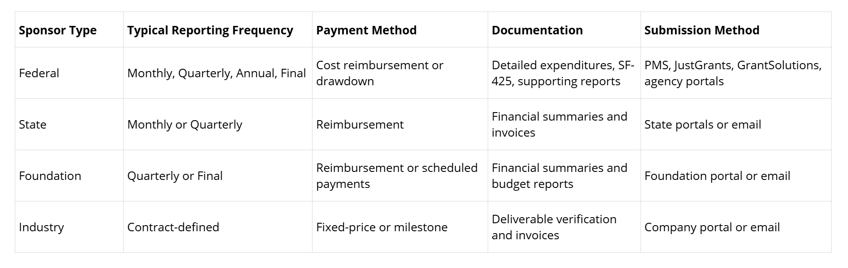
Comparing Sponsor Requirements
Notes:
Then discuss how each of these items impacts grant invoicing and financial reporting.

Slide 42
Systems & Tools

Slide 43
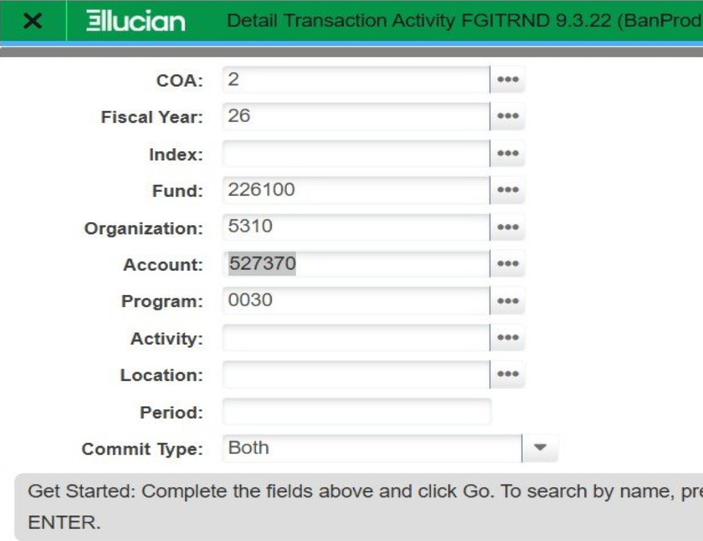
Banner Revenue - FGITRND
Banner is the official accounting system for posted revenues and expenses.
Cayuse DOES NOT display fund revenues. A quick lookup for fund revenues can be done using
FGITRND - Detail Transaction Activity
You will need Fund/ Revenue Account. Here is a short list of the most commonly used but check your Budget/ Compliance Officer to confirm.
  Federal - 527370
  State - 536710
  Local - 546710
  Private - 556702
  Miscellaneous - 596966

Slide 44
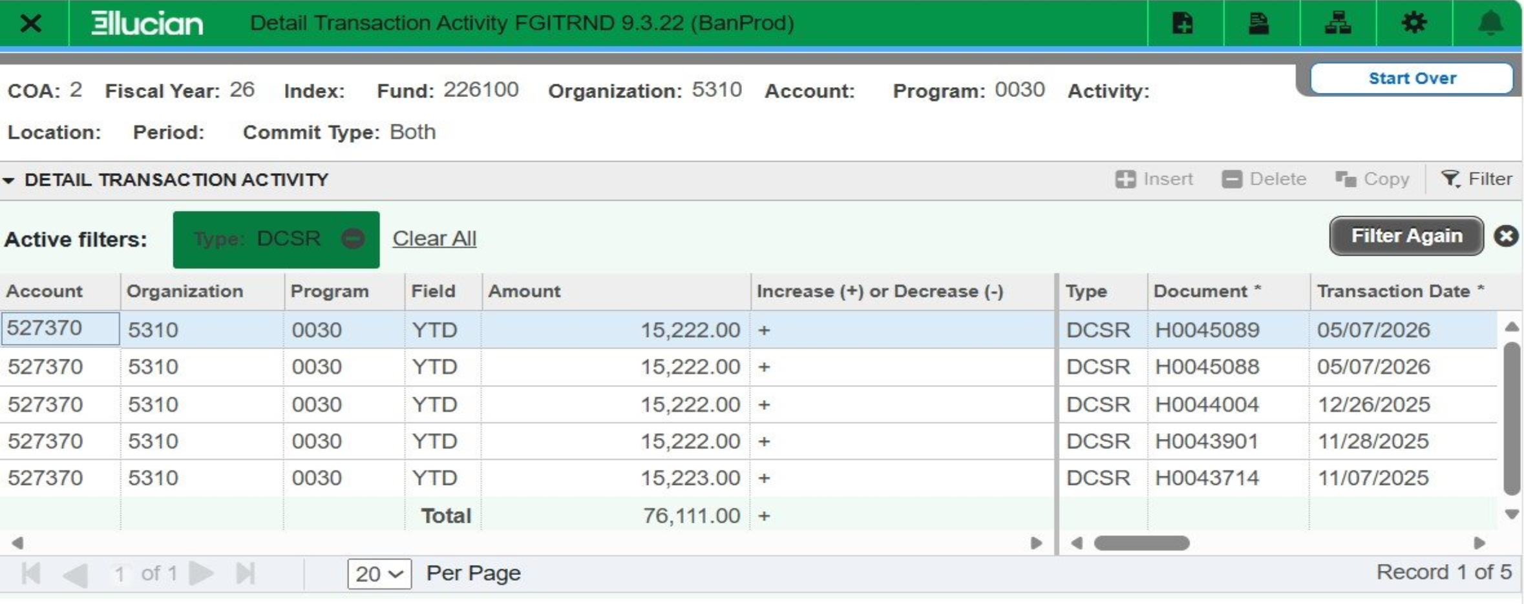
Banner Revenue - FGITRND

Slide 45
Cayuse Award Record
PI’s and Admin can use Cayuse Sponsored Project / Award Module / Award Record:
General Tab:
  Assigned Compliance and PreAward Contacts
  Banner Fund #​
  Org #​
  Award Start & End Date​
  Award Title​
  Revenue Source​
  Project Classification​
  CFDA, if applicable​
  Agency Information​
  College/Dept Information (PI/CoPI, Admin, College, etc.)​
  Additional Information (Previous Banner Fund # or message from Compliance)
Notes:
Then discuss how each of these items impacts grant invoicing and financial reporting.

Slide 46
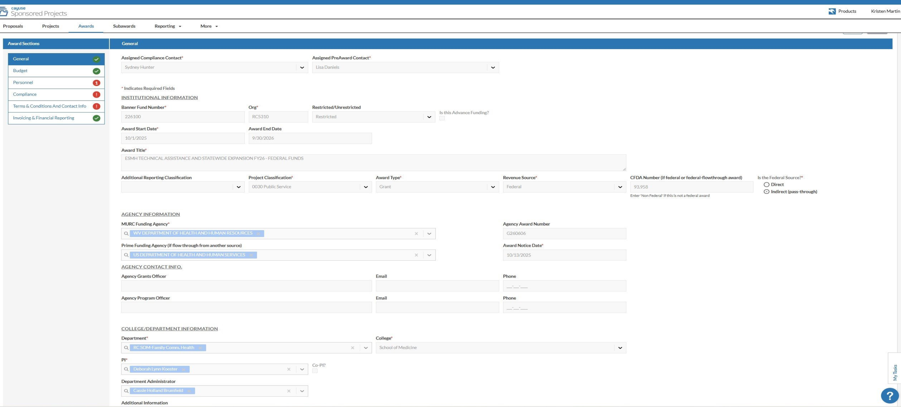
Cayuse Award Record - General Tab
Notes:
Then discuss how each of these items impacts grant invoicing and financial reporting.

Slide 47
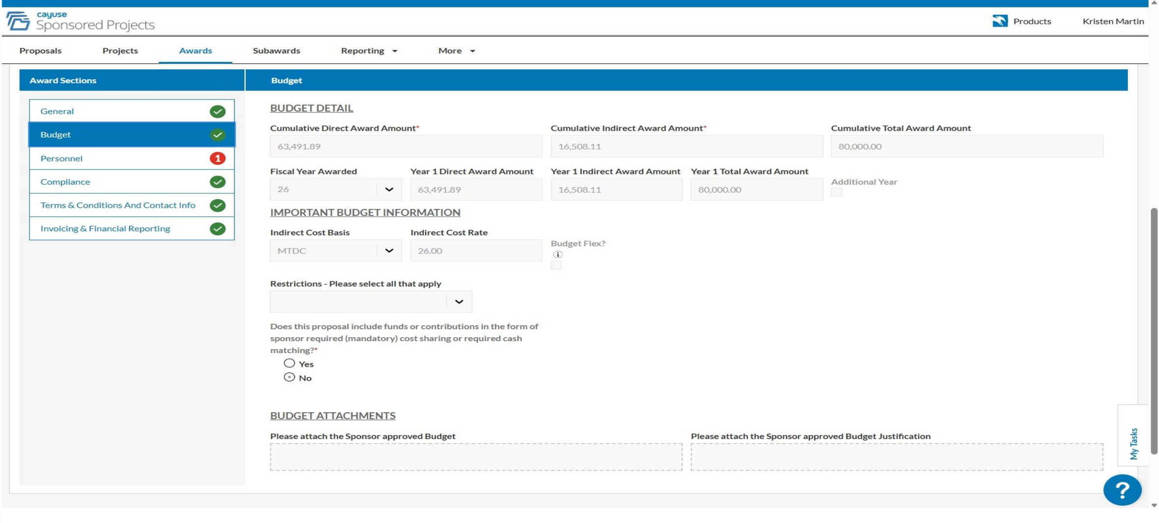
Cayuse Award Record - Budget Tab
Notes:
Then discuss how each of these items impacts grant invoicing and financial reporting.

Slide 48
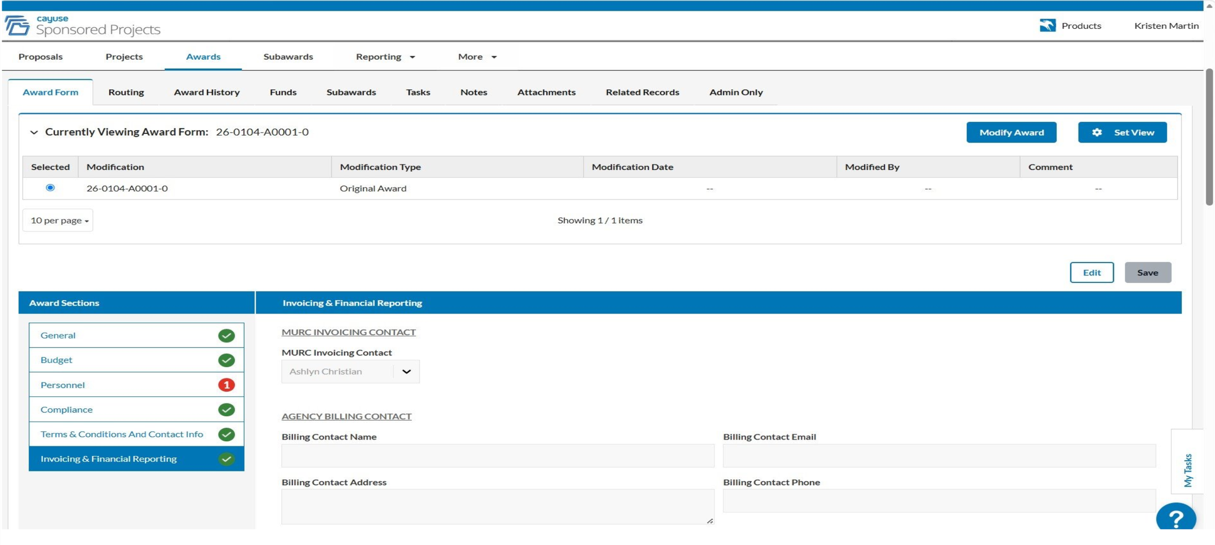
Cayuse Award Record - Invoicing & Financial Reporting Tab
Notes:
Then discuss how each of these items impacts grant invoicing and financial reporting.

Slide 49
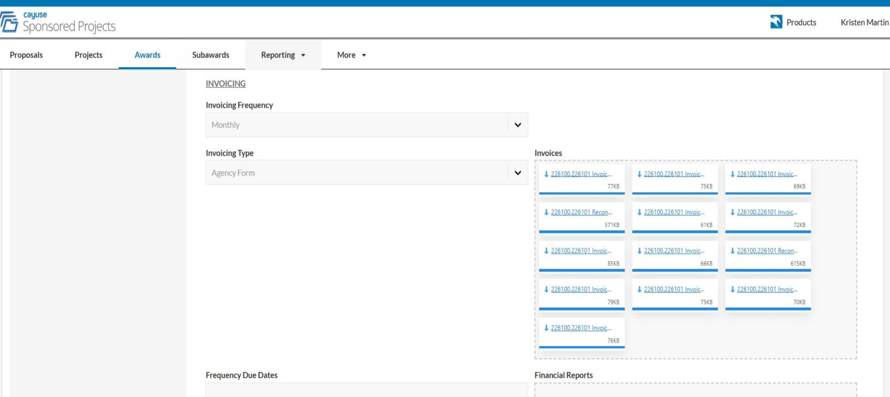
Cayuse Award Record - Invoicing & Financial Reporting Tab
Notes:
Then discuss how each of these items impacts grant invoicing and financial reporting.

Slide 50
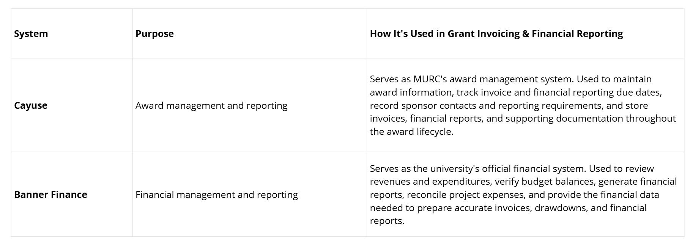
Systems Used
Notes:
Then discuss how each of these items impacts grant invoicing and financial reporting.

Slide 51
How Information Flows
Understanding how these systems work together helps illustrate the grant financial management process.
Award Received
↓
Proposals converted to Awards in Cayuse Sponsored Projects
↓
Financial Activity Recorded in Banner
↓
Transaction Details Loaded Nightly into Cayuse
↓
Expenses Reviewed
↓
Invoice or Drawdown Prepared
↓
Submitted Through Sponsor Portal
↓
Payment Received
↓
Documentation Stored in Cayuse
Notes:
Amara will start presenting here

Slide 52
Key Takeaways
  No single system manages the entire grant lifecycle—each system has a specific role.​
  Cayuse supports award management, reporting schedules, and document storage.​
  Banner serves as the official financial record for project expenditures and posted revenue.​
  Sponsor portals are used to submit invoices, drawdowns, and financial reports.​
  Understanding where information resides improves communication, efficiency, and compliance.
Notes:
Then discuss how each of these items impacts grant invoicing and financial reporting.

Slide 53
Best Practices
✔ Review your budget regularly—not just at the end of the project.
✔ Monitor expenditures throughout the award period.
✔ Monitor revenues throughout the award period.
✔ Respond promptly to requests from MURC.
✔ Keep supporting documentation organized.
✔ Communicate anticipated project changes or amendments early.
✔ Begin planning for closeout before the award end date.
✔ Ask questions early—MURC is here to help.
Notes:
Then discuss how each of these items impacts grant invoicing and financial reporting.

Slide 54
Thanks for Attending!
Questions?

