Slide 1


MURC Accounts Payable Training

Slide 2




Today’s Presenters
Kristen Martin,
Senior Finance Officer
Bradley Smith,
Senior Financial Analyst
Kristen Webb,
Contract and Subaward Compliance Officer
Email: martinkr@marshall.edu
Phone: 304-696-4665
Email: smithbra@marshall.edu
Phone: 304-696-6203
Email: kristen.webb@marshall.edu
Phone: 304-696-2589

Slide 3
Learning Objectives
Verify vendor registration and AP address accuracy before payment.
Identify invoice type and route to the correct processor.
Determine when a service agreement, encumbrance, or PO is required.
Validate required invoice elements prior to submission.
Navigate Banner and Cayuse to track payments and fund activity.
Apply proper approval and receiving workflows.
Process travel authorizations and settlements with complete documentation.
Recognize and prevent common AP processing errors.
Vendor → Requisition/Encumbrance → Compliance → Receiving → Payment

Slide 4

Mission of MURC Accounts Payable
Ensure accurate and timely vendor payments
Maintain compliance with sponsor and institutional terms and conditions
Protect financial integrity of research funds
Provide transparency in tracking payments

Slide 5
MURC Purchasing Process by Type of Invoices
Accounts Payable Dept
Kristen Martin
Kathy Chaffin
Corey Davis
Contacts/ Subawards
Kristen Webb
Kristen Martin
Travel Reimbursement
Bradley Smith
Kathy Chaffin,
Accountant
Processes encumbrances and purchase orders for goods,
services, software, rentals, and stipends/scholarships
Bradley Smith,
Senior Financial Analyst
Processes travel request.
Kristen Webb,
Contract and Subaward Compliance Officer
Handles invoicing for subawards and service agreements
Kristen Martin,
Accountant
Supervises Accounts Payable
Department. Processes Subaward payments after Compliance review.
Corey Davis,
Accountant
Processes payments for contracts and service agreements
Email: waddell@marshall.edu
Phone: 304-696-6532
Email: smithbra@marshall.edu
Phone: 304-696-6203
Email: kristen.webb@marshall.edu
Phone: 304-696-2589
Email: martinkr@marshall.edu
Phone: 304-696-4665
Email: davisco@marshall.edu
Notes:
invo

Slide 6
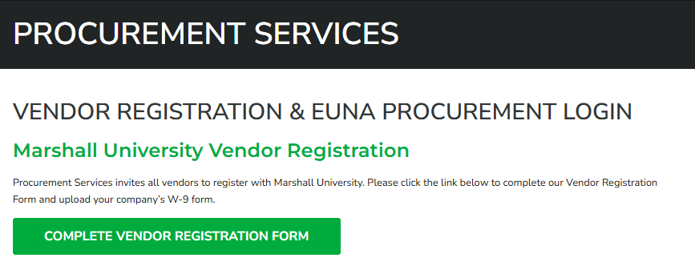
Vendor Registration
All vendors must be registered with MU Procurement Services
Students receiving stipends must be registered as vendors
Vendor must have current address on file
Used for:
Payment
1099 tax reporting
AP Address may differ from HR/Payroll address
Verify vendor setup and addresses in Banner: FTMVEND
www.marshall.edu/procurement-services/resources/vendor-registration/

Slide 7
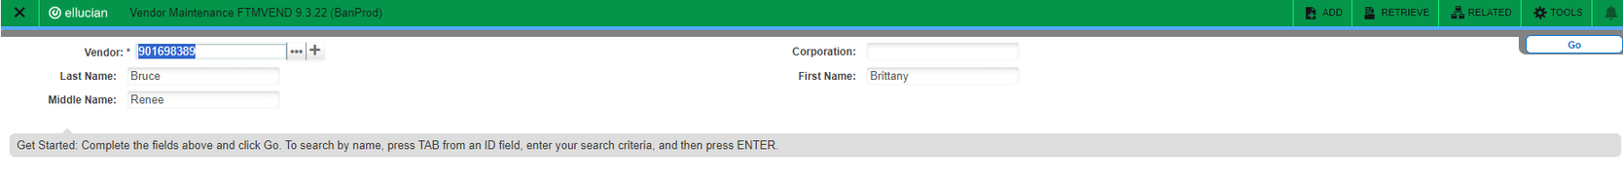


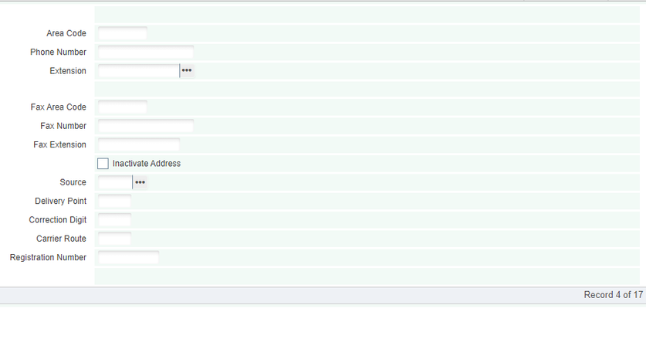


Banner Screen FTMVEND
Visit Banner here and use screen FTMVEND in the search bar. This screen is used to view the vendors address to ensure you are working with the correct vendor.
1. Type in the vendor number and click ‘Go’
2. On the next screen select ‘Address’ to check that you are working with the correct vendor.
3. If the vendor has multiple address records, you will need to use the arrows to move through the records to find the one with the ‘Inactivate Address’ box unchecked. This is the current address for the vendor.
Check AP address where the check is sent. Differs commonly from PO address of vendor setup.

Slide 8
Tracking Vendor Payments
Banner Screens
Cayuse Award Attachments
Cayuse Fund Manager – Fund Detail/Reporting
Need to include Banner and Cayuse Screenshots.
BANNER + CAYUSE

Slide 9
Goods & Services Invoices
Vendor invoice must include:
Encumbrance (E) / Purchase Order (PO) number
Vendor assigned invoice number
Include Vendor Address (in Banner System)
Date of service
Include Charges must coincide with original requested goods/ services
Encumbrance
One-time payment
No ongoing terms
Requisition/Purchase Order (PO)
Date range
Terms & conditions
Ongoing services
VS

Slide 10

Stipends, Honorariums & Scholarships
Required Documentation
Name
Current address (registered vendor)
Vendor assigned invoice number
Dates of service
Approval signature
Template stipend form (Invoice/Transfer Form (Excel .xls)
When NOT to use a service agreement procedure
One-time payment
No contract terms
Encumbrance only
Payment Due Dates - Service invoices cannot be paid in advance of the performance of service. If you pay a guest speaker (honorarium), the check can be delivered at the performance if you plan ahead, or after the event. The last date of service on the signed agreement is when the check can be issued.

Slide 11

Approvals & Receiving
Approval Process
Compliance approves E/POs
Invoices must be sent to assigned Compliance Officer
Cannot process without approval
Receiving Process
If PO requires receiving
Receiver date must be entered
Invoices cannot process without an entered Receiving date, Depts can email the date to be entered to:
MURC_Accounts_Payable@marshall.edu or
MU Receiving Dept – Jeff Nelson at nelsonjef@marshall.edu.

Slide 12

Employee Travel
MURC will only issue travel expense payments that meet the criteria outlined in the Travel Policy and Procedure Manual here.
Key Forms:
Travel Authorization Form
Travel Settlement Form
Bradley Smith,
Senior Financial Analyst
Email: smithbra@marshall.edu
Phone: 304-696-6203

Slide 13
Complete before the trip:
The Travel Authorization/Direct Bill Request Form must be submitted and approved in advance for all out-of-state, overnight, and international travel, as well as for any expenses of the trip to be directly billed to MURC by way of invoice or charged to the MURC P-Card. Travel Authorization/Direct Bill Request Form was updated on 6/5/2025, please make sure to use the new form.
1
Complete a MURC Travel Authorization/Direct Bill Request Form and attach any relevant documents for the trip in order based on how the are listed on the form. (Airfare, Rental Car, Conference Fee/Registration, Lodging, Per Diem and Misc.).
2
Send to supervisor for approval and signature. The traveler only needs to sign if a cash advance is being requested.
3
Create an encumbrance (FGAENCB) in Banner. This encumbrance number will be noted on the Travel Authorization/Direct Bill Request Form and your P-Card reconciliation at the end of the month.
Submit the form to Bradley Smith for MURC approval and processing. Travel requests should be submitted to Bradley 10 days before your trip, or 30 days in advance if you need a cash advance. Both the traveler and supervisor will be copied on this email to Bradley. Keep these documents for your records, as you will need the encumbrance number to complete the MURC Travel Settlement Form upon your return.
4

Slide 14

Things to know:
Travel Authorization/Direct Bill Request Form
Travel Authorization must be approved by MURC prior to using your PCard.
When booking airfare or lodging, please book directly with the rental agency. Using third-party booking sites can complicate refunds and may cause issues with our tax-exempt status.
We are tax exempt, make sure to take a paper copy of the tax exempt form to provide to the hotel.
For Enterprise car rentals: Marshall University has a discount code that needs to be used. Code: #XZ687MU
When filling out your address, use the one listed in Banner. If you need to change your address please send this form to Alisha Harbour at owens24@marshall.edu
If meals are not being provided, use the GSA Rates found here. Meals are not provided for single day travel. The GSA rate sheet must be included with your travel authorization, this included WV.
NOTE: If breakfast is provided by the hotel and not the conference; it does not need to be counted in the per diem amount.
You can only receive a cash advance for meals, tolls, ride share, & misc. costs prior to the trip. This does not apply to mileage. Receipts must be turned in for all cash advanced expenditures. Unused cash advance amounts will need to be returned to MURC.
When submitting the Travel Authorization/Direct Bill Request Form, please include all travel documents in a single combined PDF and make sure you have obtained all necessary signatures.

Slide 15
After the trip:
Staff are responsible for submitting for reimbursement a Travel Settlement Form with all required attachments to qualify for reimbursement of expenses. The Travel Settlement Form with the required documentation must be submitted to MURC within ten (10) business days following the last day of the approved travel.
1
Prepare a MURC Travel Settlement Form for all travel expenses and reference the encumbrance number obtained from the Travel Authorization/Direct Bill Request Form that was previously submitted by Bradley.
2
Attach all required original receipts to the Travel Settlement Form. Copies of receipts for all MURC P-Card transactions must be submitted with the monthly PCard reconciliation in accordance with P-Card policies and procedures.
3
The traveler will sign and send it to his/her supervisor for approval and signature.
4
Once supervisor has signed, submit the form to Bradley Smith for MURC approval and processing.

Slide 16
Things to know: Travel Settlement Form
The Travel Settlement Form with required documentation must be submitted to MURC within ten (10) business days following the last day of the approved travel.
When submitting the Travel Settlement Form, please make sure you are using a new form. Often forms are being reused with an encumbrance number from a previous trip.
The encumbrance number on the Travel Settlement Form must match the one listed on the Travel Authorization/Direct Bill Request Form that was previously submitted.
The miles listed in the Google Maps directions must match the "to" and "from" addresses specified on the form to verify the mileage. The travel office will not accept round trips starting and ending at home.
Per diem must be itemized daily, excluding any provided meals. Please include the GSA per diem rate sheet.
NOTE: If breakfast is provided by the hotel and not the conference; it does not need to be counted in the per diem amount.
When listing your lodging expenses, you can provide the total sum on the first or last day rather than breaking it down by daily expenses.
Entries in the "other" column must be explained in the "other expenses" section at the bottom left. This includes items paid by p-card or a personal card.
Subtract any expenses paid by the P-card (non-reimbursable) under the "Direct Billed Expenses" section. If paid by another individual's P-card, please make a note here.
The MURC Travel Settlement Form must be signed by the traveler and the PI.

Slide 17



Service Agreement Invoicing Guidelines
Purpose of the Service Agreement Invoicing Guidelines:
Clarity
Define invoice requirements and expectations
Oversight
Verify services provided and costs charged
Compliance
Maintain documentation and support audit readiness
Kristen Webb,
Contract and Subaward Compliance Officer
Email: kristen.webb@marshall.edu
Phone: 304-696-2589

Slide 18
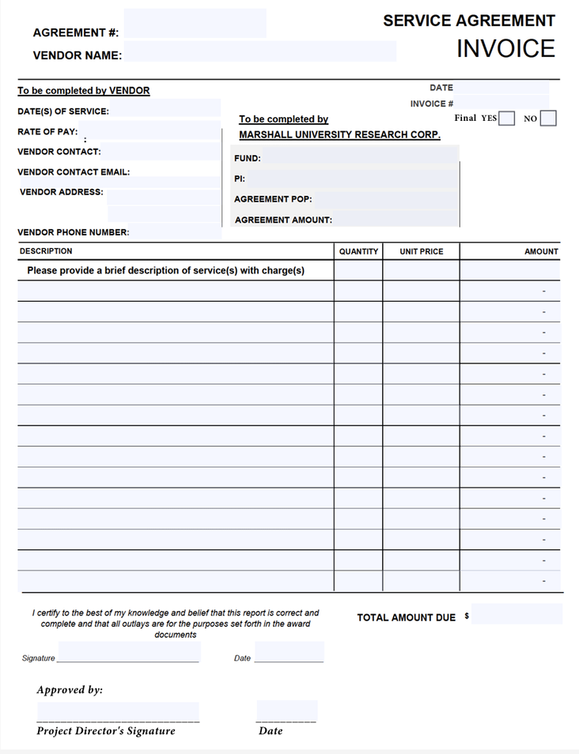
MURC Service Agreement Invoice
When invoicing against a Purchase Order (PO), the vendor is required to complete the MURC Service Agreement Invoice to ensure all relevant information is properly recorded and that the invoicing aligns with the terms of the service agreement.
It is okay if the vendor attaches their own invoice, but they must use the MURC Invoice. This document must be completed by the vendor.
Note: Vendors who use their own agreements, e.g. a company, may use their own invoicing template.

Slide 19
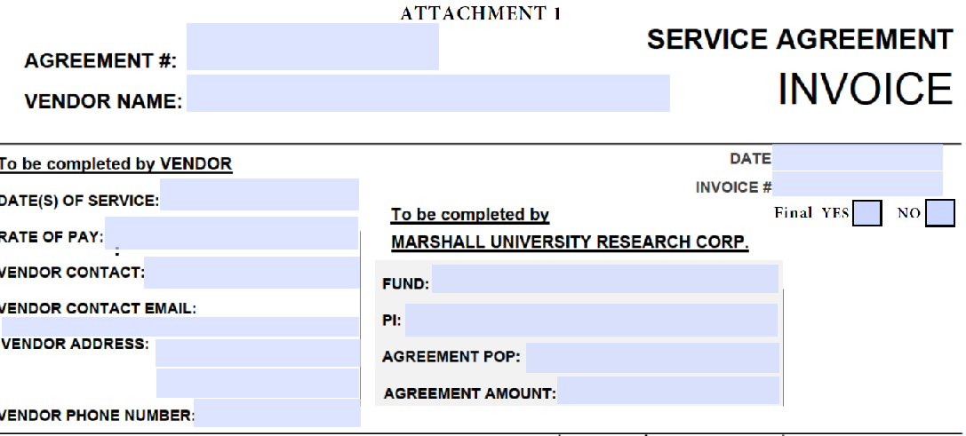
Required Invoice Information
Every Invoice must include the following:
Agreement number
RC-P# or P#-Found on the final PO/fully executed service agreement
Vendor Information
Name
Contact Information
Dates of service=Dates covered by this invoice
Rate of pay=terms of pay outlined on agreement (amount per hour, etc…)
MURC Information
This will be updated to Department Information
Agreement POP=Period of Performance=
Total agreement period
Agreement Amount=Total Agreement Amount
Invoice Details
Unique Invoice number-Vendor creates
Invoice Date
Final? Yes or no box must be checked

Slide 20
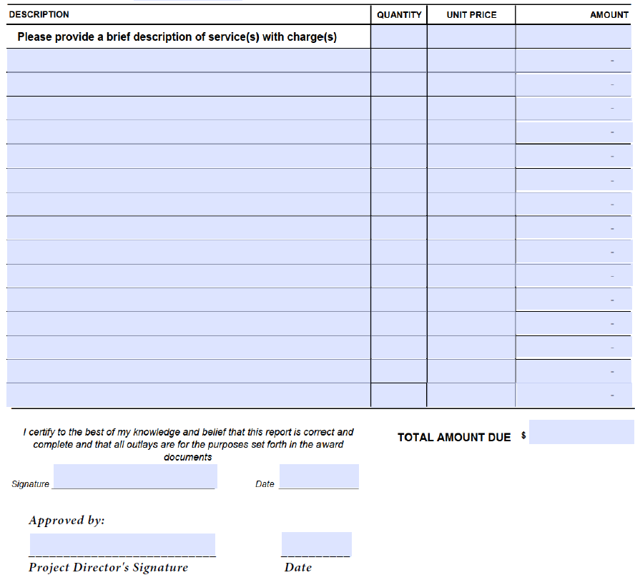
Required Invoice Information
Service Details
Brief description of services performed
If paid hourly, the invoice must include:
Dates worked
Hours worked per day
Hourly rate
Total and Signature
Total amount due
Vendor signature and date
PI signature and date
Note: The MURC Service Agreement Invoice template should be only be used for service agreements.

Slide 21
Submitting the Invoice
After PI Approval submit the following for review and processing:
Signed service agreement Invoice (both vendor and PI signature)
Supporting documentation (if applicable)
Send to:
Kristen Webb, Contract and Subaward Compliance Officer
Copy Kristen Martin, Senior Finance Officer.
This allows finance to know invoices will be submitted for payment shortly
After review, if there are no issues the invoice will be submitted for payment

Slide 22
Confirming Payment
PIs and Departments should ensure the vendor receives payment
Payment status can be checked in Banner screens FGIENCD, FAIINVE and FOIDOCH or Cayuse Fund Manager
Monitoring payment status helps ensure vendors are paid in a timely manner

Slide 23
Common Issues that Delay Payment
Payment delays often occur due to:
Missing agreement number
Missing vendor signature
Missing PI approval
Incomplete service descriptions
Missing hourly breakdown when required
Ensuring invoices are complete and accurate helps avoid delays

Slide 24
Quick Process Overview
PO is created
Services are completed
Vendor completes invoice (Includes required details and signs)
PI reviews and signs the invoice
Department submits invoice for review
Invoice is processed for payment
Department verifies payment in Banner/Cayuse

Slide 25
Subaward Invoicing Guidelines
Purpose of Subaward Invoicing Guidelines
Compliance
Meet Sponsor and institutional requirements
Maintain audit ready documentation
Oversight
Ensure costs are allowable and aligned with project work
Identify potential issues early
Consistency & Efficiency
Standardize review practices
Clarify roles for PIs and departments
Promote timely invoice processing
Kristen Webb,
Contract and Subaward Compliance Officer
Email: kristen.webb@marshall.edu
Phone: 304-696-2589

Slide 26


Overview of the Process
Invoice from Subrecipient
PI Review and Signature
Submission for Review and Approval
Processing by Accounts Payable
Payment Confirmation

Slide 27
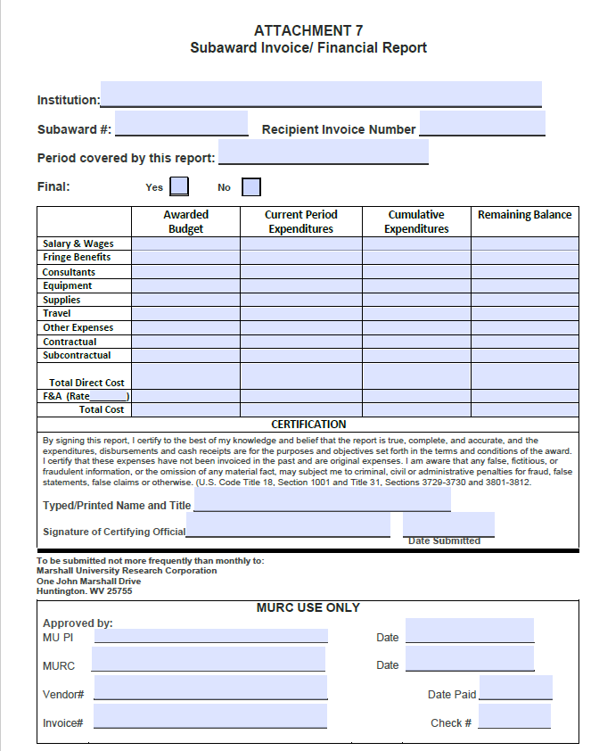
Subrecipient Invoice Submission
Per term 2 of our subaward agreement, the subrecipient is required to use our invoice template when requesting payment
The invoice includes the following:
Current and cumulative costs
Breakdown by major cost category
Subaward Agreement Number
Certification of Truth and Accuracy
Note: The subrecipient can submit their own template as part of their supporting documentation, but ours must be used for reimbursement

Slide 28
Subrecipient Invoice Supporting Documentation
What is Supporting Documentation?
Documentation that verifies costs billed on a subrecipient invoice were actually incurred and are allowable under the subaward and sponsor regulations.
When Is It Required?
Supporting documentation may be required when:
The subaward agreement requires backup with invoices
Costs appear unusual, high, or unclear
The subrecipient is high risk
Random monitoring or audit review
Requested by the prime institution
The prime institution may request supporting documentation for any invoice at any time as part of subrecipient monitoring responsibilities.

Slide 29
Documentation Examples
Budget Category | Example Supporting Documentation
Personnel | Payroll report, labor distribution report, effort certification
Fringe Benefits | Fringe rate agreement or payroll report showing fringe calculation
Equipment | Vendor invoice, purchase order, receipt
Supplies | Receipts, procurement card report, purchasing detail
Travel | Travel reimbursement report, airfare receipt, hotel receipt
Other Direct Costs | Consultant invoice, service agreement, participant payment records
Indirect Costs (F&A) | F&A rate agreement and calculation worksheet

Slide 30
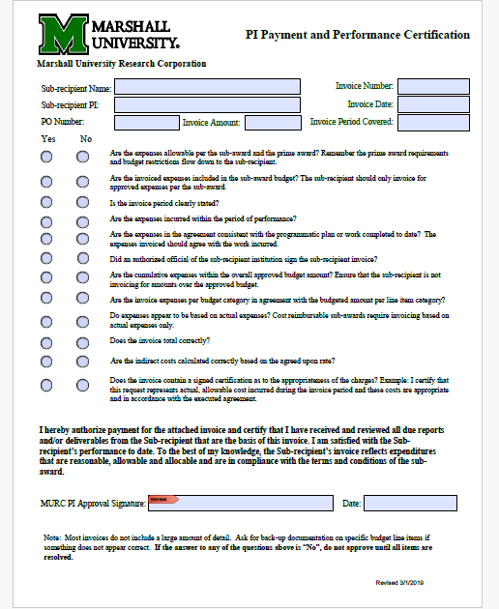
Invoice Review, Signature and Certification
Invoice review should include the following:
Review of all charges to confirm they align with the subaward agreement
Ensure expenses are reasonable, allowable, and properly documented
Supporting documentation should match the requested charges
Invoice totals (current, cumulative, balance) calculate correctly
If discrepancies are found, the PI/Dept. may request clarification or additional backup documentation from the subrecipient
Once satisfied, the PI
Signs the Invoice
Completes and signs the PI Payment and Performance Certification Form
Signing both documents confirms:
Accuracy of the charges
Performance aligns with subaward terms

Slide 31
Subrecipient Invoice Review-Optional Approach
Departments and PIs can choose to divide invoice review responsibilities: Admin staff focus on financial accuracy, budget compliance, and supporting documentation, while the PI focuses on confirming the work was performed and costs are appropriate. Together, this ‘tag-team’ approach can make reviews more thorough and efficient, but it is optional.
Department / Administrative Review
Invoice Accuracy – Verify totals, math, and indirect costs (F&A)
Categorical Alignment – Charges match approved budget categories
Supporting Documentation – Documentation matches categories, provides clear cost breakdown
Compliance Checks – Regulatory approvals, subaward terms
Red Flags / Exceptions – Large/unusual charges, vague items, end-of-project spending
Documentation of Review – Maintain records for audits
PI Review
Work Performed – Confirm milestones or deliverables completed
Reasonableness of Charges – Costs appropriate for work performed
Budget Consistency – Charges aligned with approved budget
Billing Period Verification – Costs incurred during project dates
Supporting Documentation – Traceable to work performed and invoice amounts
Subrecipient Performance – Subrecipient meets project expectations
Approval Sign-Off – Confirms work completed, costs valid, and benefit to project

Slide 32
How long do we have to pay a Subaward Invoice?
Per Uniform Guidance 2 CFR 200.305 (b)(3)
When the reimbursement method is used, the pass-through entity must make payment within 30 calendar days after the receipt of the payment request unless there is an issue with the request
Please review your subaward invoices and submit them for processing as soon as possible after you receive them.

Slide 33

Submit for Review and Approval
Submission Instructions:
Email the signed invoice, PI Certification Form and supporting documentation to:
Kristen Webb, Contract & Subaward Compliance Officer at Kristen.Webb@marshall.edu
CC: MURC_Accounts_Payable@marshall.edu
Kristen Webb’s Review:
Ensures documentation aligns with subaward terms
May request revisions or additional documents
Processing by Accounts Payable
After Approval:
Kristen Webb sends the approved invoice to MURC Accounts Payable for payment
Processing Time:
Within 10 days of receiving approval

Slide 34
Summary
Subrecipient → Invoice
PI → Review and Sign
Kristen Webb → Review and Approve
Accounts Payable → Process Payment
PI/Department → Confirm Payment

Slide 35
Invoice Tracking
Invoice tracking for subawards and service agreements helps departments and PIs stay organized by monitoring when invoices are received, reviewed, and paid, and ensuring charges align with the agreement and project timeline.
Banner Screens
FOIDOCH → shows the document chain (PO → invoice → payment)
FAIINVE → shows invoice details and status
FGIENCD → shows invoice activity and remaining balance
Cayuse Fund Manager
Note:
PI/Department should be tracking invoices from submission to payment for each contractual agreement. If payment isn’t reflected in banner within reasonable amount of time, the PI/Department should follow up with appropriate MURC staff

Slide 36
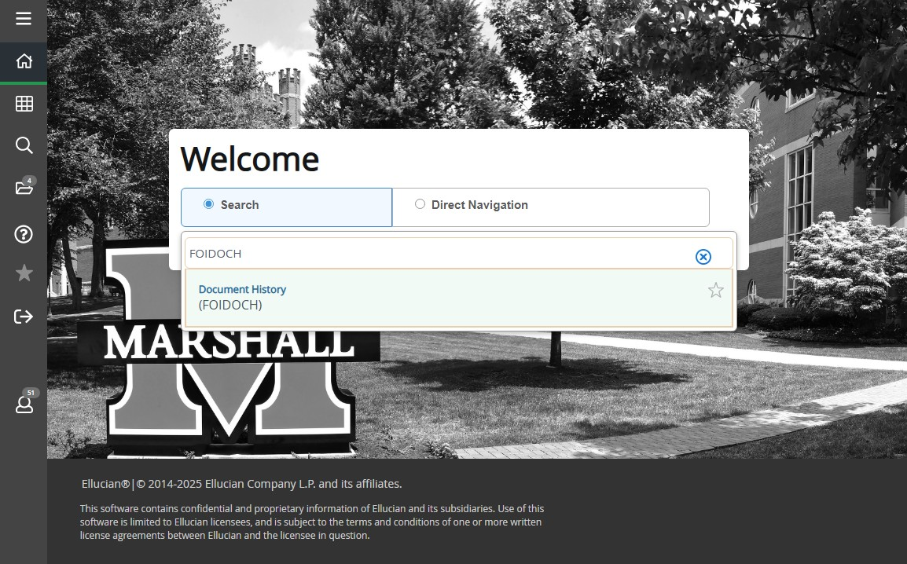
FOIDOCH-Document History

Slide 37
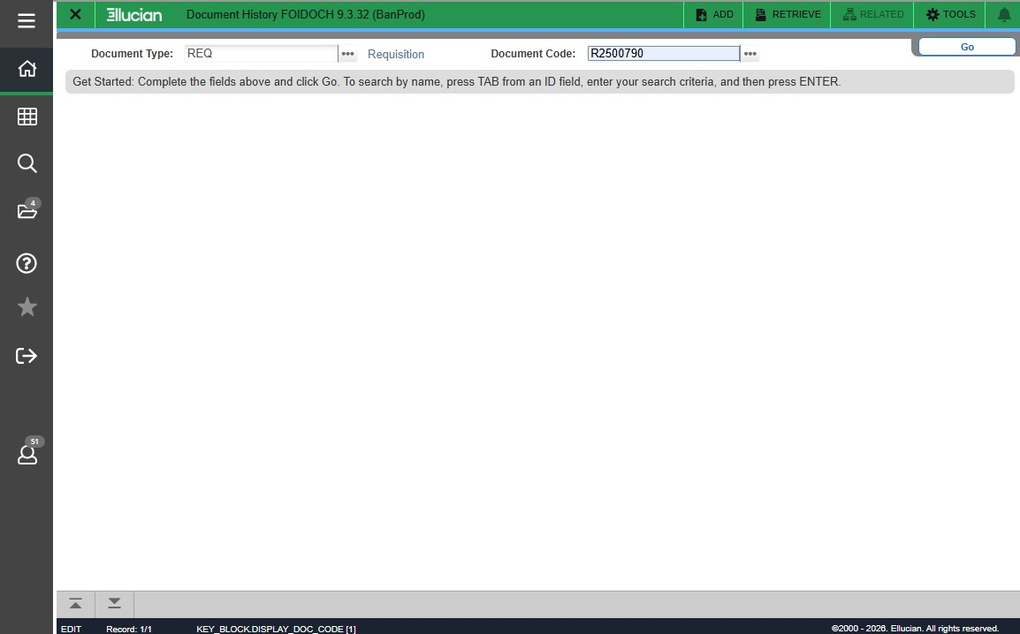
Enter REQ, Enter R#, Click Go

Slide 38
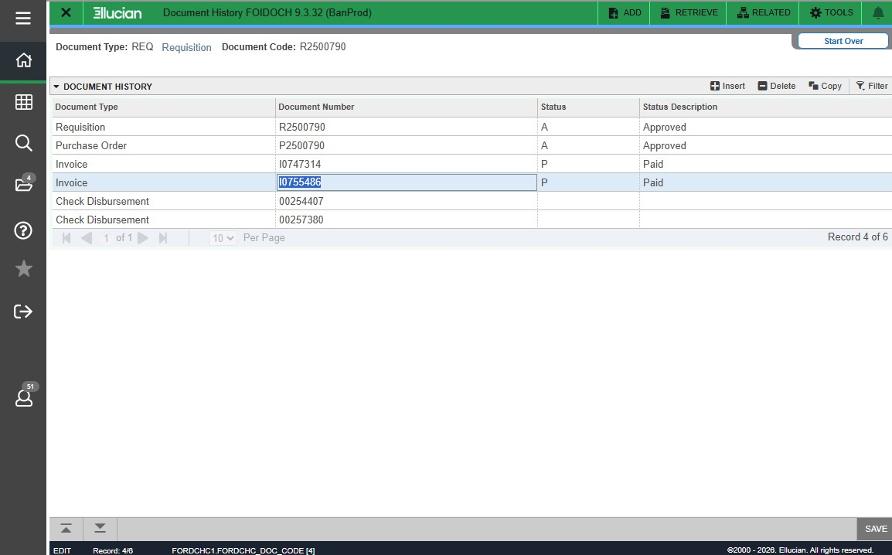
PO Creation-Invoice Payments-Check Numbers

Slide 39
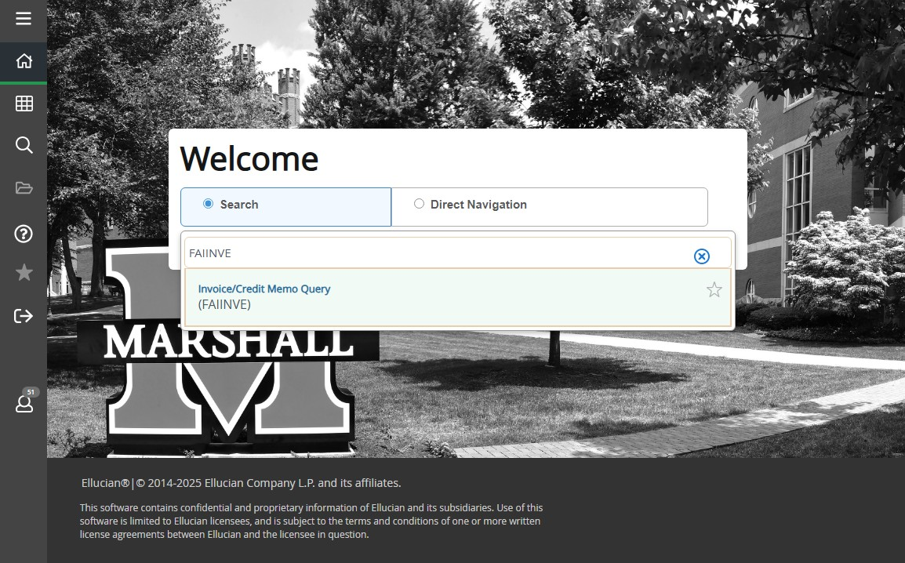
FAIINVE-Invoice Details

Slide 40
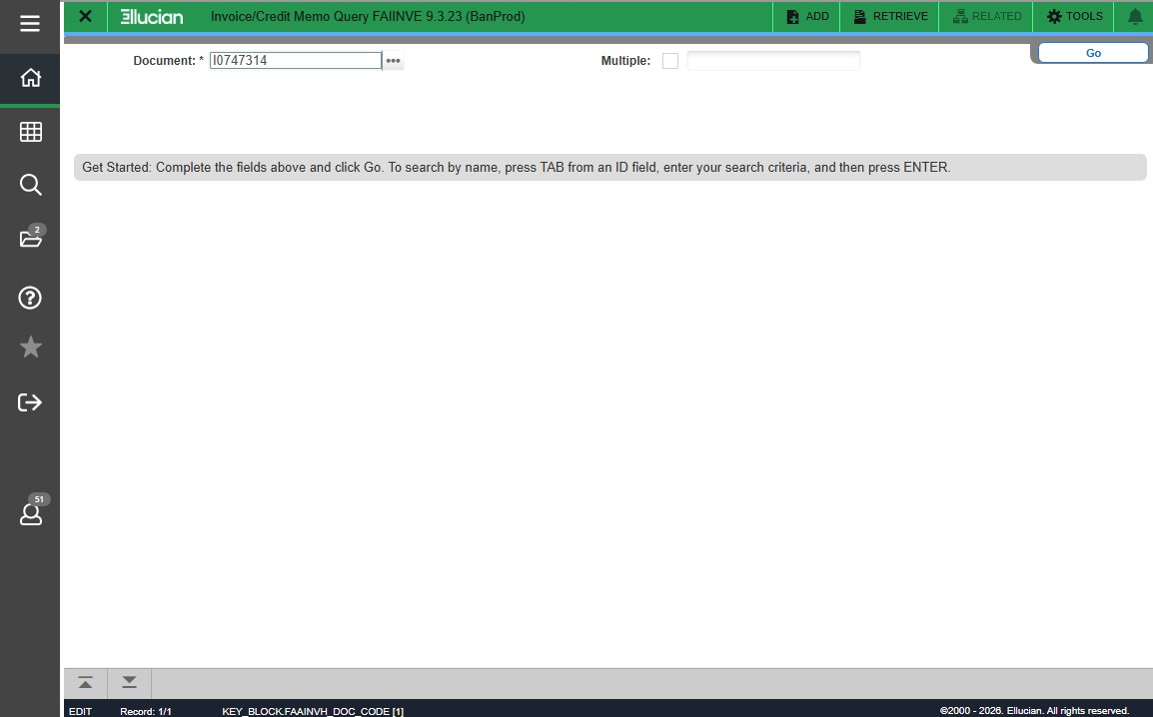
FAIINVE-Invoice Details

Slide 41
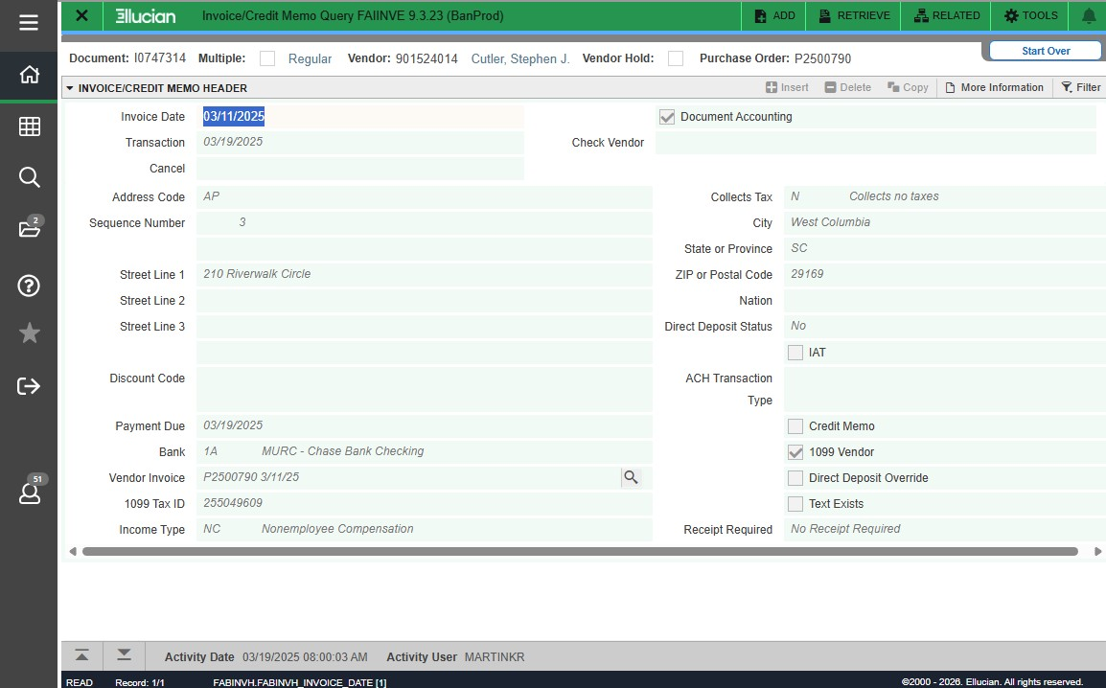
FAIINVE-Invoice Details

Slide 42
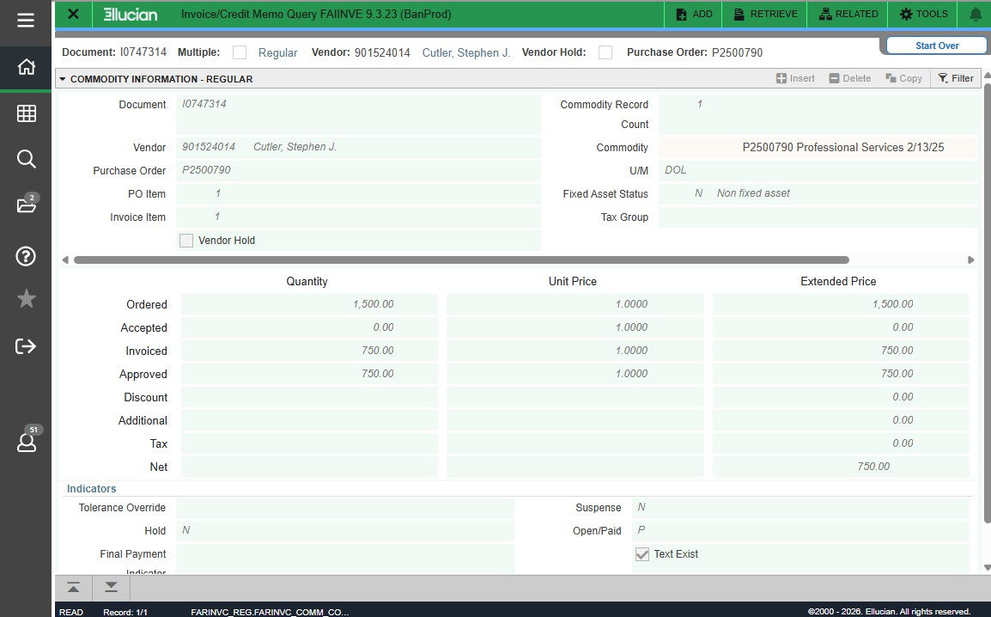
FAIINVE-Invoice Details

Slide 43

FGIENCD-Payment Activity

Slide 44
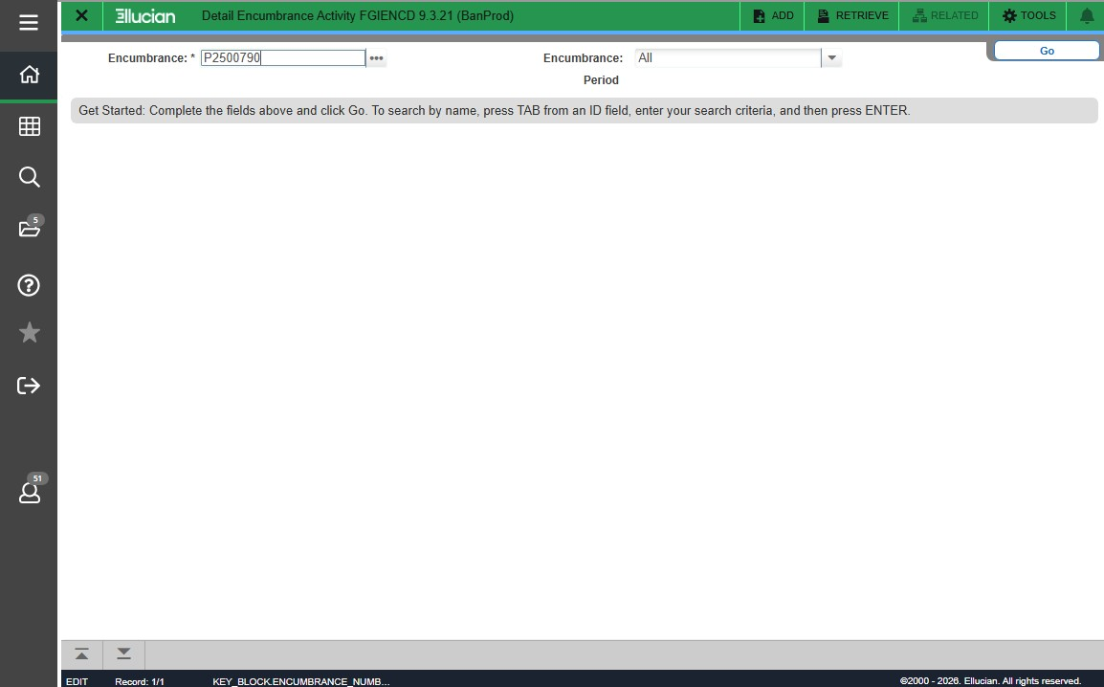
Enter P#, Click Go

Slide 45
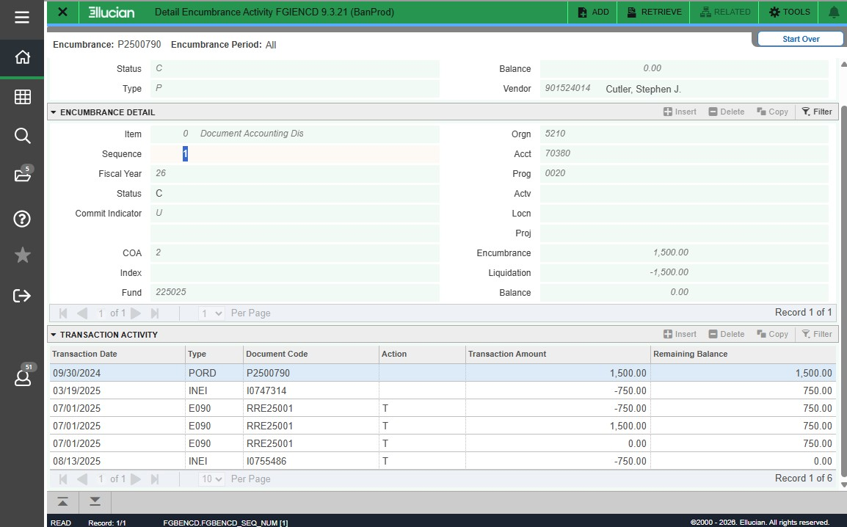
PO Detail

Slide 46
Quick Recap- FOIDOCH
Start with the Requisition
If you have the R number, you can trace the entire transaction
Open FOIDOCH – Document History
Enter the R number and click Go
FOIDOCH will show the full chain:
Requisition
Purchase Order
Invoice
Payment
This helps you see whether a PO, invoice and payment exist.
Note: You can search by Requisition or PO. Choose the document type you would like to use. If you choose Requisition, search with the R#. If you choose PO, search with the P#.

Slide 47
Quick Recap- FAIINVE
Review the Invoice
Open FAIINVE – Invoice Query
Enter the invoice number (I#) from FOIDOCH and click Go
FAIINVE allows you to view:
Invoice amount
Vendor information
Invoice status
Associated PO number
Payment information if issued
This confirms the invoice has been entered into Banner.

Slide 48
Quick Recap- FGIENCD
Check PO Activity
Open FGIENCD – Detail Encumbrance Activity
Enter the PO number and click Go
FGIENCD shows:
All invoice transactions
Amounts paid
Remaining PO balance
If the balance is $0, the PO has been fully paid.

Slide 49
Quick Recap-Summary
When checking payments:
FOIDOCH → shows the document chain (PO → invoice → payment)
FAIINVE → shows invoice details and status
FGIENCD → shows invoice activity and remaining balance
Together these screens help you confirm:
If an invoice was processed
If a vendor was paid
If there is money remaining on the PO
FOIDOCH shows you the story of the transaction, FAIINVE shows the invoice details, and FGIENCD shows you the financial activity

Slide 50
Common Banner Codes When Checking Payments
When reviewing transactions in FGIENCD or FOIDOCH, you may see the following codes:
Code | Meaning | What It Tells You
PORD | Purchase Order Created | The PO has been issued.
CORD | Change Order | The PO amount or details were modified.
INEI | Invoice Entered | An invoice has been processed against the PO.
ICEI | Invoice Cancelled | An invoice entry was cancelled or corrected.
E090 | Encumbrance Rollover | Remaining PO balance carried into the new fiscal year.
T (Action) | Transaction Applied | Payment activity reducing the PO encumbrance.

Slide 51
Invoice Tracking Spreadsheet
Invoice tracking ensures timely payment, financial compliance, and accurate expense reporting. Each department should maintain an invoice tracking log for all subawards and service agreements. An excel document is the easiest way to do this.
Recommended Spreadsheet Columns:
Vendor/Subrecipient Agreement No. Award Amount Invoice Amount Current Expenditures Cumulative Expenditures Balance Invoice Date
Date Received Billing Period Date Sent for Review PI Approval
Date Paid Follow-up Notes
Once the invoice information has been recorded, save the invoice and any applicable information (approvals) in a clearly labeled folder.
This doesn’t have to be complicated. Keeping a simple log like this helps you quickly see what has been submitted, what has been paid, and what may need follow-up.

Slide 52
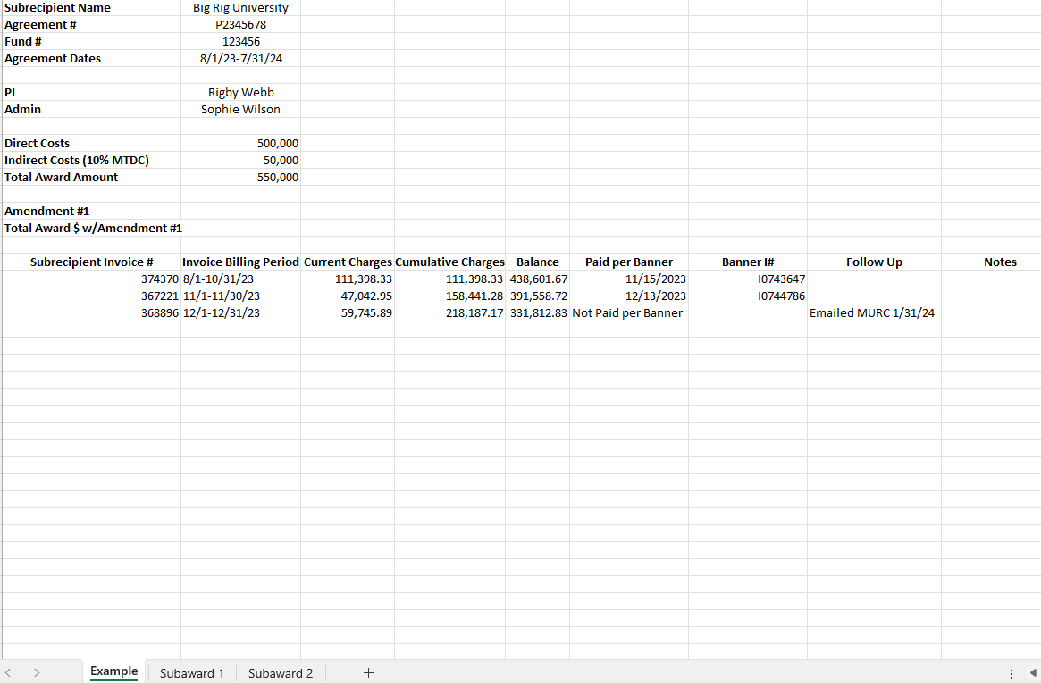
Invoice Tracking Spreadsheet

Slide 53

Cayuse Fund Manager
Cayuse Fund Manager Training Guide:
https://www.marshall.edu/murc/files/Cayuse-Fund-Manager-Training-Guide-102325.pdf
For questions or support email: cayusesupport@marshall.edu

Slide 54
Your Role in the Payment Process
Departments play a critical role in ensuring invoices are accurate, compliant, and processed on time.
Why Your Role Matters
You know the services best Departments and PIs are most familiar with the work performed and can confirm that invoices accurately reflect the services provided.
You help prevent payment delays Tracking invoices helps identify missing information or issues early so they can be resolved quickly.
You help ensure vendors are paid on time Monitoring invoice status helps maintain positive relationships with vendors and supports continued services.
You support financial accountability Accurate tracking helps ensure charges align with the approved agreement and that funds are used appropriately.

Slide 55
Your Key Responsibilities
Your Key Responsibilities
Ensure vendors submit the required invoice documentation
Review invoices for accuracy and completeness
Obtain PI approval
Track submitted invoices
Monitor payment status in Banner/Cayuse
Follow up if payments are delayed or incorrect
By reviewing invoices and tracking payments, departments help ensure services are properly documented, vendors are paid on time, and university funds are managed responsibly.

Slide 56
Thanks for Attending!
Questions?
Email: MURC_Accounts_Payable@marshall.edu

