Slide 1
Grant Budgeting Basics by MURC

Slide 2
Show me the money…
One of the most important criteria used in evaluating your proposal
A Poorly Planned Budget Can:
Result in a Project Not Being Funded
Cause Difficulty Setting Up an Award
Lead to Unreimbursed Costs

Slide 3
Terminology
Budget Detail: Financial plan for your project. This shows the budget using numbers (typically a spreadsheet)
Budget Narrative/Justification: Narrative explanation of the budget detail. This shows the budget using words. Write this after you did your spreadsheet.
If it is not in your project, do not list it in your budget. If it is in your project, be sure and list it in your budget.
The budget spreadsheet and budget narrative should tell the same story as the proposal.

Slide 4
What’s the plan?
Know your project: Have a general idea of what your project entails
Make a list: List anything that needs financial support
Read the solicitation: Know the allowable amount, exclusions and requirements
Contact your Grants Officer early in the process. Once you know you are applying, we need to know too!
Budget should be considered as the proposal narrative is written
Must be logical and reasonable
Must conform to funding agency and Institutional rules (this is when your Grants Officer comes in handy)
It is much easier to fix a budget before the proposal has been submitted than after the project has been awarded grant funds. Always work with your Grants Officer!

Slide 5
Costs must be
Reasonable: Does it contribute to the project?
Allowable: Is it allowed by the agency, institution or federal government?
Allocable: Can the cost be directly attributed to the project?

Slide 6
Typical Budget Categories
Personnel/Salaries
Fringe Benefits
Supplies (items that are individually less than $5k, such as pens, laptops, etc.)
Travel
Equipment (single item over $5k that is used multiple times)
Contractual
Construction
Other
Indirect (Facilities and Administrative) Costs

Slide 7
Personnel/Salaries
Anyone being paid from an externally sponsored project will have measurable effort (percent of effort).
Calculated from the base salary
Your best estimate of how much time will be spent on the project
Effort is a commitment whether the grant pays for it or not
No one can have more than 100% effort

Slide 8
Personnel (salaries)
Marshall Employee: Already employed by Marshall and on Marshall payroll
MURC Employee: Paid from externally funded projects (on MURC payroll)
Most new hires for grant activity will be MURC
Students:
GAs are MURC payroll - GAs must have Graduate College Dean hiring approval before they are budgeted for!
Student employees can be undergrad or grad, and MURC or MU payroll
Administrative staff: Unallowable unless specifically stated in the RFA.
Cost-of-Living increase: May or may not be included in a multi-year budget and follows Marshall HR policies (if University cuts budget, then COL increases don’t occur, even if included in the grant)

Slide 9
Personnel/salaries: students
STUDENTS
When will they be working?
Hourly restrictions: During classes restricted to 20 hours (During summer, or breaks between semesters and holidays, restricted to 37.5 hours)
May pay hourly or per semester (check with your college for current rates)
Tuition waivers for graduate students must be included in the application*
Not included in the annual 3% cost-of-living increase (when the COL increase is applicable)
Turnover rates: students are often not the same employees year to year.
*New GA positions must be approved by Academic Affairs and the Grad School office BEFORE including in your proposal and submitted to agency.

Slide 10
Fringe Benefits
A form of pay other than money for the performance of services by employees
Health, Dental, Vision, and Life Insurance
Medicare, Medicaid, and Social Security Withholding
Unemployment and Workers’ Compensation Insurance
Annual Leave/sick leave
Retirement Contributions
*Negotiated fringe rates change yearly around July 1 and the current “Institutional Data Sheet” which provides them can be found on
https://www.marshall.edu/murc/policies-procedures-and-guidelines/

Slide 11
Travel
Must be allowed and grant-related
Must follow the MURC travel policy:
MURC’s travel policy is similar to the University’s
See the MURC website for latest update.
General Services Administration Rates (www.gsa.gov)
Include miscellaneous expenses and registration fees

Slide 12
Supplies
Have a cost of less than $5,000 per unit. Includes laboratory supplies, small pieces of equipment, etc.
Allocability: must be directly allocable to the project (pipettes, beakers, etc.)
General-purpose office supplies are typically not allowed.

Slide 13
Equipment
Have a cost of more than $5,000 per item
Unless stated in the RFP, equipment quotes are not needed during the proposal stage
Must follow MU purchasing guidelines post-award
Examples include:
Freezers
Imaging equipment
Note: Most funding agencies maintain an interest in equipment purchased with grant funds.
It will be considered a capital item and a report of its location and use may be required after the project.
MURC and the PI have an obligation to inventory the item and keep it in good working order.

Slide 14
Contractual
Third Parties Working on Grant Activities
Two Broad Categories:
Subaward/Subcontract
Work Performed that is Critical to the Project
Third Party is Providing Specialized Work
Provisions of Main Award are Passed to the Sub
Service Agreements/Consulting Agreements
Work is Incidental to the Project
Similar Services are Routinely Provided by the Vendor to Other Organizations
MU/MURC employees cannot be paid via a contractual agreement.
All pay must go through the appropriate payroll offices and include fringe benefits.

Slide 15
Other costs
Costs that are not easily classified under the other cost categories
Examples:
Postage and Freight
Printing and Publication
Long Distance Telephone Charges
Tuition Waivers for Graduate Assistants

Slide 16
Facilities & administrative: calculation
Modified Total Direct Costs = Total of all costs less equipment, student tuition, scholarships, fellowships, patient care, capital expenditures, participant support costs and subaward amounts* in excess of $25,000.
*For subawards, indirects are charged on the first $25,000 of each award only once, regardless of the length of the subaward.

Slide 17
Cost Share/Matching pt.1
A portion of the project or program costs not borne by the funding agency.
Mandatory: required by sponsor
Committed: not required by sponsor, but reflected in the budget
Voluntary: not required by the sponsor or shown in the budget, but reported via the University’s effort reporting system
In-Kind: the value of non-cash contributions provided by the University (equipment use, effort, etc.)

Slide 18
Cost Share /Matching pt. 2
Cost share commitments should only be made when the program requires it. This will be stated in the RFA.
Most Federal agencies do not recommend or require voluntary cost share.
Federal funds cannot be used as match for any other federal grant proposal.
Matching that has been written into a proposal must be fully documented, approved and tracked post-award, even if it was not required by the agency.
Once it has been written in and approved, it has been committed;
therefore, you must follow-through.

Slide 19
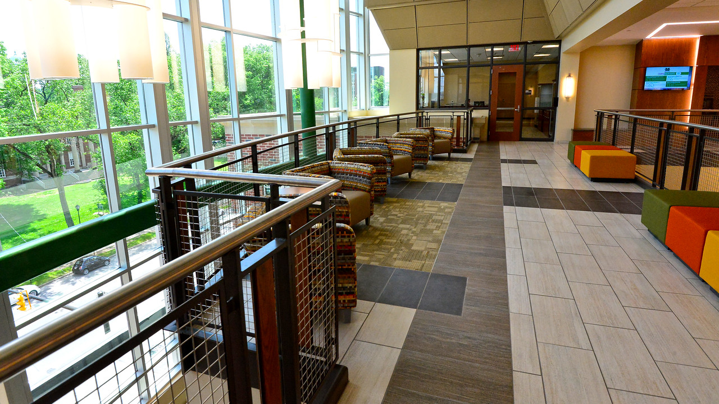
Contact Us -- MURCpreaward@marshall.edu
WAEC 4th Floor
www.marshall.edu/murc/staff

