Slide 1



Introduction and General Overview of Cayuse SP

Slide 2

Table of Contents
What is Cayuse SP?
Overview of the Proposal Submission Process:
Getting Started with Cayuse
What Brower is Supported by Cayuse SP
Logging in to Cayuse SP
Starting a New Proposal Record
Cayuse SP Dashboard
Proposal Record Form Screen
Additional Tabs on Dashboard
Understanding Form Icons
General Information Section
Basic Information Section
Sponsor Information Section
Snapshot of Sponsor Screen
Other Proposal Information Section
Snapshot of Other Proposal Information Section
Personnel Information Section
Snapshot of Project Personnel Section
Research Subjects Section
Human Subjects Section
Animal Subjects Section
Snapshot of Research Section
Research Materials Section
Radiation Safety Section
Chemical Safety Section
Biological Safety Section
Other Questions Related to the Research Materials Section
Snapshot of Research Materials Section
Budget Section
Total Budget Start Date and Total Budget End Date
Cost Share/Matching Section
What is cost sharing/match?
Budget Summary Section
Additional Resources Needed
Attachments
Subaward Section
Intellectual Property Section
Export Control Section
Application Abstract (Executive Summary) Section
Attachments and Submission Notes Section
Routing a Proposal
Understanding the Routing Tab:
Certifying a Proposal
MURC Contacts
1
2
3
3
3
4
5
6
7
8
9
9
9
10
11
12
13
14
15
15
15
15
16
16
16
16
16
17
18
18
18
18
19
19
20
22
23
24
25
26
27
28
29
31

Slide 3
Cayuse SP is used to begin a new proposal record, develop a proposal, complete MURC's internal approval process, and submit the project application. All Principal Investigators (PIs) at Marshall University must use Cayuse SP for their proposal to be eligible for submission to the sponsor. This user guide is specific to proposal development in Cayuse SP. Cayuse SP also serves as the management tool for awards, tracking post-award activities, compliance, and closeout.
What is Cayuse SP?
Cayuse is Marshall University’s new research management software that will streamline and enhance research administration processes. Cayuse offers a comprehensive suite of tools designed to simplify the entire research life cycle, from proposal development and submission to award management and compliance tracking.
Key features of Cayuse include:
  Proposal Development: Researchers can easily create, collaborate on, and forward grant proposals for approval and submission using intuitive templates and integrated workflows.
  Proposal Submission: The Cayuse system integrates with Grants.gov, allowing for the electronic submission of grant applications to funding agencies.
Important: This system will take the place of the Authorization to Submit (ATS) Form that has been previously used for institutional approval. In the first few months of Cayuse implementation, the ATS Form will still be used.
1

Slide 4
Overview of the Proposal Submission Process:
Identify Opportunity: The first step is to identify a funding opportunity or solicitation that aligns with the research project's goals and objectives. MURC provides a list of recommended search engines here. Researchers at Marshall University, you have access to the GrantForward database, which allows PIs to search for funding opportunities from government sources, private foundations, and corporations. PIs are also able to showcase their research and receive grant recommendations. For additional assistance locating an opportunity, contact Niki Rowe-Fortner with our Grant Development Office.
Review Opportunity with Assigned Pre-Award Grants Officer: Before proceeding further, contact the Pre-Award Grants Officer for your department who will provide guidance on eligibility criteria, proposal requirements, and other important details specific to the funding opportunity. This consultation helps ensure that the proposal meets all the necessary institutional and sponsor requirements. If you do not know your assigned Pre-Award Grants Officer, click here. If your department is not listed, email murcpreaward@marshall.edu.
Determine Intent to Submit: After reviewing the opportunity with your MURC Pre-Award Grants Officer, PIs will make an informed decision about whether they intend to develop and submit a competitive proposal for this opportunity. This decision should be based on the alignment of the project with the solicitation and your department's capacity to support the proposed research.
PI Starts Proposal Record in Cayuse SP: The PI will log in to Cayuse and begin the proposal record. The Cayuse system was built to be PI-driven, so PI will be empowered to complete the required sections in the Proposal Record Form. Once the Proposal Record has been initiated, the PI will receive an email from their assigned Pre-Award Grants Officer confirming that a proposal record has been started. This email will also include the Cayuse step-by-step guide to help navigate the system, links to all forms that will be requested in Cayuse, and a meeting request to answer any questions the PI may have. Cayuse has a few communication features built in that will take the place of the email correspondence (This will be outlined in this guide). Your assigned Pre-Award Grants Officer will work with the PI to ensure that all documents are obtained and information is correct. Note: The Authorization to Submit (ATS) Form will still be utilized for the first few months of Cayuse SP implementation to ensure that all routing within the system is correct.
PI Submit the Proposal Record for Routing: Once all sections of the Proposal Record Form have been completed, the PI will submit it for routing. The PI will receive an email notifying them that the proposal has been routed. The proposal will then go your Pre-Award Grants Officer for a final review before being sent on for additional signatures. These additional signatures include principal investigator (PI), co-principal investigator(s) (if applicable), primary administrative contact for department/college, department/program chair(s), dean(s), and provost/senior vice president for academic affairs (if applicable). PIs will receive an email notification once the Proposal Record Form has been fully executed.
Pre-Award Grants Officer Initiates Cayuse S2S Application: During the routing process, the Pre-Award Grants Officer will initiate the proposal application also referred to as Cayuse S2S. (If applicable) PIs will receive a notification from their assigned pre-award officer that the application has been started. PIs will work with their pre-award officer to complete the application. Only the pre-award officer will be able to submit the final proposal.
Pre-Award Grants Officer Reviews, Validates, and Submits for Review: Once all components of the application are complete, the Pre-Award Grants Officer will do a final review of the applications to ensure that all of the criteria has been met. Once the proposal is submitted, an email will be sent to the PI letting them know that the award was submitted.
2

Slide 5
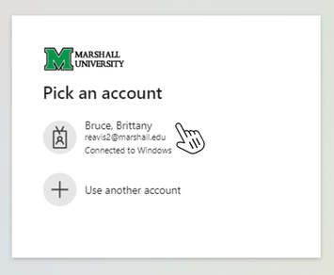
Getting Started with Cayuse
What Brower is Supported by Cayuse SP
The Research Suite can be accessed on various browsers on either Windows or iOS systems.
Windows
  Recent versions of Mozilla Firefox or Google Chrome.
  Provisional support for Microsoft Edge.
iOS
  Recent versions of Google Chrome and Apple Safari.
Note: Cayuse discontinued support for Internet Explorer 10 and older.
Cayuse SP runs entirely in a web browser. Upon navigating to Cayuse for the first time, your browser may present a security warning prompting you to accept a certificate. This is safe. Cayuse purchases and maintains electronic certificates that are approved for Internet commerce and are compliant with Internet security standards. Accept the certificate permanently and you will proceed to the login screen.
In order to use the Research Suite, you will need to configure your browser as follows:
  Cookies Enabled
  Pop-ups Allowed
  JavaScript Enabled
In some browsers, cookies, and pop-ups can be configured on a site-by-site basis. Visit the Cayuse Support page here for step-by-step directions on how to configure your browser. For additional support contact your Pre-Award Grants Officer.
Logging in to Cayuse SP
The link to log in to Cayuse can be found here. Cayuse SP is a Single Sign On (SSO) application. Your username and password are the same login assigned to you by Marshall University (this is the username you would use to log in to MYMU and other MU applications). Enter your username and password and click the Sign In button.
3

Slide 6
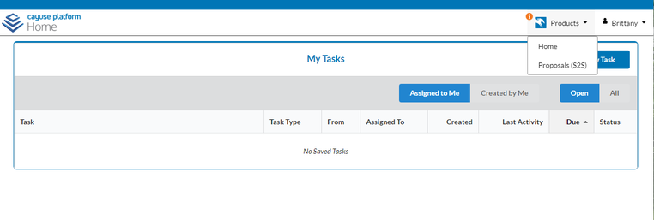


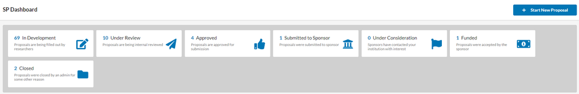

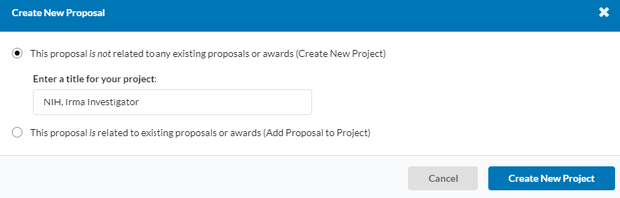
Starting a New Proposal Record
Steps to Complete a Proposal Record
Once logged in you will then see the Cayuse Platform Homepage. This page allows you to view any tasks related to your project. If you encounter any issues logging in please alert your Pre-Award Officer who will work to troubleshoot the issue with you.
1. From the Cayuse Home Page, click on the Products drop-down menu and click Sponsored Projects.
2. From the Sponsored Projects dashboard, click on Start New Proposal.
3. For New Proposal: When the pop-up window appears, select “This proposal is not related to any existing proposals or awards (Create New Project)”.
4. The title of the project here should be the agency name and the PI's name. Example: NIH, Irma Investigator.
This is not the name of the project, there will be a place to add that in later. Once filled in click Create New Project.
The Title of the Project should be, First Initial Last Name dash Sponsor/Agency Name, Abbreviated Sponsor title Month Year Due. Example: J.Griggs - NIH R21 Feb 2026
THIS IS NOT THE TITLE for your PROJECT - YOU will ENTER your PROJECT TITLE later
1
2
3
4
4

Slide 7
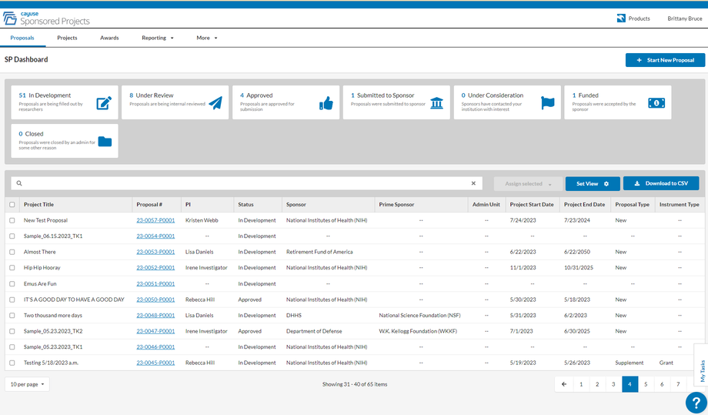
Cayuse SP Dashboard
The Cayuse SP Dashboard allows you to do the following:
1. Start a New Proposal: The PI would go here to begin a proposal record that would get routed to the assigned Pre-Award Officer to initiate the proposal application.
2. In Development: This is where users are able to view the proposals that are currently being worked on but not submitted into routing yet.
3. Under Review: Those proposals that a user has submitted into routing but have not been fully approved by those in the routing chain.
4. Approved: These are the proposals that a user has submitted into routing that have been approved.
5. Submitted to Sponsor: The user's assigned Pre-Award Officer (the last person in the routing chain) has submitted the proposal to the sponsor.
6. List of Proposals: This section can be sorted by different fields such as in development, under review, approved, and submitted to the sponsor.
1
2
3
4
5
6
5

Slide 8
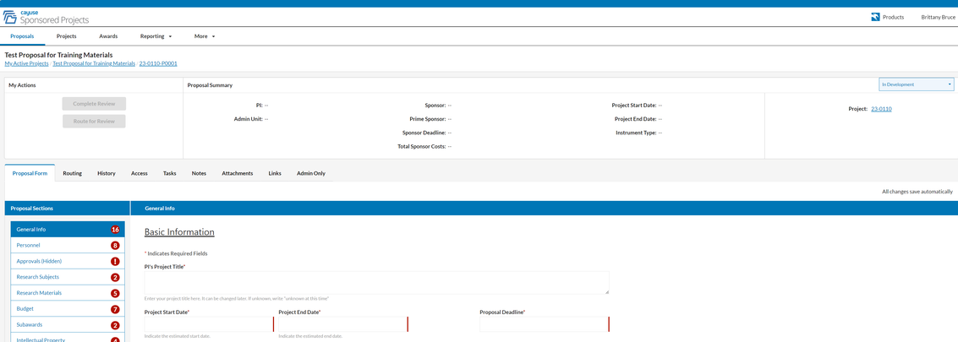
Proposal Record Form Screen
1. Project Name: This section also contains breadcrumbs back to the proposal's project,
as well as the user's active projects.
2. My Actions: The Route for Review button will activate once each section beneath Proposal Sections has a green check mark. If the user has permission to complete the review, the Complete Review button will activate once routing has finished.
3. Proposal Summary: This section will provide at-a-glance information, such as Sponsor, Deadlines, and Proposed Amount. The fields will remain blank until established at a project or proposal level.
4. Status: The status flag lets users know what phase the proposal is in: In Development, Under Review, Approved, Submitted to Sponsor, Under Consideration, Funded, and Closed.
5. Proposal Tabs: The proposal tabs provide additional information, and let you add additional assets to your proposal (see the Proposal Tabs section below for more information).
6. Proposal Sections: The proposal sections are configured through the Form Manager by a System Administrator. All sections must have a checkmark in order to route the proposal for review. An exclamation mark means that the section contains a required field that hasn't yet been completed.
7. Proposal Form: The form is where users fill out their proposal information and is configured through the Form Manager by a System Administrator.
8. Connected Link: Links to any connected project.
1
4
2
3
8
5
6
7
6

Slide 9
Additional Tabs on Dashboard
The Proposal Record Form includes additional tabs that are optional to complete You may fill in the information in the tabs at any time
  Routing: Administrators must configure Routing Rules prior to any user creating a new proposal. Information about the review process will be displayed in this tab once routing has begun.
  History: View proposal status and history. Proposal status can also be viewed from the new Sponsored Projects dashboard.
  Access: Manage who can view or edit the proposal.
  Tasks: View open tasks relating to the proposal.
  Notes: Add comments to the proposal for reference.
  Attachments: Upload files relevant to the proposal.
  Links: Displays data from records in connected systems (Developer to set up).
  Admin Only: Add notes and attachments that are only visible to other Administrators (tab only visible to SP System and SP Proposal Administrators)
7

Slide 10
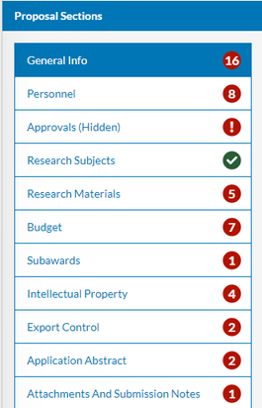



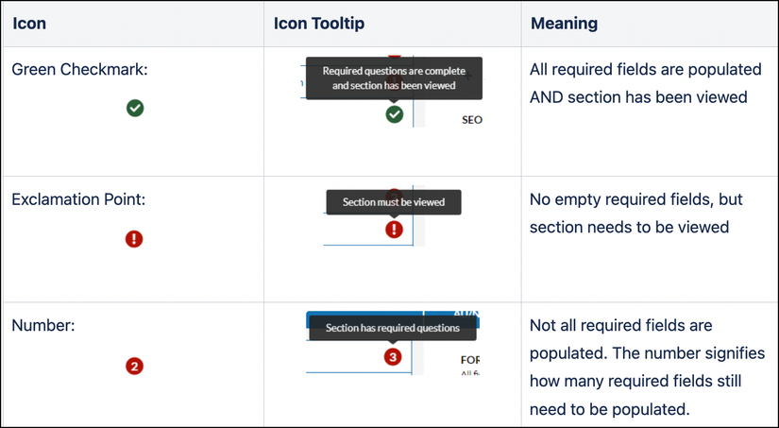
Additional Tabs on Dashboard
The Menu on the left side of the proposal form shows all of the sections that must be completed for the proposal submission. The red circle represents the number of required items in each section. The number of required items may change during form completion based on how certain questions are answered.
Each required question is designated with a red asterisk (*).
Understanding Form Icons:
It is important to understand the three different form icons, as they can change for different reasons, as shown below.
Green Checkmark
  What this means: All required fields within that section are complete.
  Action required: No further action is required.
Red Exclamation Point
  What this means: Either a change has been made to the content, or the original content has never been viewed. All required fields are populated.
  Action required: Content needs to be viewed.
Red Number
  What this means: One or more of the required fields within a section are not populated.
  Action required: Content needs to be populated in the empty field(s).
8

Slide 11
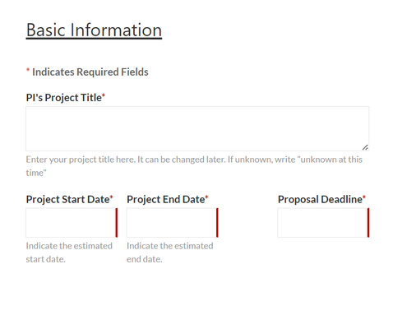
General Information Section
The General Information section of the Proposal Record contains fields related to broad areas of the proposal including the project start and end dates and the type of award mechanism, proposal type, and activity type.
Basic Information Section:
1. PI’s Project Title: The title of the proposed project as reflected on the proposal being submitted to the Sponsor.
2. Project Start and End Date: The anticipated date the project will begin and end.
3. Proposal Deadline: Deadline for proposal to be submitted to the sponsor.
1
2
3
Sponsor Information Section:
The Sponsor section of the Proposal Record contains information about the Sponsor, including deadline dates, solicitation numbers, and sponsor guidelines.
4. Funding Agency: This field is for the agency to which you are directly applying.
5. Prime Sponsor/Applicant: This field is to be used in the event of flow through of federal funds
    If the funder is not listed in the dropdown, please list the funder in the next text box on the form.
6. Agency Program Title: HBCU-UP, if no program name is available, enter N/A
7. Funding Opportunity Announcement Number: The information for this field can be found on the funding opportunity. If there is not a funding opportunity/sponsor application enter N/A.
8. Funding Source: For this field select the option that applies. Federal, State, Private, Business, Institutional, or Unknown at this time.
9. NSF Funded: Is this project funded by the National Science Foundation?
10. PHS Funded: Is this project funded by the Public Health Service of the U.S. Department of Health and Human Services?
11. Proposal Guidelines: Enter the link to the RFA/program guidelines here.
12. Sponsor Contact: Only enter if known.
9

Slide 12
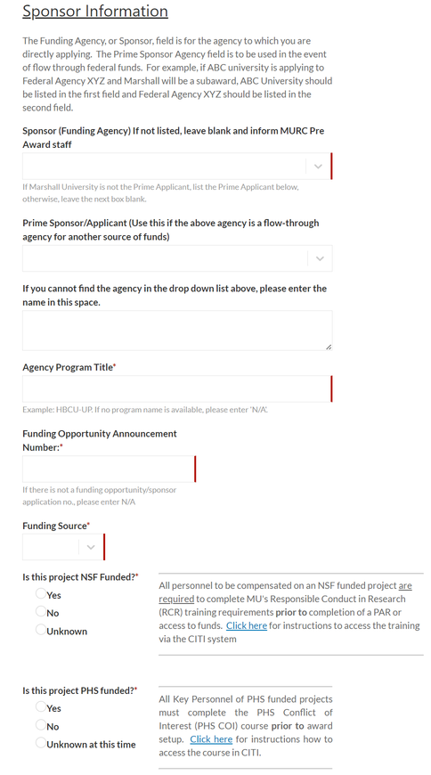
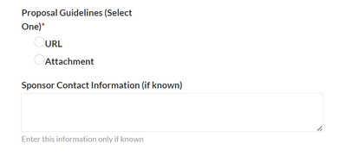
General Information Section
Snapshot of Sponsor Screen:
4
5
6
7
8
9
10
11
12
10

Slide 13
General Information Section
Other Proposal Information Section:
13. Proposal Type
14. Project Classification
15. Award Type
    Contract: An agreement to procure research services or other services from Marshall University. Activities performed under a contract are more closely controlled by the sponsor than those performed under a grant.
    Grant: Award of financial assistance with PI-defined work scope.
    Cooperative Agreement: An award of financial assistance in which the sponsor may be actively involved in defining the scope of work or program and/or anticipates having substantial involvement in the performance of the project.
    Fellowship
    IGT (Intergovernmental Transfer)
    Unknown
16. How Proposal will be Submitted: The Submission Method field indicates the portal through which the proposal will be submitted to the Sponsor. The submission portals listed in the dropdown menu include:
    Cayuse Proposal (S2S)
    Grants.gov/Workspace
    Research.gov/Fastlane
    eRA Commons/ ASSIST
    Sponsor Website
    Email
    Paper
    Other
17. Project Related to COVID-19
18. Advance Funding Anticipated
19. Does the PI have an updated SFID with the Technology Transfer Office (TTO)?
20. Is this project SBIR/STTR funded?
21. Additional Reporting Classification
22. Assigned Pre-Award Officer
11

Slide 14
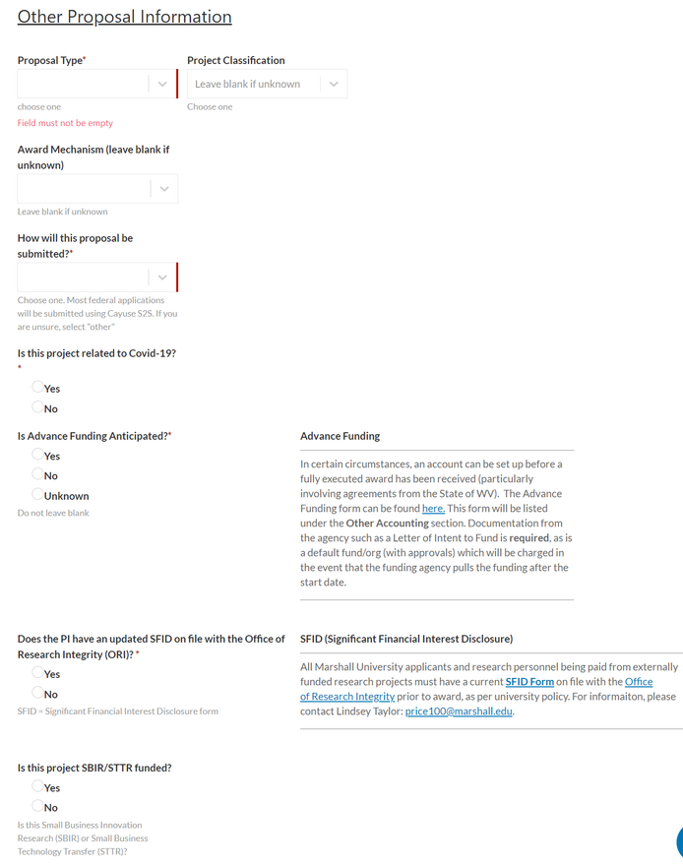
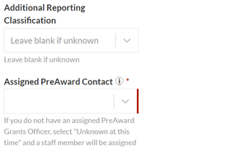
General Information Section
Snapshot of Other Proposal Information Section:
13
14
15
16
17
18
19
20
21
22
12

Slide 15
Personnel Information Section
The Project Personnel Information section of the Proposal Record is where PI’s and Co-PI’s must be entered. The PI should be the first entry with the role of Principal Investigator. To add additional project personnel, use the Add Team Member tab.
Internal Association = Department
The Department (Internal Association) will appear once the name has been entered into the Name field. This department associated with this name is made through MU's HR Connect and can reflect multiple academic appointments. If you believe that the department available for selection is in error, please make that selection (as the field cannot be blank) and notify your MURC .
Credit = Effort
Marshall University does not use this feature in Cayuse, so you may ignore these fields.
1. Name: The full name of the Key Personnel.
2. Role: The designated role of the person specified in the project.
    Principal Investigator: The MU employee responsible for the scientific, technical, and administrative conduct of the proposed project.
    Co-Principal Investigator: The investigator shares equal responsibility with the PI for the direction of a sponsored research award.
    Co-Investigator: An individual who makes significant contributions, but does not have overall responsibility and authority for the project. They are NOT considered PD/PIs.
    Investigator: An individual performing various tasks related to the conduct of human subjects research activities, such as obtaining informed consent from subjects, interacting with subjects, communicating with the IRB etc.
    Fellow: An academic research position in which an individual serves as an independent investigator or under the supervision of a Principal Investigator.
    Post-Doctoral Research Assistant: An individual who has received a doctoral degree (or equivalent) and is engaged in a temporary and defined period of mentored advanced training to enhance the professional skills and research independence needed to pursue his or her chosen career path.
    Graduate Research Assistant: A graduate student who, in the course of their academic training, is employed in part-time or under a temporary research position, where the student’s academic training is based in part on the research performed.
    Undergraduate Research Assistant: An undergraduate student who, in the course of their academic training, is employed in part-time or under a temporary research position, where the student’s academic training is based in part on the research performed.
    Other Participant: An individual who is participating in the scientific development or execution of the project but not committing any specified measurable effort (in person months) to the project.
3. Internal Association: The designated unit responsible for the application and administration of the proposed/awarded sponsored project. This field is integral to the routing process as it dictates which unit will be responsible for approving the proposal under the specified PI. If you believe that the department available for selection is in error, please make that selection (as the field cannot be blank) and notify your assigned Pre-Award Officer.
Note: In instances where a PI or Co-PI has a dual appointment, you will be able to see all of the unit associations to which the person is connected and select the one that is appropriate for the proposal.
13

Slide 16
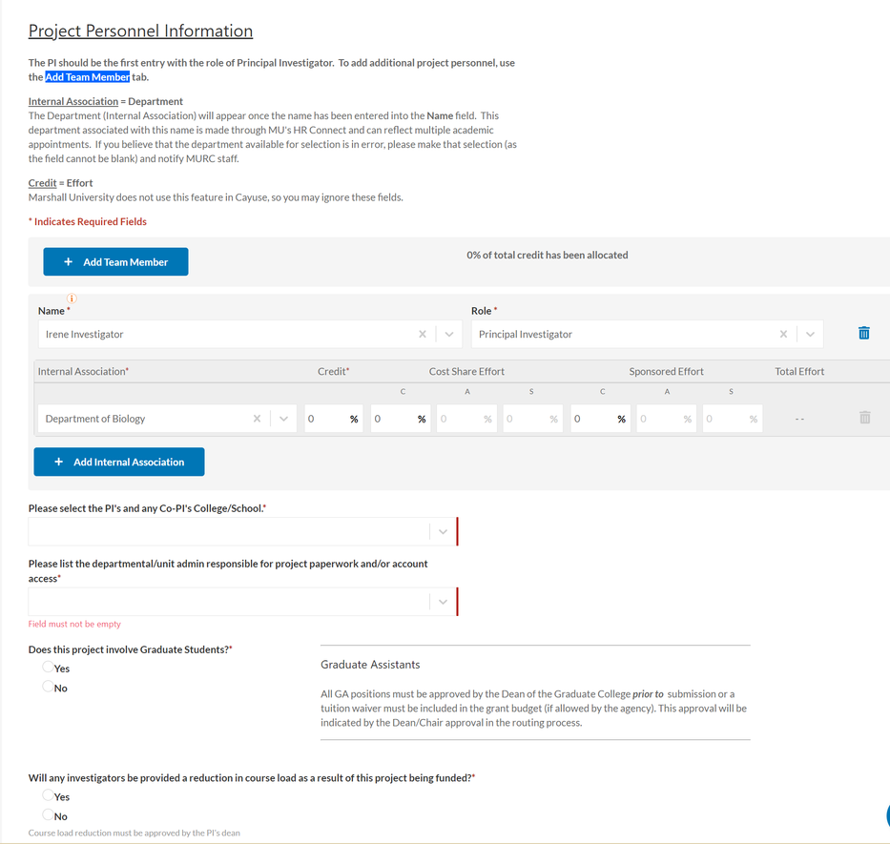
Personnel Information Section
4. Credit and Effort Fields: The credit field currently serves no function in terms of proposal routing and is not required to be completed. PIs will be able to add project effort to the project budget/justification.
5. Please select the PI's and any Co-PI's College/School: For this field select the option that applies. Federal, State, Private, Business, Institutional or Unknown at this time.
6. Please list the departmental/unit admin responsible for project paperwork and/or account access:
7. Does this project involve Graduate Students: All GA positions must be approved by the Dean of the Graduate College prior to submission or a tuition waiver must be included in the grant budget (if allowed by the agency). This approval will be indicated by the Dean/Chair approval in the routing process.
8. Will any investigators be provided a reduction in course load as a result of this project being funded?
Snapshot of Project Personnel Section:
1
2
3
4
5
6
7
8
14

Slide 17
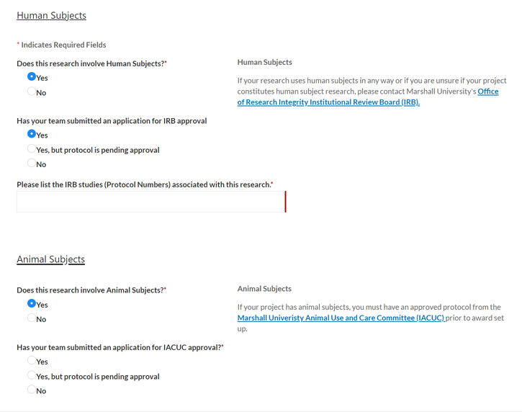
Research Subjects Section
The Research Subject will ensure the PIs have submitted the necessary applications to the Institutional Review Board (IRB) and Marshall Univeristy Animal Use and Care Committee (IACUC).
Human Subjects Section:
1. Does this research involve human subjects?:
    If “Yes” is selected, an additional question pops up: Has your team submitted an application for IRB approval? If “Yes” is selected, an additional prompt pops up: Please list the IRB studies (Protocol Numbers) associated with this research.
    If “No” is selected, an additional prompt pops up: Please indicate your reason for not submitting an IRB application. Select Not required at proposal submission (JIT) or Submission is pending
Animal Subjects Section:
2. Does this research involve animal subjects?:
    If “Yes” is selected, an additional question pops up: Has your team submitted an application for IACUC approval? If “Yes” is selected, an additional prompt pops up: Please list the IACUC application numbers
    If “No” is selected, an additional prompt pops up: Please indicate your reason for not submitting an IACUC application. Select Not required at proposal submission (JIT) or Submission is pending
Snapshot of Research Section:
1
2
15

Slide 18
Research Materials Section
The Research Materials Section refers to a specific part of your grant proposal where information about the materials and resources needed to conduct your research project will be noted. This section is essential for demonstrating the feasibility and appropriateness of your research plan.
Radiation Safety Section:
1. Does this study involve the use of Radioactive Materials?
    If “Yes” is selected, an approved biosafety protocol must be approved and on file at MURC before awarded funds can be accessed. For research requiring radiation safety approval, further guidance can be found here.
Chemical Safety Section:
2. Does this study involve the use of Hazardous Chemical Materials?
    If “Yes” is selected, an additional question pops up: Does the proposed research involve Dangerous (Toxic, Highly Toxic or Pyrophoric) Gases or Hazardous Materials not currently approved in a lab safety plan on file with the Biosafety Committee? If “Yes” is selected, an additional prompt pops up: List Gases or Hazardous Materials
Biological Safety Section:
3. Does this study involve the use of Infectious Agents, rDNA or Bloodborne Pathogens?
    If “Yes” is selected, an additional question pops up: Does the proposed research involve Dangerous (Toxic, Highly Toxic or Pyrophoric) Gases or Hazardous Materials not currently approved in a lab safety plan on file with the Biosafety Committee? If “Yes” is selected, an additional prompt pops up: Does your proposed research involve an upgrade in containment to Biosafety Level 2+ or Biosafety Level 3?
      If Biosafety Level 2+ is selected, additional prompts pop up.
        If yes, where is the work being conducted?
        If applicable, list Select Agents.
      If Biosafety Leval 3 is selected, additional prompts pop up.
        If yes, where is the work being conducted?
        If applicable, list Select Agents.
Other Questions Related to Research Materials Section:
4. Does this study involve the use of materials provided by the sponsor or any other party?
    If “Yes” is selected, an additional question pops up: If yes, from where?
5. Does this grant provide sub-awards for research involving biological, hazardous chemical, and/or radiological materials conducted at other institutions where MU is the primary institution administering the funds?
16

Slide 19
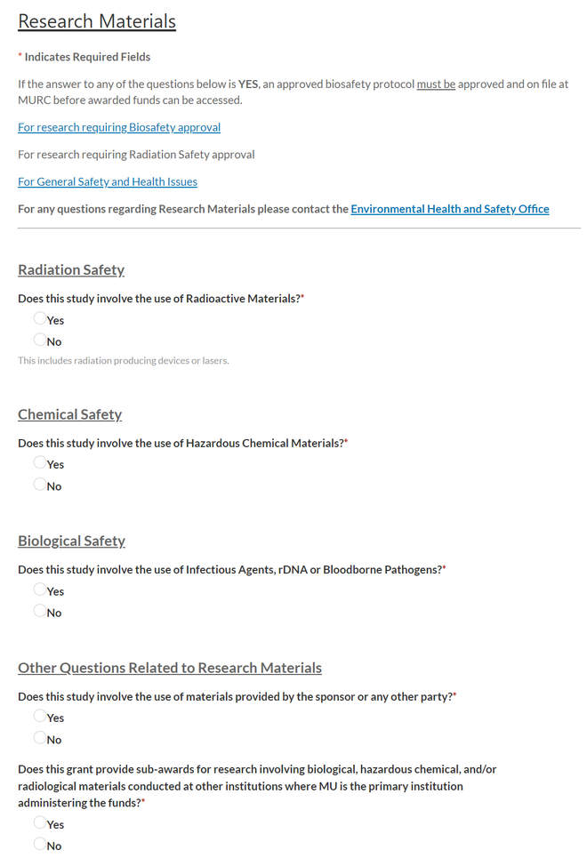
Research Materials Section
Snapshot of Research Materials Section:
1
2
3
4
5
17

Slide 20
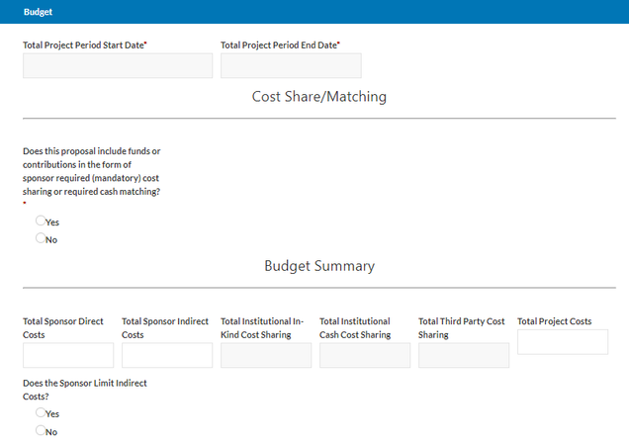
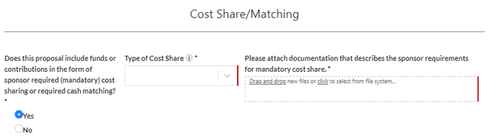
Budget Section
The Budget Section is a critical component of a grant proposal. This section outlines the financial aspects of your research project, detailing how you intend to allocate and manage the funds provided by the sponsoring agency.
Total Budget Start Date and Total Budget End Date
    Enter the anticipated start and end date for the budget period.
Cost Share/Matching Section:
What is cost sharing/match?
The portion of the project costs that are not paid by the sponsoring agency. The term includes cash contributions, in-kind (non-cash) contributions, and matching funds.
1. Does this proposal include funds or contributions in the form of sponsor-required (mandatory) cost sharing or required cash matching?
    If “Yes” is selected, an additional question pops up with a drop-down: Type of Cost Share
      Select one of the following:
        Institutional In-Kind: This is non-monetary cost sharing, often consisting of equipment that is donated or loaned for a project.
        Institutional Cash: Definition Needed
        Third-Party: Definition Needed
2. For this section, an attached document describing the sponsor requirements for mandatory cost share is needed.
1
2
18

Slide 21
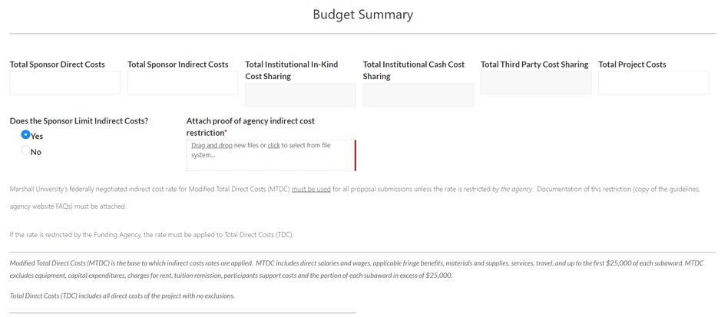
Budget Section
Budget Summary Section:
The Budget Summary section is an important component of your grant proposal that provides a concise overview of the project's financial aspects. It is a summary of the detailed budget that you have prepared, offering a high-level view of how the funds will be allocated and managed for the proposed research.
  Total Sponsor Direct Costs: The Direct cost being requested from the sponsor for the entire project.
  Total Sponsor Indirect Costs: This refers to the cumulative amount of indirect costs that a sponsoring agency or organization is willing to reimburse or cover as part of a grant or contract.
  Total Project Cost: The Total cost (Direct + F&A) being requested from the sponsor for the entire project.
Does the Sponsor Limit Indirect Costs?
    If “Yes” is selected, an attached proof of agency indirect cost restriction is required.
19

Slide 22
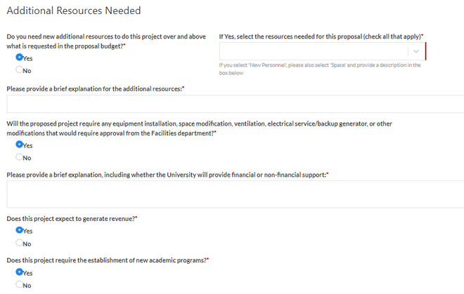
Budget Section
Additional Resources Needed:
3. Do you need new additional resources to do this project over and above what is requested in the proposal budget?
    If “Yes” is selected, an additional question pops up with a dropdown to select from: Select the resources needed for this proposal (check all that apply).
      New Personnel
      Space
      Equipment
      Other
    An additional question is required describing the additional resources. Please provide a brief explanation for the additional resources.
4. Will the proposed project require any equipment installation, space modification, ventilation, electrical service/backup generator, or other modifications that would require approval from the Facilities department?
    If “Yes” is selected, an additional question pops up: Please provide a brief explanation, including whether the University will provide financial or non-financial support.
5. Does this project expect to generate revenue?
6. Does this project require the establishment of new academic programs?
3
4
5
6
20

Slide 23
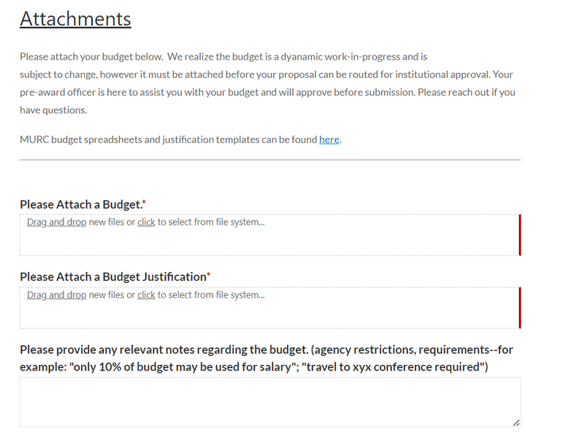
Budget Section
Attachments:
The budget spreadsheet and justification must be attached before a proposal can be routed for institutional approval. The budget must be reviewed and approved by your Pre-Award Grants Officer prior to submission.
Note: We realize the budget is a dynamic work-in-progress and is subject to change, however, it must be attached before your proposal can be routed for institutional approval
  Attach a Budget. Please attach as an Excel budget spreadsheet. Other formats make it difficult for Pre-Award to edit.
  Attach a Budget Justification
  Please provide any relevant notes regarding the budget. (agency restrictions, requirements--for example: "only 10% of budget may be used for salary"; "travel to xyx conference required")
21

Slide 24
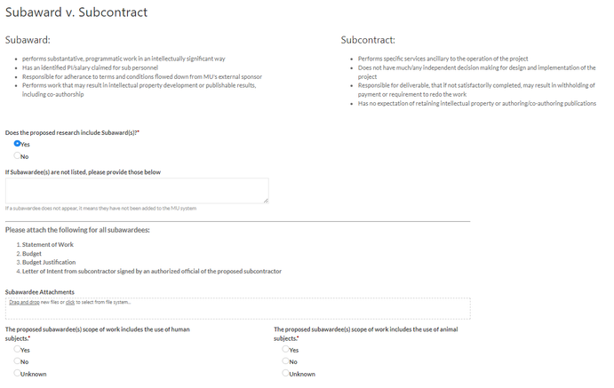
Subaward Section
Subaward is an award provided by a pass-through entity to a subrecipient for the subrecipient to carry out part of an award received by the pass-through entity. It does not include payments to a contractor or payments to an individual that is a beneficiary of a sponsored program.
1. Does the proposed research include Subaward(s)?
    If “Yes” is selected, additional questions pop up:
      If Subawardee(s) are not listed, please provide those below and notify your Pre-Award Officer.
2. Subawardee Attachments: As you are adding subrecipients, please keep in mind that for each sub-entity, you will need to provide the following attachments:
    Statement of Work
    Budget
    Budget Justification
    Letter of Intent from subcontractor signed by an authorized official of the proposed subcontractor
3. The proposed subawardee(s) scope of work includes the use of human subjects.
4. The proposed subawardee(s) scope of work includes the use of animal subjects.
22

Slide 25
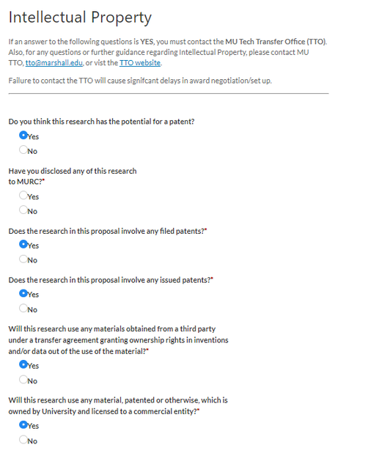
Intellectual Property Section
If the answer to any of the following questions is yes, you need to contact Amy Melton with the MU Technology Transfer Office (TTO). Failure to contact the TTO will cause significant delays in award negotiation/setup.
1. Do you think this research has the potential for a patent?
    If “Yes” is selected, an additional question pops up:
      Have you disclosed any of this research to MURC?
2. Does the research in this proposal involve any filed patents?
3. Does the research in this proposal involve any issued patents?
4. Will this research use any materials obtained from a third party under a transfer agreement granting ownership rights in inventions and/or data out of the use of the material?
5. Will this research use any material, patented or otherwise, which is owned by the University and licensed to a commercial entity?
1
2
4
5
23

Slide 26
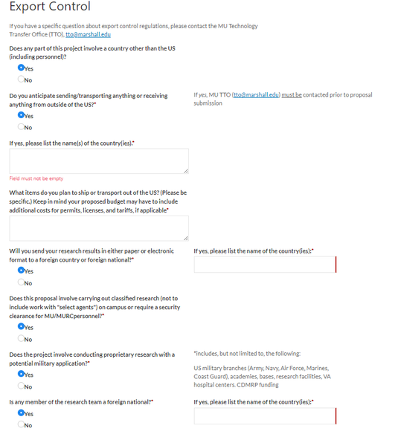
Export Control Section
If you have a specific question about export control regulations, please contact Amy Melton with the MU Technology Transfer Office (TTO).
1. Does any part of this project involve a country other than the US (including personnel)?
    If “Yes” is selected, an additional question pops up:
      Do you anticipate sending/transporting anything or receiving anything from outside of the US?
        If “Yes” is selected, an additional question pops up:
          If yes, please list the name(s) of the country(ies).
          What items do you plan to ship or transport out of the US? (Please be specific.) Keep in mind your proposed budget may have to include additional costs for permits, licenses, and tariffs, if applicable
2. Will you send your research results in either paper or electronic format to a foreign country or foreign national?
    If “Yes” is selected, an additional question pops up: If yes, please list the name of the country(ies):
3. Does this proposal involve carrying out classified research (not to include work with "select agents") on campus or require a security clearance for MU/MURC personnel?
4. Does the project involve conducting proprietary research with a potential military application?
5. Is any member of the research team a foreign national?
    If “Yes” is selected, an additional question pops up: If yes, please list the name of the country(ies):
1
2
3
4
5
24

Slide 27
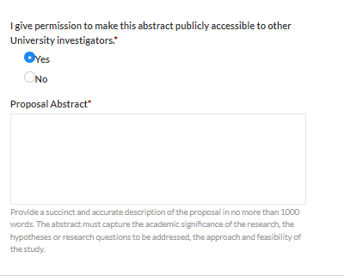
Application Abstract (Executive Summary) Section
With your permission, this abstract, or executive summary will be used to help match faculty researchers with potential collaborators and funding resources and to help identify expertise and areas of research interests.
It may also be used to search keywords in order to provide reports to University administrative offices regarding research on specific subjects.
The abstract should be plainly written and in sufficient detail to summarize the proposed activity. There is no need to write a special abstract for this purpose. The abstract or proposal summary for your proposal will be sufficient.
The abstract should not contain ANY institutional or sponsor proprietary information, such as the description of a potentially patentable invention (e.g., a new and useful process, machine, article of manufacturing, composition of manufacture, or related improvements).
If so indicated below, abstracts will be made available to the public--the public being defined as University personnel who have access to this proposal record.
25

Slide 28
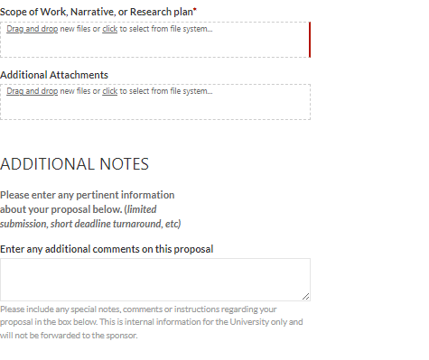
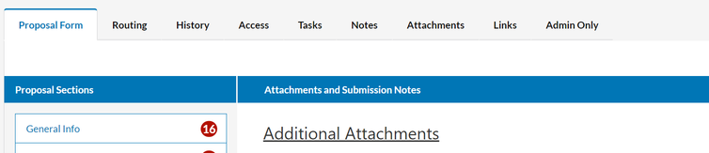
Attachments and Submission Notes Section
Where applicable, please attach the following documents if not already uploaded in previous sections (items in red below are required for every proposal):
  Scope of Work, Narrative, or Research Plan
  Subcontractor documentation (letter of commitment, budget, budget justification, scope of work) -- Subawardee section (if applicable)
  Letters of support, cover letters, etc.
Acceptable file formats include: pdf, docx, xlsx
To see all attachments added throughout the proposal, click on the Attachments tab.
26

Slide 29
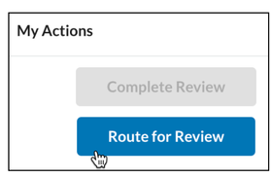
Routing a Proposal
Routing a proposal is the initiation of the MURC internal approval process. A proposal record can only be routed when all the sections in the Item List have green checkmarks. The PI should review each section of the proposal as green checkmarks do not indicate that the section is complete, rather they indicate that information has been entered into all required fields noted with a red asterisk. It is the PI’s responsibility to ensure that all the information has been entered accurately and completely prior to submitting for routing.
After all components of the Cayuse SP proposal record have been reviewed carefully, the PI will submit for routing. Once submitted for routing, the PI will receive an email notifying them that the proposal is been routed. If a PI needs to make changes to the proposal after it has been submitted for routing, they can ask their assigned pre-award officer to have the proposal changed back to the Unsubmitted status.
Approvers will also receive emails from Cayuse requesting that they review and approve the proposal. A link to the system along with the proposal number will be provided in the email. The assigned pre-award officer will track the routing process and contact any approver who has not approved a proposal within 24 hours of receiving an approval email. The PI can also view the approval process in the Routing Tab.
Routing for Review:
Any member of the project team can submit a proposal for routing in Cayuse SP.
  Once each section displays a green checkmark, the proposal is ready to begin routing.
  Click on the Route for Review button to begin the routing process.
3. The proposal will begin routing according to the Routing Rules set. Routing Rules are specific to your department. For questions regarding Routing Rules, please reach out to your Pre-Award Officer.
4. You may check the status of the proposal at any time by clicking on the History tab within the proposal.
If you need to make changes to the proposal after submitting it for routing, you can ask your Pre-Award Officer to change the proposal back to the Unsubmitted status, which will reopen the proposal. Reopening is similar to Unsubmitting in that you will be able to edit the proposal while it is Reopened.
27

Slide 30
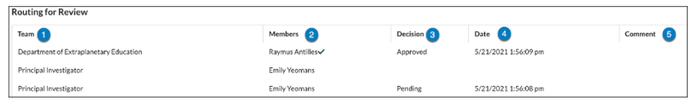
Routing a Proposal
Understanding the Routing Tab:
The Routing tab allows reviewers to see who is on the routing chain for the proposal or award, and other relevant status information. To access, open the proposal or award form, then click the Routing tab.
  Team: Unit the reviewers belong to.
  Member: Name of reviewers and a checkmark once the review is complete.
  Decision: Status of reviewer decisions.
    Approved: The reviewer is approved and the routing chain will continue.
    Pending: Under review and awaiting decision.
    N/A: A task is open for a Certification Rule and no decision has been made.
    Declined: During the Review Completion process, the reviewer chose 'Return to In Development' as their Review Decision, causing routing to halt until an Admin re-submits for routing to start over (a record will be kept in the History of prior Review Decisions).
  Date: Review completion date.
  Comment: Any comments entered during the review process.
28

Slide 31
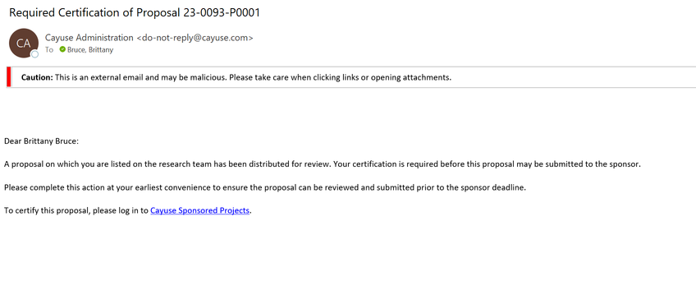
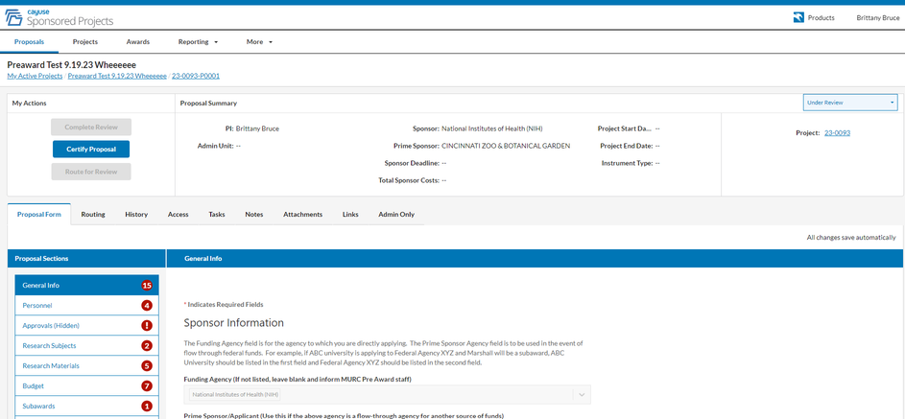
Certifying a Proposal
Once a proposal enters routing, the PI and Co-PIs will be required to certify the information included in the proposal form and contained in the documents attached to the form. Each PI/Co-PI in the routing chain will receive an email message that contains a direct link to certify the proposal. A sample email message looks like this:
Once you click the link in the email message, the proposal form will be loaded. (You may be asked to log in to Cayuse using your MUNet credentials). Once logged in, you will be directed to a website that looks similar to this.
29

Slide 32
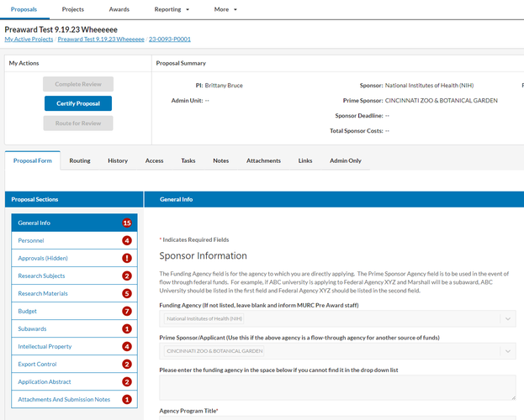
Certifying a Proposal
Locate the tabs in the middle of the screen (i.e., not the tabs at the top). On the left-hand side of the screen, in the “Proposal Form” tab, you will see “Proposal Sections”, and immediately below you will see 10 sections listed beginning with “General Info.”.
Carefully review all information provided in each of the 10 sections. As you move from one section to the next, a green check mark will appear which denotes you have reviewed that section’s information. In the event you do not wish to certify the proposal (i.e., you reviewed it and would like to make changes), please contact your assigned Pre-Award Officer for assistance.
To certify the proposal, click the blue “Certify Proposal” button.
30

Slide 33
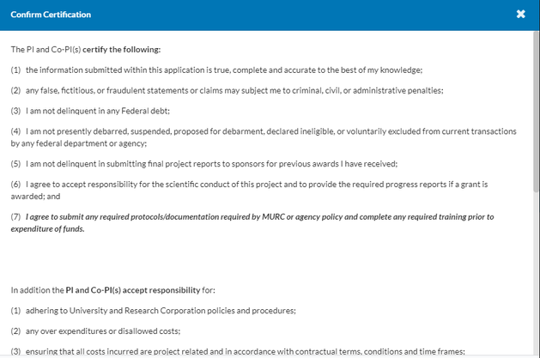
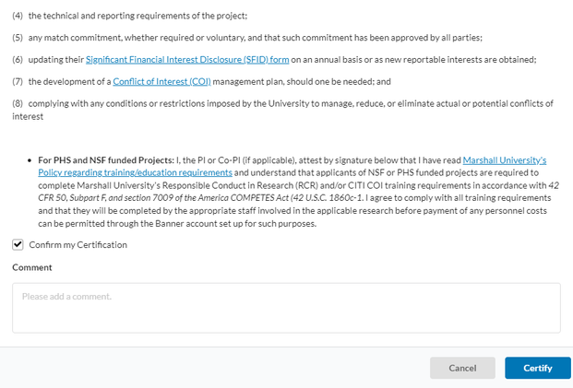
Certifying a Proposal
The Confirm Certification screen will appear. Check the box to “Confirm my Certification”. You may enter comments, but they are not required. Then click the blue “Certify” button.
30

Slide 34
MURC Contacts
Office of the Executive Director | John M. Maher, Ph.D., Vice President of Research Executive Director | maherj@marshall.edu | 304-696-4748
Office of the Executive Director | Amanda Plumley Executive Office Manager | plumleya@marshall.edu | 304-696-6271
Grants | Niki Rowe-Fortner, Director of Grants Development | rowe39@marshall.edu | 304-696-2965
Grants | Jennifer Griggs, Grant Writer | griggsj@marshall.edu
Grants | Brittany Bruce, Director of Grant Operations | brittany.bruce@marshall.edu | 304-696-6273
Grants | Leah Mason, Associate Vice President for Grant Contract and Research Integrity | masonle@marshall.edu
Grants | Suzanne Strait, Associate Vice President for Research and Development | straitho@marshall.edu
Human Resources and Payroll | Coria Kent, Human Resources Coordinator | kent1@marshall.edu | 304-696-6320
Human Resources and Payroll | Tammy Brumbaugh, Senior Payroll Administrator | brumbaught@marshall.edu | 304-696-2830
Human Resources and Payroll | Lisa Houdyschell, Payroll Accountant Generalist | houdyschell1@marshall.edu | 304-696-6793
Grants and Contracts | Joe Ciccarello, Director of Grants and Contracts | ciccarello@marshall.edu | 304-696-4837
Grants and Contracts | Joe Ciccarello, Director of Grants and Contracts | ciccarello@marshall.edu | 304-696-4837
Pre-Award (Grant Development) | Lisa Daniels, Senior Grant & Contract Officer | lisa.daniels@marshall.edu | 304-696-3368
Pre-Award (Grant Development) | Chris Schlenker, Grants & Contracts Officer | schlenker@marshall.edu | 304-696-4307
Pre-Award (Grant Development) | Kelly Stump, Grants Officer | stump4@marshall.edu | 304-696-6676
Pre-Award (Grant Development) | Kristen Webb, Grants Officer | kristen.webb@marshall.edu | 304-696-2589
Pre-Award (Grant Development) | Amy Adkins, Grants Officer | adkins387@marshall.edu | 513-908-7915
31

Slide 35
MURC Contacts
Post-Award (Compliance) | Rebecca Hill, Grants Compliance Administrator Purchasing Card Coordinator | hill286@marshall.edu | 304-696-3792
Post-Award (Compliance) | Kayla Perry, Grants Compliance Administrator | starcher41@marshall.edu | 304-696-4838
Post-Award (Compliance) | Sydney Hunter, Grants Compliance Administrator | hunter161@marshall.edu | 304-696-6275
Post-Award (Compliance) | Mary Glenn Rice, Grants Compliance Administrator | rice139@marshall.edu
Financial/Grant Accounting Office | Jennifer Wood, Assoc. Vice President for Finance and Compliance | wood@marshall.edu | 304-696-2829
Financial/Grant Accounting Office | Kristen Martin, Senior Finance Officer | martinkr@marshall.edu | 304-696-4665
Financial/Grant Accounting Office | Tina Dean, Assoc. Director of A/R & Financial Reporting | dean22@marshall.edu | 304-696-6321
Financial/Grant Accounting Office | Melissa Michels, Grants Accountant | hall183@marshall.edu | 304-696-5201
Financial/Grant Accounting Office | Ashlyn Christian, Grants Accountant | ashlyn.christian@marshall.edu | 304-696-7320
Financial/Grant Accounting Office | Amara Ross, Assoc. Grants Accountant | ross358@marshall.edu | 304-696-2344
Financial/Grant Accounting Office | Katherine Chaffin, Accountant | waddell@marshall.edu | 304-696-6532
Financial/Grant Accounting Office | Bradley Smith, Senior Financial Analyst Travel & Payable Accountant | smithbra@marshall.edu | 304-696-6203
Technology Transfer Office | Amy Melton, Director, TTO | amy.melton@marshall.edu | 304-696-4365
Office of Research Integrity | Bruce Day, Th.D., CIP, Director, ORI | day50@marshall.edu | 304-696-4303
Office of Research Integrity | Lindsey Taylor, IRB Coordinator | price100@marshall.edu | 304-696-6598
Office of Research Integrity | Brett Williams, IRB Coordinator | brett.williams@marshall.edu
32

