Slide 1
Grantsmanship 101 by MURC

Slide 2
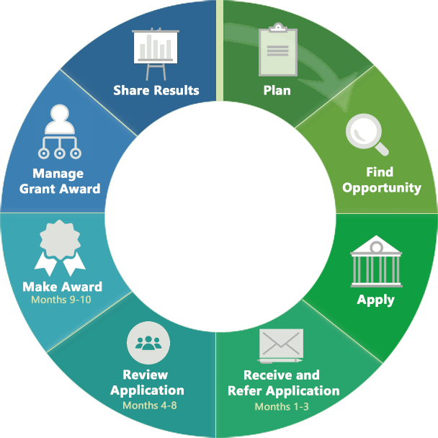
The grant life cycle
Start planning early
From “Plan” to “apply” could take 8+ Months

Slide 3
Getting Started
If you are reading this, you are most likely interested in obtaining external funding.
Which funding agency would support your project?
Why do you think the agency should fund your project?

Slide 4

Finding Funding
The best way to search for potential funding sources is to use the subscription database provided by Marshall University. This is a robust database which contains funding sources for federal, state, private and other sources. Once you create your free account using your Marshall email address, you can conduct personalize searches using your key words and profile. It is easy to use and FREE.
www.grantforward.com is the first place to search!

Slide 5
Finding Funding—more options
Federal agency websites: a Google search of XYZ agency funding opportunities will pull up searches for most agencies. Examples:
  NIH: https://grants.nih.gov/grants/guide/search_results.htm?scope=pa&year=active
  NSF: https://beta.nsf.gov/funding/opportunities
  DOJ: https://www.ojp.gov/funding/explore/current-funding-opportunities
Grants.gov: This searches most federal agencies https://www.grants.gov/web/grants/search-grants.html
Networking: Find out from your peers which agencies are most likely to fund your area of interest.
Industry

Slide 6
Examples of Funding
WV Humanities Council:
http://wvhumanities.org/grants/aboutourgrants
National Institutes of Health:
https://grants.nih.gov/grants/guide/pa-files/PA-19-052.html
Claude Worthington Benedum Foundation:
http://www.benedum.org/about/mission.shtml
Your MURC pre-award staff is here to help you navigate through the guidelines! www.marshall.edu/murc/staff

Slide 7
Basic Grantsmanship (from a NIH program officer’s presentation)
Read the application instructions carefully
Make notes and highlight details you need to remember
Don’t forget …
... follow the application instructions (page limits, margins, fonts… DO make a difference)
Know the agency requirements (forms, page limits, formatting, etc.) before you start writing.

Slide 8
Look for the following when searching through funding announcements:
Program mission/goals: Does what I want to do fit with the agency/organization?
Eligibility Requirements: Am I/we eligible to apply?
Funding amounts: Is the amount to be awarded, enough to successfully complete the project?
Application Deadline: Do I have enough time to prepare a competitive application?
Searching agency web sites is a good start … but follow up with personal contact, especially with foundations and industry.
Contact agency program staff early (But never negotiate terms and F & A rates…save that for the admin folks.)
Find out if your project would be a “good fit”.
Are there other related announcements?

Slide 9
Proposal Components
Proposals are generally comprised of these sections:
  Abstract
  Research Plan
    Preliminary Data/Needs Assessment
    Project Goals (Specific Aims)
    Implementation Plan
    Evaluation Plan
  Budget and budget narrative/justification
  PI Information (biosketch)
  Assurances
Read the program guidelines carefully for specific requirements.
To avoid proposal FAIL, always consult with your Grants Officer before the deadline. We submit on your behalf!
Notes:
Developing a PLAN.
Getting Results Framework…business plans…grants proposals. All are Plans for how you plan to implement a project idea.

Slide 10
Abstract
Brief overview of the entire project and is usually the first thing the reviewer reads (and scores).
Typically, there are two types required:
Technical: generally written for the reviewers
Layperson: written for a non-expert in your field
From a GRANT WRITER’S perspective, it should be written LAST…but not at the last minute.

Slide 11
Research Plan/Strategy pt. 1
Preliminary Studies/Needs Assessment
Why: Urgency and need to solve the problem.
Example: xx% of West Virginians are ----- and suffer from -----, which causes many issues, including --------.
Goals/Objectives
What: Plan to solve problem with measurement indicator and performance standard.
  Be realistic, not overly ambitious
  Example: First time couch-to-5K participants should not expect to qualify for the Boston Marathon as their first race attempt.

Slide 12
Research Plan/Strategy pt. 2
Implementation Plan
How (specifically) you plan to solve the problem
Evaluation
Anticipated Results:
Measurement of the project
  test scores, attendance rates, surveys, opinions, etc.
  Publication/result dissemination plan
  Possible roadblocks
  EXAMPLE: Completing a 5K or half marathon is feasible for beginning runners/walkers.

Slide 13
Budget
Should tell the same “story” as the narrative.
If it is not mentioned in the research plan, do not put it in the budget.
Nope. It is NOT an afterthought…they are real numbers.
If match is not required, don’t mention it in your proposal, because then you must track it for reporting purposes (and you just made extra work for yourself).
Under no circumstances is a PI to negotiate F & A rates with an agency.

Slide 14
PI (Principal Investigator) information
Researcher Background/Information:
  Shows reviewers that you have what it takes to complete the work
Support Letters:
  Include statements of how others intend to support your work. These can be from collaborators, chair, dean, and other partners.
Management Plan:
  This describes who is responsible for what by when.
Facilities and Other Resources:
  This is a description and listing of the resources readily available to you to complete the proposed work (institutional information, laboratory, equipment, etc.)

Slide 15
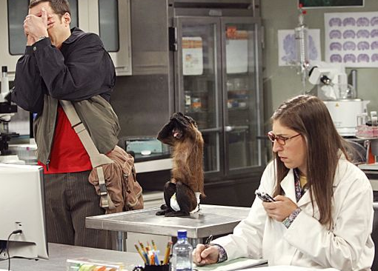
Assurances
  Certifies the institution complies with all laws, policies and regulations such as:
  discrimination
  drugfree workplace assurance
  human subject research
  vertebrate animal research
  prohibited research
  lobbying assurance
  financial conflict of interest
Projects involving animal or human subject research must be routed through appropriate channels of IRB, IACUC, etc.

Slide 16
Details matter in your writing
No matter the terminology used by the agency, each component of your proposal should match the other part of the story.
A reviewer should be able to tell the basic premise of your project from each individual component.

Slide 17
Strategy #1, The problem/objective must be
In line with the agency mission
Address an important problem, issue or need.
Realistic… not overly ambitious
(SMART) Specific, Measurable, Attainable, Relevant/Realistic, Time-based
Example of an objective Building Block:
To (action verb and statement reflecting your measurement indicator) by (performance standard) by (deadline)
Example #1: (vague)
To help West Virginians become healthy.
Example #2: (SMART) Specific, Measurable, Attainable, Realistic/Relevant, Time-bound
To have at least 90% of sedentary patients, upon completion of Couch-to-5K program, enter and successfully complete a selected community 5K within 6 months of their enrollment date, or by MM/DD/YYYY.

Slide 18
Strategy #2, Simple, Yet Thorough
Adequately address the problem—how you are going to do what you propose to do.
Limit use of acronyms; however, when used, make sure they are written out early in your proposal.
Use shorter words, unless technical vocabulary is necessary. This is not the time to impress readers with your awesome vocabulary skills. If your reviewer can’t follow along, it won’t get funded.
Avoid overly long and overly short paragraphs.
Condense, condense, condense (you have page limits)

Slide 19
Strategy #3, Communicate Clearly
Your draft reviewers need to understand
  What you intend to do
  Why you believe it is important to do
  Exactly how you are going to do it
If your draft reviewers don’t get it, you must revise your application
Don’t leave anything for the reviewers’ interpretation.
  Make use of graphs/illustrations when appropriate

Slide 20
Strategy #4, Collaborate
Do not try to be a Lone Ranger!
Collaborate with other investigators
  Fill gaps in your expertise and training
  Add critical skills to your team
Most agencies prefer collaboration.
Use the RIGHT collaborators.

Slide 21
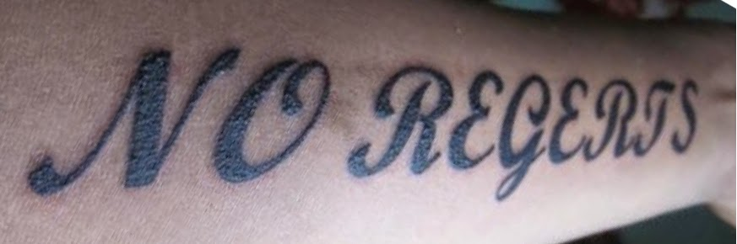
Strategy #5 , Basic Writing Skills
Formatting: Know and follow all font, margin rules, and page limits specified by the agency (typically found in the program announcement or agency website)
Grammar/Spelling: Use correct spelling and grammar rules. Spell check does not catch everything.
Slang: Avoid slang (ur, thx)
Proofreading/review:
  Content: Have someone who knows your field read your proposal to check for content/scientific accuracy.
  Grammar: Have someone read your proposal to check for basic sentence flow/logic/grammar, especially if English is not your first language (not your mom, grandma, or significant other)

Slide 22
Strategy #6, Time management
Never, never, never wait until the last minute.
Writing proposals is a time commitment.
Set aside a certain amount of time per day to write (even if it is just 20 minutes).
Leave enough time for us, your pre-award team, to make revisions too
Last-minute proposals are more prone to have mistakes that could have been easily corrected.
Make use of checklists and follow your RFA guidelines

Slide 23
Reviewers: What to know before you start
Know the audience before you start writing.
Do not write the application for yourself unless you are going to fund it yourself.
Understand the review process which will be used by the agency for your proposal. (typically written in the guidelines).
Common Review Criteria include:
Significance
Investigator
Innovation
Approach
Environment

Slide 24
Hallmarks of an Outstanding Application
Strong significance to an important problem in public health: IMPACT is high
High degree of novelty and innovation
Strong track record by a well qualified applicant; compelling publications
Clear rationale
Relevant and supportive preliminary data
Clear and focused approach that provides unambiguous results
Careful attention to details:
  Spelling, punctuation, grammar, fonts, clarity of data, error bars, etc.

Slide 25
Weak Applications usually have:
Weak impact—avoid ‘descriptive’ or incremental projects
Too ambitious, lacking focus, too many unrelated aims, aim dependency
Unclear or flawed hypothesis/rationale
Applicant track record lacks appropriate expertise
No evidence of feasibility (do not assume reviewers are as familiar with the subject as you are)
Approach flawed and no discussion of pitfalls and alternative approaches
Poor writing and many errors; small figures and densely packed text

Slide 26
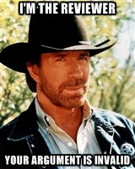
Not Funded? Revise and Resubmit
Reviewers are never right. Reviewers are never wrong. Do not take it personally.
Address the reviewer comments thoroughly with relevant updates
When responding to reviewers:
  DO NOT be Argumentative!
  DO NOT be Abrasive!
  DO NOT be Sarcastic
  DO NOT do long term damage to yourself.

Slide 27
SUMMARY
Know your potential funding agency: mission, eligibility requirements, review criteria.
Follow the directions. Follow the directions.
Tell the story logically, intelligently and succinctly. Story should be told in all components, including title.
Observe all institutional, college/departmental requirements. Know before you apply!
Do not give up. Ever.

Slide 28
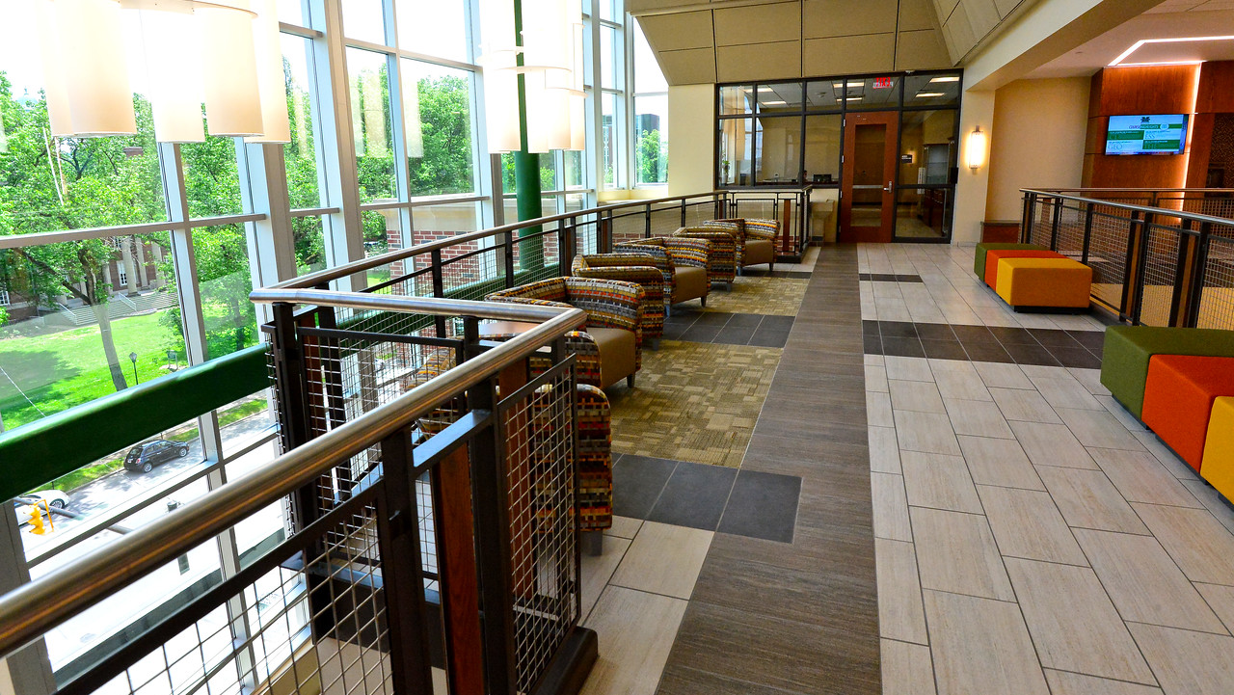
Contact Us -- MURCpreaward@marshall.edu
WAEC 4th Floor
www.marshall.edu/murc/staff

