Slide 1
Grantsmanship 101

Slide 2
The Grant Life Cycle
Start planning early
From “Plan” to “apply” could take 8+ Months

Slide 3
Find Funding: Where is the Money?
The best way to search for potential funding sources is to use the subscription database provided by Marshall University. This is a robust database that contains funding sources for federal, state, private, and other sources. Once you create your free account using your Marshall email address, you can conduct personalized searches using your keywords and profile. It is easy to use and FREE. MURC Preaward partners with the new Grant Development Office with this service.
www.grantforward.com is the first place to search!
For help with Grant Forward, contact:
MURCprewaward@marshall.edu

Slide 4
Find Funding: Additional Options
Federal agency websites: A Google search of XYZ agency funding opportunities will pull up searches for most agencies.
Grants.gov: This searches most federal agencies.
Networking: Find out from your peers which agencies are most likely to fund your area of interest.
Industry: Many times, the industry in your field will sponsor research projects to fit their needs. For larger industries/businesses, you can find funding opportunities on their website.

Slide 5
First Steps: Before you Apply
Contact MURC PreAward
If you do not know who your assigned MURC Pre Award Grants Officer is, simply send an email to MURCpreaward@marshall.edu and you will be routed to the appropriate staff member.
Failure to involve MURC in the submission process will result in one of the following:
Fatal errors in the proposal submission, causing it to be rejected
Administrative issues prohibiting the university from accepting an award
Example: An award has been received that did not go through MURC Pre Award. Once received, it is determined that the
university cannot legally agree to the terms of the award, thus the award must be rejected. This can be avoided by following
university procedures.
Serious budget issues causing a deficit in the ability to perform the research
Substantial delays in award set-up

Slide 6
Make contact with the funding agency
In most instances, it is a good idea to contact the agency before you apply.
It is recommended that you send an email to the program officer requesting a phone call to discuss your project.
Include a brief overview of your project in the email (do not “cold call”).
In many instances, if your project does not fit with an agency’s mission, the program officer can direct you to alternative funding sources (particularly in the NIH and NSF).
Our Grant Development Office is another resource that can assist you with making this connection. Contact Niki Rowe-Fortner for further assistance.

Slide 7
Basic Grantsmanship
from an NIH program officer’s presentation
Read the application instructions carefully
Make notes and highlight details you need to remember
Don’t forget to follow the application instructions (page limits, margins, font, etc.)
Finally, read and follow the application instructions.
With the high number of competitive applications received, basic grantsmanship can separate a great proposal and a funded proposal.

Slide 8
Proposal Components
Proposals are generally comprised of these sections:
Abstract
Specific Aims
Research Plan
Preliminary Data/Needs Assessment
Implementation Plan
Evaluation Plan
Budget and Budget narrative/justification
PI Information (biosketch)
Assurances
With the high number of competitive applications received, basic grantsmanship can separate a great proposal and a funded proposal.
To avoid proposal FAIL, always consult with your Grants Officer before the deadline. We submit on your behalf.

Slide 9
Getting Started
Why do you think the agency should fund your project?
Two questions drive reviewer determination about the likelihood that the proposed studies will have a strong and sustained impact on the scientific field.
This is one of the fundamental questions that you need to answer before applying. You will also need to communicate this to the reviewers in your proposal.
Should they do it?
Can they do it?

Slide 10
Abstract
The abstract is a brief overview of the entire project and is usually the first thing the reviewer reads (and scores).
In many cases, there are two types of abstracts required in an application:
Technical: This type is written for the reviewers who will have either expertise in your field or a general knowledge of your field—enough knowledge to understand “science-ese”
Layperson: This type is written for a non-expert in your field, or for the general public.
From a GRANT WRITER’S perspective, it should be written LAST…but not at the last minute.

Slide 11
Goals/Objectives (Specific Aims)
In line with the agency's mission, address an important problem, issue, or need.
Make sure to be realistic and not overly ambitious.
Unrealistic: First-time couch-to-5K participants should expect to qualify for the Boston Marathon as their first race attempt.
Realistic: Completing a 5K or half marathon is feasible for beginning runners/walkers.
(SMART) Specific, Measurable, Attainable, Relevant/Realistic, Time-based
Example of an objective Building Block:
To (action verb and statement reflecting your measurement indicator) by (performance standard) by (deadline)
Example #1: (vague)
To help West Virginians become healthy.
Example #2: (SMART) Specific, Measurable, Attainable, Realistic/Relevant, Time-bound
To have at least 90% of sedentary patients, upon completion of the Couch-to-5K program, enter and successfully complete a selected community 5K within 6 months of their enrollment date, or by MM/DD/YYYY.

Slide 12
Developing your Research Plan
Write your proposal to answer the core review criteria.
Significance:
Innovation:
Answers the “so what” question
Shows overall understanding of the field
Demonstrates that questions are novel, important, and represent a logical next step in research
Highlights critical gaps that will be addressed by the proposed research
Shows that the proposed research is new and unique by showing:
How your proposed research refines, improves, or proposes a new application of an existing concept or method, or
How your proposed research would shift a current paradigm

Slide 13
Developing your Research Plan
Write your proposal to answer the core review criteria
Preliminary Studies:
Strengthen your application
Show availability of key resources, familiarity with proposed methods, and approach to interpreting results
Show that work is promising, feasible, and has a potential impact
Can be qualitative, quantitative, and/or come from a collaborator
Why: Urgency and need to solve the problem
Example: xx% of West Virginians are ------- and suffer from -----, which causes many issues, including ----

Slide 14
Developing your Research Plan
Write your proposal to answer the core review criteria
Research Plan/ Approach: How you specifically plan to accomplish the objectives
Does your plan flow logically from the literature review and prior studies?
How will each hypothesis be tested?
Do your measures capture the variables needed to test hypotheses?
Why did you choose those measures?
Methods and analyses must match.
Example: Couch to 5K program will be advertised (give examples how) and registered participants (describe how they will be recruited and registered) will begin training (describe in as much detail as possible the type of training/qualification of trainers/how trainers will be selected).
Detail, detail, detail
Evaluation: Anticipated Results:
How will you measure your results? (test scores, attendance rates, publications, data, etc.)
How will each hypothesis be tested?
Do your measures capture the variables needed to test hypotheses? CAN YOUR RESULTS BE REPLICATED?
Why did you choose those measures?
Methods and analyses must match.
Example: xx% of Couch to 5K participants will successfully complete the designated 5K on xx/xx/xxxx
It is also important to list possible roadblocks/ alternative methods
Examples: injuries, illness, bad weather/canceled race, etc.

Slide 15
Budget
Should tell the same “story” as the narrative.
If it is not mentioned in the research plan, do not put it in the budget.
Budget figures are NOT an afterthought…they are real numbers.
If *match is not required, don’t mention it in your proposal, because then you must track it for reporting purposes—this adds an unnecessary administrative burden to both MURC and you.

Slide 16
PI (Principal Investigator) information
Researcher Background/Information:
Shows reviewers that you have what it takes to complete the work—and/or that you have access to collaborators who have a proven track record.
Example: PI is an avid runner who won the gold medal in the Barcelona Olympics for the Marathon event; Couch to 5K trainers are seasoned local runners and fitness coaches
Support Letters:
Include statements of how others intend to support your work. These can be from collaborators, the chair, the dean, and other partners.
Management Plan:
This describes who is responsible for what by when.
Facilities and Other Resources:
This is a description and listing of the resources readily available to you to complete the proposed work (IRB, IACUC, institutional information, laboratory, equipment, etc.).
Example: Do not study the ocean from the middle of a desert; do not propose a clinical trial at an institution without an IRB

Slide 17
Assurances
The applicant (MURC obo the PI) must certify that all required federal assurances are on file with the US government. MURC updates these assurances as required by law, which are monitored in the eraCommons module.
The applicant (MURC obo the PI) must certify that the project meets all institutional requirements for the project. This
includes, but is not limited to:
Conflicts of interest
Significant Financial Interest Disclosures
Required federal training for Pis and research personnel (PHS COI course and the NSF RCR)
Required protocols (IACUC, IRB, Biohazards, rDNA, etc.)
Projects involving animal or human subject research must be routed through appropriate channels of IRB, IACUC, etc.

Slide 18
Basic Writing: It should all match
No matter the terminology used by the agency, each component of your proposal should match the other part of the story.
A reviewer should be able to tell the basic premise of your project from each individual component.

Slide 19
Basic Writing: Simple, Simple, Simple
Adequately address the problem: Make sure you convey to the reviewers how you are going to do what you propose to do.
Limit the use of acronyms: When they must used, make sure they are written out early in your proposal.
Use shorter words, unless technical vocabulary is necessary: This is not the time to impress readers with your awesome vocabulary skills. If your reviewer can’t follow along, it won’t get funded.
Use “White Space” to your advantage: Avoid overly long and overly short paragraphs. You do not want to annoy the reviewer with a wall of words.
Condense: Condense…and condense (you have page limits)

Slide 20
Basic Writing: The Little Things
Formatting: Know and follow all font, margin rules, and page limits specified by the agency (typically found in the program announcement or agency website). This is another reason to read the guidelines carefully.
Grammar/Spelling: Use correct spelling and grammar rules. Spell check does not catch everything.
Slang: Avoid slang (ur, thx). Yes. We are serious—we have actually seen this in a formal proposal.
Proofreading/review:
Content: Have someone who knows your field read your proposal to check for content/scientific accuracy. (Peers, departmental chair, dean, etc.)
Grammar: Have someone read your proposal to check for basic sentence flow/logic/grammar, especially if English is not your first language—or even if English IS your first language. (not your mom, grandma, or significant other, unless they happen to be a legit, unbiased Professor of English)

Slide 21
Basic Writing: Communicate Clearly (Draft Review)
Your writing should be clear enough that the draft reviewers can understand:
What you intend to do
Why you believe it is important to do
Exactly how you are going to accomplish what you are proposing
If your draft reviewers don’t get it, you must revise your application before submitting it.
Don’t leave anything for the reviewers’ interpretation.
Make use of graphs/illustrations when appropriate—but make sure the captions are legible. You do not want to annoy the reviewer.

Slide 22
Reviewers: What to know before you start
Know the audience before you start writing.
Do not write the application for yourself unless you are going to fund it yourself.
Understand the review process which will be used by the agency for your proposal. (typically written in the guidelines).
Common Review Criteria include:
Significance
Investigator
Innovation
Approach
Environment

Slide 23
Hallmarks of an Outstanding Application
Strong significance to an important problem in public health: IMPACT is high
High degree of novelty and innovation
Strong track record by a well-qualified applicant; compelling publications
Clear rationale: Clearly state the why
Relevant and supportive preliminary data
Clear and focused approach that provides unambiguous results
Can your results be replicated by others and will others come to the same conclusion
Careful attention to details:
Spelling, punctuation, grammar, fonts, clarity of data, error bars, etc.

Slide 24
Components of a Weak Application:
Weak impact—avoid ‘descriptive’ or incremental projects
Too ambitious, lacking focus, too many unrelated aims, aim dependency
Unclear or flawed hypothesis/rationale
Applicant's track record lacks appropriate expertise
No evidence of feasibility (do not assume reviewers are as familiar with the subject as you are)
Approach is flawed and no discussion of pitfalls and alternative approaches
Poor writing and many errors; small figures and densely packed text

Slide 25
Not Funded? Revise and Resubmit
Reviewers are never right. Reviewers are never wrong. Do not take it personally.
Address the reviewer's comments thoroughly with relevant updates
When responding to reviewers:
Do not be Argumentative
Do not be Abrasive
Do not be Sarcastic
Do not do long-term damage to yourself.

Slide 26
MURC is moving to Cayuse
Cayuse is a sponsored project lifecycle management system from proposal creation to project closeout.
Cayuse Sponsored Projects 4.0:
It will help eliminate administrative burdens by allowing PIs to quickly and accurately prepare a proposal for internal routing and review. This module will replace the current ATS form routing process.
Cayuse Proposals S2S (system to system):
This module is a fast, easy-to-use Web application created specifically to simplify the creation, review, approval, and electronic submission of Grants.gov proposal applications. Anything that can be submitted via Grants.gov will be using Proposals S2S
Watch for further press releases and user training videos/guides coming soon.

Slide 27
Marshall University Research Corporation
FALL 2023 WORKSHOPS
At Marshall University Research Corporation (MURC), we understand the significance of securing grant funding to drive impactful research endeavors. That Is why we are thrilled to present our Grant Training and Services, which is designed to equip you with the skills and resources needed to be sucessful.
Introduction to MURC/Research Process
Post-Award Overview
SEPTEMBER
13
Are you curious about external funding? Delve into the role of the Marshall University Research Corporation (MURC) and our services that guide you through the world of external funding. This session not only introduces common grants administration procedures but also provides a comprehensive overview—from proposal submission to award close-out
SEPTEMBER
27
Explore the post-award phase with confidence. Discover how to manage awards effectively, stay compliant, and maximize the impact of your research.
via Microsoft Teams
via Microsoft Teams
AT NOON
AT NOON
SEPTEMBER
20
Grantsmanship 101/Proposal Basics
OCTOBER
4
Budgeting Basics
Crafting a compelling grant proposal is an art. This session unravels the key components of a standard grant proposal, including agency-specific requirements and planning timelines.
The budget is more than just numbers—it's the foundation of your proposal. Let MURC guide you through the essential components of a proposal budget and budget narrative. Discover how our budgeting assistance can help you present a robust and accurate financial plan.
via Microsoft Teams
via Microsoft Teams
AT NOON
AT NOON
Register by scanning the QR Code or visiting
www.marshall.edu/murc/training-workshops/
Questions? Contact murcpreaward@marshall.edu

Slide 28
Summary
Know your potential funding agency: mission, eligibility requirements, and review criteria.
Follow the directions. Follow the directions.
Tell the story logically, intelligently, and succinctly. The story should be told in all components, including the title.
Observe all institutional, college/departmental requirements. Know before you apply!
Do not give up. Ever.

Slide 29
Grants Development Office
Mission:
To grow Marshall University faculty and staff grant participation and research dollars through the pursuit of multi-million dollar multi-disciplinary and multi-institutional grants.
Services we provide:
Partner with faculty & and staff to develop project ideas.
Locate grants to support projects.
Conduct outreach and relationship-building with funders.
Develop internal and external project partnerships.
Conduct grantsmanship training.
Provide Project management for grant applications and projects.
Review grant applications.
Write and submit grants.
Niki Rowe-Fortner,
Director of Grants Development
Email: rowe39@marshall.edu
Phone: 304.696.2965
For more information visit: https://www.marshall.edu/murc/grants-development-office/

Slide 30
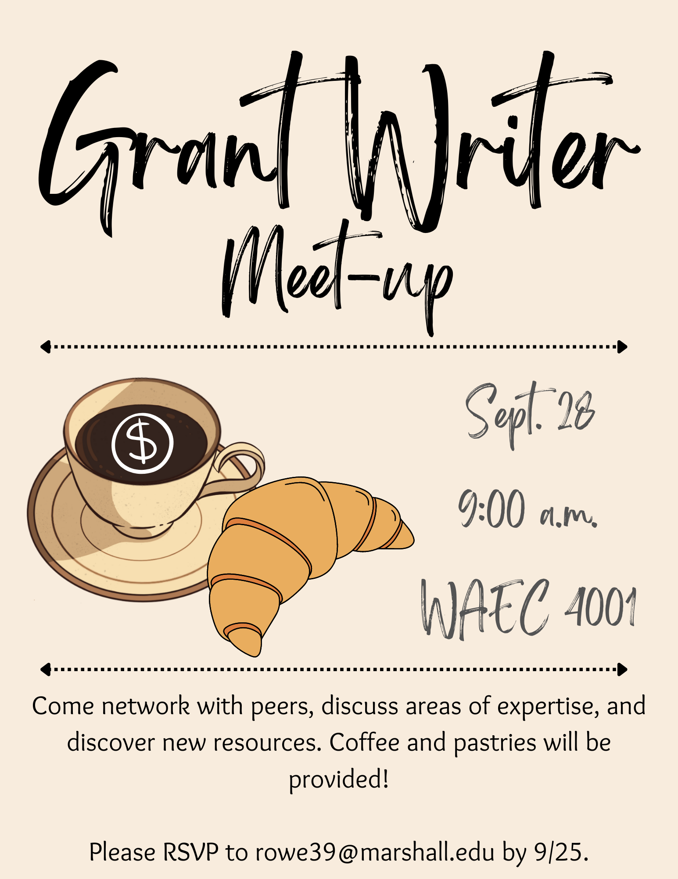

Slide 31
MURC Staff

Slide 32
Where to find us on campus.
Recruit more doctors.
Our first key focus.
Physical Address:
Fourth Floor, Arthur Weisberg Family Applied Engineering Complex
1676 Third Ave., Huntington, WV 25703
Mailing Address:
One John Marshall Dr.
Huntington, WV 25755-8100
Phone: 304-696-6271
Fax: 304-696-6300
Email: murcpreaward@marshall.edu
Staff Directory: https://www.marshall.edu/murc/our-staff-new/
We look forward to working with you!

