Slide 1
Introduction to ​
Marshall University Research Corporation​ (MURC)
Notes:
Welcome to the first sess

Slide 2
About MURC
Terms
MURC Overview/Purpose
History
MURC Services
Pre-Award (Proposal Development)
Office of Research Integrity
Technology Transfer Office
Post-Award (compliance/finance)
Grant Development Office
Further Resources, Training and Contact
Introducing Cayuse
Upcoming Trainings
Contact Information

Slide 3
Basic Terminology
Contract:
Mechanism for the procurement of services with specific obligations from both parties.
Example: The Random Agency (TRA) contracts with Computing Services for the procurement of an app, which will be utilized in tracking side effects of new drug, dramallama.
Funding Agency:
The folks who have the money, but not the capability to solve a problem.
These can be federal, state, foundations, private, or industry.
Principal Investigator (PI):
The one who has the capability, but not the money/resources, to solve a problem.
Gift:
Funds given voluntarily with no reciprocal obligations, deliverables, restrictions, or fiscal requirements (typically no terms and conditions).
Example: Alumni donor, Mr. Howell, donates $100,000 to the School of Nautical Engineering to use how they see fit. Mr. Howell does not require an account of how the money is spent.
External Funding:
Funding that comes from an outside source and is not provided/available by Marshall University.
Subaward:
Funding provided by a pass-through entity to a subrecipient, for the subrecipient to carry out part of the main project.
Example: Professor Smith from University A, receives funding from federal agency B, and needs Professor Jones from University C to do some of the work on his project. In order to do this, University A, the pass-through entity, will issue a subaward agreement from their project funded by federal agency B to University C.
Indirect Costs:
(F & A, Facilities & Administrative, Overhead): These are costs that the university incurs when research happens, but these costs cannot be specifically assigned to the project: utilities, housekeeping, clerical support, etc.
This is discussed in detail on another slide.
Fringe:
These are allowances and services provided by employers to their employees as compensation in addition to regular salaries and wages. Fringe costs include, but are not limited to, FICA, Workers Comp, leave (vacation, family-related, sick or military), employee insurance, pensions, and unemployment benefit plans. Marshall University uses fringe rates which have been negotiated by the federal government. These rates change yearly.
Example: Dr. Wes Ternblot, hires a Research Assistant on his new NIH grant for $40,000 per year. Marshall University’s federally negotiated fringe rate for this employee classification is currently 28.66%. The cost to the grant would be $40,000 (salary) plus $11,464 (fringe), for a total of $51,464.
Grant:
Any externally funded activity in which there is a formal agreement that contains a statement of work, fiscal requirements, and deliverables.
Example: Federal Agency XYZ awards Professor Workhard in the School of Pharmacy a grant for $1 million for the development of a new drug. The terms and conditions of the awards require regular financial and scientific reporting and may only be spent in the manner prescribed in the budget.

Slide 4
About MURC
MURC was created in 1987 and chartered under the laws of the State of WV.
MURC is a 501(c)3 nonprofit organization which operates separately from Marshall University.
MURC operates under an affiliation agreement with Marshall University.
MURC is the only legal entity authorized to create or enter research contracts on behalf of Marshall University.
MURC has an independent Board of Directors, with Marshall University’s President presiding as Chairman.

Slide 5
OUR COMMITMENT
The Marshall University Research Corporation is committed to an active, growing and successful research enterprise that will help address today’s challenges, improve the quality of life in the community and provide an engine for economic development.
Funding FY22
Estimated Economic Impact

Slide 6
Responsibility and Purpose
Enabling Research Growth:
MURC actively fosters the expansion of Marshall University's research endeavors, supporting the vibrant growth of our research enterprise.
Serving as Fiscal Agent:
Applying for, receiving, and efficiently distributing grants and contracts on behalf of Marshall University.
Allocating Facilities and administrative (F & A) costs back to the university to ensure equitable resource utilization.
Ensuring unwavering compliance with federal, state, and institutional regulations.
Fulfilling fiscal requirements stipulated by funding agencies.
Ensuring Research Integrity:
Overseeing Marshall University's Institutional Review Boards (IRBs) to safeguard human subject research.
Maintaining the esteemed Association for the Accreditation of Human Research Protection (AAHRP) accreditation.
Exercising oversight over the Institutional Animal Care and Use Committee (IACUC).
Managing matters related to Conflict of Interest (COI).
Supervising the university's biosafety program to ensure a safe research environment.
Managing Intellectual Property:
Offering comprehensive evaluation, development, patenting, licensing, management, and marketing services for intellectual property originating from faculty, staff, and students.
Determining the appropriate allocation of proceeds from intellectual property.
Utilizing the university's intellectual property in technology transfer, promoting economic development.

Slide 7
IMPORTANCE OF UTLIZING MURC:
MURC provides services that are helpful to you in assembling and submitting your proposal and managing an award.
Although the ultimate responsibility of the application contents are up to the Principal Investigator (PI), we help guide you through the administrative forms, guidelines, and requirements.
MURC is responsible for making sure grant and contract proposals submitted to agencies are complete, accurate, and in compliance with MU, state, and federal policies.
“It is easier to ask for forgiveness rather than permission” does not apply to federal, state, and university policies. When it comes to federal, state, and university policies, ignorance of the law is not bliss.
MURC also ensures that the Terms and Conditions of a grant or contract award are acceptable to Marshall University.
This protects both the PI and the University
MURC is the only legal entity authorized to make commitments to funding agencies on behalf of Marshall University.
No other college, department, center or individual (faculty, staff, chair, dean, or University President) has the legal authority to enter into grant or contract agreements on behalf of Marshall University. Only MURC’s Authorized Organizational Official (AOR), has this authority.
Invalid reason to bypass MURC.
“Don’t worry! I signed on behalf of the University.”
“It is only a small grant.”
“I didn’t want to trouble anyone.”
“The timeline was too short.”
“It wasn’t that much money.”

Slide 8
Our Services
Pre-Award and Grants/Contract Development
Interpreting proposal guidelines
Developing and approving budgets
Coordinating institutional approval for proposal submissions
Negotiating awards with sponsors
Submitting proposal on behalf of Marshall University
Post-Award
Providing financial administration
Ensuring agency, institutional and federal compliance
Assisting with payroll and personnel functions
Submission of progress reports & award closeout
Grant Development, Training, and Collaboration
Training in grantsmanship
Locating grants to support projects
Conducting outreach and relationship building with funders
Developing internal and external project partnerships
Providing project management for grant applications
Reviewing and editing grant applications
Writing grant applications
Research Integrity
Providing information about responsible research conduct
Supplying guidelines for research involving human and animal subjects
Coordinating the university’s institutional review boards
Maintaining public trust through disclosure and management of conflicts of interest
Technology Transfer/Business Development
Facilitating the invention disclosure process
Obtaining patents, copyrights and trademarks
Collecting and disbursing royalties
Developing technical and market assessments
Marketing university technologies to industry partners
Providing business assistance to startup companies

Slide 9
Externally Funded Award Lifecycle
Post-Award
Proposal
Development
ID Funding &
Write Proposal
Pre-Award
Tracking,
Accounting,
Closeout
Institutional
Clearances
& Approvals
Externally Funded
Award Lifecycle
Spend Money,
Purchasing, Reporting
Proposal
Submission
& Sponsor
Review
Establish
Project
Account(s)
& PI Briefing
Funded:
Awards
Terms &
Conditions

Slide 10
Our Services
Pre-Award and Grants/Contract Development
Interpreting proposal guidelines
Developing and approving budgets
Coordinating institutional approval for proposal submissions
Negotiating awards with sponsors
Submitting proposal on behalf of Marshall University
Post-Award
Providing financial administration
Ensuring agency, institutional and federal compliance
Assisting with payroll and personnel functions
Submission of progress reports & award closeout
Grant Development, Training, and Collaboration
Training in grantsmanship
Locating grants to support projects
Conducting outreach and relationship building with funders
Developing internal and external project partnerships
Providing project management for grant applications
Reviewing and editing grant applications
Writing grant applications
Research Integrity
Providing information about responsible research conduct
Supplying guidelines for research involving human and animal subjects
Coordinating the university’s institutional review boards
Maintaining public trust through disclosure and management of conflicts of interest
Technology Transfer/Business Development
Facilitating the invention disclosure process
Obtaining patents, copyrights and trademarks
Collecting and disbursing royalties
Developing technical and market assessments
Marketing university technologies to industry partners
Providing business assistance to startup companies

Slide 11
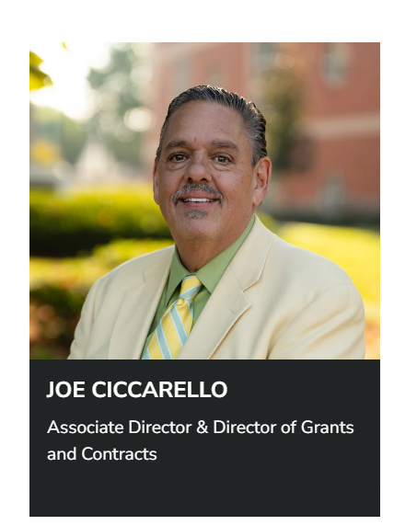
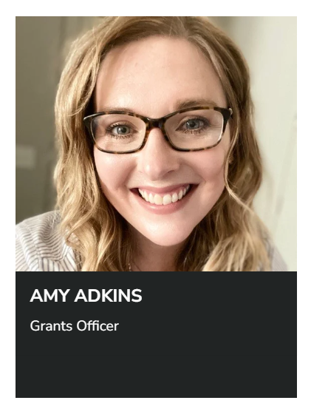
Pre-Award Staff

Slide 12
Pre-Award Functions: Proposal Preparation
Once you have found a potential funding source, it is important to read the funding announcement and contact MURC Pre-award.
Although it is the PI’s ultimate responsibility, we will help you look for the following when searching through funding announcements:
Program mission/goals: Is your project a good fit with the agency? Sometimes it is a good idea to reach out to the Program Officer before you apply.
Eligibility Requirements: Is the institution/PI eligible to apply? It is better to find out beforehand.
Funding amounts: Are the amounts feasible?
Application Deadline: Will it work? Do you have enough time?
Agency Terms and Conditions: Can the institution commit/Is it legal for the university? Not all external funding works for institutions of higher education.
It is important to contact your MURC Grants Officer with your intent to apply as soon as possible. Never submit on your own!
Contact us: MURCpreaward@marshall.edu

Slide 13
Pre-Award Functions: Proposal Preparation
During the proposal preparation process, MURC Pre-Award will help with the following:
Budget: We work with you to develop a competitive, compliant budget with the most recent fringe rates and appropriate F & A rate. Putting a good budget together beforehand will prevent major headaches in the future.
Institutional Information: We make sure all institutional information is accurate. This helps to prevent issues when an award is made.
Submission Portal: We make sure the correct portal/submission method is used
Institutional Requirements: We assist in making sure the PI is meeting the internal institutional documentation.
For most applications, we complete the forms so that the PI can concentrate on the actual proposal.
Most federal agencies have an application system that requires the PI to be affiliated with the institutional UEI or DUNS.
Many smaller agencies/foundations have one institutional portal
Some agencies have a PI-driven application. In some instances, the PI can (and must) grant MURC staff access; in others, the PI must share login credentials
For ALL applications (no matter how large or small), MURC must be involved in the submission process.
NOTE: MURC reserves the right to withdraw an application or refuse an award if it is determined to be a risk to the university.

Slide 14
Pre-Award Functions:
Authorization to Submit (ATS) Form
Marshall University’s internal routing form is the Authorization to Submit (ATS) form, which, not only provides pertinent information about the project but also serves to protect both the university and the PI.
Important: A signature on the ATS Form signifies that all parties involved fully understand the risks and liability and that all information is true and verifiable.
This form must be completed in full, signed, and routed prior to proposal submission.
Note: We will be transitioning from the ATS Form to the Cayuse system. View press release here.

Slide 15
Indirect Costs
Also referred to as Facilities and Administrative Costs (F & A) or Overhead
Indirect costs are real costs that are incurred by a grantee for common or joint objectives and cannot be identified specifically with a particular project or program such as utilities, building maintenance, and administrative support (computing services, payroll, accounting, etc.).
These are not a TAX, FEE, or a "MURC cut"
Pre Award will help determine the proper Indirect Cost Rate to apply to your project.
Example: Electricity is used throughout a university building, but when the electric bill arrives it has the composite charge for the entire building rather than breaking down individual usage per room or faculty member—that would be rather implausible; however, electricity is a REAL cost (because typically researchers rely on it to power their labs and classrooms)
Under no circumstances is the PI to negotiate a project’s F & A rate with a funding agency.

Slide 16
Indirect Costs Cont.
Marshall University’s Indirect Cost Rate (ICR) is determined by negotiations with the federal government. The ICR is the per dollar amount that the feds have determined that it costs Marshall University to conduct research.
Recruit more doctors.
Our first key focus.
Marshall’s current rate for on-campus research projects is 48%. This means that for each dollar spent on research, it costs the university $0.48.
There are specific criteria needed to determine which rate will be applied to your project
MURC will make the final determination of the appropriate rate.
Unless specifically listed in the agency guidelines, Marshall’s full appropriate rate will be applied.
Example # 1: Dr. Car D. Atch is applying for a grant from the American Heart Association. The AHA specifically restricts indirect costs to 10%. This is the rate that must be used.
Example #2: Dr. I. M. Karful is applying for a HRSA training grant.HRSA training grants specifically state in the RFA that training grants are restricted to 8% indirects. This is the rate that must be used.
Under no circumstances should a PI ever negotiate the indirect rate with an agency. Such negotiations should be considered null and void because the PI is not legally authorized to negotiate on behalf of the university.

Slide 17
Indirect Costs Cont.
Indirect Costs
Also referred to as Facilities and Administrative Costs (F & A) or Overhead
Current Rates:
Where do the Indirect Cost rates go?
On-campus research 48.00%
Off-campus research 26.00%
On-campus other sponsored activities 30.00%
Off-campus other sponsored activities 22.90%
On-campus instruction 48.80%
Off-campus instruction 26.00%
A percentage of the indirect cost rate goes to predetermined allocations as determined by university policy, such as the library. From the remainder, indirects are usually distributed as follows:
University President’s Office 25%
MURC 25%
College/Center/Institute 50%*
*allocations to individual departments are determined by each college/center/institute. Check with your dean or director.
Under no circumstances is the PI to negotiate a project’s F & A rate with a funding agency.

Slide 18
Our Services
Pre-Award and Grants/Contract Development
Interpreting proposal guidelines
Developing and approving budgets
Coordinating institutional approval for proposal submissions
Negotiating awards with sponsors
Submitting proposal on behalf of Marshall University
Research Integrity
Providing information about responsible research conduct
Supplying guidelines for research involving human and animal subjects
Coordinating the university’s institutional review boards
Maintaining public trust through disclosure and management of conflicts of interest
Technology Transfer/Business Development
Facilitating the invention disclosure process
Obtaining patents, copyrights and trademarks
Collecting and disbursing royalties
Developing technical and market assessments
Marketing university technologies to industry partners
Providing business assistance to startup companies
Post-Award
Providing financial administration
Ensuring agency, institutional and federal compliance
Assisting with payroll and personnel functions
Submission of progress reports & award closeout
Grant Development, Training, and Collaboration
Training in grantsmanship
Locating grants to support projects
Conducting outreach and relationship building with funders
Developing internal and external project partnerships
Providing project management for grant applications
Reviewing and editing grant applications
Writing grant applications

Slide 19
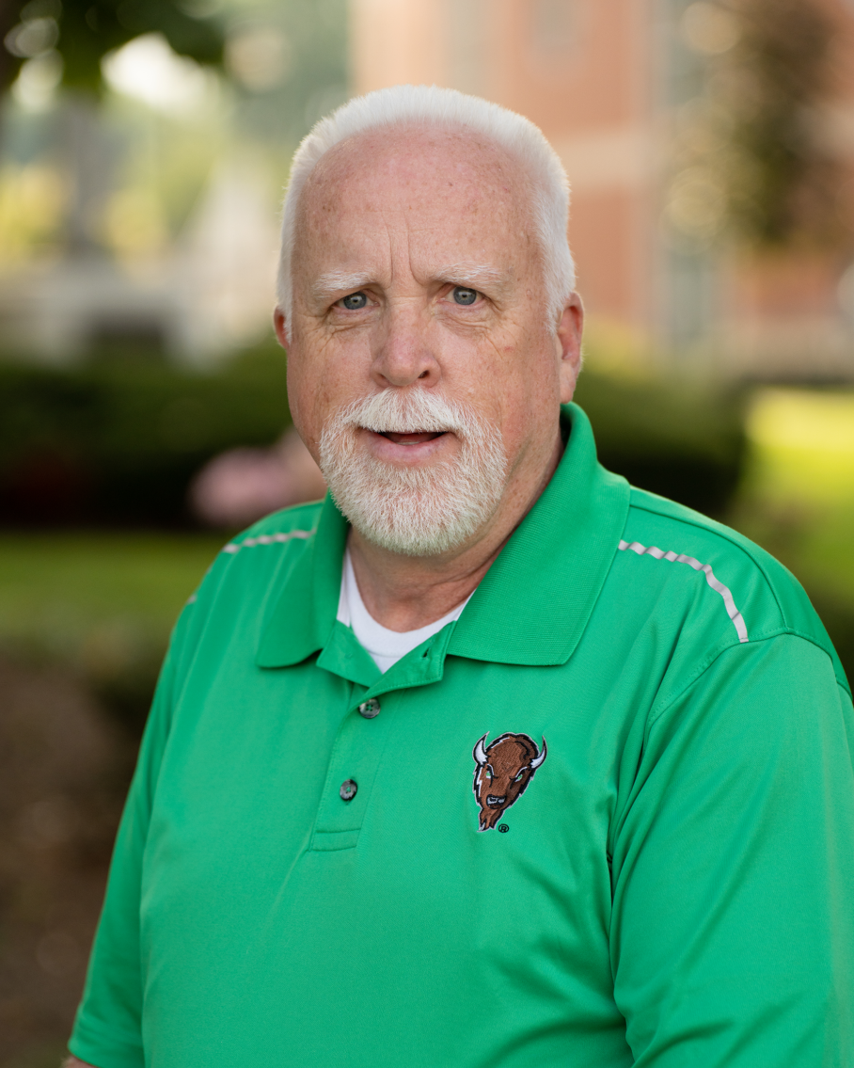
Office of Research Integrity
Significant Financial Interest Disclosure (SFID) Form:
Key research personnel who contribute in a substantive way to the project must have a current Significant Financial Interest Disclosure (SFID) form on file with the Office of Research Integrity. Individual Conflict of Interest in Research Policy and Courses Information can be found here.
Required Training for:
Public Health Service (PHS) Conflict of Interest Course (COI): This federally mandated course must be completed prior to proposal submission to any federal agency falling under the US PHS umbrella. This course is offered in the CITI system. Instructions on how to register for the COI course can be found here.
Responsible Conduct in Research Course (RCR): All researchers, staff and students of National Science Foundation (NSF) sponsored grants are required to complete an educational course on the RCR. The course is broken down into approximately 25-minute modules so you can complete the modules as time permits. The steps for completing can be found here.
Bruce Day
Director, Office of Research Integrity
Email: day50@marshall.edu
Phone: 304-696-4303
Questions? We are always here to help! Visit www.marshall.edu/ori/

Slide 20
Institutional Review Board
What is an Institutional Review Board (IRB)?
A committee of individuals (both scientific and community) established by law that oversees all research involving human subjects at an institution.
The IRB is legally viewed as the protector of integrity and ethical standards of all human research and has the authority to enforce these standards.
Why is there an IRB and what is its purpose?
The main function of the IRB review is to ensure that:
Risks are minimized and are reasonable in relation to anticipated benefits.
There is voluntary informed consent.
The rights and welfare of subjects are protected.
Note: Only the IRB office has the authority to determine what constitutes human subject research.
Not sure if it is human subject research? Contact Bruce Day with the IRB office.
It is always better to be safe than sorry.

Slide 21
Our Services
Pre-Award and Grants/Contract Development
Interpreting proposal guidelines
Developing and approving budgets
Coordinating institutional approval for proposal submissions
Negotiating awards with sponsors
Submitting proposal on behalf of Marshall University
Research Integrity
Providing information about responsible research conduct
Supplying guidelines for research involving human and animal subjects
Coordinating the university’s institutional review boards
Maintaining public trust through disclosure and management of conflicts of interest
Technology Transfer/Business Development
Facilitating the invention disclosure process
Obtaining patents, copyrights and trademarks
Collecting and disbursing royalties
Developing technical and market assessments
Marketing university technologies to industry partners
Providing business assistance to startup companies
Post-Award
Providing financial administration
Ensuring agency, institutional and federal compliance
Assisting with payroll and personnel functions
Submission of progress reports & award closeout
Grant Development, Training, and Collaboration
Training in grantsmanship
Locating grants to support projects
Conducting outreach and relationship building with funders
Developing internal and external project partnerships
Providing project management for grant applications
Reviewing and editing grant applications
Writing grant applications

Slide 22
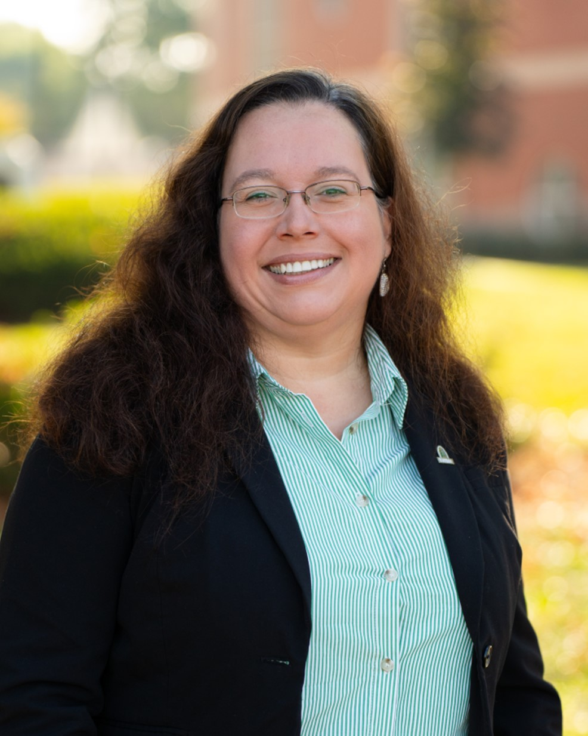
Technology Transfer Office
The primary focus of the Technology Transfer Office (TTO) is to make the unique products and services generated by Marshall University faculty, staff and students available to the public for commercialization.
Extending beyond the typical technology transfer programs on other campuses, the Marshall Technology Transfer Office works with regional economic development partners to help create high-tech, high-paying jobs in West Virginia.
The office’s first goal is to see that the new enterprises growing out of Marshall stay here.
Amy Melton
Director,
Technology Transfer Office
Email: amy.melton@marshall.edu
Phone: 304-696-4365
Questions? We are always here to help! tto@marshall.edu or visit www.marshall.edu/tto/

Slide 23
Our Services
Pre-Award and Grants/Contract Development
Interpreting proposal guidelines
Developing and approving budgets
Coordinating institutional approval for proposal submissions
Negotiating awards with sponsors
Submitting proposal on behalf of Marshall University
Research Integrity
Providing information about responsible research conduct
Supplying guidelines for research involving human and animal subjects
Coordinating the university’s institutional review boards
Maintaining public trust through disclosure and management of conflicts of interest
Technology Transfer/Business Development
Facilitating the invention disclosure process
Obtaining patents, copyrights and trademarks
Collecting and disbursing royalties
Developing technical and market assessments
Marketing university technologies to industry partners
Providing business assistance to startup companies
Post-Award
Providing financial administration
Ensuring agency, institutional and federal compliance
Assisting with payroll and personnel functions
Submission of progress reports & award closeout
Grant Development, Training, and Collaboration
Training in grantsmanship
Locating grants to support projects
Conducting outreach and relationship building with funders
Developing internal and external project partnerships
Providing project management for grant applications
Reviewing and editing grant applications
Writing grant applications

Slide 24
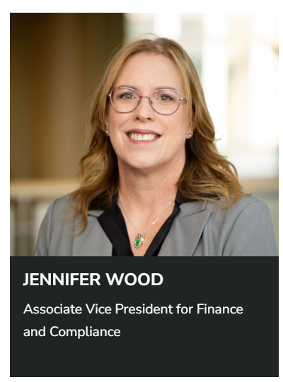
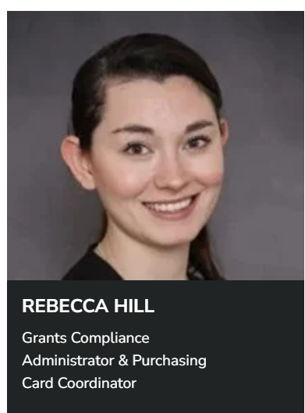
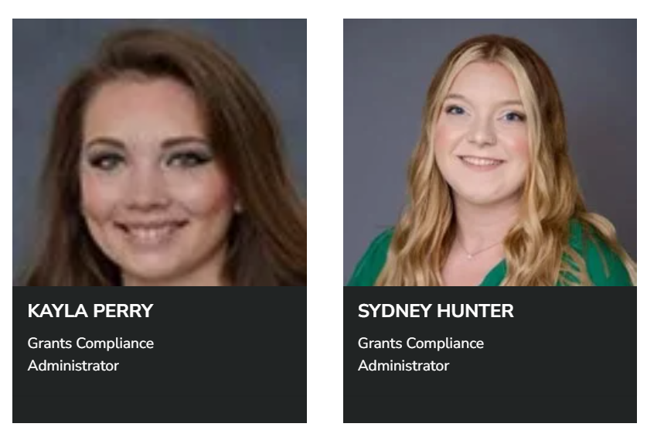
Post-Award Staff

Slide 25
Award Notice
Recruit more doctors.
Don’t start spending money yet.
Congrats! You have been awarded. What are the next steps?
Our first key focus.
Several things must occur before funds can be accessed for project spending.
Award Negotiation: An agency will send a Notice of Award to either MURC staff, the VP for Research or the PI. Once received, MURC Preaward will review the award to make sure the university can accept the contract as written. Particularly with non-federal awards, MURC Preaward will contact the agency for clarification and/or changes that need to be made before the award is ready for university acceptance.
MURC Preaward will take care of all negotiations with the agency and will work with Post Award for transition and account set up
Under no circumstances is the PI to negotiate terms and conditions with the funding agency or are they to sign the agreement.
ONLY MURC can negotiate and/or accept awards, contracts, terms and conditions.

Slide 26
Award Notice Cont.
Internal Approvals/Mandatory Requirements:
Recruit more doctors.
Congrats! You have been awarded. What are the next steps?
ATS Form: A fully routed Authorization to Submit (ATS) form must be in place prior to the expenditure of grant funds. Using this form, MURC will verify whether all prior approvals are in place, including:
Our first key focus.
IACUC and IRB Protocols/Requirements:
SFID From: A current SFID form must be on file with the Office of Research Integrity (ORI).
Conflict of Interest Management Plan: If applicable, any conflicts of interest must be reported and have a plan in place via the ORI.
IRB/IACUC: Individuals engaging in human and/or animal research must complete the federally mandated courses on Human Subject Research. These are offered via the CITI system. A certificate of completion must be on file with the Office of Research Integrity (ORI). The IRB and/or IACUC protocols must be approved prior to account set up.
NSF COI: NSF funded applicants must complete this training.
Under no circumstances is the PI to negotiate terms and conditions with the funding agency or are they to sign the agreement.
ONLY MURC can negotiate and/or accept awards, contracts, terms and conditions.

Slide 27
Post-Award Functions: Award Setup
Once the award has been reviewed and accepted by the appropriate institutional official, your award is sent to MURC Post Award, where you will be assigned a Compliance Officer who will be with you for the duration of your project.
The Compliance Officer will process the award and documentation from the pre-award. This documentation* includes:
Approved budget and justification
Internal Routing Form, which documents departmental/college approval of the project
Copies of IRB, IACUC, and safety protocols
Proof that the PI/Key Personnel have completed all federal and institutional Conflict of Interest requirements (PHS COI course, SFID form, etc.)
*Funds cannot be accessed until all institutional requirements have been met.
Your Compliance Officer will then set up the account and issue a unique account number for that specific project. They will guide the PI and admin(s) through the process of completing the required university forms which allow access to those accounts. Your Compliance Officer will review basic procedures such as:
Purchasing (MURC has its own P-Card system, which is separate from the state)
Payroll (everyone wants to be paid)
Account financial reports
MURC Post-Award is here to partner with you throughout your project.
https://www.marshall.edu/murc/our-staff-new/

Slide 28
Post-Award Functions: Other Functions of MURC
Payroll: MURC has its own Human Resources/Payroll department to take care of employees who are paid exclusively from external funds.
Travel: If applicable, any conflicts of interest must be reported and have a plan in place via the ORI.
Invoicing: The invoicing specialists send the documentation so that the university receives the money from the agencies
Award Closeout: MURC Compliance will work with you to ensure that all requirements have been met (reporting, financials, etc.) prior to award closeout once you have successfully completed your funded project.
Our MURC Payroll and Human Resources staff is here to assist you throughout your project.
https://www.marshall.edu/murc/our-staff-new/

Slide 29
Post-Award:
Ensure Agency, Federal, State and Institutional Compliance
What you don’t know CAN hurt you.
There are an infinite number of federal regulations and laws that the PI and institution must follow—and these regulations change constantly. Your Compliance Officer will help you keep up-to-date and make sure that you do not unintentionally break the law.
Both the PI and MURC are responsible for meeting all agency, federal, state, and institutional fiscal and legislative requirements.
It is the PI’s ultimate responsibility to ensure that the project meets the agency’s programmatic requirements.

Slide 30
Our Services
Pre-Award and Grants/Contract Development
Interpreting proposal guidelines
Developing and approving budgets
Coordinating institutional approval for proposal submissions
Negotiating awards with sponsors
Submitting proposal on behalf of Marshall University
Research Integrity
Providing information about responsible research conduct
Supplying guidelines for research involving human and animal subjects
Coordinating the university’s institutional review boards
Maintaining public trust through disclosure and management of conflicts of interest
Technology Transfer/Business Development
Facilitating the invention disclosure process
Obtaining patents, copyrights and trademarks
Collecting and disbursing royalties
Developing technical and market assessments
Marketing university technologies to industry partners
Providing business assistance to startup companies
Post-Award
Providing financial administration
Ensuring agency, institutional and federal compliance
Assisting with payroll and personnel functions
Submission of progress reports & award closeout
Grant Development, Training, and Collaboration
Training in grantsmanship
Locating grants to support projects
Conducting outreach and relationship building with funders
Developing internal and external project partnerships
Providing project management for grant applications
Reviewing and editing grant applications
Writing grant applications

Slide 31
Grants Development Office
Mission:
To grow Marshall University faculty and staff grant participation and research dollars through the pursuit of multi-million dollar multi-disciplinary and multi-institutional grants.
Services we provide:
Partner with faculty & and staff to develop project ideas.
Locate grants to support projects.
Conduct outreach and relationship-building with funders.
Develop internal and external project partnerships.
Conduct grantsmanship training.
Provide Project management for grant applications and projects.
Review grant applications.
Write grants.
Niki Rowe-Fortner,
Director of Grants Development
Email: rowe39@marshall.edu
Phone: 304-696-2965
For more information visit: https://www.marshall.edu/murc/grants-development-office/

Slide 32
Find Funding: Where is the money?
The best way to search for potential funding sources is to use the subscription database provided by Marshall University. This is a robust database that contains funding sources for federal, state, private, and other sources. Once you create your free account using your Marshall email address, you can conduct personalized searches using your keywords and profile. It is easy to use and FREE. MURC Preaward partners with the new Grant Development Office with this service.
www.grantforward.com is the first place to search!
For help with Grant Forward, contact:
MURCpreaward@marshall.edu

Slide 33
MURC is moving to Cayuse
Cayuse is a sponsored project lifecycle management system from proposal creation to project close out.
Cayuse Sponsored Projects 4.0:
It will help eliminate administrative burden by allowing PIs to quickly and accurately prepare a proposal for internal routing and review. This module will replace the current ATS form routing process.
Cayuse Proposals S2S (system to system):
This module is a fast, easy-to-use Web application created specifically to simplify the creation, review, approval and electronic submission of Grants.gov proposal applications. Anything that can be submitted via Grants.gov will be using Proposals S2S
Watch for further press releases and user training videos/guides coming soon.

Slide 34
MURC Staff

Slide 35
Resources
MURC Quick Start Guide
http://www.marshall.edu/murc/files/Quick-Start-Guide-Final-08252023.pdf
MURC Forms
https://www.marshall.edu/murc/forms/
National Institutes of Health Grants & Funding
https://grants.nih.gov/grants/oer.htm
Grants.gov Learn Grants
https://www.grants.gov/web/grants/learn-grants.html
Grants Forward MU’s funding search database
https://www.grantforward.com/index
USDA Grants Training
https://nifa.usda.gov/grant-training
NSF Information Site
https://www.research.gov/research-web/content/aboutpsm

Slide 36
Where to find us on campus.
Recruit more doctors.
Our first key focus.
Physical Address:
Fourth Floor, Arthur Weisberg Family Applied Engineering Complex
1676 Third Ave., Huntington, WV 25703
Mailing Address:
One John Marshall Dr.
Huntington, WV 25755-8100
Phone: 304-696-6271
Fax: 304-696-6300
Email: murcpreaward@marshall.edu
Staff Directory: https://www.marshall.edu/murc/our-staff-new/
We look forward to working with you!

