Slide 1
Introduction to
Marshall University Research Corporation
(MURC)

Slide 2
About the Marshall University Research Corporation (MURC)
MURC was created in 1987 & chartered under the laws of the State of WV
MURC is a 501(c)3 nonprofit organization which operates separately from Marshall University
MURC operates under an affiliation agreement with Marshall University
MURC is the only legal entity authorized to create or enter research contracts on behalf of Marshall University
MURC has an independent Board of Directors, with the Marshall University President presiding as Chairman of the

Slide 3
Why Must I Use MURC?
You must go through MURC because:
MURC is responsible for making sure grant and contract proposals submitted to agencies are complete, accurate, and in compliance with MU, state, and federal policies.
  “It is easier to ask for forgiveness rather than permission” does not apply to federal, state, and university policies. When it comes to federal, state, and university policies, ignorance of the law is not bliss.
MURC is the only legal entity authorized to make commitments to funding agencies on behalf of Marshall University.
  No other college, department, center or individual (faculty, staff, chair, dean, or University President) has the legal authority to enter into grant or contract agreements on behalf of Marshall University. Only MURC’s Authorized Organizational Official (AOR), has this authority.

Slide 4
Why Must I Use MURC? (con’t)
MURC provides services that are helpful to you in assembling and submitting your proposal and managing an award.
  Although the ultimate responsibility of the application contents are up to the Principal Investigator (PI), we help guide you through the administrative forms, guidelines and requirements.
MURC also ensures that the Terms and Conditions of a grant or contract award are acceptable to Marshall University.
  This protects both the PI and the University
Invalid reasons to bypass MURC:
  “Don’t worry! I signed on behalf of the University.”
  “It is only a small grant.”
  “I didn’t want to trouble anyone.”
  “The timeline was too short.”
  “It wasn’t that much money.”

Slide 5
How we work
to facilitate the growth of the research enterprise/perpetuate institutional mission
Every grant and contract is a legal agreement between the sponsor/funding agency and the Marshall University Research Corporation on behalf of Marshall University on behalf of the university college/s.
The Authorized Organization Representative, (AOR) is the Vice President for Research/Executive Director of MURC. This the only individual authorized to sign grant agreements or contracts on behalf of the university.
The agreement stipulates that the PI will perform the work described in the statement of work.

Slide 6
Basic Terminology
Funding Agency: The folks who have the money, but not the capability to solve a problem.
  These can be federal, state, foundations, private, or industry.
Principal Investigator (PI): The one who has the capability, but not the money/resources, to solve a problem.
External Funding: Funding that comes from an outside source and is not provided/available by Marshall University.
Indirect Costs: (F & A, Facilities & Administrative, Overhead): These are costs that the employer incurs when research happens, but these costs cannot be specifically assigned to the project: utilities, housekeeping, clerical support, etc. This is discussed in detail on another slide.

Slide 7
Basic Terminology (continued):
Grant: Any externally funded activity in which there is a formal agreement which contains a statement of work, fiscal requirements, and deliverables.
  Example: Federal Agency XYZ awards Professor Workhard in the School of Pharmacy a grant for $1 million for the development of a new drug. The terms and conditions of the awards require regular financial and scientific reporting and may only be spent in the manner prescribed in the budget.
Contract: Mechanism for the procurement of services with specific obligations from both parties.
  Example: The Random Agency (TRA) contracts with Computing Services for the procurement of an app, which will be utilized in tracking side effects of new drug, dramallama.
Gift: Funds given voluntarily with no reciprocal obligations, deliverables, restrictions, or fiscal requirements (typically no terms and conditions).
  Example: Alumni donor, Mr. Howell, donates $100,000 to the School of Nautical Engineering to use how they see fit. Mr. Howell does not require an account of how the money is spent.

Slide 8
Basic Terminology (continued):
Subaward: Funding provided by a pass-through entity to a subrecipient, for the subrecipient to carry out part of the main project.
  Example: Professor Smith from University A, receives funding from federal agency B, needs Professor Jones from University C to do some of the work on his project. In order to do this, University A, the pass-through entity, will issue a subaward agreement from their project funded by federal agency B to University C.
Fringe: These are allowances and services provided by employers to their employees as compensation in addition to regular salaries and wages. Fringe benefits include, but are not limited to, the costs of leave (vacation, family related, sick or military), employee insurance, pensions, and unemployment benefit plans. Marshall University uses fringe rates which have been negotiated by the federal government. These rates change yearly.
  Example: Dr. Wes Ternblot, hires a Research Assistant on his new NIH grant for $40,000 per year. Marshall University’s federally negotiated fringe rate for this employee classification is currently 31.33%. The cost to the grant would be $40,000 (salary) plus $12,532 (fringe), for a total of $52,532.

Slide 9
Indirect Costs
Indirect Costs are:
Also referred to as Facilities and Administrative Costs (F &A) or Overhead
Real costs that are incurred by a grantee for common or joint objectives and cannot be identified specifically with a particular project or program such as: utilities, building maintenance, administrative support (computing services, payroll, accounting, etc.).
  Example: Electricity is used throughout a university building, but when the electric bill arrives it has the composite charge for the entire building rather break down individual usage per room or faculty member—that would be rather implausible; however, electricity is a REAL cost (because typically researchers rely on it to power their labs and classrooms)
Not a TAX, FEE, or a “MURC cut”

Slide 10
Indirect Costs (continued):
Current Rates:
    On-campus research 48.00%
    Off-campus research 26.00%
    On-campus other sponsored activities 30.00%
    Off-campus other sponsored activities 22.90%
Where do the Indirect Cost rates go?
A percentage of the indirect cost rate goes to predetermined allocations as determined by university policy, such as the library. From the remainder, indirects are usually distributed as follows:
    University President’s Office 25%
    MURC 25%
    College/Center/Institute 50%*
    *allocations to individual departments are determined by each college/center/institute. Check with your dean or director.
Under no circumstances is the PI to negotiate a project’s F & A rate with a funding agency.

Slide 11
Indirect Costs (con’t)
Marshall University’s Indirect Cost Rate (ICR) is determined by negotiations with the federal government. The ICR is the per dollar amount that the feds have determined that it cost Marshall University to conduct research.
  Marshall’s current rate for on-campus research project is 48%. This means that for each dollar spent on research, it cost the university $0.48.
There are specific criteria needed to determine which rate will be applied to your project
MURC will make the final determination of the appropriate rate.

Slide 12
Indirect Costs (con’t)
Unless specifically listed in the agency guidelines, Marshall’s full appropriate rate will be applied.
    Example # 1: Dr. Car D. Atch is applying for a grant from the American Heart Association. The AHA specifically restricts indirect costs to 10%. This is the rate that must be used.
    Example #2: Dr. I. M. Karful is applying for a HRSA training grant. HRSA training grants specifically state in the RFA that training grants are restricted to 8% indirects. This is the rate that must be used.
Under no circumstances should a PI ever negotiate the indirect rate with an agency. Such negotiations should be considered null and void because the PI is not legally authorized to negotiate on behalf of the university.

Slide 13
Institutional Responsibilities
MURC’s Responsibilities include:
Applying for, receiving and executing grants and contracts on behalf of Marshall University
Maintaining and assurance of compliance with all federal, state, local and institutional guidelines, policies and laws
  This includes policies such as the Patriot Act, Uniform Guidance…
Fulfilling all financial accounting and reporting for grants and contract for the agency and federal government
  FFATA Reporting, Audit Requirements
Distributing collected indirect costs (F & A) back to the proper locations at the university
Notes:
Main Responsibility

Slide 14
Institutional Responsibilities
MURC’S Responsibilities include:
Management of equipment/property purchased with external funds
  MURC
Assurance of research integrity
Managing Marshall University’s intellectual property
Managing Conflict of Interest (COI)
IACUC (Animal Assurance Committee)
Institutional Review Board (IRB)
Notes:
Put contact info and briefly discuss
Additional training available
Seeeeeee Amy

Slide 15
Institutional Review Board
WHAT is an INSTITUTIONAL REVIEW BOARD (IRB)?
  Committee of individuals (both scientific and community) established by law that oversees all RESEARCH involving HUMAN SUBJECTS at an institution.
  The IRB is legally viewed as the protector of integrity and ethical standards of all human research and has the authority to enforce these standards.
WHY is there an IRB and what is its PURPOSE?
  The MAIN function of the IRB review is to assure that:
  Risks are minimized and are reasonable in relation to anticipated benefits.
  There is voluntary informed consent.
  Rights and welfare of subjects are protected.
Not sure if it is human subject research? Contact the IRB office.
It is always better to be safe than sorry.
Only the IRB office has the authority to determine what constitutes human subject research.

Slide 16
Who does what?
Pre-Award: www.marshall.edu/murc/home/pre-award-services/
    Proposal Development of Budget and Budget Narrative
    Ensure guidelines are followed for application
    Submission of application on your behalf
Post-Award: www.marshall.edu/murc/home/post-award-services/
    Financial Administration
    Ensure agency, institutional and federal compliance
    Payroll/Personnel
    Progress Reports & award closeout

Slide 17

Pre-Award Functions: Finding Funding
The best way to search for potential funding sources is to use the subscription database provided by Marshall University. This is a robust database which contains funding sources for federal, state, private and other sources. Once you create your free account using your Marshall email address, you can conduct personalize searches using your key words and profile. It is easy to use and FREE.
www.grantforward.com is the first place to search!
For help with Grant Forward, contact:
Kelly Stump
stump4@marshall.edu
304-696-6676

Slide 18
Pre-Award Functions: Proposal Application
Once you have found a potential funding source, it is important to read the funding announcement and contact MURC Preaward.
Although it is the PI’s ultimate responsibility, we will help you look for the following when searching through funding announcements:
  Program mission/goals: Is your project a good fit with the agency? Sometimes it is a good idea to reach out to the Program Officer before you apply.
  Eligibility Requirements: Is the institution/PI eligible to apply? It is better to find out before hand.
  Funding amounts: Are the amounts feasible?
  Application Deadline: Will it work? Do you have enough time?
  Agency Terms and Conditions: Can the institution commit/Is it legal for the university? Not all external funding works for institutions of higher education.
It is important to contact your MURC Grants Officer with your intent to apply as soon as possible. Never submit on your own! Find us at www.marshall.edu/murc/staff/
Notes:
18
18

Slide 19
Pre-Award Functions: Application Process
During the application process, MURC Preaward will help with the following:
  Budget. We work with you to develop a competitive, compliant budget with the most recent fringe rates and appropriate F & A rate. Putting a good budget together before hand will prevent major headaches in the future.
  Institutional Information. We make sure all institutional information is accurate. This helps to prevent issues when an award is made.
  Submission portal. We make sure the correct portal/submission method is used
  Institutional requirements. We assist in making sure the PI is meeting the internal institutional documentation.
Notes:
19
19

Slide 20
Pre-Award Functions: Application Process
For most applications, we complete the forms so that the PI can concentrate on the actual proposal.
  Most federal agencies have an application system which require the PI to be affiliated with the institutional UEI or DUNS.
  Many smaller agencies/foundations have one institutional portal
  Some agencies have a PI-driven application. In some instances, the PI can (and must) grant MURC staff access; in others, the PI must share login credentials
For ALL applications (no matter how large or small), MURC must be involved in the submission process.
Notes:
20
20

Slide 21
CONGRATULATIONS! You’ve been awarded. Now what?
An agency will send a Notice of Award to either MURC staff, the VP for Research or the PI. Once received, MURC Preaward will review the award to make sure the university can accept the contract as written. Particularly with non-federal awards, MURC Preaward will contact the agency for clarification and/or changes that need to be made before the award is ready for university acceptance.
Once the award/contract/agreement has been accepted, the PI’s department or college typically will issue an official press release through University Communications.
Under no circumstances is the PI to negotiate terms and conditions with the funding agency. Nor are they to sign the agreement.
ONLY MURC can negotiate and/or accept awards, contracts, terms and conditions.

Slide 22
MURC Post Award
Once the award has been reviewed and accepted by the appropriate institutional official, your award is sent to MURC Post Award, where you will be assigned a Compliance Officer who will be with you the duration of your project.
The Compliance Officer will process the award and documentation from Pre Award. This documentation* includes:
    Approved budget and justification
    Internal Routing Form, which documents departmental/college approval of the project
    Copies of IRB, IACUC and safety protocols
    Proof that the PI/Key Personnel have completed all federal and institutional Conflict of Interest requirements (PHS COI course, SFID form, etc.)
  *Funds cannot be accessed until all institutional requirements have been met.
MURC Post-Award is here to partner with you throughout your project. www.marshall.edu/murc/staff/

Slide 23
MURC Post Award (con’t.)
Your Compliance Officer will then set up the account and issue a unique account number for that specific project. They will guide the PI and admin(s) through the process of completing the required university forms which allow access to those accounts.
Your Compliance Officer will review basic procedures such as:
  Purchasing (MURC has its own P-Card system, which is separate from the state)
  Payroll (everyone wants to be paid)
  Account financial reports
Your Compliance Officer will be there to assist and answer your question throughout the duration of your project
MURC Post-Award is here to partner with you throughout your project. www.marshall.edu/murc/staff/

Slide 24
MURC Post Award (con’t.)
Other Functions of MURC:
Payroll: MURC has its own Human Resources/Payroll department to take care of employees who are paid exclusively from external funds.
Travel: MURC has its own travel department to process travel made using grant funds
Invoicing: The invoicing specialists send the documentation so that the university receives the money from the agencies
MURC Post-Award is here to partner with you throughout your project. www.marshall.edu/murc/staff/

Slide 25
MURC Post Award (con’t.)
Ensure Agency, Federal, State and Institutional Compliance
What you don’t know CAN hurt you. There are an infinite number of federal regulations and laws that the PI and institution must follow—and these regulations change constantly. Your Compliance Officer will help you keep up-to-date and make sure that you do not unintentionally break the law.
Both the PI and MURC are responsible to meet all agency, federal, state, and institutional fiscal and legislative requirements.
It is the PI’s ultimate responsibility to ensure that the project meets the agency’s programmatic requirements.

Slide 26

1. Proposal
Development
ID Funding &
Write Proposal
2. Institutional
Clearances
&
Approvals
3. Proposal
Submission
&
Sponsor Review
4. Funded:
Awards
Terms &
Conditions
5. Establish
Project
Account(s)
&
PI Briefing
6. Spend Money,
Purchasing, Reporting
7. Tracking,
Accounting,
Closeout
Post-Award
Pre-Award
Externally Funded Award Lifecycle
MARSHALL UNIVERSITY
RESEARCH CORPORATION
Notes:
These are not fully inclusive steps, just an example of the life cycle of grants.

Slide 27
RESOURCES
National Institutes of Health Grants & Funding
https://grants.nih.gov/grants/oer.htm
Grants.gov Learn Grants
https://www.grants.gov/web/grants/learn-grants.html
Grants Forward MU’s funding search database
https://www.grantforward.com/index
USDA Grants Training
https://nifa.usda.gov/grant-training

Slide 28
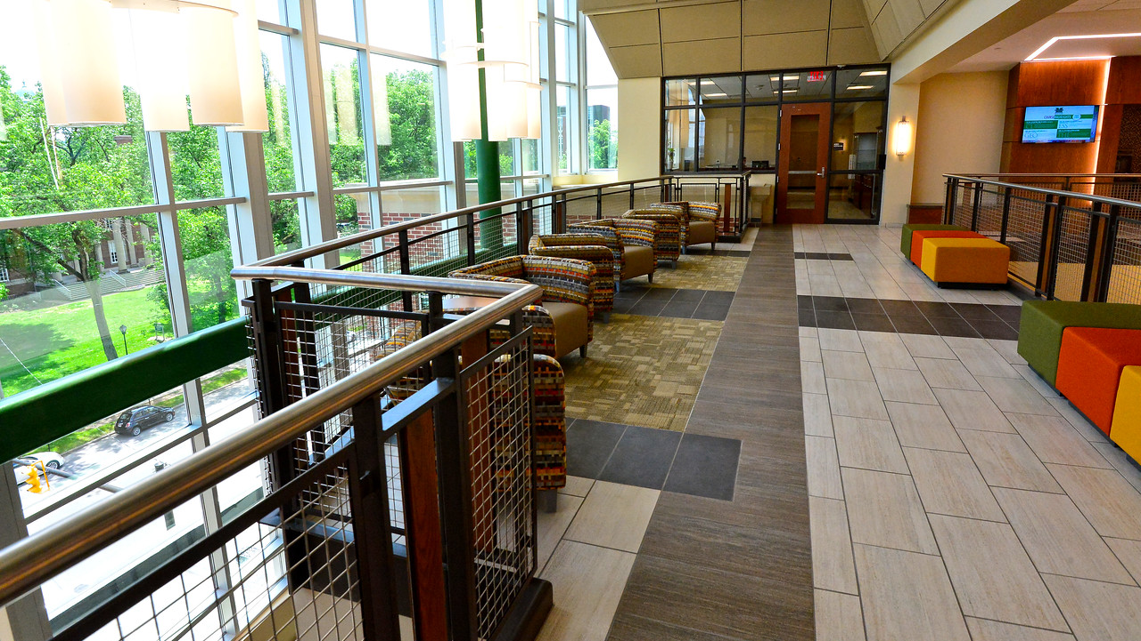
Contact Us -- MURCpreaward@marshall.edu
WAEC 4th Floor
www.marshall.edu/murc/staff

