Slide 1



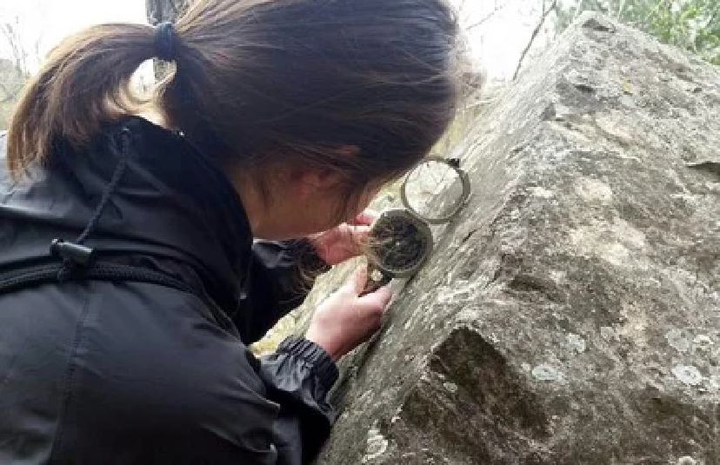
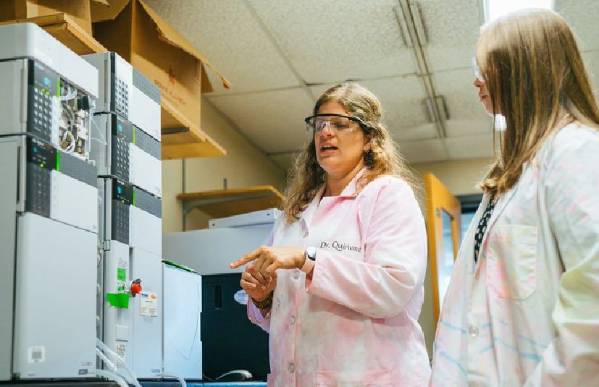




MASTERING REQUISITIONS
Visit Our Website for More Training Materials
www.marshall.edu/murc
Updated on 11/7/2025

Slide 2


Training Objectives
Understand what a requisition is and why it’s used.
Identify when a requisition is required.
Follow the step-by-step process for submitting a requisition. Know the roles and responsibilities in the approval workflow. Avoid common mistakes and delays.

Slide 3
IMPORTANT
This training will discuss the process for requisitions that fall under other goods and services. These will be reviewed by your Grants Compliance Administrator (GCA).
This excludes those listed under contractual.
You can use the expense account code list here to determine how the line item is coded.
Grants Compliance Administrator
Agreements for the following:
Contract & Subaward Compliance Officer - Kristen Webb
Service Agreements/Subawards that are listed under Contractual in your grant budget.
Software
Rental/Hotel Agreements Equipment
Maintenance Agreements
This includes:
Consultants & Consulting Fees Professional Services Contractual Services
Instructions on processing these types of agreements can be found here.

Slide 4
What is a Requisition?
Definition: A formal request to purchase goods or services. A requisition is the first step in the issuance of a Purchase Order (PO). Purchase Orders are a method of procurement, not payment.
Purpose: Ensures fiscal compliance, budget availability, and appropriate approvals.
Common examples: Supply purchases, equipment purchases, etc.
When is a Requisition Required?
Orders greater than $9,999 and all equipment
If there are terms and conditions associated with an order regardless of amount
If there is a contractual agreement involved regardless of amount
Service Agreements/Subawards

Slide 5


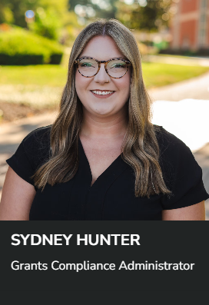

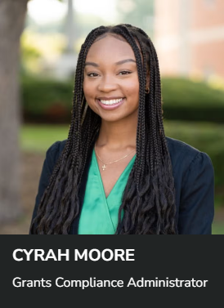
MURC Contact: Grants Compliance Administrators

Slide 6
Lifecycle of a Requisition
1
Department completes requisition packet based on purchase amount.
2
Department emails completed requisition packet to MURC Compliance for review.
3
MURC Compliance reviews the award budget for allowability, obtains the necessary signatures on the addendum or contract (if applicable), and approves requisition in Banner. Once approved, MURC Compliance submits the documentation to Procurement Services.
4
Procurement Services reviews and converts to Purchase Order. Procurement Services sends completed Purchase Order to the vendor, MURC and Department contact.
5
Department submits invoice referencing PO# to MURC Accounts Payable for payment.
6
MURC Accounts Payable confirms receipt of items, pays invoice and closes purchase order.

Slide 7
Requisition Packet: What Documentation is Required?
At this point, work closely with the GCA and Procurement Services to complete the required documentation based on the dollar threshold of other goods or services.
Orders Between
Orders Between
Orders $50,000 & more
$0 and $24,999
$25,000 and $49,999
Quote from vendor - requested by department.
Requisition created in Banner. The
Requisition # should be referenced on the top right hand corner of the quote. MURC addendum – only if there are terms and conditions associated with the quote.
Submit referenced documentation to MURC Compliance.
Choose one of the following:
3 Quotes from different vendors
The department should gather their own quotes.
Select the vendor with the lowest reasonable price.
Direct Award Form
Used when there is only one qualified vendor (e.g., a sole-source provider or specialized expertise).
MURC Addendum – only if there are
terms and conditions associated with the selected quote.
Requisition created in Banner.
The requisition # should be referenced on the top right hand corner of the quote.
Submit referenced documentation to MURC Compliance.
Choose one of the following:
Formal Bidding Process
Conducted by Procurement Services (departments are not allowed to collect their own quotes at this level).
Direct Award Form
Used when there is only one qualified vendor (e.g., a sole-source provider or specialized expertise).
MURC Addendum required.
Requisition created in Banner.
The requisition # should be referenced on the top right hand corner of the quote.
Submit referenced documentation to MURC Compliance.
Note: Any purchases under 5k that do not have terms and conditions or an agreement associated may be purchased on MURC P-Card.
1
Department completes requisition packet based on purchase amount.

Slide 8
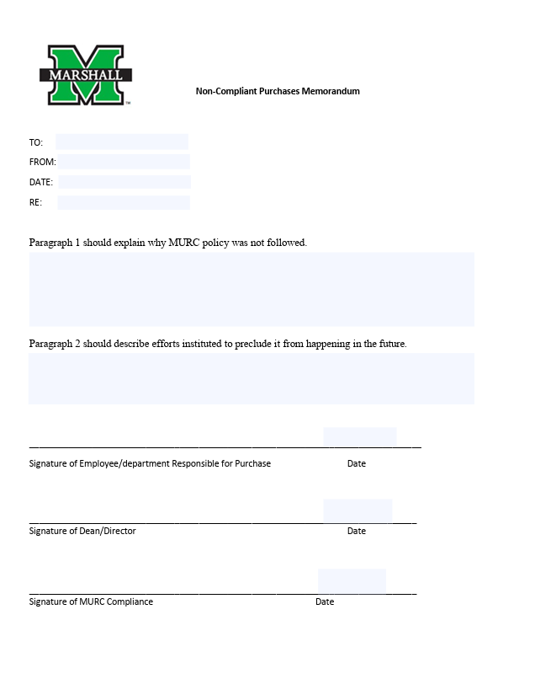
After The Fact Purchases
After the fact purchases (non-compliant purchases) are made without prior approval of MURC Compliance. These orders are against policy. Payment of such orders will be reviewed on a case by case basis and payment is subject to the department cost recovery account.
Required Documentation:
Non-Compliant Purchases Memorandum Form complete detailing:
Why this order was purchased outside of the required purchasing procedures.
The steps the department will take going forward to prevent the situation from reoccurring.
Invoice from vendor
Requisition created in Banner. The requisition # should be referenced on the top right hand corner of the invoice.
Submit all referenced documentation via email to MURC Compliance.
Access Form Here
1
Department completes requisition packet based on purchase amount.

Slide 9
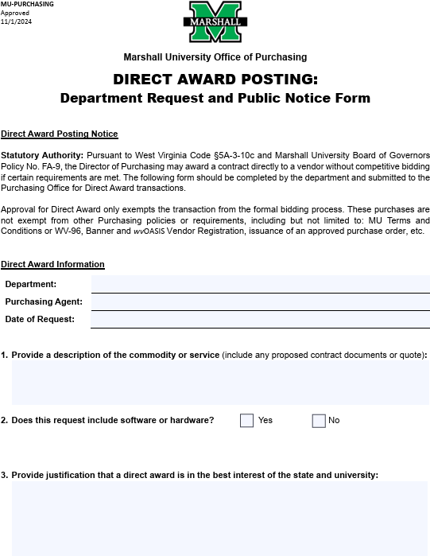
Direct Award Form
This form replaced the previously used sole/single source form.
Should only be used when only one vendor can provide the good or service.
Note: It is not a shorter procurement process.
There is a 5-day advertisement period associated with orders procured using the Direct Award form.
Direct Award forms are reviewed and approved by Procurement Services.
Access Form Here
1
Department completes requisition packet based on purchase amount.

Slide 10

Technology Procurement Form
Required for software IT purchases.
Note: For computer purchases through Dell & Apple (or similar vendor) only IT approval from Jody Perry or Holly Dunmore is required.
How to Submit Technology Procurement Review Form:
Navigate to the myMU portal and click the My Support tab.
In the "Technology Procurement" section, click the “Submit Technology Procurement Review Form” button to begin. This form will allow requesters to track the status of their submissions in myMU - My Support Cases, ensuring greater transparency throughout the technology review process.
1
Department completes requisition packet based on purchase amount.

Slide 11
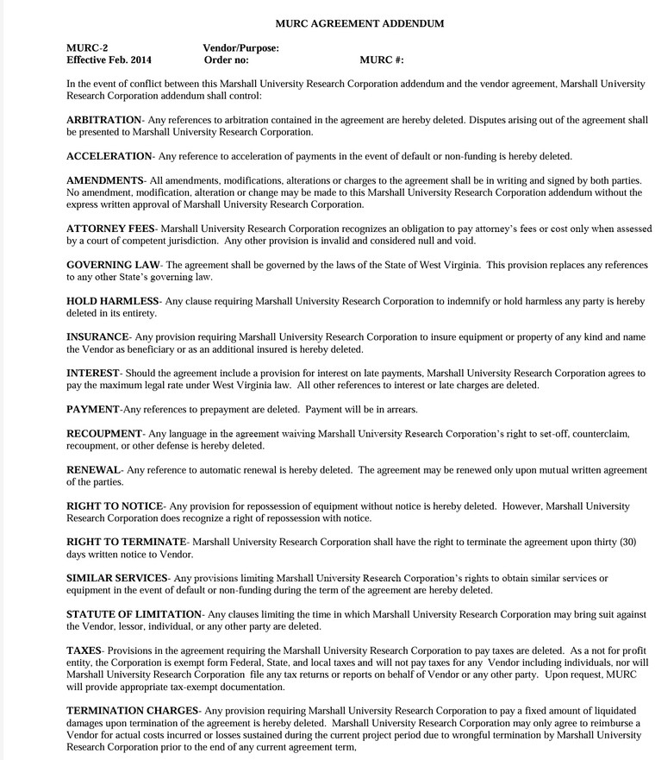
MURC Addendum
Required for orders containing terms and conditions, and all orders over 50k.
If a vendor would like to make changes to the MURC addendum, contact your assigned GCA for assistance.
Note: There is a separate MURC addendum specifically for hotels.
Access Form Here
1
Department completes requisition packet based on purchase amount.

Slide 12


Vendor Setup in Banner
Before a requisition can be created, you must confirm that the vendor is properly set up in Banner, Marshall’s financial system. This ensures no roadblocks in routing requisition documentation for approval and processing.
Step 1: Looking for a vendor in Banner
Banner screen FTIIDEN
Step 2: Verify vendor address in Banner
Banner screen FTMVEND
1
Department completes requisition packet based on purchase amount.

Slide 13
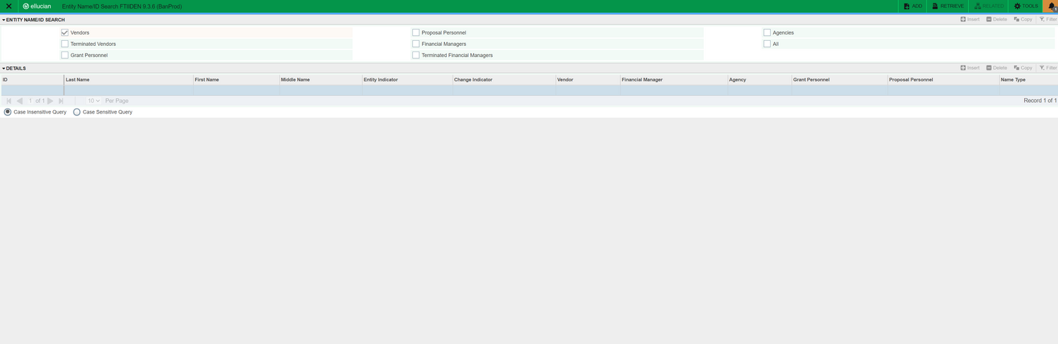
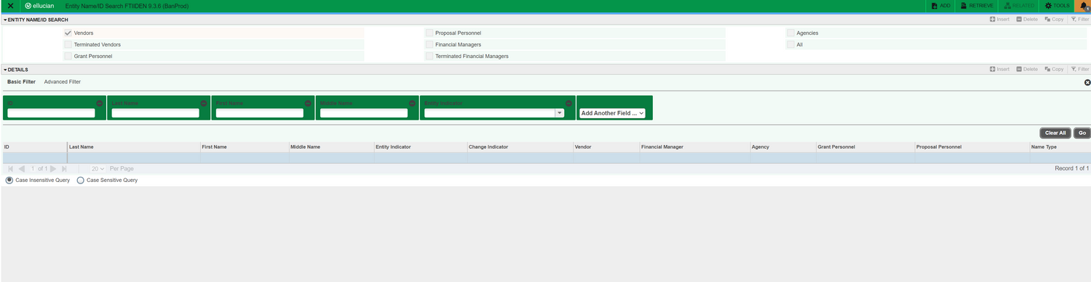
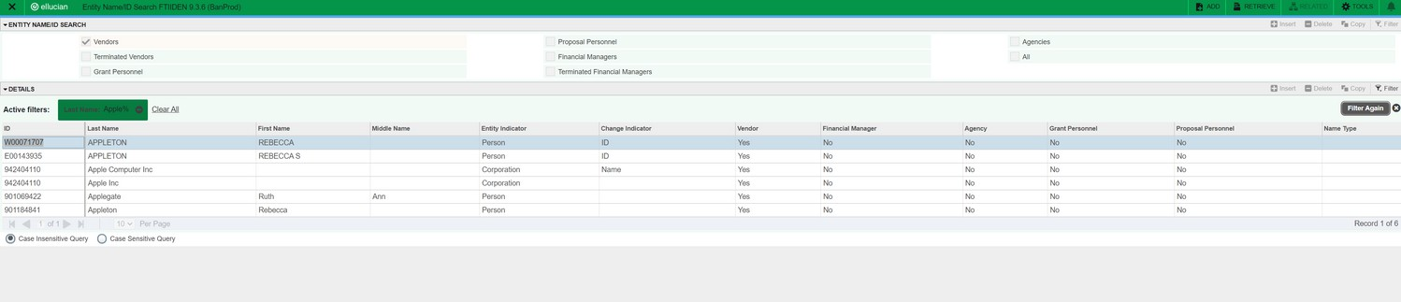
Banner Screen FTIIDEN
Visit Banner here and search screen FTIIDEN in the search bar. This screen will be used first to locate the vendor number (FEIN# if working with an organization). You will need to use screen FTMVEND to view the vendors address.
Click on the light green box under the ‘Last Name’ field.
In the ‘Last Name’ box, type the vendor’s name.
Hint: If you are unsure of the exact name, you can try a variation of what you think it may be and type the wildcard, %, after the name. It will pull up all IDs in Banner that have those characteristics.
For example: If you know the vendor is Bulldog Creative Services you can type %Bulldog% in the Last Name field.
Hit F8, or click ‘Go’.
It will populate all the options with your search criteria.
The vendor number (FEIN #) can be located in the ID box.
Write down the vendor number (FEIN #). It will be needed to view the address in Banner screen FTMVEND and in the requisition creation process.
1
Department completes requisition packet based on purchase amount.

Slide 14
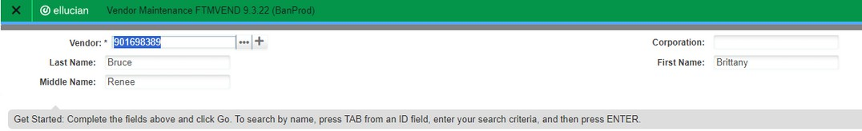
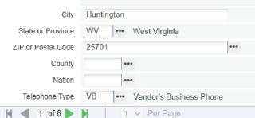
Banner Screen FTMVEND
Visit Banner here and search screen FTMVEND in the search bar. This screen is used to view the vendors address to ensure you are working with the correct vendor, and payment is submitted to the correct location.
1. Type in the vendor number and click ‘Go’.
Hint: If you forgot to locate the vendor IS #, click on the 3 dots box to the right
Of the vendor field and it will take you to the FTIIDEN screen.
2. On the next screen select ‘Address’ to check that the appropriate address is available in Banner.
3. If the vendor has multiple address records, you will need to use the arrows to move through the records to review the addresses listed in Banner. Ensure the correct vendor provided address is listed in Banner.
3
1
Department completes requisition packet based on purchase amount.

Slide 15
If Vendor Is Not in Banner – Initiate Setup
If Vendor Is Not in Banner – Initiate Setup
The vendor registration process is complete through Procurement Services. The vendor registration form can be located here.
If the vendor does not appear in Banner, the dept contact must initiate vendor registration working with the vendor and Procurement Services.
It is the departments responsibility to:
Follow up with the vendor to ensure the registration is submitted.
Check back in Banner to confirm when the vendor
appears and is active.
Only proceed with requisition creation once the vendor setup is confirmed.
✅ Tip: Don’t delay the registration step—vendor setup is one of the most common causes of processing delays.
1
Department completes requisition packet based on purchase amount.

Slide 16
Creating the Requisition in Banner
Create a requisition in Banner using the FPAREQN screen. Requisition instructions located here.
This officially begins the internal purchasing process and is essential for establishing the Purchase Order (PO) that authorizes payments to the vendor.
It is important to make sure you use the correct account code in Banner. You can use the expense code list here to determine how the line item is coded.
Be sure to write down the requisition # to reference on the requisition documentation.
🧾 Who Creates the Requisition?
The PI/Project Director/Department Admin creates the requisition in Banner.
1
Department completes requisition packet based on purchase amount.

Slide 17
Requisition Packet
Once the requisition has been successfully entered into Banner (FPAREQN), the next step is to compile the requisition documentation to submit to MURC Compliance for review and approval.
Why This Step is Important:
The requisition is required to generate a Purchase Order (PO).
Properly linking the requisition to the required requisition documentation ensures smooth processing and avoids delays in issuing payments. Missing or incorrect requisition details can cause compliance issues, financial reporting errors, or rejected invoices.
Where to Document the Requisition Number
The requisition number generated in Banner should be referenced on the top right hand corner of the quote.
This step ensures easy identification between all moving queues.
The department must email the completed requisition packet to their MURC GCA.
2
Department emails completed requisition packet to MURC Compliance.

Slide 18
Compliance Review/Signatures/Submission to Procurement Services
Once the requisition has been completed by the department and all required documentation (such as quotes or the Direct Award Form) is attached:
GCA Review & Verification
GCA will:
Verify that all required backup documentation is included based on the procurement threshold. Ensure everything complies with MURC Purchasing policies and sponsor requirements.
Obtain the necessary signatures on the addendum or contract if applicable.
Note: Allow adequate time for your GCA to review—especially during peak submission periods.
Next Step
After approval, GCA will send the approved requisition documentation to Procurement Services and cc the dept contact.
3
MURC Compliance reviews the award budget for allowability, obtains necessary signatures, and approves the requisition in Banner. Once approved, MURC Compliance submits the documentation to Procurement Services.

Slide 19
Procurement Services: Purchase Order Creation
Once MURC Compliance has submitted the approved requisition documentation to Procurement Services, Procurement Services will work to convert from requisition to purchase order (PO). This is the final step in activating the PO for payment and financial tracking.
Note: At this stage Procurement Services reviews and approves the Direct Award Form if the form was included in procurement.
What Is a Purchase Order?
A Purchase Order is an official document issued by Procurement Services that allows MURC to begin processing payments against the PO.
The PO:
Allows for the submission and payment of invoices.
Note: The department must submit invoices for payment to MURC AP once a PO has been established.
Why This Step is Important:
Without a PO, no invoices can be processed, and no payments can be made to the vendor.
The PO establishes the financial structure that allows MURC to encumber funds and track spending accurately.
📧 If you're unsure of the PO status or haven't received confirmation within a reasonable timeframe, contact your GCA to follow up with Procurement Services.
4
Procurement Services reviews the request, converts it into a Purchase Order, and distributes the finalized Purchase Order to the vendor, MURC, and the designated department contact.

Slide 20
PO Notification: Final Confirmation and Communication
Once the PO is created in Banner by Procurement Services, official email notifications are sent out to both the PI/Department and the vendor to confirm that the PO is fully established and ready for invoicing and project activity.
Note: The PO submission from Procurement Services to the vendor serves as the order mechanism.
📩 What the Notification Includes:
Copy of the Purchase Order (PO).
Purchase Order Number
This is the internal tracking number that links the agreement to Banner and must be referenced on all invoices. The PO # can be found on the top right hand corner of the PO document from Procurement Services under Purchase Order Number. MURC PO #s start with RC-PXXXXXXX.
Tip: Save a copy of the PO for your project records.
4
Procurement Services reviews the request, converts it into a Purchase Order, and distributes the finalized Purchase Order to the vendor, MURC, and the designated department contact.

Slide 21
Next Step: Invoicing Can Begin – Moving into the Payment Phase
Once the Purchase Order (PO) has been issued and notifications have been sent, the vendor is now authorized to begin invoicing MURC.
This phase officially activates the financial relationship, and timely, accurate invoicing is key to ensuring smooth payments and sponsor compliance.
Departments are responsible for tracking open Purchase Orders and submitting invoices to murc_accounts_payable@marshall.edu for payment.
Do not solely rely on the vendor to submit invoices associated with the PO. The department should ensure invoices are submitted timely and track activity within Banner.
Unpaid purchase orders are reflected in the commitments column in Banner FGIBAVL.
Monitor commitments and follow up with vendors to request invoices for open purchase orders.
You can check payment on purchase orders in Banner screen FGIENCD. Type PO# and hit ‘Go'.
5
Department submits invoice to MURC Accounts Payable, referencing PO number.

Slide 22
Next Step: Invoicing Can Begin – Moving into the Payment Phase
MURC Accounts Payable verifies that the goods or services have been received as outlined in the PO. Upon confirmation, MURC AP processes the invoice for payment and closes the Purchase Order in the system.
6
MURC Accounts Payable confirms receipt of items, pays invoice and closes Purchase Order.

Slide 23
When is a requisition required?
Orders greater than $9,999 and all equipment.
If there are terms and conditions associated with an order.
If there is a contractual agreement involved.
When is a MURC addendum
When there are terms and conditions associated with the quote. When order is $50,000 & more.
Use Hotel addendum for contracts with Hotel vendors.
required?
The department obtains vendor signature on the addendum, and sends to Compliance for MURC signature. This form should be submitted at the same time as the quote as part of the reconciliation packet. Please avoid sending documents in piecemeal.
Who gets the MURC addendum
signed by vendor?
Who creates the requisition in
The department
banner?
I don’t have access to my fund in
No. Please hold until you have access and are able to create the requisition in Banner.
Banner yet, can I go ahead and
submit the paperwork?

Slide 24
What if the vendor has changes
Send requested changes to MURC Compliance for review.
to the MURC addendum?
How is the requisition packet
Send completed requisition packet in one PDF via email to your assigned GCA.
submitted?
How long does a requisition take
If all required documentation is submitted, conversion to a PO typically takes appx 7-10 business days.
to be converted into a PO?
When is a Direct Award form
Required for any order over 25k in which only one vendor can provide the good/service. Consult with Procurement Services.
required?
What happens if the order was placed by
This order is considered unauthorized and after the fact. After the fact purchases are subject to payment from the departments cost recovery funds. See after the fact section for details.
the department and did not go through
Procurement Services/MURC Compliance?
Can PI sign any contracts, such as
No. Only MURC’s Executive, John Maher, can sign contracts on behalf of MURC. MURC Compliance routes documentation for MURC signature once requisition packet is submitted to MURC Compliance.
hotel contracts?

Slide 25

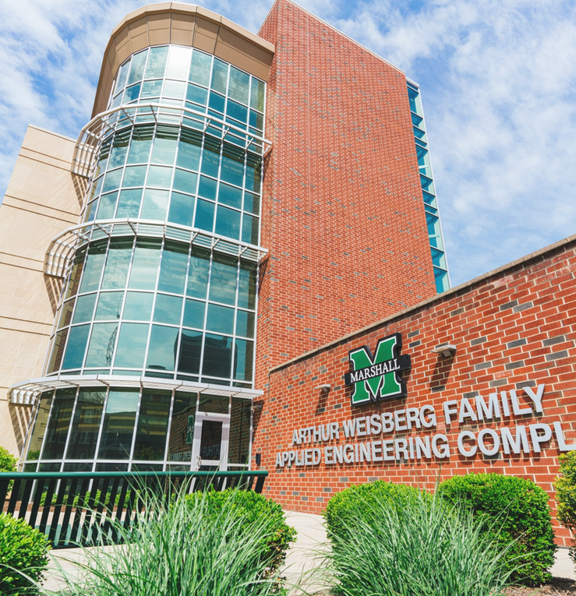
Physical Address:
Fourth Floor, Arthur Weisberg Family Applied Engineering Complex 1676 Third Ave., Huntington, WV 25703
Mailing Address:
One John Marshall Dr. Huntington, WV 25755-8100
Staff Directory: https://www.marshall.edu/murc/our-staff-new/
We look forward to working with you!

