Slide 1




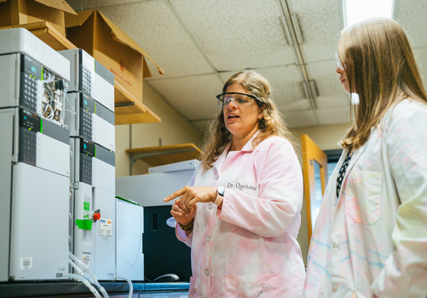

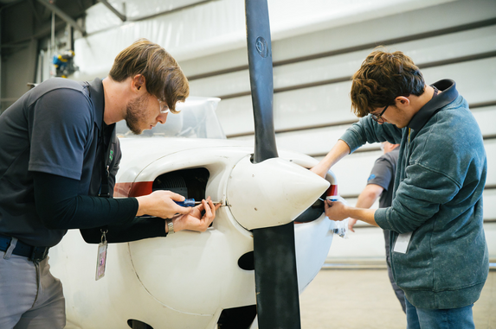



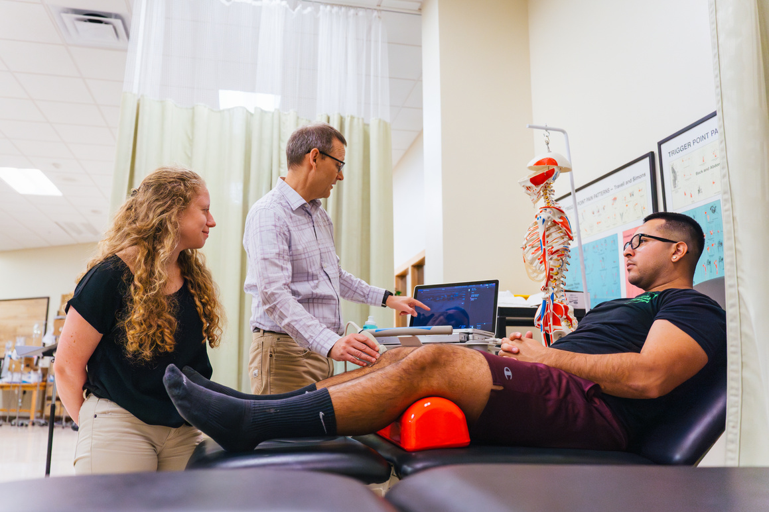

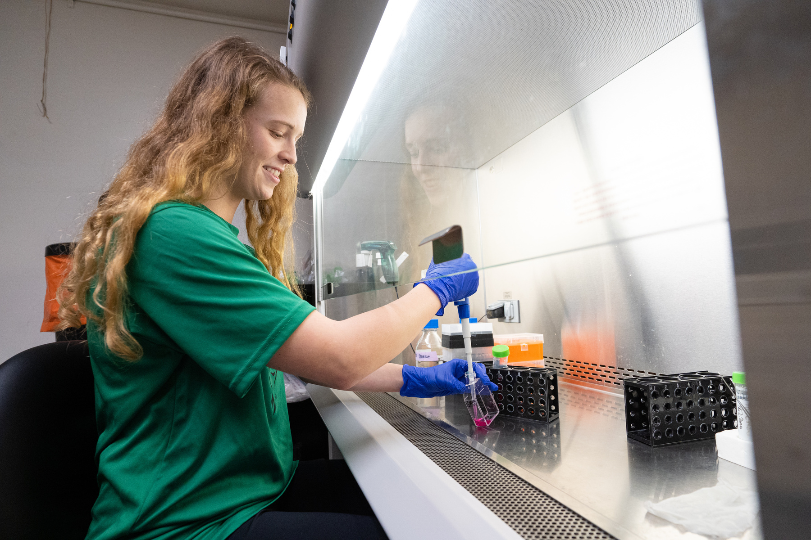
Post-Award Essentials

Slide 2


Topics
What is Post-Award?
Process Overview
Banner Fund Number and Access
New Award Quick Start Guide
Spending Funds
Traveling on your Grant
Creating an Encumbrance
Invoicing and Setting up a Vendor in Banner
PAR: Personnel Action Request
Managing your Grant Finances

Slide 3
What is Post-Award?
  Liaison between PI and funding agency once the award is issued.
  Award setup, including review of terms & conditions.
  Review and approve expense allocations.
  Assist with modification of award budget, such as
    Re-budgeting
    Carryovers
    Expense transfers
  Project invoicing, including financial/cost share reporting.
  Award close-out activities

Slide 4

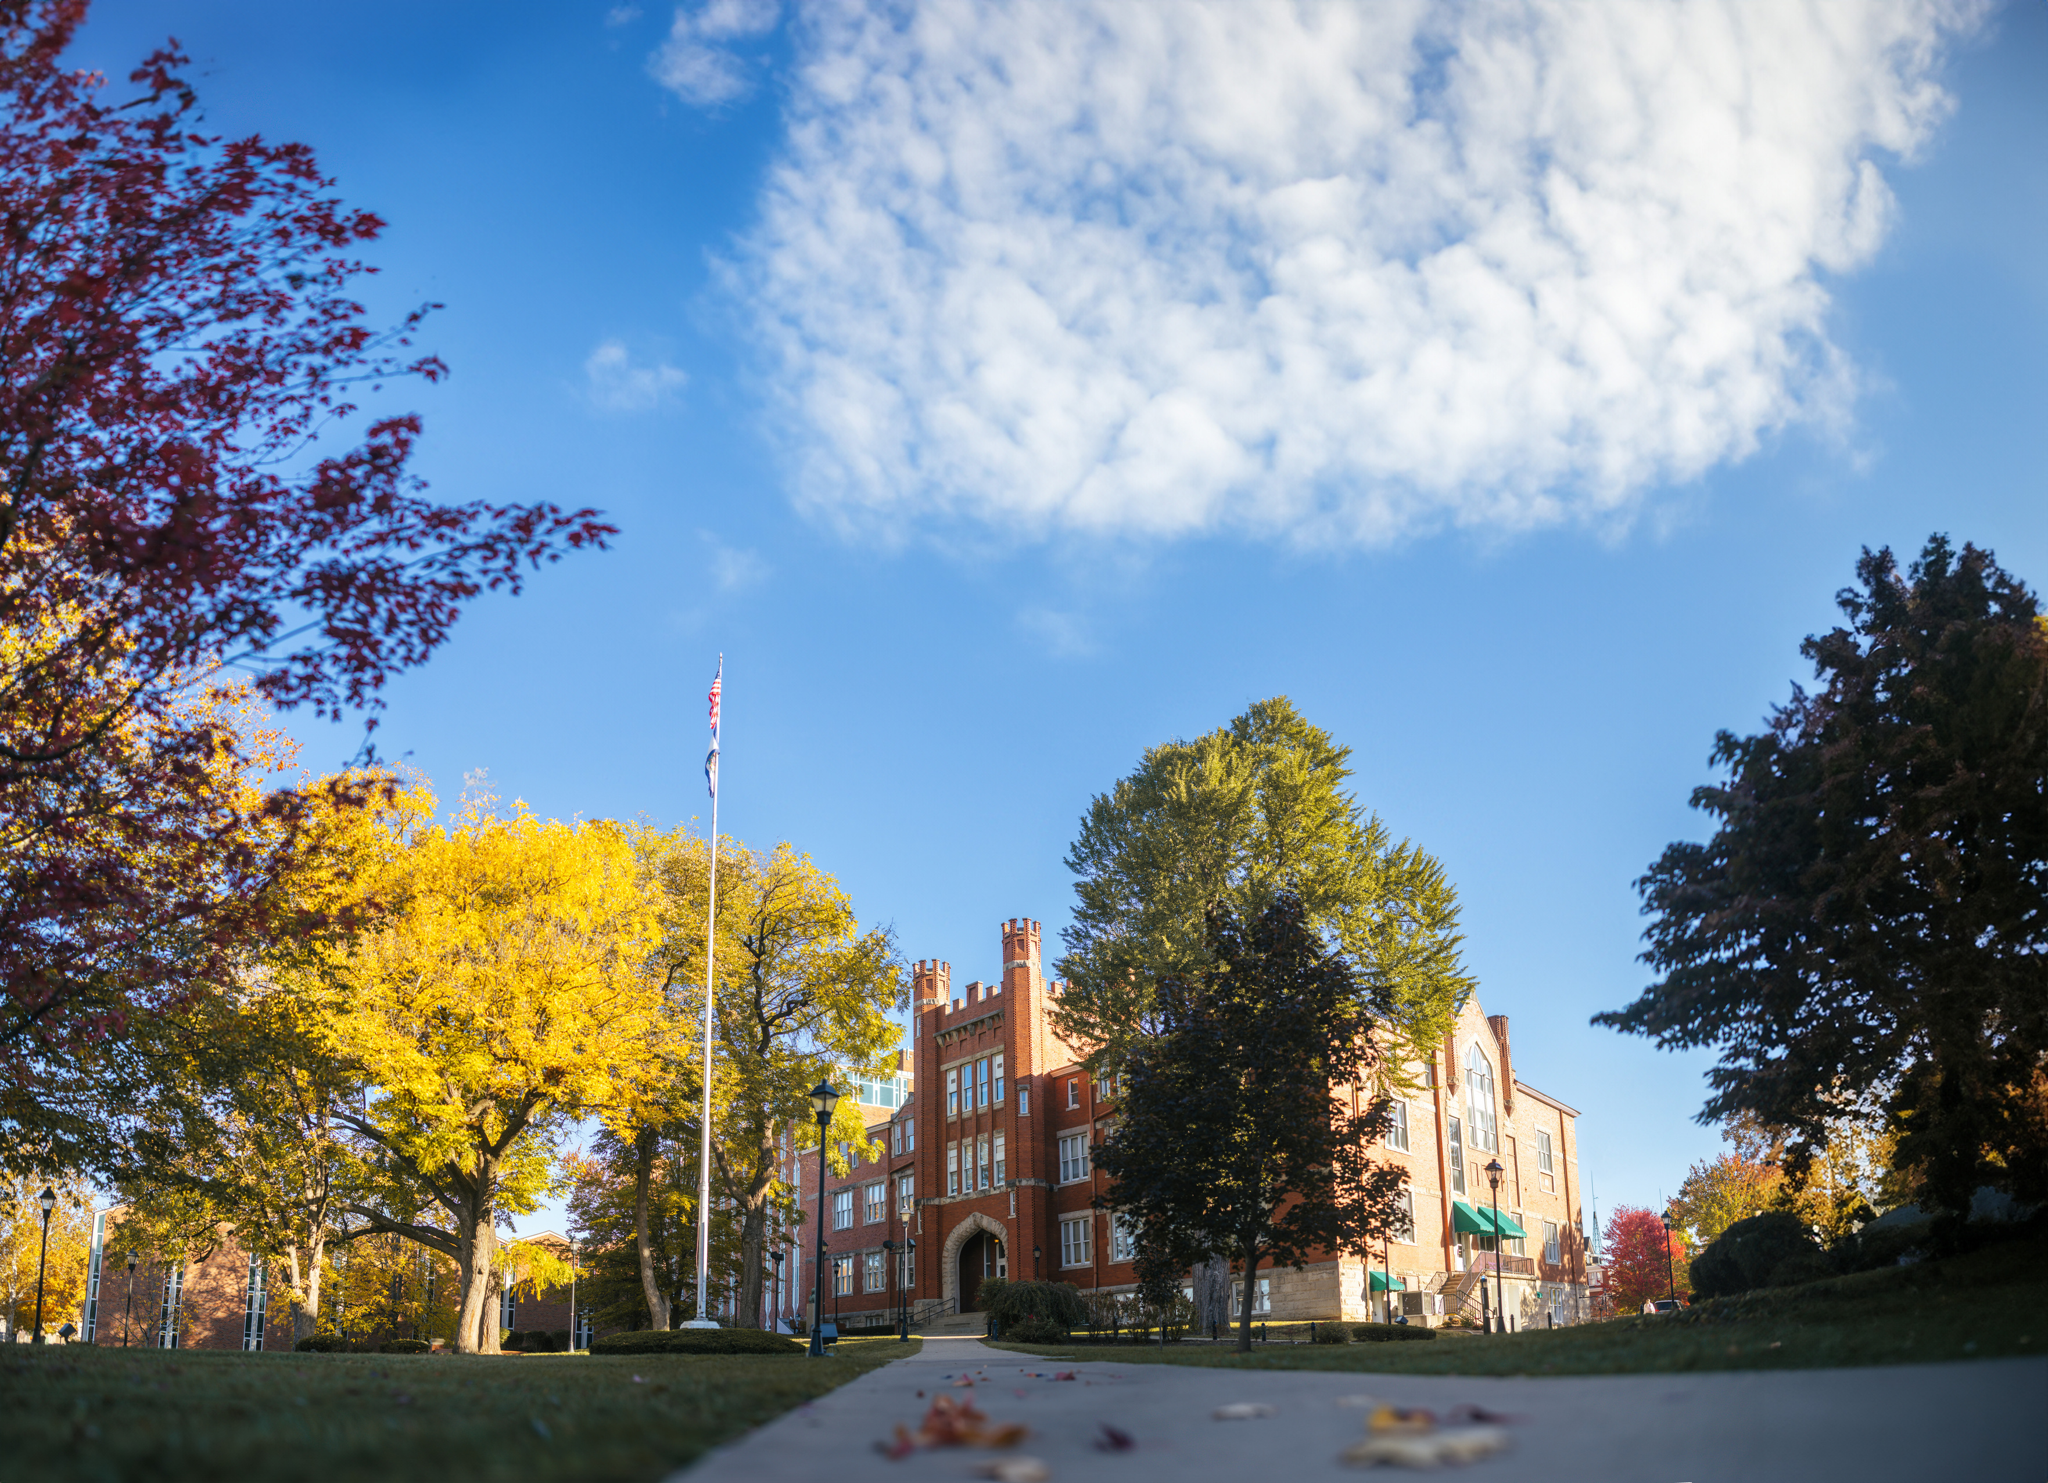

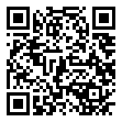
POST-AWARD/COMPLIANCE SERVICES
The MURC Post-Award/Compliance Team is dedicated to supporting and managing the financial and administrative aspects of research projects after they have been awarded. Our services encompass a range of crucial functions to ensure the successful execution of research grants and contracts.
OUR SERVICES
  Guide principal investigators in the administration of funded projects in compliance with sponsor, university, and regulatory agency guidelines.
  Serve as the fiscal agent for all grants/contracts on behalf of Marshall University.
  Provide personnel and payroll services for grant-funded positions.
Contact Us:
MURC_Compliance@marshall.edu
www.marshall.edu/murc/post-award-services/

Slide 5
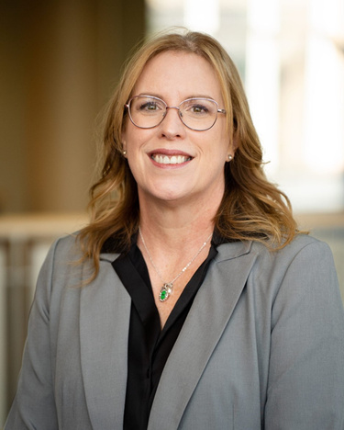
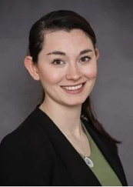
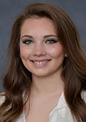


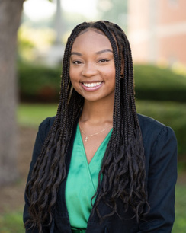

POST-AWARD/COMPLIANCE Team
Jennifer Wood,
Associate Vice President for Finance and Compliance
wood@marshall.edu
Rebecca Hill,
Senior Grants Compliance Administrator
& Purchasing Card Coordinator
hill286@marshall.edu
Kayla Perry,
Grants Compliance
Administrator
starcher41@marshall.edu
Sydney Hunter,
Grants Compliance
Administrator
hunter161@marshall.edu
Mary Glen Rice,
Grants Compliance
Administrator
rice139@marshall.edu
Cyrah Moore,
Associate Grants Compliance Administrator
moore875@marshall.edu
Kristen Webb,
Contract & Subaward Compliance Administrator
kristen.webb@marshall.edu
Find your Department’s Officer at www.marshall.edu/murc/post-award-services/

Slide 6
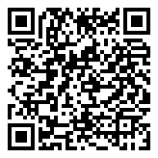
FINANCIAL ADMINISTRATION OFFICE
At the Financial Administration Office at MURC, we are dedicated to supporting Principal Investigators (PIs) in managing the financial and administrative aspects of their research projects. We want to ensure that your project remains compliant with institutional and sponsor guidelines, allowing you to focus on your research with confidence and peace of mind.
OUR SERVICES
  Accounting: Handle all financial transactions for grants, ensuring compliance.
  Accounts Payable: Process and manage payments for grant-related expenses.
  Travel Reimbursement: Manage reimbursement for grant-related travel expenses.
  Accounts Receivable: Track and manage incoming grant funds.
  Financial Reporting: Prepare and submit financial reports for sponsors.
  Property/Inventory Records: Maintain and track grant-funded property and inventory.
Contact Us:
MURC_Accounts_Payable@marshall.edu
www.marshall.edu/murc/post-award-services/financial-administration/
MURC_Compliance@marshall.edu

Slide 7

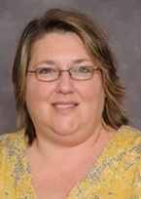
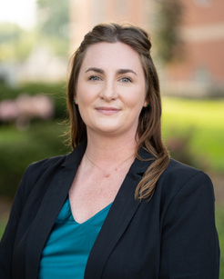
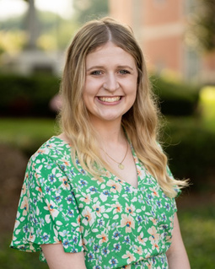
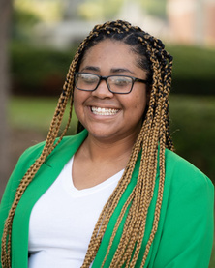
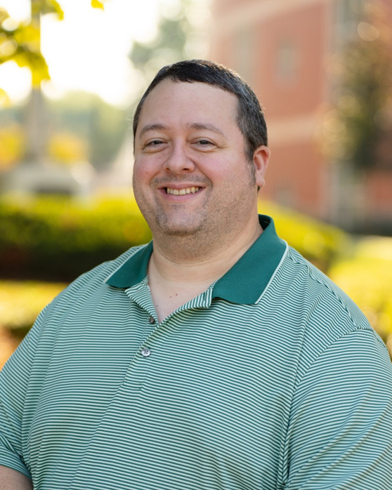
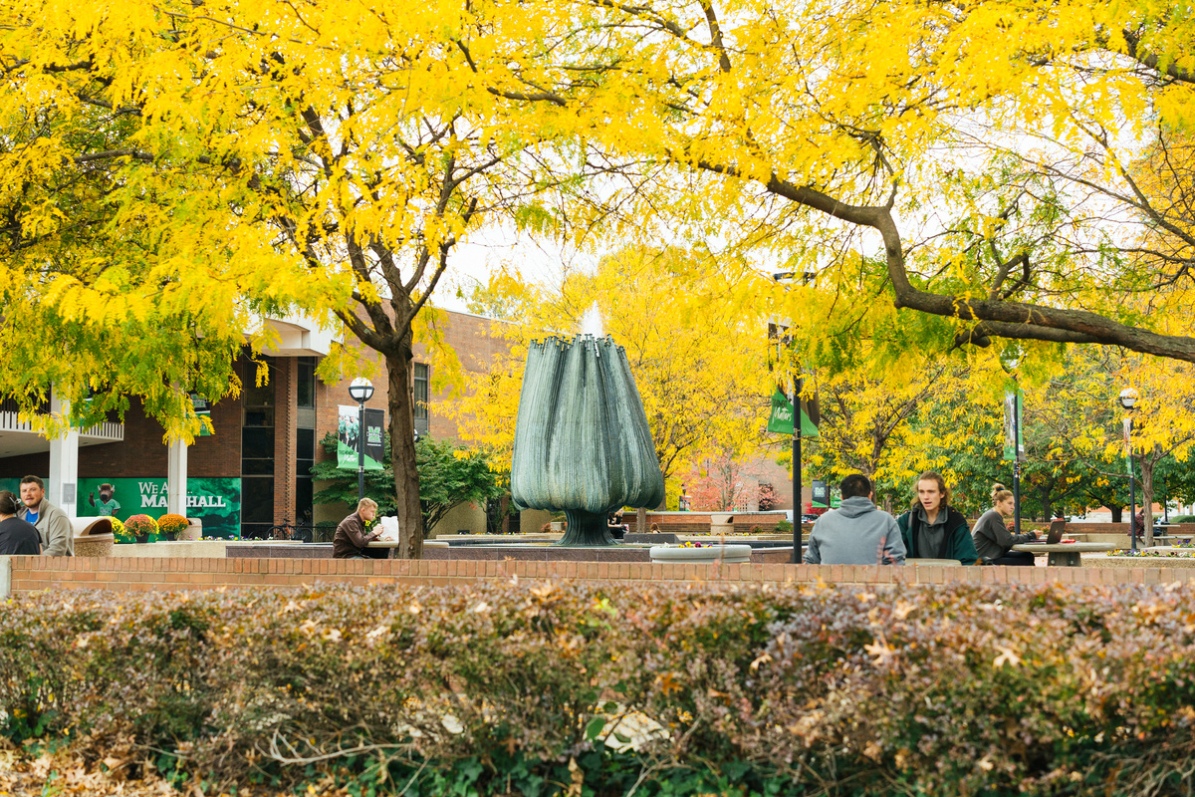

FINANCIAL ADMINISTRATION Team
Jennifer Wood,
Associate Vice President for Finance and Compliance
wood@marshall.edu
Kristen Martin,
Senior Financial Officer
martinkr@marshall.edu
Tina Dean,
Assoc. Director of A/R
& Financial Reporting
dean22@marshall.edu
Melissa Hall,
Grants Accountant
hall183@marshall.edu
Photo Coming Soon
Ashlyn Christian,
Grants Accountant
ashlyn.christian@marshall.edu
Amara Ross,
Associate Grants Accountant
ross358@marshall.edu
Bradley Smith,
Senior Financial Analyst
smithbra@marshall.edu
Katherine Chaffin,
Accountant
waddell@marshall.edu

Slide 8
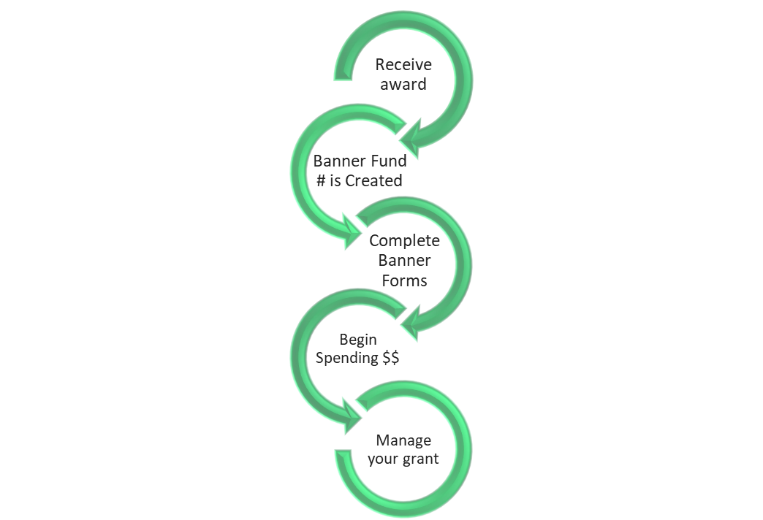
Post-Award
Process
Overview

Slide 9
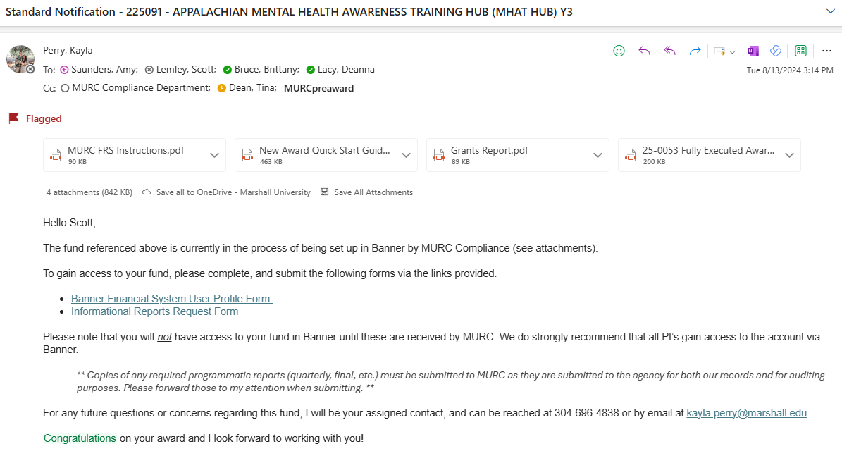
Standard Notification: Banner Fund Number
Once you receive an award, your MURC Grants Compliance Administrator will email you your new Banner Fund number.
FUND NUMBER - NAME OF PROJECT
Also included in the email:
  Banner Finance Privilege Request Form
  MURC Informational Reports Form
  New Award Quick Start Guide

Slide 10

Getting Started
To obtain access to Banner you need:
1. If you are a first-time Banner user: Complete the Banner Basic Navigation Course.
    This is a virtual training.
    After you have completed Banner Navigation, you have to complete the required document here. Be sure to follow directions for appropriate signatures.
2. Anytime you get a new fund this step needs to be completed: Complete the Banner Privilege Request Form here.
    This is a dynamic form that will be routed to your supervisor for approval.
    You will need the fund number, org, and PI email.
    Once you sign it will be routed for signature and approval.
3. Those working remotely: The Virtual Private Network (VPN) service is required to connect you to the Marshall University Network (MUNet). This is needed to access:
    Banner-related services not available thru myMU (e.g. Banner Production and Pre-prod environments)
    Network Shares
    Internal SharePoint sites
    Remote Desktop Access to a computer or server
To access and view installation instructions visit the VPN page here. For any issues with installation contact IT at itservicedesk@marshall.edu or 304-696-3200
It is also recommended to obtain access to MURC Informational Reports. This allows you to view payroll and P-card information. Payroll is helpful during grant reporting. This form is provided by your assigned Post-Award Officer during fund set-up. You can also access here.
Notes:
If you are not an existing banner user, you must get a banner account established first before you can request access to your fund in banner. To do this you will complete banner basic navigation rainining which is an online course through MU IT. After the training is completed, you will complete the form linked here and submit to MU IT.

Slide 11


Banner Access: New User
MU Banner Trainings
MU Access
Form
New User Set Up
http://www.marshall.edu/human-resources/training/training-schedule/banner-basic-navigation/
Notes:
If you are not an existing banner user, you must get a banner account established first before you can request access to your fund in banner

Slide 12
New Award Quick Start Guide

Slide 13







Spending Award Funds
MURC Purchase Card (Pcard)
Travel
Encumbrance/Requisition
PAR Forms

Slide 14
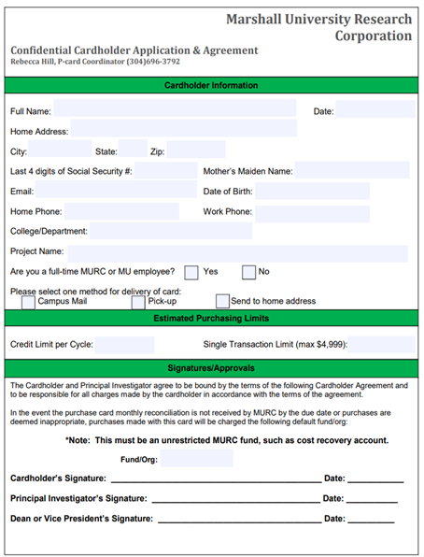
PCARD: Purchasing Card
  To make small purchases throughout your award, you can apply for a MURC PCARD.
  You must be a full-time MURC or MU employee to be a PCARD holder.
  MURC Pcard Application

Slide 15

PCARD: Processing Time
Cardholder submits signed Application & Agreement to MURC
MURC receives and reviews application for completion & eligibility
MURC contacts applicant for training
MURC issues new card to
P-Cardholder
P-Cardholder activates card

Slide 16
Travel Authorization
Complete before the trip:
The Travel Authorization/Direct Bill Request Form must be submitted and approved in advance for all out-of-state, overnight, and international travel, as well as for any expenses of the trip to be directly billed to MURC by way of invoice or charged to the MURC P-Card. Travel Authorization/Direct Bill Request Form was updated on 6/5/2024, please make sure to use the new form.
1
Complete a MURC Travel Authorization/Direct Bill Request Form and attach any relevant documents for the trip such as a map, agenda, hotel reservation, plane ticket, car rental reservation, etc.
2
Send to PI for approval and signature. The traveler only needs to sign if a cash advance is being requested.
3
Once signed, create an encumbrance (FGAENCB) in Banner. This encumbrance number will be noted on the Travel Authorization/Direct Bill Request Form and your P-Card reconciliation at the end of the month.
4
Submit the form to Bradley Smith for MURC approval and processing. Travel requests should be submitted to Bradley 10 days before your trip, or 30 days in advance if you need a cash advance. Keep these documents for your records, as you will need the encumbrance number to complete the MURC Travel Settlement Form upon your return.

Slide 17

Things to know: Travel Authorization/Direct Bill Request Form
Travel Authorization must be approved by MURC prior to using your PCard.
MURC allows the use of third-party booking sites
We are tax exempt, make sure to take a paper copy of the tax exempt form to provide to the hotel.
For Enterprise car rentals: Marshall University has a discount code that needs to be used. Code: #XZ687MU
If meals are not being provided, use the GSA Rates found here. Meals are not provided for single day travel. The GSA rate sheet must be included with your travel authorization, this included WV.
NOTE: If breakfast is provided by the hotel and not the conference; it does not need to be counted in the per diem amount.
You can only receive a cash advance for meals, tolls, taxis, & misc. costs prior to the trip. This does not apply to mileage. Receipts must be turned in for all cash advanced expenditures. Unused cash advance amounts will need to be returned to MURC.
When submitting the Travel Authorization/Direct Bill Request Form, please include all travel documents in a single combined PDF and make sure you have obtained all necessary signatures.

Slide 18
Travel Settlement
After the trip:
Staff are responsible for submitting for reimbursement a Travel Settlement Form with all required attachments to qualify for reimbursement of expenses. The Travel Settlement Form with the required documentation must be submitted to MURC within ten (10) business days following the last day of the approved travel.
1
Prepare a MURC Travel Settlement Form for all travel expenses and reference the encumbrance number obtained from the Travel Authorization/Direct Bill Request Form that was previously submitted by Bradley.
2
Attach all required original receipts to the Travel Settlement Form. Copies of receipts for all MURC P-Card transactions must be submitted with the monthly PCard reconciliation in accordance with P-Card policies and procedures.
3
The traveler will sign and send it to PI for approval and signature.
4
Once signed submit the form to Bradley Smith for MURC approval and processing.

Slide 19
Things to know: Travel Settlement Form
The Travel Settlement Form with required documentation must be submitted to MURC within ten (10) business days following the last day of the approved travel.
When submitting the Travel Settlement Form, please make sure you are using a new form. Often forms are being reused with an encumbrance number from a previous trip.
The encumbrance number on the Travel Settlement Form must match the one listed on the Travel Authorization/Direct Bill Request Form that was previously submitted.
The miles listed in the Google Maps directions must match the "to" and "from" addresses specified on the form to verify the mileage. The travel office will not accept round trips starting and ending at home.
Per diem must be itemized daily, excluding any provided meals. Please include the GSA per diem rate sheet.
NOTE: If breakfast is provided by the hotel and not the conference; it does not need to be counted in the per diem amount.
When listing your lodging expenses, you can provide the total sum on the first or last day rather than breaking it down by daily expenses.
Entries in the "other" column must be explained in the "other expenses" section at the bottom left. This includes items paid by p-card or a personal card.
Subtract any expenses paid by the P-card (non-reimbursable) under the "Direct Billed Expenses" section. If paid by another individual's P-card, please make a note here.
The MURC Travel Settlement Form must be signed by the traveler and the PI or approved project director. If the traveler is the PI/PD, the applicable supervisor should sign

Slide 20
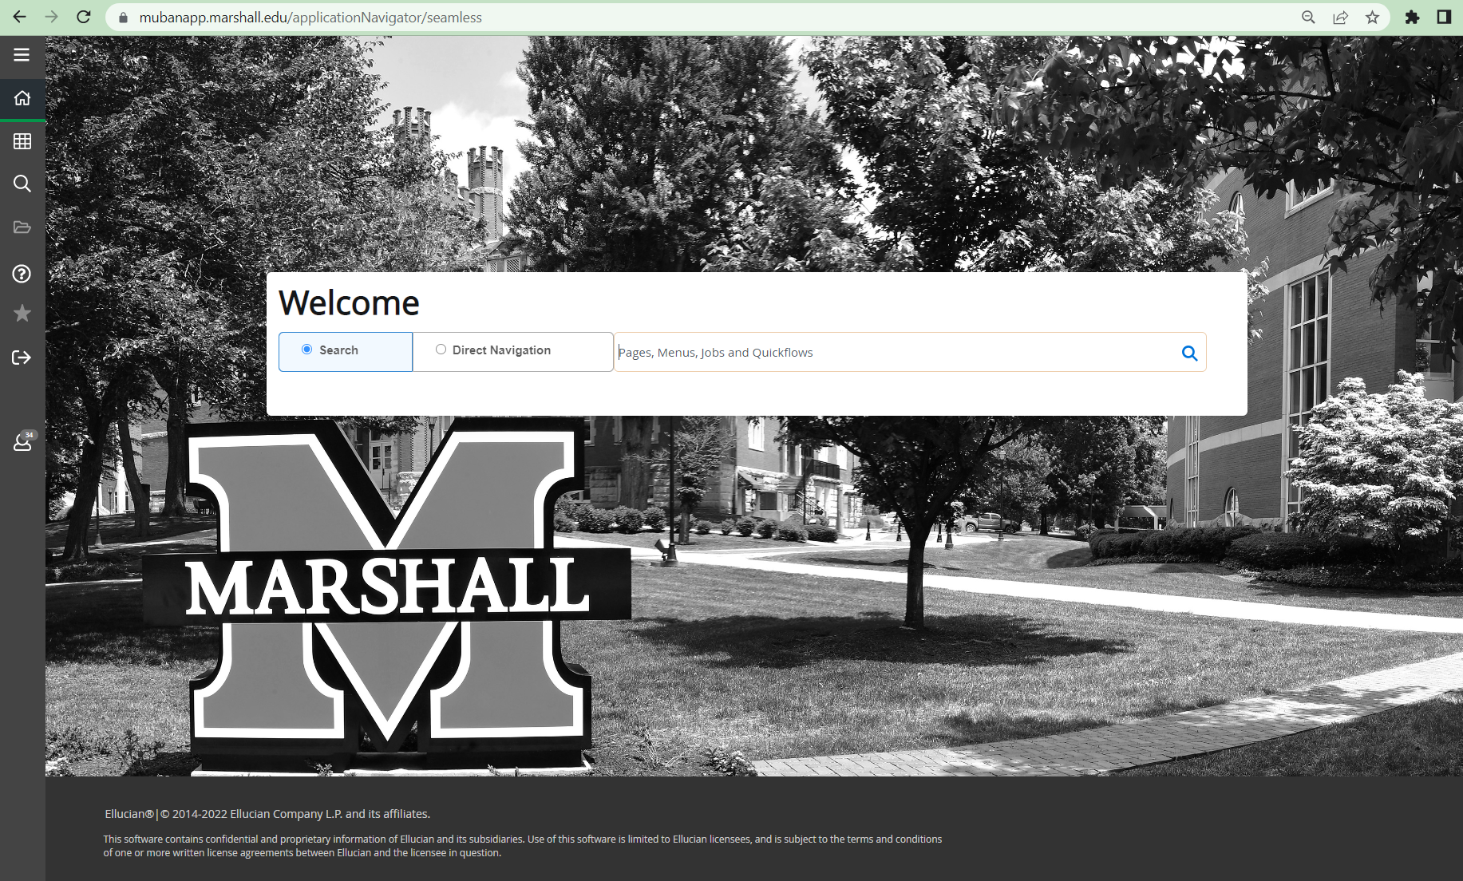
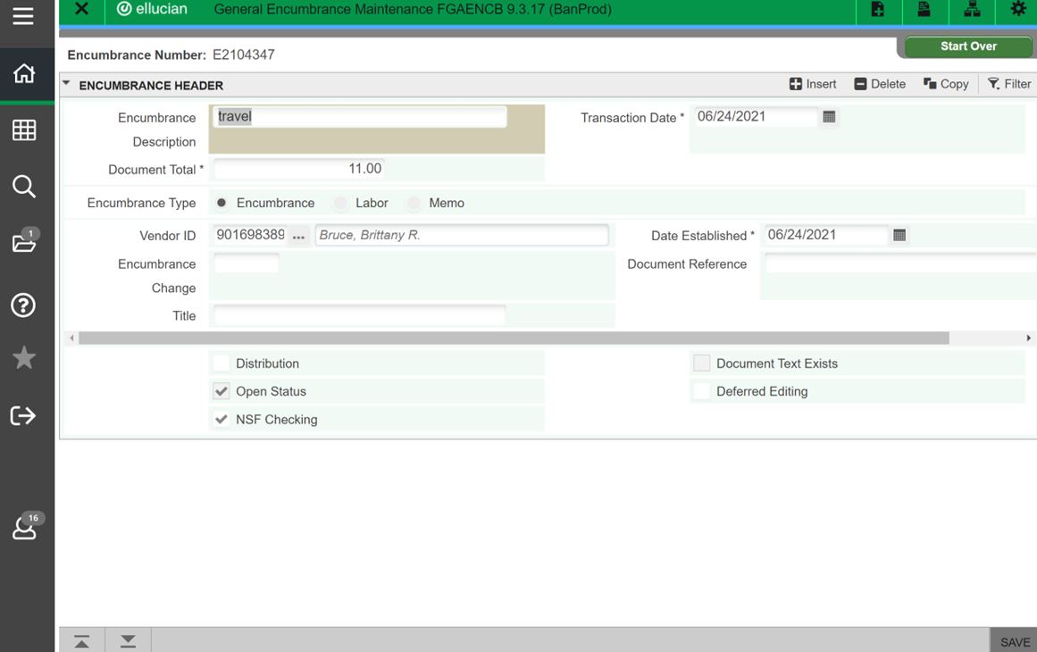
Creating an Encumbrance in Banner
What is a encumbrance?
Encumbrances are used to make payments in banner for all travel and for expenses that are ineligible for pcard purchase.
On the next screen type NEXT in the Encumbrance Number box. Then hit GO or use Alt Page Down.
FGAENCB
Input the following on this screen:
  Encumbrance Description: Type in a description of the encumbrance for example travel or office supplies
  Document Total: This will be the total listed on the travel settlement form or invoice
  Vender ID: This will be the travelers 901/903 number. You can click the three dots to search my name if you do not have the 901/903 number.
This is the only information needed on this screen. Hit GO or use Alt Page Down.
After the encumbrance is complete, it will need approved in the department queue in screen FOAUAPP

Slide 21
Travel Contact
Bradley Smith,
Senior Financial Analyst
smithbra@marshall.edu

Slide 22
Setting up a vendor
Determine if the vendor has been set up by using the FTIIDEN screen in Banner.
If not set up in Banner:
Vendor already in system: check address
Email the vendor and provide them with this link to complete registration to get set up in the Banner payment system.
It is the PI/PD responsibility to check back in Banner to see if the vendor has been set up.
Use the screen FTMVEND to view the vendor's address. You want to make sure that the address on the hotel agreement matches what is listed in Banner. See instructions on how to use screen FTMVEND here.
If you need to update vendor information, such as their address, please email Kim Fry, and she will handle the update. Do not submit a new Dynamic Form for an existing vendor.

Slide 23
Invoice Payment: Orders over 5k
Please follow the MURC Purchasing Guidelines for requisitions.
Order > $4,999
or if quote has terms and conditions
Must create a Requisition
Use Banner Screen FPAREQN

Slide 24
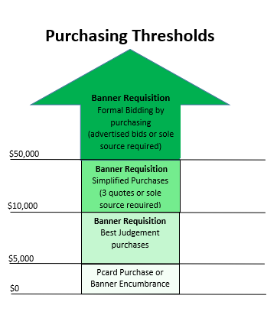
Invoicing: Orders over 5k
Please follow the MURC Purchasing Guidelines for requisitions.

Slide 25
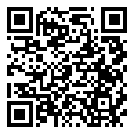
HUMAN RESOURCES / PAYROLL OFFICE
The Human Resources and Payroll Office is your central hub for all personnel-related needs, offering comprehensive support to ensure your experience is seamless and efficient. From managing payroll and benefits to onboarding, we are here to guide you through every aspect of your employment journey. If you need assistance with day-to-day HR matters, our team is dedicated to providing timely, accurate, and personalized service.
HR SERVICES
PAYROLL SERVICES
  Benefits
  Employee Relations
  Job Performance Consultation
  Policy Creation or Implementation
  Salary Employee Onboarding
  Modified Work Schedules/Telecommuting
  Workplace Injuries
  Medical Accommodations/ADA
  FMLA
  Grievance Process
  Salary Employee Terminations
  Payroll Processing
  Hourly/Student Onboarding
  Annual/Sick Leave
  Personnel Action Requests
  Hourly & Salary Timesheets
  Employment Verifications
  Affordable Care Act
  Child Support Verifications
  Garnishments
Learn more:
https://www.marshall.edu/murc/human-resources-payroll-office/

Slide 26
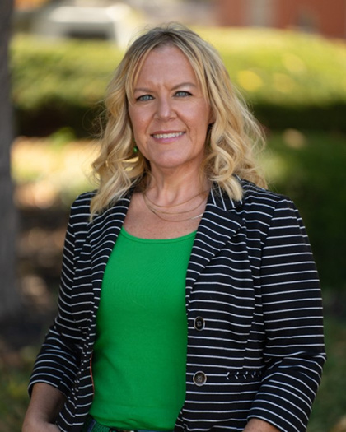
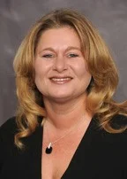
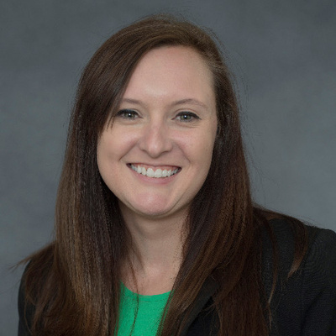
HUMAN RESOURCES / PAYROLL OFFICE Team
Coria Kent,
Human Resources Coordinator
kent1@marshall.edu
Tammy Brumbaugh,
Senior Payroll Administrator
brumbaught@marshall.edu
Alisha Harbour,
Payroll Accountant
owens24@marshall.edu

Slide 27
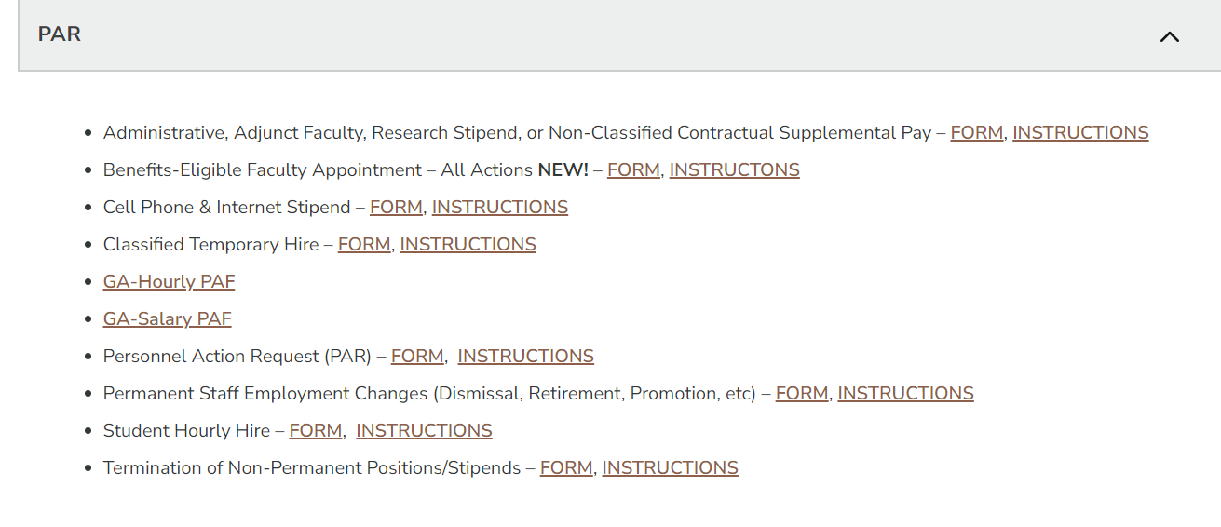
PAR: Personnel Action Request - MU
If you are hiring someone already employed by MU, you will need to complete a MU PAR to capture the MURC supported effort.
PARs must be initiated at the department level by the PI or assigned department administrator
MU PAR forms are located on the MUHR website under the PAR section: https://www.marshall.edu/human-resources/forms-2/
For assistance filling out MU PARs, please contact Marshall’s HR department. Located in 207 Old Main or by phone at (304) 696-6455.

Slide 28
PAR: Personnel Action Request - MURC
PARs must be completed to pay employees from MURC funds. MURC PARs are completed on dynamic forms (see below links).
  Personnel Action Request (PAR) Dynamic Form for salaried employees and
  Personnel Action Request (PAR) Dynamic Form for hourly employees
  These can before found on the form section of the MURC website under Human Resources/Payroll.
PARs are created by the Principal Investigators and submitted to MURC.
Compliance will approve them based on award terms.
Once approved we forward on to the MURC Payroll Administrator.

Slide 29
Manage your Grant
These are all resources to assist you in tracking your spending in accordance with your awarded budget.
MURC Reports System
Informational Reports Request Form
Monthly Financial Reports
MURC FRS SYSTEM
Banner Screens
FGIBAVL, FGIBDST

Slide 30
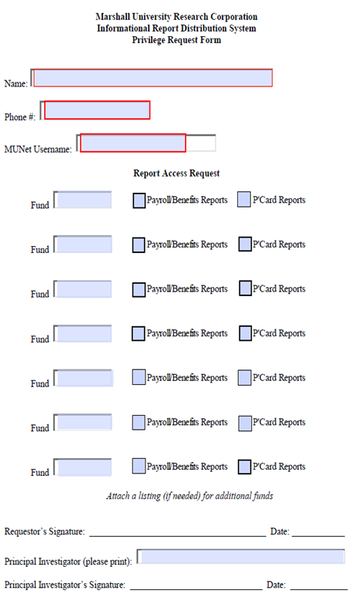
MURC Reports System
  This form is attached in the original email notification you will receive with your Banner fund number.
  Send this completed form to Jennifer Wood at MURC.

Slide 31
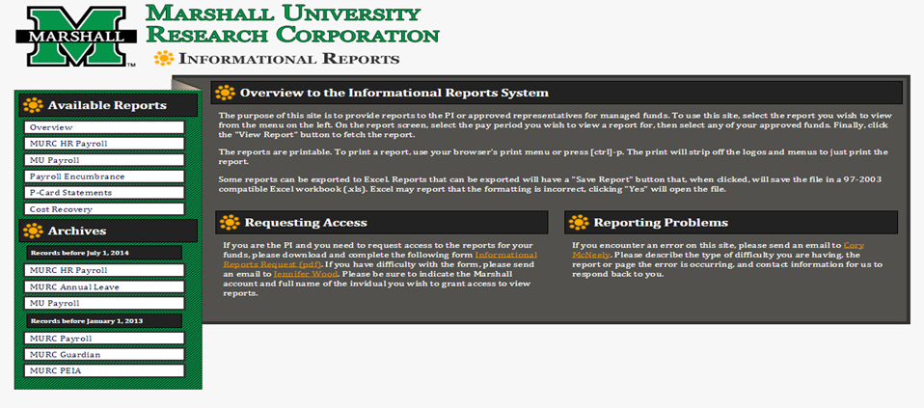
MURC Reports System
MURC Reports System

Slide 32
Monthly Financial Reports (MURC FRS System)
  All Summary & Detail Transaction Reports are available via the MURC FRS System.
  The Principal Investigator, Co-PI, and anyone they designate to copy reports can access these monthly reports.
  You must review this information and advise MURC Compliance of any errors to ensure accurate financial reporting and billing to the Agency. If anything is incorrect or you have questions about the reports, please contact your MURC Compliance Officer,
  The system is located here: MURC FRS

Slide 33
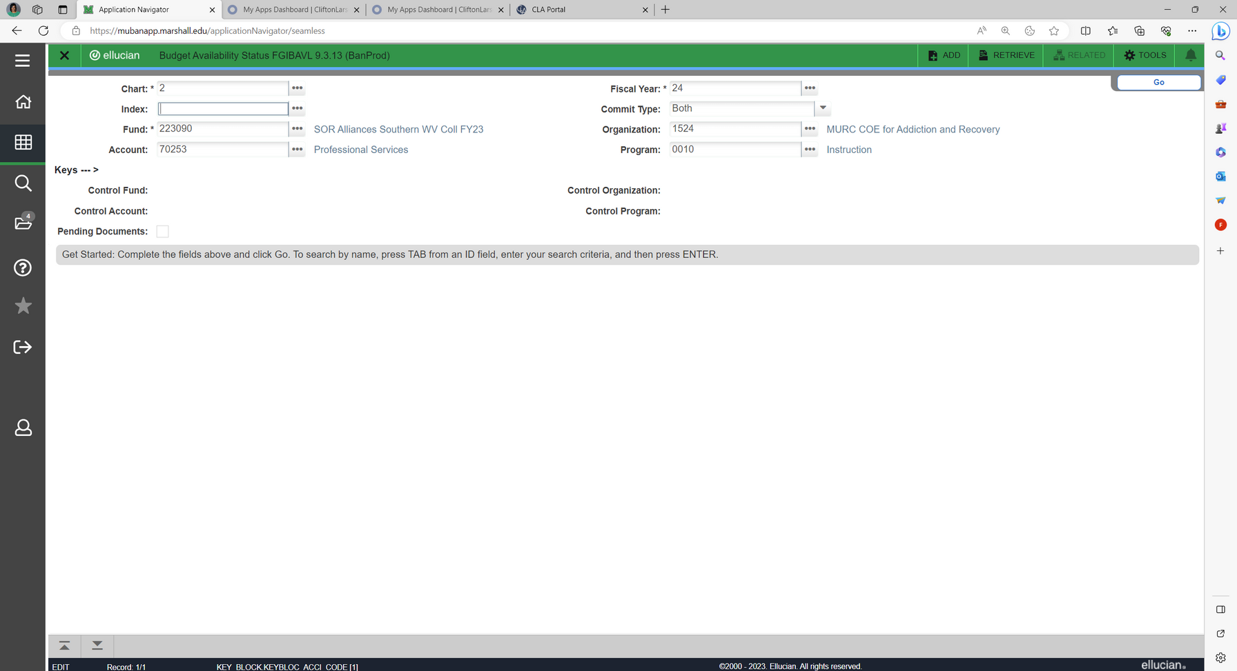

Banner Screen FGIBAVL:
Check Account Availability
Use Banner Screen FGIBAVL
This screen will show the available balance as of today
This is a real-time balance with the expectation of the below.
    MU Payroll
    P-Card Expenses – This is uploaded on the 10th -15th of the following month. Example: October P-Card won’t be reflected until November 10th-15th
    Indirect costs for the month in question
Fill in:
  Chart: 2
  Fund: Put the fund number you are inquiring about here.
  Account: 601
  Fiscal Year: Current fiscal year unless want to look at past fund availability.
  Commit Type: Both
  Hit Go or Alt Page Down as a shortcut

Slide 34
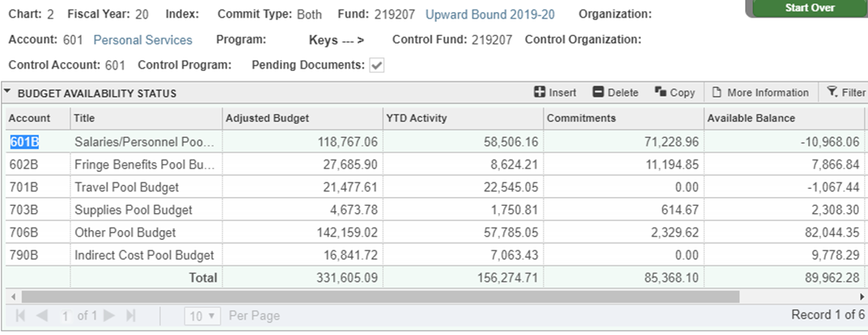
Screen FGIBAVL: What does it mean?
This screen is viewed by fiscal year
  Adjusted Balance: What is available in the account as of June 30. Commitments are included in the total.
  YTD Activity: Any expenses since the beginning of the year.
  Commitments: Anything encumbered to the fund but not charged.
    Example: MURC encumbers salary and benefits through the end date of the fiscal year or the end date of the PAR, whichever comes first.
    Example: Contractual Pool Budget is where the money is allocated to the Sub-awardees/Subrecipients. This is where the money is pulled from when an invoice is submitted, and a requisition is created. The entire subaward is encumbered in the commitment column.

Slide 35
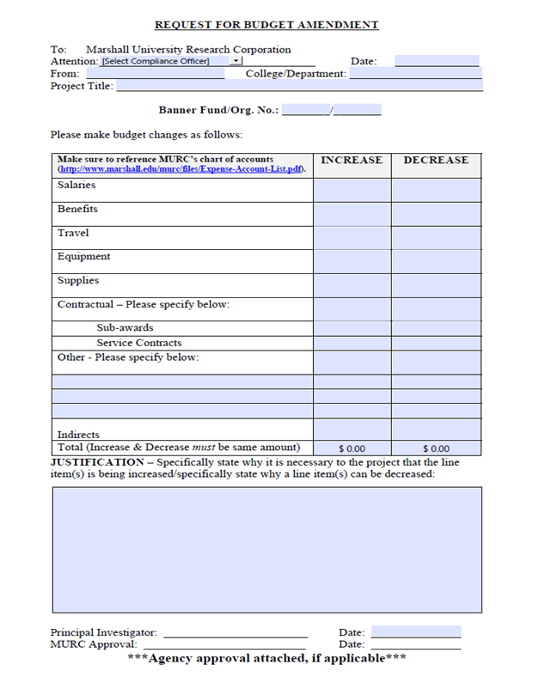
Budget Amendments

Slide 36
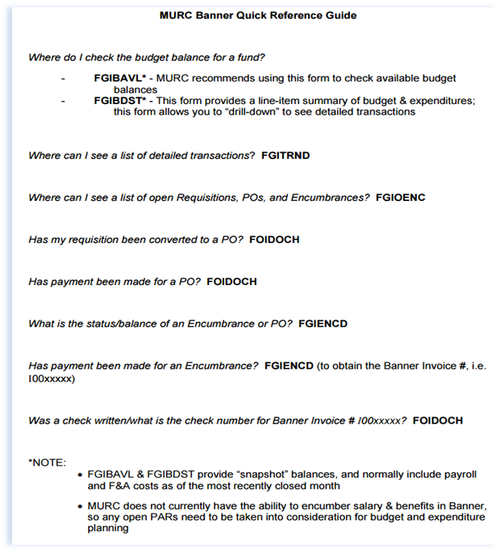
Banner Quick Reference Guide
Banner Quick Reference Guide

Slide 37
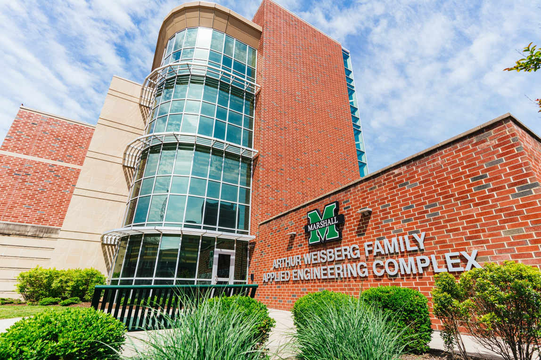
Where to find us on campus
Recruit more doctors.
Our first key focus.
Physical Address:
Fourth Floor, Arthur Weisberg Family Applied Engineering Complex
1676 Third Ave., Huntington, WV 25703
Mailing Address:
One John Marshall Dr.
Huntington, WV 25755-8100
Phone: 304-696-6271
Fax: 304-696-6300
Email: murcpreaward@marshall.edu
Staff Directory: https://www.marshall.edu/murc/our-staff-new/
We look forward to working with you!

Slide 38


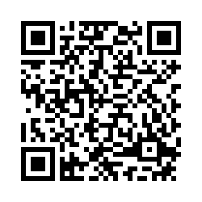



Thank you for your participation!
Your feedback is valuable to us as we aim to improve future training sessions.
Please take a few minutes to complete this survey.
https://marshall.az1.qualtrics.com/jfe/form/SV_4H3jfebbv8W4ZrE
Questions?
304-696-6271
www.marshall.edu/murc

