Slide 1


Purchase Card
Training
Presented by:
MURC Compliance
Notes:
Hello, welcome to the introductory training for the MURC PCard. Today we will be covering the policies, procedures, and use of the MURC PCard. At the end of the training, you will follow a link to a questionnaire where you will answer ten questions about the training you have received. After receiving a score of 100%, we will contact you to release your PCard for use. Should you have any questions or concerns regarding this training, please feel free to contact your Compliance Officer.

Slide 2
APPLICATION TO ACTIVATION
Cardholder submits signed Application & Agreement to MURC
MURC receives and reviews application for completion & eligibility
MURC contacts applicant for training
MURC issues new card to P-Cardholder
P-Cardholder activates card
Notes:
We will begin with a general overview of the application to activation steps. After determining the need for a MURC Pcard, you submitted an application and agreement to MURC for review and approval. We then determined your eligibility, and once you are approved, we place an order for your card and reached out to schedule your training. You will complete this training, and once we have received your questionnaire results, we will contact you about releasing your PCard.

Slide 3


Ordering
Secure Internet Sites Only
Phone
Only items allowable by the Grant (call Compliance if unsure)
Notes:
You are able to order via online and telephone with your MURC PCard. When placing an order online with your PCard we ask that you purchase via secure internet sites only, making sure there is a secure lock in the top of your browser. Please make sure that you are only purchasing items that are allowable by the Grant in which you are purchasing for. If you are ever unsure of the allowability of a purchase, please contact your Compliance Officer.

Slide 4
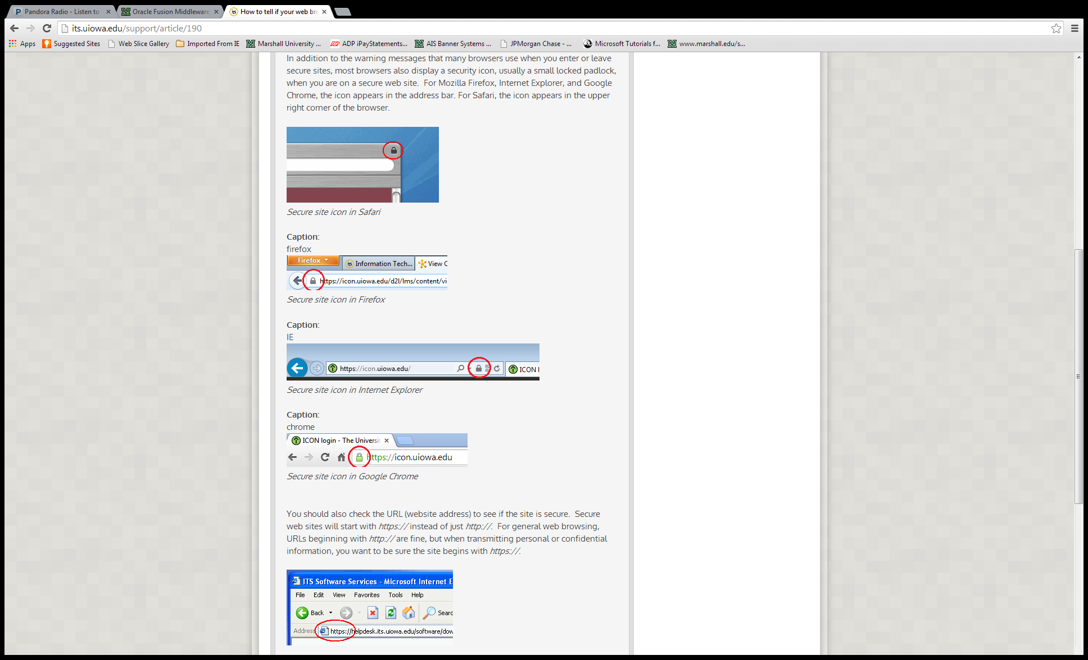
PURCHASING FROM SECURE WEBSITES
Most browsers display a security icon, usually a small locked padlock. For Mozilla Firefox, Internet Explorer, and Google Chrome, the icon appears in the address bar. For Safari, the icon appears in the upper right corner of the browser.
You should also check the URL (website address) to see if the site is secure. It will start with https:// instead of http://
Notes:
Below are examples of where the security lock may be placed in your browser when purchasing online.

Slide 5
What is the Default fund?
It is the fund identified on your application. Any purchases charged to the card that cannot be paid by the Grant or are not sufficiently documented must be charged to the default fund. This is typically a cost recovery account.
Notes:
As you become more familiar with MURC and the terms used for grants and contracts within MURC, you will hear terms such as “default fund”, “cost recovery”, and “ICR”. These all reference the same thing. This is an unrestricted account that is used for purchases for the department/college, taxes that are unallowable on the grant, defaulted PCard charges, or charges that are unallowable on a grant. For the purposes of the PCard, any purchases charged to the grant that are unallowable, charges in which receipts are missing, or charges for which the grant does not have sufficient funding, will be charged to the default fund.

Slide 6
Restricted Items
Alcoholic Beverages
Cash Advances
Legal Services
Firearms
Capital Equipment(=>$5,000)
Radioactive Materials
Live Animals
Insurance
Tax Reportable Services
Telephone/Cell Phone Services
Gas for personal vehicle and meals for travel
Building Leases
Utilities
Contracts (other than Statewide)
Flowers or Gifts
Notes:
Below is a list of the restricted items in relation to the PCard. Please note the bullet for Capital Equipment. Anything $5,000 and over is unallowable on your MURC PCard, and the purchase will need to be routed through the Purchasing Office. The intention of the PCard is to use for smaller purchases that you need quickly that do not have terms and conditions or a contract associated with them. Another important note to make about the restrictions are contracts. Contracts are always routed through the Purchasing Office and often require additional documentation that cannot be provided via a PCard. Please note that if there is ever a deposit required for a contract, such as a hotel conference room rental, the deposit cannot be made with your PCard. It must be included in the requisition for the contract itself, and MURC will pay the deposit via check directly to the vendor.

Slide 7
Sales/Use Tax
MURC is exempt from sales and use tax
Tax ID Number on Card
Keep extra copies of Tax-Exempt Certificate
Sign up for Amazon Tax Exempt Program
If sales tax gets charged and it is under $5, contact the vendor for reimbursement.
If the sales tax is over $5, please contact the vendor for a refund. If the vendor refuses to reimburse your card, contact the MURC P-Card Coordinator.
Notes:
MURC is sales and use tax exempt in the state of West Virginia. The MURC Tax ID number is printed on the front of your card for convenience, but should a vendor ever request a copy of our certificate, you can contact your Compliance Officer for a copy. If you find yourself needing to purchase from Amazon frequently, they do offer a tax-exempt program, in which you create an account specifically for your MURC PCard where you can enter the tax ID number and it will automatically remove the taxes for your Purchases. Please note that MU does have an agreement with Amazon regarding their MU PCard, but we are not part of that agreement so a separate account may have to be created for the MURC PCard.

Slide 8
Disputed Items Process
Contact Vendor first to see if it can be resolved.
If not, Cardholder must email JP Morgan Chase at ccsColumbusDisputes@Chase.com as well as copying the PCard Coordinator, Rebecca Hill, at hill286@marshall.edu and include an explanation of the fraudulent charge, amount, vendor and date along with the Cardholder’s last four digits of the p-card number.
Disputed Item Payment to Default Fund
Notes:
These next two slides address disputed items and fraudulent charges. In the event that you discover charges that need to be disputed or are fraudulent please contact Chase immediately to inform them.

Slide 9
Immediate notification
Notify the financial institution first via the phone number on the back of your p-card then notify the MURC P-Card Coordinator:
  If card is lost or stolen
  Fraudulent charges
Notify the MURC P-Card Coordinator via email at hill286@marshall.edu immediately in order to:
  To cancel a card
  When cardholder transfers departments
  When cardholder employment has ended
Notes:
Once you’ve contacted Chase, please also contact Rebecca Hill, our PCard Coordinator so that she is aware of the situation. At that time if your card needs to be cancelled and a new one reissued, and she will assist you in that process.

Slide 10
Significant p-card violations
Transactions over $4999
Stringing of payments
Delegation (allowing someone else to use your card)
Personal charges
Contract purchases
Disciplinary Action for Misuse and/or Fraud
  Loss of Privilege
  Termination
  Prosecution by MURC or the granting agency
  Civil action to collect any amounts deemed fraudulent
  Do not store with your personal credit cards. Official MURC use ONLY
Notes:
Listed below are violations associated with the PCard. We kindly ask that you avoid the below listed items. We do understand that mistakes are made, but if they become a recurring issue, we do require a retraining with your Compliance Officer on how to properly use your PCard. Should the violations continue beyond that, you are at risk of losing your PCard privilege. Please note that in regard to stringing payments, this is referring to breaking down a purchase or an invoice to circumvent the $5,000 capital expenditure cap. If a single transaction is more than $4,999 it will be denied, and you will need to purchase it via other methods such as requisition or encumbrance.

Slide 11
End of Project Orders
You are at risk of items being charged to your Default Fund account if used 30 days before end of Project
Items purchased at end of calendar month will not be reflected until next billing cycle and may be omitted from final invoice to agency
It is your responsibility to:
Notify your Compliance Contact immediately
Only order consumable items that will be used prior to the end date of grant
Notes:
As you near the end of your project, we ask that you do not make any purchases within the last 30 days. If purchases are necessary within the last 30 days, we just ask that you email us copies of the invoices and which fund you will be allocating those purchases to. The reasoning for this is so that our invoicing department is able to include them on final invoices, as you won’t be reconciling those charges until the following month. For some of our agencies, that is beyond the due date for the final invoice that is due to them. Emailing us copies ensures that everything is included in our final invoice to be paid.

Slide 12
Account Maintenance
Name Change
Limit Change
Card Termination
Department Transfer
Address Change
Employment
Status
Changes must be submitted to the MURC Purchase Card Coordinator using the Cardholder Maintenance Form found under the forms section
http://muwww-new.marshall.edu/murc/forms/
Notes:
For any changes to your account, such as these listed on account maintenance, please refer to our PCard Maintenance request form.

Slide 13
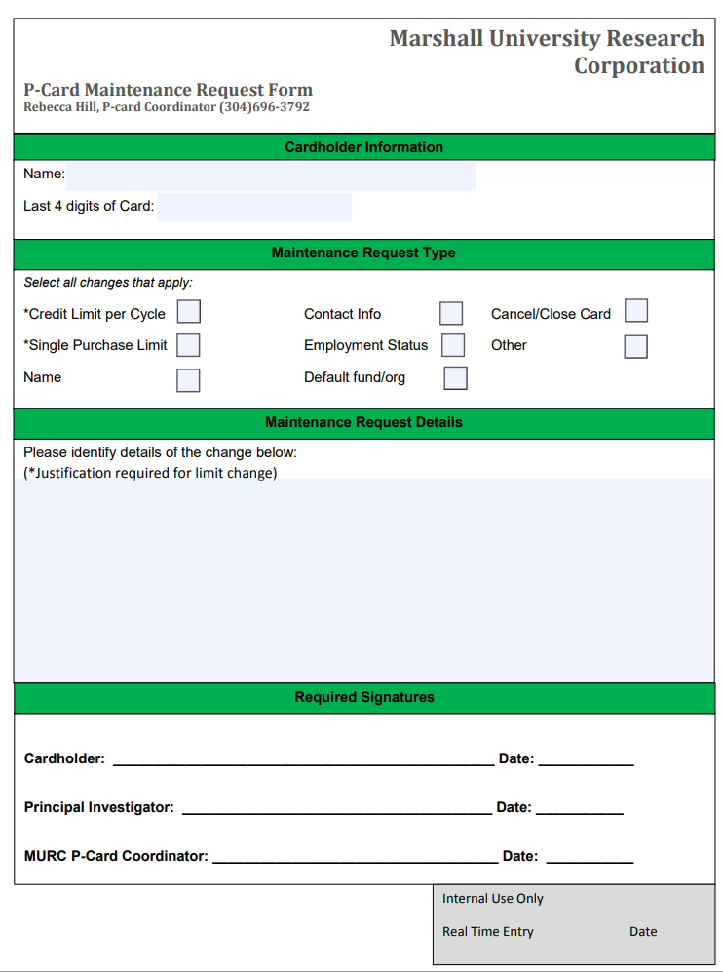
Notes:
This form allows you to make any changes, from increasing your PCard limit monthly, to cancelling your card. Once completed and signed, you can forward directly to our PCard Coordinator, Rebecca Hill, for processing.

Slide 14
Reconciliation process:
Print fillable Reconciliation Form off MURC website
Log into Smart Data Generation 2 (SDG2)
Code your transactions
Schedule and Run Accounting Code Detail Report (ACDR)
Obtain Signatures from appropriate PIs on the ACDR
Scan your receipts. Make sure they are legible.
Assemble your package in this order and email the scanned copy to: MURC_COMPLIANCE@MARSHALL.EDU
Notes:
Each month, if purchases were made, you will complete what we call a PCard Reconciliation. This is essentially a packet of documents that include a cover sheet, report of transactions, and receipts to show for those transactions. The account that you are charging to will be listed on the report so that we are able to identify which grant you are making purchases for, and review for allowability. Once completed, you will email that “packet” to the email address you see below. We will then review your submission, and if we have any questions or concerns, we will reach out to you. If you won’t hear back from us, we have finished processing the reconciliation you sent.

Slide 15
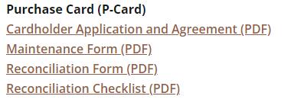
Print reconciliation form
http://muwww-new.marshall.edu/murc/forms/
Notes:
Via our website you will find a reconciliation form link under “forms”. This is the “cover sheet” of your packet. You will use this to include your identifying information, such as your name, the last four digits of your card, the billing cycle, amount spent, and any comments you may have about purchases that you made.

Slide 16
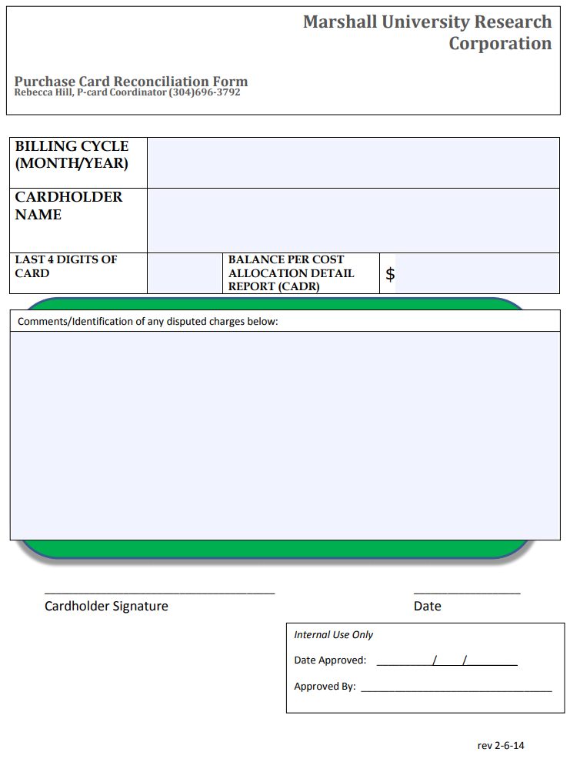
Notes:
This is what the cover page of the reconciliation packet will look like.

Slide 17
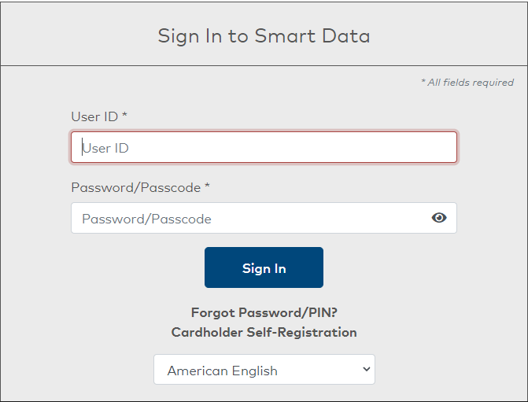
TO LOGIN:
https://smartdata.jpmorgan.com
Only use Internet Explorer as your browser to open Smart Data
Do not use Chrome or Safari browsers
Notes:
When you receive your card, you will need to go into the JP Morgan Chase website and register your new account. You will follow the link included below to complete the registration. Please note that users have been unsuccessful in using the website in certain browsers. It seems we have the most success with Microsoft Edge and Internet Explorer.

Slide 18
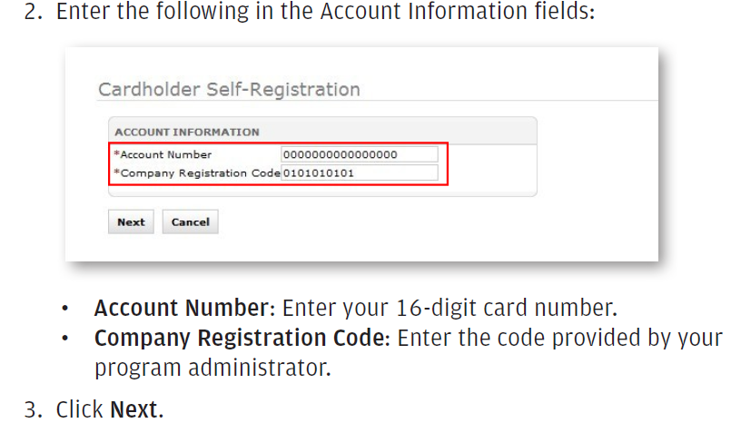
NEW CARDHOLDER SELF REGISTRATION:
MURC Company Registration Code: 1987830
Notes:
For the registration process you will want to enter your account number (card number), and the company registration code included here in the green box. You’ll then select next.

Slide 19
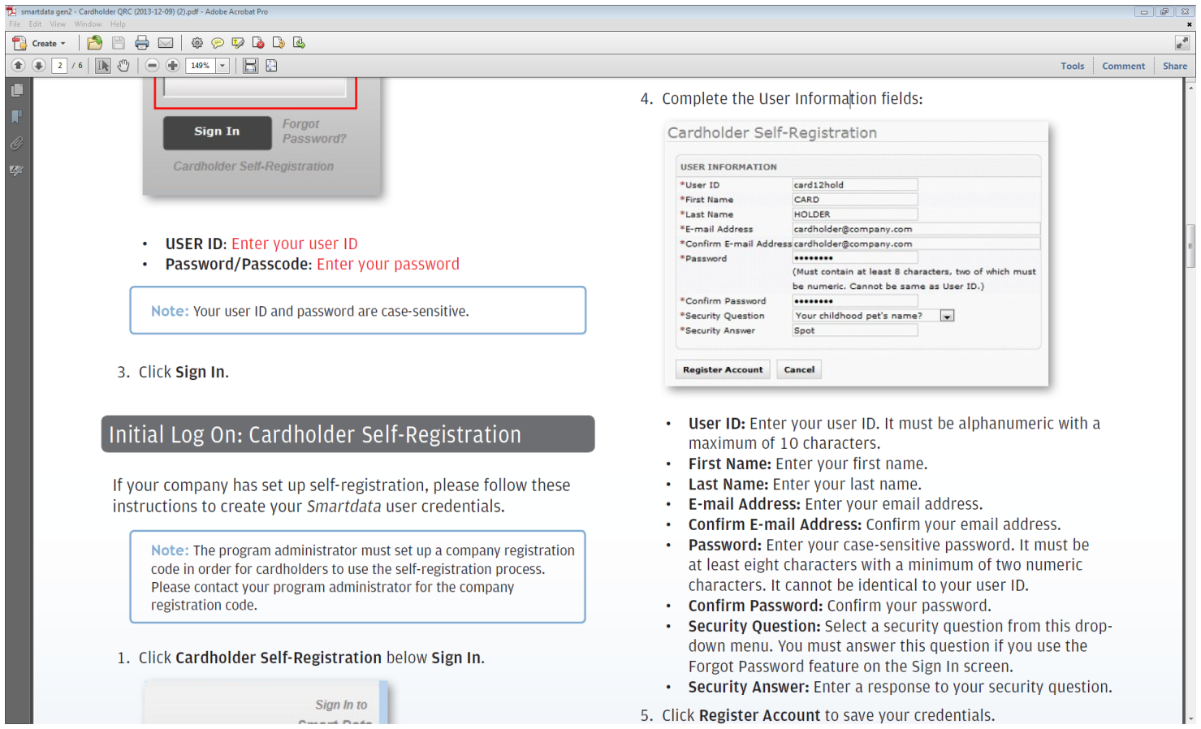
NEW CARDHOLDER SELF REGISTRATION:
Notes:
On the next page, you will enter all of the necessary information, keeping in mind that it is all case sensitive. Upon completion you will select register account.

Slide 20
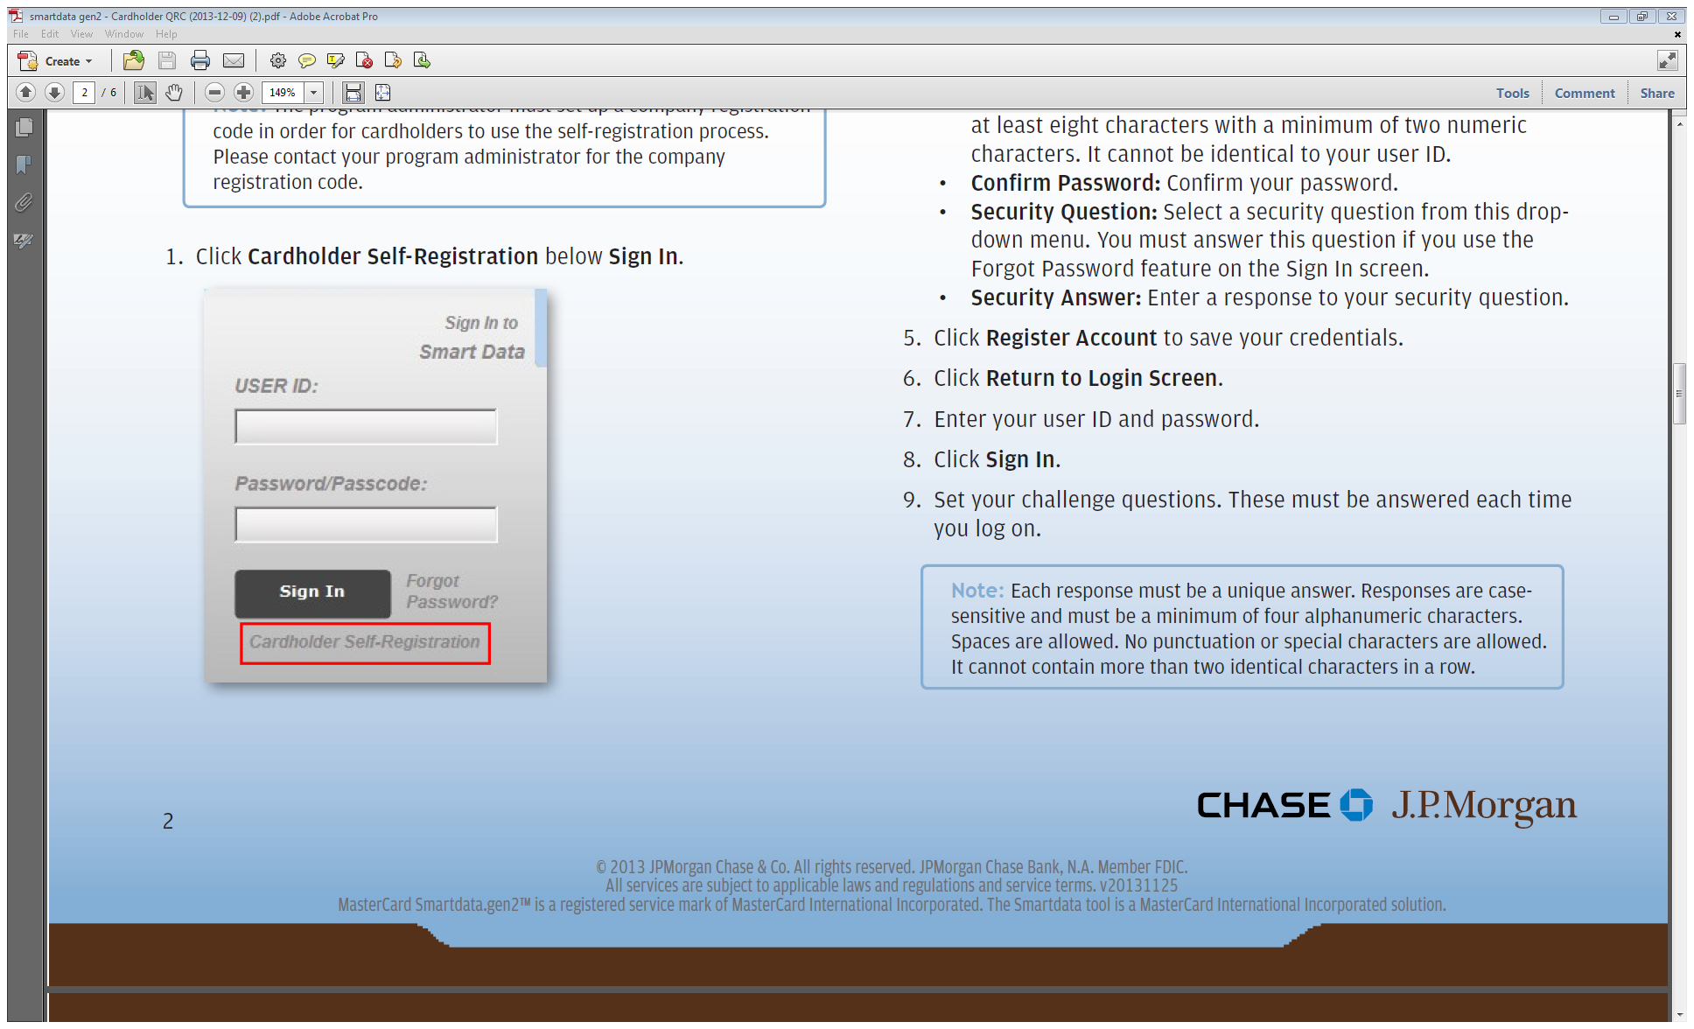
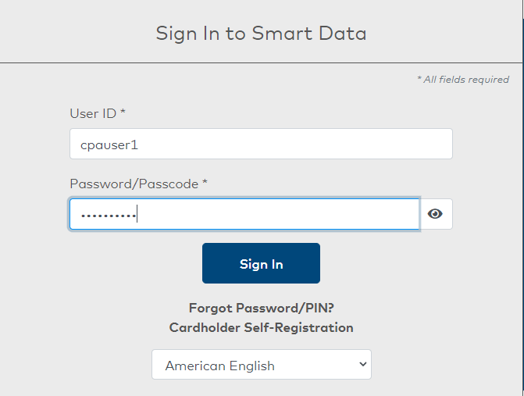
NEW CARDHOLDER SELF REGISTRATION:
You will return to this Login Screen. This is how your login screen will look each month.
Your user ID and password are case-sensitive.
Use “Forgot Password” feature if needed.
Notes:
After completing registration, you will be taken back to the home screen where you will enter your new user ID and password that you just created, and it will bring you to a new page where it will ask you to complete 3 challenge questions.

Slide 21
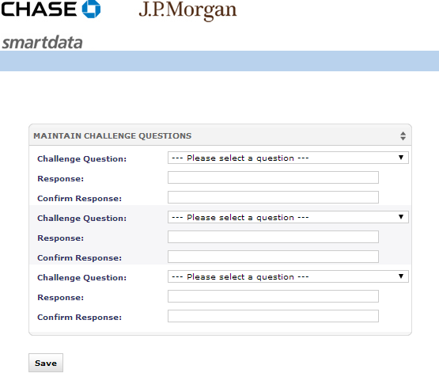
NEW CARDHOLDER SELF REGISTRATION:
Create challenge questions
Please write down your username, password and security questions.
Keep in a safe place.
Notes:
After this initial question and answer, it will always make you answer one of these 3 questions upon signing in. Please keep in mind that these are also case sensitive. Once completed, select “save”.

Slide 22
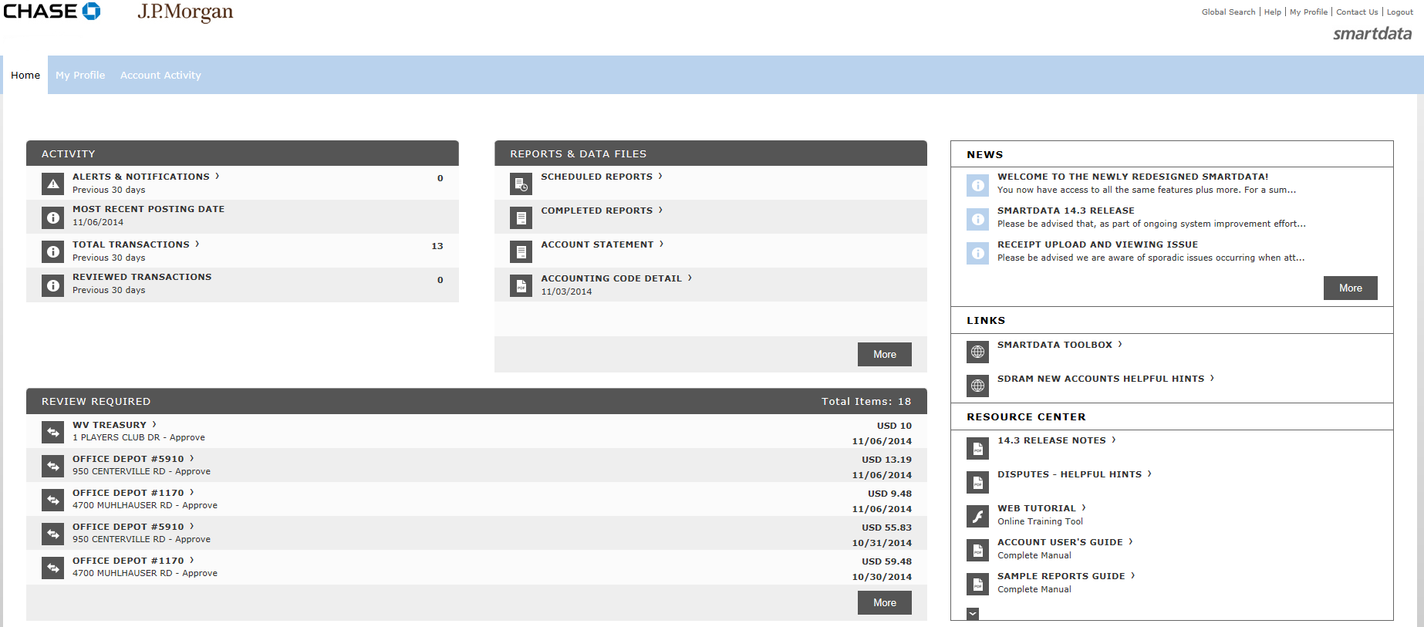
TO CODE transactions:
Select “Account Activity.”
Notes:
To begin coding your transactions, please see the Account Activity tab at the top of the screen. When hovering over it,

Slide 23
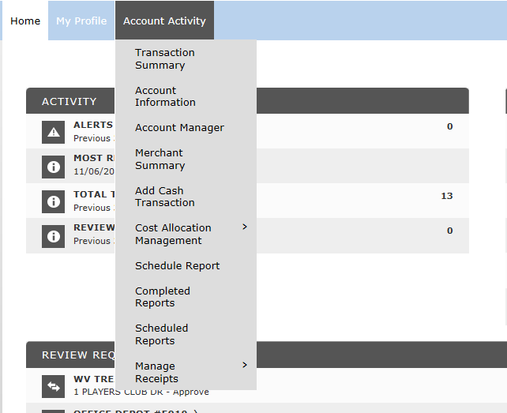
TO CODE transactions:
Select “Transaction Summary.”
Notes:
you will notice a drop down that indicates “transaction summary” and you will select that option.

Slide 24
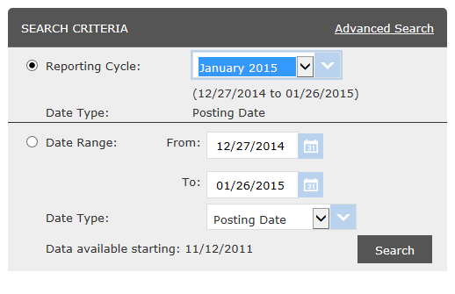
TO CODE transactions:
Select “Reporting Cycle.”
Next, use the drop down to select the month.
Then select “Search”
Notes:
On the next page you will select the reporting cycle that you wish to code transactions for. We use the reporting cycle option, rather than the “date range” option. This is important in making sure all transactions are included for coding. Once selected, click search.

Slide 25
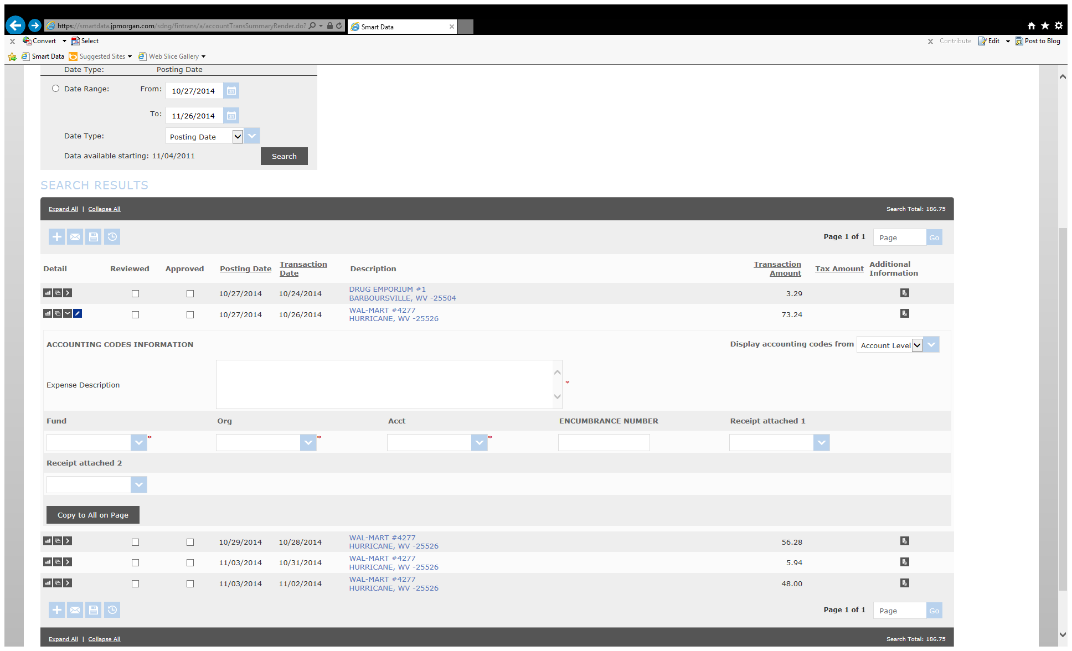
TO CODE transactions:
Notes:
The following six slides will walk you through how to code your transactions.

Slide 26
TO CODE transactions:
Click the Accounting Detail icon for the transaction you need to change.
Notes:
Click the detail icon for the transaction you want to code:

Slide 27
TO CODE transactions:
If the drop down box does not appear, select “Transaction in Edit Mode” button in order to make the fields fillable.
Notes:
Ensure the transaction is in edit mode;

Slide 28

TO CODE transactions:
Use the drop down lists to select Fund, Org, and Account.
Add an Expense Description.
Add the Encumbrance number if the transaction pertains to travel.
  Please note that all travel encumbrances should be completed and approved by your Compliance Administrator before charges are made to the P-card
Notes:
You will want to be sure to include the fund, org, and account code for each transaction, as well as a brief description of that transaction prior to saving. Once filled in, you will save and the page will refresh letting you know that your transaction was saved successfully.

Slide 29
TO CODE transactions:
You can use the “Copy to All on Page” button to apply accounting codes to all transactions on the page.
Click Save.
Notes:
You’ll note the “copy to all on page” button that is available. This will copy your fund, org, and account code if you are purchasing from the same grant for all of your charges. It will not copy the description, so you will need to go in and update that for each transaction.

Slide 30
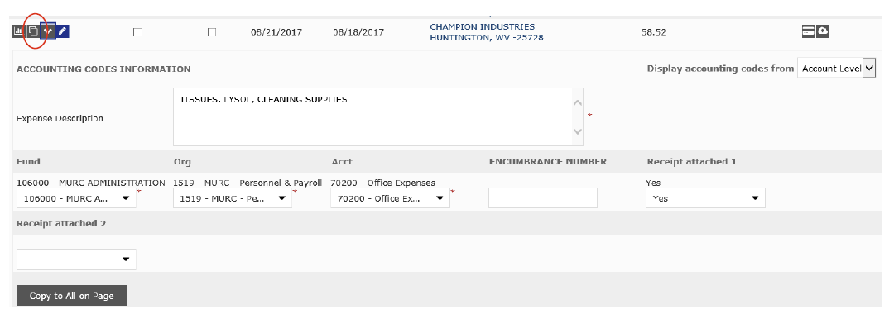
Split transaction:
Select Split Transaction Icon:
Notes:
These next five slides walk you through how to split a charge.

Slide 31
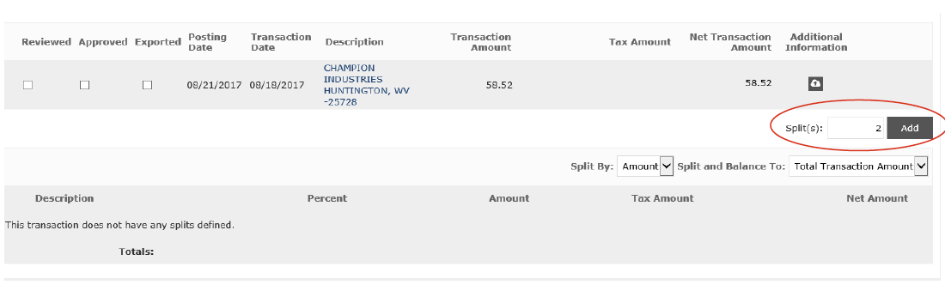
Split transaction:
Select Add Splits
Notes:
You may need to split a charge if you have tax associated with a transaction, or if something that you purchased is being used for multiple accounts.

Slide 32
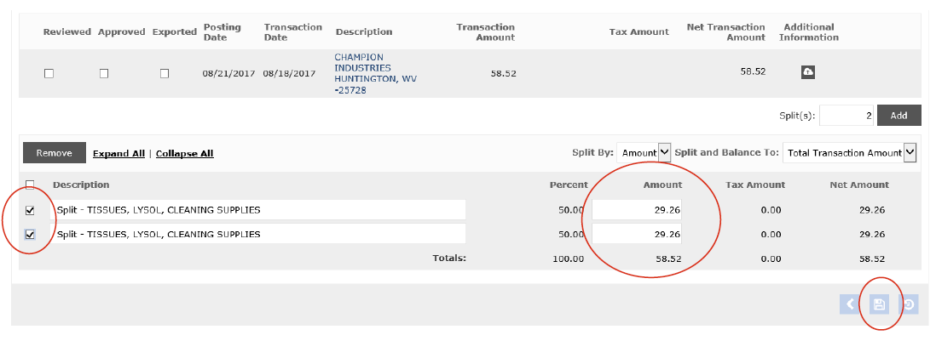
Split transaction:
Select Check boxes beside split transaction
Enter amounts for each split
Click save
Notes:
You want to ensure that your split totals the transaction amount below the amount boxes and that 100% is totaled to the bottom left.

Slide 33
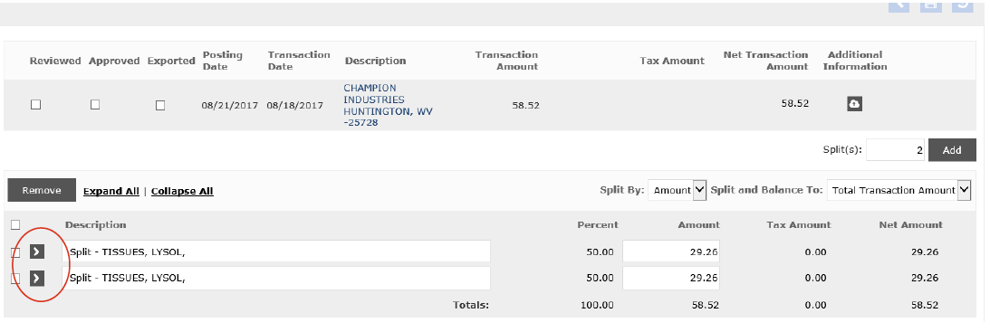
Split transaction:
Code each transaction via accounting code detail icon
Notes:
Prior to saving for the first time, you will notice that the far-left boxes are check marks instead of arrows.

Slide 34
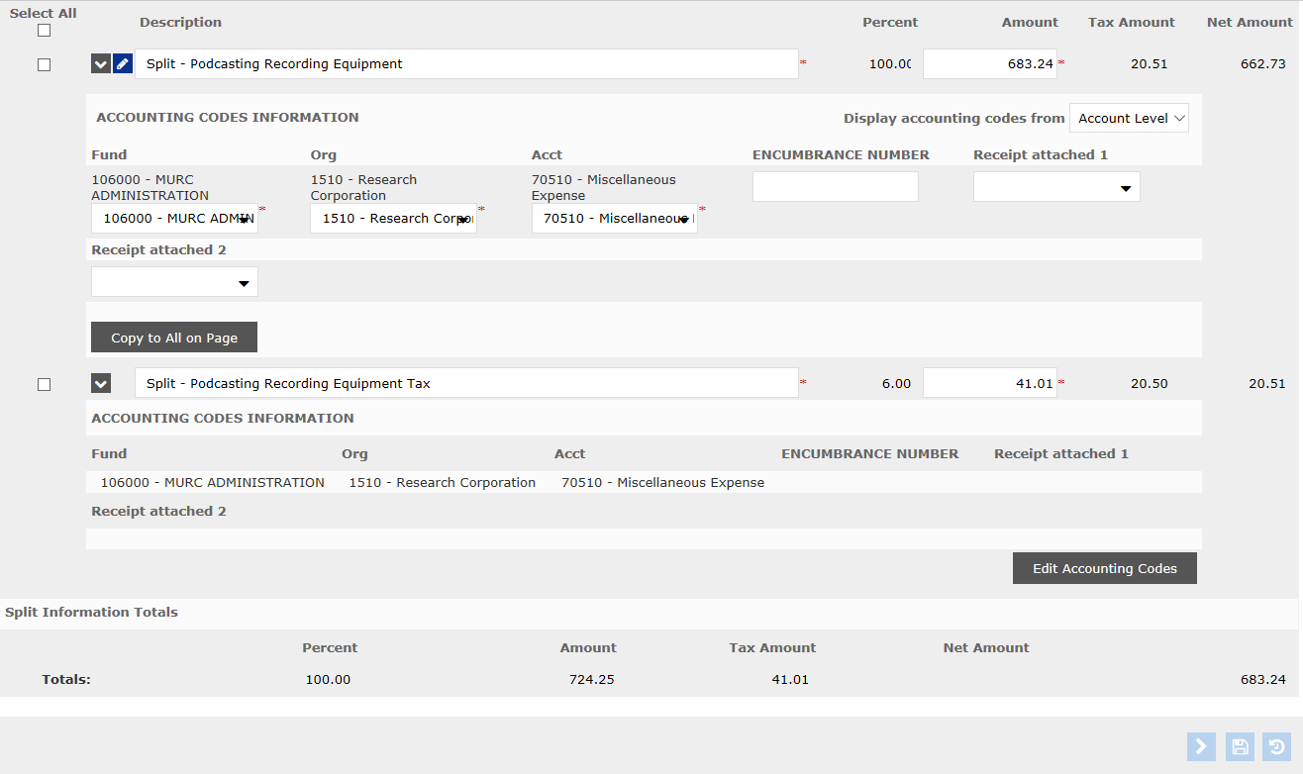
SPLIT TRANSACTION:
Enter account information
Save transactions
Notes:
After saving, those same boxes become arrows, and you will select those arrows to go in and code your information. After you’ve coded, you will select the save button.

Slide 35
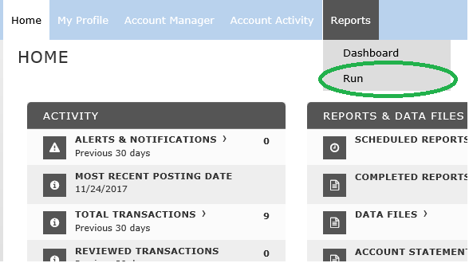
SCHEDULING THE REPORT:
Hover over the “Reports” Tab
Select “Run”
Notes:
Once all transactions are coded, you will then run a report that shows all of the transactions and the accounts that they are coded to. To do this, you will to the top of the screen and hover over “reports”. You will then select the “run” option.

Slide 36
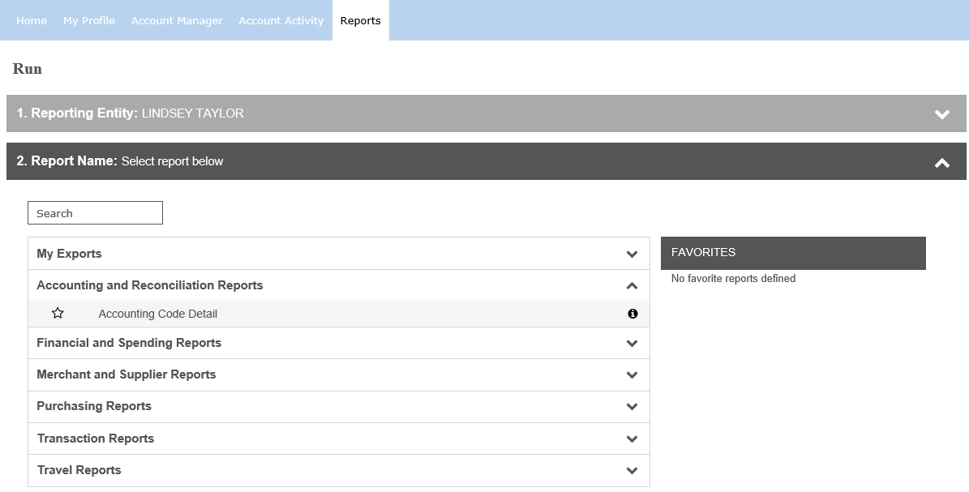
SCHEDULING THE REPORT:
Step 1 will list the Cardholder’s Name.
For Step 2, you will select the “Accounting and Reconciliation Reports” and then select “Accounting Code Detail”.
Notes:
A new screen will appear with two steps. The first step will show your name here in green, and the second step will ask you to select a report. You will click on “accounting and reconciliation reports” and it will drop down to show you “accounting code detail”. You will select this, and it will generate steps 3-7. (quick tip, if you select the start to the left of the “accounting code detail” it will add that report to your favorites on the right, and you will always be able to select it quickly.

Slide 37
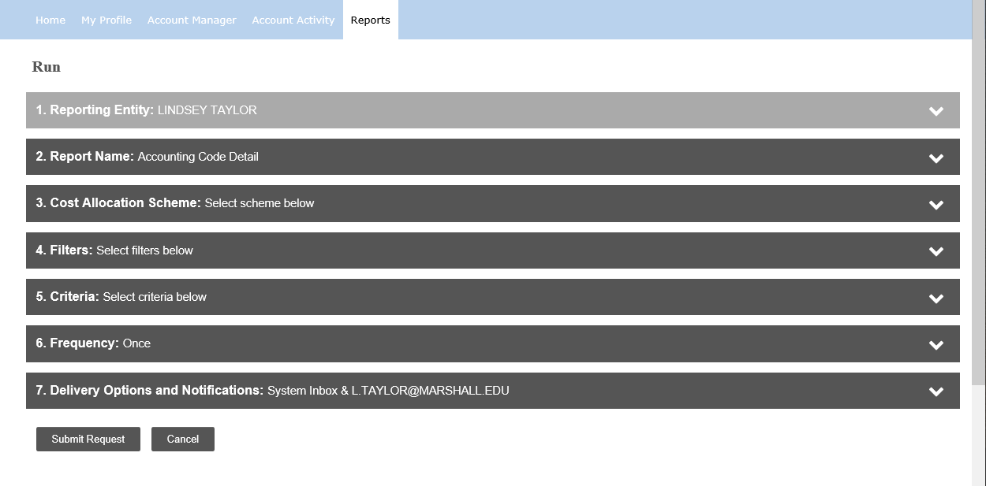
SCHEDULING THE REPORT:
For Step 3, MARSHALL UNIVERSITY RESEARCH should already be selected.
Skip Step 4.
Notes:
Please disregard steps 3 &4.

Slide 38
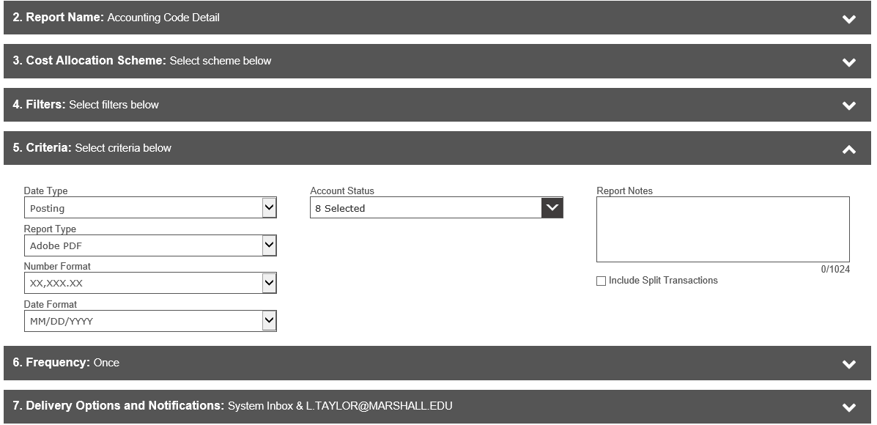

SCHEDULING THE REPORT:
For Step 5, you will leave all fields as they are, unless you are splitting transactions. If you have split transactions, make sure to put a check mark next to “Include Splits”
Notes:
You will only use 5 if you split charges. If you split charges, please be sure to select this check box so that they are included.

Slide 39
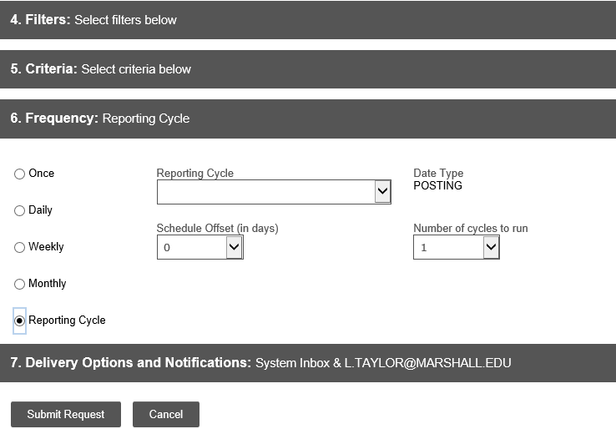
SCHEDULING THE REPORT:
This report can only be scheduled to run after the billing cycle has ended.
Select Step 6, select “Reporting Cycle”, and use the drop down feature to select the billing cycle month.
Then select Step 7.
Notes:
On step 6, please make sure to select “reporting cycle” and select your month and year for the report.

Slide 40
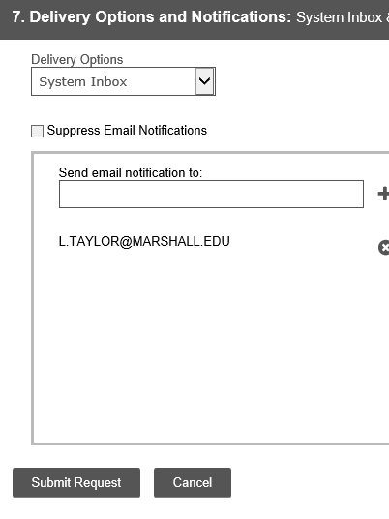
SCHEDULING THE REPORT:
While on Step 7, please make sure that your email address is listed correctly in the Email Notifications box.
Select “Submit Request”
Email@marshall.edu
Notes:
For step 7, you will only make a change if you do not already see your email address listed. If it is not, please type it in and select the + button. This will include your email so that when your report has completed running you will receive an email and can go in to download it.

Slide 41
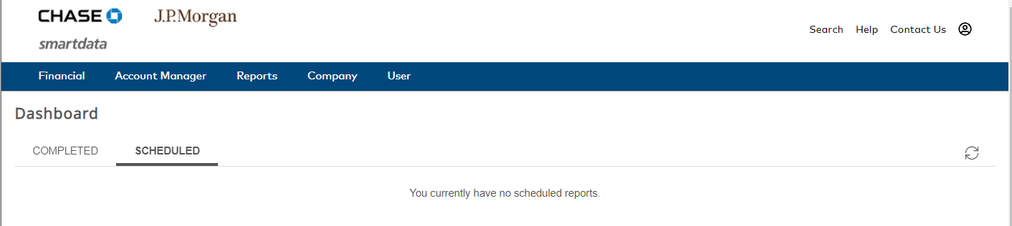
VIEW THE COMPLETED REPORT:
After selecting “Submit Request” the Reports Dashboard Screen will automatically populate. The report will take a few minutes to run.
You will receive an email notification when the report is complete, and you will then refresh the page that you are currently on and the report will populate.
Notes:
Once you submit your report, it will take you to this dashboard screen where you will see your report queued under the “scheduled” tab.

Slide 42
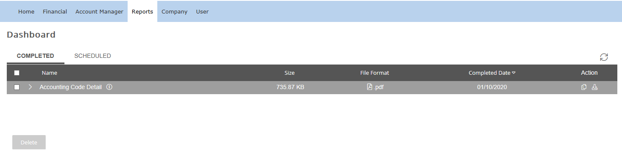
VIEW THE COMPLETED REPORT:
Select the report that you just ran.
Print a copy for the reconciliation.
Notes:
Once it is complete, it will move to the “completed” tab and you will be able to download it via the download button on the far right. It will download as a PDF file. You will print this off and have the PI of each account that you charged to sign showing their approval of your charges to their funds.

Slide 43
Assembling your reconciliation:
Reconciliation Form
Accounting Code Detail Report w/ PI signatures
Receipts following the order as listed on the Accounting Code Detail report
Notes:
Finally, you’ll take the reconciliation form (cover sheet) that you filled in in the beginning, and you will place it on top of your report. Behind your report you will place the receipts for your charges in the order that they are on your report. You will take this “packet” and scan it to the email address that you see here as a single PDF file.

Slide 44
Monthly reconciliation:
The cardholder must scan and email the required completed reconciliation in pdf format to MURC_COMPLIANCE@marshall.edu for review by the 1st business day of the month following the statement closing date.
This deadline is given to ensure our ability to in turn provide you timely financial reports.
Always include other necessary backup (Participant Lists, meeting/training form, copies of etc.)
Format MUST be PDF!
Notes:
PCards are always due on the first business day of every month. If you do not believe you can make that deadline for any reason, please contact your Compliance Officer immediately to determine another solution to your submission. You will receive an email a few days prior to the due date to remind you that it is upcoming. Even if you did not have charges for the month, you will receive this reminder. Please note that if you did not spend anything for the month, you are not required to submit anything to us for a reconciliation.

Slide 45
P-CARD POINTERS
Always turn in on time. Make it a PDF.
To keep from having a lot of transactions at the end of the period, review transactions every week.
Retain reconciliation reports with copies of receipts for 3 years. We do undergo random audit of records at MURC.
Make sure you have all your receipts, and the scan is legible.
Catch sales tax charges up front.
To assure that all transactions have been accounted for by Chase, we suggest not running The Accounting Cost Detail Report until the afternoon of the 27th.
Notes:
Below is a list of PCard Pointers for you. If you have any questions regarding these, please contact us.

Slide 46
Resources
Policy and Procedure Manual
Application & Cardholder Agreement
Maintenance Request Form
Reconciliation Form
Checklist
http://muwww-new.marshall.edu/murc/policies-procedures-and-guidelines/
Notes:
Our resources are listed here and available on our website.

Slide 47
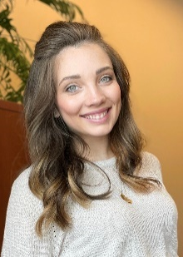
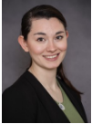
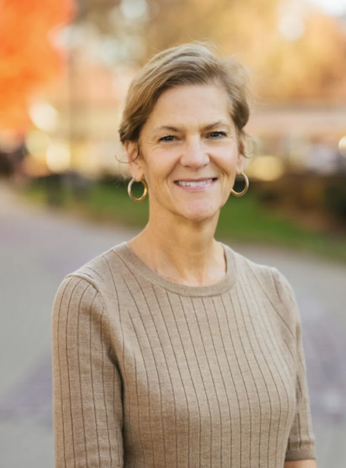
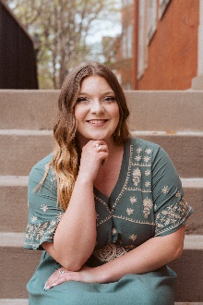
Please contact your MURC Compliance Administrator for assistance.
Kayla Perry
Grants Compliance Administrator
Applied Engineering Building, 4th floor
Phone: 304-696-4838
kayla.perry@marshall.edu
Rebecca Hill
Senior Grants Compliance Administrator
P-Card Coordinator
Applied Engineering Building, 4th floor
Phone: 304-696-3792
hill286@marshall.edu
Mary Glenn Rice
Grants Compliance Administrator
Applied Engineering
Building, 4th floor
Phone: 304-696-3325 rice139@marshall.edu
Sydney Hunter
Grants Compliance Administrator
Applied Engineering Building, 4th floor
Phone: 304-696-6275
hunter161@marshall.edu
Notes:
Please contact your MURC Compliance Officer for any assistance you may need. Below we have listed our Compliance team members. If you are unsure who your Compliance Officer may be, feel free to contact any of the ladies below and they will assist you.

Slide 48
Mandatory training quiz
Click this qualtrics link to take the Pcard Training Quiz.
You must answer the questions 100% correctly to pass the training. The quiz will automatically send your completed training information to the compliance office, who will then send you further information to get your pcard.
Notes:
As a reminder, there is a link below for you to follow to take a short mandatory quiz on what we just went over. After your Compliance Officer receives your quiz results, they will contact you to issue you your PCard. We look forward to working with you. Have a wonderful day!

