Slide 1


P-CARD Training
Presented by:

Slide 2
General Overview
Monthly Reconciliation

Slide 3
GENERAL OVERVIEW

Slide 4
APPLICATION TO ACTIVATION
Cardholder submits signed Application & Agreement to MURC
MURC receives and reviews application for completion & eligibility
MURC contacts applicant for training
MURC issues new card to P-Cardholder
P-Cardholder activates card

Slide 5
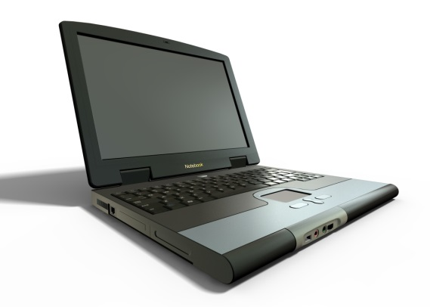

Ordering
Secure Internet Sites Only
Phone
Only items allowable by the Grant (call Compliance if unsure)

Slide 6
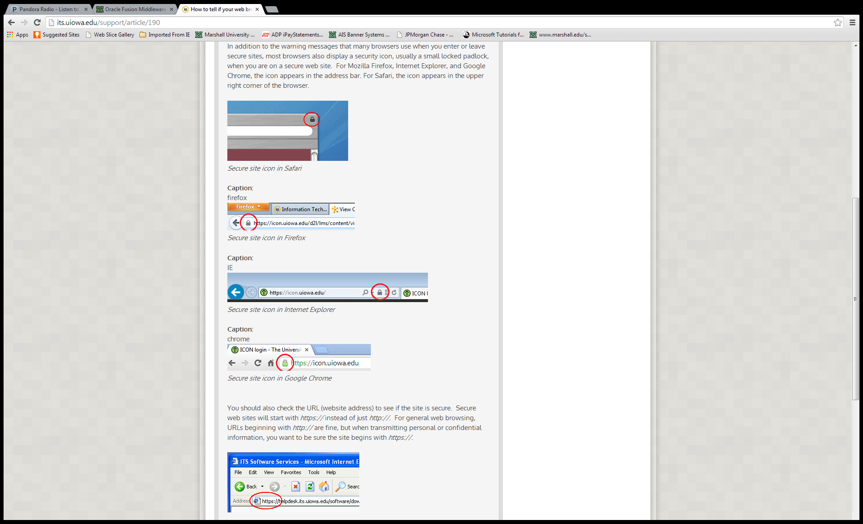
PURCHASING FROM SECURE WEBSITES
Most browsers display a security icon, usually a small locked padlock. For Mozilla Firefox, Internet Explorer, and Google Chrome, the icon appears in the address bar. For Safari, the icon appears in the upper right corner of the browser.
You should also check the URL (website address) to see if the site is secure. It will start with https:// instead of http://

Slide 7
What is the Default fund?
It is the fund identified on your application. Any purchases charged to the card that cannot be paid by the Grant or are not sufficiently documented must be charged to the default fund. This is typically a cost recovery account.

Slide 8
Restricted Items
Alcoholic Beverages
Cash Advances
Legal Services
Firearms
Capital Equipment(=>$5,000)
Radioactive Materials
Live Animals
Insurance
Tax Reportable Services
Telephone/Cell Phone Services
Gas for personal vehicle and meals for travel
Building Leases
Utilities
Contracts (other than Statewide)
Flowers or Gifts

Slide 9
Sales/Use Tax
MURC is exempt from sales and use tax
Tax ID Number on Card
Keep extra copies of Tax Exempt Certificate
Copy request available on our website at
http://muwww-new.marshall.edu/murc/forms/
Sign up for Amazon Tax Exempt Program
If sales tax gets charged and it is under $5, contact the vendor for reimbursement.
If the sales tax is over $5, please contact the vendor for a refund. If the vendor refuses to reimburse your card, contact the MURC P-Card Coordinator.

Slide 10
Disputed Items Process
Contact Vendor first to see if it can be resolved.
If not, Cardholder must email JP Morgan Chase at ccscolumbusdisputes@chase.com as well as copying the PCard Coordinator, Rebecca Hill, at hill286@marshall.edu and include an explanation of the fraudulent charge, amount, vendor and date along with the Cardholder’s last four digits of the p-card number.
Disputed Item Payment to Default Fund

Slide 11
Immediate notification
Notify the financial institution first at 800-316-6056 then notify the MURC P-Card Coordinator:
  If card is lost or stolen
  Fraudulent charges
Notify the MURC P-Card Coordinator at 304-696-3792 immediately in order to:
  To cancel a card
  When cardholder transfers departments
  When cardholder employment has ended

Slide 12
Significant p-card violations
Transactions over $4999
Stringing of payments
Delegation (allowing someone else to use your card)
Personal charges
Disciplinary Action for Misuse and/or Fraud
  Loss of Privilege
  Termination
  Prosecution by MURC or the granting agency
  Civil action to collect any amounts deemed fraudulent
  Do not store with your personal credit cards. Official MURC use ONLY

Slide 13
End of Project Orders
You are at risk of items being charged to your Default Fund account if used 30 days before end of Project
Items purchased at end of calendar month will not be reflected until next billing cycle and may be omitted from final invoice to agency
It is your responsibility to:
Notify your Compliance Contact immediately
Only order consumable items that will be used prior to the end date of grant

Slide 14
Account Maintenance
Name Change
Limit Change
Card Termination
Department Transfer
Address Change
Employment
Status
Changes must be submitted to the MURC Purchase Card Coordinator using the Cardholder Maintenance Form found under the forms section
http://muwww-new.marshall.edu/murc/forms/

Slide 15
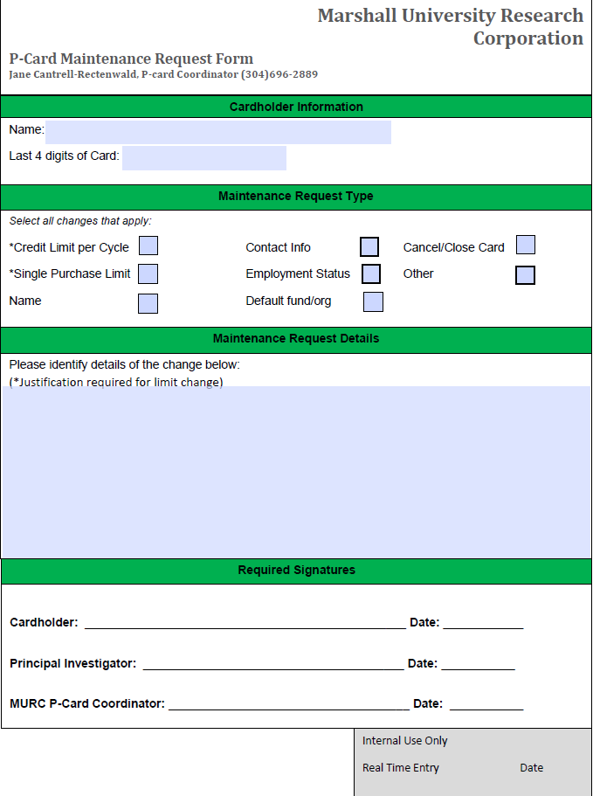
Cardholder maintenance form

Slide 16
MONTHLY RECONCILIATION

Slide 17
Summary of new process:
Print fillable Reconciliation Form off MURC website
Log into Smart Data Generation 2 (SDG2)
Code your transactions
Schedule and Run Accounting Code Detail Report (ACDR)
Obtain Signatures from appropriate PIs on the ACDR
Scan your receipts. Make sure they are legible.
Assemble your package in this order and email the scanned copy to: MURC_REPORTS@MARSHALL.EDU

Slide 18
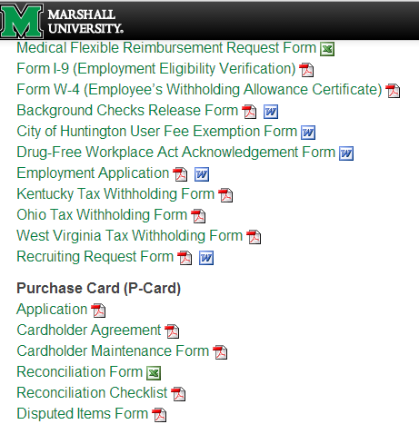
Print reconciliation form
http://muwww-new.marshall.edu/murc/forms/

Slide 19
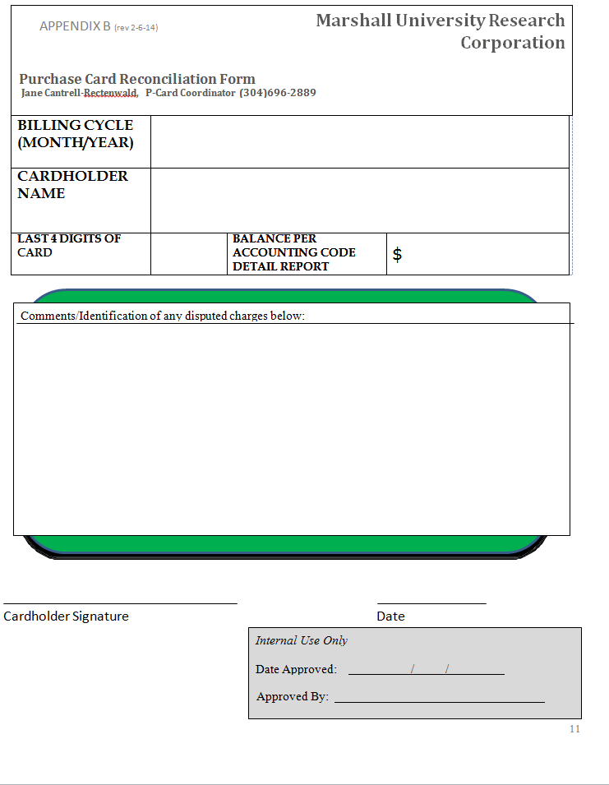

Slide 20
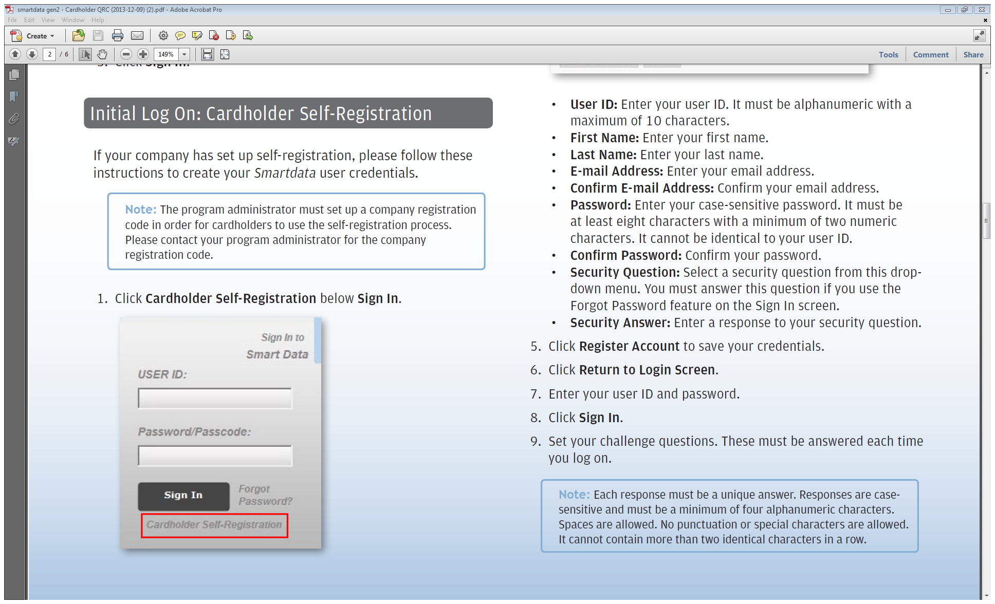
TO LOGIN:
https://smartdata.jpmorgan.com
Only use Internet Explorer or Firefox as your browsers to open Smart Data
Do not use Chrome or Safari browsers

Slide 21
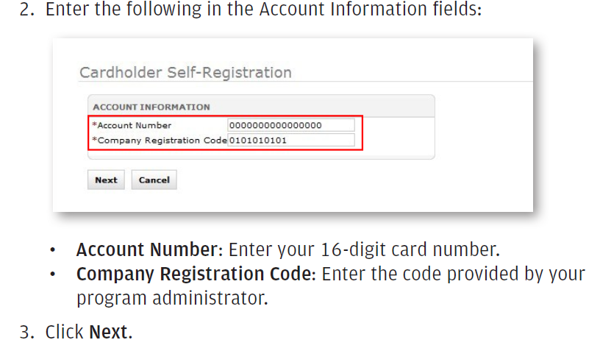
NEW CARDHOLDER SELF REGISTRATION:
MURC Company Registration Code: 1987830

Slide 22
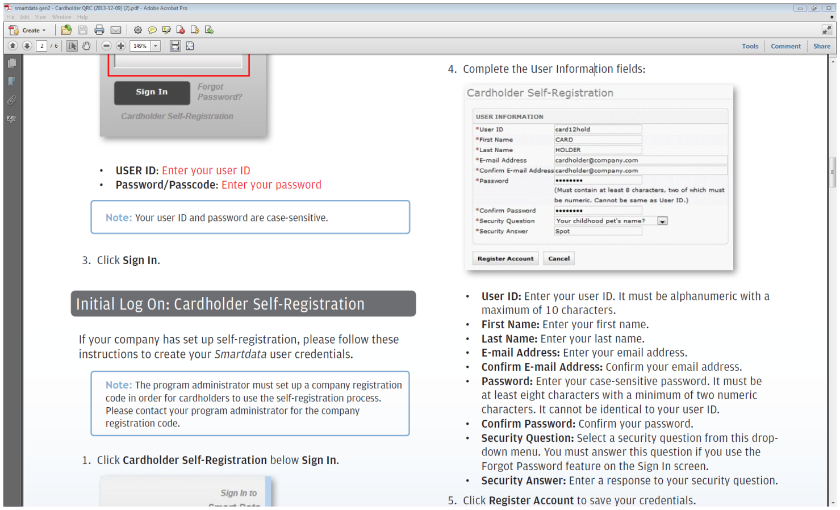
NEW CARDHOLDER SELF REGISTRATION:
Notes:
This is to be used if you have to sign up as a new user.

Slide 23
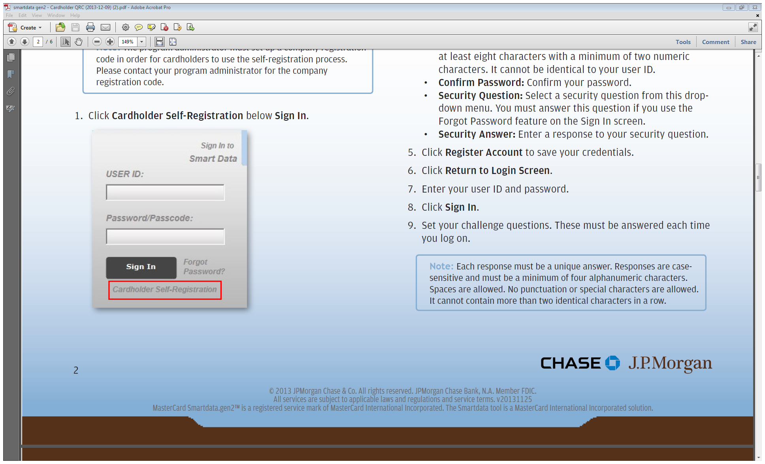
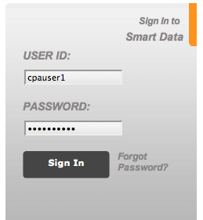
NEW CARDHOLDER SELF REGISTRATION:
You will return to this Login Screen. This is how your login screen will look each month.
Your user ID and password are case-sensitive.
Use “Forgot Password” feature if needed.

Slide 24
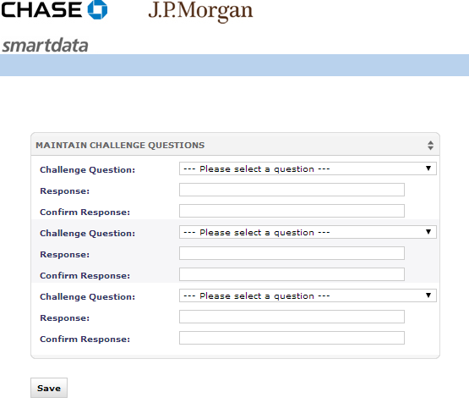
NEW CARDHOLDER SELF REGISTRATION:
Create challenge questions
Please write down your username, password and security questions.
Keep in a safe place.

Slide 25
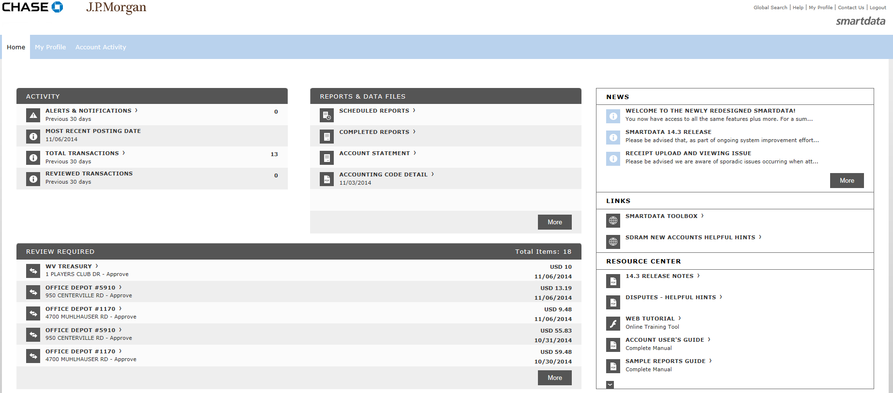
TO CODE transactions:
Select “Account Activity.”

Slide 26
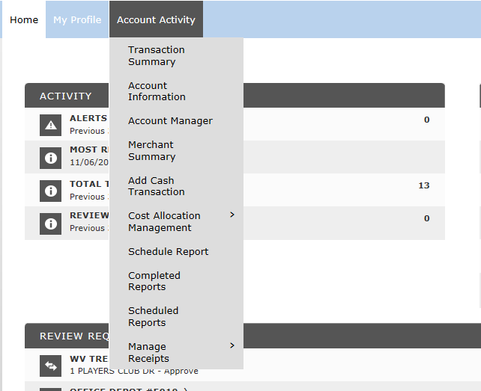
TO CODE transactions:
Select “Transaction Summary.”

Slide 27
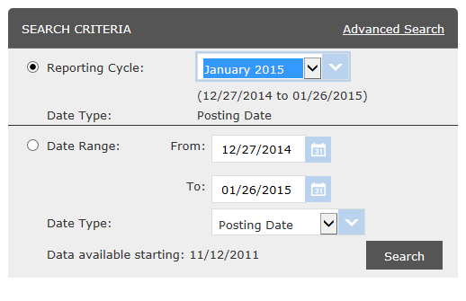
TO CODE transactions:
Select “Reporting Cycle.”
Next, use the drop down to select the month.
Then select “Search”

Slide 28
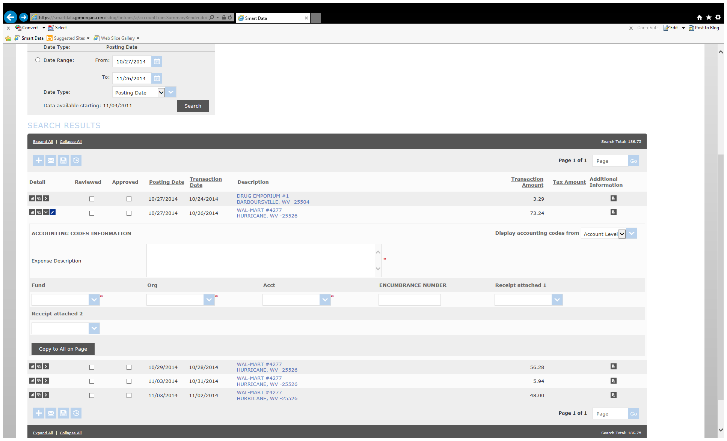
TO CODE transactions:
Click the Split Transaction icon for the transaction you need to split.

Slide 29
TO CODE transactions:
Click the Accounting Detail icon for the transaction you need to change.

Slide 30
TO CODE transactions:
If the drop down box does not appear, select “Transaction in Edit Mode” button in order to make the fields fillable.

Slide 31

TO CODE transactions:
Use the drop down lists to select Fund, Org, and Account.
Add an Expense Description.
Add the Encumbrance number if the transaction pertains to travel.
  Please note that all travel encumbrances should be completed and approved by your Compliance Administrator before charges are made to the P-card

Slide 32
TO CODE transactions:
You can use the “Copy to All on Page” button to apply accounting codes to all transactions on the page.
Click Save.

Slide 33
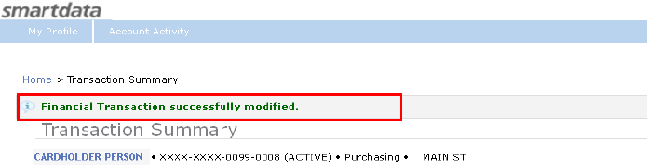
TO CODE transactions:
The Financial Transaction successfully modified confirmation message displays.

Slide 34
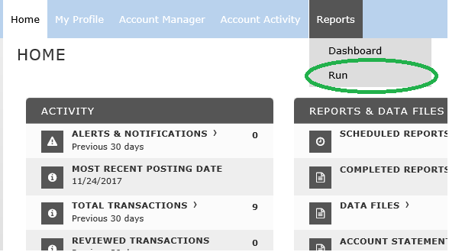
SCHEDULING THE REPORT:
Hover over the “Reports” Tab
Select “Run”
Notes:
Instead of running a report like before, the new system is set up so that all reports are scheduled and then later retrieved from your System Inbox. The only report you will need to run each month is the Accounting Code Detail Report.

Slide 35
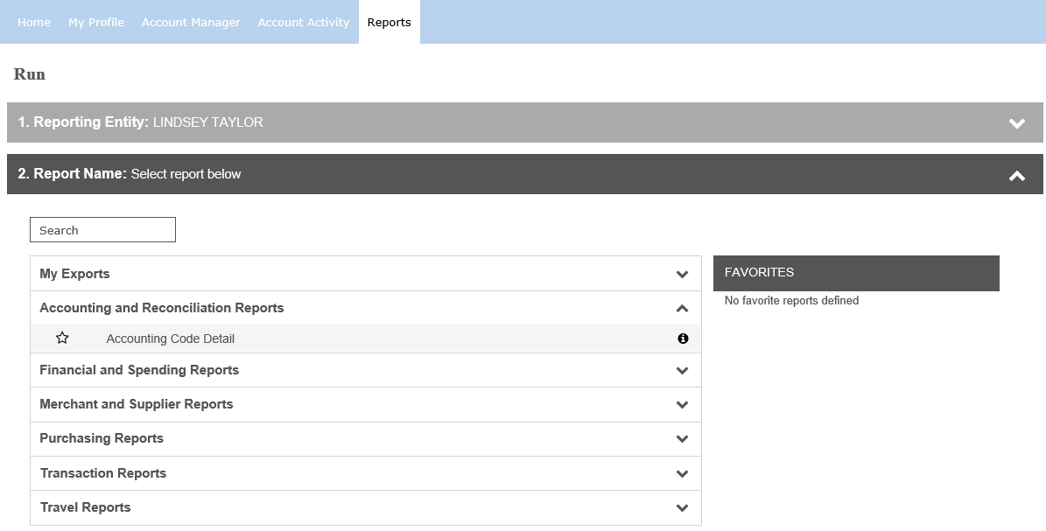
SCHEDULING THE REPORT:
Step 1 will list the Cardholder’s Name.
For Step 2, you will select the “Accounting and Reconciliation Reports” and then select “Accounting Code Detail”.

Slide 36
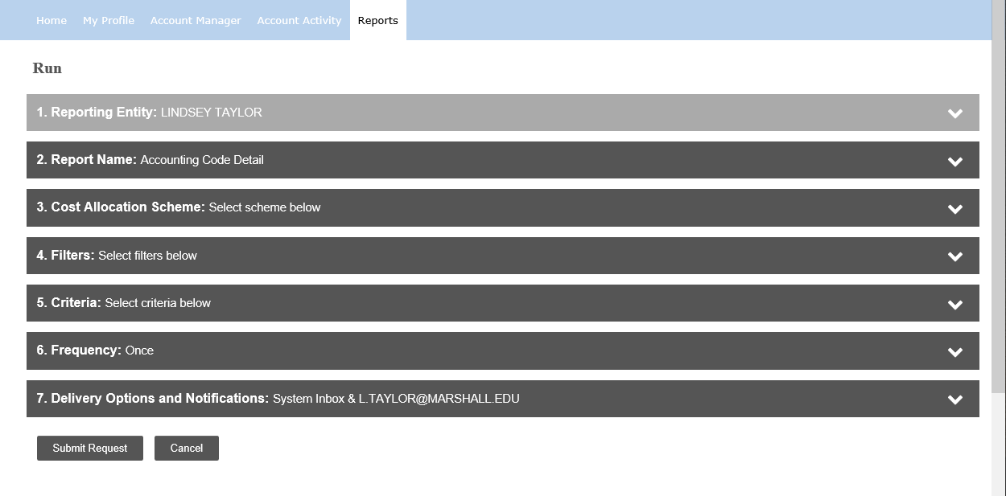
SCHEDULING THE REPORT:
For Step 3, MARSHALL UNIVERSITY RESEARCH should already be selected.
Skip Step 4.

Slide 37
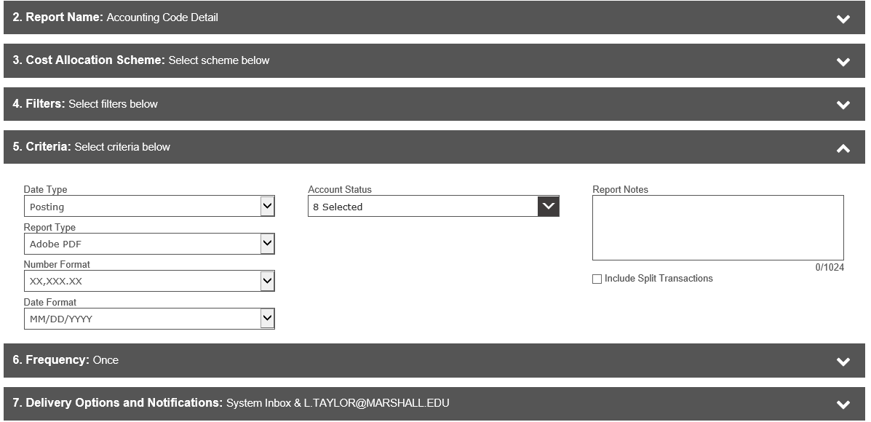

SCHEDULING THE REPORT:
For Step 5, you will leave all fields as they are, unless you are splitting transactions. If you have split transactions, make sure to put a check mark next to “Include Splits”

Slide 38
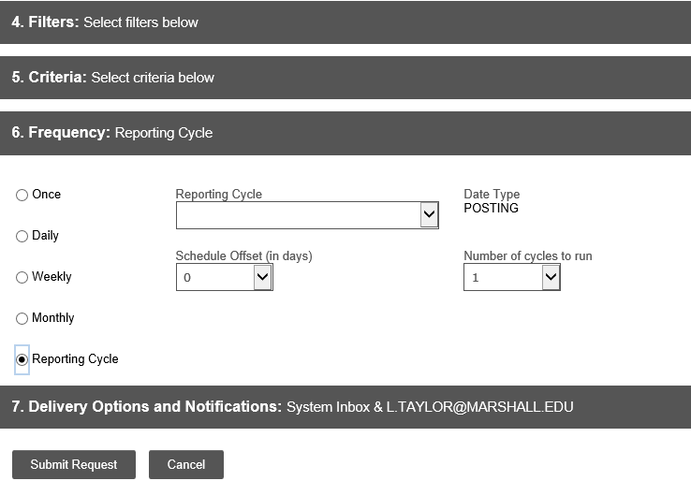
SCHEDULING THE REPORT:
This report can only be scheduled to run after the billing cycle has ended.
Select Step 6, select “Reporting Cycle”, and use the drop down feature to select the billing cycle month.
Then select Step 7.

Slide 39
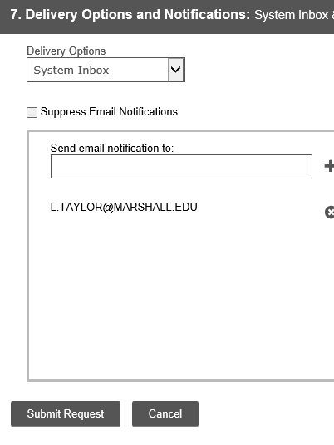
SCHEDULING THE REPORT:
While on Step 7, please make sure that your email address is listed correctly in the Email Notifications box.
Select “Submit Request”
Email@marshall.edu

Slide 40
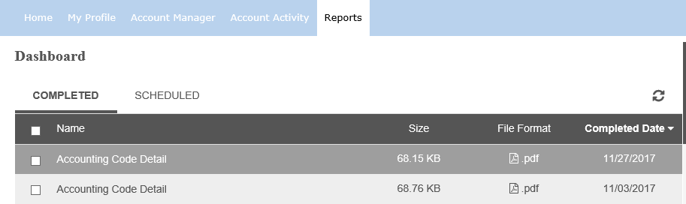
VIEW THE COMPLETED REPORT:
After selecting “Submit Request” the Reports Dashboard Screen will automatically populate. The report will take a few minutes to run.
You will receive an email notification when the report is complete, and you will then refresh the page that you are currently on and the report will populate.

Slide 41
VIEW THE COMPLETED REPORT:
Select the report that you just ran.
Print a copy for the reconciliation.

Slide 42
Assembling your reconciliation:
Reconciliation Form
Accounting Code Detail Report w/ PI signatures
Receipts following the order as listed on the Accounting Code Detail report
Notes:
Present dummy packet

Slide 43
Monthly reconciliation:
The cardholder must scan and email the required completed reconciliation in pdf format to MURC_REPORTS@marshall.edu for review by the 1st business day of the month following the statement closing date.
This deadline is given to ensure our ability to in turn provide you timely financial reports.
Always include other necessary backup (Participant Lists, meeting/training form, copies of etc.)
Notes:
EMPHASIZE PDF FORMAT

Slide 44
P-CARD POINTERS
Always turn in on time.
To keep from having a lot of transactions at the end of the period, review transactions every week.
Retain reconciliation reports with copies of receipts for 3 years. We do undergo random audit of records at MURC.
Make sure you have all of your receipts and the scan is legible.
Catch sales tax charges up front.
To assure that all transactions have been accounted for by Chase, we suggest not running The Accounting Cost Detail Report until the afternoon of the 27th.

Slide 45
Resources
Policy and Procedure Manual
Application & Cardholder Agreement
Maintenance Request Form
Reconciliation Form
Checklist
http://muwww-new.marshall.edu/murc/policies-procedures-and-guidelines/

Slide 46
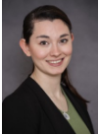
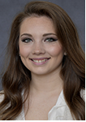
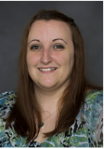
Please contact your MURC Compliance Administrator for assistance.
Rebecca Hill
Grants Compliance Administrator
P-Card Coordinator
Applied Engineering Building, 4th floor
Phone: 304-696-3792
hill286@marshall.edu
Kayla Perry
Grants Compliance Administrator
Applied Engineering Building, 4th floor
Phone: 304-696-4838
kayla.perry@marshall.edu
Lindsey Taylor
Grants Compliance Administrator
Applied Engineering Building, 4th floor
Phone: 304-696-6598
l.taylor@marshall.edu

