Slide 1
Post-Award Overview Marshall University Research Corporation

Slide 2
What is Post Award?
Liaison between PI and Funding Agency once award is issued
Award setup, including review of terms & conditions
Review and approve expense allocations
Assist with modification of award budget, such as
Re-budgeting
Carryovers
Expense transfers
Project invoicing, including financial/cost share reporting
Award Close Out Activities
Notes:
At MURC, prior to submission of your proposal, PI’s work closely with Pre Award Officers who assist in the submission process. After submission and the award is granted, the PI and his/her staff then work closely with Post Award.
Post Award consists of Compliance Officers and Accountants who process the financial account set-up in Banner to enable spending of the awarded funds, along with assisting with monitoring the budget and spending activity, and ensuring compliance with university, state, federal and private agencies.

Slide 3
Process Overview
Receive award
Banner Fund # is Created
Complete Banner Forms
Begin Spending $$
Manage your grant

Slide 4
Banner Fund Number
Once you receive an award, MURC will send you an email with your new Banner Fund number.
Notes:
This email is sent to the Principal Investigator (PI), Co-PI, and designated administrative staff listed on the ATS form.

Slide 5
Banner ACCESS: NEW USER
MU Access Forms
MU Banner Training
New User Set up
http://www.marshall.edu/human-resources/training/training-schedule/banner-basic-navigation/

Slide 6
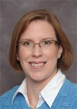
Banner Finance Privilege Request Forms
Banner Finance Privilege Request Forms must be completed in order to start spending your money.
These forms should be e-mailed to MURC:
Jennifer Wood
MURC Chief Financial Officer
wood@marshall.edu
**Please note: For first-time Banner users, please mail your forms to MU Computing Services. For existing Banner users, please mail your form to Jennifer Wood at MURC.

Slide 7
Form Instructions
Make sure you have at least 2 people who are able to approve and input on every fund.
Remove people if they leave so that your encumbrances do not get stuck in Banner.
Notes:
These are Marshall Forms and will ultimately be sent to MU Computing Services, however, they first must be sent to Jennifer Wood at MURC for approval.

Slide 8
New Award Quick Start Guide

Slide 9
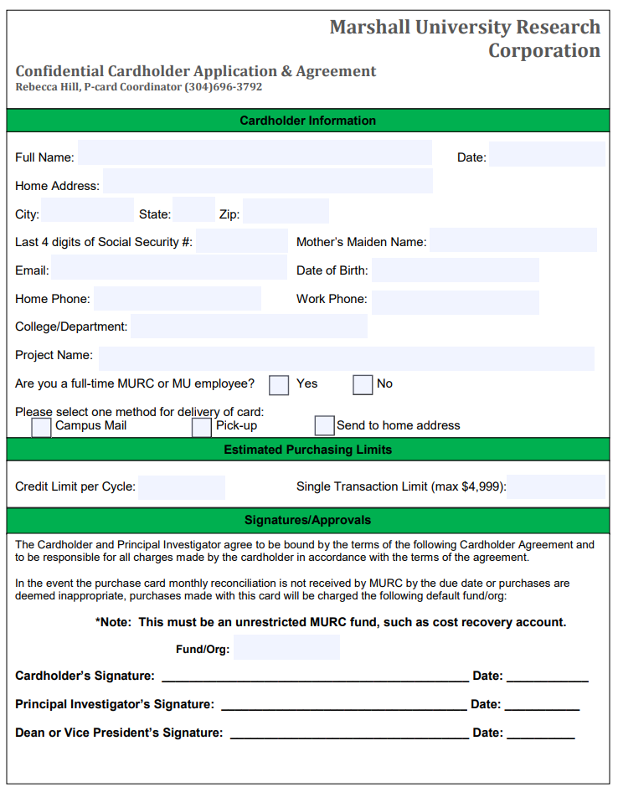
PCARD: Purchasing Card
To make small purchases throughout your award, you can apply for a MURC PCARD.
You must be a full-time employee to be a PCARD holder.

Slide 10
PCARD: processing timeline
Cardholder submits signed Application & Agreement to MURC
MURC receives and reviews application for completion & eligibility
MURC contacts applicant for training
MURC issues new card to P-Cardholder
P-Cardholder activates card

Slide 11
Travel
Complete Travel Authorization prior to travel
All travel forms can be found on the MURC website. http://www.marshall.edu/murc/forms/
Travel Authorization must be approved by MURC prior to using your PCARD
Booking airfare/lodging
MURC allows the use of competitive travel search engines like Expedia, Priceline, etc.
International Travel
Must be approved by Provost Office
Check banner screen FOIAPPH for approval
Submission
All travel documents are to be submitted to Bradley Smith

Slide 12
Travel Guidelines
Include benefit of travel to grant in the “Purpose of Travel.”
Verify A/P address matches Banner
If an address change is needed, contact Kim Fry.
Include estimates for all costs
Use GSA Rates for hotel & meals
http://www.gsa.gov
Watch for meals provided at conferences
Meals are not provided for same day travel
Attach quotes, agenda, and get needed signatures
Submit Form to MURC:
10 days prior if no cash advance
30 days prior for cash advance
You can only receive a cash advance for meals, taxis, & misc. costs prior to trip. Not mileage.
Notes:
Please note these are Estimated Expenses – quotes from airline agency or hotel websites/map quest mileage estimates/ or when needed use an educated guess.

Slide 13
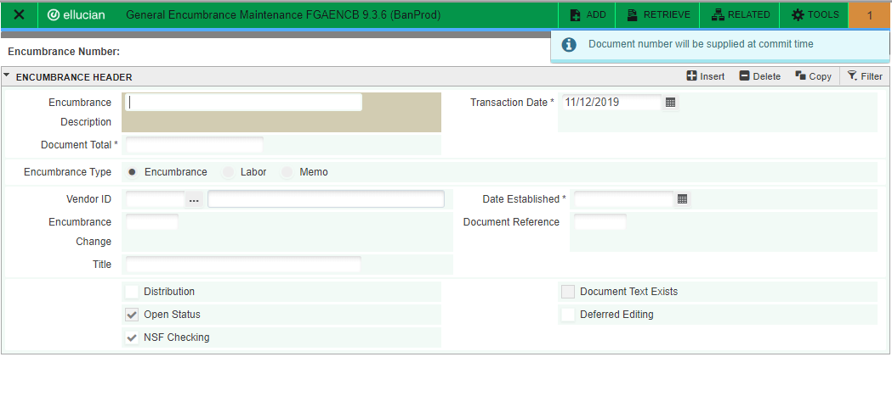
Create Encumbrance in Banner
FGAENCB

Slide 14
Enter detail in Banner
FOATEXT
Enter Vendor Name and description of costs

Slide 15
Do not send MURC paperwork UNTIL
Encumbrance # has been added to form
Encumbrance is approved in Banner
All signatures are obtained
Backup is attached

Slide 16
Travel Settlement Form
Submit within 10 days after travel
Do not create a new encumbrance.
Enter correct travel times
Deduct anything paid by p-card under the “Direct Billed Expenses” section.
Get Needed signatures. If PI is traveler, get supervisor signature.

Slide 17
Travel
Please reference the MURC travel policies prior to traveling.
MURC Travel Policy and Procedure Manual
For assistance filling out the Travel Forms, please contact Bradley Smith.

Slide 18
Invoices
To set up a vendor in Banner, submit MU vendor set up forms to:
Kim Fry at MU
fry@marshall.edu
304-696-2237
Create encumbrance in Banner
Note the encumbrance & fund #s on invoice
Send invoice to MURC for payment
Notes:
Please do not create the encumbrance in Banner until you have an invoice from the vendor.
If a check needs sent to a department or needs to be picked up, please make a note on the invoice. If you just make a note in FOATEXT, it might get missed when check is being cut.

Slide 19
Invoices
Please follow the MU Purchasing Guidelines for Requisitions.
MU Purchasing Handbook
Invoice > $4999 or if quote has terms and conditions
Must create a Requisition
Notes:
You must also create a requisition when there are terms and conditions associated with the purchase

Slide 20
Employee Reimbursements
MURC Employee Reimbursement Request
This form is NOT to be used for travel reimbursements.
MURC Fund Number: |  |  | Employee Name:
MURC Org Number:
 |  |  | Vendor ID #:
Encumbrance Number:
Qty | Description of Items Purchased |  |  |  | Unit Price | Total
Purpose of Expenditure:
Employee Signature: |  |  | Supervisor Signature:
Date: |  |  | Date:
Make sure you have paid receipts.
Not packing slips
Not an invoice without “showing paid”
Examples of “showing paid”
Last four digits of credit card – “Paid by AMX #5671”
Statement “Paid by Cash”

Slide 21
BANNER QUICK REFERENCE GUIDE
Banner Quick Reference Guide

Slide 22
PAR: Personnel Action Request
PARs are created by the Principal Investigators and submitted to MURC.
Compliance will approve them based on award terms.
Once approved we forward on to the MURC Payroll Administrator.

Slide 23
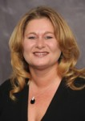
PAR: Personnel Action Request
For assistance filling out MURC PARs, please contact MURC payroll.
Tammy Brumbaugh Payroll Administrator brumbaught@marshall.edu
304-696-2830
All MURC PAR forms can be found on MURC’s website under Human Resources/Payroll
http://www.marshall.edu/murc/forms/
Notes:
Make sure to use the most up to date PAR form found on our website.

Slide 24
PAR: Personnel Action Request
Please note: If you are hiring someone already employed by MU, you will need to use a MU PAR.
The MU PAR should be sent first to MURC for approval. MURC will then forward the PAR to MU payroll for processing.
Any requests for increases in pay or supplemental pay must be submitted by the PI/Supervisor to for Oversight Committee Review. These requests should be submitted to your Compliance Officer.
For assistance filling out MU PARs, please contact Marshall’s payroll department.
Located in 203 Old Main or by phone at (304) 696-6457.
http://www.marshall.edu/human-resources/forms/
Notes:
Please check with MU payroll if you have any questions or concerns about position numbers or coding.

Slide 25
Payroll Related Checklists

Slide 26
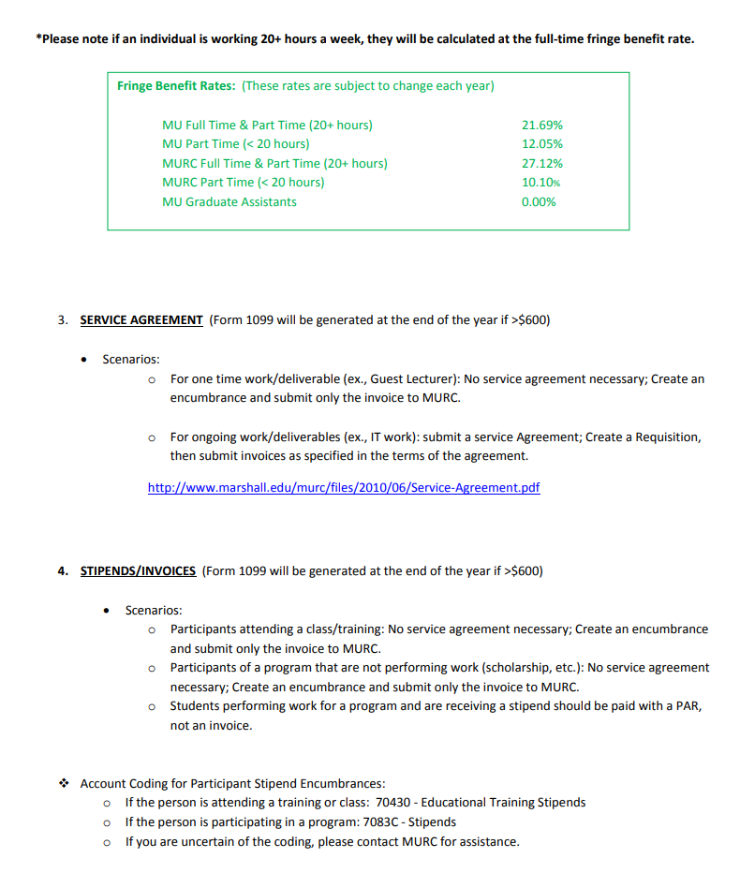
Payroll Related Checklists
http://www.marshall.edu/murc/policies-procedures-and-guidelines/

Slide 27
Supplemental Pay/Increases
All supplemental pay and pay increases for MURC employees, part-time and full-time, must be submitted for review by the Oversight Committee.
Supplemental pay and overall pay increases for MU employees are reviewed and approved at the discretion of the MU Payroll Office and are subject to MURC approval based on allowability for the project they are to be paid from.
Oversight Committee packets are to be submitted to your Compliance Officer for review of completion, and will then be passed on for review by Oversight.
Meetings for the Oversight Committee are scheduled on an as needed bases. Dates are not predetermined.
If a project ends prior to the approval of a request and the funding is no longer available, the request will not be backdated using the funding listed.
For any questions, contact your Compliance Officer

Slide 28
Manage Your Grant
MURC Reports System
Informational Reports Request Form
Monthly Financial Reports
MURC FRS SYSTEM
Banner Screens
FGIBAVL, FGIBDST
These are all resources to assist you in tracking your spending in accordance with your awarded budget.

Slide 29
MURC Reports System
Informational Reports Request Form
This form is attached in the original email notification you will receive with your Banner fund number.
Send this completed form to Jennifer Wood at MURC.

Slide 30
MURC REPORTS SYSTEM
MURC Reports System

Slide 31
Monthly Financial Reports
MURC FRS SYSTEM
All Summary & Detail Transaction Reports are available via the MURC FRS System.
The Principal Investigator, Co-PI, and anyone they designate to copy reports can access these monthly reports.
It is important that you review this information and advise MURC Compliance of any errors to ensure accurate financial reporting and accurate billing to the Agency. If anything is incorrect or you have any questions about the reports, please contact your MURC Compliance Contact.
The system is located here: MURC FRS

Slide 32
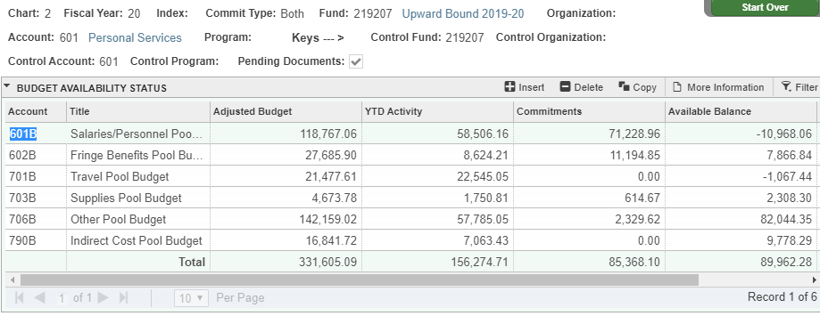
Banner Screen
FGIBAVL
Notes:
Discuss Commitment Column – for salary and benefits committed / captured in a fiscal year.

Slide 33
Budget Amendments Request Form

Slide 34
More information can be found on our website
Post Award Services
https://www.marshall.edu/murc/post-award-services/
Policies, Procedures, and Guidelines
https://www.marshall.edu/murc/policies-procedures-and-guidelines/
Forms
https://www.marshall.edu/murc/forms/
Staff Directory
https://www.marshall.edu/murc/staff/
Email Us
MURC_Compliance@marshall.edu

Slide 35
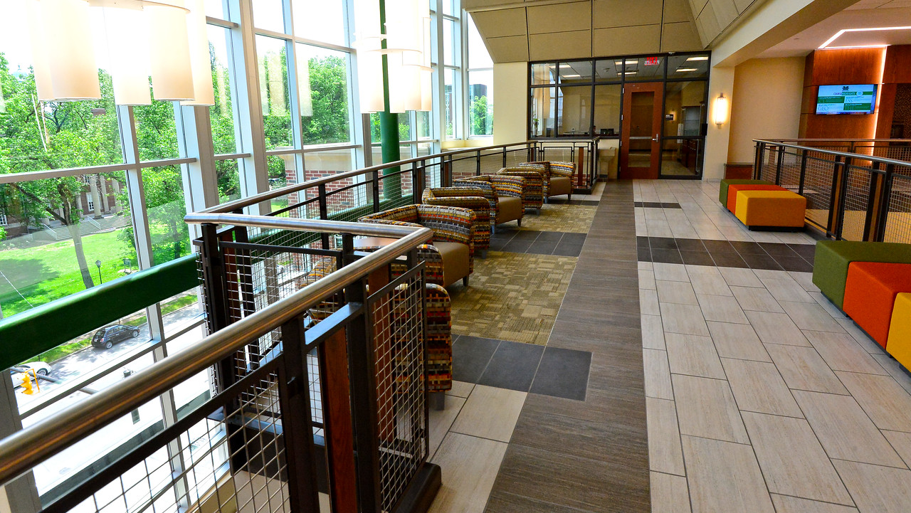
Contact Us MURC_Compliance@marshall.edu
WAEC 4th Floor
www.marshall.edu/murc/staff

