Slide 1

Finishing Strong:
Grant Closeout Best Practices Training
Updated: 10/27/26

Slide 2

Topics to Cover
Summary of closeout timeline
Why closeout matters
How to check financial status – open commitments, balance information, payment status
Roles and responsibilities
End of project orders
Frequent closeout issues
Best Practices
PI Checklist

Slide 3
Why Closeout Matters
Failure to properly close an award can result in:
Disallowed Costs
Loss of sponsor reimbursement
Return of awarded funds
Audit findings
Delayed future funding
Increased administrative burden
Sponsors generally require all financial and technical reports within 30–120 days following the end of the period of performance.

Slide 4
Roles and Responsibilities
  Closeout is a shared responsibility between the PI/ Department and MURC
Principal Investigator (PI)
Ensure that all project deliverables and technical/progress reports are completed and submitted in accordance with the schedule outlined in the award agreement. Send copies of reports to Compliance contact.
Submit outstanding subaward and service agreement invoices to Associate Director of Subaward and Contract Compliance (kristen.webb@marshall.edu) for payment.
Submit all other outstanding invoices for open encumbrances and purchase orders to MURC AP (murc_accounts_payable@marshall.edu) for payment.
Review employees currently paid from expiring funds and prepare new PARs to reallocate employees to an active funding source when fund expires.
Review and submit all final expenditures to ensure they are allowable, allocable, reasonable, and within the project period.
Confirm that all cost sharing/matching requirements have been met and documented. Cost Share reports can be submitted to Bradley Smith (Smithbra@marshall.edu).
Complete and submit Progress Reporting.

Slide 5
Roles and Responsibilities
MURC
Notify the PI of upcoming project end dates.
Notify the PI of upcoming final financial report and invoice due date to ensure all expenses are accounted for.
  Note: Final invoice deadlines vary by funding agency. MURC invoicing will send the deadline in the final invoice reminder notification.
Review final expenditures for compliance with sponsor requirements and to ensure they are allowable, allocable, reasonable, and within the project period.
Approve expenditures for payment in Banner financial system and issue payment to vendors.
Prepare and submit final financial reports, final invoices, and certifications to the sponsor.
Coordinate with Finance, Procurement, and Human Resources to ensure all encumbrances, subawards, and payroll are reconciled and closed.
Maintain official award closeout documentation in institutional records.

Slide 6
Award End Date vs Final Liquidation Date
  End date is the end of the performance period.
    All goods/services must be incurred/received prior to this end date.
  Liquidation date is the date that final invoices and financial reports are due to the awarding agency.
    Final liquidation dates can vary by sponsor and are specified in the award agreement.
    Federal agencies typically allow 120 days.
    State agencies vary and can be anywhere from 10 days to 30 days.
      Note: This applies to federal awards that are awarded to MURC via a pass through entity.
NOTE: As best practice, MURC recommends submitting all expenses possible by the end date of the fund.

Slide 7
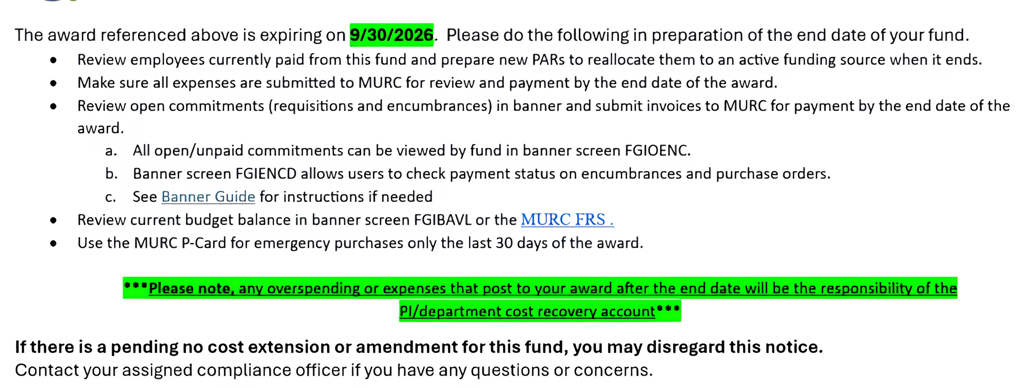
Close out reminder timeline
  End date reminder sent 30 days prior to project expiration. Example closeout notice sent by Compliance:

Slide 8
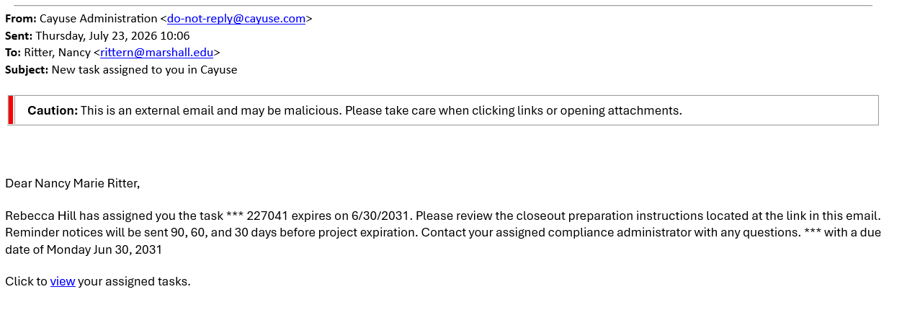
Cayuse Tasks Reminders
  Expiring Fund Task in Cayuse
    Supplemental reminder of end date.
    Task established when an award is setup.
    Reminder notifications automatically send at 90, 60, and 30 days before project expiration.

Slide 9
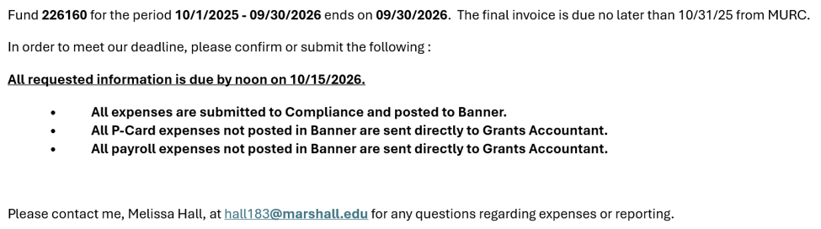
Close out reminder timeline
  Final Invoice/Report reminder sent 30 days prior to final invoice deadline. This is a last call for any outstanding expenses.
    Example final invoice reminder sent by Grants Accounting:

Slide 10
Submitting Final Expenses
Department Responsibility
Outstanding subaward or service contract invoices can be submitted to the Associate Director of Subaward and Contract Compliance (kristen.webb@marshall.edu)
Please coordinate with Kristen to ensure all subaward invoices have been submitted, approved, and paid.
  It is the department’s responsibility to ensure that all outstanding invoices are submitted to MURC for payment and to track open purchase orders, encumbrances, and invoices.
  Submit outstanding invoices for open encumbrances and purchase orders to MURC AP (murc_accounts_payable@marshall.edu) for payment.

Slide 11
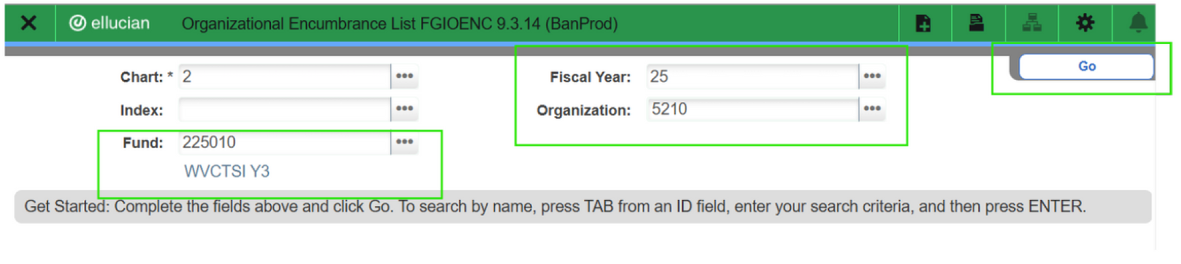
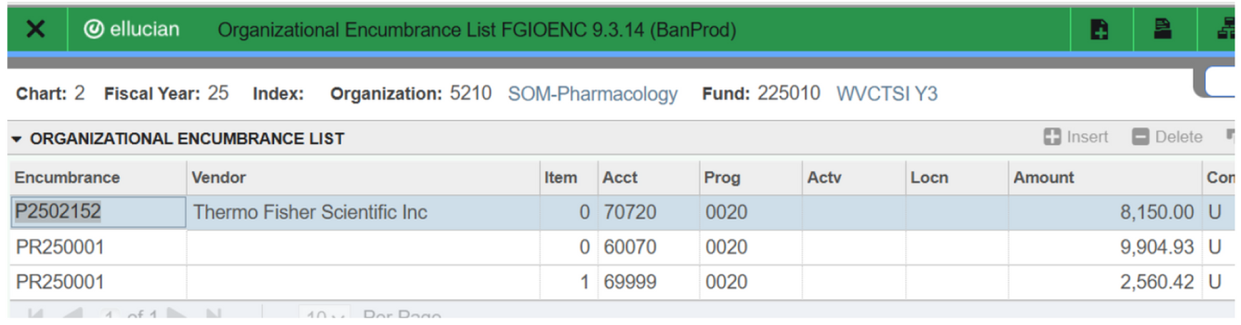
Banner Screen FGIOENC
  Open commitments can be viewed by fund in Banner screen FGIOENC.
    Banner Guide – Detailed instructions

Slide 12
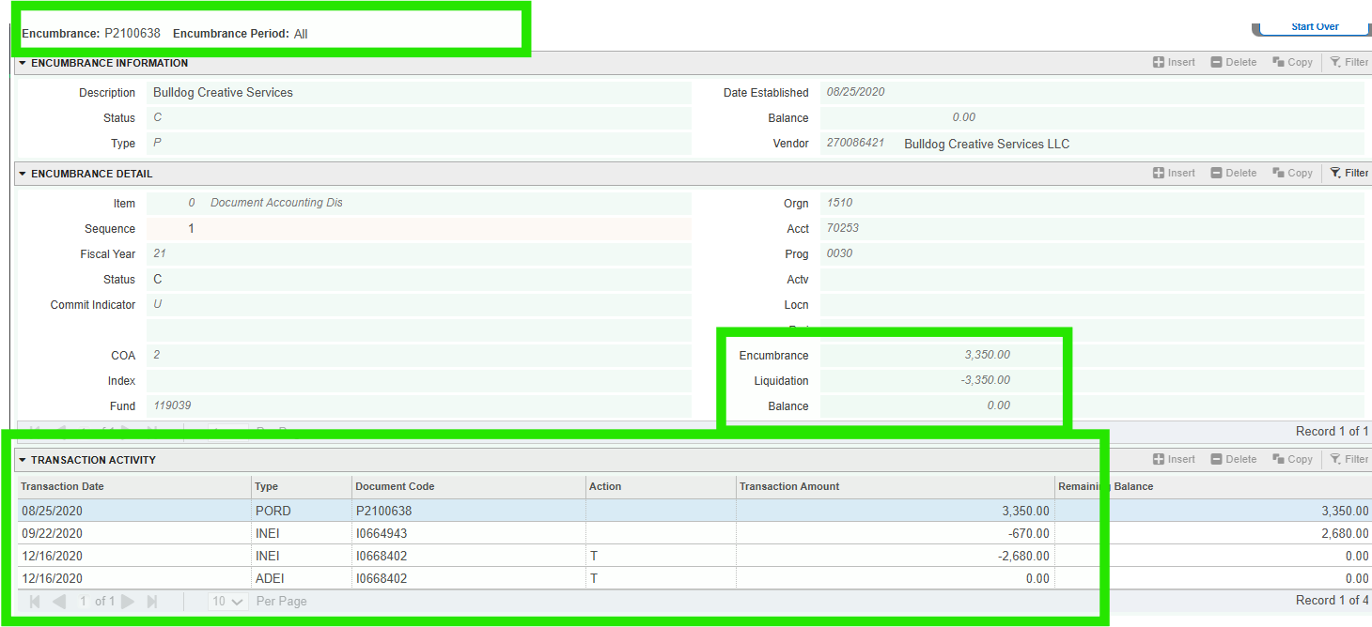
Banner Screen FGIENCD
  Payment status on a Purchase Order or Encumbrance can be viewed in Banner screen FGIENCD.
    Banner Guide – Detailed instructions
    Items starting with “I0” are payments issued.

Slide 13
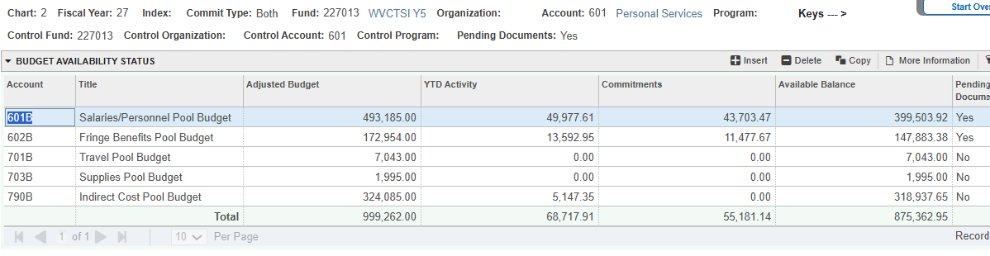
Check Budget Balance - Banner Screen FGIBAVL
  Remaining budget balance can be viewed in Banner screen FGIBAVL or Cayuse Fund Manager.
    Banner Guide – Detailed Instructions

Slide 14
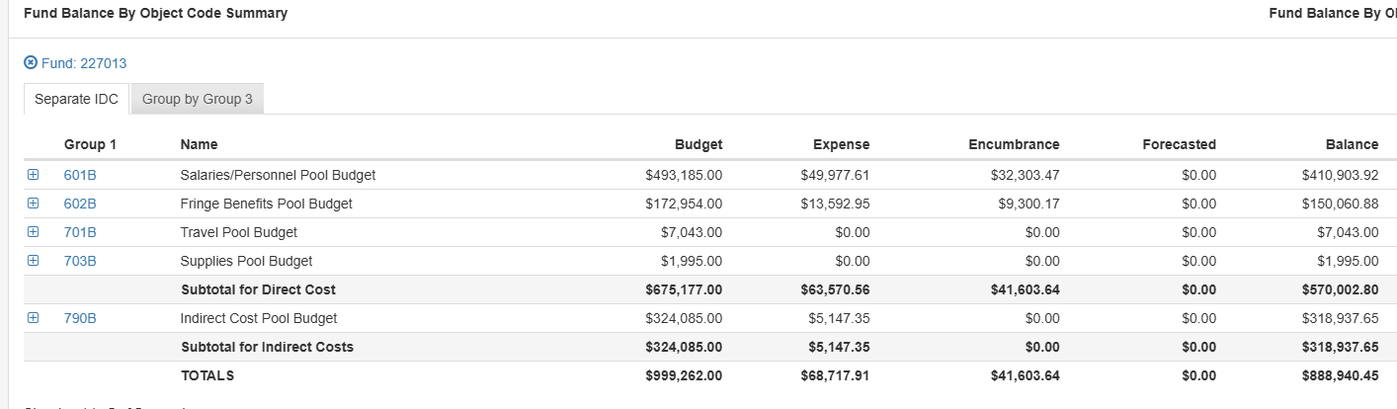
Check Budget Balance – Cayuse Fund Manager
  Cayuse Fund Manager
  Cayuse Fund Manager Navigation Guide
NOTE: Cayuse Fund Manager data is pulled from Banner.
It is uploaded into Cayuse 1 business behind being post to Banner.

Slide 15
End of Project Orders – Last 30 days
Focus
Reconcile existing commitments and process payments for currently allocated personnel.
Risk
Expenses submitted late may not be included in the final invoice or financial report to the agency and therefore cannot be reimbursed.
MURC PCard
Avoid using the last 10 days of project due to delayed posting. If there is an extenuating circumstance, contact your assigned Compliance administrator.
New Purchases
Limited to items necessary to complete the project and that directly benefit the award. Avoid making large orders.
  Any expense initiated during the last 30 days of the project needs to be received prior to the end date to be allocable.
Department responsibility
If an expense is submitted to MURC after the final invoice and financial report are due to the agency, it will be covered by departmental funds.

Slide 16
Reporting
Depending on the sponsor, final reports may include:
Final Financial Report
MURC
Final Technical/ Progress Report
PI
Invention Statement
PI
Equipment/Property Report
MURC
The PI is responsible for all technical reports and invention statements. MURC completes all financial reporting and completes the invoices for reimbursement to the agency.

Slide 17
Frequent Closeout Issues
The most common reasons awards are delayed include:
Late departmental invoices
Outstanding payroll corrections
Open purchase orders
Missing subcontract invoices
Cost transfers submitted after closeout
Unapproved expenditures
Missing technical reports

Slide 18
Best Practices/ Tips
Successful closeouts occur when departments:
Review expenses monthly through Banner or Cayuse Fund Manager
Check in with subrecipients throughout project.
Review open commitments for encumbrances and purchase orders.
Review posted payroll periodically. Submit Payroll corrections promptly.
Communicate early with MURC to notify of unexpected delays or issues.
Resolve expense transfers/corrections promptly.
Submit invoices for payment as early as possible and by the end date of the fund.
All required reports are submitted on time by both the PI (technical) and MURC (financial).
Request No-Cost Extensions before the award expires.
Begin processing contractual agreements as soon as funding is received and the subrecipient or service provider is identified.
Complete most purchases before last 30 days of project.

Slide 19
Principal Investigator (PI) Pre Closeout Checklist
Please do the following in preparation for your award closeout:
Review employees currently paid from the expiring fund and prepare new PARs to reallocate them to an active funding source when it ends.
Make sure all expenses are submitted to MURC for review and payment by the end date of the award.
Review open commitments (requisitions and encumbrances) in Banner and submit invoices to MURC for payment by the end date of the award.
  Open/unpaid commitments can be viewed in Banner screen FGIOENC.
  FGIENCD allows users to check payment status on encumbrances and purchase orders. Type in E# or PO# and hit “Go”.
  See Banner Guide for detailed instructions.
Review current balance and expenses posted in Banner screen FGIBAVL and FGIBDST or the MURC FRS.
  If an expense transfer is needed, contact your assigned Compliance administrator as soon as possible.
Use the MURC P-Card for emergency purchases only within the last 30 days of the award.
Please note, any overspending or expenses that are received after the final invoice is submitted to the agency will be the responsibility of the PI/department cost recovery account.

Slide 20

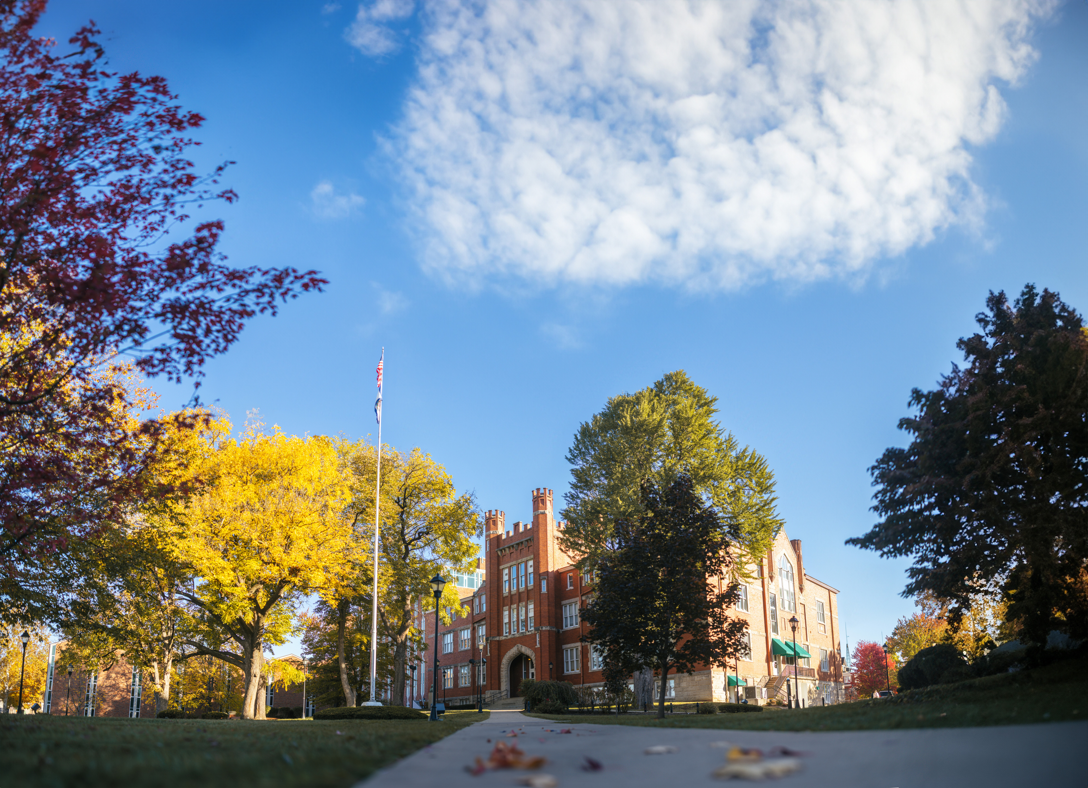
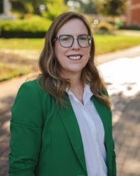






Post Award Compliance Team
Jennifer Wood,
CFO and Associate Vice President for Finance and Compliance
wood@marshall.edu
Rebecca Hill,
Director of Grants Compliance
& Purchasing Card Coordinator
hill286@marshall.edu
Kayla Perry,
Grants Compliance
Administrator
starcher41@marshall.edu
Sydney Hunter,
Grants Compliance
Administrator
hunter161@marshall.edu
Mary Glenn Rice,
Grants Compliance
Administrator
rice139@marshall.edu
Angel Wallace
Grants Compliance Administrator
wallace213@marshall.edu
Kristen Webb,
Associate Director of Subaward and Contract Compliance
kristen.webb@marshall.edu
Find your Department’s Officer at www.marshall.edu/murc/post-award-services/

Slide 21
QUESTIONS?
Visit our website:
https://www.marshall.edu/murc/ourservices/post-award-services/
Contact your assigned compliance officer if you have any questions or concerns

