Slide 1

How to format a Thesis or a research article?
Ammar Alzarrad, Ph.D., PMP, CPEM
Associate Professor and Director of The Engineering Management Program
Department of Civil Engineering

Slide 2
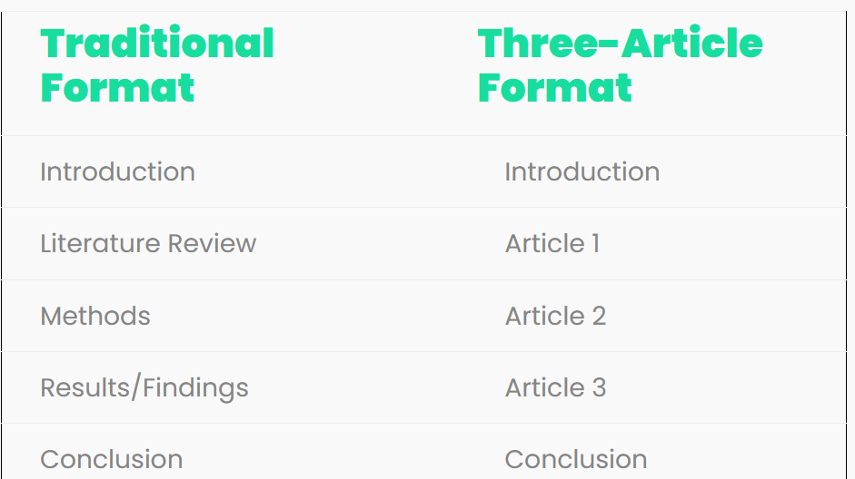
Dissertation / Thesis Format
Traditional vs. three-article
Discussion

Slide 3
dissertation / Thesis Format
Traditional Format
Chapter 1: Introduction
  What will you be investigating (in plain-language, big picture-level)?
  Why is that worth investigating? How is it important?
  What are your research aims and research question(s)?
  What is the limitation of your study?
  How will you approach your research? In other words, what methodology will you adopt?
  How will you structure your dissertation? What are the core chapters and briefly what will you do in each of them?

Slide 4
dissertation / Thesis Format
Traditional Format
Chapter 2: Literature Review
  What does the literature currently say about the topic you’re investigating?
  Is the literature lacking or well established? Is it divided or in disagreement?
  How does your research fit into the bigger picture?
  How does your research contribute something original?
  How does the methodology of previous studies help you develop your own?

Slide 5
dissertation / Thesis Format
Traditional Format
Chapter 3: Methodology
In this chapter, you need to address two critical questions:
Exactly HOW will you carry out your research (i.e. what is your intended research design – describe the design and create a visual of it)?
Exactly WHY have you chosen to do things this way (i.e. how do you justify your design)?

Slide 6
dissertation / Thesis Format
Traditional Format
Chapter 4: Results/Discussion
What data did you collect/generate? Present the raw data and describe the data
What do the results mean for your research questions? Interpret findings in relation to your research aims.
How do your results compare to existing literature? Discuss whether your findings align with or differ from existing research.
What are the key implications? Explain what the results suggest and their contribution to the field.

Slide 7
dissertation / Thesis Format
Traditional Format
Chapter 5: Conclusion
Summary of the dissertation’s major findings:
  Briefly recap key findings.
  Bring the discussion back to the original research questions and clearly state your conclusions in relation to these questions.
Discussion and recommendations:
  What do your answers to the research questions mean for the real world or academia?
Limitations:
  Acknowledge any limitations encountered during the research.
Agenda for future research:
  Articulate key directions for further research on the issues addressed in the dissertation.

Slide 8
dissertation / Thesis Format three-article Format
Chapter 1: Introduction
Provide background to the general topic area.
  Serves as a connecting thread that weaves together the various papers.
  Describes the ‘collective meaning’ and ‘combined contribution’ to the field.
Include the following elements:
  Definition or statement of the problem.
  Importance of the problem:
    Why it is worth researching.
  Overview of important literature:
    A general review, as each paper will have its own detailed literature review.
  Research questions to be addressed in each paper.

Slide 9
dissertation / Thesis Format three-article Format
Chapter 2: Article 1
Include:
Subsections of Article #1 (Abstract, Introduction, Review of Literature, Method, Results/Discussion, Conclusion)
Reference List
Appendices (if applicable)
Abstract includes:
A description of the problem statement and why do we care.
A brief discussion of the methods used to solve the problem.
A summary of the main findings.
A brief conclusion or discussion of the implications of the results.
*** Write after drafting the paper and avoid citations and math***

Slide 10
dissertation / Thesis Format three-article Format
Chapter 3: Article 2
Include:
Subsections of Article #2 (Abstract, Introduction, Review of Literature, Method, Results/Discussion, Conclusion)
Reference List
Appendices (if applicable)

Slide 11
dissertation / Thesis Format three-article Format
Chapter 4: Article 3
Include:
Subsections of Article #3 (Abstract, Introduction, Review of Literature, Method, Results/Discussion, Conclusion)
Reference List
Appendices (if applicable)

Slide 12
dissertation / Thesis Format three-article Format
Chapter 5: Conclusion
Summary of the dissertation’s major findings:
  Briefly recap key findings.
Discussion and recommendations:
  Provide insights based on the findings.
Linkages between manuscripts:
  Discuss similarities and differences among the individual papers included in the dissertation. Present the dissertation as a coherent body of work.
Limitations:
  Acknowledge any limitations encountered during the research.
Agenda for future research:
  Articulate key directions for further research on the issues addressed in the dissertation.

