Slide 1
Recovery Support
How to support others

Slide 2
Scope of the Problem
23.5 million (10%) of American adults report being in “recovery” from a substance use disorder.
In light of the current epidemic and the explosion of technology, it would be a missed opportunity not to capitalize on technology to promote treatment and recovery successes.

Slide 3
Treatment and Recovery Barriers
Reasons for not entering treatment:
Not ready to stop using 40.3%
No health coverage 31.4%
Possible negative effect on job 10.7
Concern that getting treatment might cause other to have negative opinions 10.1%
Not knowing where to go for treatment 9.2%
No program have type of treatment 8.0%

Slide 4
Other Barriers
Lack of awareness of the problem
Fear of entering treatment services
Time conflicts
Admission difficulty – waiting list
Location of services – co-location
Co-occurring illness and trauma
Stigma

Slide 5
Relapse Rates
Studies show that more than 85% of patients receiving services relapse and return to substance use within 1 year.
Barriers and relapse rates have driven the addiction treatment and recovery support fields to investigate:
Expanding peer-based recovery support service and
Pioneering new models of post-treatment services.

Slide 6
Policy Consideration
Peer Support should be fully integrated into all treatment and recovery services and not a self-contained initiative to be abandoned at the moment of discharge.
The goal is to transform the entire treatment system to a recovery supporting system.
How do we give treatment providers and peer recovery support specialists greater reach and tools to address these barriers

Slide 7
Recovery Support can reach Diverse Populations
Sexual orientation
Gender identity
Race/ethnicity
Co-occurring issues
Poverty or under-educated
Youth
Disabilities

Slide 8
Recovery Support Addresses Unmet Needs
Adolescents
Young adults
Socioeconomically disadvantaged
Frequent movers
Latinos and African Americans
Those engaging in high-risk behaviors.

Slide 9
Maintaining relationship Boundaries
Avoid “friending” clients on personal Facebook pages.
Establish protocols for when and how to communicate via technology.
Do not monitor clients on social networks, online support groups, or other media.
Come to agreement with clients on the boundaries and expectations for online setting.

Slide 10
Safety Guidelines
Have a plan for how to get help during a crisis
If someone is harassing or threatening you, remove them from your friends list, block them or report them to the site administrator.
Watch out for triggers and think about how to avoid them.
Consider unintended consequences, such as increased feelings of isolation.

Slide 11
Resources on campuses
Counseling Center
Student Support Services
Veteran Affair Services
Student Health & Wellness Center
Disability Services
Office of Multicultural Affairs
Collegiate Recovery Program
Public Safety Office
Student Health & Medical Center

Slide 12
Mutual Groups and resources
Alcoholics Anonymous
Narcotics Anonymous
Smart Recovery
Celebrate Recovery
Depression and Bipolar Support Alliance
Wellness Recovery Action Planning
Active Minds
Adult Children of Alcoholics
Al-Anon
Cocaine Anonymous
Dual Recovery Anonymous
Gamblers Anonymous
National Alliance on Mental Illness (NAMI)

Slide 13
Recovery language
Words Matter: Language and Stigma Reduction

Slide 14
Stigma
a relationship between an attribute and a stereotype that assigns undesirable labels to a person
discredits a person or a group
marginalizes affected individuals
diminishes achieving full potential

Slide 15
Stigma is Visible and Invisible
From within
Blame self, feel hopeless
Recovery community
Medications vs Abstinence
Clinicians & medical providers
Treatment is ineffective
From general public
Choice/moral failing vs disease

Slide 16
Types of Stigma
Public
Attitudes and feelings towards SUD
Institutional
Policies, practices, and cultures of orgs, systems
Self
Internalization

Slide 17
Looking Ahead
Be mindful of stigma and discrimination, long before people look for recovery support services
Engage with dignified language across the spectrum, including PWUD health, prevention, public health, and harm reduction settings

Slide 18
The Words We Use Are Critical
“Words are important. If you want to care for something, you call it a ‘flower;’ if you want to kill something, you call it a ‘weed.’”

Slide 19
Science of Language
In a study, individuals read similar case studies that used different language to make recommendations of care
When the subject was described as a ‘substance abuser’ punitive action was recommended
When described as a person ‘having a substance use disorder’ therapeutic action was recommended
This study was replicated with clinicians at two different mental health conferences. Results were the same.
(Kelly, J.F., Westerhoff 2010)

Slide 20
Science of Language
General public polled for biases towards PWUD/SUD
Bias for people described as
Addict
Alcoholic
Medication-assisted treatment
Relapse
Positive association toward people described using
Long-term recovery
Pharmacotherapy
Medication-assisted recovery
Recurrence of use (Ashford, R.D., et al 2018)

Slide 21
When is it appropriate?

Slide 22
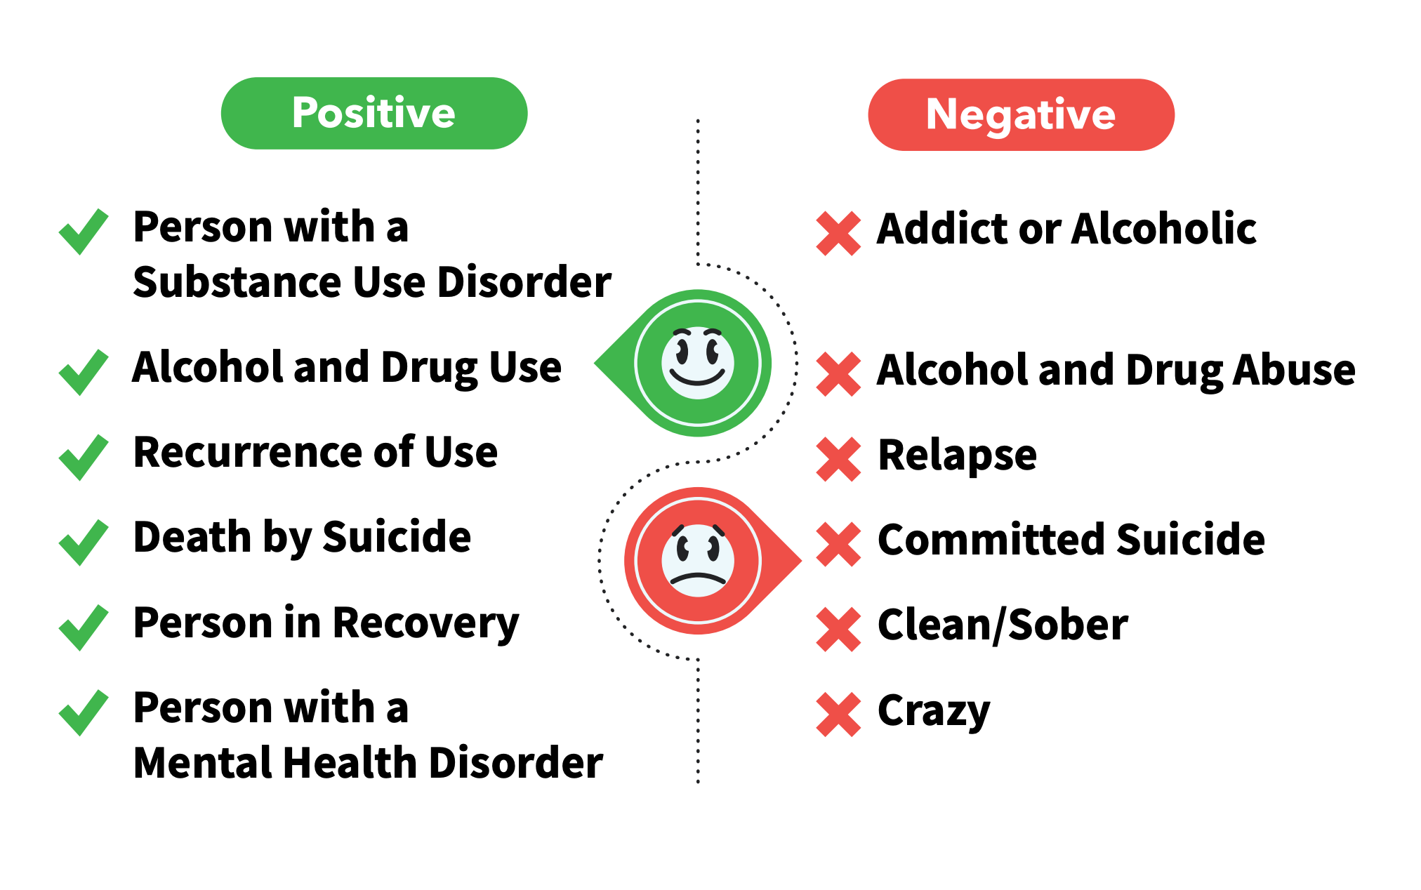
Language Matters
Notes:
Because we are not the language police. There is a time and place for all of our chosen identifiers. When I am with my support group, I identify accordingly. And when it comes to sharing stories in the 12 step community, of which I am a member, I rely on the cultural shortcuts of language to relay an identifiable cultural experience. In fact, some of the research indicates that within our small, personal recovery circles, the same language that is viewed negatively by the public, can engender a sense of regard and kinship, likely due to the phenomena of group psychology and sociology. The verdict is still out on how that all fits together.
Suffice it to say, when I am working, or speaking in a public manner, I use different language. This graphic by Ashford, Brown, and Curtis, (2018) can quickly help us determine the best use of language.
Again, from Ashford, Brown, and Curtis (2018) and building upon the Addictionary.

Slide 23
The Power of Positive Language
Using positive language increases public support for:
Effective substance use and mental health disorder policies
Additional funding for substance use and mental health disorder services
Interactions and engagements with those who are affected by substance use and mental health disorders

Slide 24
Evidence Based Interventions
Through Contact
Peer storytelling
Role modeling
Through Education
Science of addiction & recovery
To peers, families, stakeholders & the community
Through Language
Use non-stigmatizing & recovery-oriented language
Hold each other accountable with teachable moments

Slide 25
When to Use Recovery Messaging
When speaking to
Family
Friends
Neighbors
General public
When writing
Articles
Newsletters
Blogging
During media interview

Slide 26
How to Use Recovery Messaging
Make it personal
Adds credibility
Breaks down negative perceptions
Speak with one voice
Personal stories
Consistent messaging
Maximum impact
Focus on recovery
Not the disorder

Slide 27
Components of Messaging Introductions
Identify yourself
Your relationship to recovery
Self, family, ally
What recovery means to you
Why you are sharing your recovery

Slide 28
Operationalizing Recovery
Abstinence is not a valid measure
Length of time is not an adequate descriptor
Recovery is not linear
Exclusive affiliation with a type of recovery is not an accurate reflection of the varieties of recovery experience
Discerning between remission and recovery

